Slide 1
Assorted Topics in Probabilistic ML (1)
CS772A: Probabilistic Machine Learning
Piyush Rai

Slide 2
Plan for today
2
Wrapping up BO (acquisition functions)
Assorted Topics (1)
  Frequentist vs Bayesian
  Model Calibration to reduce overconfidence
  Conformal Prediction (simple and fast way to get prediction uncertainty/set)

Slide 3
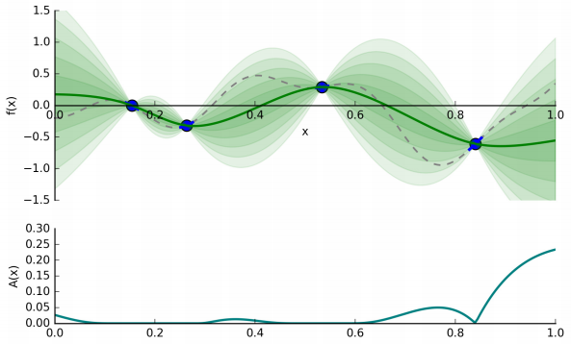
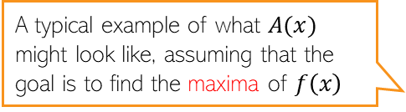
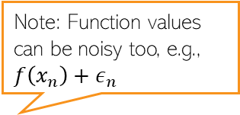

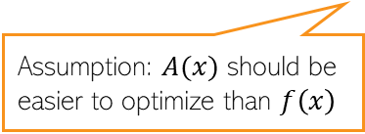
Bayesian Optimization
3
Note: Function values can be noisy too, e.g., $f\left(x_{n}\right)+ε_{n}$
BO requires two ingredients
  A regression model to learn a surrogate of $f(x)$ given previous queries ${\{\left(x_{n},f\left(x_{n}\right)\right)\}}_{n=1}^{N}$
  An acquisition function $A(x)$ to tell us where to query next
Note: The regression model must also have estimate of function’s uncertainty
  Bayesian nonlinear regression, such as GP, Bayesian Neural network, etc would be ideal
Assumption: $A(x)$ should be easier to optimize than $f\left(x\right)$
Dotted curve: True function
Green curve: Current surrogate of the function
Shaded region: Uncertainty in the function’s estimate
A typical example of what $A(x)$ might look like, assuming that the goal is to find the maxima of $f\left(x\right)$

Slide 4
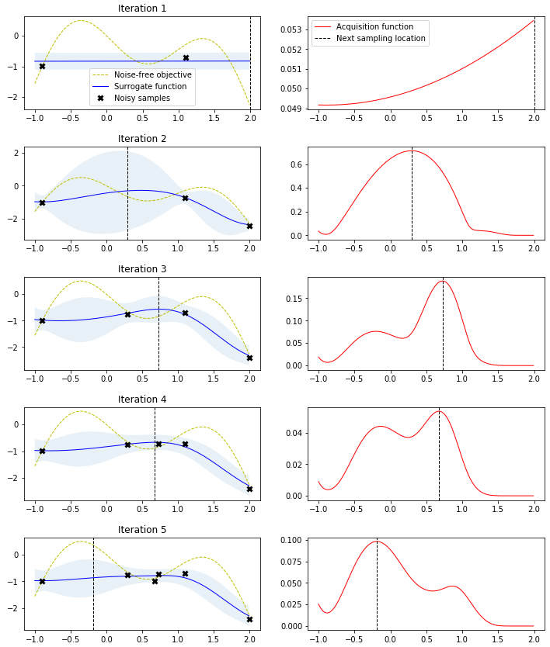
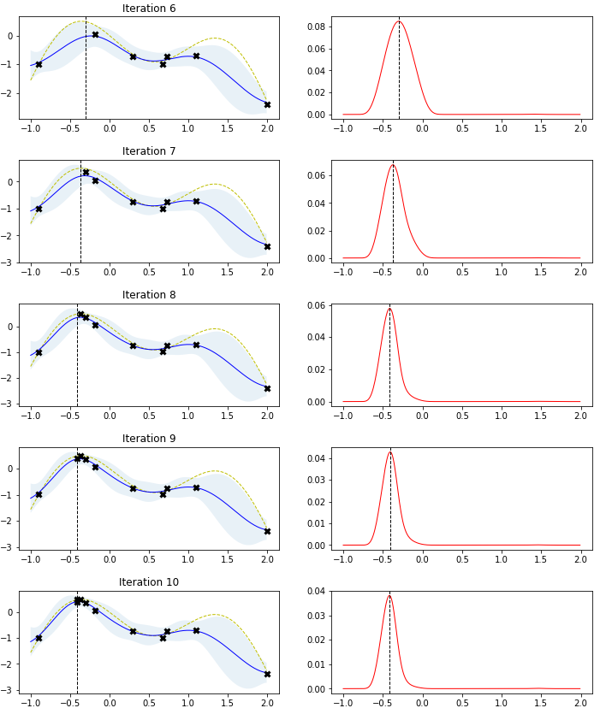

Bayesian Optimization: An Illustration
4
Suppose our goal is to find the maxima of $f(x)$ using BO
Pic source: http://krasserm.github.io/2018/03/21/bayesian-optimization/

Slide 5
Some Basic Acquisition Functions for BO
5
(assuming we are finding the minima)

Slide 6
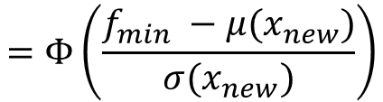
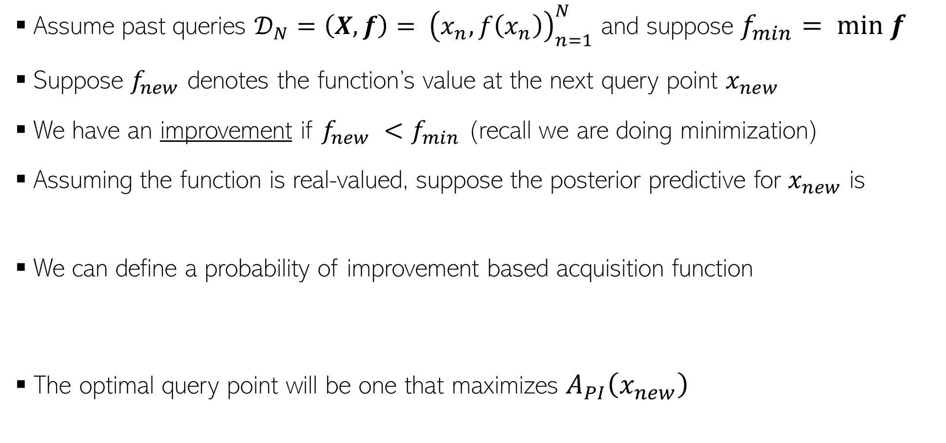
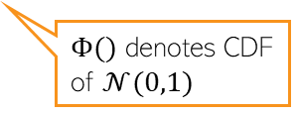

Acquisition Functions: Probability of Improvement
6
Assume past queries ${𝒟_{N}=\left(X,f\right)= \left(x_{n},f\left(x_{n}\right)\right)}_{n=1}^{N}$ and suppose $f_{min}= min f$
Suppose $f_{new}$ denotes the function’s value at the next query point $x_{new}$
We have an improvement if $f_{new} <f_{min}$ (recall we are doing minimization)
Assuming the function is real-valued, suppose the posterior predictive for $x_{new}$ is
We can define a probability of improvement based acquisition function
The optimal query point will be one that maximizes $A_{PI}\left(x_{new}\right)$
$$p(f_{new}|x_{new},𝒟_{N})= 𝒩(f_{new}|μ\left(x_{new}\right),σ^{2}\left(x_{new}\right))$$
Exercise: Verify
$$A_{PI}\left(x_{new}\right)=p\left(f_{new}≤f_{min}\right)=\int_{−∞}^{f_{min}}{𝒩\left(f_{new} | μ\left(x_{new}\right),σ^{2}\left(x_{new}\right)\right)df_{new}}$$
$$=Φ\left(\frac{f_{min} −μ(x_{new})}{σ(x_{new})}\right)$$
$Φ()$ denotes CDF of $𝒩(0,1)$
$${x_{∗}= {argmax}_{x_{new}}A}_{PI}(x_{new})$$

Slide 7

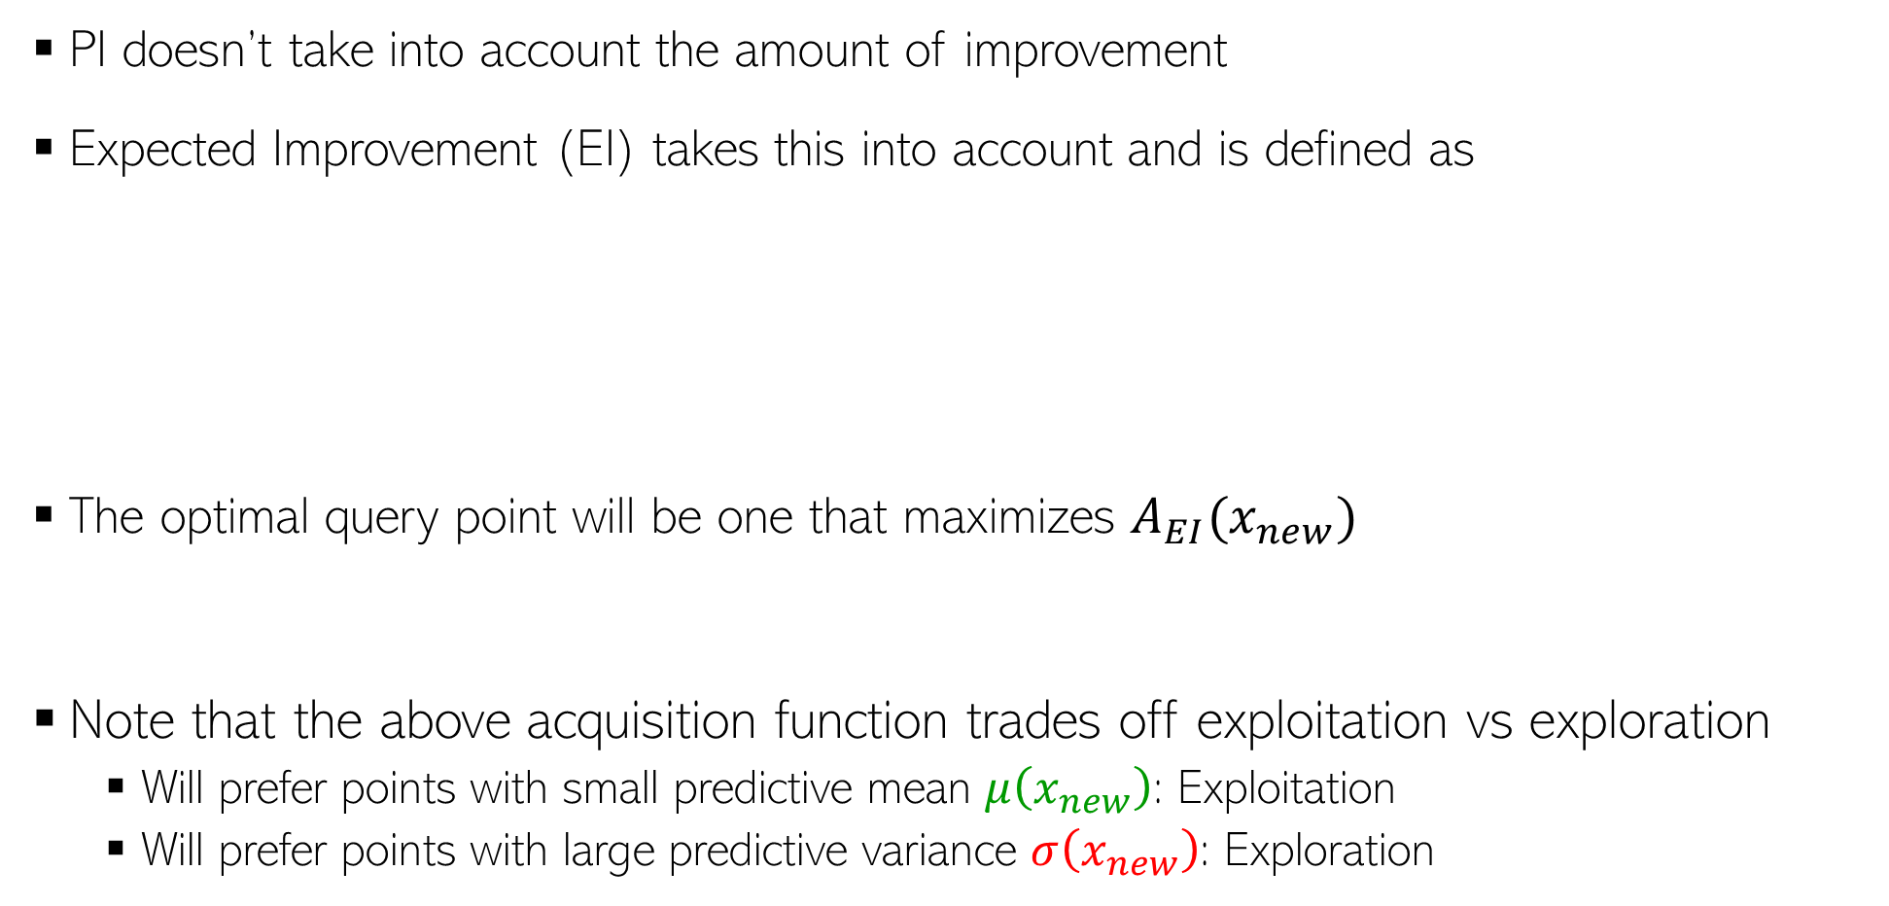
Acquisition Functions: Expected Improvement
7
PI doesn’t take into account the amount of improvement
Expected Improvement (EI) takes this into account and is defined as
The optimal query point will be one that maximizes $A_{EI}(x_{new})$
Note that the above acquisition function trades off exploitation vs exploration
  Will prefer points with small predictive mean $μ\left(x_{new}\right)$: Exploitation
  Will prefer points with large predictive variance $σ\left(x_{new}\right)$: Exploration
$$A_{EI}\left(x_{new}\right)=𝔼[f_{min} −f_{new}]=\int_{−∞}^{f_{min}}{(f_{min} −f_{new})𝒩\left(f_{new} | μ\left(x_{new}\right),σ^{2}\left(x_{new}\right)\right)df_{new}}$$
Exercise: Prove this result
$$=\left(f_{min} −μ\left(x_{new}\right)\right)Φ\left(\frac{f_{min} −μ\left(x_{new}\right)}{σ\left(x_{new}\right)}\right)+σ\left(x_{new}\right)𝒩\left(\frac{f_{min} −μ\left(x_{new}\right)}{σ\left(x_{new}\right)};0,1\right)$$
Focus on points where the function has high uncertainty (so that including them improves our estimate of the function)
$${x_{∗}= {argmax}_{x_{new}}A}_{EI}(x_{new})$$
Focus on points where the function has small values (since we are looking for its minima)

Slide 8


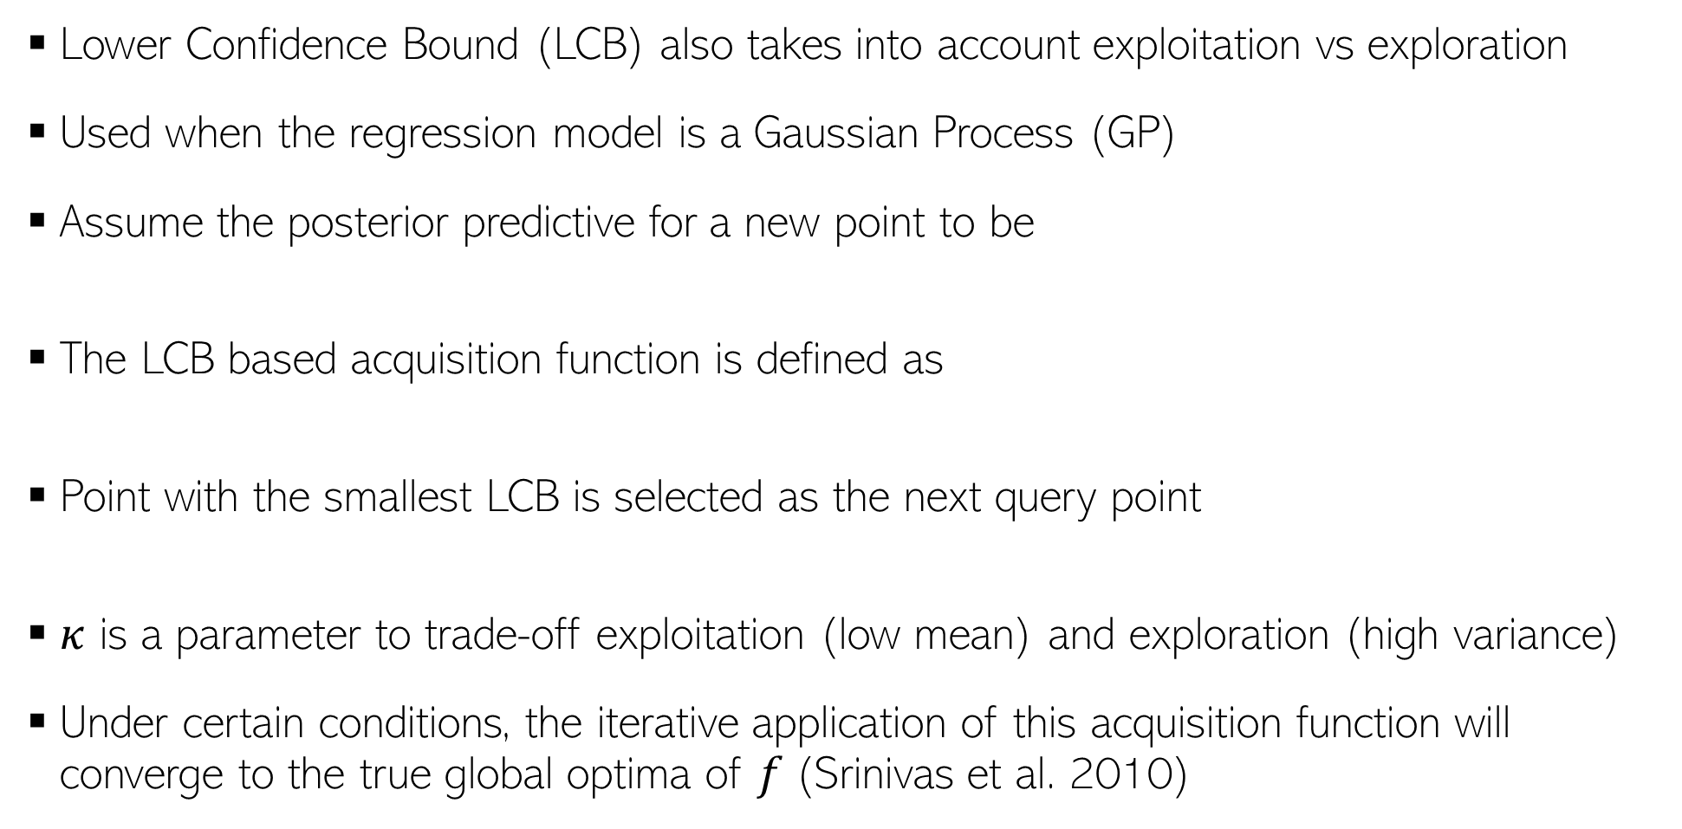
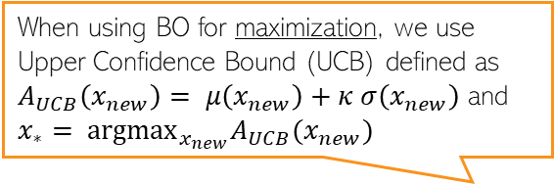
Acquisition Functions: Lower Confidence Bound
8
Lower Confidence Bound (LCB) also takes into account exploitation vs exploration
Used when the regression model is a Gaussian Process (GP)
Assume the posterior predictive for a new point to be
The LCB based acquisition function is defined as
Point with the smallest LCB is selected as the next query point
$κ$ is a parameter to trade-off exploitation (low mean) and exploration (high variance)
Under certain conditions, the iterative application of this acquisition function will converge to the true global optima of $f$(Srinivas et al. 2010)
When using BO for maximization, we use Upper Confidence Bound (UCB) defined as $A_{UCB}\left(x_{new}\right)= μ\left(x_{new}\right)+κ σ\left(x_{new}\right)$ and ${x_{∗}= {argmax}_{x_{new}}A}_{UCB}(x_{new})$
$$p(f_{new}|x_{new},𝒟_{N})= 𝒩(f_{new}|μ\left(x_{new}\right),σ^{2}\left(x_{new}\right))$$
$$A_{LCB}\left(x_{new}\right)=μ\left(x_{new}\right)−κ σ\left(x_{new}\right)$$
Thus prefer points at which the function has low mean but high variance
$${x_{∗}= {argmin}_{x_{new}}A}_{LCB}(x_{new})$$

Slide 9


Bayesian Optimization: The Overall Algo
9
Initialize $𝒟=\{\}$
For $n=1,2,…,N$ (or until the budget doesn’t exhaust)
  Select the next query point $x_{n}$ by optimizing the acquisition function
  Get function’s value from the black-box oracle: $f_{n}=f\left(x_{n}\right)$
  $𝒟=\{𝒟∪(x_{n},f_{n})\}$
  Update the regression model for $f$ using data $𝒟$
$$x_{n}= {argopt}_{x} A(x)$$
Can get the function’s minima from this set of function’s values

Slide 10
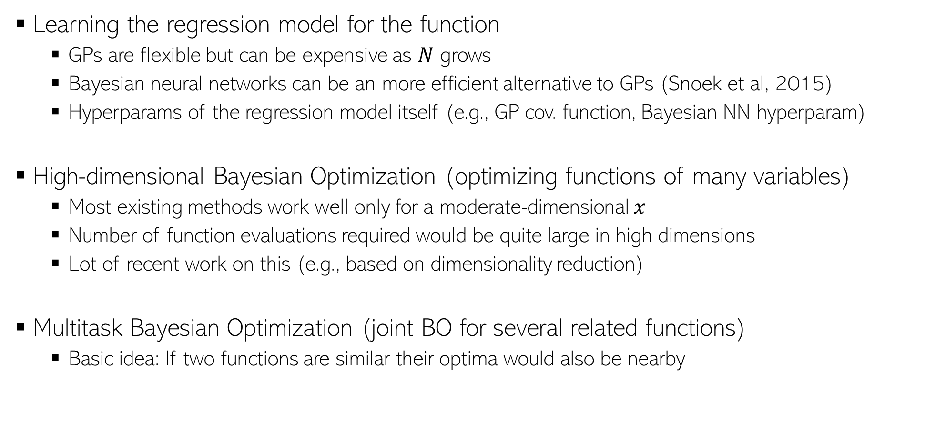
BO: Some Challenges/Open Problems
10
Learning the regression model for the function
  GPs are flexible but can be expensive as $N$ grows
  Bayesian neural networks can be an more efficient alternative to GPs (Snoek et al, 2015)
  Hyperparams of the regression model itself (e.g., GP cov. function, Bayesian NN hyperparam)
High-dimensional Bayesian Optimization (optimizing functions of many variables)
  Most existing methods work well only for a moderate-dimensional $x$
  Number of function evaluations required would be quite large in high dimensions
  Lot of recent work on this (e.g., based on dimensionality reduction)
Multitask Bayesian Optimization (joint BO for several related functions)
  Basic idea: If two functions are similar their optima would also be nearby

Slide 11
BO: Some Further Resources
11
Some survey papers:
  A Tutorial on Bayesian Optimization of Expensive Cost Functions, with Application to Active User Modeling and Hierarchical Reinforcement Learning (Brochu et al., 2010)
  Taking the Human Out of the Loop: A Review of Bayesian Optimization (Shahriari et al., 2015)
Some open source software libraries
  BoTorch: Bayesian Optimization in PyTorch
  GPflowOpt: Bayesian Optimization in Tensorflow (and using GP for modeling the function)
  Also available in scikit-optimize

Slide 12
Frequentist Statistics
(vs Bayesian Statistics)
12

Slide 13

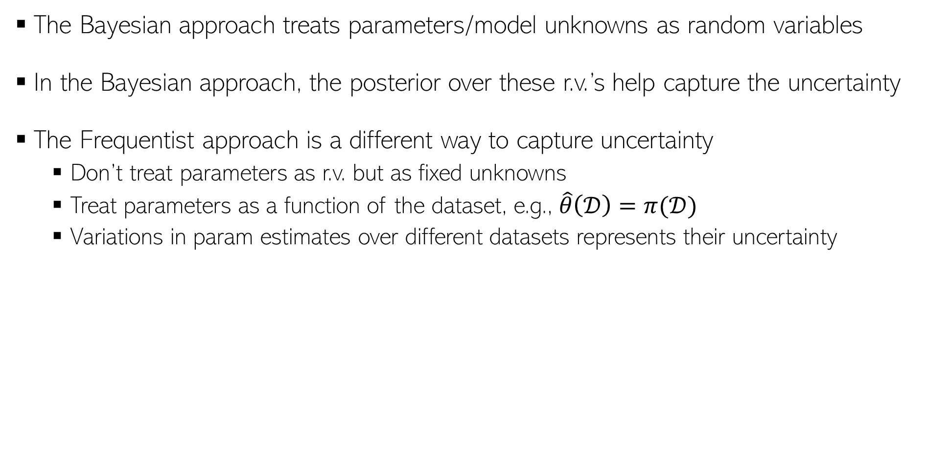
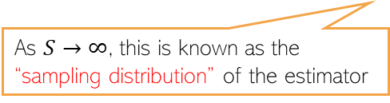

Frequentist Statistics
13
The Bayesian approach treats parameters/model unknowns as random variables
In the Bayesian approach, the posterior over these r.v.’s help capture the uncertainty
The Frequentist approach is a different way to capture uncertainty
  Don’t treat parameters as r.v. but as fixed unknowns
  Treat parameters as a function of the dataset, e.g., $\hat{θ}\left(𝒟\right)=π(𝒟)$
  Variations in param estimates over different datasets represents their uncertainty
This can be some point estimate, e.g., MLE, MAP, method of moments, etc.
A random dataset drawn from the true data distribution
True unknown value of the parameter
$$(s=1, 2, …, S)$$
The estimated distribution of the parameters given any randomly drawn dataset from the true data distribution
Param estimate using the $s$-th sampled dataset
As $S→∞$, this is known as the “sampling distribution” of the estimator
Note that sampling distribution is different from a posterior distribution we infer in Bayesian learning (there, we condition on a fixed training set)
But if the estimator is MLE and Bayesian method’s prior is uniform, then both distributions are very similar (sampling distribution is often called “poor man’s posterior”

Slide 14






Approximating the sampling distribution
14
Since the true $θ^{∗}$ is not known, we can’t compute the sampling distribution exactly
Bootstrap is a popular method to approximate the sampling distribution
Two types of bootstrap methods: parametric and nonparametric bootstrap
$$(s=1, 2, …, S)$$
Parametric Bootstrap
Nonparametric Bootstrap
Get a point est. of $θ$ using training data
Generate multiple datasets using $\hat{θ}$ as
Now compute the approximation as
Use sampling with replacement on original training set to generate $S$ datasets with $N$ datapoints in each
Now compute the approximation as
$$\hat{θ}=π(𝒟)$$
Each dataset will contain roughly 63% unique datapoints from original training set
$$(s=1, 2, …, S)$$

Slide 15
Model Calibration
15

Slide 16
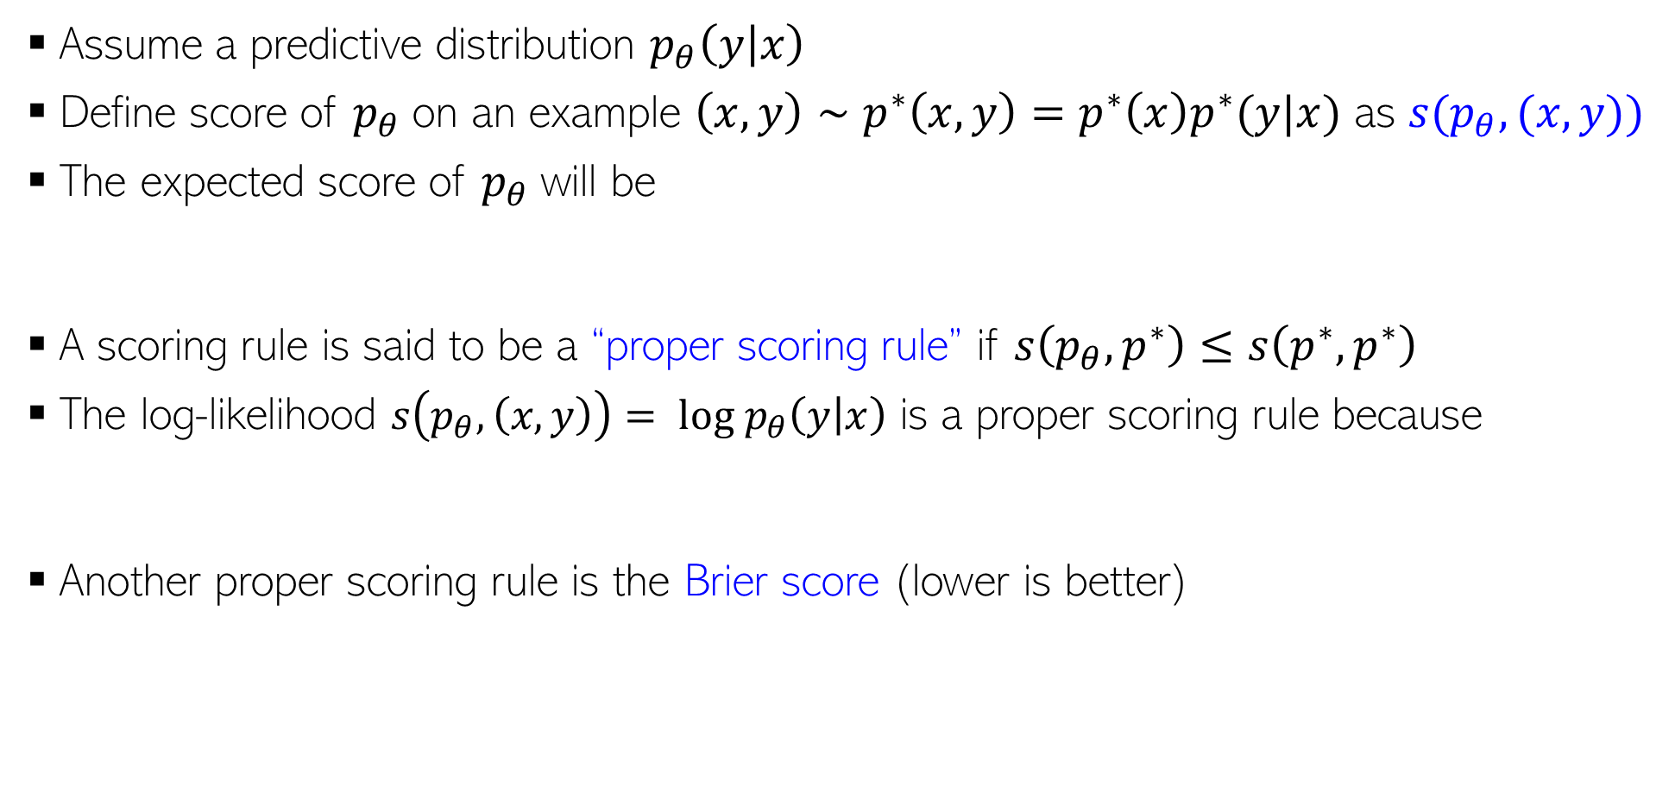
Evaluation of Predictive Models
16
Assume a predictive distribution $p_{θ}\left(y | x\right)$
Define score of $p_{θ}$on an example $\left(x,y\right)∼p^{∗}\left(x,y\right)=p^{∗}\left(x\right)p^{∗}(y|x)$ as $s(p_{θ},(x,y))$
The expected score of $p_{θ}$will be
A scoring rule is said to be a “proper scoring rule” if $s\left(p_{θ},p^{∗}\right)≤s\left(p^{∗},p^{∗}\right)$
The log-likelihood $s\left(p_{θ},\left(x,y\right)\right)= log p_{θ}\left(y | x\right)$ is a proper scoring rule because
Another proper scoring rule is the Brier score (lower is better)
$$s\left(p_{θ},p^{∗}\right)=∫p^{∗}\left(x\right)p^{∗}\left(y | x\right)s\left(p_{θ},\left(x,y\right)\right)dydx$$
Holds because of Gibbs inequality
Squared error of predictive distribution as compared to one-hot vector

Slide 17
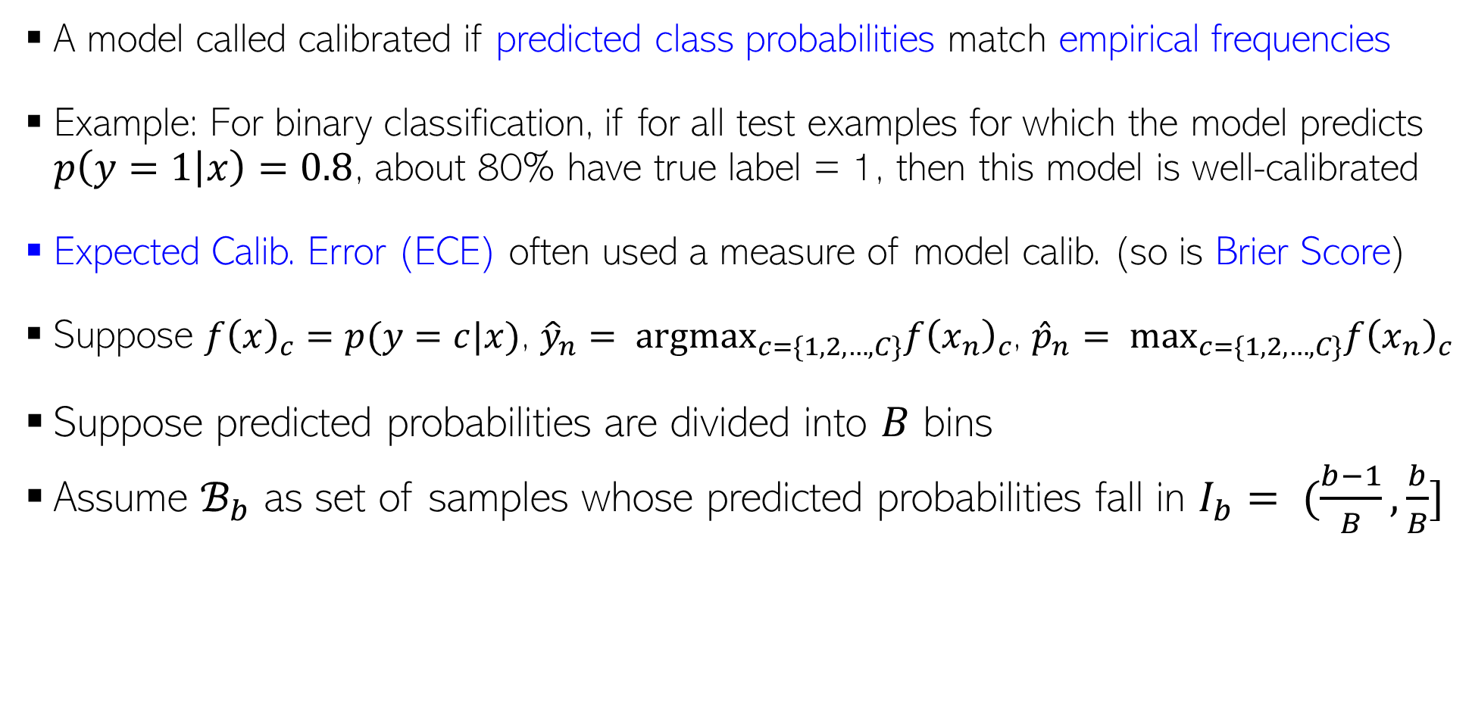
Calibration
17
A model called calibrated if predicted class probabilities match empirical frequencies
Example: For binary classification, if for all test examples for which the model predicts $p\left(y=1 | x\right)=0.8$, about 80% have true label = 1, then this model is well-calibrated
Expected Calib. Error (ECE) often used a measure of model calib. (so is Brier Score)
Suppose $f{\left(x\right)}_{c}=p(y=c|x)$, ${\hat{y}}_{n}= {argmax}_{c=\{1,2,…,C\}}f{\left(x_{n}\right)}_{c}$, ${\hat{p}}_{n}= \max_{c=\{1,2,…,C\}}f{\left(x_{n}\right)}_{c}$
Suppose predicted probabilities are divided into $B$ bins
Assume $ℬ_{b}$ as set of samples whose predicted probabilities fall in $I_{b}= (\frac{b−1}{B},\frac{b}{B}]$
Difference between confidence and accuracy

Slide 18
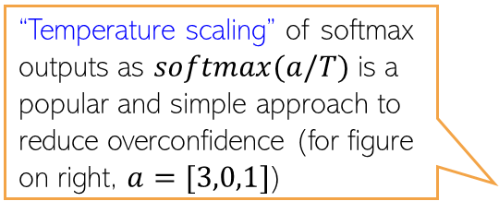
Calibration
18
A reliability diagram is often used as a visual indicator of calibration
Several approaches to improve a model’s calibration
In general, we want to reduce the model’s overconfidence
Reliability diagram of the same model after applying calibration post-processing via temperature scaling method
ECE is the average “gap” area in the reliability diagram
Reliability diagram of an uncalibrated model
Many other approaches: Platt Scaling, Histogram Binning, Label Smoothing, etc are also popular, and can be applied as post-processing step to the outputs of Bayesian/non-Bayesian methoods to improve calibration
Confidence
Confidence
Bayesian methods are usually better calibrated but can still have poor calibration if test data is from a different distribution
“Temperature scaling” of softmax outputs as $softmax(a/T)$is a popular and simple approach to reduce overconfidence (for figure on right, $a=[3,0,1]$)

Slide 19
Conformal Prediction
19

Slide 20
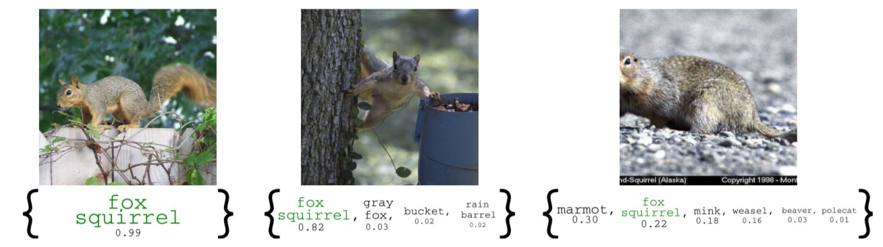
Conformal Prediction
20
A simple technique to easily obtain confidence intervals
  In classification, such an interval may refer to the set of highly likely classes for a test input
  For more difficult test inputs, the set would typically be larger
In a way, conformal prediction also gives predictive uncertainty
  However, unlike Bayesian ML, we don’t get model uncertainty
  Only one model is learned in the standard way and we construct the set (next slide)
  It’s like a black-box method; no change to training procedure for the model

Slide 21
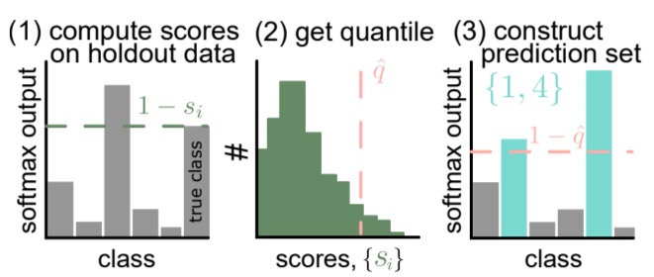
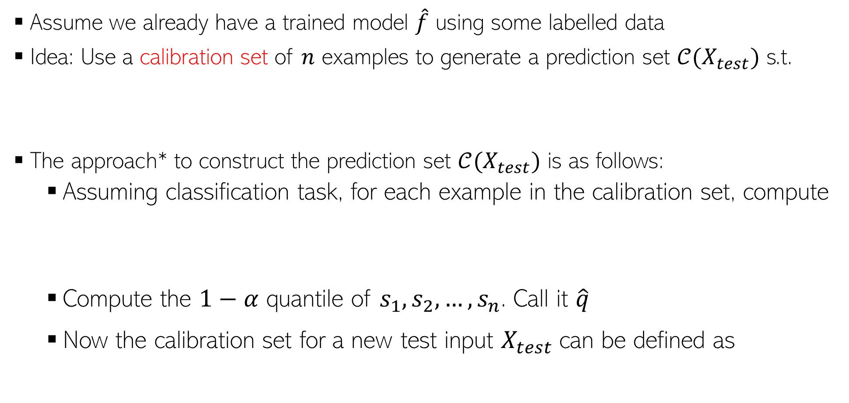

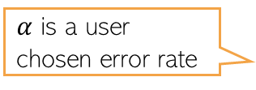
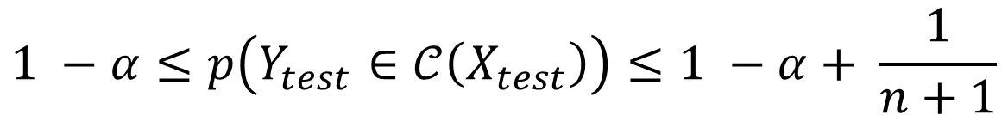
Conformal Prediction
21
Assume it’s a classification model which produces softmax scores
Conformal prediction can be used for regression problems too*
Assume we already have a trained model $\hat{f}$ using some labelled data
Idea: Use a calibration set of $n$ examples to generate a prediction set $𝒞(X_{test})$ s.t.
The approach* to construct the prediction set $𝒞(X_{test})$ is as follows:
  Assuming classification task, for each example in the calibration set, compute
  Compute the $1−α$ quantile of $s_{1},s_{2},…, s_{n}$. Call it $\hat{q}$
  Now the calibration set for a new test input $X_{test}$can be defined as
$α$ is a user chosen error rate
Another fresh test input
Its true label
$$1 −α≤p\left(Y_{test}∈𝒞\left(X_{test}\right)\right)≤1 −α+ \frac{1}{n+1}$$
high means bad prediction by the model
Conformal score: one minus the softmax score of the correct class
$$s_{i}=1−\hat{f}{\left(x_{i}\right)}_{y_{i}}$$
Set of all classes whose predicted softmax values are “high enough”
$$𝒞\left(X_{test}\right)=\{y:\hat{f}{\left(X_{test}\right)}_{y}≥1−\hat{q}\}$$
*A Gentle Introduction to Conformal Prediction and Distribution-Free Uncertainty Quantification (Angelopoulos and Bates, 2022)

