Slide 1
(1) Active Learning
(2) Bayesian Optimization
CS772A: Probabilistic Machine Learning
Piyush Rai

Slide 2
Plan for today
2
Two important problems where model/predictive uncertainty is used
  Active Learning
  Bayesian Optimization

Slide 3
Active Learning
3

Slide 4
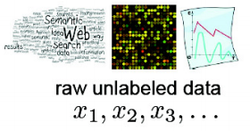

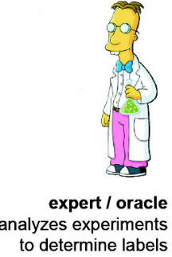

Passive Learning
4
Standard supervised learning is passive
  Learner has no control over what labelled training examples it gets to learn from
Random Unlabeled
Examples
Labeled Training Examples
$$\left(x_{1},y_{1}\right), \left(x_{2},y_{2}\right), \left(x_{3},y_{3}\right), …$$
Supervised Passive Learner

Slide 5

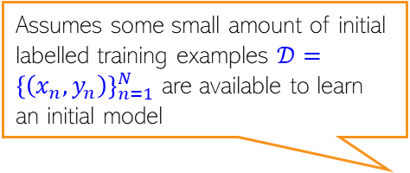



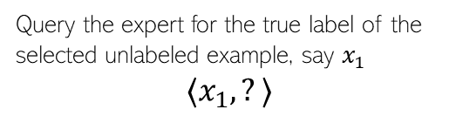
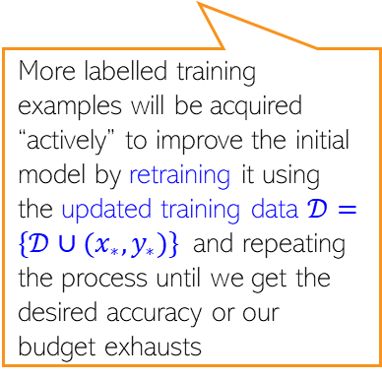
Active Learning
5
It is therefore also a sequential learning strategy (training data is not given all at once)
In Active Learning, the learner can request specific labelled examples as it trains
  In particular, examples that the learner thinks will be most useful to learn the underlying function
Will soon see what are some common notions of usefulness
Using the current model, identify the most useful example(s) from the unlabeled data pool
Although one example in each iteration is more common, labels of one or more than one examples can be queried (“batch” active learning”)
Assumes some small amount of initial labelled training examples $𝒟={\left\{\left(x_{n},y_{n}\right)\right\}}_{n=1}^{N}$ are available to learn an initial model
Query the expert for the true label of the selected unlabeled example, say $x_{1}$
$$⟨x_{1},?⟩$$
More labelled training examples will be acquired “actively” to improve the initial model by retraining it using the updated training data $𝒟=\{𝒟∪(x_{∗},y_{∗})\}$ and repeating the process until we get the desired accuracy or our budget exhausts
$$⟨x_{1},y_{1}⟩$$
$$⟨x_{2},?⟩$$
$$⟨x_{2},y_{2}⟩$$
Supervised Active Learner

Slide 6
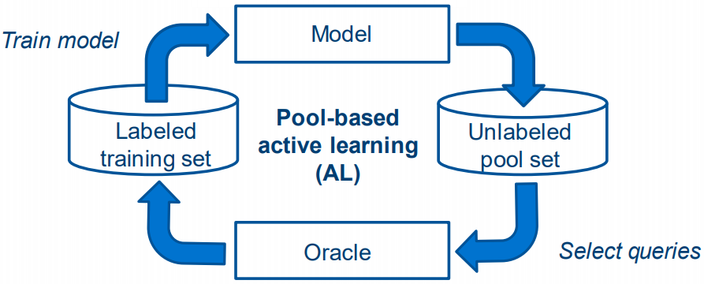
Active Learning
6
The figure below is another illustration of AL
(provides true labels for
the unlabeled examples)
(unlabeled examples)

Slide 7
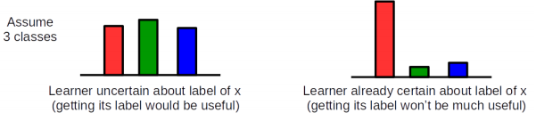
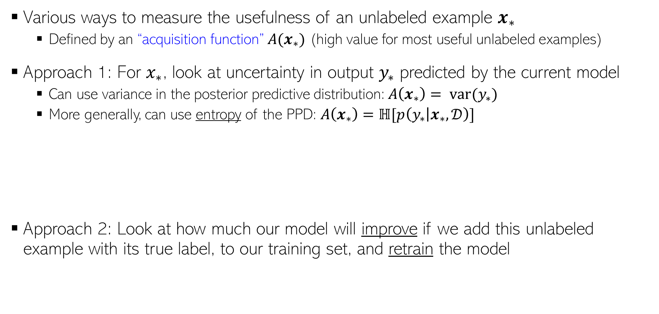
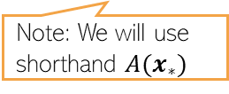
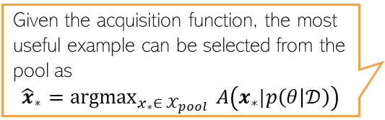
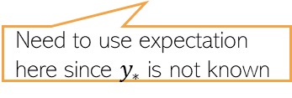
Measuring Usefulness in AL
7
Given the acquisition function, the most useful example can be selected from the pool as
$${\hat{x}}_{∗}={argmax}_{x_{∗}∈ 𝒳_{pool} }A\left(x_{∗}|p\left(θ | 𝒟\right)\right)$$
Various ways to measure the usefulness of an unlabeled example $x_{∗}$
  Defined by an “acquisition function” $A(x_{∗})$ (high value for most useful unlabeled examples)
Approach 1: For $x_{∗}$, look at uncertainty in output $y_{∗}$ predicted by the current model
  Can use variance in the posterior predictive distribution: $A\left(x_{∗}\right)= var(y_{∗})$
  More generally, can use entropy of the PPD: $A\left(x_{∗}\right)=ℍ[p\left(y_{∗} | x_{∗}, 𝒟\right)]$
Approach 2: Look at how much our model will improve if we add this unlabeled example with its true label, to our training set, and retrain the model
Note: We will use shorthand $A(x_{∗})$
High entropy
Low entropy
Note that this is the “marginal entropy” of the output distribution since the posterior predictive of the output is obtained by marginalizing over the posterior
Mutual Information
$$A\left(x_{∗}\right)= ℍ\left[p\left(θ | 𝒟\right)\right]−𝔼_{p\left(y_{∗} | x_{∗},𝒟\right)}ℍ\left[p\left(θ | 𝒟∪\left(x_{∗},y_{∗}\right)\right)\right]=𝕀[θ; y_{∗}|𝒟,x_{∗}]$$
Entropy of the current posterior
Need to use expectation here since $y_{∗}$ is not known
Entropy of the new posterior after including the new example in our training set

Slide 8
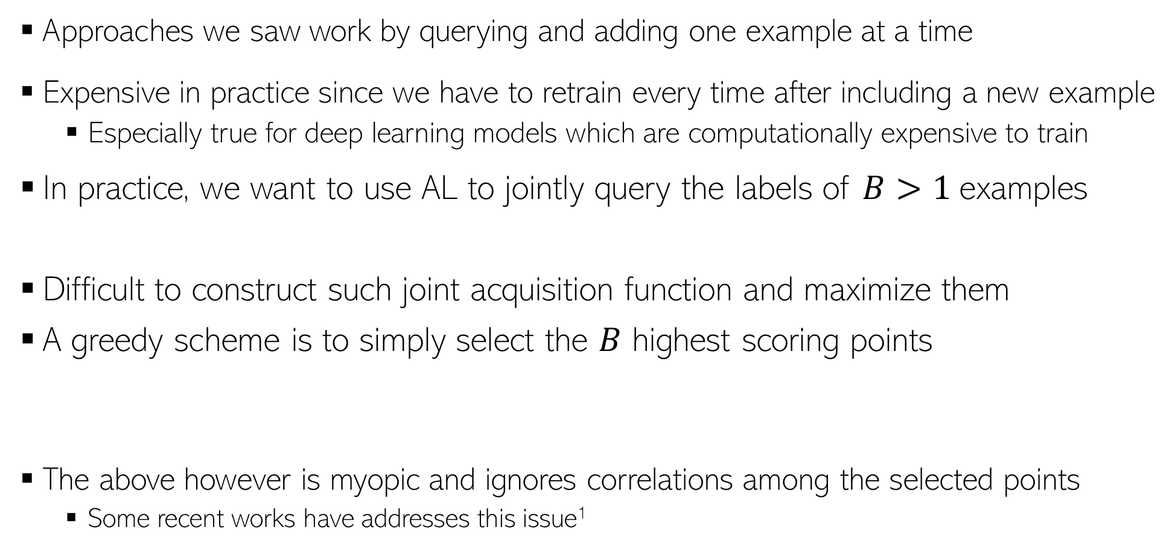
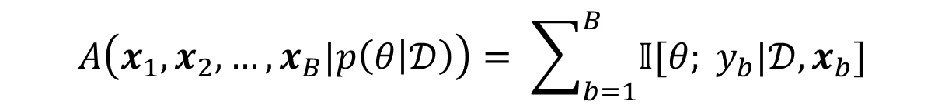
Batch Active Learning
8
Approaches we saw work by querying and adding one example at a time
Expensive in practice since we have to retrain every time after including a new example
  Especially true for deep learning models which are computationally expensive to train
In practice, we want to use AL to jointly query the labels of $B>1$examples
Difficult to construct such joint acquisition function and maximize them
A greedy scheme is to simply select the $B$ highest scoring points
The above however is myopic and ignores correlations among the selected points
  Some recent works have addresses this issue¹
$${(\hat{x}}_{1},{\hat{x}}_{2},…,{\hat{x}}_{B})={argmax}_{(x_{1},x_{2},…, x_{B})∈ 𝒳_{pool} }A\left(x_{1},x_{2},…, x_{B}|p\left(θ | 𝒟\right)\right)$$
$$A\left(x_{1},x_{2},…, x_{B}|p\left(θ | 𝒟\right)\right)= \sum_{b=1}^{B}{𝕀[θ; y_{b}|𝒟,x_{b}]}$$
¹BatchBALD: Efficient and Diverse Batch Acquisition for Deep Bayesian Active Learning (Kirsch et al, NeurIPS 2019)

Slide 9
Bayesian Optimization
9

Slide 10
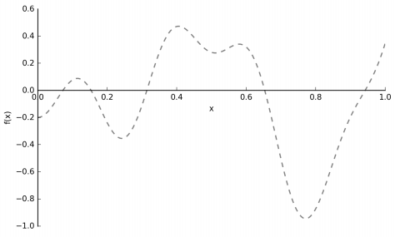

Bayesian Optimization: The Basic Formulation
10
Consider finding the optima $x_{∗}$(say minima) of a function $f\left(x\right)$
Caveat: We don’t know the form of the function; can’t get its gradient, Hessian, etc
Can only query the function’s values at certain points (i.e., only “black-box” access)
  The values may or may not be noisy (i.e., we may be given $f(x)$ or $f\left(x\right)+ε$)

Slide 11
Bayesian Optimization: Some Applications
11
Drug Design: Want to find the optimal chemical composition for a drug
  Optimal composition will be the one that has the best efficacy
  But we don’t know the efficacy function
  Can only know the efficacy via doing clinical trials
  Each trial is expensive; can’t do too many trials
Hyperparameter Optimization: Want to find the optimal hyperparameters for a model
  Optimal hyperparam values will be those that give the lowest test error
  Don’t know the true “test error” function
  Need to train the model each time with different h.p. values and compute test error
  Training every time will be expensive (e.g., for deep nets)
  Note: Hyperparams here can even refer to the structure of a deep net (depth, width, etc)
Many other applications: Website design via A/B testing, material design, optimizing physics based models (e.g., aircraft design), etc

Slide 12
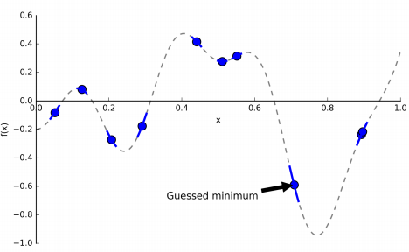
Bayesian Optimization
12
Can use BO to find maxima or minima
Would like to locate the optima by querying the function’s values (say, from an oracle)
We would like to do so using as few queries as possible
Reason: The function’s evaluation may be time-consuming or costly
Assuming the goal is to find the minima

Slide 13
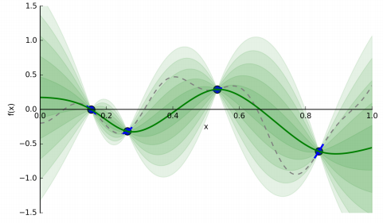
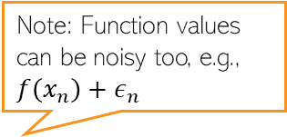

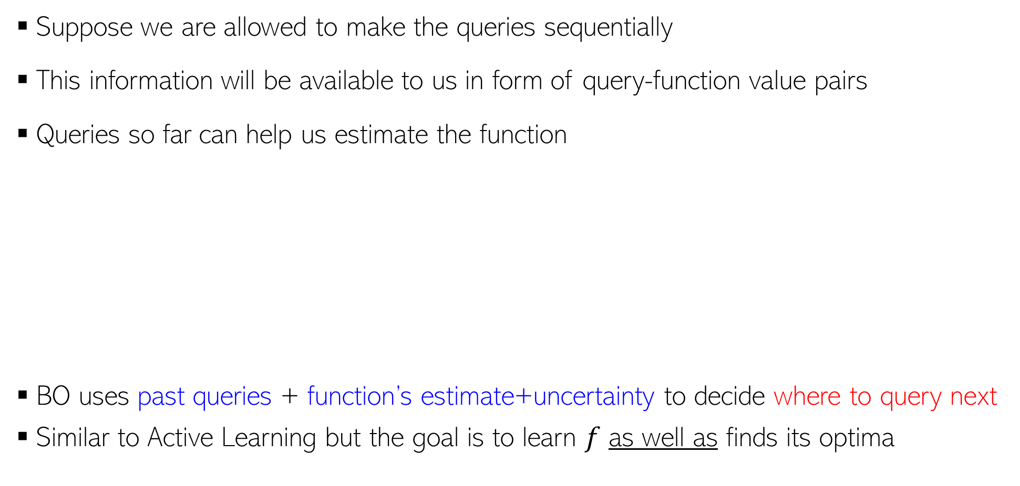
Bayesian Optimization
13
Note: Function values can be noisy too, e.g., $f\left(x_{n}\right)+ε_{n}$
Suppose we are allowed to make the queries sequentially
This information will be available to us in form of query-function value pairs
Queries so far can help us estimate the function
BO uses past queries + function’s estimate+uncertainty to decide where to query next
Similar to Active Learning but the goal is to learn $f$ as well as finds its optima
$${\{\left(x_{n},f\left(x_{n}\right)\right)\}}_{n=1}^{N}$$
By solving a regression problem
Dotted curve: True function
Green curve: Current estimate (“surrogate”) of the function
Shaded region: Uncertainty in the function’s estimate

Slide 14
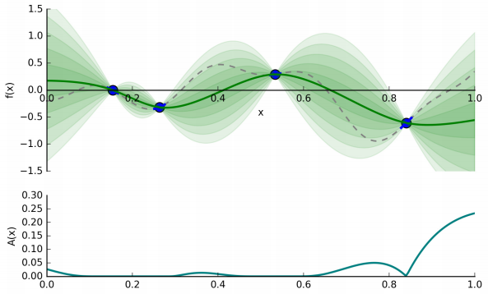
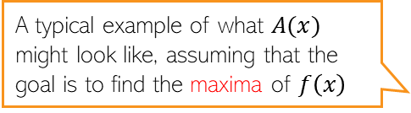


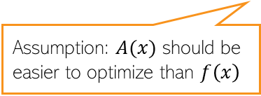
Bayesian Optimization
14
Note: Function values can be noisy too, e.g., $f\left(x_{n}\right)+ε_{n}$
BO requires two ingredients
  A regression model to learn a surrogate of $f(x)$ given previous queries ${\{\left(x_{n},f\left(x_{n}\right)\right)\}}_{n=1}^{N}$
  An acquisition function $A(x)$ to tell us where to query next
Note: The regression model must also have estimate of function’s uncertainty
  Bayesian nonlinear regression, such as GP, Bayesian Neural network, etc would be ideal
Assumption: $A(x)$ should be easier to optimize than $f\left(x\right)$
Dotted curve: True function
Green curve: Current surrogate of the function
Shaded region: Uncertainty in the function’s estimate
A typical example of what $A(x)$ might look like, assuming that the goal is to find the maxima of $f\left(x\right)$

Slide 15
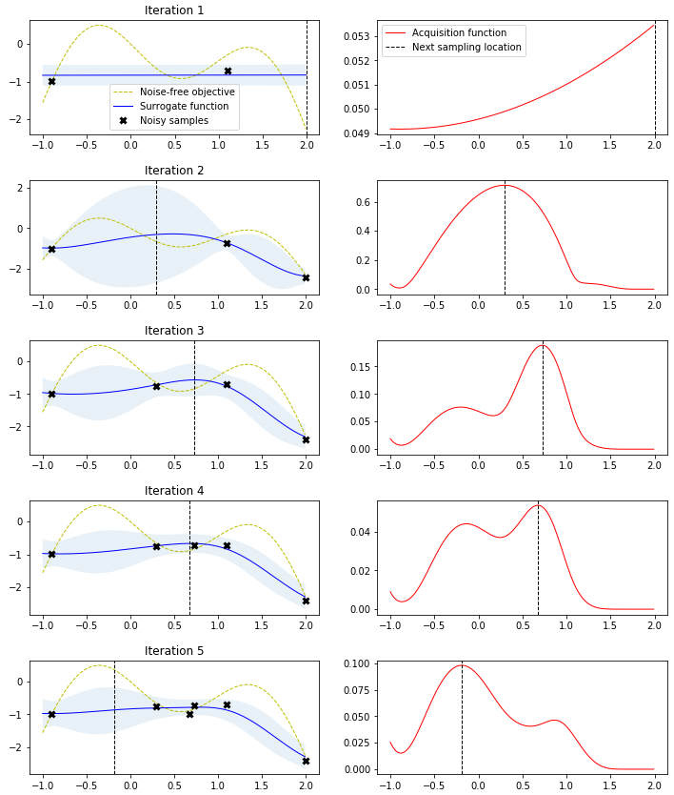
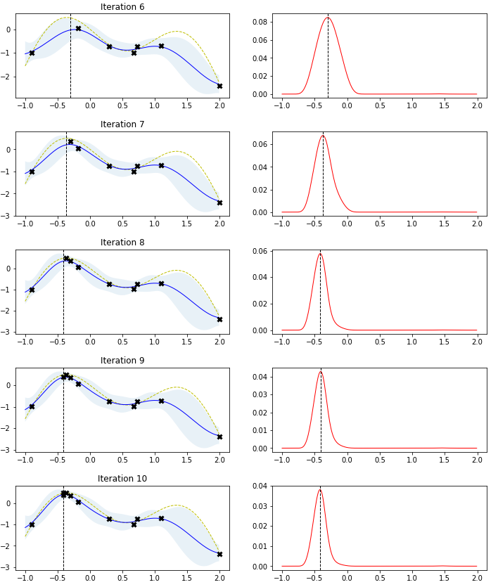

Bayesian Optimization: An Illustration
15
Suppose our goal is to find the maxima of $f(x)$ using BO
Pic source: http://krasserm.github.io/2018/03/21/bayesian-optimization/

Slide 16
Some Basic Acquisition Functions for BO
16
(assuming we are finding the minima)

Slide 17
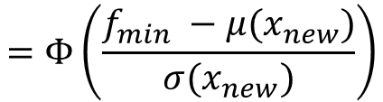
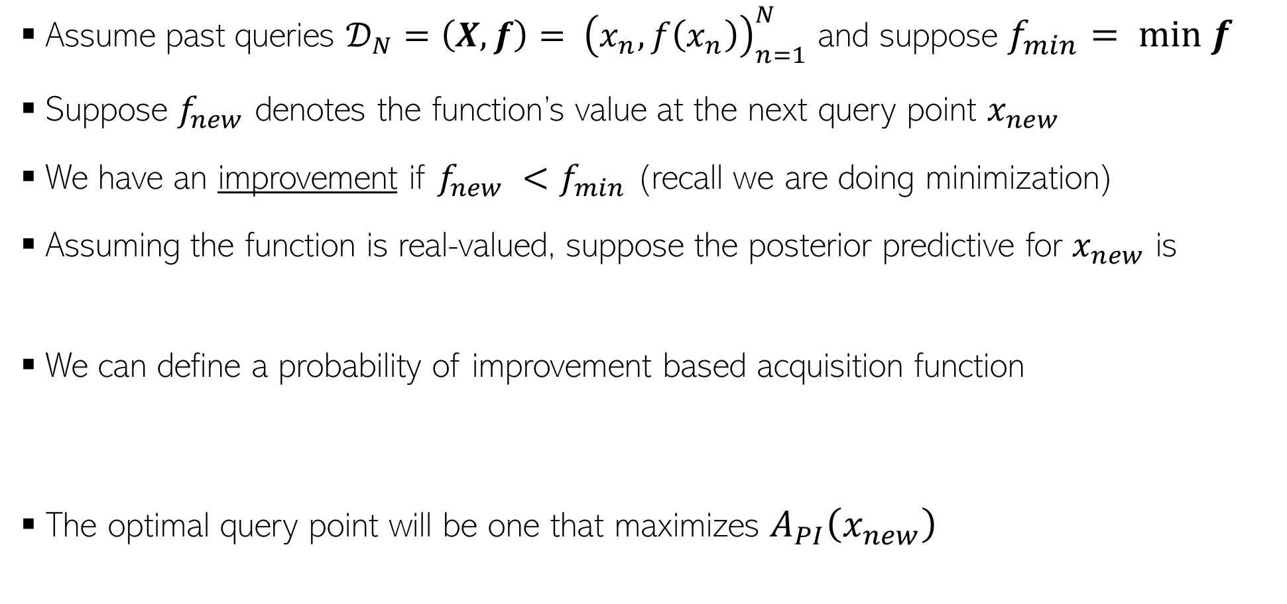
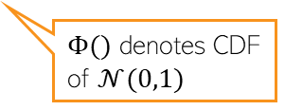

Acquisition Functions: Probability of Improvement
17
Assume past queries ${𝒟_{N}=\left(X,f\right)= \left(x_{n},f\left(x_{n}\right)\right)}_{n=1}^{N}$ and suppose $f_{min}= min f$
Suppose $f_{new}$ denotes the function’s value at the next query point $x_{new}$
We have an improvement if $f_{new} <f_{min}$ (recall we are doing minimization)
Assuming the function is real-valued, suppose the posterior predictive for $x_{new}$ is
We can define a probability of improvement based acquisition function
The optimal query point will be one that maximizes $A_{PI}\left(x_{new}\right)$
$$p(f_{new}|x_{new},𝒟_{N})= 𝒩(f_{new}|μ\left(x_{new}\right),σ^{2}\left(x_{new}\right))$$
Exercise: Verify
$$A_{PI}\left(x_{new}\right)=p\left(f_{new}≤f_{min}\right)=\int_{−∞}^{f_{min}}{𝒩\left(f_{new} | μ\left(x_{new}\right),σ^{2}\left(x_{new}\right)\right)df_{new}}$$
$$=Φ\left(\frac{f_{min} −μ(x_{new})}{σ(x_{new})}\right)$$
$Φ()$ denotes CDF of $𝒩(0,1)$
$${x_{∗}= {argmax}_{x_{new}}A}_{PI}(x_{new})$$

Slide 18

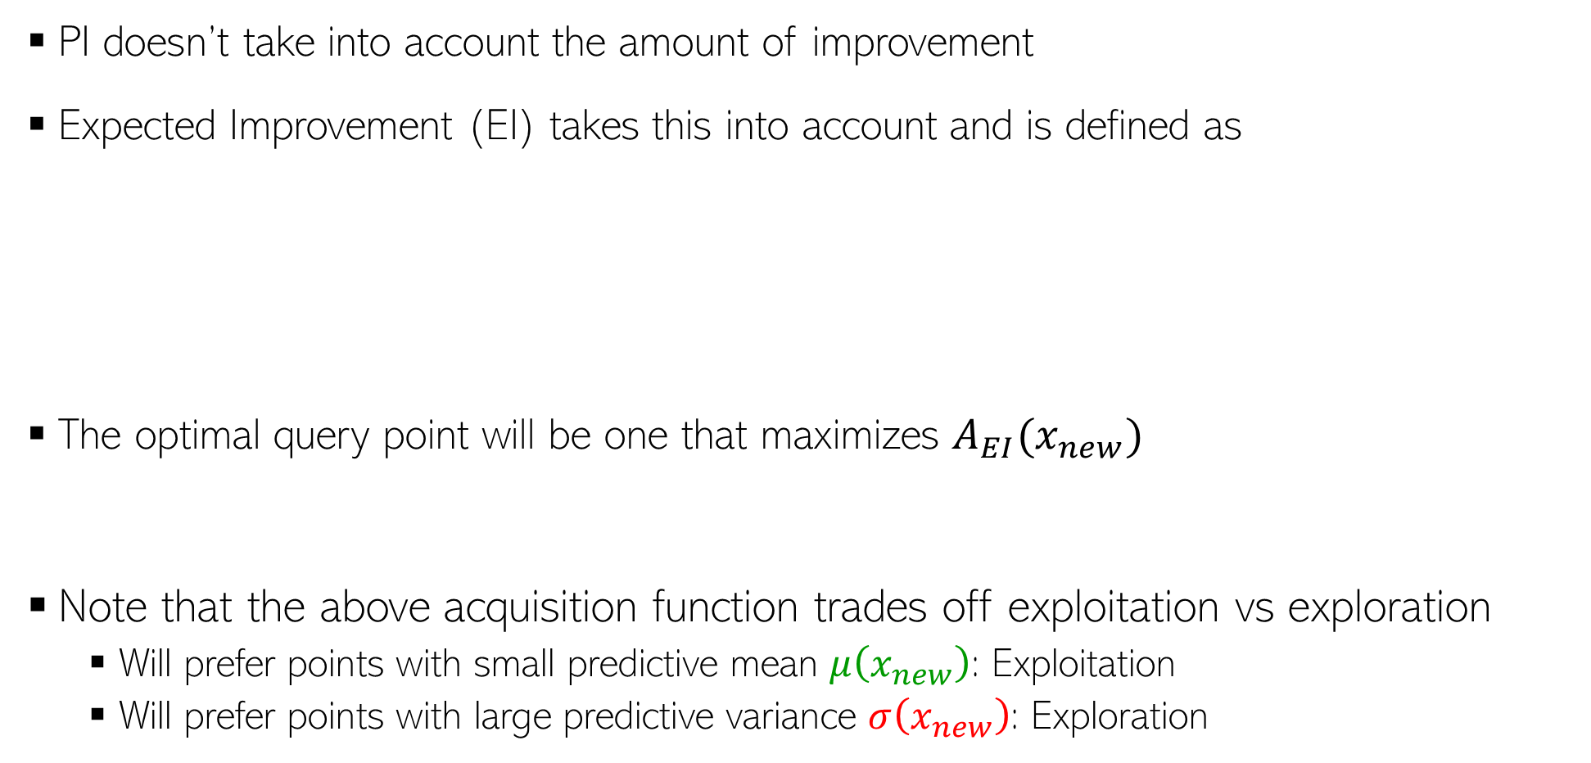
Acquisition Functions: Expected Improvement
18
PI doesn’t take into account the amount of improvement
Expected Improvement (EI) takes this into account and is defined as
The optimal query point will be one that maximizes $A_{EI}(x_{new})$
Note that the above acquisition function trades off exploitation vs exploration
  Will prefer points with small predictive mean $μ\left(x_{new}\right)$: Exploitation
  Will prefer points with large predictive variance $σ\left(x_{new}\right)$: Exploration
$$A_{EI}\left(x_{new}\right)=𝔼[f_{min} −f_{new}]=\int_{−∞}^{f_{min}}{(f_{min} −f_{new})𝒩\left(f_{new} | μ\left(x_{new}\right),σ^{2}\left(x_{new}\right)\right)df_{new}}$$
Exercise: Prove this result
$$=\left(f_{min} −μ\left(x_{new}\right)\right)Φ\left(\frac{f_{min} −μ\left(x_{new}\right)}{σ\left(x_{new}\right)}\right)+σ\left(x_{new}\right)𝒩\left(\frac{f_{min} −μ\left(x_{new}\right)}{σ\left(x_{new}\right)};0,1\right)$$
Focus on points where the function has high uncertainty (so that including them improves our estimate of the function)
$${x_{∗}= {argmax}_{x_{new}}A}_{EI}(x_{new})$$
Focus on points where the function has small values (since we are looking for its minima)

Slide 19

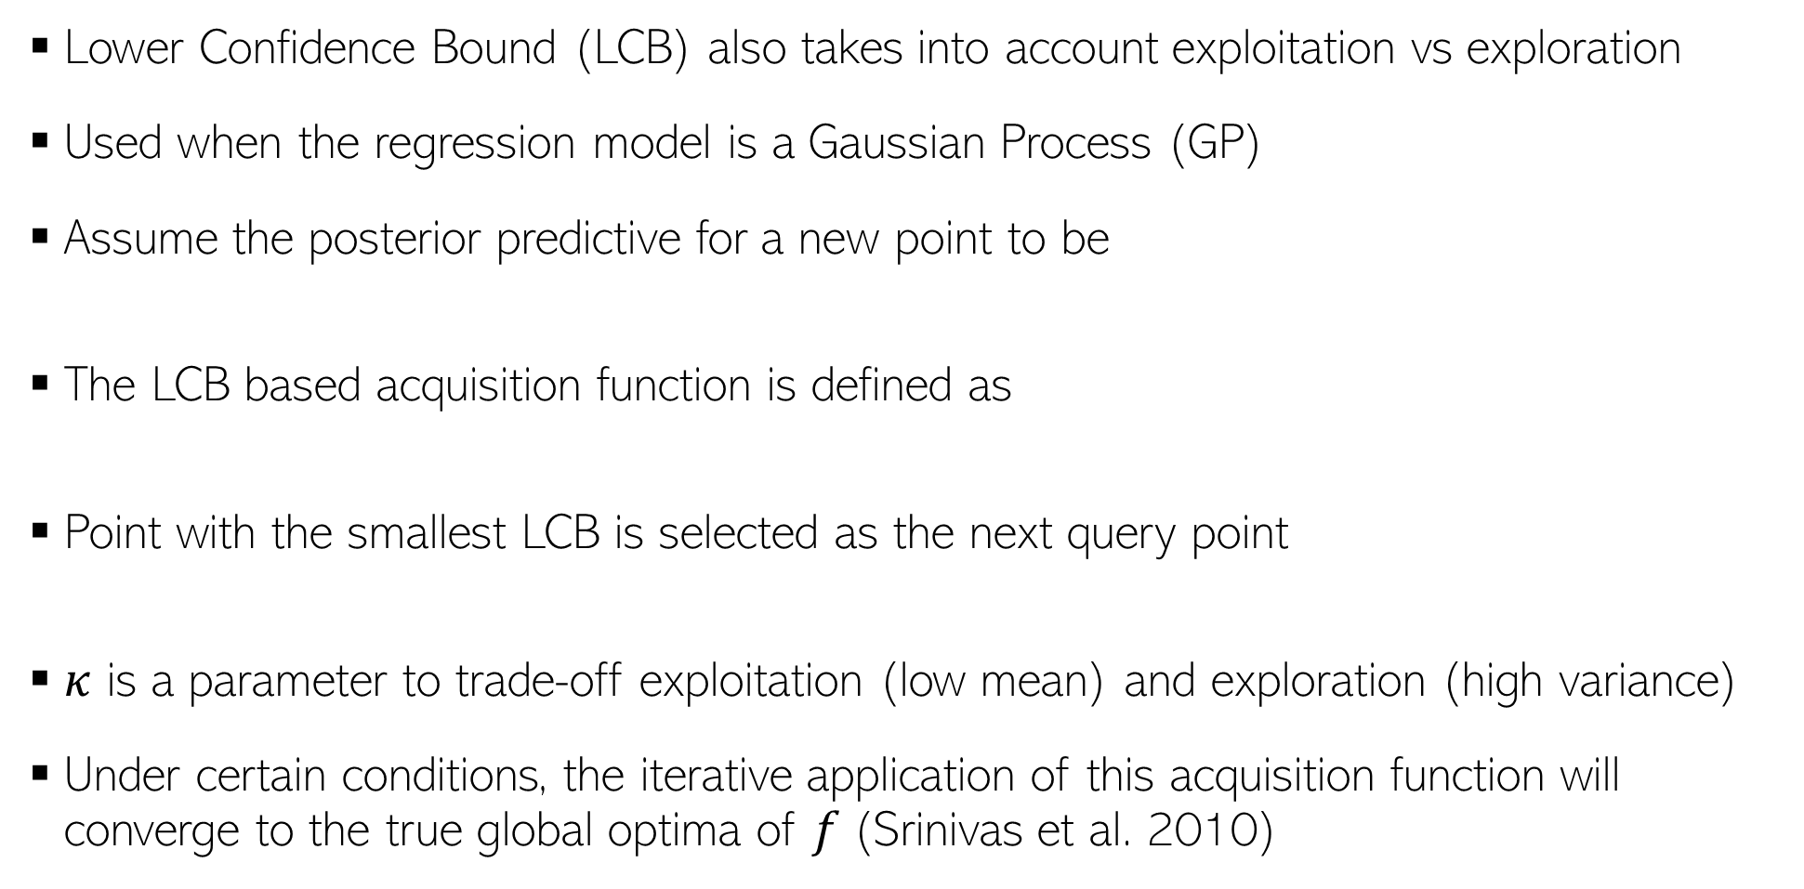
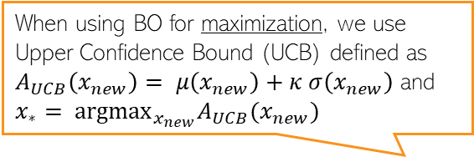
Acquisition Functions: Lower Confidence Bound
19
Lower Confidence Bound (LCB) also takes into account exploitation vs exploration
Used when the regression model is a Gaussian Process (GP)
Assume the posterior predictive for a new point to be
The LCB based acquisition function is defined as
Point with the smallest LCB is selected as the next query point
$κ$ is a parameter to trade-off exploitation (low mean) and exploration (high variance)
Under certain conditions, the iterative application of this acquisition function will converge to the true global optima of $f$(Srinivas et al. 2010)
When using BO for maximization, we use Upper Confidence Bound (UCB) defined as $A_{UCB}\left(x_{new}\right)= μ\left(x_{new}\right)+κ σ\left(x_{new}\right)$ and ${x_{∗}= {argmax}_{x_{new}}A}_{UCB}(x_{new})$
$$p(f_{new}|x_{new},𝒟_{N})= 𝒩(f_{new}|μ\left(x_{new}\right),σ^{2}\left(x_{new}\right))$$
$$A_{LCB}\left(x_{new}\right)=μ\left(x_{new}\right)−κ σ\left(x_{new}\right)$$
Thus prefer points at which the function has low mean but high variance
$${x_{∗}= {argmin}_{x_{new}}A}_{LCB}(x_{new})$$

Slide 20


Bayesian Optimization: The Overall Algo
20
Initialize $𝒟=\{\}$
For $n=1,2,…,N$ (or until the budget doesn’t exhaust)
  Select the next query point $x_{n}$ by optimizing the acquisition function
  Get function’s value from the black-box oracle: $f_{n}=f\left(x_{n}\right)$
  $𝒟=\{𝒟∪(x_{n},f_{n})\}$
  Update the regression model for $f$ using data $𝒟$
$$x_{n}= {argopt}_{x} A(x)$$
Can get the function’s minima from this set of function’s values

Slide 21
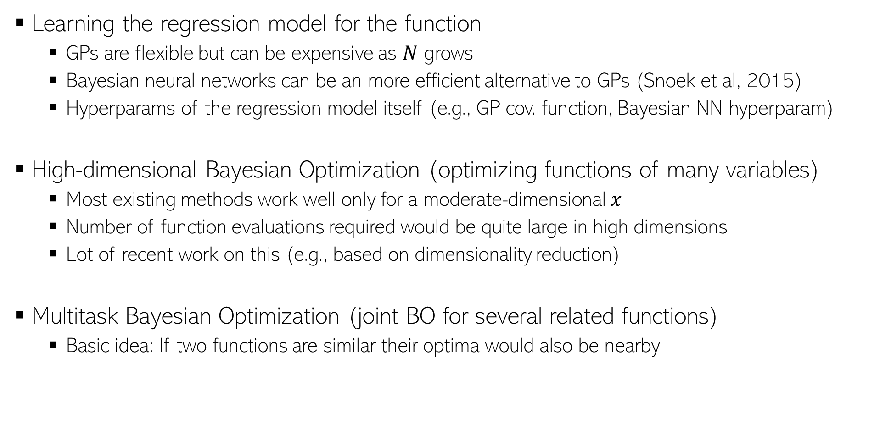
BO: Some Challenges/Open Problems
21
Learning the regression model for the function
  GPs are flexible but can be expensive as $N$ grows
  Bayesian neural networks can be an more efficient alternative to GPs (Snoek et al, 2015)
  Hyperparams of the regression model itself (e.g., GP cov. function, Bayesian NN hyperparam)
High-dimensional Bayesian Optimization (optimizing functions of many variables)
  Most existing methods work well only for a moderate-dimensional $x$
  Number of function evaluations required would be quite large in high dimensions
  Lot of recent work on this (e.g., based on dimensionality reduction)
Multitask Bayesian Optimization (joint BO for several related functions)
  Basic idea: If two functions are similar their optima would also be nearby

Slide 22
BO: Some Further Resources
22
Some survey papers:
  A Tutorial on Bayesian Optimization of Expensive Cost Functions, with Application to Active User Modeling and Hierarchical Reinforcement Learning (Brochu et al., 2010)
  Taking the Human Out of the Loop: A Review of Bayesian Optimization (Shahriari et al., 2015)
Some open source software libraries
  BoTorch: Bayesian Optimization in PyTorch
  GPflowOpt: Bayesian Optimization in Tensorflow (and using GP for modeling the function)
  Also available in scikit-optimize

