Slide 1
Deep Generative Models
CS772A: Probabilistic Machine Learning
Piyush Rai

Slide 2
Plan
2
Variational Autoencoders
Generative Adversarial Networks
Denoising Diffusion Models

Slide 3
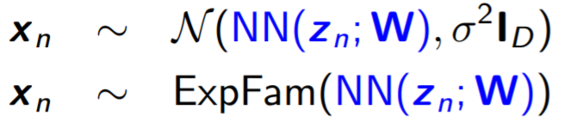
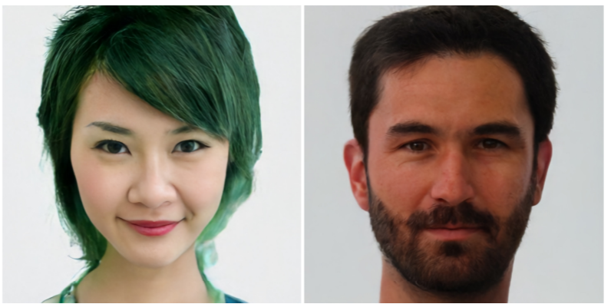
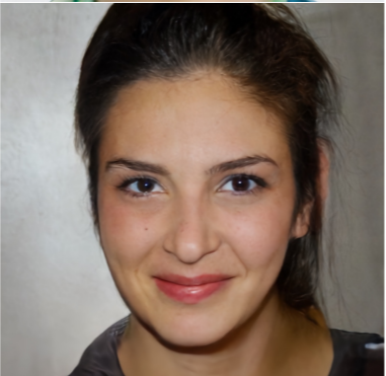
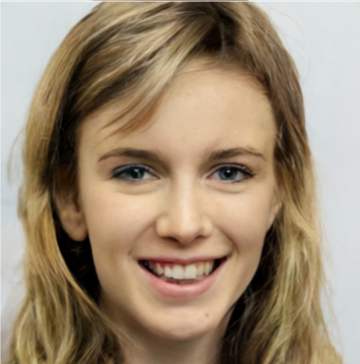
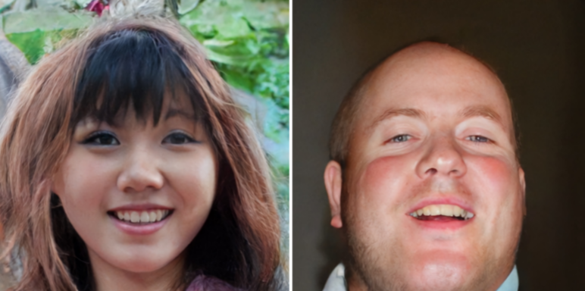
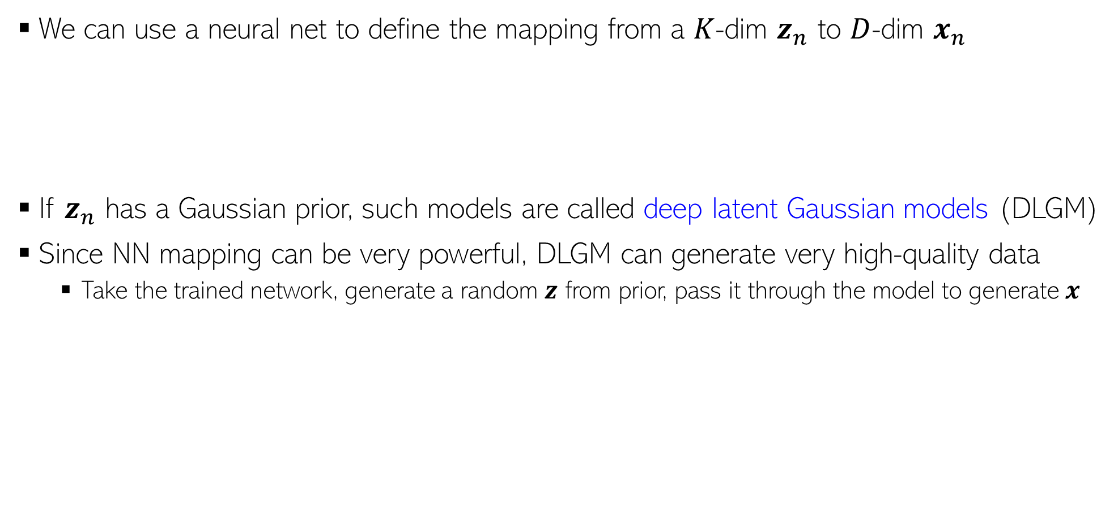




Constructing Generative Models using Neural Nets
3
We can use a neural net to define the mapping from a $K$-dim $z_{n}$ to $D$-dim $x_{n}$
If $z_{n}$ has a Gaussian prior, such models are called deep latent Gaussian models (DLGM)
Since NN mapping can be very powerful, DLGM can generate very high-quality data
  Take the trained network, generate a random $z$ from prior, pass it through the model to generate $x$
$$p(z)$$
$$p(x|NN\left(z;W\right))$$
$$z_{n}$$
$$x_{n}$$
Another alternative is to use a GP instead of a neural net
Some sample images generated by Vector Quantized Variational Auto-Encoder (VQ-VAE), a state-of-the-art DLGM

Slide 4
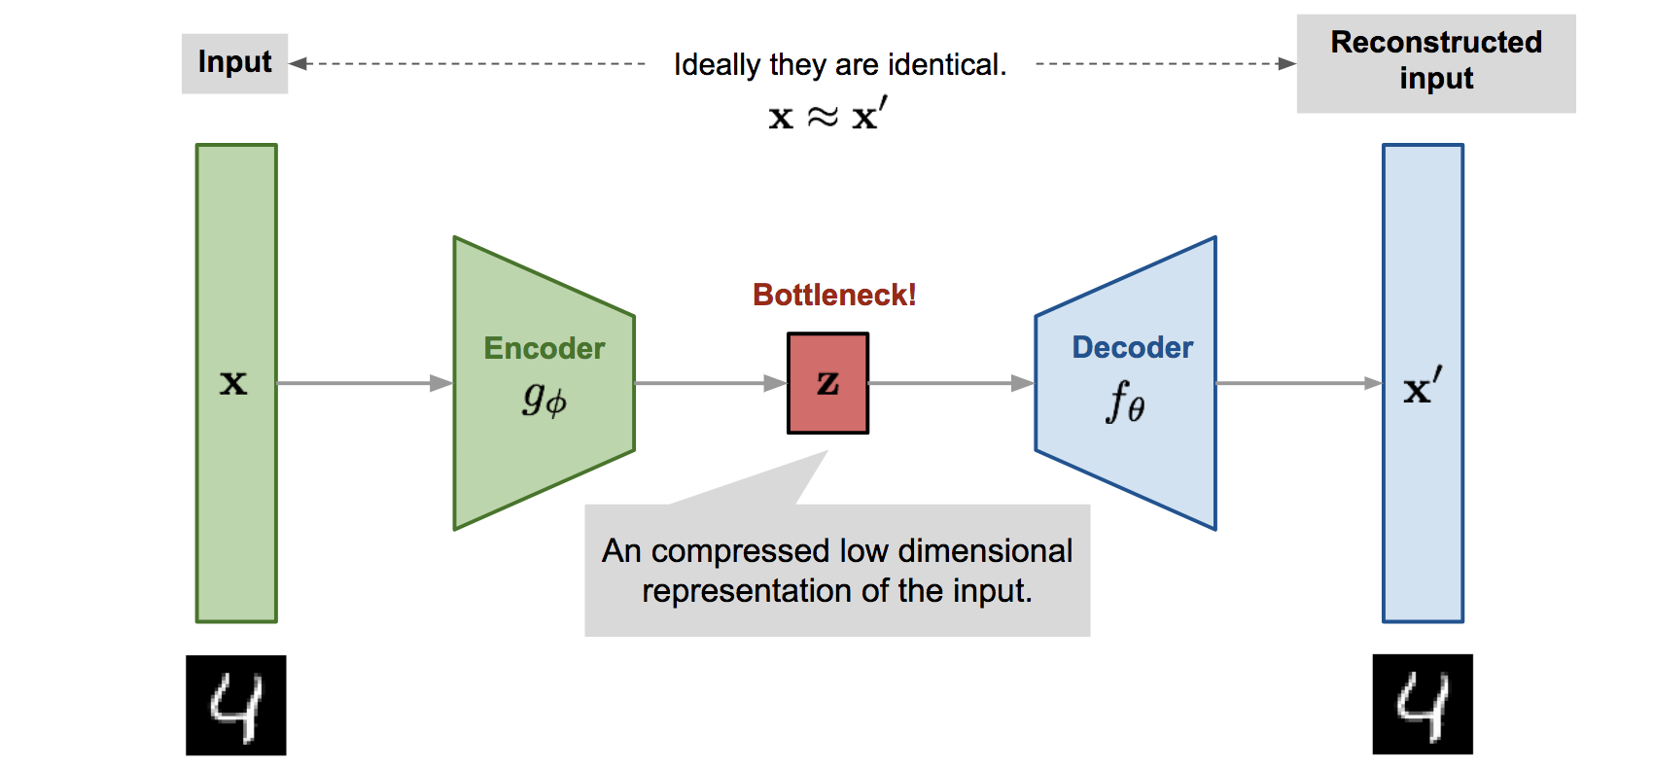

Variational Autoencoder (VAE)
4
VAE* is a probabilistic extension of autoencoders (AE)
The basic difference is that VAE assumes a prior $p(z)$ on the latent code $z$
  This enables it to not just compress the data but also generate synthetic data
  How: Sample $z$ from a prior and pass it through the decoder
Thus VAE can learn good latent representation + generate novel synthetic data
The name has “Variational” in it since it is learned using VI principles
*Autoencoding Variational Bayes (Kingma and Welling, 2013)
Pic source: https://lilianweng.github.io/lil-log/2018/08/12/from-autoencoder-to-beta-vae.html

Slide 5
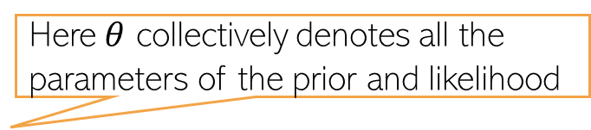
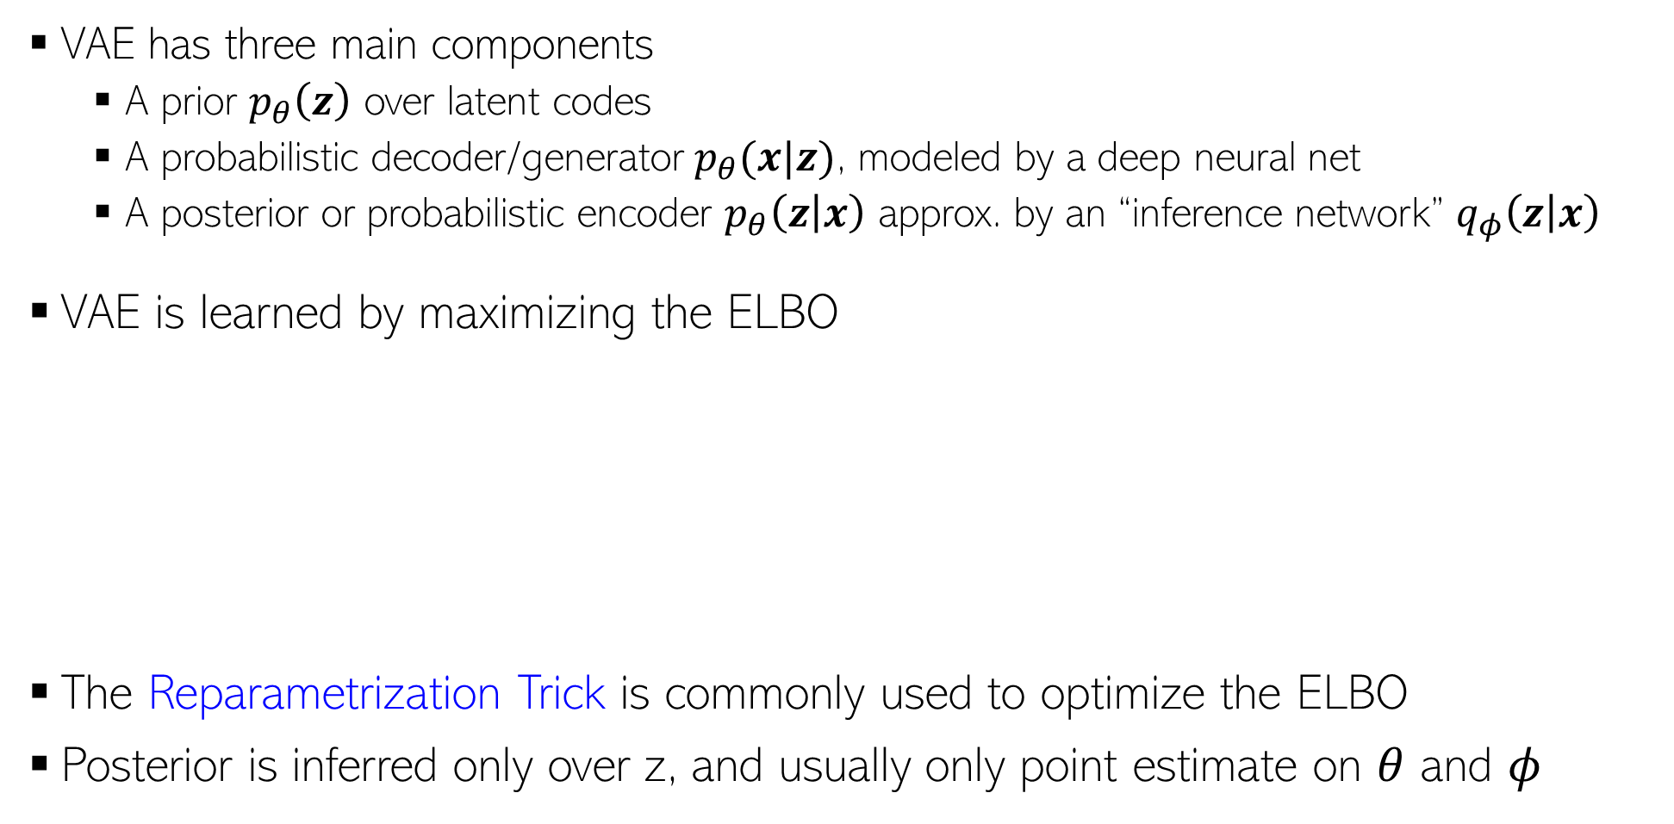
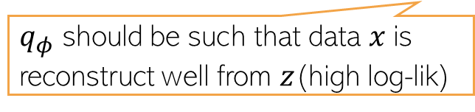
Variational Autoencoder (VAE)
5
VAE has three main components
  A prior $p_{θ}\left(z\right)$ over latent codes
  A probabilistic decoder/generator $p_{θ}(x|z)$, modeled by a deep neural net
  A posterior or probabilistic encoder $p_{θ}\left(z | x\right)$ approx. by an “inference network” $q_{φ}\left(z | x\right)$
VAE is learned by maximizing the ELBO
The Reparametrization Trick is commonly used to optimize the ELBO
Posterior is inferred only over z, and usually only point estimate on $θ$ and $φ$
Here $θ$ collectively denotes all the parameters of the prior and likelihood
Using the idea of “Amortized Inference” (next slide)
Here $φ$ collectively denotes all the parameters that define the inference network
ELBO for a single data point
$$−$$
Maximized to find the optimal $θ$ and $φ$
$q_{φ}$ should be such that data $x$is reconstruct well from $z$(high log-lik)
$q_{φ}$ should also be simple (close to the prior)

Slide 6
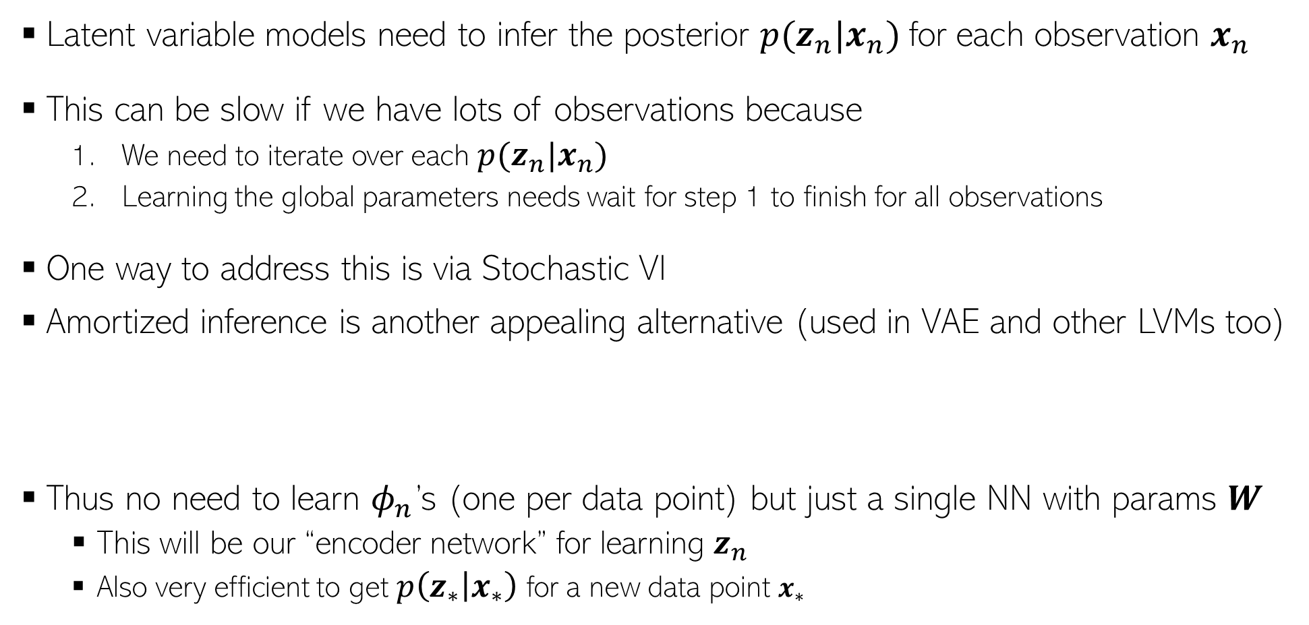
Amortized Inference
6
Latent variable models need to infer the posterior $p(z_{n}|x_{n})$for each observation $x_{n}$
This can be slow if we have lots of observations because
  We need to iterate over each $p(z_{n}|x_{n})$
  Learning the global parameters needs wait for step 1 to finish for all observations
One way to address this is via Stochastic VI
Amortized inference is another appealing alternative (used in VAE and other LVMs too)
Thus no need to learn $φ_{n}$’s (one per data point) but just a single NN with params $W$
  This will be our “encoder network” for learning $z_{n}$
  Also very efficient to get $p\left(z_{∗} | x_{∗}\right)$ for a new data point $x_{∗}$
If $q$ is Gaussian then the NN will output a mean and a variance
$$p\left(z_{n} | x_{n}\right)≈q\left(z_{n} | φ_{n}\right)=q\left(z_{n}\right|NN(x_{n};W))$$

Slide 7
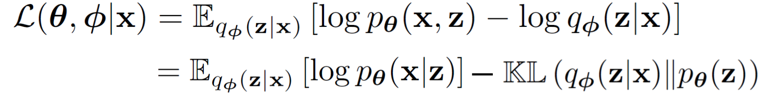
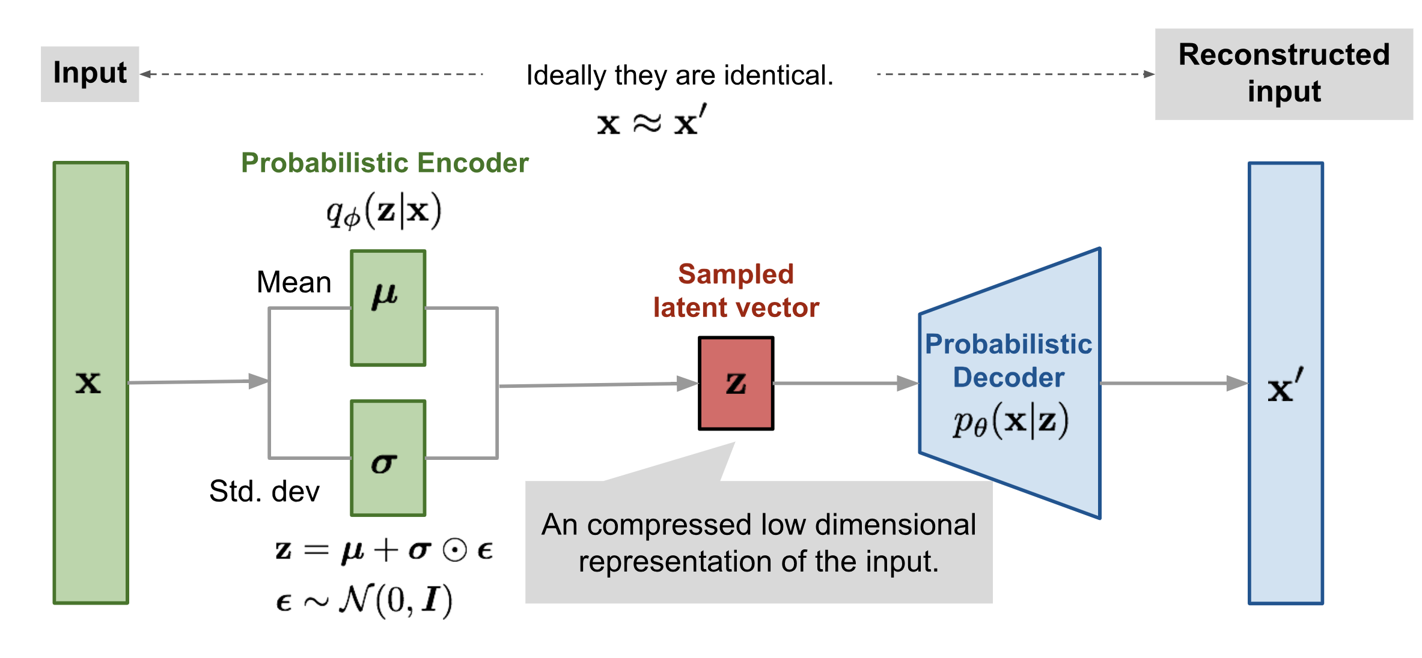
Variational Autoencoder: The Complete Pipeline
7
Both probabilistic encoder and decoder learned jointly by maximizing the ELBO
Pic source: https://lilianweng.github.io/lil-log/2018/08/12/from-autoencoder-to-beta-vae.html

Slide 8
VAE and Posterior Collapse
8
Decoder is a neural net and can be arbitrarily powerful making this term very large
Consequently, KL will become close to zero collapsing posterior to the prior
VAEs may suffer from posterior collapse
Thus, due to posterior collapse, reconstruction will still be good but the code $z$ may be garbage (not useful as a representation for $x$)
Several ways to prevent posterior collapse, e.g.,
  Use KL annealing
  Avoid KL from becoming 0 using some $q$ doesn’t collapse to the prior
  More tightly couple $z$ with $x$ using skip-connections (Skip-VAE)
$$−$$
A carefully tuned value between 0 and 1
For example, keep the variance of $q$ as fixed
Besides these, MCMC (sometimes used for inference in VAE), or improved VI techniques can also help in preventing posterior collapse in VAEs
$$z_{n}$$
$$x_{n}$$
Hidden layers of NN

Slide 9
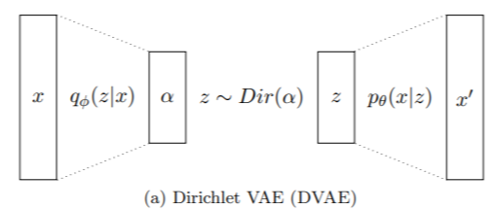
VAE: Some Comments
9
One of the state-of-the-art latent variable models
Useful for both generation as well as representation learning
Many improvements and extensions, e.g.,
  For text data and sequences (VAE for topic models or “neural topic models”)
  VAE-style models with more than one layer of latent variables (Sigmoid Belief Networks, hierarchical VAE, Ladder VAE, Deep Exponential Families, etc)
Document (e.g., as a vector of word counts)
Decoupling Sparsity and Smoothness in the Dirichlet Variational Autoencoder Topic Model (Burkhardt and Kramer, 2020)

Slide 10
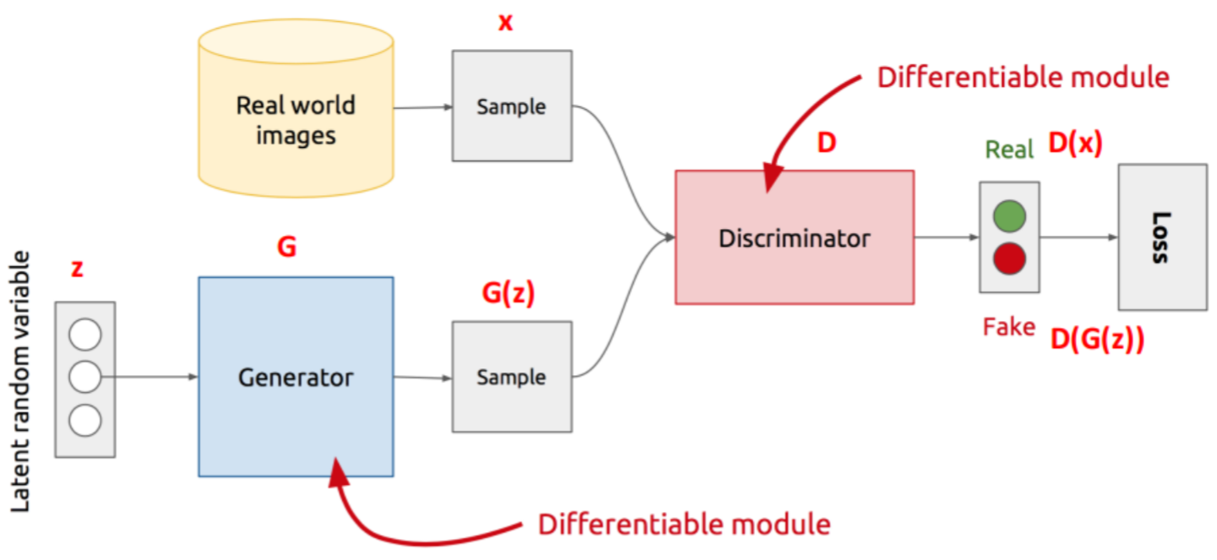
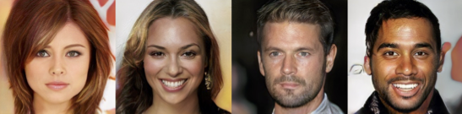
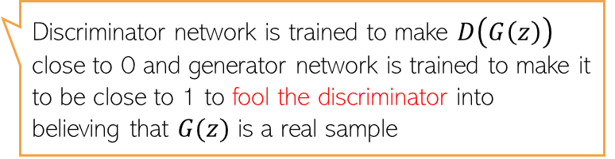

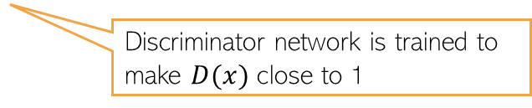
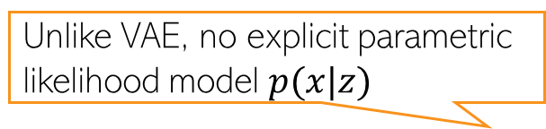
Generative Adversarial Network (GAN)
10
Unlike VAE, no explicit parametric likelihood model $p(x|z)$
GAN is an implicit generative latent variable model
Can generate from it but can’t compute $p(x)$ - the model doesn’t define it explicitly
GAN is training using an adversarial way (Goodfellow et al, 2013)
Thus can’t train using methods that require likelihood (MLE, VI, etc)
Assuming data is images
The discriminator can be a binary classifier or any method that can compare b/w two distributions (real and fake here)
Discriminator network is trained to make $D(x)$ close to 1
Discriminator network is trained to make $D\left(G\left(z\right)\right)$ close to 0 and generator network is trained to make it to be close to 1 to fool the discriminator into believing that $G(z)$ is a real sample
Min-max optimization

Slide 11
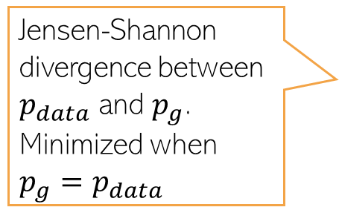

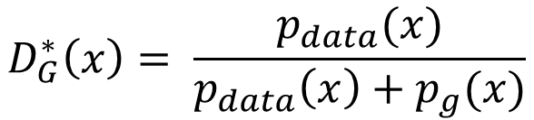
Generative Adversarial Network (GAN)
11
The GAN training criterion was
With 𝐺 fixed, the optimal 𝐷 (exercise)
Given the optimal $D$, The optimal generator $G$ is found by minimizing
Distribution of real data
$$D_{G}^{∗}\left(x\right)= \frac{p_{data}(x)}{p_{data}\left(x\right)+p_{g}(x)}$$
Distribution of synthetic data
$$V\left(D_{G}^{∗},G\right)= 𝔼_{x∼p_{data}}\left[log\frac{p_{data}(x)}{p_{data}\left(x\right)+p_{g}(x)}\right]+𝔼_{x∼p_{g}}\left[log\frac{p_{g}(x)}{p_{data}\left(x\right)+p_{g}(x)}\right]$$
Jensen-Shannon divergence between $p_{data}$ and $p_{g}$. Minimized when $p_{g}=p_{data}$
$$= KL\left[p_{data}\left(x\right) \frac{p_{data}\left(x\right)+p_{g}(x)}{2}\right]+KL\left[p_{g}\left(x\right) \frac{p_{data}\left(x\right)+p_{g}(x)}{2}\right]−log 4$$
Thus GAN can learn the true data distribution if the generator and discriminator have enough modeling power

Slide 12
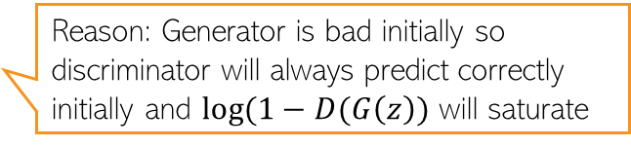
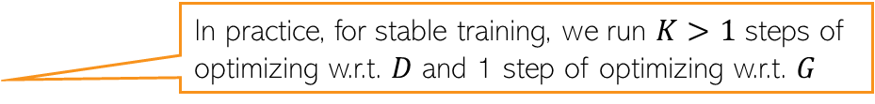
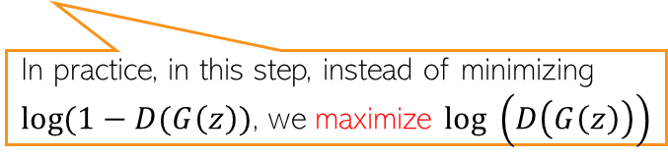
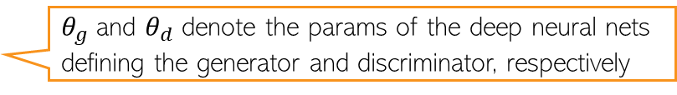
GAN Optimization
12
The GAN training procedure can be summarized as
$θ_{g}$ and $θ_{d}$ denote the params of the deep neural nets defining the generator and discriminator, respectively
In practice, for stable training, we run $K>1$ steps of optimizing w.r.t. $D$ and 1 step of optimizing w.r.t. $G$
Reason: Generator is bad initially so discriminator will always predict correctly initially and $log(1−D(G\left(z\right))$ will saturate
In practice, in this step, instead of minimizing $log(1−D(G\left(z\right))$, we maximize $log \left(D\left(G\left(z\right)\right)\right)$

Slide 13
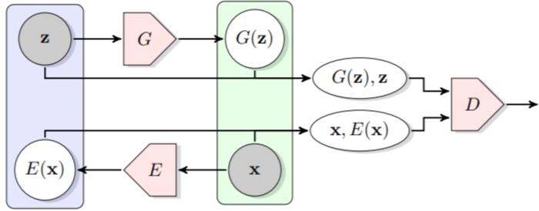

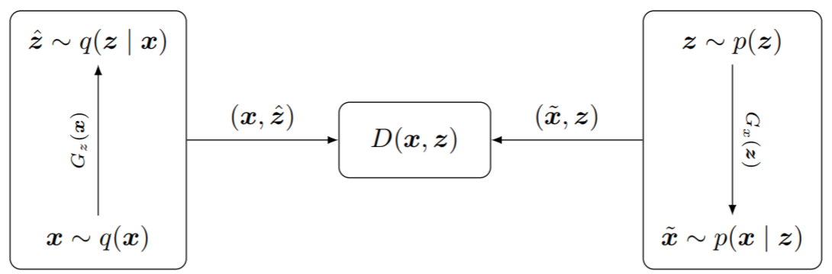

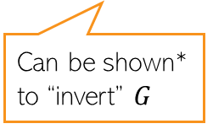
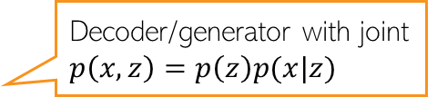
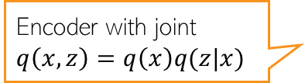
GANs that also learn latent representations
13
The standard GAN can only generate data. Can’t learn the latent $z$ from $x$
Bidirectional GAN* (BiGAN) is a GAN variant that allows this
Adversarially Learned Inference# (ALI) is another variant that can learn representations
Consists of an encoder as well
Real pair/fake pair?
Can be shown* to “invert” $G$
Encoder with joint $q\left(x,z\right)=q\left(x\right)q(z|x)$
Decoder/generator with joint $p\left(x,z\right)=p\left(z\right)p(x|z)$
Discriminator: Real pair or fake pair?
*Adversarial Feature Learning (Donahue et a Dumoulin l, 2017)
#Adversarially Learned Inference (Dumoulin et al, 2017)

Slide 14
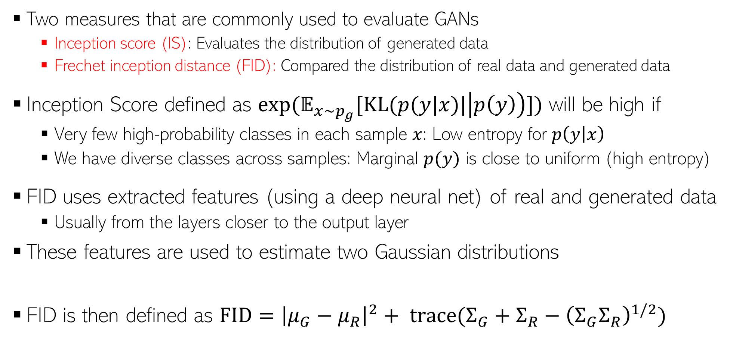


Evaluating GANs
14
High IS and low FID is desirable
Two measures that are commonly used to evaluate GANs
  Inception score (IS): Evaluates the distribution of generated data
  Frechet inception distance (FID): Compared the distribution of real data and generated data
Inception Score defined as $exp(𝔼_{x∼p_{g}}[KL(p(y|x)|\left|p\left(y\right)\right)])$ will be high if
  Very few high-probability classes in each sample $x$: Low entropy for $p\left(y | x\right)$
  We have diverse classes across samples: Marginal $p(y)$ is close to uniform (high entropy)
FID uses extracted features (using a deep neural net) of real and generated data
  Usually from the layers closer to the output layer
These features are used to estimate two Gaussian distributions
FID is then defined as $FID={\left|μ_{G}−μ_{R}\right|}^{2}+ trace(Σ_{G}+Σ_{R}−{\left(Σ_{G}Σ_{R}\right)}^{1/2})$
Both IS and FID measure how realistic the generated data is
Using real data
$$𝒩(μ_{R}, Σ_{R})$$
$$𝒩(μ_{G}, Σ_{G})$$
Using generated data

Slide 15
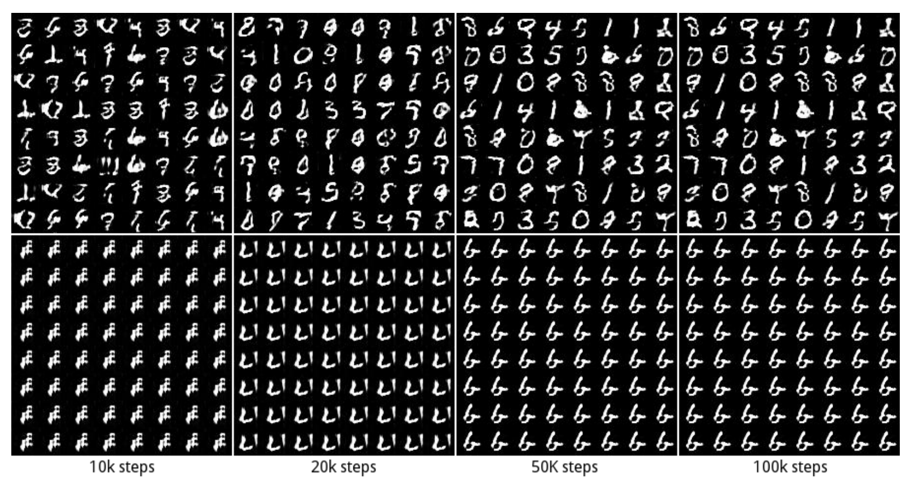
GAN: Some Issues/Comments
15
GAN training can be hard and the basic GAN suffers from several issues
Instability of training procedure
Mode Collapse problem: Lack of diversity in generated samples
  Generator may find some data that can easily fool the discriminator
  It will stuck at that mode of the data distribution and keep generating data like that
Some work on addressing these issues (e.g., Wasserstein GAN, Least Squares GAN, etc)
GAN 1: No mode collapse (all 10 modes captured in generation)
GAN 2: Mode collapse (stuck on one of the modes)

Slide 16
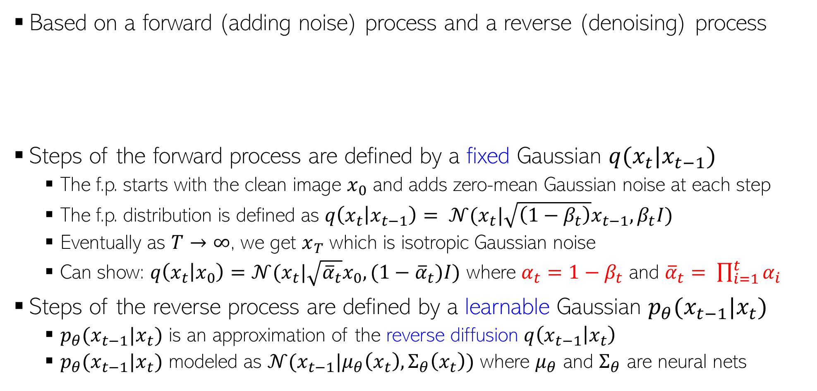

Denoising Diffusion Models
16
After learning the model, can use the reverse process to generate data from random noise
Based on a forward (adding noise) process and a reverse (denoising) process
Steps of the forward process are defined by a fixed Gaussian $q(x_{t}|x_{t−1})$
  The f.p. starts with the clean image $x_{0}$ and adds zero-mean Gaussian noise at each step
  The f.p. distribution is defined as $q\left(x_{t} | x_{t−1}\right)= 𝒩(x_{t}|\sqrt{\left(1−β_{t}\right)}x_{t−1},β_{t}I)$
  Eventually as $T→∞$, we get $x_{T}$ which is isotropic Gaussian noise
  Can show: $q\left(x_{t} | x_{0}\right)=𝒩(x_{t}|\sqrt{{\overline{α}}_{t}}x_{0},(1−{\overline{α}}_{t})I)$ where $α_{t}=1−β_{t}$ and ${\overline{α}}_{t}= \prod_{i=1}^{t}{α_{i}}$
Steps of the reverse process are defined by a learnable Gaussian $p_{θ}(x_{t−1}|x_{t})$
  $p_{θ}(x_{t−1}|x_{t})$ is an approximation of the reverse diffusion $q\left(x_{t−1} | x_{t}\right)$
  $p_{θ}(x_{t−1}|x_{t})$ modeled as $𝒩(x_{t−1}|μ_{θ}\left(x_{t}\right),Σ_{θ}\left(x_{t}\right))$ where $μ_{θ}$ and $Σ_{θ}$ are neural nets
$$β_{t}∈(0,1)$$

Slide 17
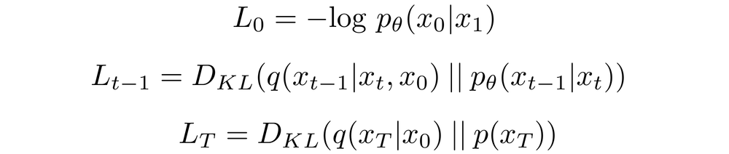
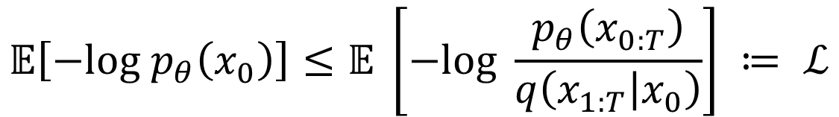
Denoising Diffusion Models: Training
17
Upper bound on the negative log-likelihood (negative of the ELBO)
The model is trained by minimizing the following objective
In some ways, denoising diffusion models are similar to VAEs
$$𝔼\left[−log p_{θ}\left(x_{0}\right)\right]≤𝔼 \left[−log \frac{p_{θ}\left(x_{0:T}\right)}{q\left(x_{1:T} | x_{0}\right)}\right] ≔ ℒ$$
$$ℒ=L_{0}+L_{1}+L_{2}+…+L_{T−1}+L_{T}$$
Overall loss is just a sum of several KL divergences between Gaussians, and thus available in closed form
This is also a Gaussian

Slide 18
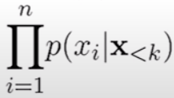
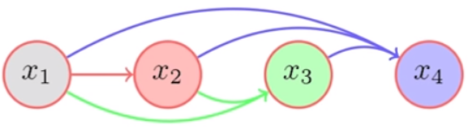
Summary
18
Looked at various methods for generative modeling for unsupervised learning
  Classical methods (FA, PPCA, other latent factor models, topic models, etc)
  Deep generative models (VAE, GAN, Denoising Diffusion Models)
Many of these methods can also be extended to model data other than images
There are also generative models that do not use latent variables
  Can still be used to generate data and learn the underlying data distribution
Assuming each observation is n-dimensional
An auto-regressive model
Can use a neural network to learn (parameters of) each of these distributions
An example: Neural Autoregressive Density Estimator (NADE)

