Slide 1
(Shallow and Deep) Generative Models
CS772A: Probabilistic Machine Learning
Piyush Rai

Slide 2
Plan for today
2
Latent Factor Models
Latent Dirichlet Allocation (LDA)
Deep generative models: Variational Autoencoders

Slide 3
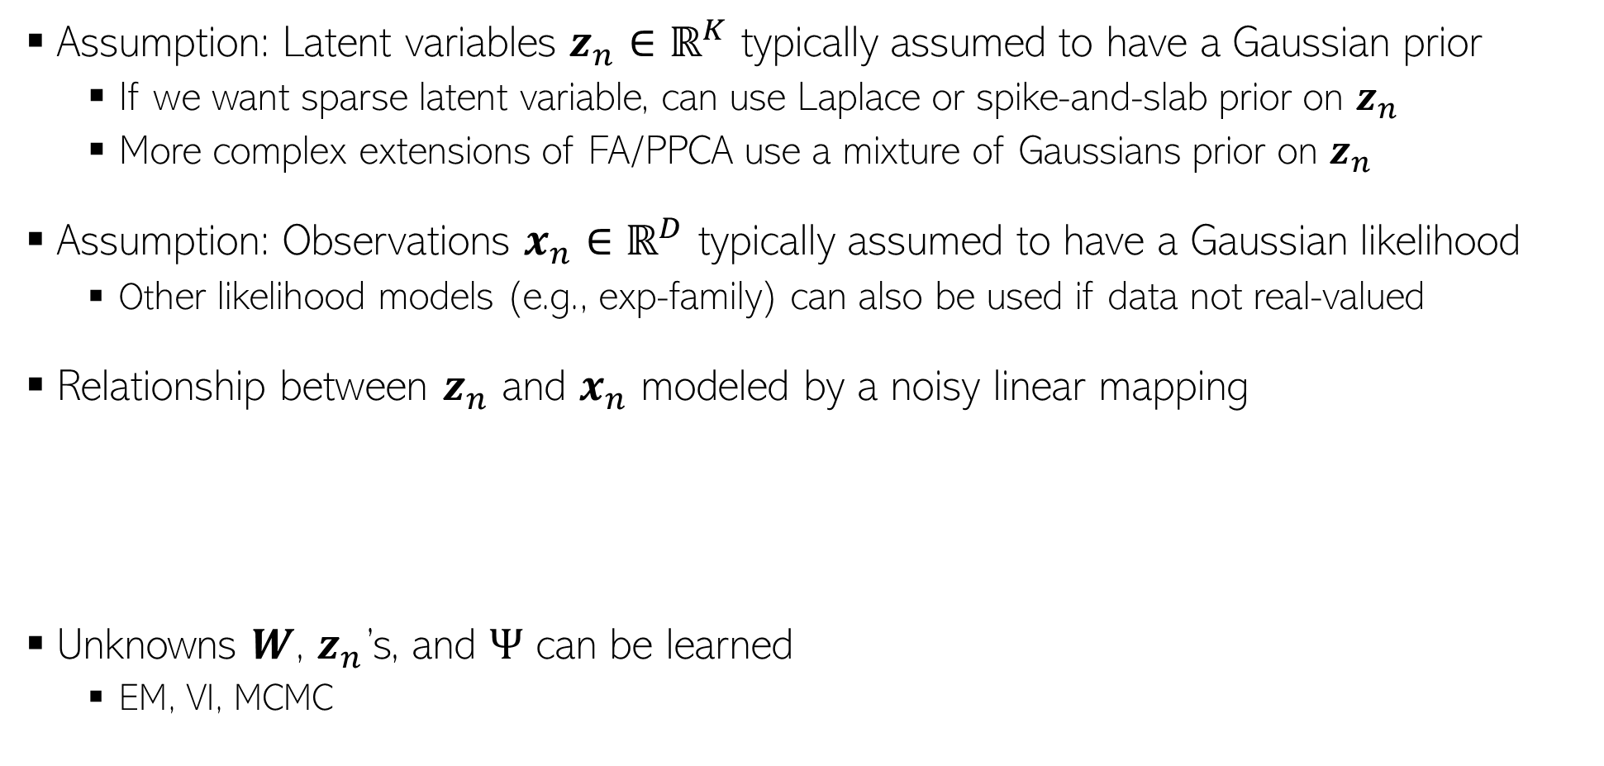
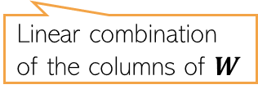


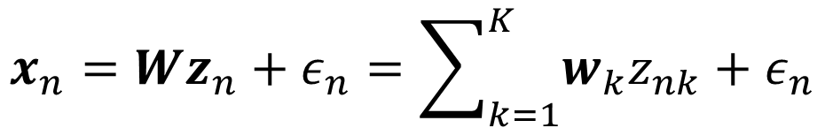
Factor Analysis and Probabilistic PCA
3
Assumption: Latent variables $z_{n}∈ℝ^{K}$ typically assumed to have a Gaussian prior
  If we want sparse latent variable, can use Laplace or spike-and-slab prior on $z_{n}$
  More complex extensions of FA/PPCA use a mixture of Gaussians prior on $z_{n}$
Assumption: Observations $x_{n}∈ℝ^{D}$ typically assumed to have a Gaussian likelihood
  Other likelihood models (e.g., exp-family) can also be used if data not real-valued
Relationship between $z_{n}$ and $x_{n}$ modeled by a noisy linear mapping
Unknowns $W$, $z_{n}$’s, and $Ψ$ can be learned
  EM, VI, MCMC
$$x_{n}=Wz_{n}+ε_{n}=\sum_{k=1}^{K}{w_{k}z_{nk}}+ε_{n}$$
$$p\left(z_{n}\right)= 𝒩\left(z_{n} | 0,I\right)$$
$$p\left({x_{n}|z}_{n}\right)= 𝒩\left(x_{n} | Wz_{n},Ψ\right)$$
Zero-mean and diagonal or spherical Gaussian noise
Linear combination of the columns of $W$
Diagonal for FA, spherical for PPCA

Slide 4
Some Other Classical Models
4
Non-negative priors often give a nice interpretability to such latent variable models (will see some more examples of such models shortly)
Popular for modeling count-valued data (in text analysis, recommender systems, etc)
Gamma-Poisson latent factor model
  Assumes $K$-dim non-negative latent variable $z_{n}$ and $D$-dim count-valued observations $x_{n}$
  An example: Each $x_{n}$ is the word-count vector representing a document
  This can be thought of as a probabilistic non-negative matrix factorization model
Dirichlet-Multinomial/Multinoulli PCA
  Assumes $K$-dim non-negative latent variable $z_{n}$ and $D$ categorical obs $x_{n}={\{x_{nd}\}}_{d=1}^{D}$
  An example: Each $x_{n}$ is a document with $D$ words in it (each word is a categorical value)
$p\left(z_{n}\right)= \prod_{k=1}^{K}{Gamma(z_{nk}|a_{k}, b_{k}))}$
This is the rate of the Poisson. It should be non-negative, $exp⁡(w_{d}^{⊤}z_{n})$, or simply $w_{d}^{⊤}z_{n}$ if $w_{d}$ is also non-negative (e.g., using a gamma/Dirichlet prior on it)
$p\left(x_{n}|z_{n}\right)= \prod_{d=1}^{D}{Poisson(x_{nd}|f({w_{d}, z}_{n}))}$
Also sums to 1
This should give the probability vector of the multinoulli over $x_{nd}$. It should be non-negative and should sums to 1
$p\left(z_{n}\right)= Dirichlet(z_{n}|α)$
$p\left(x_{n}|z_{n}\right)= \prod_{d=1}^{D}{Multinoulli(x_{nd}|f({w_{d}, z}_{n}))}$

Slide 5
Latent Dirichlet Allocation (LDA) a.k.a. “Topic Model”
5

Slide 6





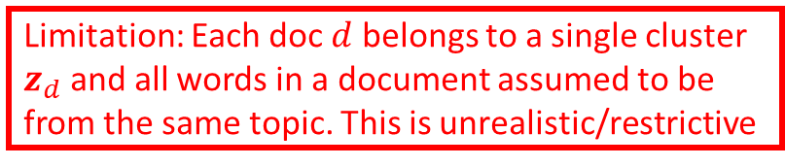
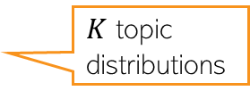






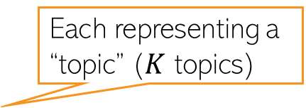
Motivation: Multinomial Mixture Model for Text
6
Assume $D$ documents, and document $d$ has $N_{d}$ words in it
We can represent doc $d$ by a word count vector $w_{d}$
Assuming a vocab of $V$ unique words, $w_{d}$ is a $V×1$ vector of counts
  $w_{dv}$ = no of times word $v$ appears in doc $d$
Let’s model the docs by a mixture of $K$ multinomial distributions, each $V$-dim
  The $k^{th}$ multinomial modeled by a $V$-dim prob vector $φ_{k}$ (sums to 1)
  $φ_{k}$ can be thought of as a “topic vector” (or just “topic”), $φ_{kv}$: prob of word $v$ in topic $k$
Generative model and plate diagram below
Each topic is a prob. distribution over word tokens
Each representing a “topic” ($K$ topics)
Limitation: Each doc $d$ belongs to a single cluster $z_{d}$ and all words in a document assumed to be from the same topic. This is unrealistic/restrictive
Topic Mixing proportion vector
Cluster/topic of document $d$
$$z_{d}∼multinoulli(π)$$
$$π$$
$$z_{d}$$
$$w_{d}$$
$$φ_{k}$$
$K$ topic distributions
$$w_{d}∼multinomial(φ_{z_{d}},N_{d})$$
$$D$$
$$K$$
Counts will sum to $N_{d}$

Slide 7
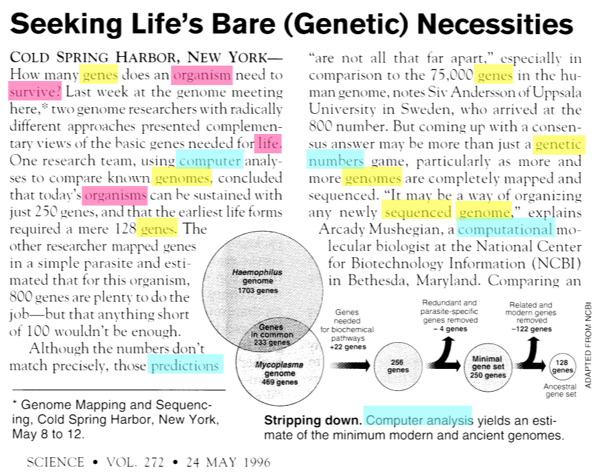
Documents can be about multiple topics
7
How do we find the word-topic associations in each document?
How do we use them to learn topics in the given text collection?
How do we learn low-dim document representations in terms of the topics they represent?

Slide 8













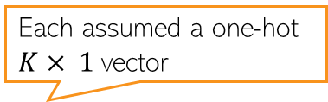

A More Fine-Grained Mixture Model for Text
8
Assume a corpus-level topic mixing proportions $α$ ($K× 1$prob vector)
Also assume doc-level topic mixing props $θ_{d}$ ($K× 1$prob vector)
Instead of assuming a single cluster $z_{d}$ for doc $d$, cluster each word in it
  $z_{d,n}∈\{1,2,…, K\}$ denotes the cluster/topic of word $w_{d,n}∈\{1,2,…, V\}$
Can obtain the “average” clustering for doc $d$ using $θ_{d}$ or ${\overline{z}}_{d}= \frac{1}{N_{d}}\sum_{n=1}^{N_{d}}{z_{d,n}}$
The generative model is as follows
Each assumed a one-hot $K× 1$vector
Locally-conjugate. Easy Gibbs sampling, VI, etc
Somewhat similar to Dir-Mult PCA model
Latent Dirichlet Allocation* (LDA) Topic Model
$$φ_{k}∼Dirichlet\left(η\right) k=1,2,…, K$$
($V$-dim Dirichlet)
$$η$$
$$θ_{d}∼Dirichlet\left(α\right) d=1,2,…, D$$
($K$-dim Dirichlet)
$$z_{d,n}∼multinoulli(θ_{d})$$
$$α$$
$$θ_{d}$$
$$z_{d,n}$$
$$w_{d,n}$$
$$φ_{k}$$
$$w_{d,n}∼multinoulli(φ_{z_{d,n}})$$
$$N_{d}$$
$$K$$
$$D$$

Slide 9
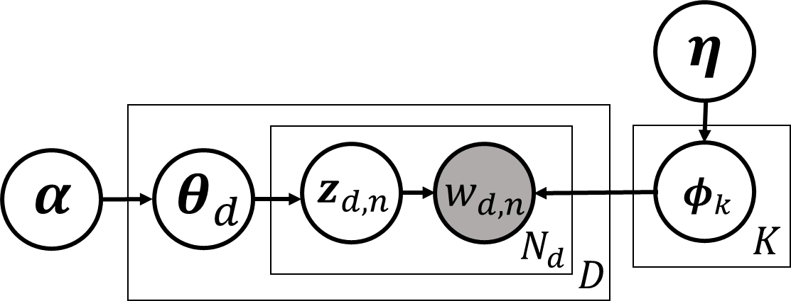
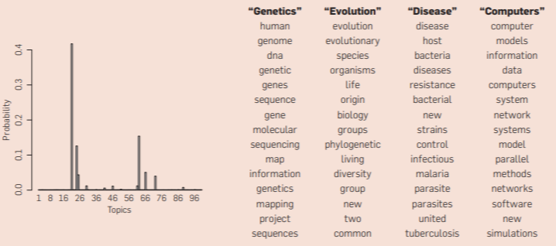





Latent Dirichlet Allocation (LDA)
9
A very widely used probabilistic model for text data
Nice and easy insights into the text collection
  Each $φ_{k}=[φ_{k1},…, φ_{kV}]$ can be interpreted as topic ($φ_{kv}=$ prob. of word $v$ in topic $k$)
  $θ_{d}=[θ_{d1},…, θ_{dK}]$: how much each topic is present in document $d$ (topic distribution)
  ${\overline{z}}_{d}= \frac{1}{N_{d}}\sum_{n=1}^{N_{d}}{z_{d,n}}$ also has a similar interpretation as $θ_{d}$
15 most frequent (most probable) words from four most prominent topics in this doc
A topic is a set of words that tend to co-occur together
$$φ_{1}$$
$$φ_{2}$$
Distribution over topics
$$φ_{3}$$
Word-topic assignments
$$φ_{4}$$
Topic distribution for the document on left

Slide 10
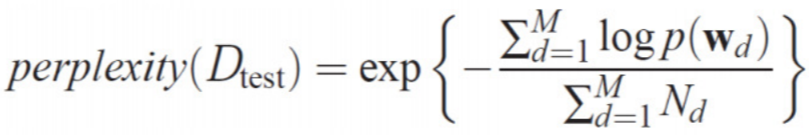
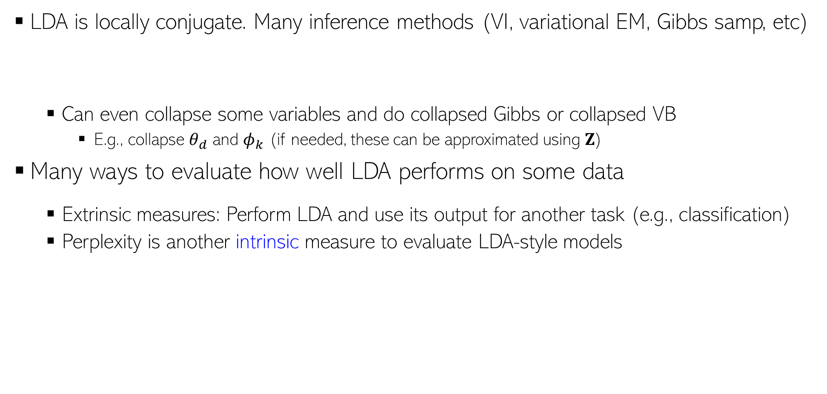
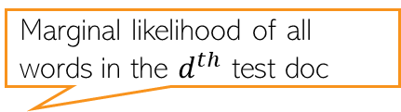

LDA: Inference and Evaluation
10
LDA is locally conjugate. Many inference methods (VI, variational EM, Gibbs samp, etc)
  Can even collapse some variables and do collapsed Gibbs or collapsed VB
    E.g., collapse $θ_{d}$ and $φ_{k}$ (if needed, these can be approximated using $Z$)
Many ways to evaluate how well LDA performs on some data
  Extrinsic measures: Perform LDA and use its output for another task (e.g., classification)
  Perplexity is another intrinsic measure to evaluate LDA-style models
Marginal likelihood of all words in the $d^{th}$ test doc
Test set with $M$ docs
Lower is better

Slide 11
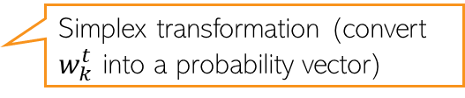



LDA: Limitations and Extensions
11
LDA assumes topics remain static over time (improvement: Dynamic Topic Model)
LDA assumes topics are uncorrelated (improvement: Corr-LDA)
  Use a logistic normal distribution on $θ_{d}$ (cov matrix of log-normal makes component correlated)
LDA ignores the sequential structure in the text (improvement: HMM-LDA)
Assume a first-order Markov evolution for each topic w.r.t. time
$$w_{k}^{t}∼𝒩(w_{k}^{t−1},σ^{2}I)$$
$$φ_{k}^{t}= 𝒮(w_{k}^{t})$$
Simplex transformation (convert $w_{k}^{t}$ into a probability vector)
Evolution of topic “Neuroscience”
(learned from the journal Science)
Fig courtesy: Dynamic Topic Models (Blei and Lafferty, 2006)

Slide 12
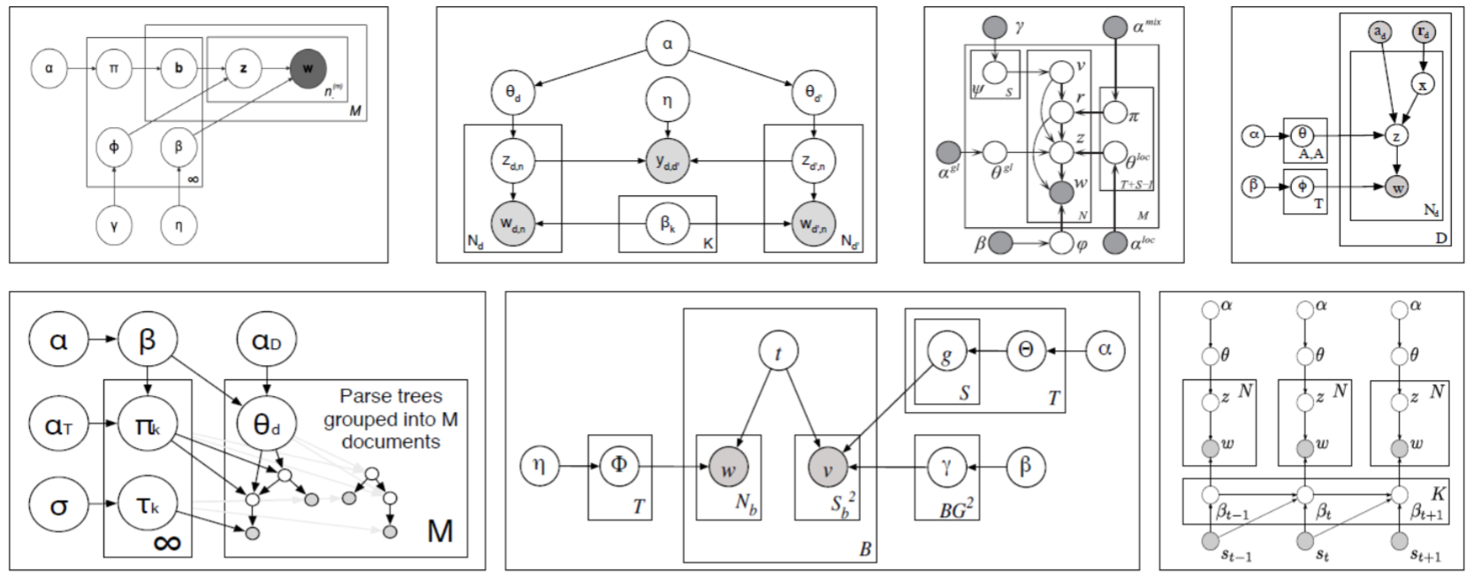
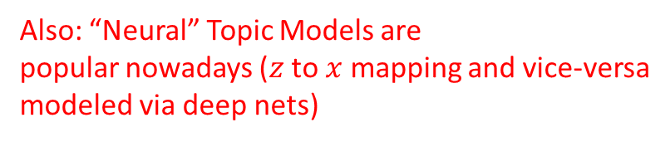


LDA Extensions (Contd)
12
Also: “Neural” Topic Models are
popular nowadays ($z$ to $x$ mapping and vice-versa
modeled via deep nets)
LDA for non-text data, e.g., images
  Each image can be represented as a bag of “visual words” and LDA can be applied
Supervised/Labeled LDA (when we have have a label for each document)
LDA for paired/multimodality data (e.g., images and text caption)
LDA for graph-structured data instead of documents
LDA is also equivalent to doing a non-negative matrix fact. of the $V× D$word-document matrix $X$ using a Poisson likelihood model*
$Φ$ $(V×K)$and $Θ$ $(K×D)$can be given any non-negative priors (Dirichlet/gamma)
This can be extended to “deep” matrix factorization** (modeling $Θ$ using many layers)
Plate diagrams for some LDA extensions
$$X∼Poisson(ΦΘ)$$
*Sec 4 and 5 of “Beta-Negative Binomial Process and Poisson Factor Analysis” (Zhou et al, 2012)
** Poisson-gamma belief networks” (Zhou et al, 2015)

Slide 13
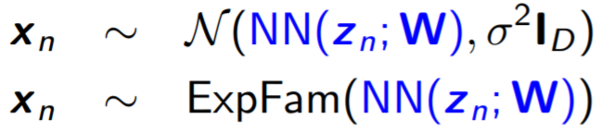
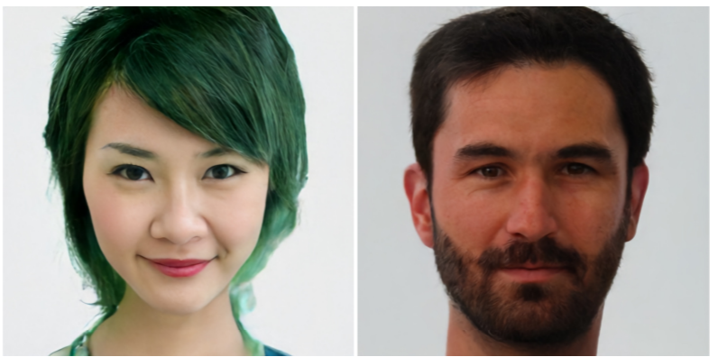
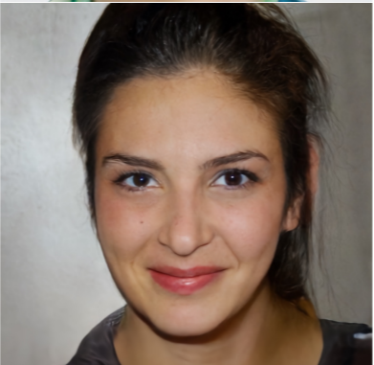
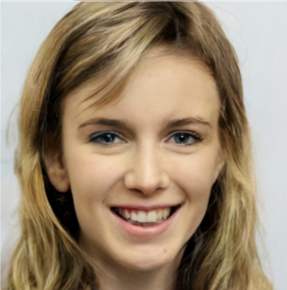

Constructing Generative Models using Neural Nets
13
We can use a neural net to define the mapping from a $K$-dim $z_{n}$ to $D$-dim $x_{n}$
If $z_{n}$ has a Gaussian prior, such models are called deep linear Gaussian models (DLGM)
Since NN mapping can be very powerful, DLGM can generate very high-quality data
  Take the trained network, generate a random $z$ from prior, pass it through the model to generate $x$
$$p(z)$$
$$p(x|NN\left(z;W\right))$$
$$z_{n}$$
$$x_{n}$$
Some sample images generated by Vector Quantized Variational AutoEncoder (VQ-VAE), a state-of-the-art DLGM

Slide 14
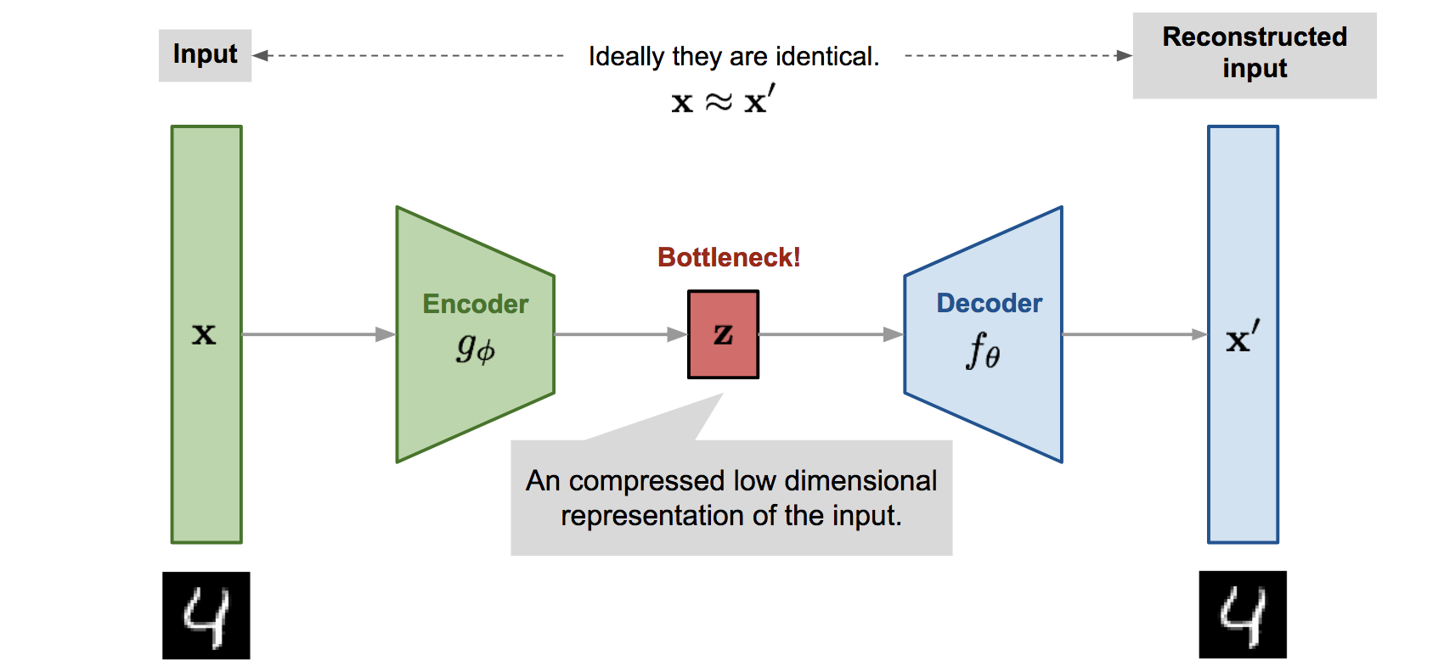

Variational Autoencoder (VAE)
14
VAE* is a probabilistic extension of autoencoders (AE)
The basic difference is that VAE assumes a prior $p(z)$ on the latent code $z$
  This enables it to not just compress the data but also generate synthetic data
  How: Sample $z$ from a prior and pass it through the decoder
Thus VAE can learn good latent representation + generate novel synthetic data
The name has “Variational” in it since it is learned using VI principles
*Autoencoding Variational Bayes (Kingma and Welling, 2013)
Pic source: https://lilianweng.github.io/lil-log/2018/08/12/from-autoencoder-to-beta-vae.html

Slide 15
Variational Autoencoder (VAE)
15
VAE has three main components
  A prior $p_{θ}\left(z\right)$ over latent codes
  A probabilistic decoder $p_{θ}(x|z)$
  A posterior or probabilistic encoder $p_{θ}\left(z | x\right)$ approx. by an “inference network” $q_{φ}\left(z | x\right)$
VAE is learned by maximizing the ELBO
The Reparametrization Trick is commonly used to optimize the ELBO
Posterior is inferred only over z, and usually only point estimate on $θ$ and $φ$
Here $θ$ collectively denotes all the parameters of the prior and likelihood
Using the idea of “Amortized Inference” (next slide)
Here $φ$ collectively denotes all the parameters that define the inference network
ELBO for a single data point
$$−$$
Maximized to find the optimal $θ$ and $φ$
$q_{φ}$ should reconstruct the data $x$well from $z$(high log-lik)
$q_{φ}$ should also be simple (close to the prior)

Slide 16
Amortized Inference
16
Latent variable models need to infer the posterior $p(z_{n}|x_{n})$for each observation $x_{n}$
This can be slow if we have lots of observations because
  We need to iterate over each $p(z_{n}|x_{n})$
  Learning the global parameters needs wait for step 1 to finish for all observations
One way to address this is via Stochastic VI (already saw)
Amortized inference is another appealing alternative (used in VAE and other LVMs too)
Thus no need to learn $φ_{n}$’s (one per data point) but just a single NN with params $W$
  This will be our “encoder network” for learning $z_{n}$
  Also very efficient to get $p\left(z_{∗} | x_{∗}\right)$ for a new data point $x_{∗}$
If $q$ is Gaussian then the NN will output a mean and a variance
$$p\left(z_{n} | x_{n}\right)≈q\left(z_{n} | φ_{n}\right)=q\left(z_{n}\right|NN(x_{n};W))$$

Slide 17
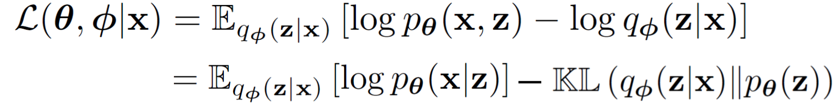
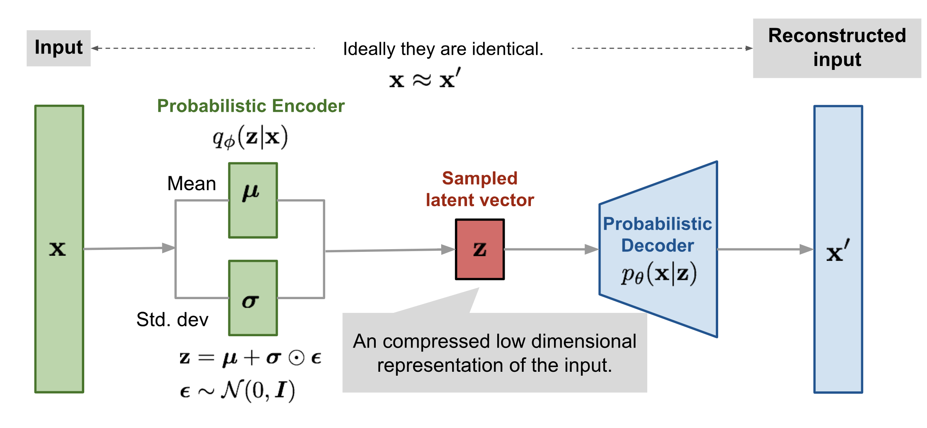
Variational Autoencoder: The Complete Pipeline
17
Both probabilistic encoder and decoder learned jointly by maximizing the ELBO
Pic source: https://lilianweng.github.io/lil-log/2018/08/12/from-autoencoder-to-beta-vae.html

Slide 18
VAE and Posterior Collapse
18
Decoder is a neural net and can be arbitrarily powerful making this term very large
Consequently, KL will become close to zero collapsing posterior to the prior
VAEs may suffer from posterior collapse
Thus, due to posterior collapse, reconstruction will still be good but the code $z$ may be garbage (not useful as a representation for $x$)
Several ways to prevent posterior collapse, e.g.,
  Use KL annealing
  Avoid KL from becoming 0 using some $q$ doesn’t collapse to the prior
  More tightly couple $z$ with $x$ using skip-connections (Skip-VAE)
$$−$$
A carefully tuned value between 0 and 1
For example, keep the variance of $q$ as fixed
Besides these, MCMC (sometimes used for inference in VAE), or improved VI techniques can also help in preventing posterior collapse in VAEs
$$z_{n}$$
$$x_{n}$$
Hidden layers of NN

