Slide 1
Bayesian Deep Learning (contd),
(Shallow and Deep) Generative Models
CS772A: Probabilistic Machine Learning
Piyush Rai

Slide 2
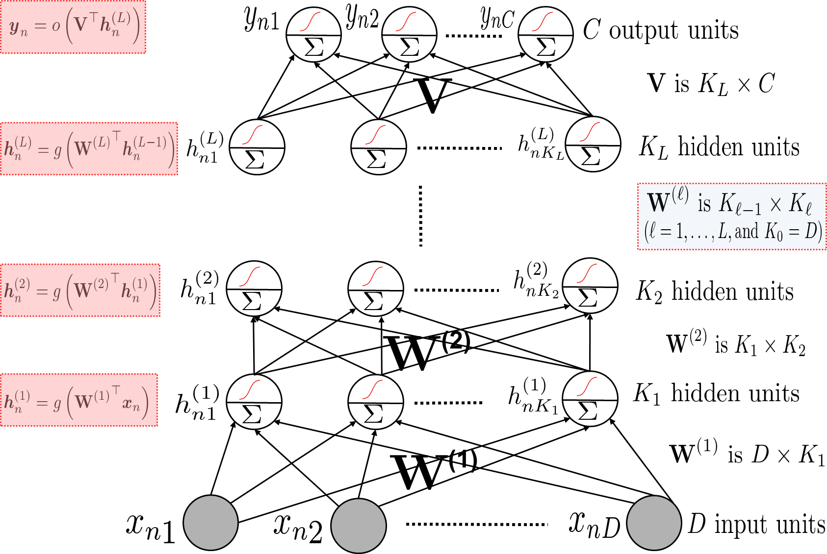
(Deep) Neural Networks
2
These are nonlinear function approximators
Consists of an input layer, one or more hidden layers, and an output layer
Can think of the last hidden layer’s node values being used as features in a GLM (linear/logistic/softmax, etc) modeled by the output layer
Network weights typically learned by backpropagation (basically, gradient descent + chain rule)
Hidden layers act as feature extractors

Slide 3
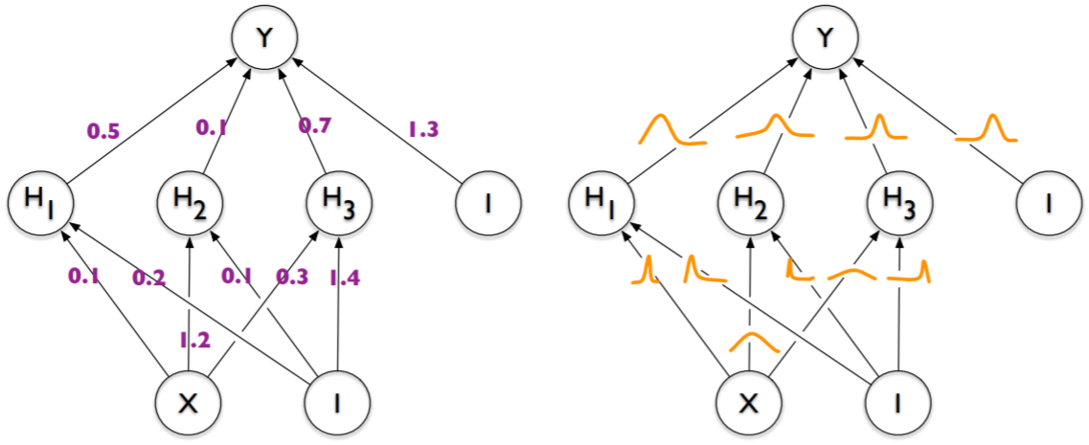
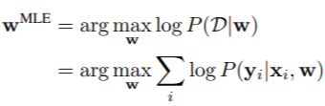
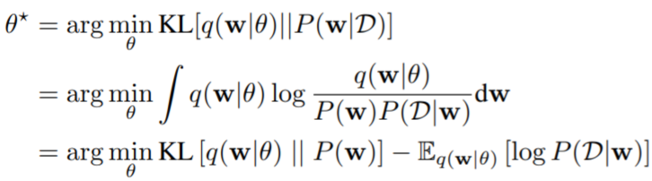

Bayesian Neural Networks
3
Backprop for neural nets only gives us point estimates for the weights
Another alternative is to be Bayesian and learn the posterior distribution over weights
Bayesian neural net: Each weight has a posterior distribution inferred by some Bayesian inference algo (VI/MCMC/Laplace approx., etc)
Standard neural net: Each weight has a fixed value, learned by backprop
Note: Just having a likelihood and prior will still give us a standard neural net if we choose to do MLE/MAP only
Also, test time will require computing PPD, not just a plug-in prediction
VI for Bayesian neural net
Using reparametrization trick (known as “Bayes by Backprop”* in this context), BBVI etc
Pic from: *Weight Uncertainty in Neural Networks (Blundell et al, 2015)

Slide 4
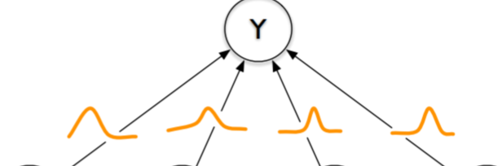
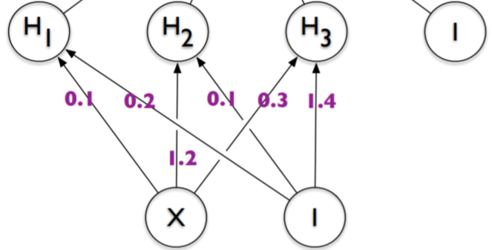
A Hybrid Bayesian Neural Net
4
$$p\left(y_{∗} | x_{∗},𝒟\right)≈ \frac{1}{S}\sum_{s=1}^{S}{p(y_{∗}|x_{∗},θ^{\left(s\right)}})$$
Learning the posterior for all weights can be expensive
PPD computation is also slow if using Monte Carlo approximation for PPD
A cheaper practical alternative is
  Do point estimation for hidden layer weights ($W$)
  Infer the full posterior for output layer weights ($V$)
  The PPD will then be
A rough approximation of the above is the following
  Use a pretrained neural net to extract feature
  Train Bayesian linear model (e.g., Bayesian linear/logistic/softmax/GLM reg.) on these features
where $θ^{(s)}∼p(θ|𝒟)$
Faster because the posterior of $V$ is much lower dimensional
$$p\left(y_{∗} | x_{∗},𝒟\right)≈ \frac{1}{S}\sum_{s=1}^{S}{p(y_{∗}|x_{∗},V^{\left(s\right)},\hat{W} })$$
where $V^{(s)}∼p(V|𝒟)$
Approximation since in the hybrid approach, we still learn $W$ and $V$together, unlike this approach where it is a two-step process

Slide 5

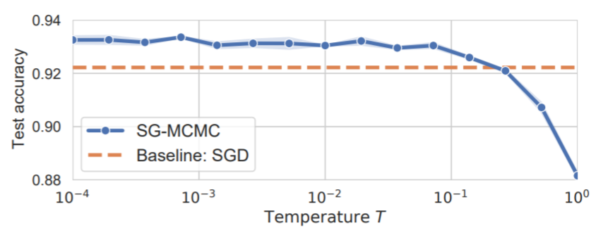
Bayesian Neural Networks: The Priors
5
Zero-mean isotropic Gaussian priors are common and convenient
  Corresponds to weight-decay or $ℓ_{2}$ regularizer
Another alternative is to use sparsity-inducing priors, e.g.,
Gaussian priors have been found somewhat problematic in recent work
  Cold-posterior effect
$T$ is like temperature
$T=1$ is the standard Bayesian inference
Recent work has shown that BNNs with standard Gaussian priors work poorly for $T=1$ but $T≪1$ improves performance
Maybe Gaussian priors aren’t really ideal??
Pic from: *How Good is the Bayes Posterior in Deep Neural Networks Really? (Wenzel et al, 2020)

Slide 6
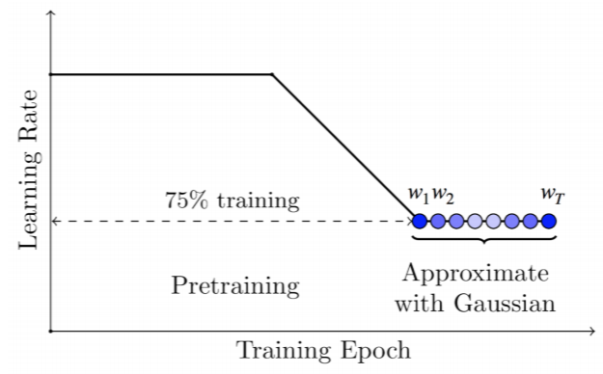

Other Inference Methods for Bayesian Neural Nets
6
Laplace approximation is very common: $p\left(W | 𝒟\right)≈ 𝒩(W_{MAP}, H^{−1})$
  However, can be slow since the number of parameters is very large
  One option is to use a simpler covariance matrix (e.g,, diagonal or block-diag)
  Another option is to use the hybrid Bayesian neural net
    Use MAP estimates for the hidden layer weights
    Use Laplace approximation only for the output layer weights
Using SGD iterates obtained from backprop
Extension: A mixture of Gaussian approximation: Multi-SWAG – Run SGD $M$ times and use a mixture of M such Gaussians
SWA based Gaussian approximation: SWAG
Stochastic weight averaging (SWA)
$$p\left(w | 𝒟\right)≈$$
Pic from: *A Simple Baseline for Bayesian Uncertainty in Deep Learning (Maddox et al, 2019)

Slide 7
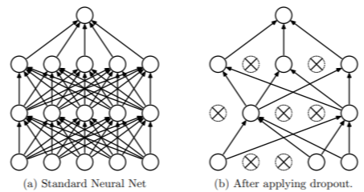
Other Inference Methods for Bayesian Neural Nets
7
Monte Carlo Dropout is another popular and efficient way
Standard Dropout
  Drop some weights randomly (with some “drop” probability) during training
  At test time, multiply each weight by the “keep” probability
  Note: Dropout applied only at training time
Monte Carlo Dropout*
Can be seen as learning a variational approximation of the weights (see paper for details, if interested)
$$p\left(y_{∗} | x_{∗},𝒟\right)≈ \frac{1}{S}\sum_{s=1}^{S}{p(y_{∗}|x_{∗},θ^{\left(s\right)}})$$
$$p\left(y_{∗} | x_{∗},𝒟\right)≈ \frac{1}{S}\sum_{s=1}^{S}{p(y_{∗}|x_{∗},θ^{\left(s\right)}})$$
where $θ^{(s)}=ε^{(s)}⊙ \hat{θ}$
where $θ^{(s)}∼p(θ|𝒟)$
Vector of Bernoulli or Gaussian noise
Point estimate
Elementwise product
*Dropout as a Bayesian Approximation: Representing Model Uncertainty in Deep Learning (Gal and Ghahramani, 2016)

Slide 8
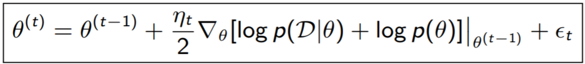
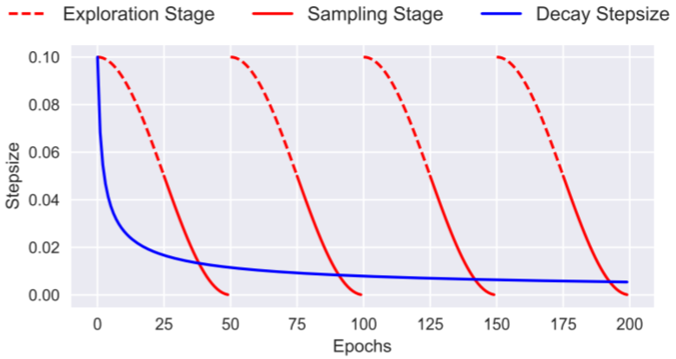
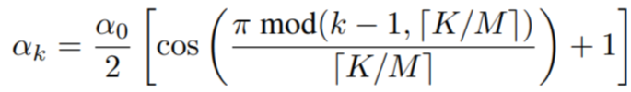
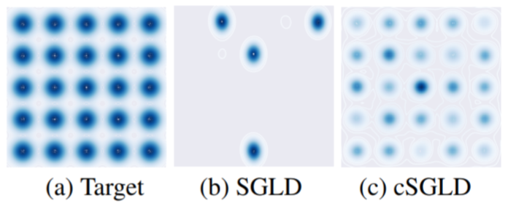
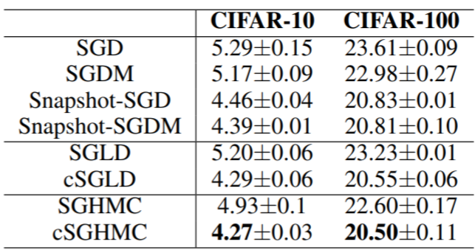
Other Inference Methods for Bayesian Neural Nets
8
SGMCMC methods like SGLD and SGHMC are also used nowadays (very efficient)
Recently, SGMCMC with cyclic step sizes (cSGLD) was proposed (Zhang et al, 2020)
  Use big steps to explore different modes
  Use small steps later to sample once a mode is localized
Step size in iteration $k$
$K$ is the total number of iterations and $M$ is the number of cycles
A complex mixture of Gaussian distributions
Pic from: *Cyclical Stochastic Gradient MCMC for Bayesian Deep Learning (Zhang et al, 2020)

Slide 9
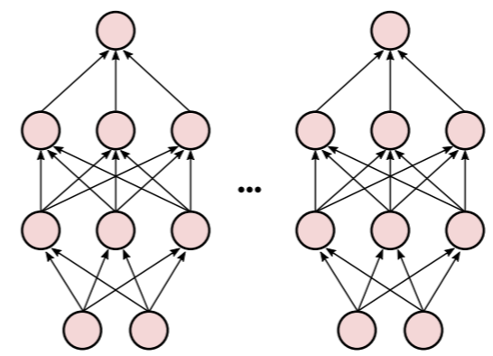
Deep Ensembles
9
Both VI and Sampling may be prone to capturing only a single “Basin of attraction”
Most inference methods tend to produce local approximations only
  VI methods typically learn an approximation around one of the modes
  Sampling methods may give most samples near one of the modes (though in principle they may explore other modes as well)
  Thus the uncertainties may be underestimated in general
Deep Ensembles* is a method that tries to address this issue
  Train the network $M$ times with different seeds and permutations of training data
  Denote the learned weights by $θ_{1},θ_{2},…, θ_{M}$ (assuming these are $M$ modes)
  Approximate the posterior by the following
  This approach is considered non-Bayesian but often performs better (in terms of more diversity in the set of parameters learned) than other inference methods
$$p\left(θ | 𝒟\right)= \frac{1}{M}\sum_{m=1}^{M}{δ_{θ_{m}}(θ)}$$
Akin to Bayesian Model Averaging using $M$ models
*Simple and Scalable Predictive Uncertainty Estimation using Deep Ensembles (Lakshminarayanan, 2017)

Slide 10
10
Deep Generative Models
(for unsupervised learning)

Slide 11
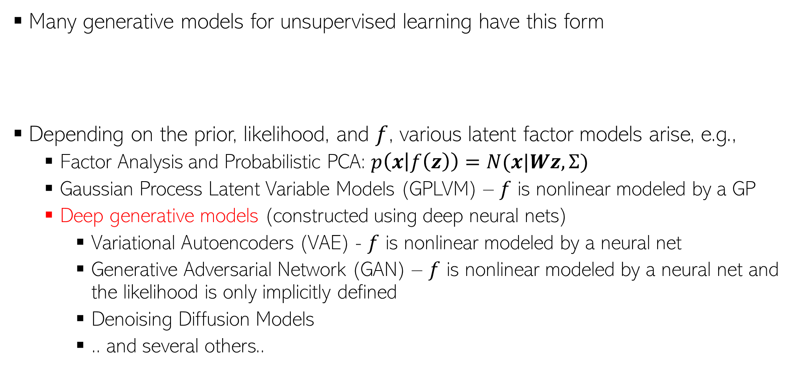
Generative Models for Unsupervised Learning
11
Many generative models for unsupervised learning have this form
Depending on the prior, likelihood, and $f$, various latent factor models arise, e.g.,
  Factor Analysis and Probabilistic PCA: $p\left(x | f\left(z\right)\right)=N(x|Wz,Σ)$
  Gaussian Process Latent Variable Models (GPLVM) – $f$ is nonlinear modeled by a GP
  Deep generative models (constructed using deep neural nets)
    Variational Autoencoders (VAE) - $f$ is nonlinear modeled by a neural net
    Generative Adversarial Network (GAN) – $f$ is nonlinear modeled by a neural net and the likelihood is only implicitly defined
    Denoising Diffusion Models
    .. and several others..
There also exist generative models that do not have latent variables (example: NADE)
Can be used as a “representation” or “code” or “embedding” (often low-dim) for $x_{n}$
$$p(z)$$
$$p(x|f\left(z\right))$$
$$z_{n}$$
$$x_{n}$$
Latent variable
Observation

Slide 12
Some Classical Models
12

Slide 13
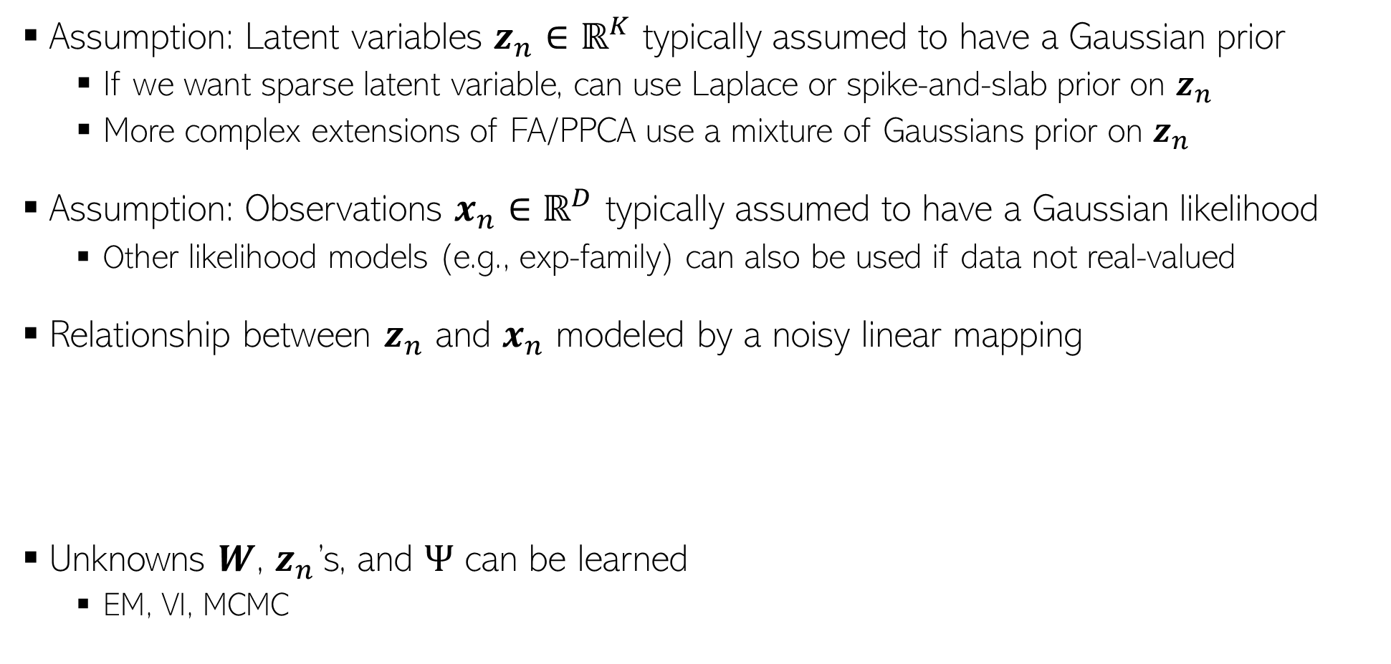
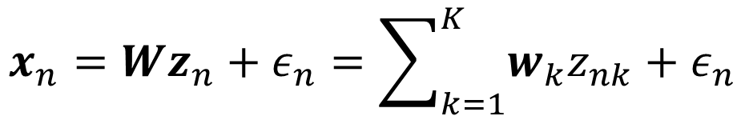
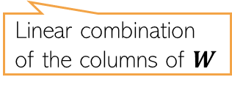
Factor Analysis and Probabilistic PCA
13
Assumption: Latent variables $z_{n}∈ℝ^{K}$ typically assumed to have a Gaussian prior
  If we want sparse latent variable, can use Laplace or spike-and-slab prior on $z_{n}$
  More complex extensions of FA/PPCA use a mixture of Gaussians prior on $z_{n}$
Assumption: Observations $x_{n}∈ℝ^{D}$ typically assumed to have a Gaussian likelihood
  Other likelihood models (e.g., exp-family) can also be used if data not real-valued
Relationship between $z_{n}$ and $x_{n}$ modeled by a noisy linear mapping
Unknowns $W$, $z_{n}$’s, and $Ψ$ can be learned
  EM, VI, MCMC
$$x_{n}=Wz_{n}+ε_{n}=\sum_{k=1}^{K}{w_{k}z_{nk}}+ε_{n}$$
$$p\left(z_{n}\right)= 𝒩\left(z_{n} | 0,I\right)$$
$$p\left({x_{n}|z}_{n}\right)= 𝒩\left(x_{n} | Wz_{n},Ψ\right)$$
Zero-mean and diagonal or spherical Gaussian noise
Linear combination of the columns of $W$
Diagonal for FA, spherical for PPCA

Slide 14
Some Other Classical Models
14
Non-negative priors often give a nice interpretability to such latent variable models (will see some more examples of such models shortly)
Popular for modeling count-valued data (in text analysis, recommender systems, etc)
Gamma-Poisson latent factor model
  Assumes $K$-dim non-negative latent variable $z_{n}$ and $D$-dim count-valued observations $x_{n}$
  An example: Each $x_{n}$ is the word-count vector representing a document
  This can be thought of as a probabilistic non-negative matrix factorization model
Dirichlet-Multinomial/Multinoulli PCA
  Assumes $K$-dim non-negative latent variable $z_{n}$ and $D$ categorical obs $x_{n}={\{x_{nd}\}}_{d=1}^{D}$
  An example: Each $x_{n}$ is a document with $D$ words in it (each word is a categorical value)
$p\left(z_{n}\right)= \prod_{k=1}^{K}{Gamma(z_{nk}|a_{k}, b_{k}))}$
This is the rate of the Poisson. It should be non-negative, $exp⁡(w_{d}^{⊤}z_{n})$, or simply $w_{d}^{⊤}z_{n}$ if $w_{d}$ is also non-negative (e.g., using a gamma/Dirichlet prior on it)
$p\left(x_{n}|z_{n}\right)= \prod_{d=1}^{D}{Poisson(x_{nd}|f({w_{d}, z}_{n}))}$
Also sums to 1
This should give the probability vector of the multinoulli over $x_{nd}$. It should be non-negative and should sums to 1
$p\left(z_{n}\right)= Dirichlet(z_{n}|α)$
$p\left(x_{n}|z_{n}\right)= \prod_{d=1}^{D}{Multinoulli(x_{nd}|f({w_{d}, z}_{n}))}$

Slide 15
Latent Dirichlet Allocation (LDA) a.k.a. “Topic Model”
15

Slide 16





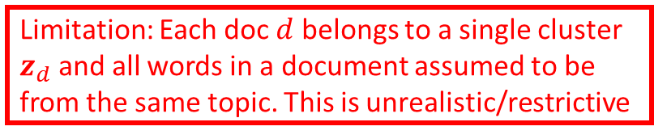








Motivation: Multinomial Mixture Model for Text
16
Assume $D$ documents, and document $d$ has $N_{d}$ words in it
We can represent doc $d$ by a word count vector $w_{d}$
Assuming a vocab of $V$ unique words, $w_{d}$ is a $V×1$ vector of counts
  $w_{dv}$ = no of times word $v$ appears in doc $d$
Let’s model the docs by a mixture of $K$ multinomial distributions, each $V$-dim
  The $k^{th}$ multinomial modeled by a $V$-dim prob vector $φ_{k}$ (sums to 1)
  $φ_{k}$ can be thought of as a “topic vector” (or just “topic”), $φ_{kv}$: prob of word $v$ in topic $k$
Generative model and plate diagram below
Each topic is a prob. distribution over word tokens
Each representing a “topic” ($K$ topics)
Limitation: Each doc $d$ belongs to a single cluster $z_{d}$ and all words in a document assumed to be from the same topic. This is unrealistic/restrictive
Topic Mixing proportion vector
Cluster/topic of document $d$
$$z_{d}∼multinoulli(π)$$
$$π$$
$$z_{d}$$
$$w_{d}$$
$$φ_{k}$$
$K$ topic distributions
$$w_{d}∼multinomial(φ_{z_{d}},N_{d})$$
$$D$$
$$K$$
Counts will sum to $N_{d}$

Slide 17
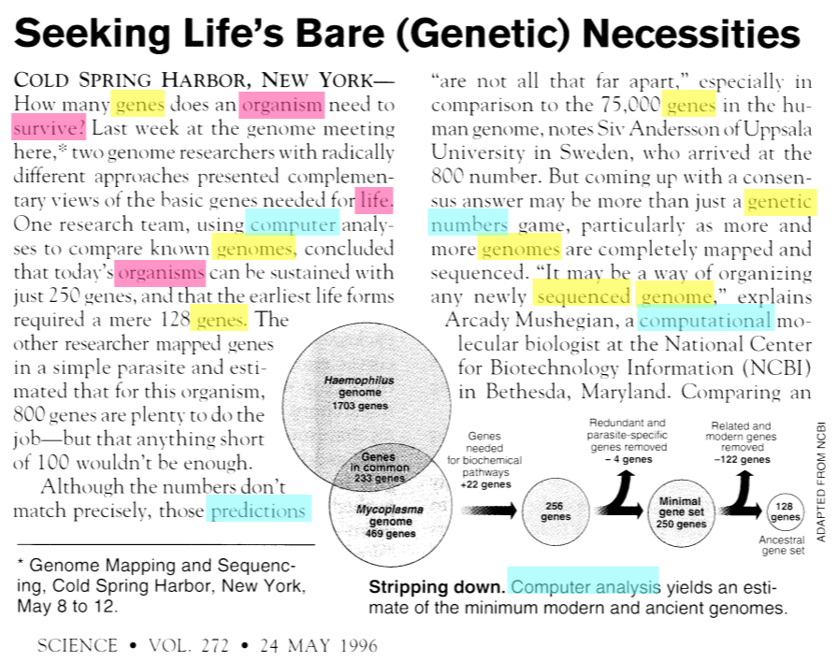
Documents can be about multiple topics
17
How do we find the word-topic associations in each document?
How do we use them to learn topics in the given text collection?
How do we learn low-dim document representations in terms of the topics they represent?

Slide 18













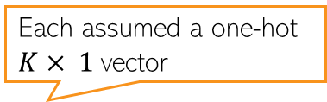

A More Fine-Grained Mixture Model for Text
18
Assume a corpus-level topic mixing proportions $α$ ($K× 1$prob vector)
Also assume doc-level topic mixing props $θ_{d}$ ($K× 1$prob vector)
Instead of assuming a single cluster $z_{d}$ for doc $d$, cluster each word in it
  $z_{d,n}∈\{1,2,…, K\}$ denotes the cluster/topic of word $w_{d,n}∈\{1,2,…, V\}$
Can obtain the “average” clustering for doc $d$ using $θ_{d}$ or ${\overline{z}}_{d}= \frac{1}{N_{d}}\sum_{n=1}^{N_{d}}{z_{d,n}}$
The generative model is as follows
Each assumed a one-hot $K× 1$vector
Locally-conjugate. Easy Gibbs sampling, VI, etc
Somewhat similar to Dir-Mult PCA model
Latent Dirichlet Allocation* (LDA) Topic Model
$$φ_{k}∼Dirichlet\left(η\right) k=1,2,…, K$$
($V$-dim Dirichlet)
$$η$$
$$θ_{d}∼Dirichlet\left(α\right) d=1,2,…, D$$
($K$-dim Dirichlet)
$$z_{d,n}∼multinoulli(θ_{d})$$
$$α$$
$$θ_{d}$$
$$z_{d,n}$$
$$w_{d,n}$$
$$φ_{k}$$
$$w_{d,n}∼multinoulli(φ_{z_{d,n}})$$
$$N_{d}$$
$$K$$
$$D$$

Slide 19
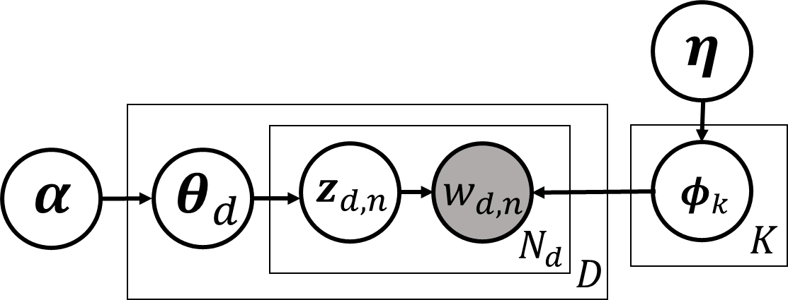
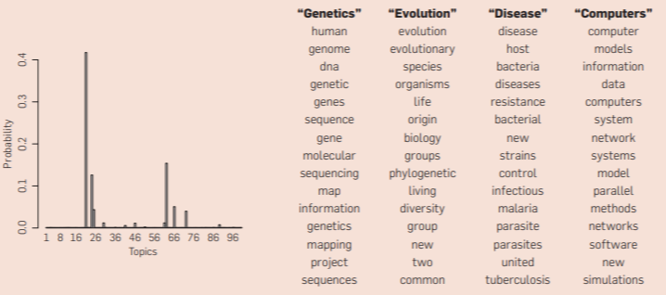





Latent Dirichlet Allocation (LDA)
19
A very widely used probabilistic model for text data
Nice and easy insights into the text collection
  Each $φ_{k}=[φ_{k1},…, φ_{kV}]$ can be interpreted as topic ($φ_{kv}=$ prob. of word $v$ in topic $k$)
  $θ_{d}=[θ_{d1},…, θ_{dK}]$: how much each topic is present in document $d$ (topic distribution)
  ${\overline{z}}_{d}= \frac{1}{N_{d}}\sum_{n=1}^{N_{d}}{z_{d,n}}$ also has a similar interpretation as $θ_{d}$
15 most frequent (most probable) words from four most prominent topics in this doc
A topic is a set of words that tend to co-occur together
$$φ_{1}$$
$$φ_{2}$$
Distribution over topics
$$φ_{3}$$
Word-topic assignments
$$φ_{4}$$
Topic distribution for the document on left

Slide 20
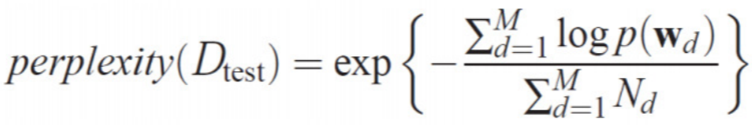
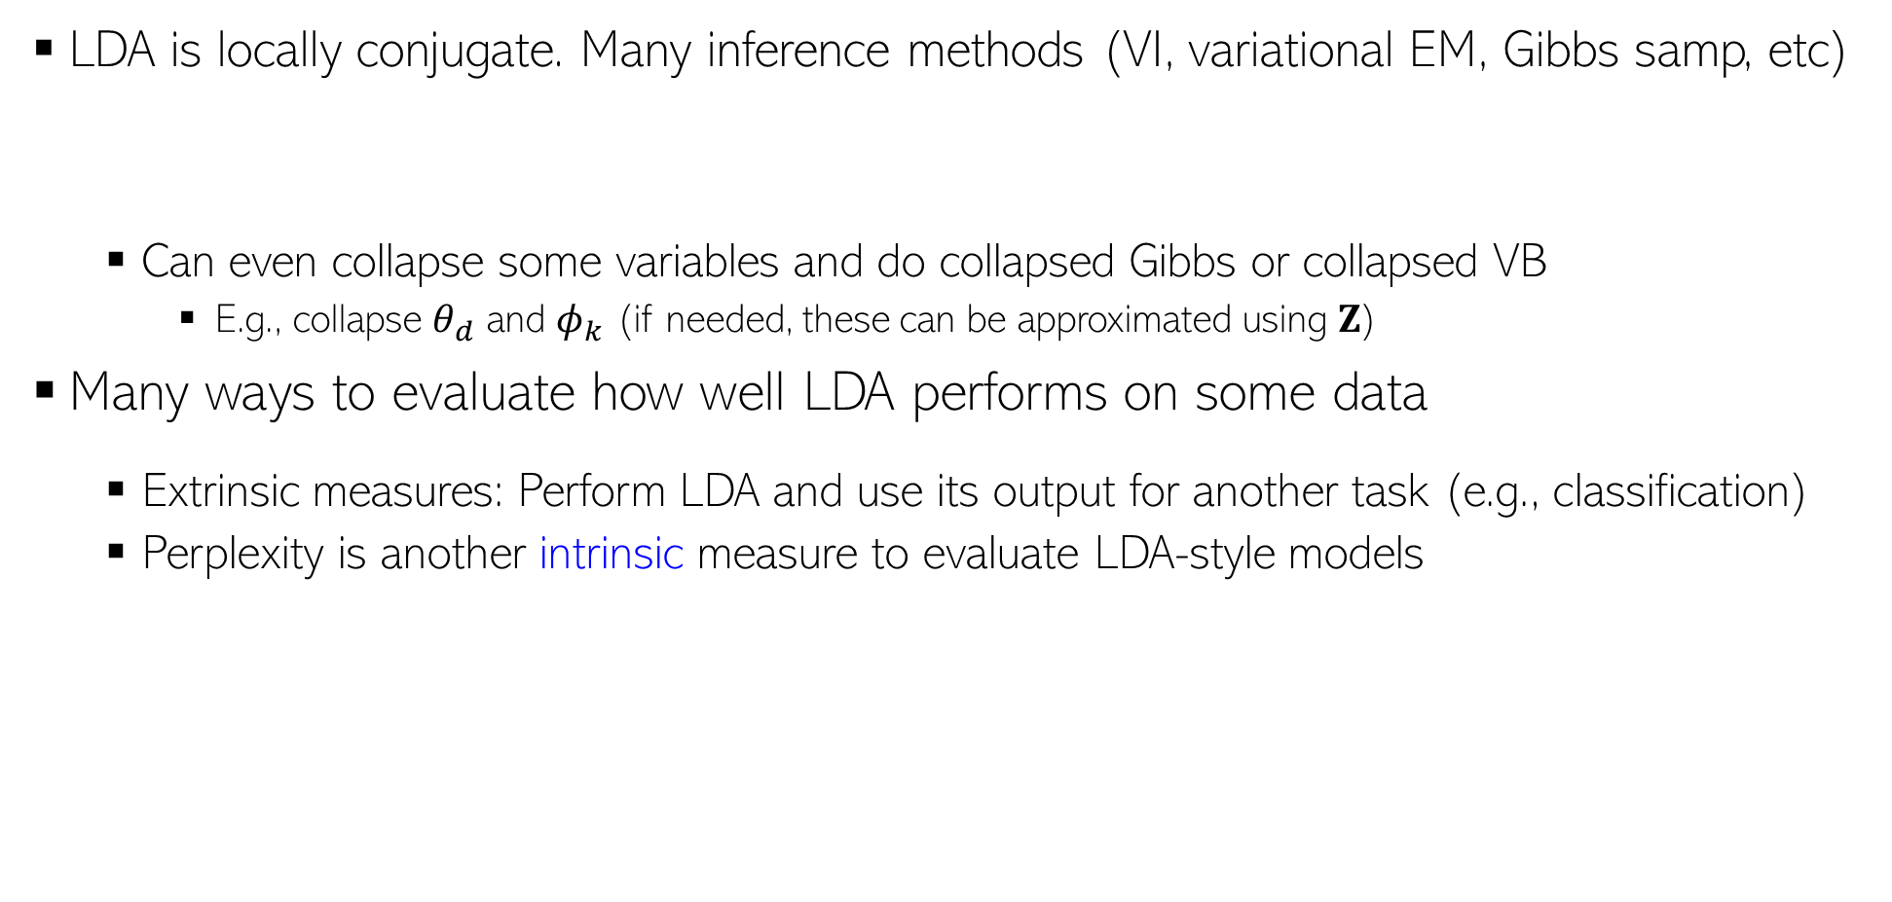
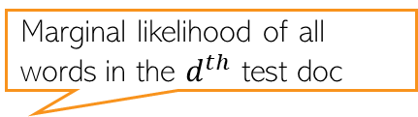

LDA: Inference and Evaluation
20
LDA is locally conjugate. Many inference methods (VI, variational EM, Gibbs samp, etc)
  Can even collapse some variables and do collapsed Gibbs or collapsed VB
    E.g., collapse $θ_{d}$ and $φ_{k}$ (if needed, these can be approximated using $Z$)
Many ways to evaluate how well LDA performs on some data
  Extrinsic measures: Perform LDA and use its output for another task (e.g., classification)
  Perplexity is another intrinsic measure to evaluate LDA-style models
Marginal likelihood of all words in the $d^{th}$ test doc
Test set with $M$ docs
Lower is better

Slide 21
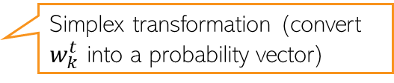



LDA: Limitations and Extensions
21
LDA assumes topics remain static over time (improvement: Dynamic Topic Model)
LDA assumes topics are uncorrelated (improvement: Corr-LDA)
  Use a logistic normal distribution on $θ_{d}$ (cov matrix of log-normal makes component correlated)
LDA ignores the sequential structure in the text (improvement: HMM-LDA)
Assume a first-order Markov evolution for each topic w.r.t. time
$$w_{k}^{t}∼𝒩(w_{k}^{t−1},σ^{2}I)$$
$$φ_{k}^{t}= 𝒮(w_{k}^{t})$$
Simplex transformation (convert $w_{k}^{t}$ into a probability vector)
Evolution of topic “Neuroscience”
(learned from the journal Science)
Fig courtesy: Dynamic Topic Models (Blei and Lafferty, 2006)

Slide 22
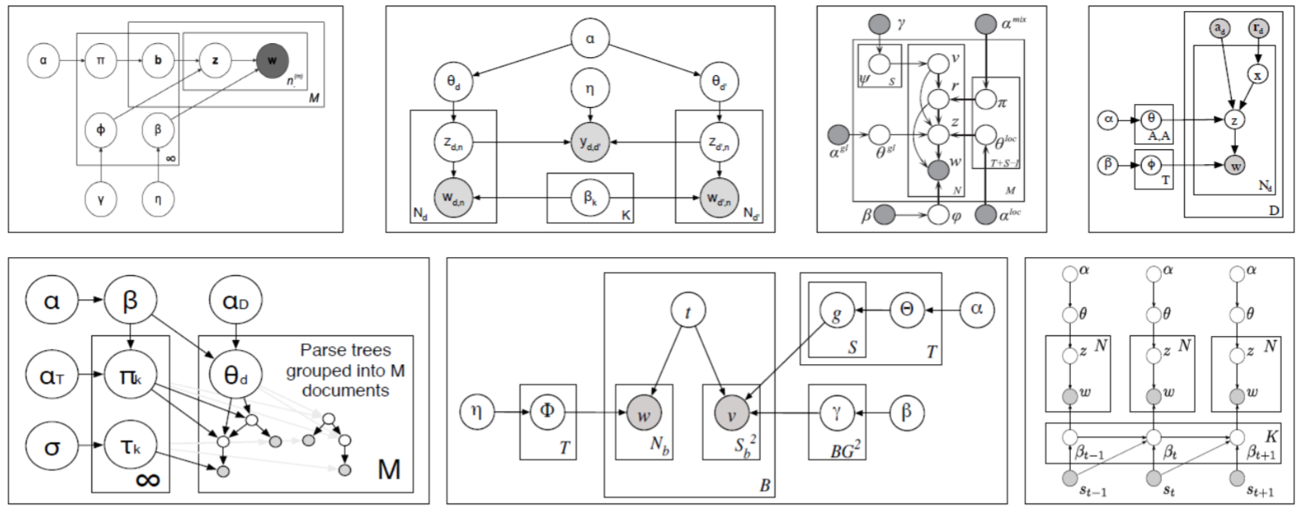


LDA Extensions (Contd)
22
LDA for non-text data, e.g., images
  Each image can be represented as a bag of “visual words” and LDA can be applied
Supervised/Labeled LDA (when we have have a label for each document)
LDA for paired/multimodality data (e.g., images and text caption)
LDA for graph-structured data instead of documents
LDA is also equivalent to doing a non-negative matrix fact. of the $V× D$word-document matrix $X$ using a Poisson likelihood model*
$Φ$ $(V×K)$and $Θ$ $(K×D)$can be given any non-negative priors (Dirichlet/gamma)
This can be extended to “deep” matrix factorization** (modeling $Θ$ using many layers)
Plate diagrams for some LDA extensions
$$X∼Poisson(ΦΘ)$$
*Sec 4 and 5 of “Beta-Negative Binomial Process and Poisson Factor Analysis” (Zhou et al, 2012)
** Poisson-gamma belief networks” (Zhou et al, 2015)

Slide 23
Next Class
23
Generative models using deep neural networks
  Variational Autoencoders
  Generative Adversarial Networks
  Denoising Diffusion Models

