Slide 1
Basics of Probabilistic ML:
Intro to Parameter Estimation
CS772A: Probabilistic Machine Learning
Piyush Rai

Slide 2
Plan Today
Some other benefits of probabilistic machine learning
Some basic ideas
  Likelihood, prior, posterior, marginal likelihood
  Parameter estimation via MLE, MAP, and fully Bayesian inference

Slide 3
Use Probabilistic ML also because..
3

Slide 4
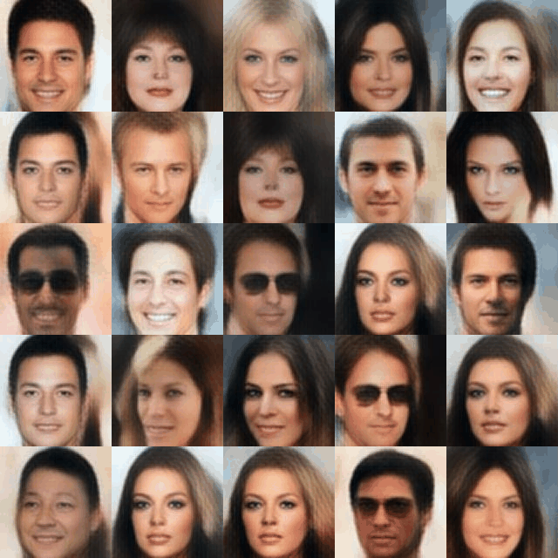
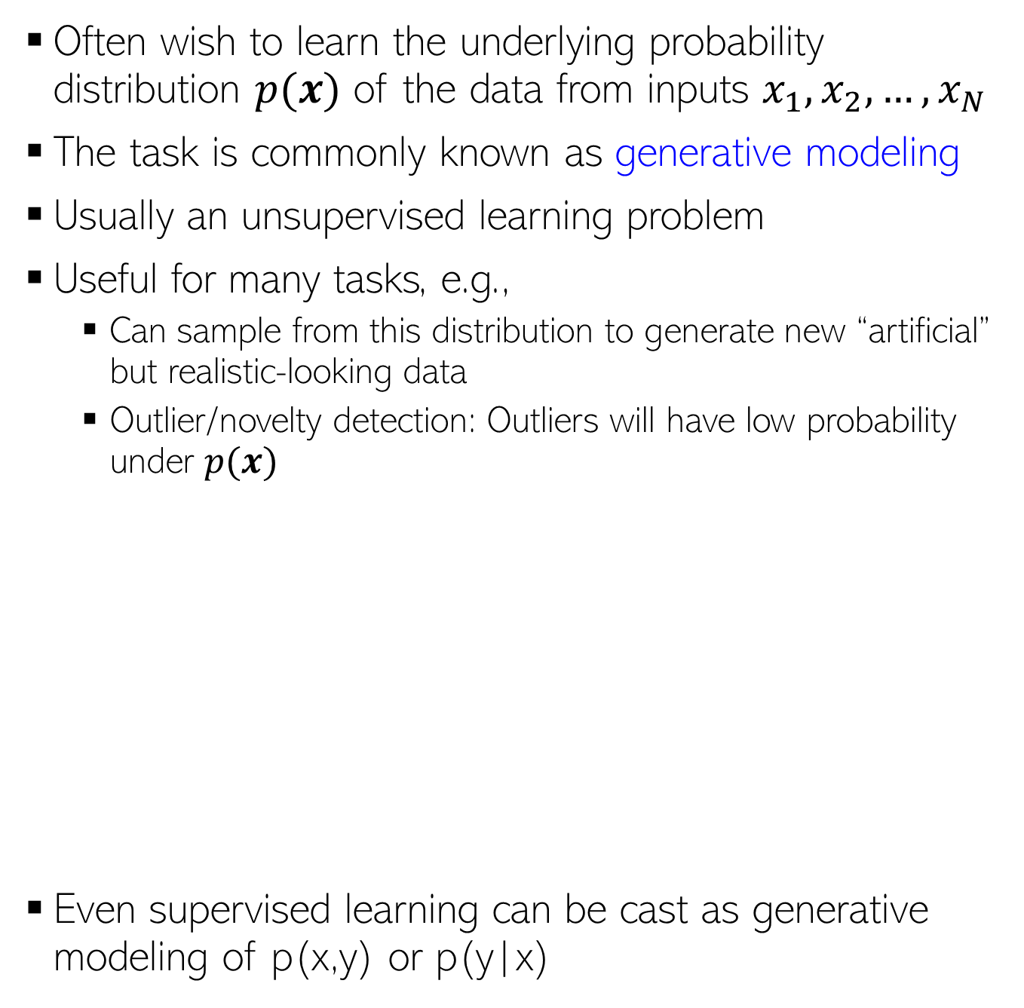
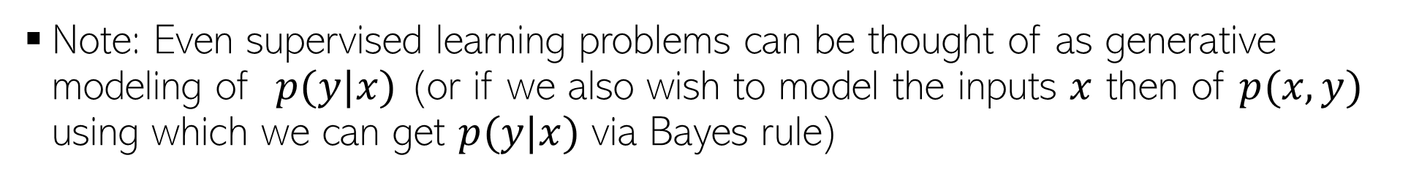
Can Learn Data Distribution and Generate Data
4
Often wish to learn the underlying probability distribution $p(x)$ of the data from inputs $x_{1},x_{2}, …, x_{N}$
The task is commonly known as generative modeling
Usually an unsupervised learning problem
Useful for many tasks, e.g.,
  Can sample from this distribution to generate new “artificial” but realistic-looking data
  Outlier/novelty detection: Outliers will have low probability under $p(x)$
Even supervised learning can be cast as generative modeling of p(x,y) or p(y|x)
Several models, such as generative adversarial networks (GAN), variational auto-encoders (VAE), denoising diffusion models, etc can generate realistic looking data (we will study some of these)
The probabilistic perspective of thinking about supervised learning
Note: Even supervised learning problems can be thought of as generative modeling of $p(y|x)$ (or if we also wish to model the inputs $x$ then of $p(x,y)$ using which we can get $p(y|x)$ via Bayes rule)
Pic credit: https://medium.com/analytics-vidhya/an-introduction-to-generative-deep-learning-792e93d1c6d4

Slide 5
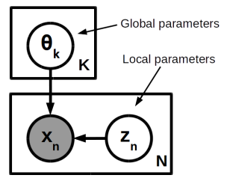
Learning Latent Structures within Data
5
Can endow generative models of data with latent variables. For example:
Such models are used in many problems, especially unsupervised learning: Gaussian mixture model, probabilistic PCA, topic models, deep generative models, etc.
We will look at several of these in this course and way to learn such models
Each data point $x_{n}$ is associated with a latent variable $z_{n}$
The latent variable $z_{n}$ can be used to encode some property of $x_{n}$ (e.g., its cluster membership, or its low-dim representation, or missing parts of $x_{n}$)

Slide 6
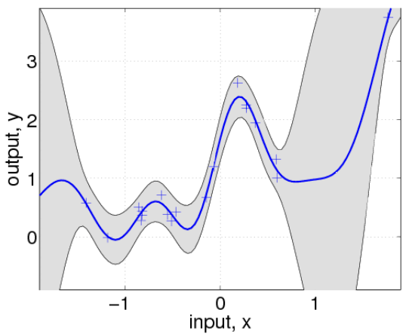
Helps in Sequential Decision-Making Problems
6
Sequential decision-making: Information about uncertainty can “guide” us, e.g.,
Applications in active learning, reinforcement learning, Bayesian optimization, etc
Given our current estimate of the regression function, which training input(s) should we add next to improve its estimate the most?
Blue curve is the mean of the function (learned so far using the available data), shaded region denotes the current predictive uncertainty
Uncertainty can help here: Acquire training inputs from regions where the function is most uncertain about its current predictions

Slide 7
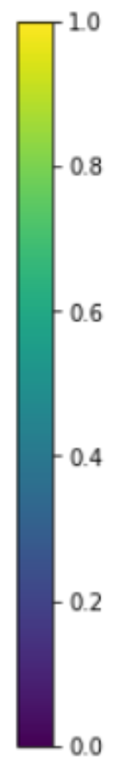
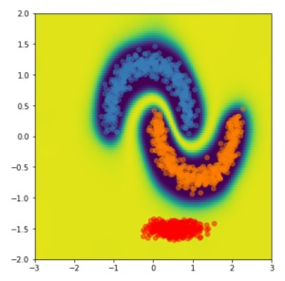
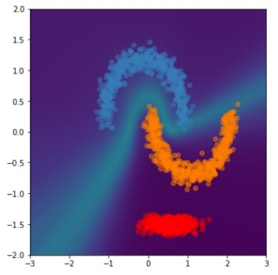
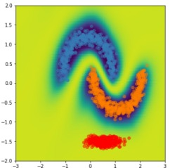
Can Better Handle OOD Data
7
For classification, “confidence” refers to the probability of the class predicted to be the most likely
Many modern deep neural networks (DNN) tend to be overconfident
Especially true if test data is “out-of-distribution (OOD)”
Prob. deep models often provide better uncertainty estimates to flag OOD data
One of the reasons is that they don’t incorporate uncertainty
Model has high confidence for predictions on even inputs that are far away from training data
Overconfident model
Desirable confidence map
Confidence map of a
non-probabilistic DNN
Confidence map of a probabilistic
DNN incorporating uncertainty
Class 1
Low confidence
Class 2
Some OOD
test data
High confidence
Image source: “Simple and Principled Uncertainty Estimation with Deterministic Deep Learning via Distance Awareness” (Liu et al, 2020)

Slide 8
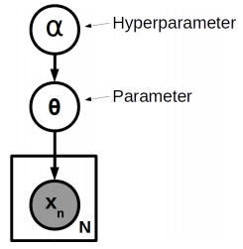
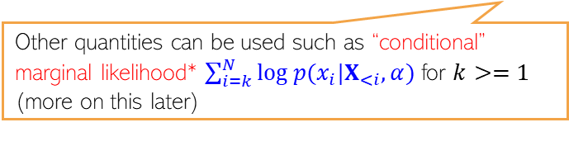
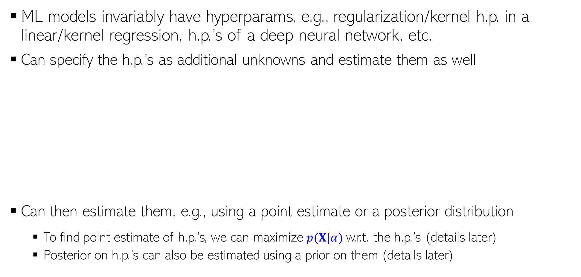



Hyperparameter Estimation
8
ML models invariably have hyperparams, e.g., regularization/kernel h.p. in a linear/kernel regression, h.p.’s of a deep neural network, etc.
Can specify the h.p.’s as additional unknowns and estimate them as well
Can then estimate them, e.g., using a point estimate or a posterior distribution
  To find point estimate of h.p.’s, we can maximize $p(X|α)$w.r.t. the h.p.’s (details later)
  Posterior on h.p.’s can also be estimated using a prior on them (details later)
Pretty much the same way we estimate other unknowns
This doesn’t require a separate validation set unlike cross-validation
Marginal likelihood (more on this later) is like an “averaged” likelihood (averaged over all parameters drawn from the prior)
Assuming $θ$ (its prior distribution) depends on $α$
A way to find the point estimate of the hyperparameters by maximizing the marginal likelihood
The approach of using marginal likelihood for doing such thing has some issues (e.g., dependence on the prior)
$$\hat{α}=arg\max_{α} log p(X|α)$$
Other quantities can be used such as “conditional” marginal likelihood* $\sum_{i=k}^{N}{log p(x_{i}|X_{<i},α)}$ for $k>=1$
(more on this later)
$=arg\max_{α} log ∫p\left(X | θ\right)p\left(θ | α\right)θ$
*Bayesian Model Selection, the Marginal Likelihood, and Generalization (Lotfi et al, 2022)

Slide 9
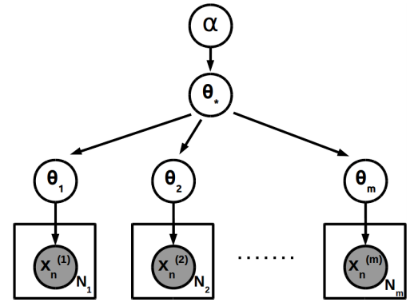


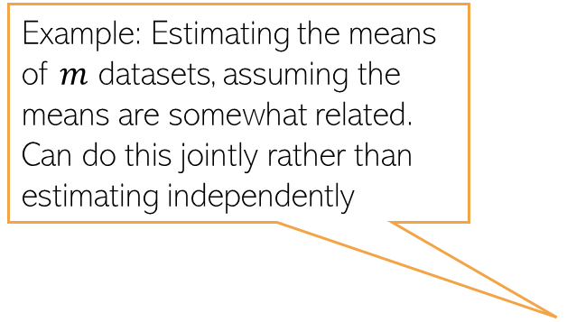
Hierarchical Modeling
9
Can design models that can jointly learn from multiple datasets and share information across multiple datasets using shared parameters with a prior distribution
Example: Estimating the means of $m$ datasets, assuming the means are somewhat related. Can do this jointly rather than estimating independently
Prior with shared $θ_{∗}$ parameters
An example of transfer learning or multitask learning using a probabilistic approach
$$p(θ_{i}|θ_{∗})$$
Helps especially if the amount of training data per task is small
Easy to do it using a probabilistic approach with shared parameters (will see details later)

Slide 10
Non-probabilistic ML Methods?
10
Some non-probabilistic ML methods can give probabilistic answers via heuristics
Doesn’t mean these methods are not useful/used but they don’t follow the PML paradigm, so we won’t study them in this course
Some examples which you may have seen
  Converting distances from hyperplane (in hyperplane classifiers) to compute class probabilities
  Using class-frequencies in nearest neighbors to compute class probabilities
  Using class-frequencies at leaves of a Decision Tree to compute class probabilities
  Soft k-means clustering to compute probabilistic cluster memberships
Or methods like Platt Scaling used to get class probabilities for SVMs

Slide 11
Basics of Probabilistic ML
11

Slide 12
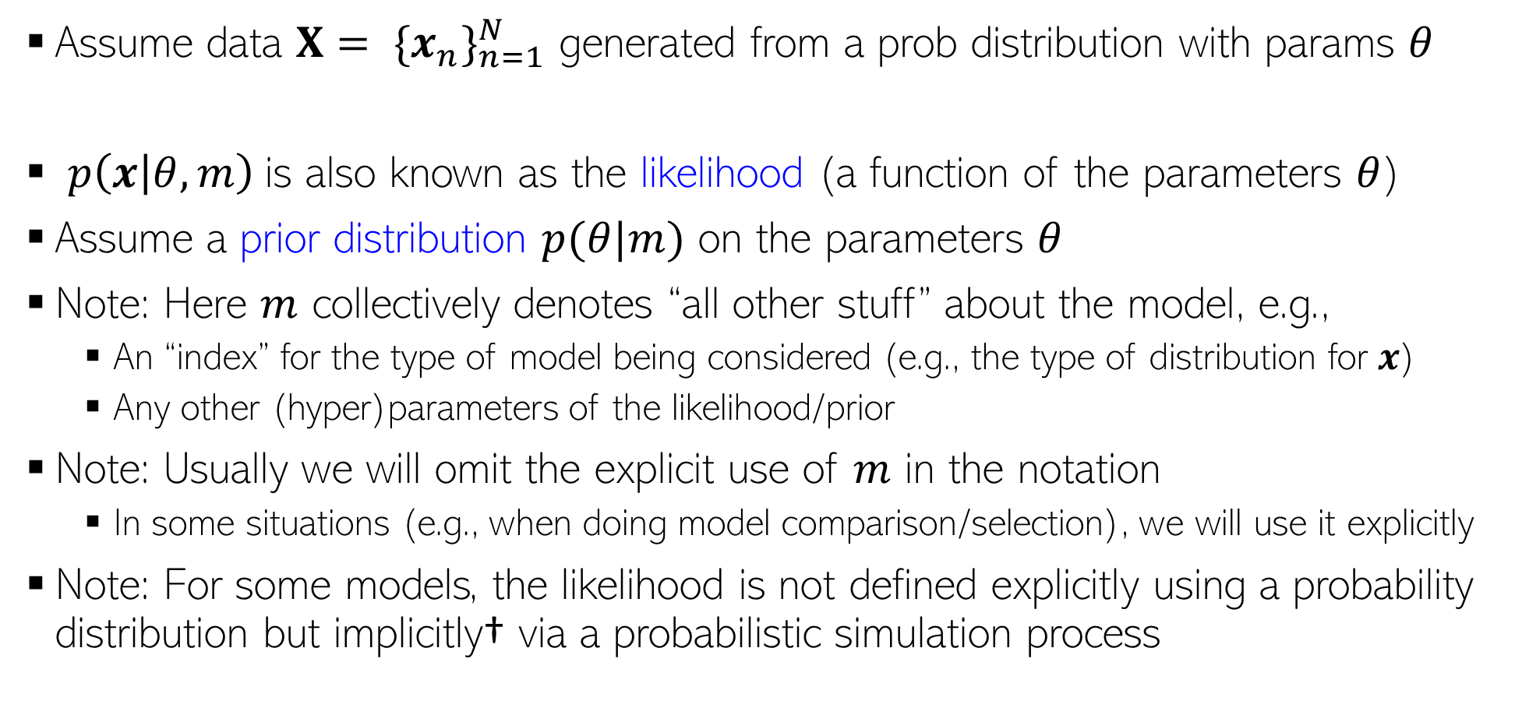
Probabilistic Modeling
12
Assume data $X= {\{x_{n}\}}_{n=1}^{N}$ generated from a prob distribution with params $θ$
$p\left(x | θ, m\right)$is also known as the likelihood (a function of the parameters $θ$)
Assume a prior distribution $p(θ|m)$ on the parameters $θ$
Note: Here $m$ collectively denotes “all other stuff” about the model, e.g.,
  An “index” for the type of model being considered (e.g., the type of distribution for $x$)
  Any other (hyper)parameters of the likelihood/prior
Note: Usually we will omit the explicit use of $m$ in the notation
  In some situations (e.g., when doing model comparison/selection), we will use it explicitly
Note: For some models, the likelihood is not defined explicitly using a probability distribution but implicitly† via a probabilistic simulation process
$$x_{n}∼p\left(x | θ, m\right) n=1,2,…, N$$
†Hierarchical Implicit Models and Likelihood-Free Variational Inference (Tran et al (NIPS 2017))

Slide 13
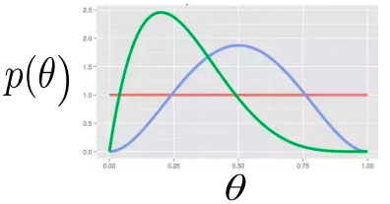
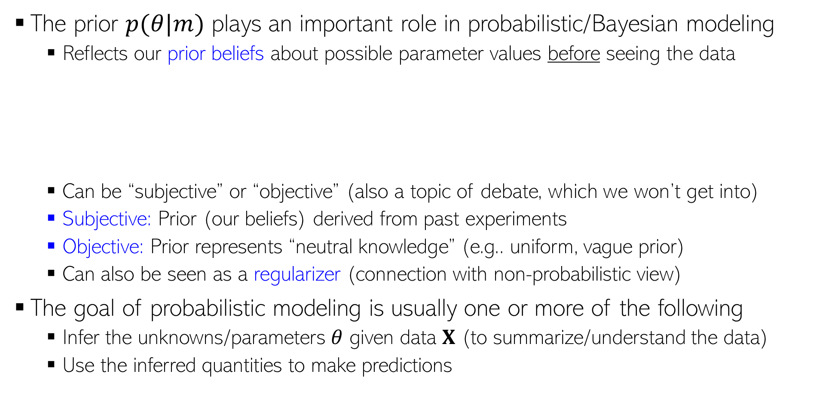
Probabilistic Modeling
13
The prior $p(θ|m)$ plays an important role in probabilistic/Bayesian modeling
  Reflects our prior beliefs about possible parameter values before seeing the data
  Can be “subjective” or “objective” (also a topic of debate, which we won’t get into)
  Subjective: Prior (our beliefs) derived from past experiments
  Objective: Prior represents “neutral knowledge” (e.g.. uniform, vague prior)
  Can also be seen as a regularizer (connection with non-probabilistic view)
The goal of probabilistic modeling is usually one or more of the following
  Infer the unknowns/parameters $θ$ given data $X$ (to summarize/understand the data)
  Use the inferred quantities to make predictions

Slide 14
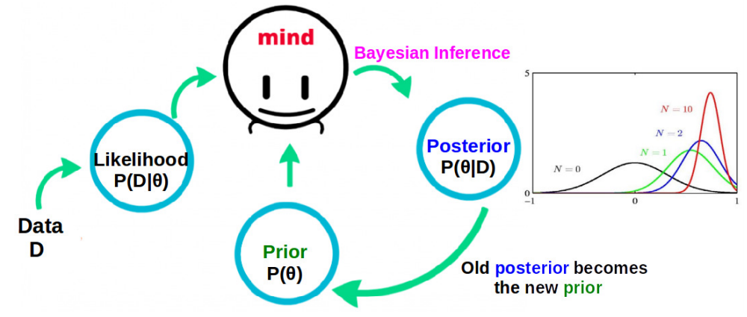
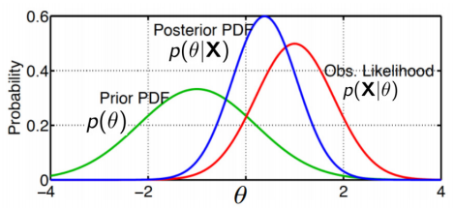
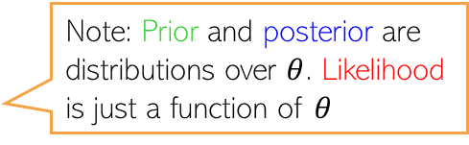

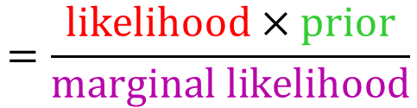
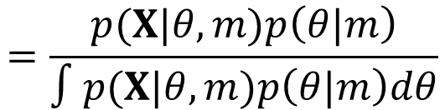
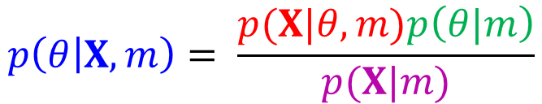
Parameter Estimation/Inference
14
Can infer params by computing posterior distribution (fully Bayesian inference)
Marginal likelihood is an important quantity (used for hyperparam est. or model sel.)
  It’s the probability of data after integrating out some/all of the unknowns from the likelihood $p(X|θ, m)$
  𝑝(𝐗|𝑚) above is the likelihood obtained after integrating out $θ$ from the likelihood $p(X|θ, m)$
  Not always available in closed form (the key reason why full posterior is often hard to compute)
$$p\left(θ | X,m\right)= \frac{p(X|θ, m)p\left(θ|m\right)}{p(X|m)}$$
$$=\frac{p(X|θ, m)p\left(θ|m\right)}{∫p(X|θ, m)p\left(θ|m\right)dθ}$$
$$=\frac{likelihood×prior}{marginal likelihood}$$
Posterior’s spread/variance gets smaller as we use more and more data to infer it
Note: Prior and posterior are distributions over $θ$. Likelihood is just a function of $θ$

Slide 15


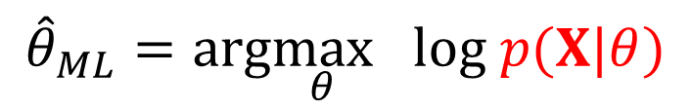
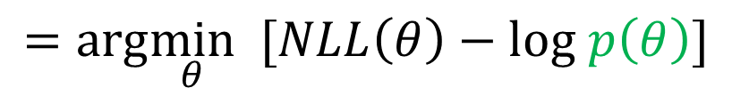
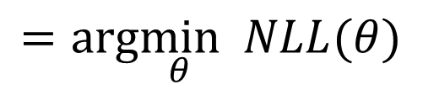

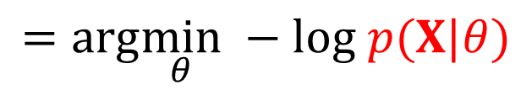
Point Estimation of Parameters
15
Intractable mainly because the marginal likelihood (the denominator on the RHS is intractable in general)
Recall that the posterior is
Point estimation is a cheaper alternative to computing the full posterior
  Maximum likelihood (ML) estimation: Find $θ$ for which observed data has largest probability
  Maximum a posteriori (MAP) estimation: Find $θ$ that has the largest posterior probability
In some problems as we will see, hybrid inference is also possible/desirable – infer full posterior for some parameters and point estimate for others
Intractable to compute except for some very simple models or if the likelihood and prior are conjugate (discussed later) to each other
$$p\left(θ | X,m\right)= \frac{p(X|θ, m)p\left(θ|m\right)}{p(X|m)}$$
Negative Log likelihood (equivalent to a loss function)
$${\hat{θ}}_{ML}=arg\max_{θ} log p(X|θ)$$
$$=arg\min_{θ} −log p(X|θ)$$
$$=arg\min_{θ} NLL(θ)$$
$${\hat{θ}}_{MAP}=arg\max_{θ} log p\left(θ | X\right)=arg\max_{θ} [log p\left(X | θ\right)+log p\left(θ\right)]$$
$$=arg\min_{θ} [NLL\left(θ\right)−log p\left(θ\right)]$$
Like MLE with info from prior added
Note: The regularizer hyperparameter is part of the prior
Akin to a regularizer added to the loss

Slide 16

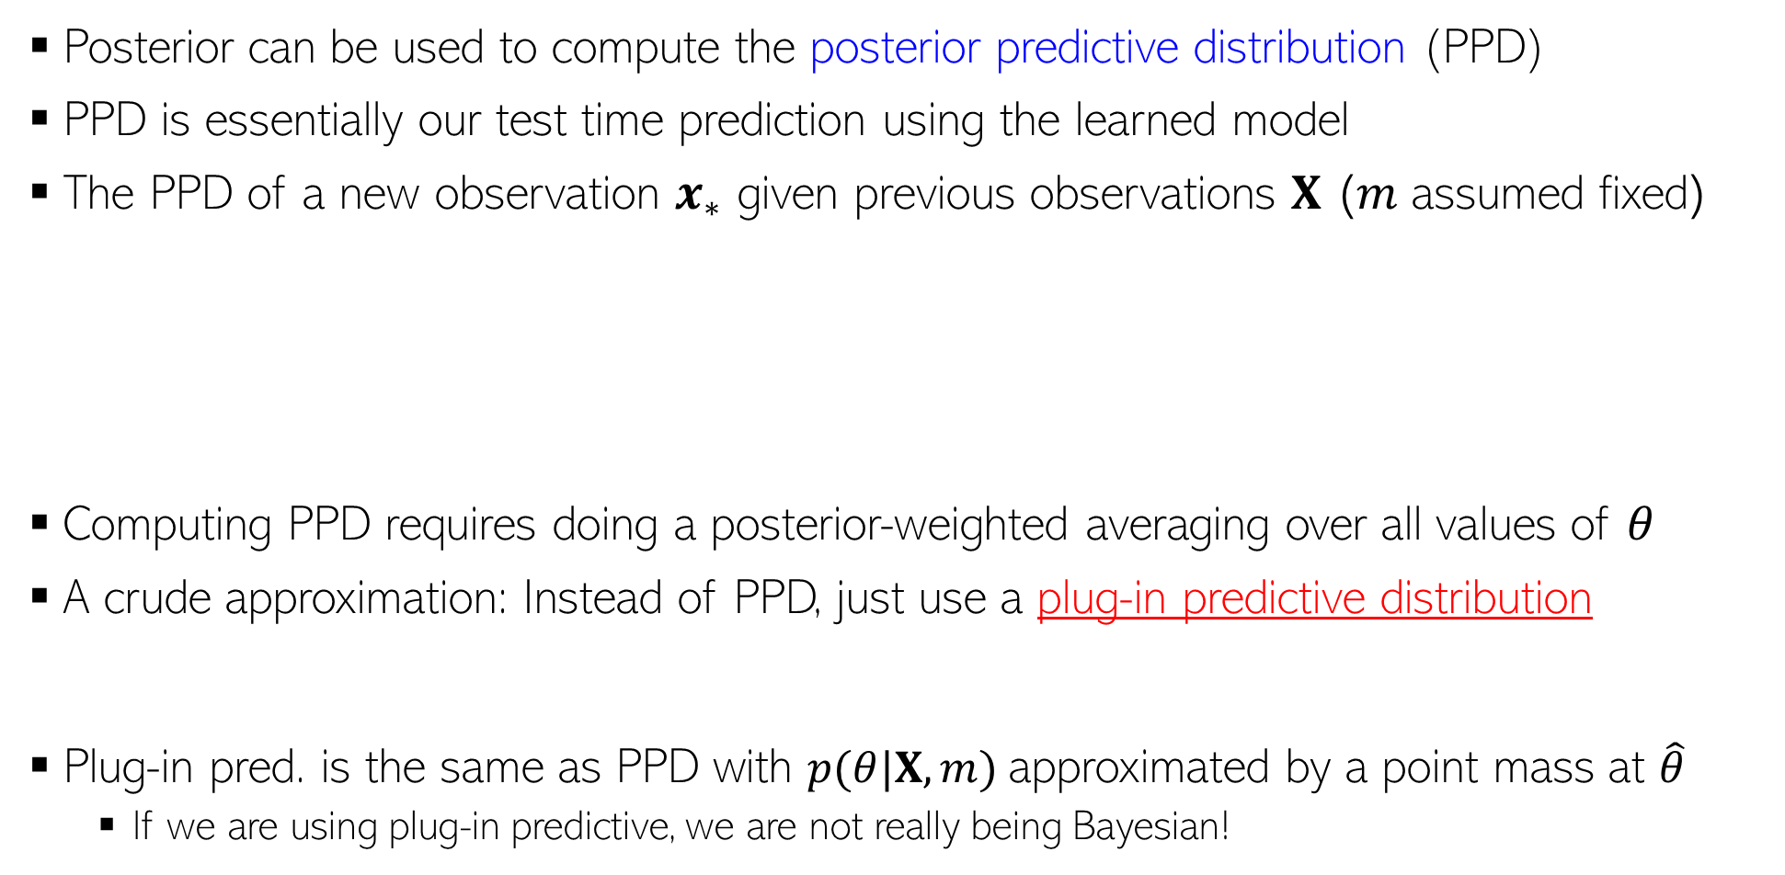


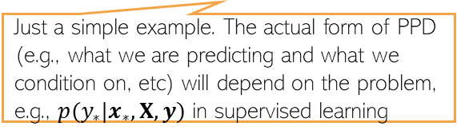


Making Predictions: Predictive Distribution
16
Posterior can be used to compute the posterior predictive distribution (PPD)
PPD is essentially our test time prediction using the learned model
The PPD of a new observation $x_{∗}$ given previous observations $X$ ($m$ assumed fixed)
Computing PPD requires doing a posterior-weighted averaging over all values of $θ$
A crude approximation: Instead of PPD, just use a plug-in predictive distribution
Plug-in pred. is the same as PPD with $p(θ|X,m)$approximated by a point mass at $\hat{θ}$
  If we are using plug-in predictive, we are not really being Bayesian!
New (test) data
Past (training) data
$$p\left(x_{∗} | X,m\right)=∫p(x_{∗},θ|X,m) dθ$$
$$=∫p\left(x_{∗} | θ,X,m\right)p(θ|X,m) dθ$$
This integral is only rarely tractable
Just a simple example. The actual form of PPD (e.g., what we are predicting and what we condition on, etc) will depend on the problem, e.g., $p(y_{∗}|x_{∗},X,y)$ in supervised learning
Assuming observations are i.i.d. given $θ$
$$=∫p\left(x_{∗} | θ,m\right)p(θ|X,m) dθ$$
Prediction by averaging over the posterior distribution of the unknowns parameters
$$p\left(x_{∗} | X,m\right)≈p\left(x_{∗} | \hat{θ},m\right)$$
Here $\hat{θ}$ is the ML or MAP estimate of the parameters
However, this ignores all the uncertainty about $θ$

Slide 17
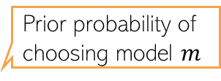


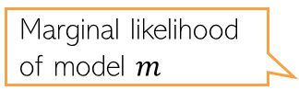
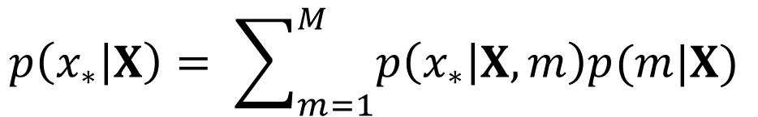
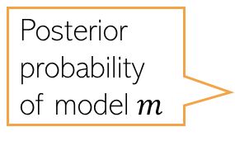
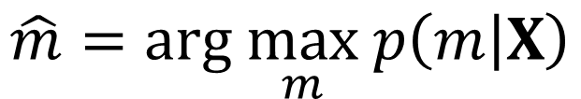
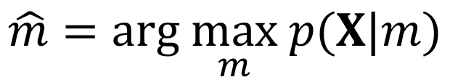
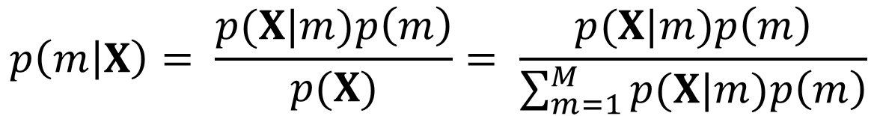
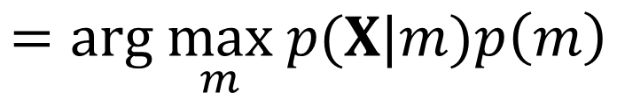
Model Selection and Model Averaging
17
Can use Bayes rule to find the best model from a set of models $m=1,2,…,M$
If all models equally likely a priori then
For PPD, can use either the best model $\hat{m}$ or can average over all models
Marginal likelihood of model $m$
Prior probability of choosing model $m$
Will discuss later how to compute marginal likelihood
Posterior probability of model $m$
$$p\left(m | X\right)= \frac{p(X|m)p\left(m\right)}{p(X)}= \frac{p(X|m)p\left(m\right)}{\sum_{m=1}^{M}{p(X|m)p\left(m\right)}}$$
In general, intractable to compute exactly
Marginal likelihood over all models
$$p\left(X | m\right)=∫p\left(X | θ,m\right)p\left(θ | m\right)dθ$$
Integrating out all unknown parameters of the model
Best model
$$\hat{m}=arg \max_{m} p\left(m | X\right)$$
$$=arg \max_{m} p(X|m)p\left(m\right)$$
$$\hat{m}=arg \max_{m} p(X|m)$$
Test data
Training data
$$p\left(x_{∗} | X\right)= \sum_{m=1}^{M}{p\left(x_{∗} | X,m\right)p(m|X)}$$
$$p\left(x_{∗} | X\right)≈p\left(x_{∗} | X,\hat{m}\right)$$
OR

Slide 18
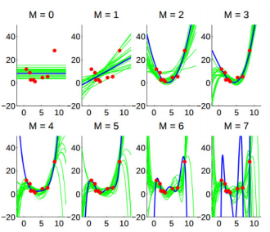
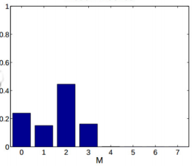
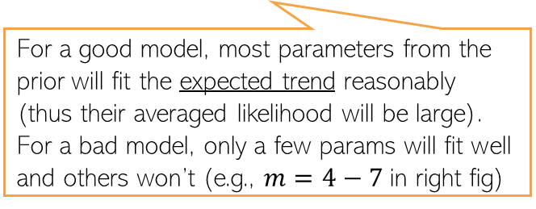

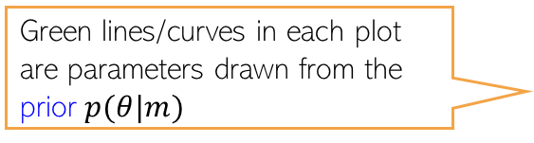

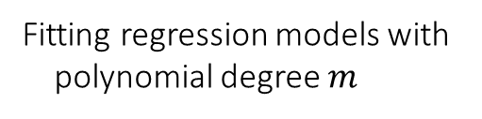

Marginal Likelihood: An Illustration
18
Marginal likelihood is a hard-to-compute but an important quantity
  $p(X|α)$ where $α$ is a hyperparameter can be used to find the best hyperparameter
  $p(X|m)$ where $m$ is a model index can be used to find the best model
Recall that marg. lik. is akin to “averaged” likelihood:
$$p\left(X | m\right)=∫p\left(X | θ,m\right)p\left(θ | m\right)dθ$$
Fitting regression models with
polynomial degree $m$
Green lines/curves in each plot are parameters drawn from the prior $p(θ|m)$
$$p(X|m)$$
For a good model, most parameters from the prior will fit the expected trend reasonably (thus their averaged likelihood will be large). For a bad model, only a few params will fit well and others won’t (e.g., $m=4−7$in right fig)
No validation data needed
Note that we can get these plots (and compute marginal likelihood) before doing parameter estimation for each model

