Slide 1
Approx. Inference via Sampling (wrap-up),
Bayesian Deep Learning
CS772A: Probabilistic Machine Learning
Piyush Rai

Slide 2
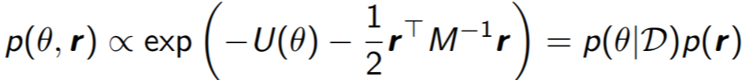
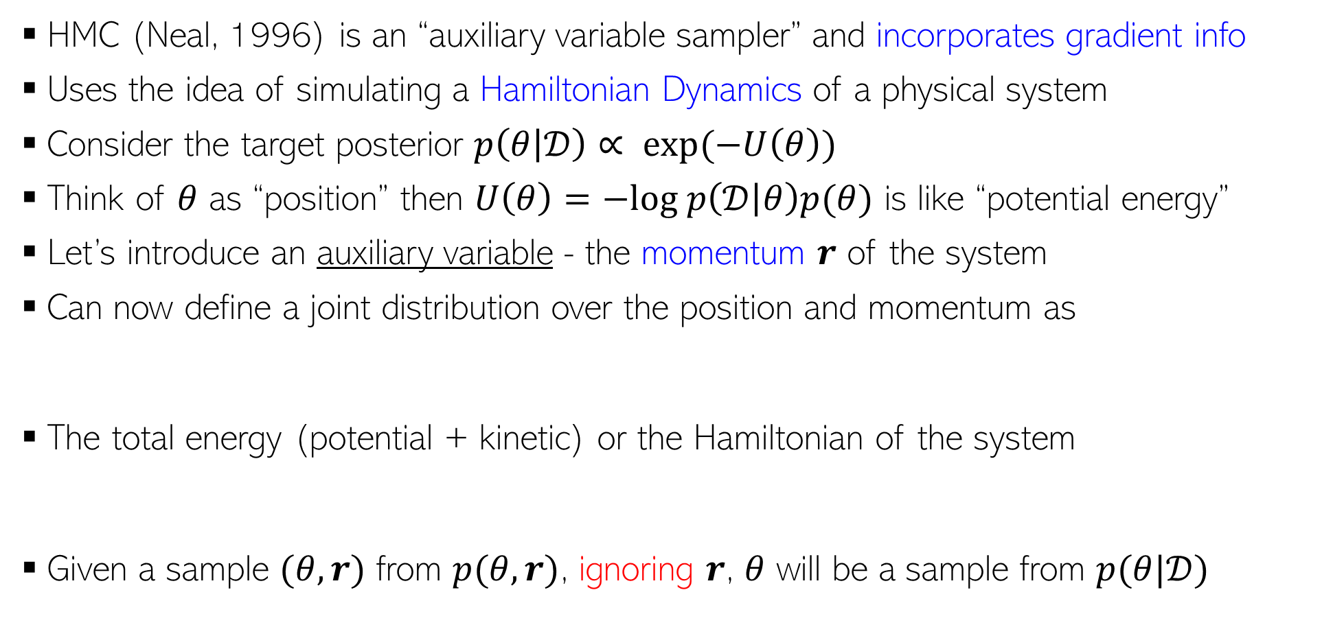
Hamiltonian/Hybrid Monte Carlo (HMC)
2
HMC (Neal, 1996) is an “auxiliary variable sampler” and incorporates gradient info
Uses the idea of simulating a Hamiltonian Dynamics of a physical system
Consider the target posterior $p\left(θ | 𝒟\right)∝ exp(−U\left(θ\right))$
Think of $θ$ as “position” then $U\left(θ\right)=−log p\left(𝒟 | θ\right)p(θ)$ is like “potential energy”
Let’s introduce an auxiliary variable - the momentum $r$ of the system
Can now define a joint distribution over the position and momentum as
The total energy (potential + kinetic) or the Hamiltonian of the system
Given a sample $(θ,r)$ from $p(θ,r)$, ignoring $r$, $θ$ will be a sample from $p(θ|𝒟)$
Constant w.r.t. time

Slide 3
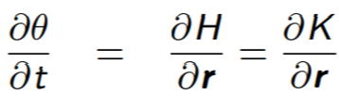



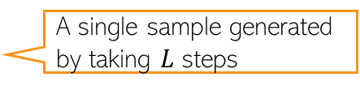
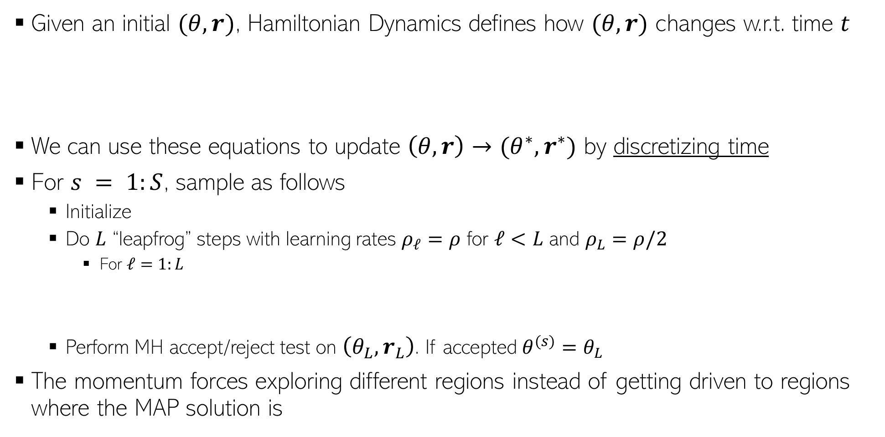
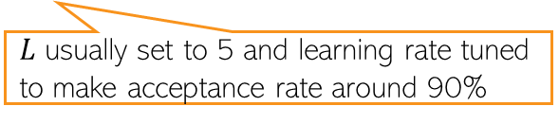
Generating Samples in HMC
3
Given an initial $(θ,r)$, Hamiltonian Dynamics defines how $(θ,r)$ changes w.r.t. time $t$
We can use these equations to update $\left(θ,r\right)→(θ^{∗},r^{∗})$ by discretizing time
For $s = 1:S$, sample as follows
  Initialize
  Do $L$ “leapfrog” steps with learning rates $ρ_{ℓ}=ρ$ for $ℓ<L$ and $ρ_{L}=ρ/2$
    For $ℓ=1:L$
  Perform MH accept/reject test on $\left(θ_{L},r_{L}\right)$. If accepted $θ^{(s)}=θ_{L}$
The momentum forces exploring different regions instead of getting driven to regions where the MAP solution is
Reason: Getting analytical solutions for the above requires integrals which is in general intractable
$L$ usually set to 5 and learning rate tuned to make acceptance rate around 90%
A single sample generated by taking $L$ steps

Slide 4
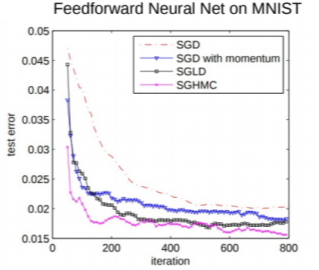
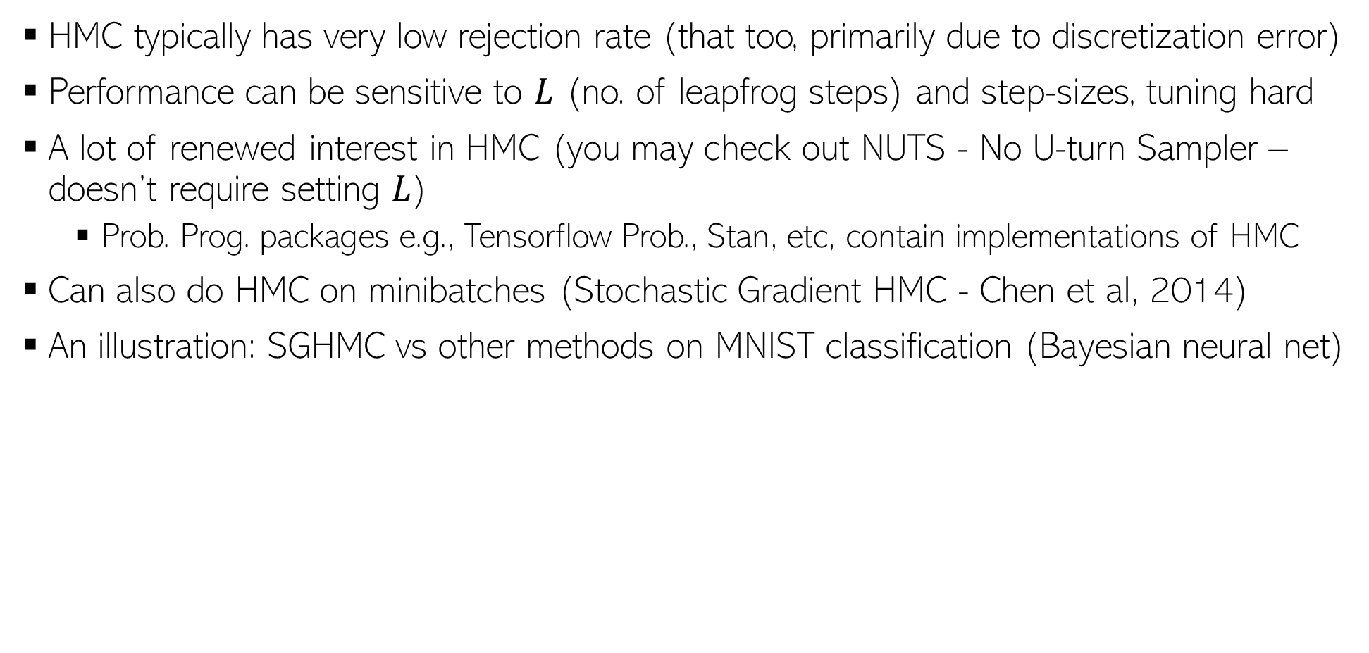
HMC in Practice
4
HMC typically has very low rejection rate (that too, primarily due to discretization error)
Performance can be sensitive to $L$ (no. of leapfrog steps) and step-sizes, tuning hard
A lot of renewed interest in HMC (you may check out NUTS - No U-turn Sampler – doesn’t require setting $L$)
  Prob. Prog. packages e.g., Tensorflow Prob., Stan, etc, contain implementations of HMC
Can also do HMC on minibatches (Stochastic Gradient HMC - Chen et al, 2014)
An illustration: SGHMC vs other methods on MNIST classification (Bayesian neural net)

Slide 5
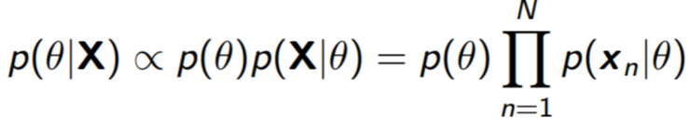
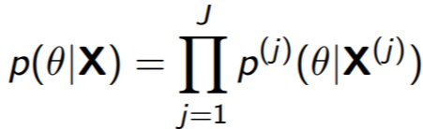

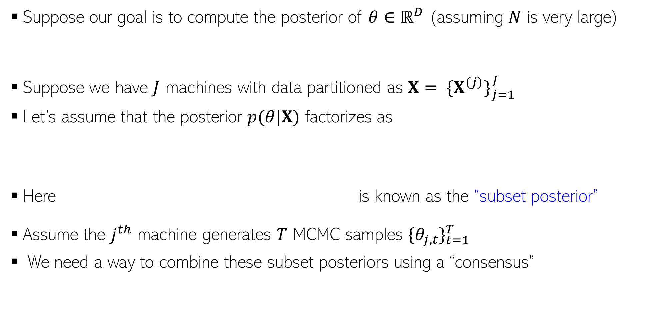
Parallel/Distributed MCMC
5
Suppose our goal is to compute the posterior of $θ∈ℝ^{D}$ (assuming $N$ is very large)
Suppose we have $J$ machines with data partitioned as $X= {\{X^{\left(j\right)}\}}_{j=1}^{J}$
Let’s assume that the posterior $p(θ|X)$ factorizes as
Here is known as the “subset posterior”
Assume the $j^{th}$ machine generates $T$ MCMC samples ${\{θ_{j,t}\}}_{t=1}^{T}$
We need a way to combine these subset posteriors using a “consensus”

Slide 6
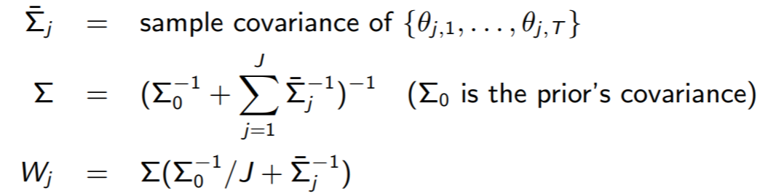

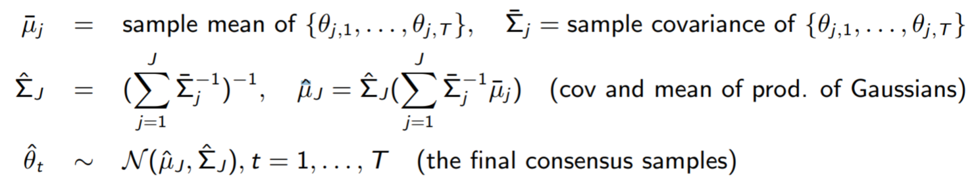
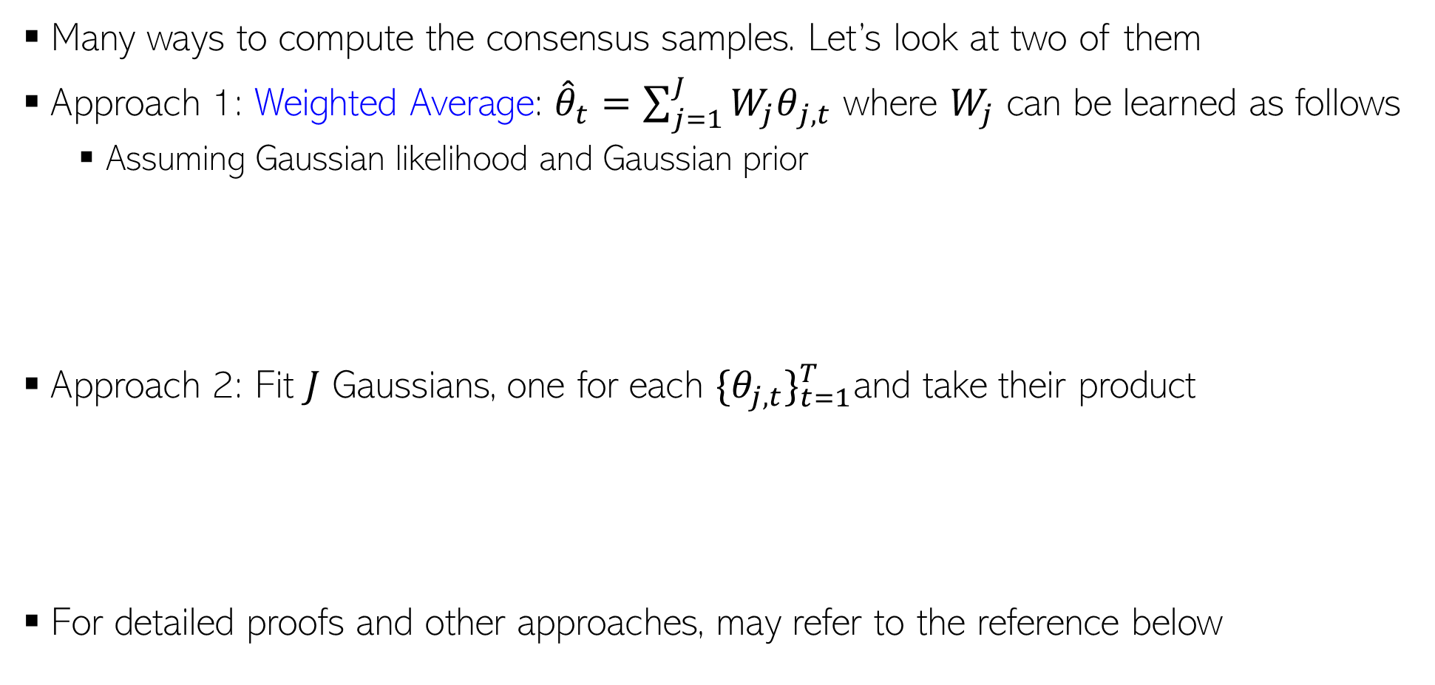
Parallel/Distributed MCMC
6
Many ways to compute the consensus samples. Let’s look at two of them
Approach 1: Weighted Average: ${\hat{θ}}_{t}=\sum_{j=1}^{J}{{W_{j}θ}_{j,t}}$ where $W_{j}$ can be learned as follows
  Assuming Gaussian likelihood and Gaussian prior
Approach 2: Fit $J$ Gaussians, one for each ${\{θ_{j,t}\}}_{t=1}^{T}$and take their product
For detailed proofs and other approaches, may refer to the reference below
These approaches can also be used to make VI parallel/distributed
Patterns of Scalable Bayesian Inference (Angelino et al, 2016)

Slide 7
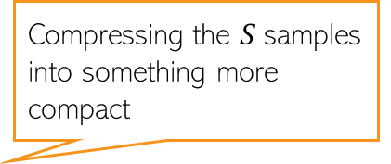

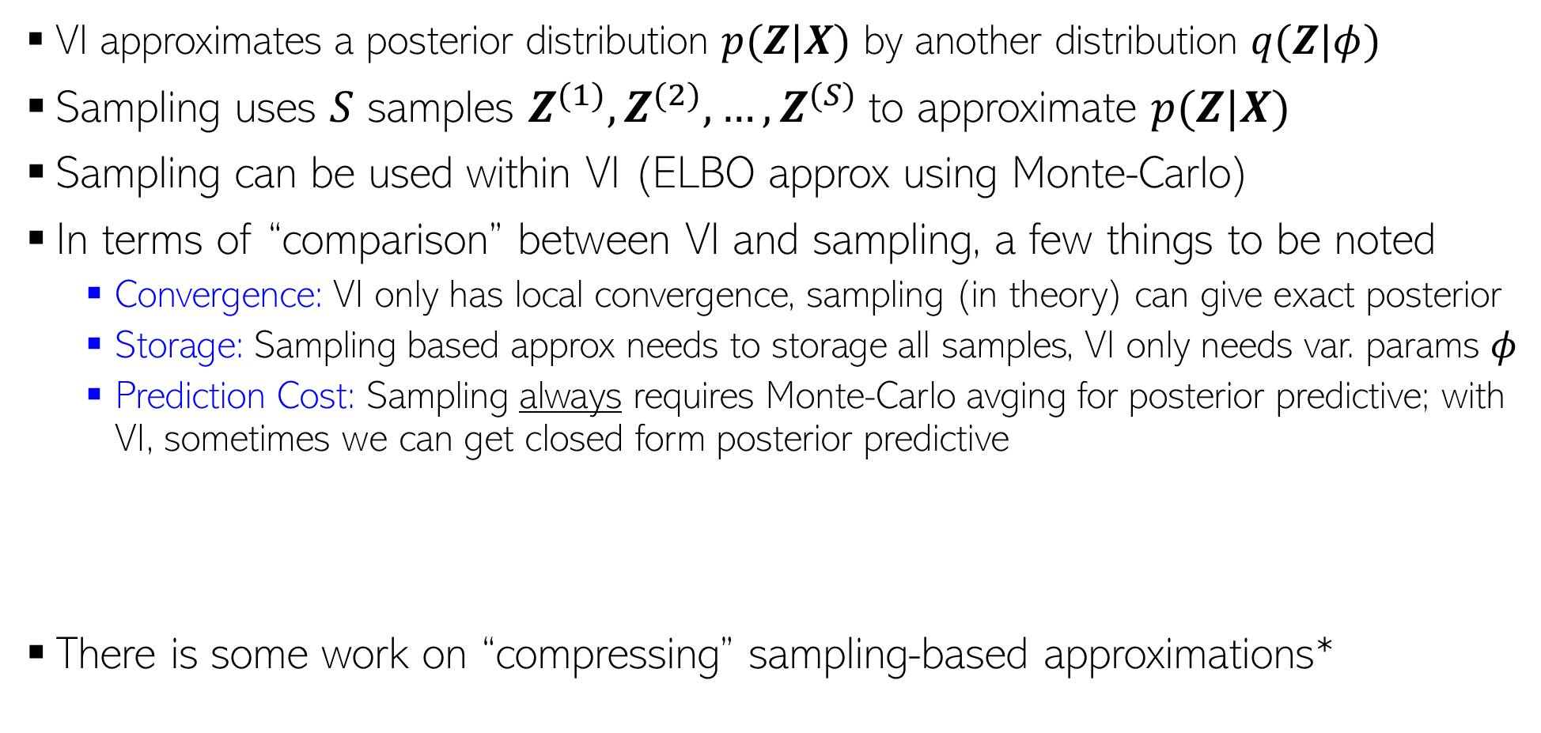
Approximate Inference: VI vs Sampling
7
VI approximates a posterior distribution $p(Z|X)$ by another distribution $q(Z|φ)$
Sampling uses $S$ samples $Z^{(1)},Z^{(2)},…,Z^{(S)}$to approximate $p(Z|X)$
Sampling can be used within VI (ELBO approx using Monte-Carlo)
In terms of “comparison” between VI and sampling, a few things to be noted
  Convergence: VI only has local convergence, sampling (in theory) can give exact posterior
  Storage: Sampling based approx needs to storage all samples, VI only needs var. params $φ$
  Prediction Cost: Sampling always requires Monte-Carlo avging for posterior predictive; with VI, sometimes we can get closed form posterior predictive
There is some work on “compressing” sampling-based approximations*
PPD if using sampling:
$$p\left(x_{∗} | X\right)=∫p\left(x_{∗} | Z\right)p\left(Z | X\right)dZ≈\frac{1}{S}\sum_{s=1}^{S}{p\left(x_{∗} | Z^{\left(s\right)}\right)}$$
Compressing the $S$samples into something more compact
PPD if using VI:
$$p\left(x_{∗} | X\right)=∫p\left(x_{∗} | Z\right)p\left(Z | X\right)dZ≈∫p\left(x_{∗} | Z\right)q\left(Z | φ\right)dZ$$
*”Compact approximations to Bayesian predictive distributions” by Snelson and Ghaharamani, 2005; and “Bayesian Dark Knowledge” by Korattikara et al, 2015

Slide 8
Inference Methods: Summary
8
MLE/MAP: Straightforward for differentiable models (can even use automatic diff.)
Conjugate models with one “main” parameter: Straightforward posterior updates
MLE-II/MAP-II: Often useful for estimating the hyperparameters
EM: If we want to do MLE/MAP for models with latent variables
  Very general algorithm, can also be made online
  Used when we want point estimates for some unknowns and posterior over others
  Can use it for hyperparameter estimation as well
  Often better than using direct gradient methods
VI and sampling methods can be used to get full posterior for complex models
  Quite easy if we have local conjugacy (VI has closed form updates, Gibbs sampler is easy to derive)
  In other cases, we have general VI with Monte-Carlo gradients, MH sampling
  MCMC can also make use of gradient info (LD/SGLD)
For large-scale problems, online/distributed VI/MCMC, or SGD based posterior approx

Slide 9
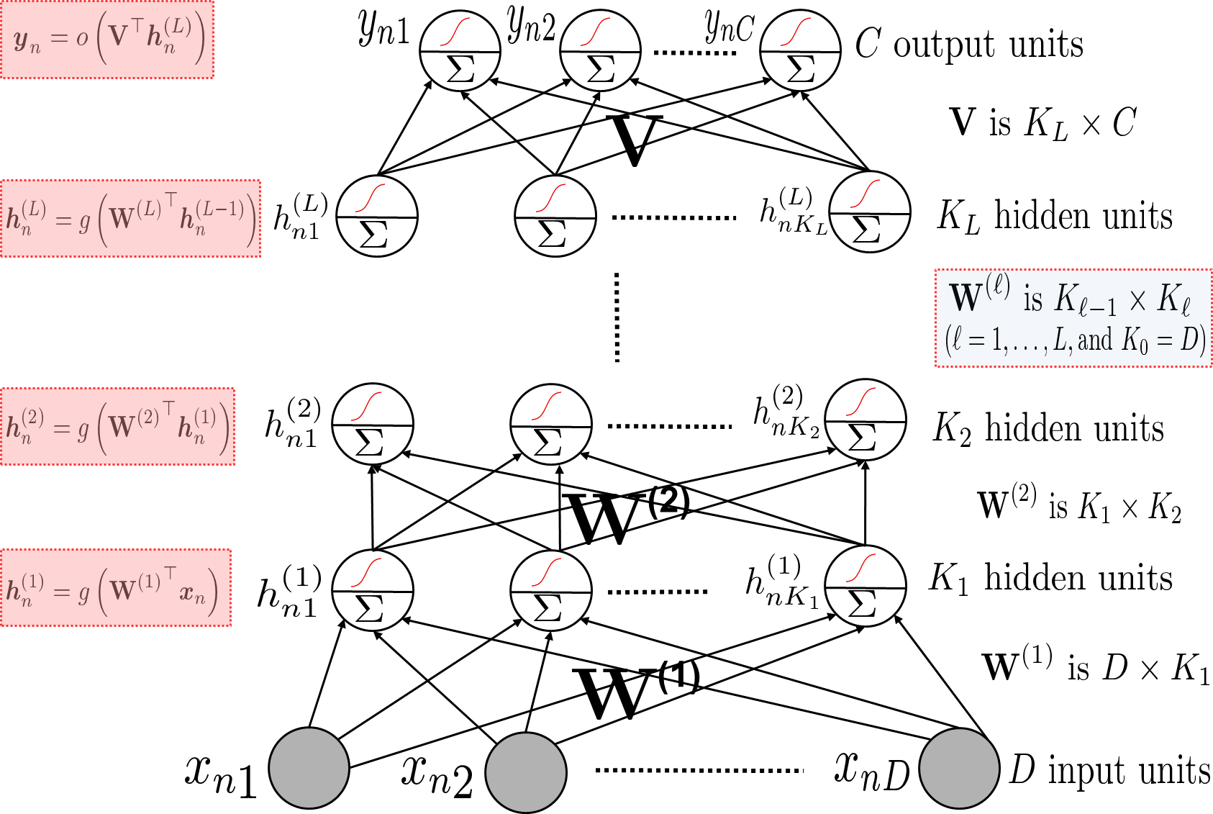
(Deep) Neural Networks
9
These are nonlinear function approximators
Consists of an input layer, one or more hidden layers, and an output layer
Can think of the last hidden layer’s node values being used as features in a GLM (linear/logistic/softmax, etc) modeled by the output layer
Network weights typically learned by backpropagation (basically, gradient descent + chain rule)
Hidden layers act as feature extractors

Slide 10
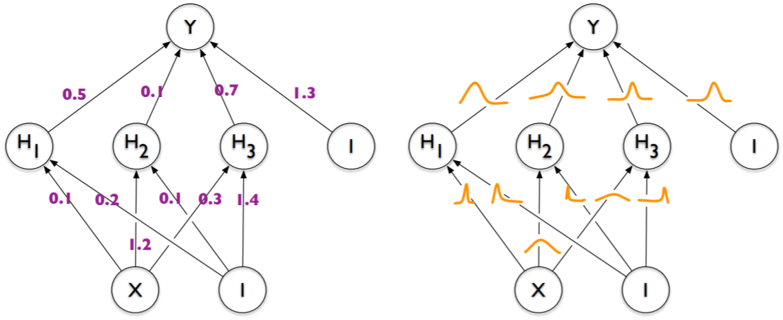
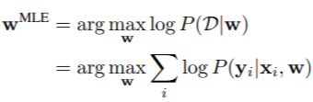
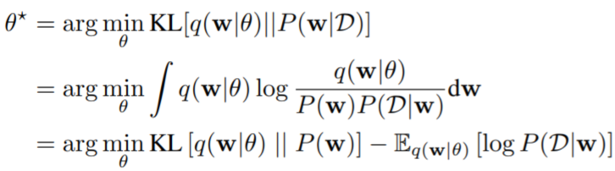

Bayesian Neural Networks
10
Backprop for neural nets only gives us point estimates for the weights
Another alternative is to be Bayesian and learn the posterior distribution over weights
Bayesian neural net: Each weight has a posterior distribution inferred by some Bayesian inference algo (VI/MCMC/Laplace approx., etc)
Standard neural net: Each weight has a fixed value, learned by backprop
Note: Just having a likelihood and prior will still give us a standard neural net if we choose to do MLE/MAP only
Also, test time will require computing PPD, not just a plug-in prediction
VI for Bayesian neural net
Using reparametrization trick (known as “Bayes by Backprop”* in this context), BBVI etc
Pic from: *Weight Uncertainty in Neural Networks (Blundell et al, 2015)

Slide 11
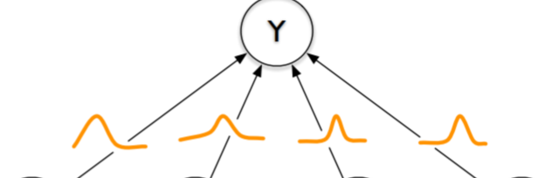
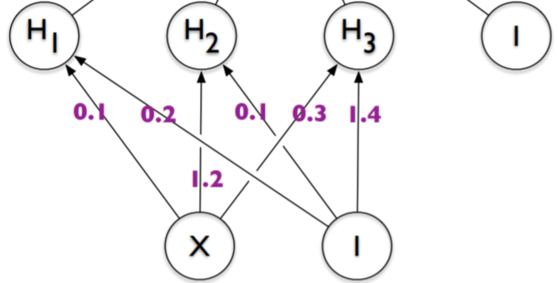
A Hybrid Bayesian Neural Net
11
$$p\left(y_{∗} | x_{∗},𝒟\right)≈ \frac{1}{S}\sum_{s=1}^{S}{p(y_{∗}|x_{∗},θ^{\left(s\right)}})$$
Learning the posterior for all weights can be expensive
PPD computation is also slow if using Monte Carlo approximation for PPD
A cheaper practical alternative is
  Do point estimation for hidden layer weights ($W$)
  Infer the full posterior for output layer weights ($V$)
  The PPD will then be
A rough approximation of the above is the following
  Use a pretrained neural net to extract feature
  Train Bayesian linear model (e.g., Bayesian linear/logistic/softmax/GLM reg.) on these features
where $θ^{(s)}∼p(θ|𝒟)$
Faster because the posterior of $V$ is much lower dimensional
$$p\left(y_{∗} | x_{∗},𝒟\right)≈ \frac{1}{S}\sum_{s=1}^{S}{p(y_{∗}|x_{∗},V^{\left(s\right)},\hat{W} })$$
where $V^{(s)}∼p(V|𝒟)$
Approximation since in the hybrid approach, we still learn $W$ and $V$together, unlike this approach where it is a two-step process

Slide 12

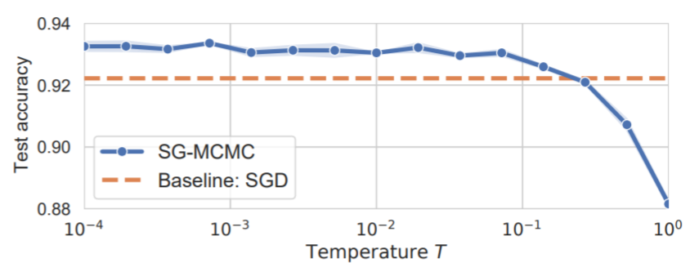
Bayesian Neural Networks: The Priors
12
Zero-mean isotropic Gaussian priors are common and convenient
  Corresponds to weight-decay or $ℓ_{2}$ regularizer
Another alternative is to use sparsity-inducing priors, e.g.,
Gaussian priors have been found somewhat problematic in recent work
  Cold-posterior effect
$T$ is like temperature
$T=1$ is the standard Bayesian inference
Recent work has shown that BNNs with standard Gaussian priors work poorly for $T=1$ but $T≪1$ improves performance
Maybe Gaussian priors aren’t really ideal??
Pic from: *How Good is the Bayes Posterior in Deep Neural Networks Really? (Wenzel et al, 2020)

Slide 13
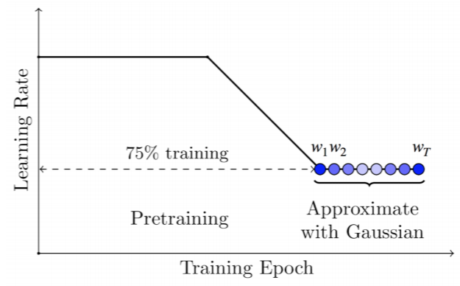

Other Inference Methods for Bayesian Neural Nets
13
Laplace approximation is very common: $p\left(W | 𝒟\right)≈ 𝒩(W_{MAP}, H^{−1})$
  However, can be slow since the number of parameters is very large
  One option is to use a simpler covariance matrix (e.g,, diagonal or block-diag)
  Another option is to use the hybrid Bayesian neural net
    Use MAP estimates for the hidden layer weights
    Use Laplace approximation only for the output layer weights
Using SGD iterates obtained from backprop
Extension: A mixture of Gaussian approximation: Multi-SWAG – Run SGD $M$ times and use a mixture of M such Gaussians
SWA based Gaussian approximation: SWAG
Stochastic weight averaging (SWA)
$$p\left(w | 𝒟\right)≈$$
Pic from: *A Simple Baseline for Bayesian Uncertainty in Deep Learning (Maddox et al, 2019)

Slide 14
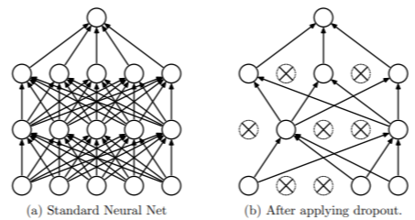
Other Inference Methods for Bayesian Neural Nets
14
Monte Carlo Dropout is another popular and efficient way
Standard Dropout
  Drop some weights randomly (with some “drop” probability) during training
  At test time, multiply each weight by the “keep” probability
  Note: Dropout applied only at training time
Monte Carlo Dropout*
Can be seen as learning a variational approximation of the weights (see paper for details, if interested)
$$p\left(y_{∗} | x_{∗},𝒟\right)≈ \frac{1}{S}\sum_{s=1}^{S}{p(y_{∗}|x_{∗},θ^{\left(s\right)}})$$
$$p\left(y_{∗} | x_{∗},𝒟\right)≈ \frac{1}{S}\sum_{s=1}^{S}{p(y_{∗}|x_{∗},θ^{\left(s\right)}})$$
where $θ^{(s)}=ε^{(s)}⊙ \hat{θ}$
where $θ^{(s)}∼p(θ|𝒟)$
Vector of Bernoulli or Gaussian noise
Point estimate
Elementwise product
*Dropout as a Bayesian Approximation: Representing Model Uncertainty in Deep Learning (Gal and Ghahramani, 2016)

Slide 15
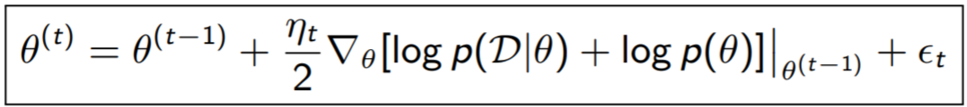
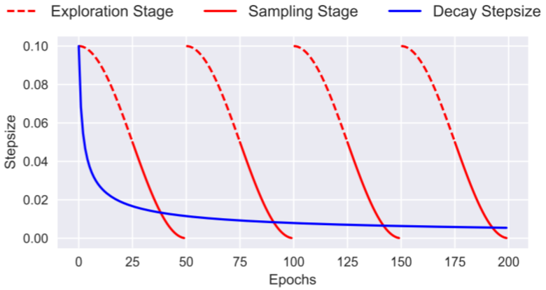
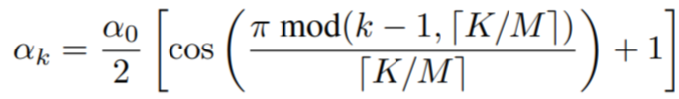
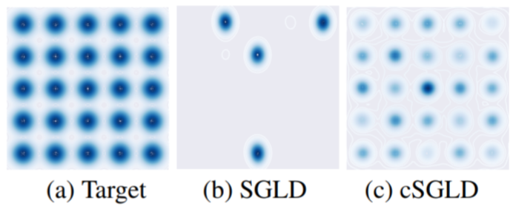
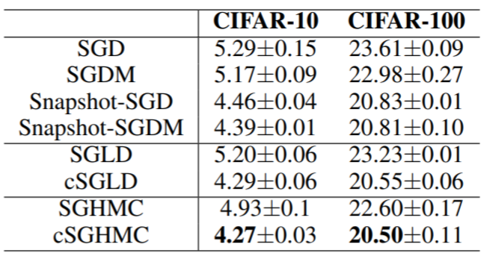
Other Inference Methods for Bayesian Neural Nets
15
SGMCMC methods like SGLD and SGHMC are also used nowadays (very efficient)
Recently, SGMCMC with cyclic step sizes (cSGLD) was proposed (Zhang et al, 2020)
  Use big steps to explore different modes
  Use small steps later to sample once a mode is localized
Step size in iteration $k$
$K$ is the total number of iterations and $M$ is the number of cycles
A complex mixture of Gaussian distributions
Pic from: *Cyclical Stochastic Gradient MCMC for Bayesian Deep Learning (Zhang et al, 2020)

Slide 16
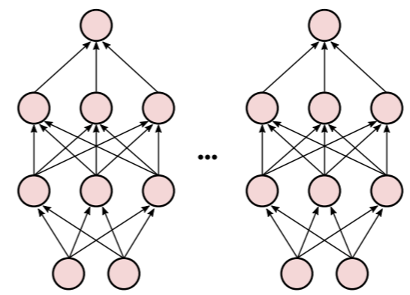
Deep Ensembles
16
Both VI and Sampling may be prone to capturing only a single “Basin of attraction”
Most inference methods tend to produce local approximations only
  VI methods typically learn an approximation around one of the modes
  Sampling methods may give most samples near one of the modes (though in principle they may explore other modes as well)
  Thus the uncertainties may be underestimated in general
Deep Ensembles* is a method that tries to address this issue
  Train the network $M$ times with different seeds and permutations of training data
  Denote the learned weights by $θ_{1},θ_{2},…, θ_{M}$ (assuming these are $M$ modes)
  Approximate the posterior by the following
  This approach is considered non-Bayesian but often performs better (in terms of more diversity in the set of parameters learned) than other inference methods
$$p\left(θ | 𝒟\right)= \frac{1}{M}\sum_{m=1}^{M}{δ_{θ_{m}}(θ)}$$
Akin to Bayesian Model Averaging using $M$ models
*Simple and Scalable Predictive Uncertainty Estimation using Deep Ensembles (Lakshminarayanan, 2017)

