Slide 1
Approx. Inference via Sampling (Contd):
MCMC with Gradients, Recent Advances
CS772A: Probabilistic Machine Learning
Piyush Rai

Slide 2
Plan for today
2
Some other aspects of MCMC
MCMC with gradient
Some other recent advances

Slide 3
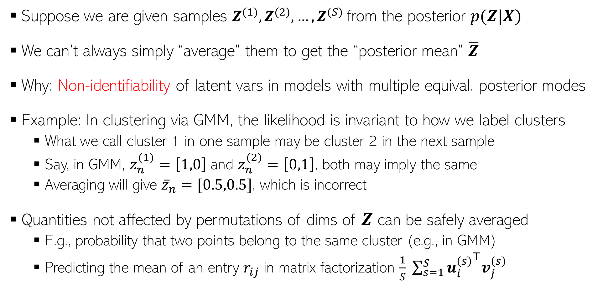

Sampling Methods: Label Switching Issue
3
Suppose we are given samples $Z^{(1)},Z^{(2)},…,Z^{(S)}$from the posterior $p(Z|X)$
We can’t always simply “average” them to get the “posterior mean” $\overline{Z}$
Why: Non-identifiability of latent vars in models with multiple equival. posterior modes
Example: In clustering via GMM, the likelihood is invariant to how we label clusters
  What we call cluster 1 in one sample may be cluster 2 in the next sample
  Say, in GMM, $z_{n}^{(1)}=\left[1,0\right]$ and $z_{n}^{(2)}=\left[0,1\right]$, both may imply the same
  Averaging will give ${\overline{z}}_{n}=[0.5,0.5]$, which is incorrect
Quantities not affected by permutations of dims of $Z$ can be safely averaged
  E.g., probability that two points belong to the same cluster (e.g., in GMM)
  Predicting the mean of an entry $r_{ij}$ in matrix factorization $\frac{1}{S} \sum_{s=1}^{S}{{u_{i}^{\left(s\right)}}^{⊤}v_{j}^{\left(s\right)}}$
One sample may be from near one of the modes and the other may be from near the other mode
Changes in order of entries in these $K× 1$ vectors across different samples doesn’t affect the inner product

Slide 4
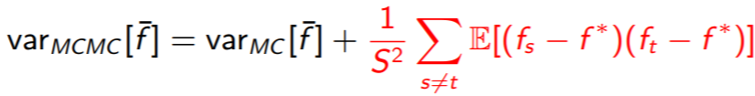
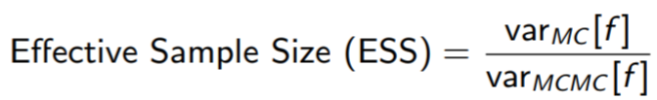
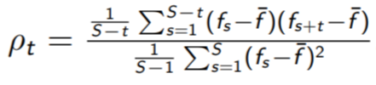


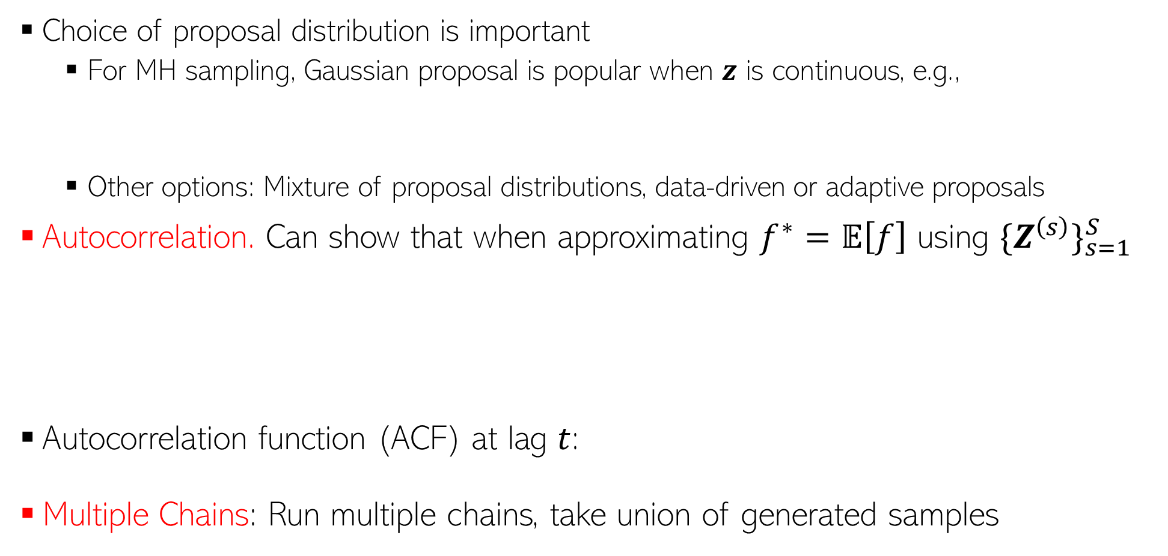

MCMC: Some Practical Aspects
4
Choice of proposal distribution is important
  For MH sampling, Gaussian proposal is popular when $z$ is continuous, e.g.,
  Other options: Mixture of proposal distributions, data-driven or adaptive proposals
Autocorrelation. Can show that when approximating $f^{∗}=𝔼\left[f\right]$ using ${\{Z^{\left(s\right)}\}}_{s=1}^{S}$
Autocorrelation function (ACF) at lag $t$:
Multiple Chains: Run multiple chains, take union of generated samples
Hessian at the MAP of the target distribution
$$q\left(z | z^{\left(ℓ−1\right)}\right)= 𝒩(z|z^{\left(ℓ−1\right)},H)$$
Change at each iter
Basically measures what fractions of the total samples are uncorrelated. Want it to be close to 1
$$\overline{f}= \frac{1}{S}\sum_{s=1}^{S}{f_{s}}$$
Monte Carlo assumes uncorrelated samples
Value of $f$ using $s^{th}$ MCMC sample
Lower is better

Slide 5
Coming Up Next
5
Avoiding the random-walk behavior of MCMC
  Using gradient information of the posterior
Scalable MCMC methods

Slide 6
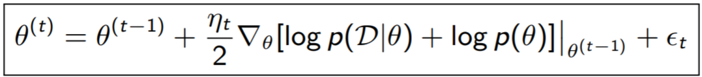

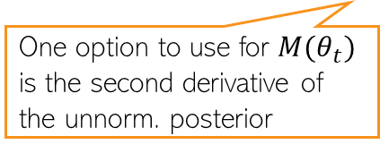
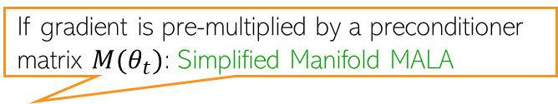

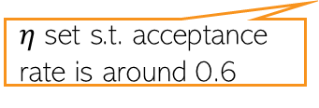

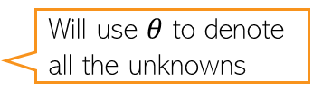
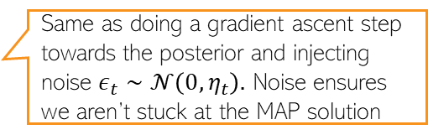
Using Gradients in MCMC: Langevin Dynamics
6
MCMC uses a random-walk based proposal to generate the next sample, e.g.,
Langevin dynamics: Use (unnormalized) posterior’s gradient info in the proposal as
Note that the above is equivalent to
After some waiting period $T_{0}$, iterates ${\left\{θ^{(t)}\right\}}_{t=T_{0}+1}^{T_{0}+S}$ are MCMC samples from $p(θ|𝒟)$
Will use $θ$ to denote all the unknowns
Can use automatic differentiation methods for this
And then accept/reject (MH)
$$θ^{(t)}∼𝒩(θ^{\left(t−1\right)},η_{t})$$
Likelihood
Prior
Move towards the mode of the posterior (like finding MAP est)
And then accept/reject (MH)
$$θ^{(t)}∼𝒩(θ^{∗},η_{t})$$
Same as doing a gradient ascent step towards the posterior and injecting noise $ε_{t}∼𝒩\left(0,η_{t}\right).$ Noise ensures we aren’t stuck at the MAP solution
Using gradient info in the proposal helps us move faster towards high-prob regions
$η$ set s.t. acceptance rate is around 0.6
Helps also incorporate the curvature info of the posterior
If gradient is pre-multiplied by a preconditioner matrix $M(θ_{t})$: Simplified Manifold MALA
And then accept/reject (MH)
One option to use for $M(θ_{t})$ is the second derivative of the unnorm. posterior
Known as Metropolis-Adjusted Langevin Algorithm (MALA)
“Bayesian Learning via Stochastic Gradient Langevin Dynamics” by Welling and Teh (2011)

Slide 7

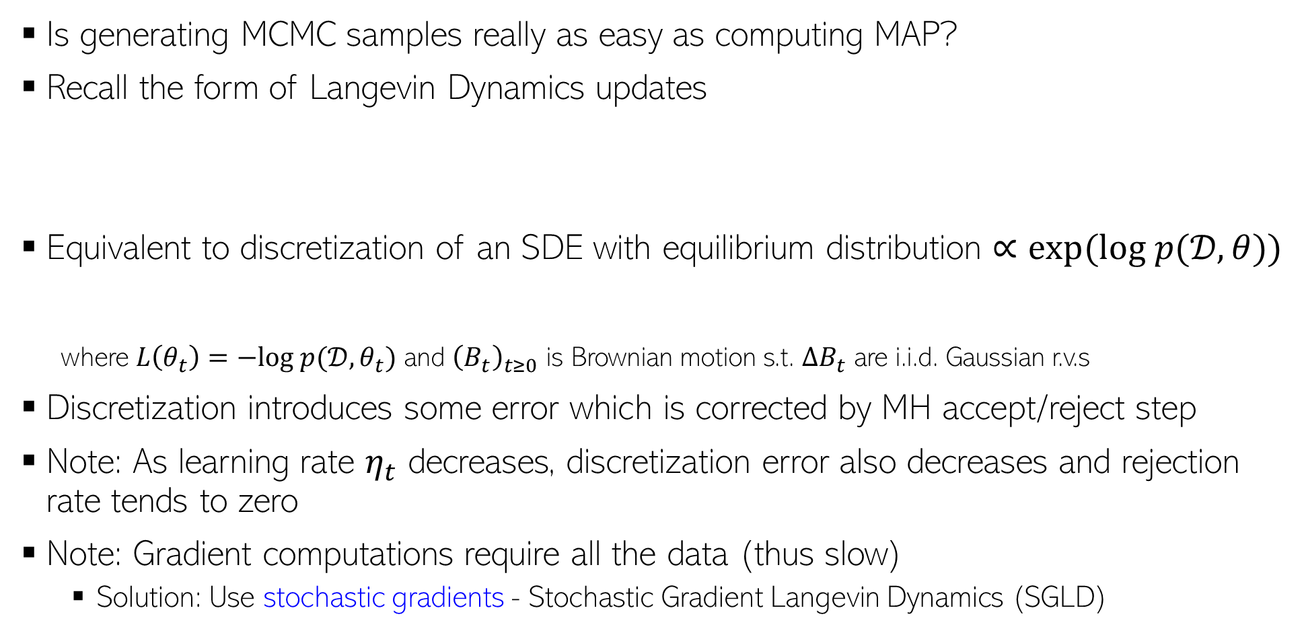
Langevin Dynamics: A Closer Look
7
Is generating MCMC samples really as easy as computing MAP?
Recall the form of Langevin Dynamics updates
Equivalent to discretization of an SDE with equilibrium distribution $∝exp(log p(𝒟,θ))$
where $L\left(θ_{t}\right)=−log p(𝒟,θ_{t})$ and ${\left(B_{t}\right)}_{t≥0}$ is Brownian motion s.t. $ΔB_{t}$ are i.i.d. Gaussian r.v.s
Discretization introduces some error which is corrected by MH accept/reject step
Note: As learning rate $η_{t}$ decreases, discretization error also decreases and rejection rate tends to zero
Note: Gradient computations require all the data (thus slow)
  Solution: Use stochastic gradients - Stochastic Gradient Langevin Dynamics (SGLD)
And then accept/reject (MH)
Same as our target posterior
Above update is its discretiization
Note that this is continuous time
$$dθ_{t}=−∇L\left(θ_{t}\right)dt+ \sqrt{2}dB_{t}$$

Slide 8
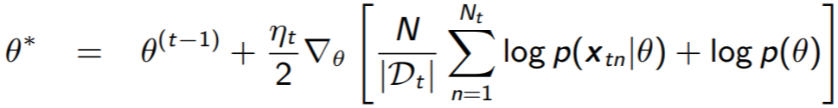

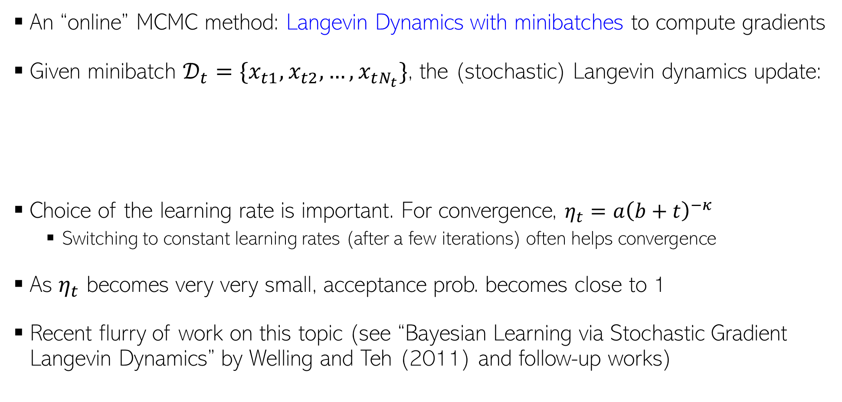
Stochastic Gradient Langevin Dynamics (SGLD)
8
An “online” MCMC method: Langevin Dynamics with minibatches to compute gradients
Given minibatch $𝒟_{t}=\{x_{t1},x_{t2}, …, x_{tN_{t}}\}$, the (stochastic) Langevin dynamics update:
Choice of the learning rate is important. For convergence, $η_{t}=a{\left(b+t\right)}^{−κ}$
  Switching to constant learning rates (after a few iterations) often helps convergence
As $η_{t}$ becomes very very small, acceptance prob. becomes close to 1
Recent flurry of work on this topic (see “Bayesian Learning via Stochastic Gradient Langevin Dynamics” by Welling and Teh (2011) and follow-up works)
Almost as fast as doing SGD updates ☺
And then accept/reject (MH)
$$θ^{(t)}∼𝒩(θ^{∗},η_{t})$$
No need for accept/reject (MH)

Slide 9
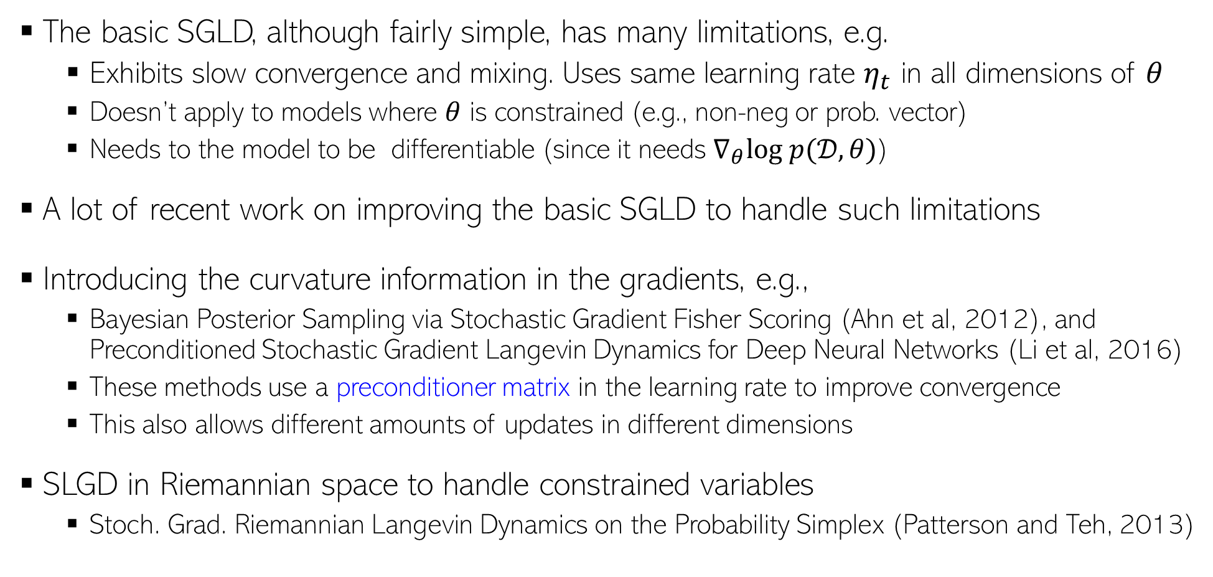
Improvements to SGLD
9
The basic SGLD, although fairly simple, has many limitations, e.g.
  Exhibits slow convergence and mixing. Uses same learning rate $η_{t}$ in all dimensions of $θ$
  Doesn’t apply to models where $θ$ is constrained (e.g., non-neg or prob. vector)
  Needs to the model to be differentiable (since it needs $∇_{θ}log p(𝒟,θ)$)
A lot of recent work on improving the basic SGLD to handle such limitations
Introducing the curvature information in the gradients, e.g.,
  Bayesian Posterior Sampling via Stochastic Gradient Fisher Scoring (Ahn et al, 2012), and Preconditioned Stochastic Gradient Langevin Dynamics for Deep Neural Networks (Li et al, 2016)
  These methods use a preconditioner matrix in the learning rate to improve convergence
  This also allows different amounts of updates in different dimensions
SLGD in Riemannian space to handle constrained variables
  Stoch. Grad. Riemannian Langevin Dynamics on the Probability Simplex (Patterson and Teh, 2013)
Based on reparametrizing the constrained variables to make them unconstrainted

Slide 10
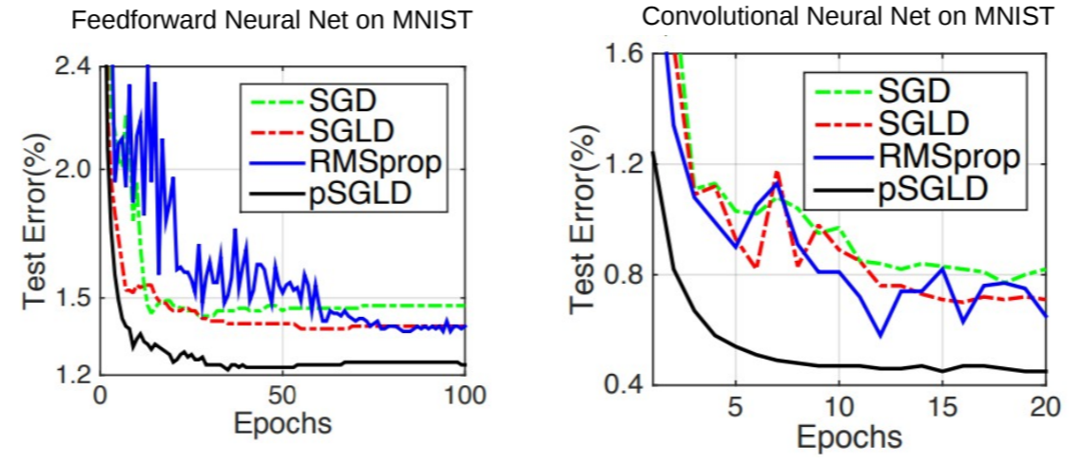
Applications of SGLD
10
Popular for Bayesian neural networks and other complex Bayesian models
Reason: SGLD = backprop based updates + Gaussian noise

Slide 11
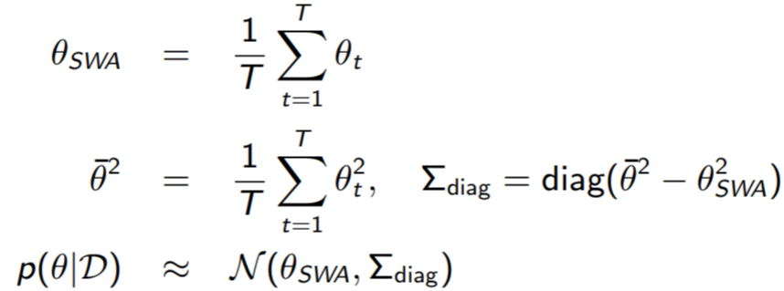
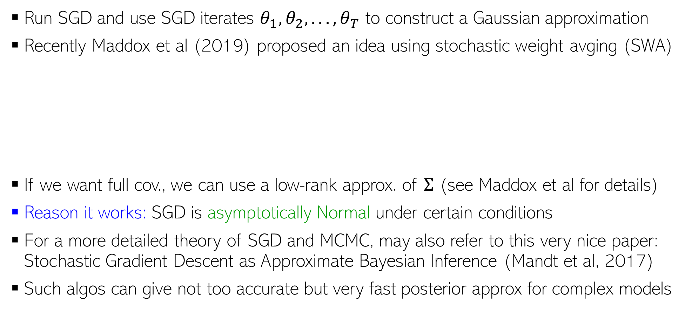
Other Recent “SGD-inspired” Sampling Algorithms
11
Run SGD and use SGD iterates $θ_{1}, θ_{2}, . . . , θ_{T}$ to construct a Gaussian approximation
Recently Maddox et al (2019) proposed an idea using stochastic weight avging (SWA)
If we want full cov., we can use a low-rank approx. of $Σ$ (see Maddox et al for details)
Reason it works: SGD is asymptotically Normal under certain conditions
For a more detailed theory of SGD and MCMC, may also refer to this very nice paper: Stochastic Gradient Descent as Approximate Bayesian Inference (Mandt et al, 2017)
Such algos can give not too accurate but very fast posterior approx for complex models
Approach known as SWA-Gaussian (SWAG)
A Simple Baseline for Bayesian Uncertainty in Deep Learning, Maddox et al (2019)

Slide 12
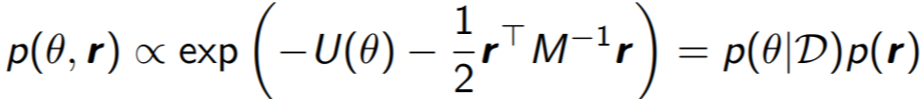
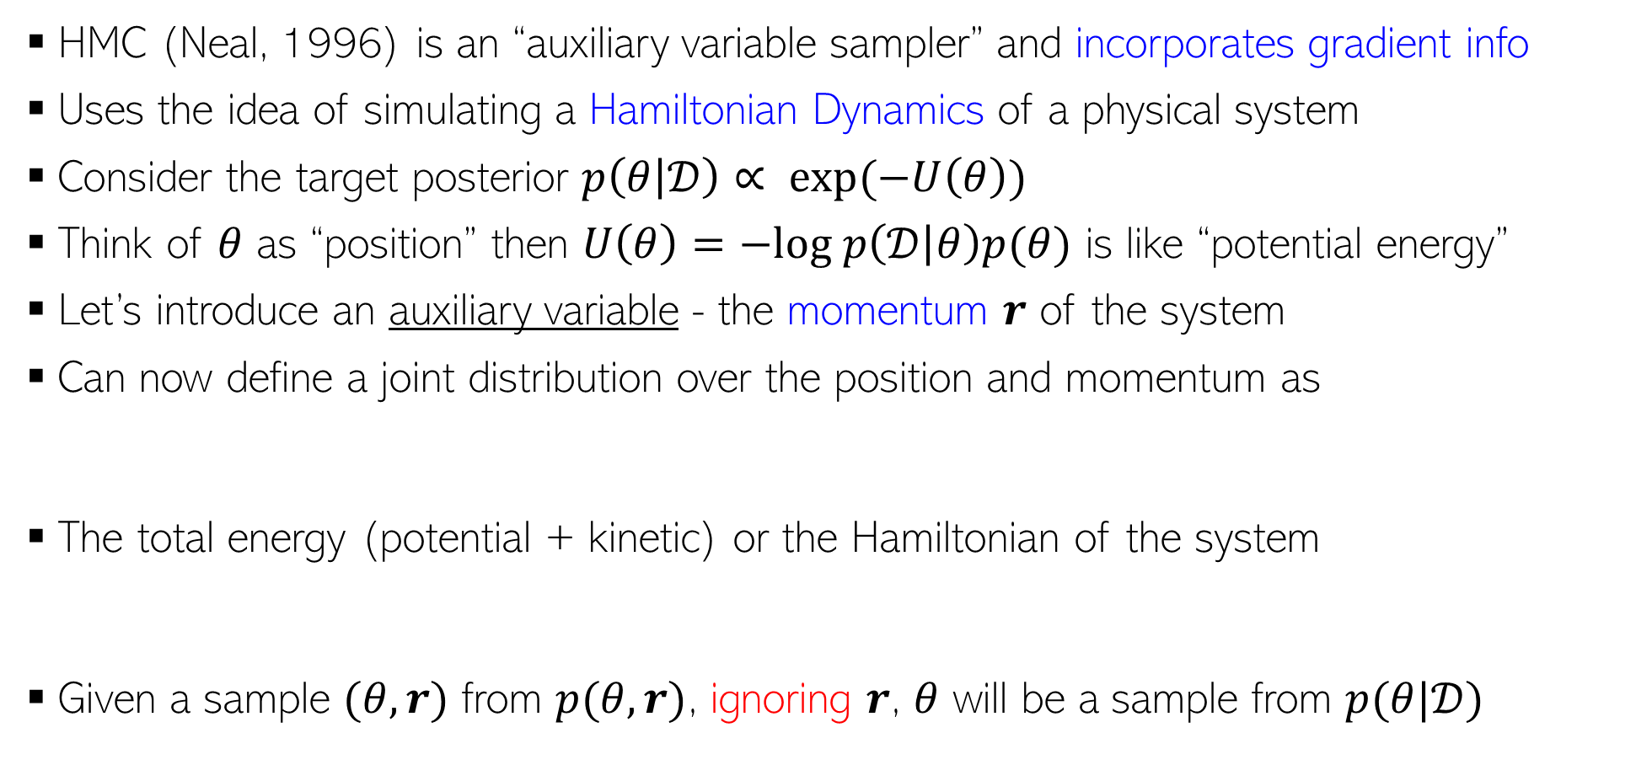
Hamiltonian/Hybrid Monte Carlo (HMC)
12
HMC (Neal, 1996) is an “auxiliary variable sampler” and incorporates gradient info
Uses the idea of simulating a Hamiltonian Dynamics of a physical system
Consider the target posterior $p\left(θ | 𝒟\right)∝ exp(−U\left(θ\right))$
Think of $θ$ as “position” then $U\left(θ\right)=−log p\left(𝒟 | θ\right)p(θ)$ is like “potential energy”
Let’s introduce an auxiliary variable - the momentum $r$ of the system
Can now define a joint distribution over the position and momentum as
The total energy (potential + kinetic) or the Hamiltonian of the system
Given a sample $(θ,r)$ from $p(θ,r)$, ignoring $r$, $θ$ will be a sample from $p(θ|𝒟)$
Constant w.r.t. time

Slide 13
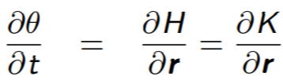



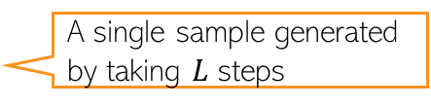
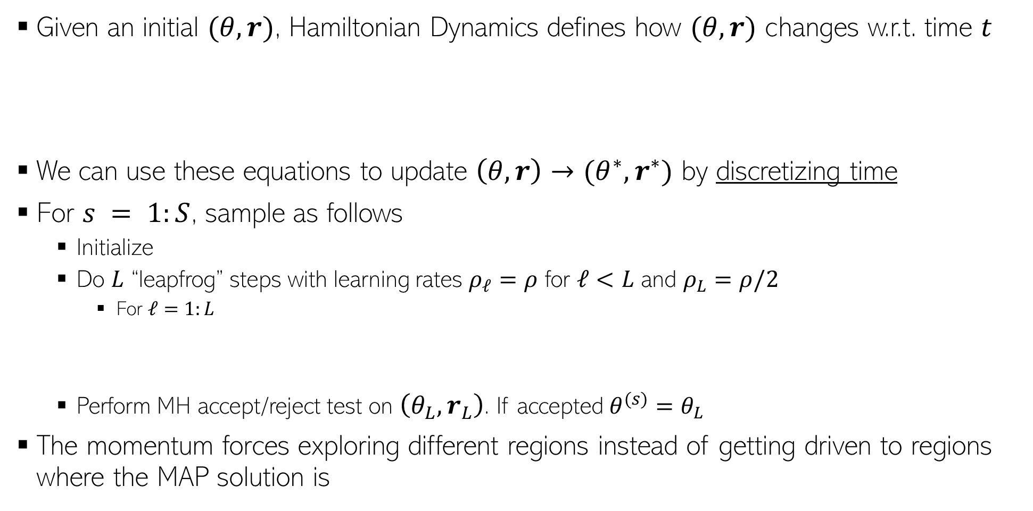
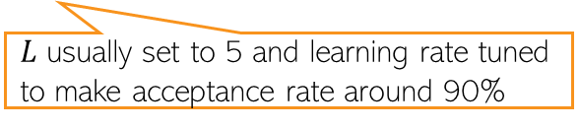
Generating Samples in HMC
13
Given an initial $(θ,r)$, Hamiltonian Dynamics defines how $(θ,r)$ changes w.r.t. time $t$
We can use these equations to update $\left(θ,r\right)→(θ^{∗},r^{∗})$ by discretizing time
For $s = 1:S$, sample as follows
  Initialize
  Do $L$ “leapfrog” steps with learning rates $ρ_{ℓ}=ρ$ for $ℓ<L$ and $ρ_{L}=ρ/2$
    For $ℓ=1:L$
  Perform MH accept/reject test on $\left(θ_{L},r_{L}\right)$. If accepted $θ^{(s)}=θ_{L}$
The momentum forces exploring different regions instead of getting driven to regions where the MAP solution is
Reason: Getting analytical solutions for the above requires integrals which is in general intractable
$L$ usually set to 5 and learning rate tuned to make acceptance rate around 90%
A single sample generated by taking $L$ steps

Slide 14
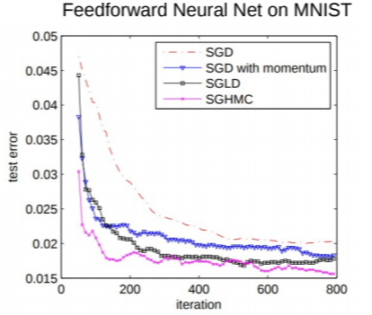
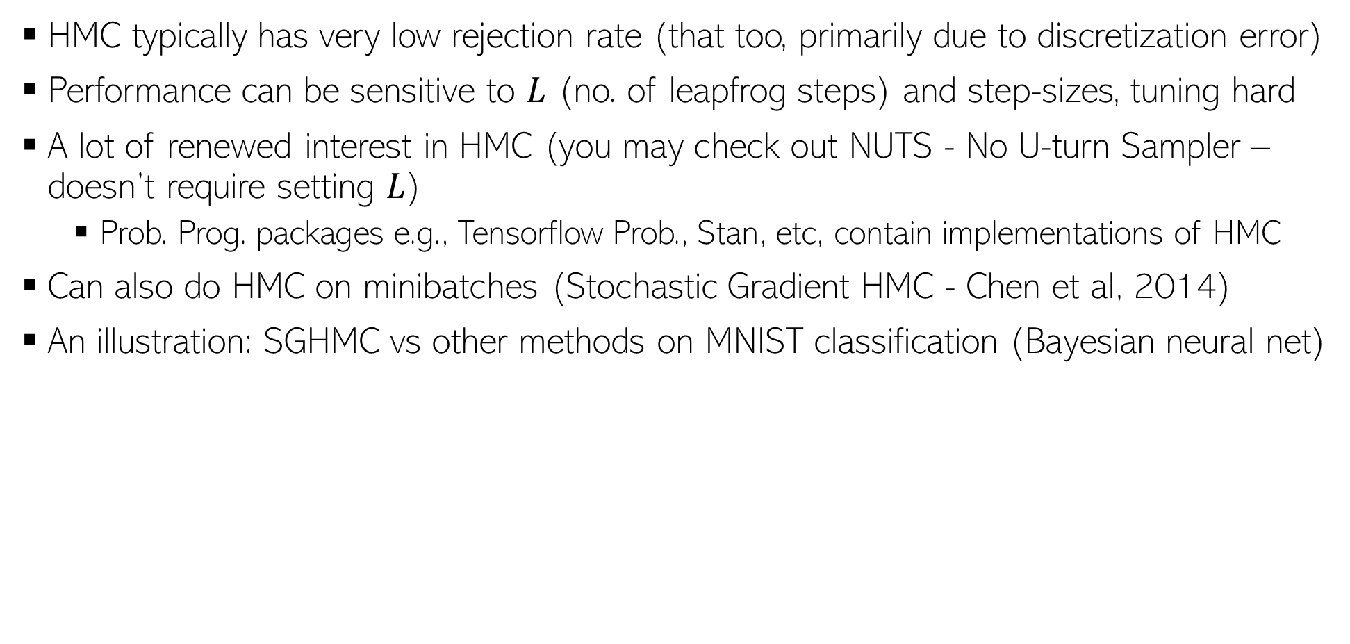
HMC in Practice
14
HMC typically has very low rejection rate (that too, primarily due to discretization error)
Performance can be sensitive to $L$ (no. of leapfrog steps) and step-sizes, tuning hard
A lot of renewed interest in HMC (you may check out NUTS - No U-turn Sampler – doesn’t require setting $L$)
  Prob. Prog. packages e.g., Tensorflow Prob., Stan, etc, contain implementations of HMC
Can also do HMC on minibatches (Stochastic Gradient HMC - Chen et al, 2014)
An illustration: SGHMC vs other methods on MNIST classification (Bayesian neural net)

Slide 15
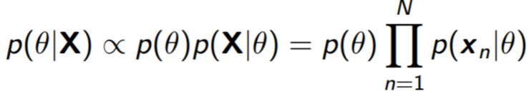
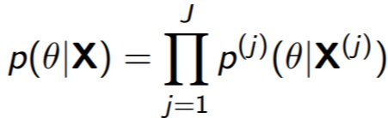

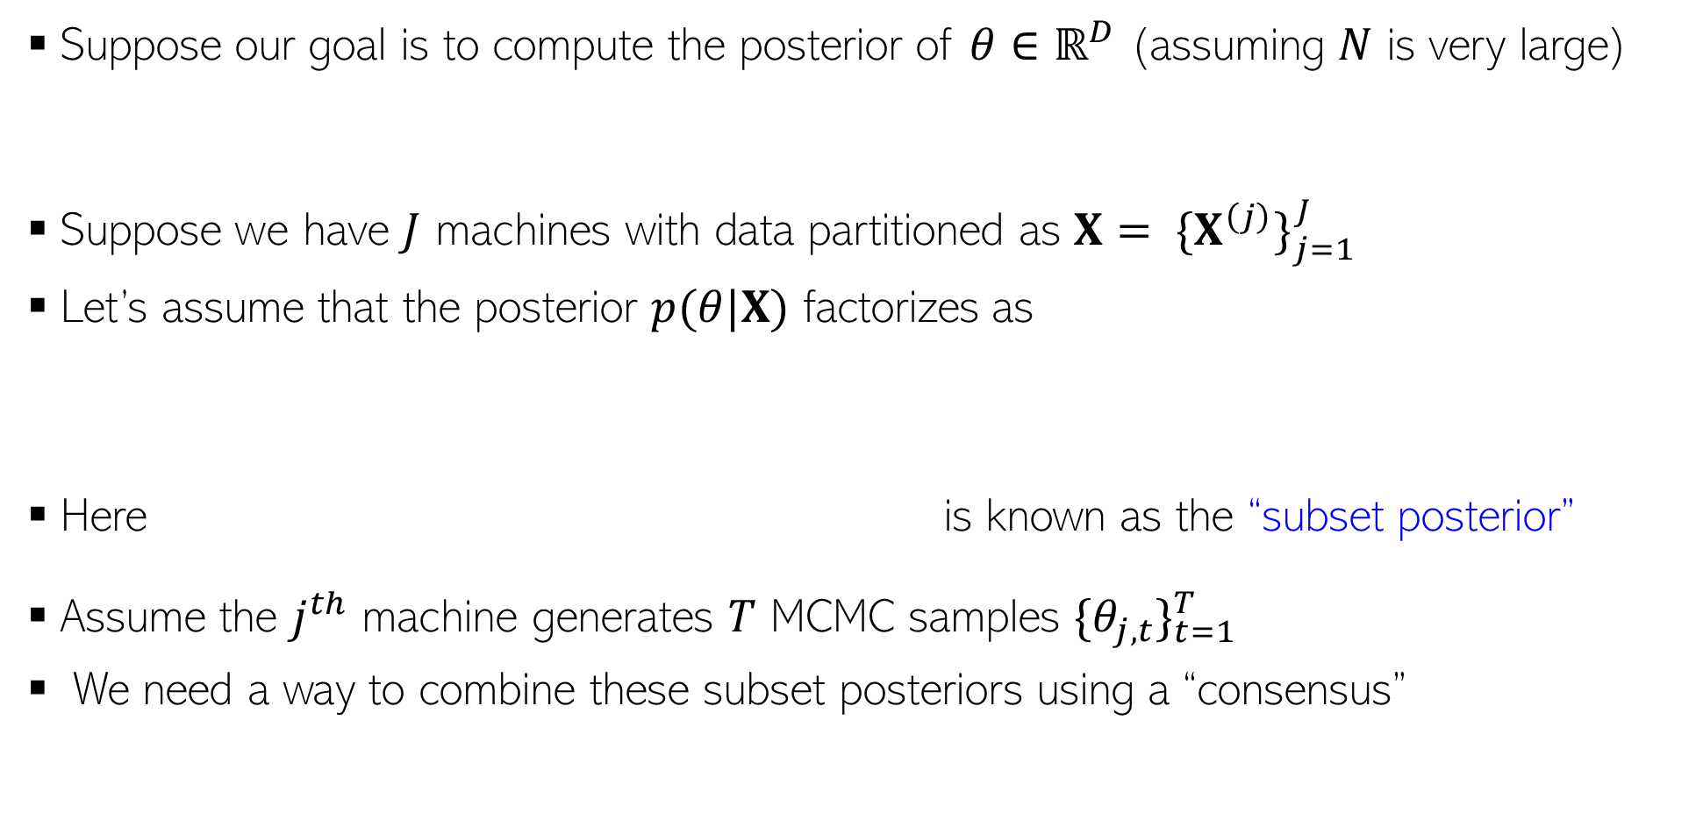
Parallel/Distributed MCMC
15
Suppose our goal is to compute the posterior of $θ∈ℝ^{D}$ (assuming $N$ is very large)
Suppose we have $J$ machines with data partitioned as $X= {\{X^{\left(j\right)}\}}_{j=1}^{J}$
Let’s assume that the posterior $p(θ|X)$ factorizes as
Here is known as the “subset posterior”
Assume the $j^{th}$ machine generates $T$ MCMC samples ${\{θ_{j,t}\}}_{t=1}^{T}$
We need a way to combine these subset posteriors using a “consensus”

Slide 16
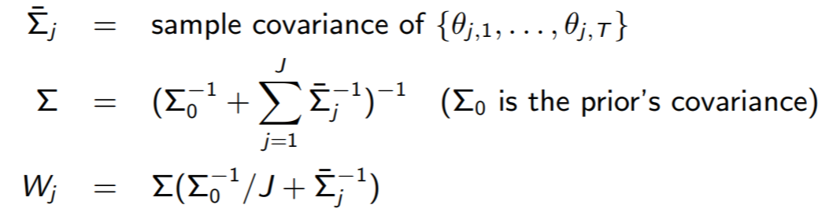

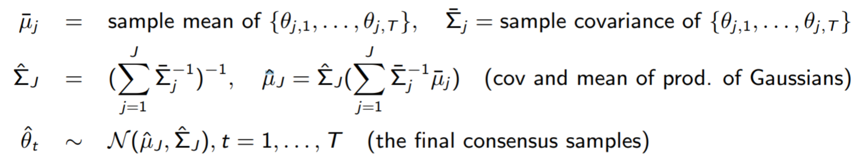
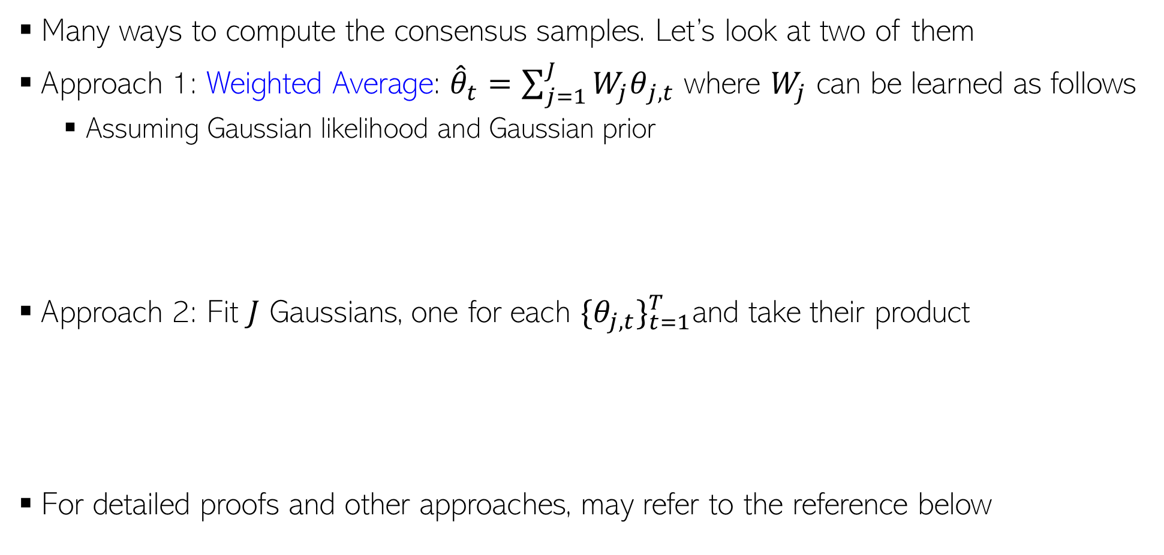
Parallel/Distributed MCMC
16
Many ways to compute the consensus samples. Let’s look at two of them
Approach 1: Weighted Average: ${\hat{θ}}_{t}=\sum_{j=1}^{J}{{W_{j}θ}_{j,t}}$ where $W_{j}$ can be learned as follows
  Assuming Gaussian likelihood and Gaussian prior
Approach 2: Fit $J$ Gaussians, one for each ${\{θ_{j,t}\}}_{t=1}^{T}$and take their product
For detailed proofs and other approaches, may refer to the reference below
These approaches can also be used to make VI parallel/distributed
Patterns of Scalable Bayesian Inference (Angelino et al, 2016)

Slide 17
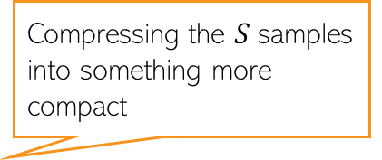

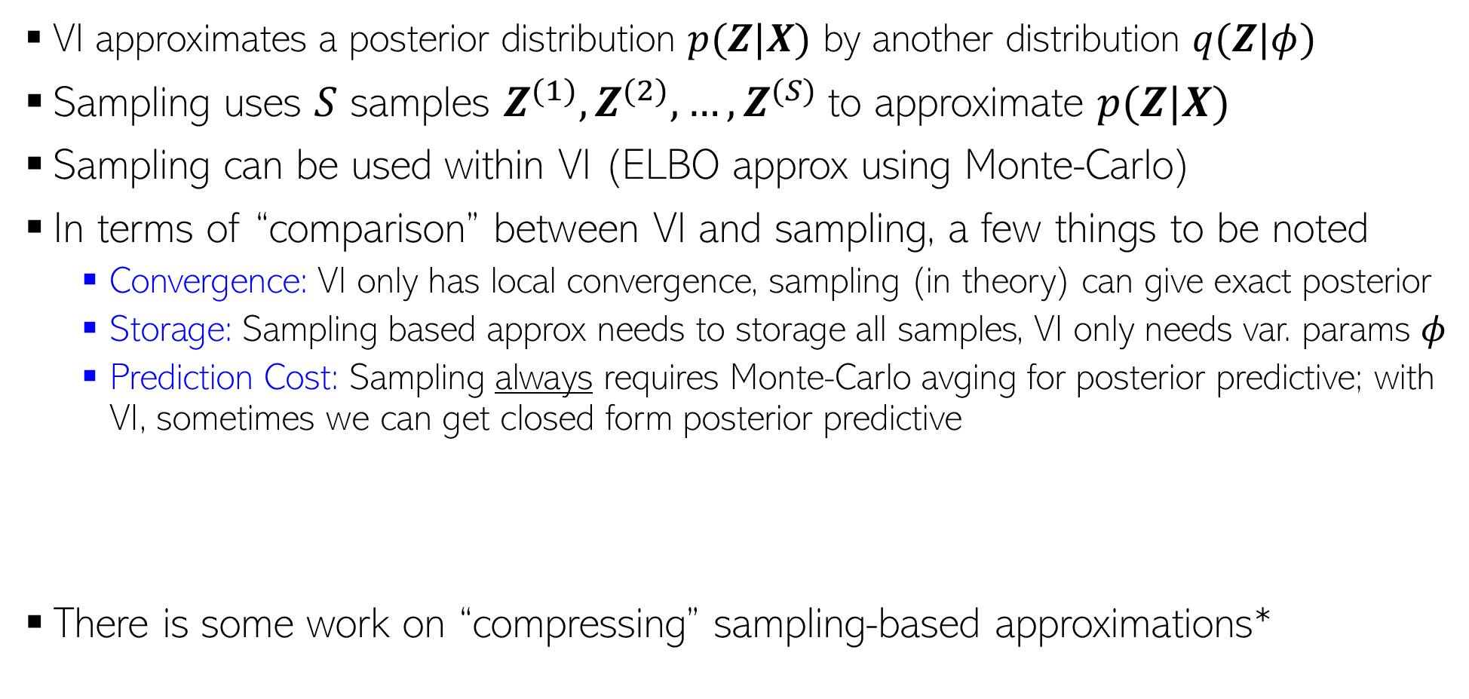
Approximate Inference: VI vs Sampling
17
VI approximates a posterior distribution $p(Z|X)$ by another distribution $q(Z|φ)$
Sampling uses $S$ samples $Z^{(1)},Z^{(2)},…,Z^{(S)}$to approximate $p(Z|X)$
Sampling can be used within VI (ELBO approx using Monte-Carlo)
In terms of “comparison” between VI and sampling, a few things to be noted
  Convergence: VI only has local convergence, sampling (in theory) can give exact posterior
  Storage: Sampling based approx needs to storage all samples, VI only needs var. params $φ$
  Prediction Cost: Sampling always requires Monte-Carlo avging for posterior predictive; with VI, sometimes we can get closed form posterior predictive
There is some work on “compressing” sampling-based approximations*
PPD if using sampling:
$$p\left(x_{∗} | X\right)=∫p\left(x_{∗} | Z\right)p\left(Z | X\right)dZ≈\frac{1}{S}\sum_{s=1}^{S}{p\left(x_{∗} | Z^{\left(s\right)}\right)}$$
Compressing the $S$samples into something more compact
PPD if using VI:
$$p\left(x_{∗} | X\right)=∫p\left(x_{∗} | Z\right)p\left(Z | X\right)dZ≈∫p\left(x_{∗} | Z\right)q\left(Z | φ\right)dZ$$
*”Compact approximations to Bayesian predictive distributions” by Snelson and Ghaharamani, 2005; and “Bayesian Dark Knowledge” by Korattikara et al, 2015

Slide 18
Inference Methods: Summary
18
MLE/MAP: Straightforward for differentiable models (can even use automatic diff.)
Conjugate models with one “main” parameter: Straightforward posterior updates
MLE-II/MAP-II: Often useful for estimating the hyperparameters
EM: If we want to do MLE/MAP for models with latent variables
  Very general algorithm, can also be made online
  Used when we want point estimates for some unknowns and posterior over others
  Can use it for hyperparameter estimation as well
  Often better than using direct gradient methods
VI and sampling methods can be used to get full posterior for complex models
  Quite easy if we have local conjugacy (VI has closed form updates, Gibbs sampler is easy to derive)
  In other cases, we have general VI with Monte-Carlo gradients, MH sampling
  MCMC can also make use of gradient info (LD/SGLD)
For large-scale problems, online/distributed VI/MCMC, or SGD based posterior approx

