Slide 1
Approx. Inference via Sampling (Contd):
Metropolis Hastings and Gibbs Sampling
CS772A: Probabilistic Machine Learning
Piyush Rai

Slide 2
Plan for today
2
MCMC algorithms
  Metropolis Hastings (MH)
  Gibbs sampling (special case of MH)
  Some examples of Gibbs sampling

Slide 3
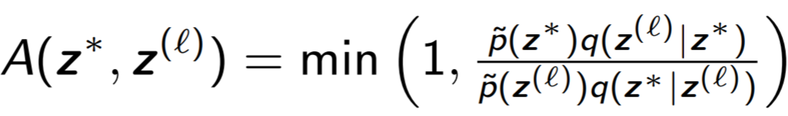



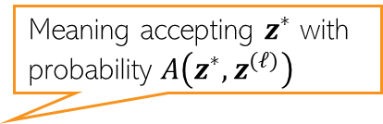
The MH Sampling Algorithm
3
Initialize $z^{(1)}$ randomly
For $ℓ=1,2,…, L$
  Sample $z^{∗}∼q(z^{∗}|z^{(ℓ)})$ and $u∼Unif(0,1)$
  Compute acceptance probability
  If $A\left(z^{∗},z^{(ℓ)}\right)>u$
  Else
Meaning accepting $z^{∗}$ with probability $A\left(z^{∗},z^{(ℓ)}\right)$
$$z^{(ℓ+1)}=z^{∗}$$
$$z^{(ℓ+1)}=z^{(ℓ)}$$

Slide 4
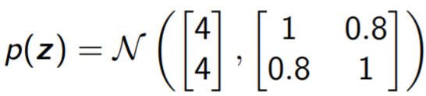
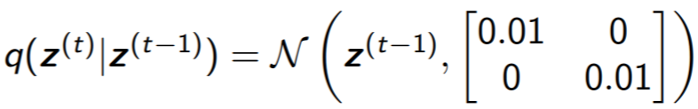
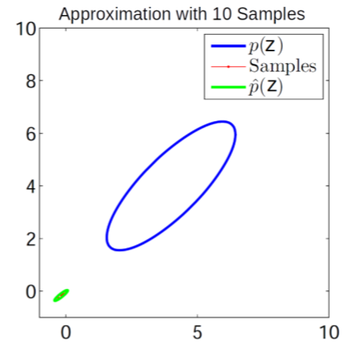
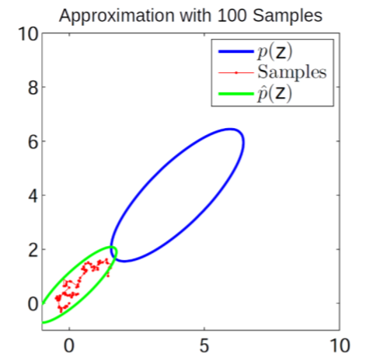
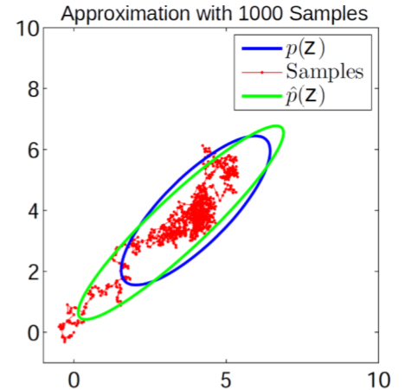
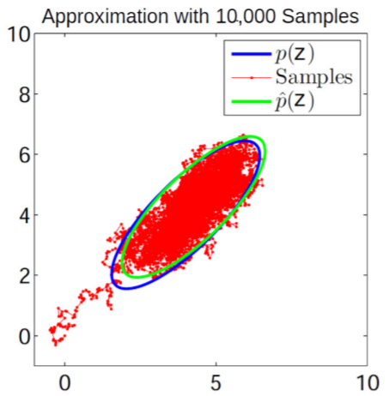
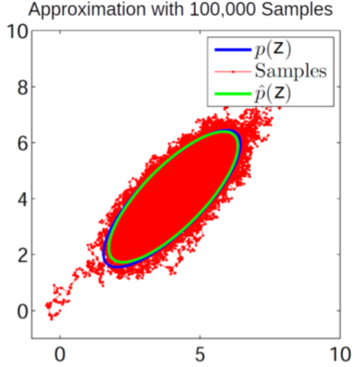
MH Sampling in Action: A Toy Example..
4
Target distribution
Proposal distribution

Slide 5
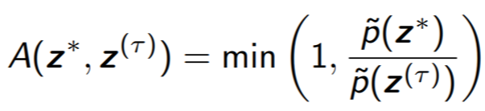
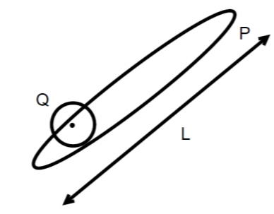

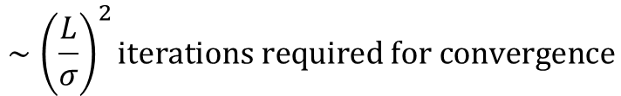
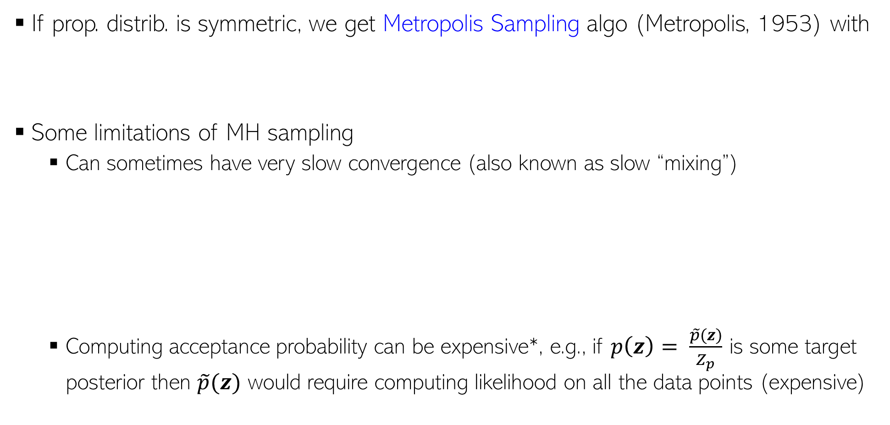


MH Sampling: Some Comments
5
If prop. distrib. is symmetric, we get Metropolis Sampling algo (Metropolis, 1953) with
Some limitations of MH sampling
  Can sometimes have very slow convergence (also known as slow “mixing”)
  Computing acceptance probability can be expensive*, e.g., if $p\left(z\right)= \frac{\tilde{p}(z)}{Z_{p}}$ is some target posterior then $\tilde{p}(z)$ would require computing likelihood on all the data points (expensive)
$$Q\left(z | z^{\left(τ\right)}\right)=𝒩(z|z^{\left(τ\right)},σ^{2}I)$$
$$∼{\left(\frac{L}{σ}\right)}^{2}iterations required for convergence$$
$$σ large⇒many rejections$$
$$σ small⇒slow diffusion$$
*Austerity in MCMC Land: Cutting the Metropolis-Hastings Budget (Korattikara et al, 2014), Firefly Monte Carlo: Exact MCMC with Subsets of Data {(Maclaurin and Adams, 2015)

Slide 6
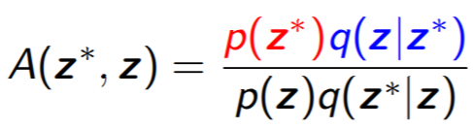
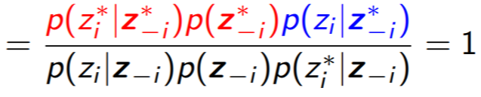
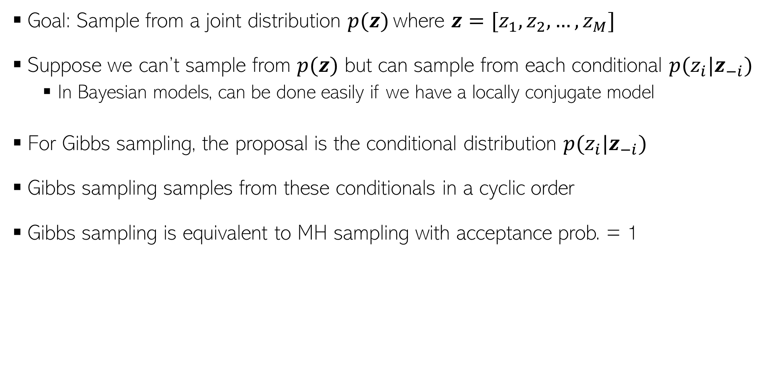
Gibbs Sampling (Geman & Geman, 1984)
6
Goal: Sample from a joint distribution $p(z)$ where $z=[z_{1},z_{2},…, z_{M}]$
Suppose we can’t sample from $p(z)$ but can sample from each conditional $p(z_{i}|z_{−i})$
  In Bayesian models, can be done easily if we have a locally conjugate model
For Gibbs sampling, the proposal is the conditional distribution $p(z_{i}|z_{−i})$
Gibbs sampling samples from these conditionals in a cyclic order
Gibbs sampling is equivalent to MH sampling with acceptance prob. = 1
Hence no need to compute it
Since only one component is changed at a time

Slide 7
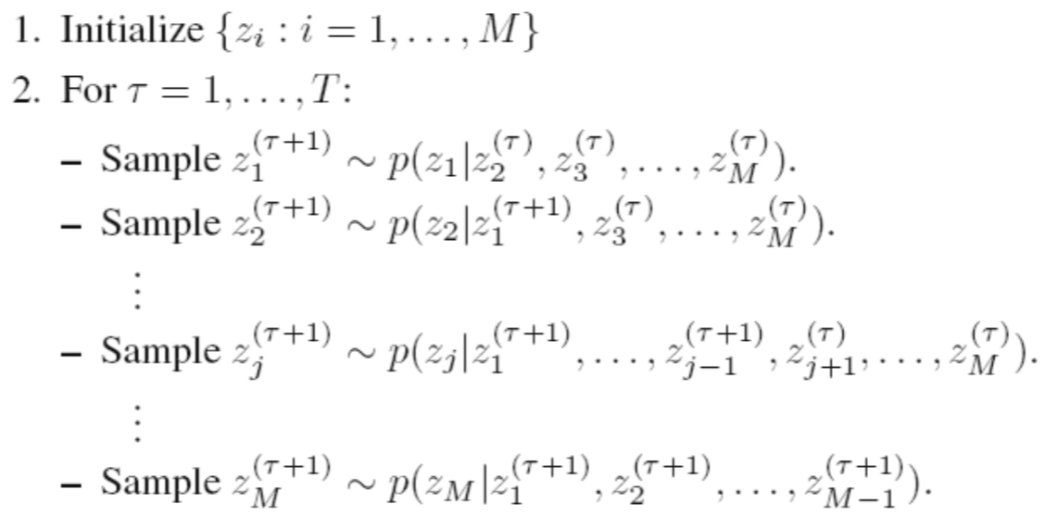

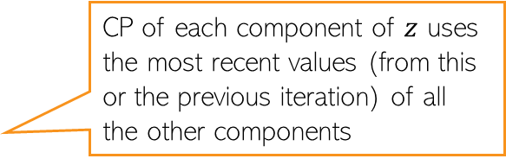

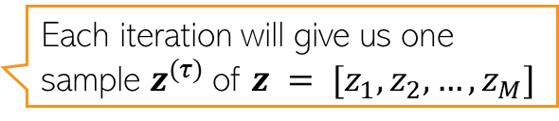
Gibbs Sampling: Sketch of the Algorithm
7
$M$: Total number of variables, $T$: number of Gibbs sampling iterations
Note: Order of updating the variables usually doesn’t matter (but see “Scan Order in Gibbs Sampling: Models in Which it Matters and Bounds on How Much” from NIPS 2016)
Assuming $z = [z_{1}, z_{2}, …, z_{M}]$
CP of each component of $z$ uses the most recent values (from this or the previous iteration) of all the other components
Each iteration will give us one sample $z^{(τ)}$of $z = [z_{1}, z_{2}, …, z_{M}]$

Slide 8
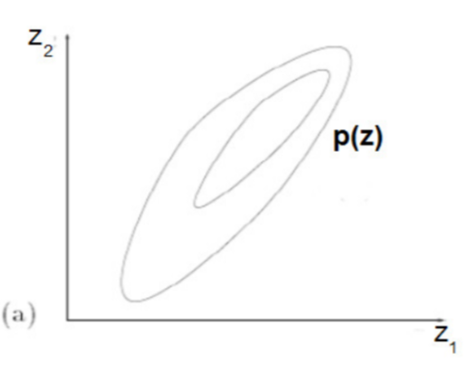
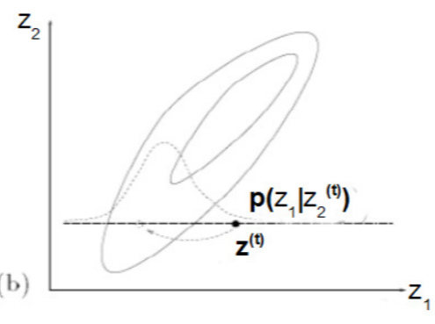
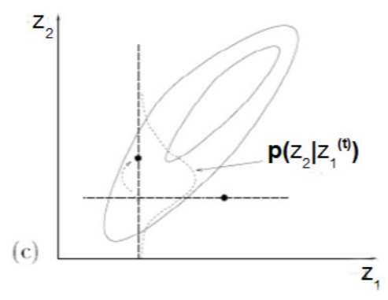
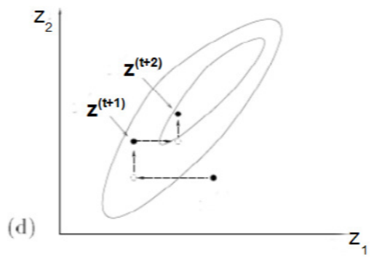
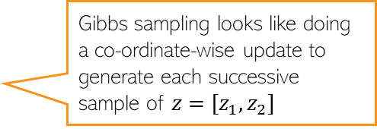
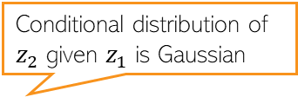

Gibbs Sampling: A Simple Example
8
Can sample from a 2-D Gaussian using 1-D Gaussians
Contours of a 2-D Gaussian
Conditional distribution of $z_{1}$ given $z_{2}$ is Gaussian
Conditional distribution of $z_{2}$ given $z_{1}$ is Gaussian
Gibbs sampling looks like doing a co-ordinate-wise update to generate each successive sample of $z=[z_{1},z_{2}]$

Slide 9
Gibbs Sampling: Some Comments
9
One of the most popular MCMC algorithms
Very easy to derive and implement for locally conjugate models
Many variations exist, e.g.,
  Blocked Gibbs: sample more than one component jointly (sometimes possible)
  Rao-Blackwellized Gibbs: Can collapse (i.e., integrate out) the unneeded components while sampling. Also called “collapsed” Gibbs sampling
  MH within Gibbs: If CPs are not easy to sample distributions
Instead of sampling from CPs, an alternative is to use the mode of the CPs
  Called the “Iterative Conditional Mode” (ICM) algorithm
  ICM doesn’t give the posterior though – it’s more like ALT-OPT to get (approx) MAP estimate

Slide 10
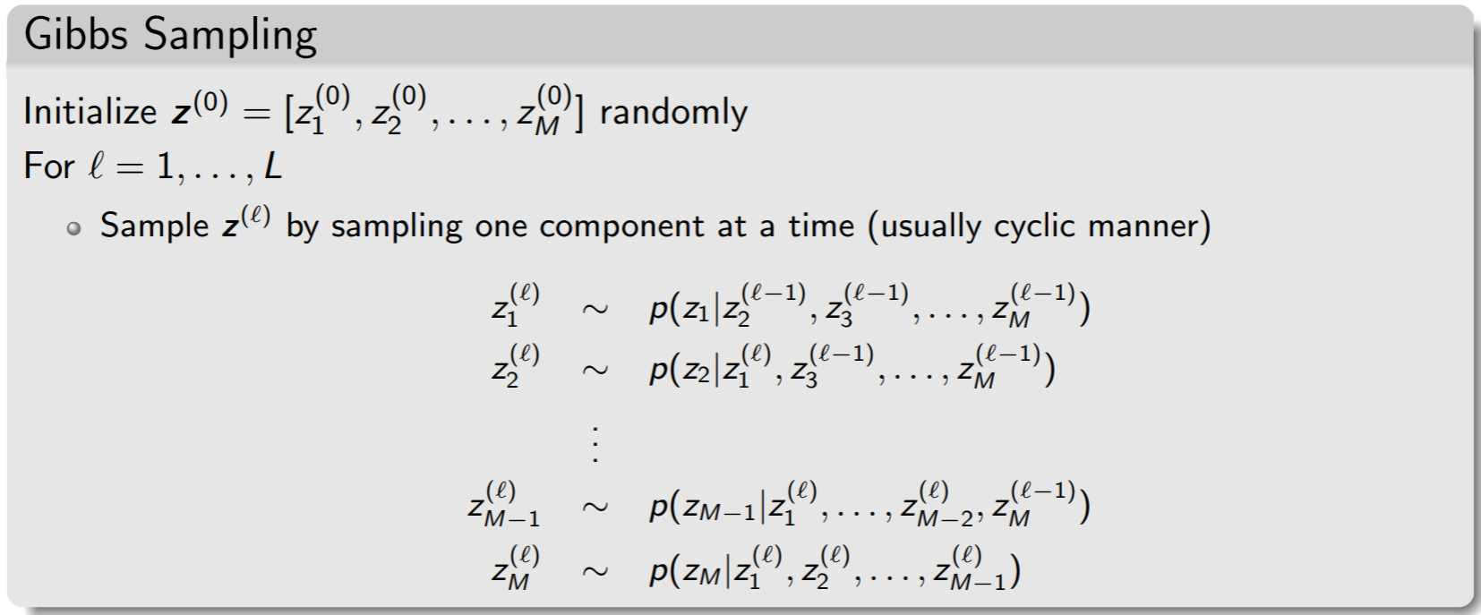



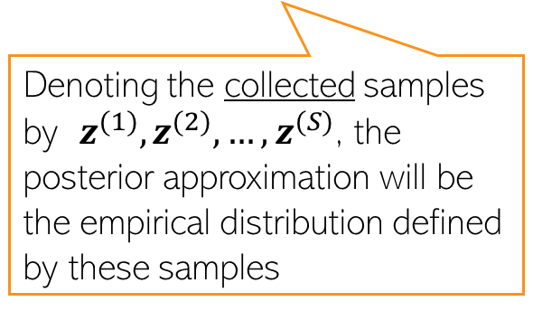
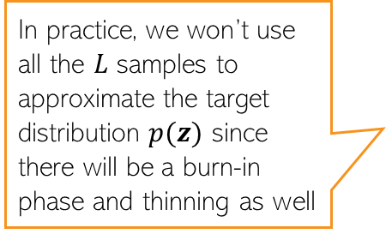
Recap: Gibbs Sampling
10
An instance of MH sampling where the acceptance probability = 1
Based on sampling $z$ one “component” at a time with proposal = conditional distr.
Very easy to derive if the conditional distributions are easy to obtain
In practice, we won’t use all the $L$ samples to approximate the target distribution $p(z)$ since there will be a burn-in phase and thinning as well
Denoting the collected samples by $z^{(1)},z^{(2)},…,z^{(S)}$, the posterior approximation will be the empirical distribution defined by these samples
$$z^{(ℓ)}$$

Slide 11
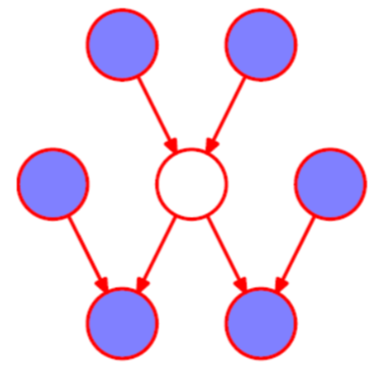
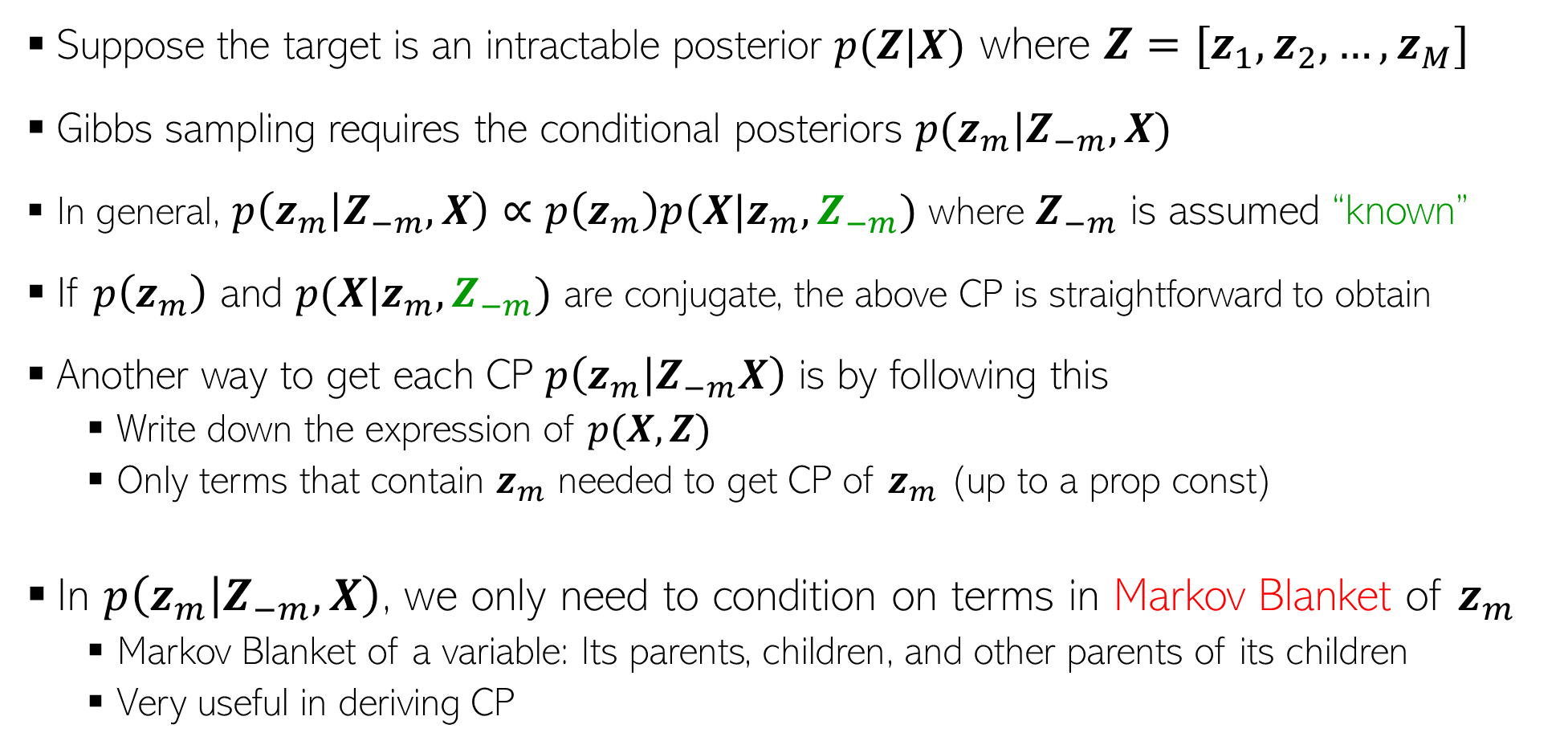
Deriving A Gibbs Sampler: The General Recipe
11
Suppose the target is an intractable posterior $p(Z|X)$ where $Z=[z_{1},z_{2},…, z_{M}]$
Gibbs sampling requires the conditional posteriors $p(z_{m}|Z_{−m},X)$
In general, $p\left(z_{m} | Z_{−m},X\right)∝p\left(z_{m}\right)p(X|z_{m},Z_{−m})$ where $Z_{−m}$ is assumed “known”
If $p\left(z_{m}\right)$ and $p(X|z_{m},Z_{−m})$ are conjugate, the above CP is straightforward to obtain
Another way to get each CP $p\left(z_{m} | Z_{−m}X\right)$ is by following this
  Write down the expression of $p(X,Z)$
  Only terms that contain $z_{m}$ needed to get CP of $z_{m}$ (up to a prop const)
In $p\left(z_{m} | Z_{−m},X\right)$, we only need to condition on terms in Markov Blanket of $z_{m}$
  Markov Blanket of a variable: Its parents, children, and other parents of its children
  Very useful in deriving CP
Markov Blanket

Slide 12
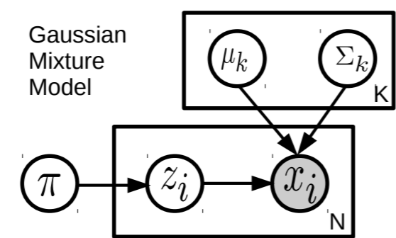
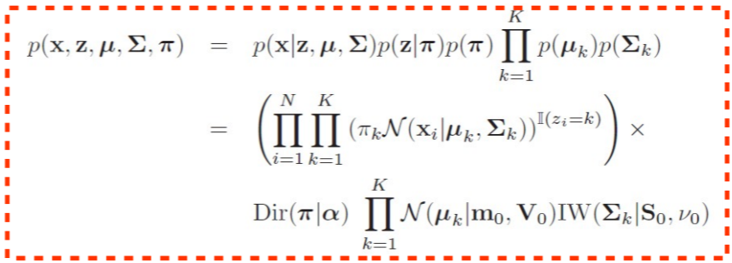
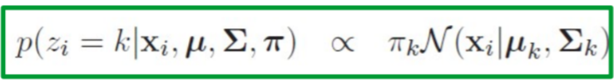
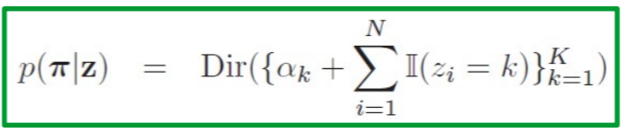
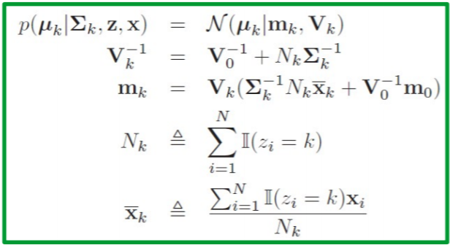
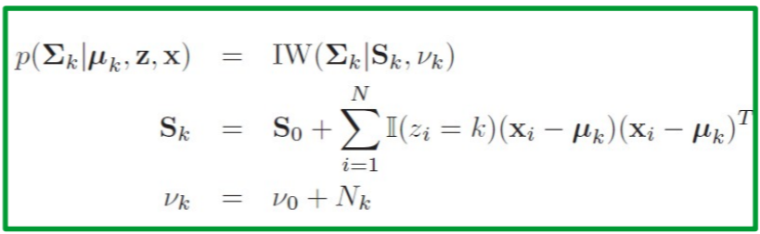
Gibbs Sampling: An Example
12
The CPs for the Gibbs sampler for a GMM are as shown in green rectangles below
Joint distribution of data and unknowns
Can verify that Markov Blanket property holds for each CP

Slide 13
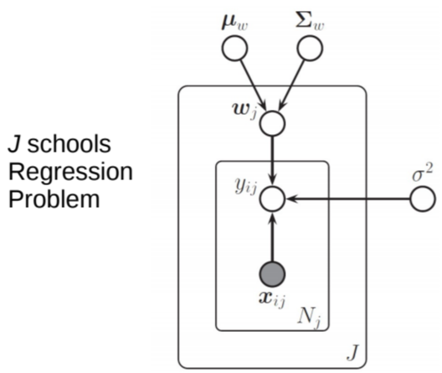
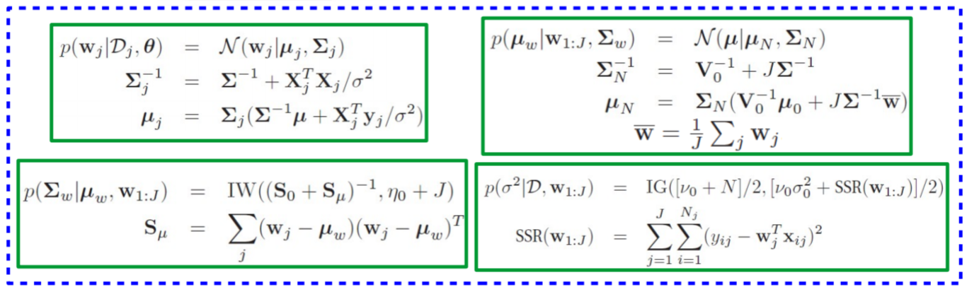

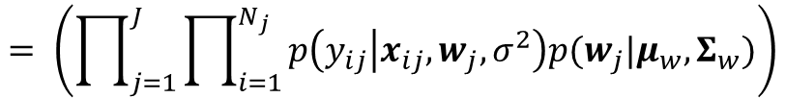




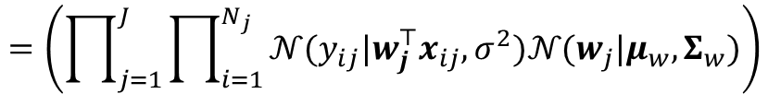
Gibbs Sampling: Another Example
13
$$p\left(Y,{\left\{w_{j}\right\}}_{j=1}^{J}μ_{w},Σ_{w},σ^{2} | X\right)$$
Joint distribution of data and unknowns
$$= \left(\prod_{j=1}^{J}{\prod_{i=1}^{N_{j}}{p\left(y_{ij} | x_{ij},w_{j},σ^{2}\right)p(w_{j}|μ_{w},Σ_{w})}}\right)$$
$$p\left(μ_{w}\right)p\left(Σ_{w}\right)p\left(σ^{2}\right)$$
$$=\left(\prod_{j=1}^{J}{\prod_{i=1}^{N_{j}}{𝒩(y_{ij}|w_{j}^{⊤}x_{ij},σ^{2})𝒩(w_{j}|μ_{w},Σ_{w})}}\right)$$
$$𝒩(μ_{w}|μ_{0},V_{0})$$
$$IW(Σ_{w}|η_{0},S_{0}^{−1})$$
$$IG(σ^{2}|ν_{0}/2,ν_{0}σ_{0}^{2}/2)$$
Can verify that Markov Blanket property holds for each CP

Slide 14







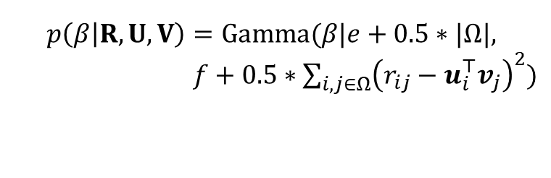




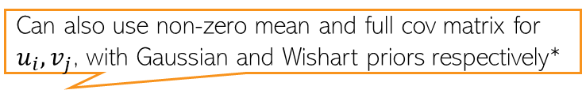





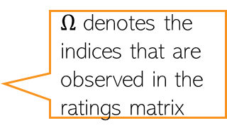
Gibbs Sampling: One More Example
14
$$p(R,{\left\{u_{i}\right\}}_{i=1}^{N},{\left\{v_{j}\right\}}_{j=1}^{M},λ_{u},λ_{v}, β)$$
Joint distribution of data and unknowns
Assuming even the hyperparams to be unknown
$$N$$
$$λ_{u}$$
$$u_{i}$$
$$=\prod_{(i,j)∈Ω}{p\left(r_{ij} | u_{i},v_{j},β\right) \prod_{i}{p\left(u_{i} | λ_{u}\right)}\prod_{j}{p\left(v_{j} | λ_{v}\right)}p\left(λ_{u}\right)p\left(λ_{v}\right)p(β)}$$
Can also use non-zero mean and full cov matrix for $u_{i}, v_{j}$, with Gaussian and Wishart priors respectively*
$$β$$
$$r_{ij}$$
$$v_{i}$$
$$λ_{v}$$
$$=\prod_{(i,j)∈Ω}{𝒩\left(r_{ij} | u_{i}^{⊤}v_{j},β\right) \prod_{i}{𝒩\left(u_{i} | 0,λ_{u}^{−1}I\right)}\prod_{j}{𝒩\left(v_{j} | 0,λ_{v}^{−1}I\right)}}$$
$$M$$
Bayesian Matrix Factorization
$$Gamma(λ_{u}|a,b)Gamma(λ_{v}|c,d)Gamma(β|e,f)$$
Can verify that Markov Blanket property holds for each CP
$$p\left(λ_{u} | U\right)=Gamma(λ_{u}|a+0.5∗NK,b+0.5∗\sum_{i=1}^{N}{u_{i}^{⊤}u_{i}})$$
$Ω$ denotes the indices that are observed in the ratings matrix
$$p\left(β | R,U,V\right)=Gamma(β|e+0.5∗|Ω|,$$
$f+0.5∗\sum_{i,j∈Ω}{{\left(r_{ij}−u_{i}^{⊤}v_{j}\right)}^{2}})$
$$p\left(λ_{v} | V\right)=Gamma(λ_{v}|c+0.5∗MK,d+0.5∗\sum_{j=1}^{M}{v_{j}^{⊤}v_{j}})$$
*Bayesian Probabilistic Matrix Factorization using Markov Chain Monte Carlo (Salakhutdinov and Mnih, 2008)

Slide 15
MCMC: Some Other Aspects
15

Slide 16
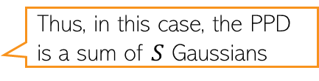
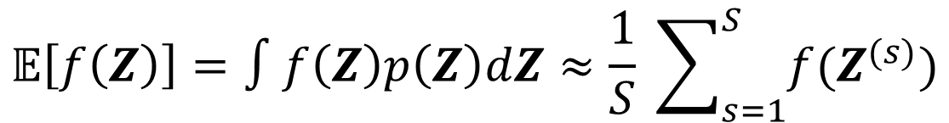

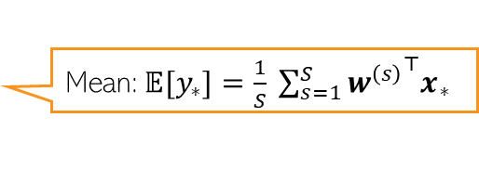

Using the Samples to make Predictions
16
Using the $S$ samples $Z^{(1)},Z^{(2)},…,Z^{(S)}$, our approx. $p\left(Z\right)≈\frac{1}{S} \sum_{s=1}^{S}{δ_{Z^{(s)}}(Z)}$
Any expectation that depends on $p(Z)$ be approximated as
For Bayesian lin. reg., assuming $w,β, λ$ to be unknown, the PPD approx. will be
Sampling based approx. for PPD of other models can also be obtained likewise
$$𝔼\left[f\left(Z\right)\right]=∫f\left(Z\right)p\left(Z\right)dZ≈\frac{1}{S} \sum_{s=1}^{S}{f(Z^{(s)})}$$
Joint posterior over all unknowns
Thus, in this case, the PPD is a sum of $S$ Gaussians
$$∫p\left(y_{∗} | x_{∗},w,β\right)p\left(w,β,λ | X,y\right)dwdβdλ≈\frac{1}{S} \sum_{s=1}^{S}{p\left(y_{∗} | x_{∗},w^{\left(s\right)},β^{(s)}\right)}$$
Sampling based approximation of PPD
Mean:$𝔼{[y}_{∗}]=\frac{1}{S} \sum_{s=1}^{S}{{w^{\left(s\right)}}^{⊤}x_{∗}}$
Mean and variance of $y_{∗}$ can be computed using sum of Gaussian properties
Variance: Exercise! Use definition of variance and use Monte-Carlo approximation

Slide 17


Sampling Methods: Label Switching Issue
17
Suppose we are given samples $Z^{(1)},Z^{(2)},…,Z^{(S)}$from the posterior $p(Z|X)$
We can’t always simply “average” them to get the “posterior mean” $\overline{Z}$
Why: Non-identifiability of latent vars in models with multiple equival. posterior modes
Example: In clustering via GMM, the likelihood is invariant to how we label clusters
  What we call cluster 1 in one sample may be cluster 2 in the next sample
  Say, in GMM, $z_{n}^{(1)}=\left[1,0\right]$ and $z_{n}^{(2)}=\left[0,1\right]$, both samples imply the same
  Averaging will give ${\overline{z}}_{n}=[0.5,0.5]$, which is incorrect
Quantities not affected by permutations of dims of $Z$ can be safely averaged
  E.g., probability that two points belong to the same cluster (e.g., in GMM)
  Predicting the mean of an entry $r_{ij}$ in matrix factorization $\frac{1}{S} \sum_{s=1}^{S}{{u_{i}^{\left(s\right)}}^{⊤}v_{j}^{\left(s\right)}}$
One sample may be from near one of the modes and the other may be from near the other mode
Changes in order of entries in these $K× 1$ vectors across different samples doesn’t affect the inner product

Slide 18







MCMC: Some Practical Aspects
18
Choice of proposal distribution is important
  For MH sampling, Gaussian proposal is popular when $z$ is continuous, e.g.,
  Other options: Mixture of proposal distributions, data-driven or adaptive proposals
Autocorrelation. Can show that when approximating $f^{∗}=𝔼\left[f\right]$ using ${\{Z^{\left(s\right)}\}}_{s=1}^{S}$
Autocorrelation function (ACF) at lag $t$:
Multiple Chains: Run multiple chains, take union of generated samples
Hessian at the MAP of the target distribution
$$q\left(z | z^{\left(ℓ−1\right)}\right)= 𝒩(z|z^{\left(ℓ−1\right)},H)$$
Change at each iter
Basically measures what fractions of the total samples are uncorrelated. Want it to be close to 1
$$\overline{f}= \frac{1}{S}\sum_{s=1}^{S}{f_{s}}$$
Monte Carlo assumes uncorrelated samples
Value of $f$ using $s^{th}$ MCMC sample
Lower is better

Slide 19



Approximate Inference: VI vs Sampling
19
VI approximates a posterior distribution $p(Z|X)$ by another distribution $q(Z|φ)$
Sampling uses $S$ samples $Z^{(1)},Z^{(2)},…,Z^{(S)}$to approximate $p(Z|X)$
Sampling can be used within VI (ELBO approx using Monte-Carlo)
In terms of “comparison” between VI and sampling, a few things to be noted
  Convergence: VI only has local convergence, sampling (in theory) can give exact posterior
  Storage: Sampling based approx needs to storage all samples, VI only needs var. params $φ$
  Prediction Cost: Sampling always requires Monte-Carlo avging for posterior predictive; with VI, sometimes we can get closed form posterior predictive
There is some work on “compressing” sampling-based approximations*
PPD if using sampling:
$$p\left(x_{∗} | X\right)=∫p\left(x_{∗} | Z\right)p\left(Z | X\right)dZ≈\frac{1}{S}\sum_{s=1}^{S}{p\left(x_{∗} | Z^{\left(s\right)}\right)}$$
Compressing the $S$samples into something more compact
PPD if using VI:
$$p\left(x_{∗} | X\right)=∫p\left(x_{∗} | Z\right)p\left(Z | X\right)dZ≈∫p\left(x_{∗} | Z\right)q\left(Z | φ\right)dZ$$
*”Compact approximations to Bayesian predictive distributions” by Snelson and Ghaharamani, 2005; and “Bayesian Dark Knowledge” by Korattikara et al, 2015

Slide 20
Coming Up Next
20
Avoiding the random-walk behavior of MCMC
  Using gradient information of the posterior
Scalable MCMC methods

