Slide 1
Approximate Inference via Sampling
CS772A: Probabilistic Machine Learning
Piyush Rai

Slide 2
Sampling for Approximate Inference
2
Some typical tasks that we have to solve in probabilistic/fully-Bayesian inference
Sampling methods provide a general way to (approximately) solve these problems
More general than VI methods which only approximate the posterior distribution
Posterior distribution
Posterior predictive distribution
Needed for model selection (and in computing posterior too)
Marginal likelihood
Needed in EM
Expected complete data log-likelihood
Evidence lower bound (ELBO)
]
Needed in VI

Slide 3
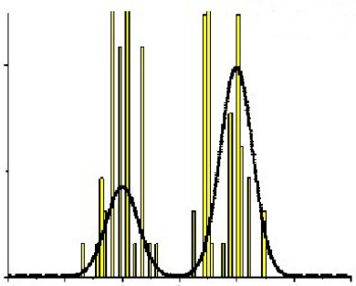
Approximating a Prob. Distribution using Samples
3
Can approximate any distribution using a set of randomly drawn samples from it
The samples can also be used for computing expectations (Monte-Carlo averaging)
Usually straightforward to generate samples if it is a simple/standard distribution
The interesting bit: Even if the distribution is “difficult” (e.g., an intractable posterior), it is often possible to generate random samples from such a distribution, as we will see.
Samples can thought of as a histogram-based approximation of a distribution
Given large-enough samples, it is proportional to the probability density at that location
Height of each bar denotes how many times that location was sampled
$$p(z)$$

Slide 4
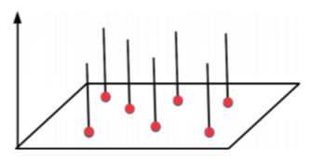
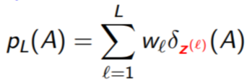
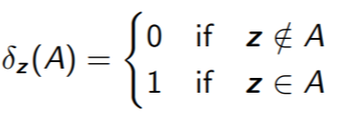
The Empirical Distribution
4
Sampling based approx. can be formally represented using an empirical distribution
Given $L$ points/samples $z^{(1)},z^{(2)},…,z^{(L)}$, empirical distr. defined by these is
Weights sum to 1
Dirac Distribution with finite support at $z^{(1)},z^{(2)},…,z^{(L)}$
Weight of point $z^{(ℓ)}$
Can think of $A$ as being the area over which we want to evaluate the distribution
Dirac Distribution

Slide 5
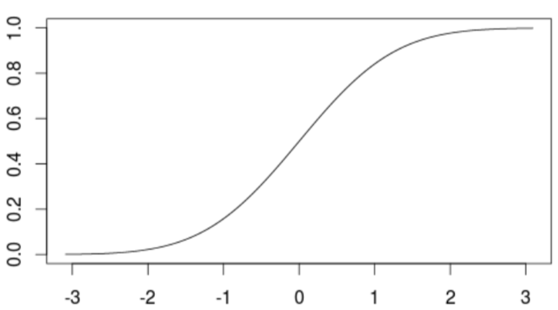
Sampling: Some Basic Methods
$$p\left(z\right)=q(x)\left|\frac{∂x}{∂z}\right|$$
5
Most of these basic methods are based on the idea of transformation
Generate a random sample $x$ from a distribution $q(x)$ which is easy to sample from
Apply a transformation on $x$ to make it random sample $z$ from a complex distr $p(z)$
Some popular examples of transformation methods
Inverse CDF method
Reparametrization method
Box-Mueller method: Given $(x_{1}, x_{2})$from $Unif(−1, +1)$, generate $(z_{1}, z_{2})$from $𝒩(0,I_{2})$
$z_{1}= \sqrt{−2 ln x_{1}}cos\left(2πx_{2}\right), z_{1}= \sqrt{−2 ln x_{1}}sin(2πx_{2})$
Transformation Methods are simple but have limitations
Mostly limited to standard distributions and/or distributions with very few variables
Determinant of Jacobian
$F(z)$: CDF of $p(z)$
$$x$$
$$z=F^{−1}(x)$$

Slide 6
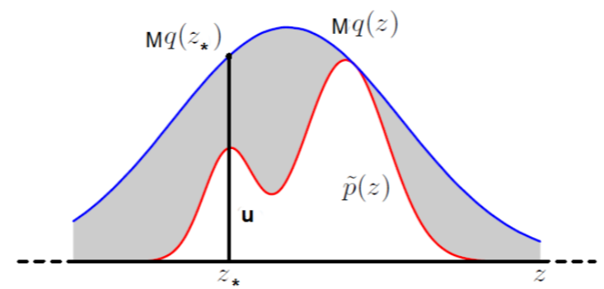
Rejection Sampling
6
Goal: Generate a random sample from a distribution of the form $p\left(z\right)= \frac{\tilde{p}(z)}{Z_{p}}$, assuming
We can only evaluate the value of numerator $\tilde{p}(z)$ for any $z$
The denominator (normalization constant) $Z_{p}$ is intractable and we don’t know its value
Assume a proposal distribution $q(z)$ we can generate samples from, and
Rejection Sampling then works as follows
Sample an random variable $z_{∗}$ from $q(z)$
Sampling a uniform r.v. $u∼Unif\left[0,Mq\left(z_{∗}\right)\right]$
If $u≤\tilde{p}(z_{∗})$ then accept $z_{∗}$, otherwise reject it
All accepted $z_{∗}$’s will be random samples from $p\left(z\right)$. Proof on next slide
Should have the same support as $p(z)$

Slide 7
Rejection Sampling
7
Why $z ∼ q(z)$+ accept/reject rule is equivalent to $z ∼ p(z)$?
Let’s look at the pdf of the $z$’s that were accepted, i.e., $p(z|accept)$

Slide 8
Computing Expectations via Monte Carlo Sampling
8
Often we are interested in computing expectations of the form
where $f(z)$ is some function of the random variable $z∼ p(z)$
A simple approx. scheme to compute the above expectation: Monte Carlo integration
Generate $L$ independent samples from $p(z)$: ${\left\{z^{(ℓ)}\right\}}_{ℓ=1}^{L}∼p(z)$
Approximate the expectation by the following empirical average
Since the samples are independent of each other, we can show the following (exercise)
$$𝔼\left[f\right]= \int{f\left(z\right)p\left(z\right)dz}$$
Assuming we know how to sample from $p(z)$
$𝔼\left[f\right]≈ \hat{f}= \frac{1}{L}\sum_{ℓ=1}^{L}{f(z^{(ℓ)})}$
Variance in our estimate decreases as $L$increases
Unbiased expectation

Slide 9
Computing Expectations via Importance Sampling
9
How to compute Monte Carlo expec. if we don’t know how to sample from $p(z)$?
One way is to use transformation methods or rejection sampling
Another way is to use Importance Sampling (assuming $p(z)$ can be evaluated at least)
Generate $L$ indep samples from a proposal $q(z)$ we know how sample from: ${\left\{z^{(ℓ)}\right\}}_{ℓ=1}^{L}∼q(z)$
Now approximate the expectation as follows
This is basically “weighted” Monte Carlo integration
$w^{(ℓ)}=\frac{p\left(z^{(ℓ)}\right)}{q\left(z^{(ℓ)}\right)}$ denotes the importance weight of each sample $z^{(ℓ)}$
IS works even when we can only evaluate $p\left(z\right)= \frac{\tilde{p}(z)}{Z_{p}}$ up to a prop. constant
Note: Monte Carlo and Importance Sampling are NOT sampling methods!
These are only uses for computing expectations (approximately)
$$𝔼\left[f\right]= \int{f\left(z\right)p\left(z\right)dz}=\int{f\left(z\right)\frac{p\left(z\right)}{q\left(z\right)}q\left(z\right)dz}$$
$$≈\frac{1}{L}\sum_{ℓ=1}^{L}{f(z^{(ℓ)})}\frac{p\left(z^{(ℓ)}\right)}{q\left(z^{(ℓ)}\right)}$$
See PRML 11.1.4

Slide 10
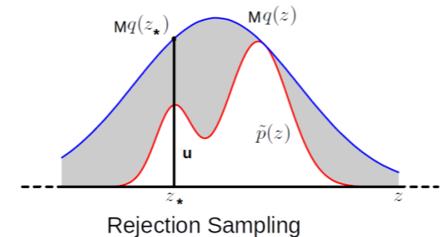
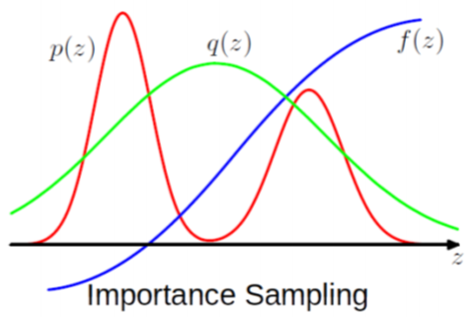
Limitations of the Basic Methods
10
Transformation based methods: Usually limited to drawing from standard distributions
Rejection Sampling and Importance Sampling: Require good proposal distributions
In general, difficult to find good prop. distr. especially when $z$ is high-dim
More sophisticated sampling methods like MCMC work well in such high-dim spaces
$$𝔼\left[f\right]≈\frac{1}{L}\sum_{ℓ=1}^{L}{f(z^{(ℓ)})}\frac{p\left(z^{(ℓ)}\right)}{q\left(z^{(ℓ)}\right)}$$
$q(z)$ should be such that $Mq(z)$ envelopes $\tilde{p}(z)$ everywhere
Ideally, would like $q(z)$ to give samples from where $p(z)$ is large or $f(z)p(z)$ is large
Difficult to guarantee so if $z$ is high-dimensional

Slide 11
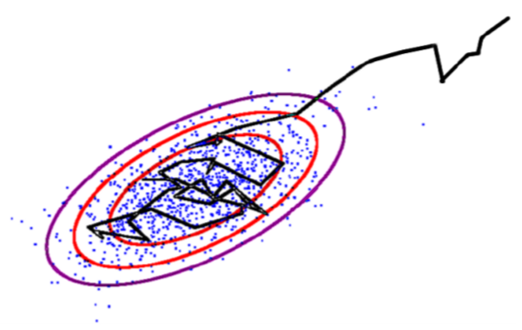
Markov Chain Monte Carlo (MCMC)
11
If the target is a posterior, it will be conditioned on data, i.e., $p(z|x)$
Goal: Generate samples from some target distribution $p\left(z\right)= \frac{\tilde{p}(z)}{Z_{p}}$
Assume we can evaluate $p(z)$ at least up to a proportionality constant
MCMC uses a Markov Chain which, when converged, starts giving samples from $p(z)$
Given current sample $z^{(ℓ)}$ from the chain, MCMC generates the next sample $z^{(ℓ+1)}$ as
Use a proposal distribution $q(z|z^{(ℓ)})$ to generate a candidate sample $z_{∗}$
Accept/reject $z_{∗}$ as the next sample based on an acceptance criterion (will see later)
If accepted, set $z^{(ℓ+1)}=z_{∗}$. If rejected, set $z^{(ℓ+1)}$ = $z^{(ℓ)}$
Important: The proposal distribution $q(z|z^{(ℓ)})$ depends on the previous sample $z^{(ℓ)}$
$z$ usually is high-dim
Means we can at least evaluate $\tilde{p}(z)$
Should also have the same support as $p(z)$

Slide 12
MCMC: The Basic Scheme
12
The chain run infinitely long (i.e., upon convergence) will give ONE sample from $p\left(z\right)$
But we usually require several samples to approximate $p\left(z\right)$
This is done as follows
Start the chain at an initial $z^{(0)}$
Using the proposal $q(z|z^{(ℓ)})$, run the chain long enough, say $T_{1}$ steps
Discard the first $T_{1}−1$ samples (called “burn-in” samples) and take last sample $z^{(T_{1})}$
Continue from $z^{(T_{1})}$ up to $T_{2}$ steps, discard intermediate samples, take last sample $z^{(T_{2})}$
This discarding (called “thinning”) helps ensure that $z^{(T_{1})}$ and $z^{(T_{2})}$ are uncorrelated
Repeat the same for a total of $S$ times
In the end, we now have $S$ approximately independent samples from $p\left(z\right)$
Note: Good choices for $T_{1}$ and $T_{i}−T_{i−1}$(thinning gap) are usually based on heuristics
MCMC is exact in theory but approximate in practice since we can’t run the chain for infinitely long in practice
Thus we say that the samples are approximately from the target distribution
Will treat it as our first sample from $p(z)$
Requirement for Monte Carlo approximation

Slide 13
MCMC: Some Basic Theory
13
A first order Markov Chain assumes $p\left(z^{(ℓ+1)}|z^{\left(1\right)},…,z^{(ℓ)}\right)=p(z^{\left(ℓ+1\right)}|z^{(ℓ)})$
A 1st order Markov Chain $z^{(0)},$ $z^{(1)},…,z^{(L)}$ is a sequence of r.v.’s and is defined by
An initial state distribution $p(z^{\left(0\right)})$
A Transition Function (TF): $T_{ℓ}\left(z^{\left(ℓ\right)}→z^{\left(ℓ+1\right)}\right)=p(z^{\left(ℓ+1\right)}|z^{(ℓ)})$
TF is a distribution over the values of next state given the value of the current state
Assuming a $K$-dim discrete state-space, TF will be $K × K$probability table
Homogeneous Markov Chain: The TF is the same for all $ℓ$ , i.e., $T_{ℓ}=T$

Slide 14
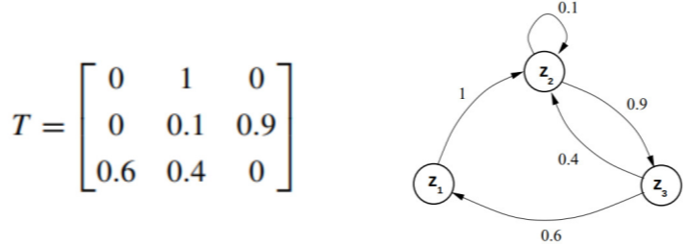
MCMC: Some Basic Theory
14
Consider the following Markov Chain with a $K=3$ discrete state-space
$p(z)$ being Stationary means no matter what $p\left(z^{\left(0\right)}\right)$is, we will reach $p(z)$
A Markov Chain has a stationary distribution if $T$ has the following properties
Irreducibility: T’s graph is connected (ensures reachability from anywhere to anywhere)
Aperiodicity: T’s graph has no cycles (ensures that the chain isn’t trapped in cycles)
$$p\left(z^{\left(0\right)}\right)=p\left(z_{1}^{\left(0\right)},z_{2}^{\left(0\right)},z_{3}^{\left(0\right)}\right)$$
$$=[0.5,0.2,0.3]$$
$$p\left(z^{\left(1\right)}\right)= p\left(z^{\left(0\right)}\right)×T=[0.2,0.6,0.2]$$
$$(rounded to single digit after decimal)$$
After doing it a few more (say some $m$) times
Stationary/Invariant Distribution $p(z)$ of this Markov Chain
$p(z)$ is multinoulli with $π=[0.2,0.4,0.4]$
$$p\left(z^{\left(0\right)}\right)×T^{m}=[0.2,0.4,0.4]$$
$$(rounded to single digit after decimal)$$

Slide 15
MCMC: Some Basic Theory
15
A Markov Chain with transition function $T$ has stationary distribution $p(z)$ if $T$ satisfies
Integrating out (or summing over) detailed balanced condition on both sides w.r.t. $z^{′}$
Thus a Markov Chain with detailed balance always converges to a stationary distribution
Detailed Balance ensures reversibility
Detailed balance is sufficient but not necessary condition for having a stationary distr.
Here $T\left(b | a\right)$ denotes the transition probability of going from state $a$ to state $b$
Known as the Detailed Balance condition
$$p\left(z\right)T\left(z^{′}|z\right)=p\left(z^{′}\right)T(z|z^{′})$$
$$p\left(z\right)=\int{p\left(z^{′}\right)T\left(z | z^{′}\right)dz^{′}}$$
Thus $p(z)$ is the stationary distribution of this Markov Chain

Slide 16
Coming Up Next
16
MCMC algorithms
Metropolis Hastings (MH)
Gibbs sampling (special case of MH)

Slide 17
Some MCMC Algorithms
17

Slide 18
Metropolis-Hastings (MH) Sampling (1960)
18
Suppose we wish to generate samples from a target distribution $p\left(z\right)= \frac{\tilde{p}(z)}{Z_{p}}$
Assume a suitable proposal distribution $q(z|z^{(τ)})$, e.g., $𝒩(z|z^{\left(τ\right)},σ^{2}I)$
In each step, draw $z^{∗}$ from $q(z|z^{(τ)})$ and accept $z^{∗}$ with probability
Transition function of this Markov Chain: $T\left(z^{∗}|z^{(τ)}\right)=A(z^{∗},z^{\left(τ\right)})q(z^{∗}|z^{(τ)})$
Exercise: Show that $T\left(z^{∗}|z^{(τ)}\right)$ satisfies the detailed balance property
Also “unfavor” $z^{∗}$ if its generation was favored too much by the proposal distribution
Favors acceptance of $z^{∗}$ if it is more probable than $z^{(τ)}$ (under $p(z)$)
Favor acceptance of $z^{∗}$ if it had very low chance of being generated by the proposal but it does have high probability $\tilde{p}(z^{∗})$ under the target
$$p\left(z\right)T\left(z^{(τ)}|z\right)=p\left(z^{(τ)}\right)T(z|z^{(τ)})$$

Slide 19
The MH Sampling Algorithm
19
Initialize $z^{(1)}$ randomly
For $ℓ=1,2,…, L$
Sample $z^{∗}∼q(z^{∗}|z^{(ℓ)})$ and $u∼Unif(0,1)$
Compute acceptance probability
If $A\left(z^{∗},z^{(ℓ)}\right)>u$
Else
Meaning accepting $z^{∗}$ with probability $A\left(z^{∗},z^{(ℓ)}\right)$
$$z^{(ℓ+1)}=z^{∗}$$
$$z^{(ℓ+1)}=z^{(ℓ)}$$

Slide 20
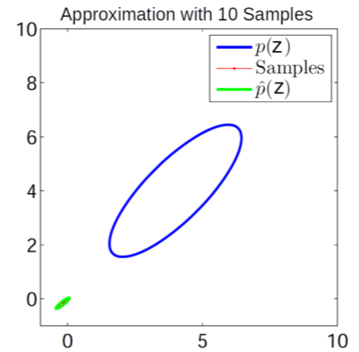
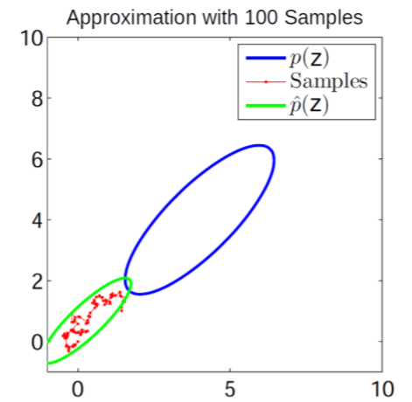
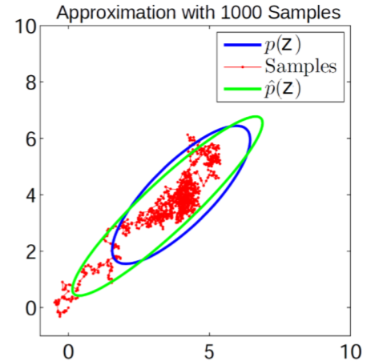
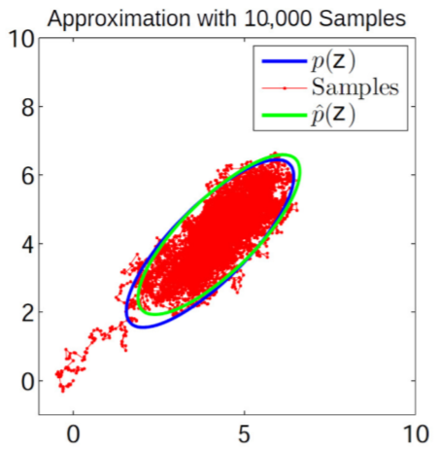
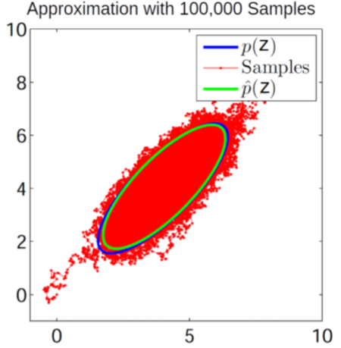
MH Sampling in Action: A Toy Example..
20
Target distribution
Proposal distribution

Slide 21
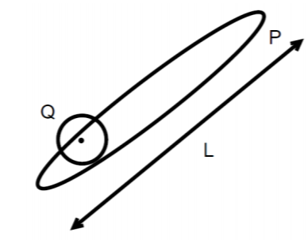
MH Sampling: Some Comments
21
If prop. distrib. is symmetric, we get Metropolis Sampling algo (Metropolis, 1953) with
Some limitations of MH sampling
Can sometimes have very slow convergence (also known as slow “mixing”)
Computing acceptance probability can be expensive*, e.g., if $p\left(z\right)= \frac{\tilde{p}(z)}{Z_{p}}$ is some target posterior then $\tilde{p}(z)$ would require computing likelihood on all the data points (expensive)
$$Q\left(z | z^{\left(τ\right)}\right)=𝒩(z|z^{\left(τ\right)},σ^{2}I)$$
$$∼{\left(\frac{L}{σ}\right)}^{2}iterations required for convergence$$
$$σ large⇒many rejections$$
$$σ small⇒slow diffusion$$
*Austerity in MCMC Land: Cutting the Metropolis-Hastings Budget (Korattikara et al, 2014), Firefly Monte Carlo: Exact MCMC with Subsets of Data {(Maclaurin and Adams, 2015)

Slide 22
Gibbs Sampling (Geman & Geman, 1984)
22
Goal: Sample from a joint distribution $p(z)$ where $z=[z_{1},z_{2},…, z_{M}]$
Suppose we can’t sample from $p(z)$ but can sample from each conditional $p(z_{i}|z_{−i})$
In Bayesian models, can be done easily if we have a locally conjugate model
For Gibbs sampling, the proposal is the conditional distribution $p(z_{i}|z_{−i})$
Gibbs sampling samples from these conditionals in a cyclic order
Gibbs sampling is equivalent to MH sampling with acceptance prob. = 1
Hence no need to compute it
Since only one component is changed at a time

Slide 23
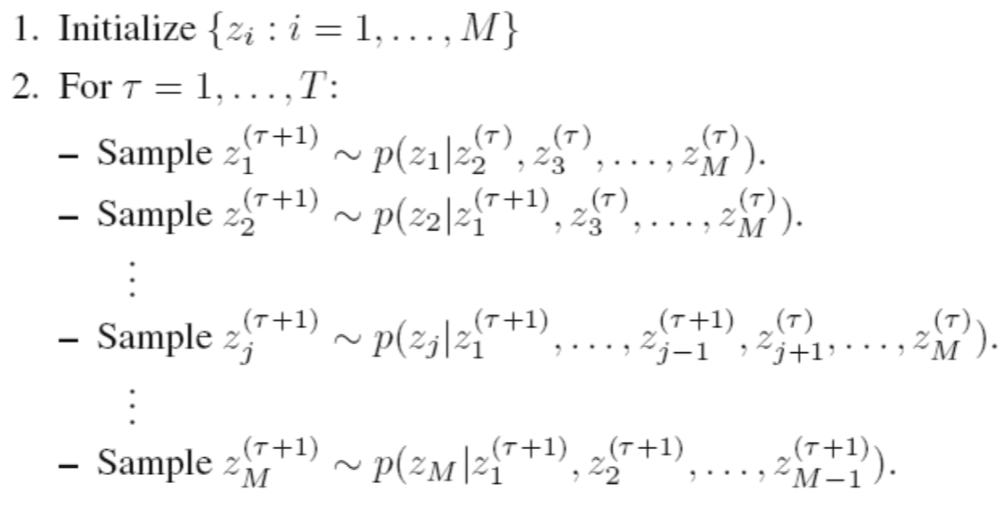
Gibbs Sampling: Sketch of the Algorithm
23
$M$: Total number of variables, $T$: number of Gibbs sampling iterations
Note: Order of updating the variables usually doesn’t matter (but see “Scan Order in Gibbs Sampling: Models in Which it Matters and Bounds on How Much” from NIPS 2016)
Assuming $z = [z_{1}, z_{2}, …, z_{M}]$
CP of each component of $z$ uses the most recent values (from this or the previous iteration) of all the other components
Each iteration will give us one sample $z^{(τ)}$of $z = [z_{1}, z_{2}, …, z_{M}]$

Slide 24
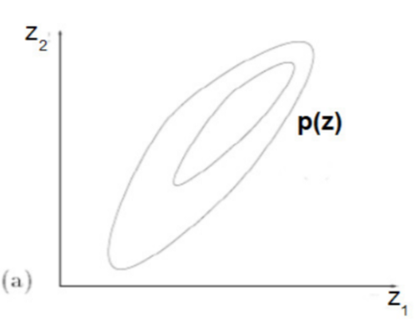
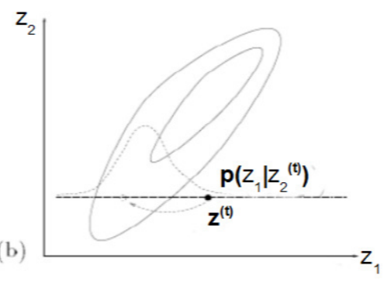
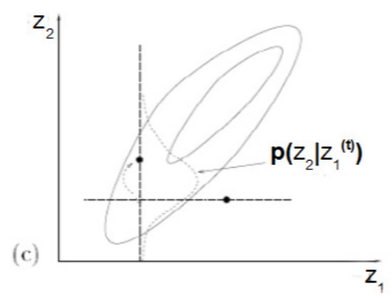
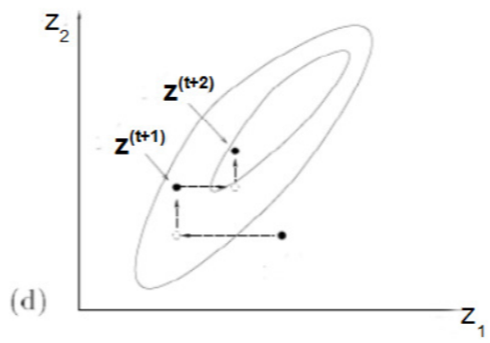
Gibbs Sampling: A Simple Example
24
Can sample from a 2-D Gaussian using 1-D Gaussians
Contours of a 2-D Gaussian
Conditional distribution of $z_{1}$ given $z_{2}$ is Gaussian
Conditional distribution of $z_{2}$ given $z_{1}$ is Gaussian
Gibbs sampling looks like doing a co-ordinate-wise update to generate each successive sample of $z=[z_{1},z_{2}]$

Slide 25
Gibbs Sampling: Some Comments
25
One of the most popular MCMC algorithms
Very easy to derive and implement for locally conjugate models
Many variations exist, e.g.,
Blocked Gibbs: sample more than one component jointly (sometimes possible)
Rao-Blackwellized Gibbs: Can collapse (i.e., integrate out) the unneeded components while sampling. Also called “collapsed” Gibbs sampling
MH within Gibbs: If CPs are not easy to sample distributions
Instead of sampling from CPs, an alternative is to use the mode of the CPs
Called the “Iterative Conditional Mode” (ICM) algorithm
ICM doesn’t give the posterior though – it’s more like ALT-OPT to get (approx) MAP estimate

Slide 26
Coming Up Next
26
Using posterior’s gradient info in sampling algorithms
Online MCMC algorithms
Recent advances in MCMC
Some other practical issues (convergence etc)

