Slide 1
Variational Inference (wrap-up)
CS772A: Probabilistic Machine Learning
Piyush Rai

Slide 2
Plan
2
VI for non-conjugate models
  Black-box VI (BBVI) for general purpose VI
  Reparametrization Trick for general purpose VI
  Some model-specific tricks
Some other recent advances in VI
  Amortized VI
  Structured VI
  Automatic Differentiation VI (ADVI)

Slide 3
VI for Non-conjugate Models
3

Slide 4
(1) Black-Box VI
4

Slide 5
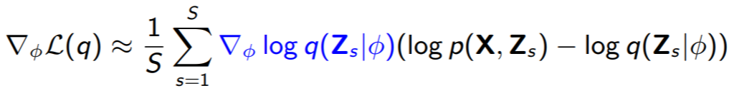
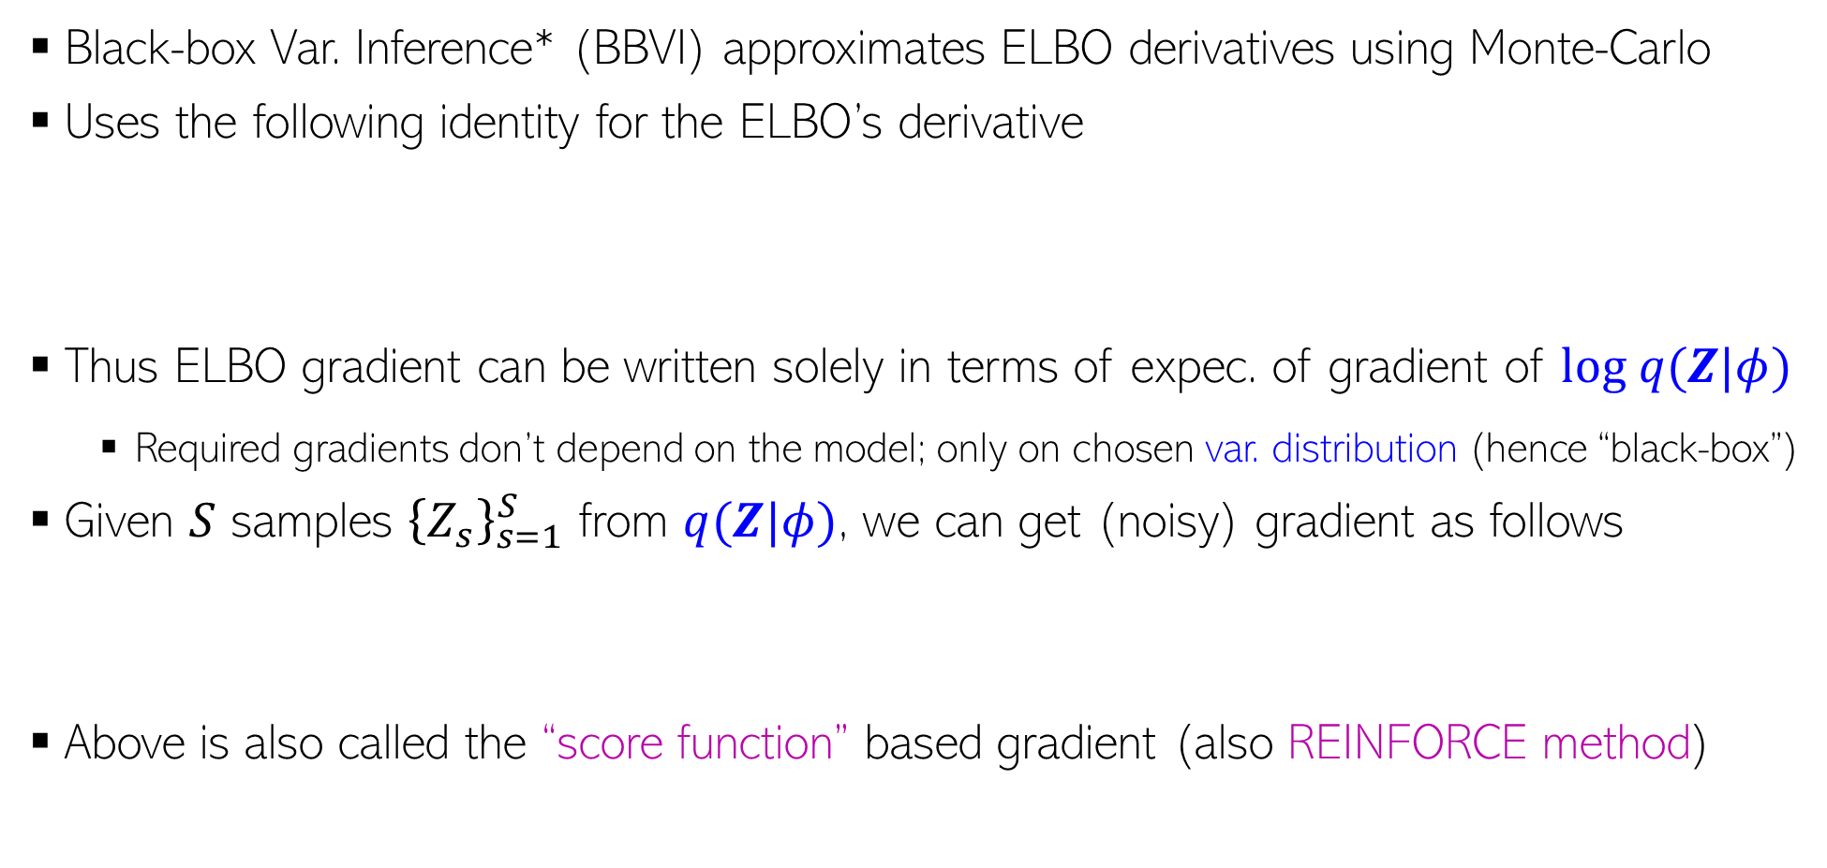
Black-Box Variational Inference (BBVI)
5
Black-box Var. Inference* (BBVI) approximates ELBO derivatives using Monte-Carlo
Uses the following identity for the ELBO’s derivative
Thus ELBO gradient can be written solely in terms of expec. of gradient of $log q(Z|φ)$
  Required gradients don’t depend on the model; only on chosen var. distribution (hence “black-box”)
Given $S$ samples ${\left\{Z_{s}\right\}}_{s=1}^{S}$ from $q(Z|φ)$, we can get (noisy) gradient as follows
Above is also called the “score function” based gradient (also REINFORCE method)
Gradient of a log-likelihood or log-probability function w.r.t. its params is called score function; hence the name
∗Black Box Variational Inference - Ranganath et al (2014)

Slide 6
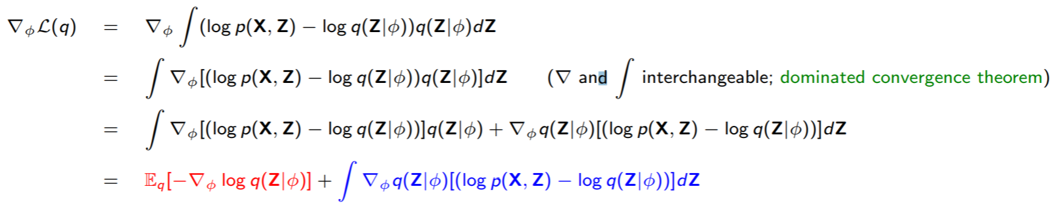

Proof of BBVI Identity
6
The ELBO gradient can be written as
Note that
Also note that , using which
Therefore

Slide 7
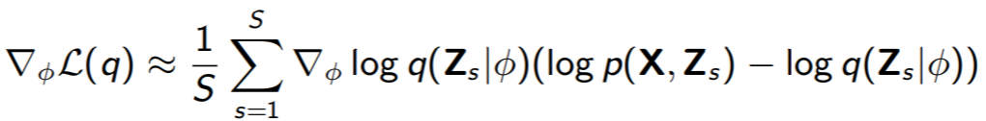
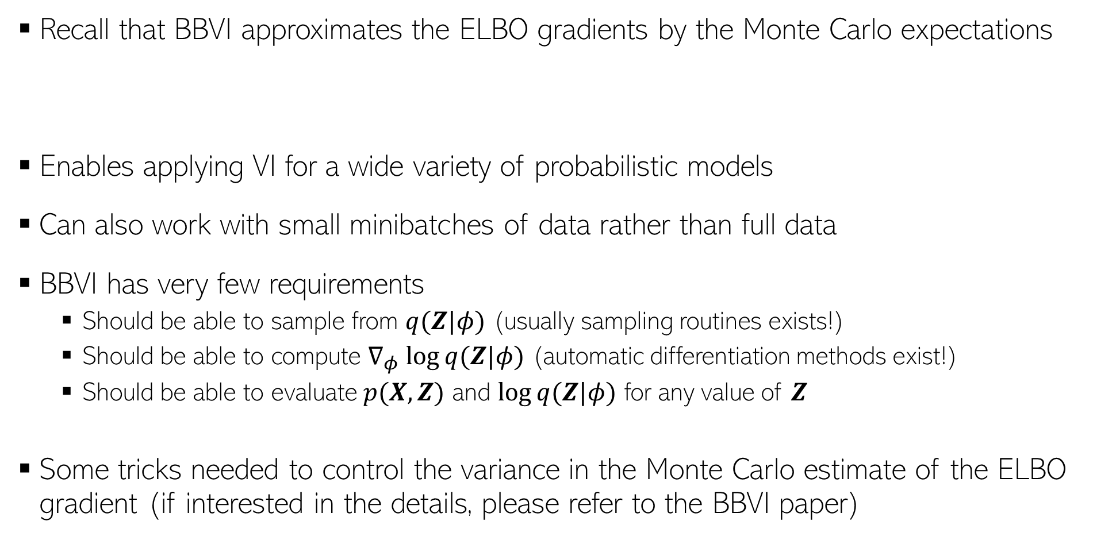
Benefits of BBVI
7
Recall that BBVI approximates the ELBO gradients by the Monte Carlo expectations
Enables applying VI for a wide variety of probabilistic models
Can also work with small minibatches of data rather than full data
BBVI has very few requirements
  Should be able to sample from $q(Z|φ)$ (usually sampling routines exists!)
  Should be able to compute $∇_{φ} log⁡q(Z|φ)$ (automatic differentiation methods exist!)
  Should be able to evaluate $p(X, Z)$ and $log⁡q(Z|φ)$ for any value of $Z$
Some tricks needed to control the variance in the Monte Carlo estimate of the ELBO gradient (if interested in the details, please refer to the BBVI paper)

Slide 8
(2) VI using Reparametrization Trick
8

Slide 9


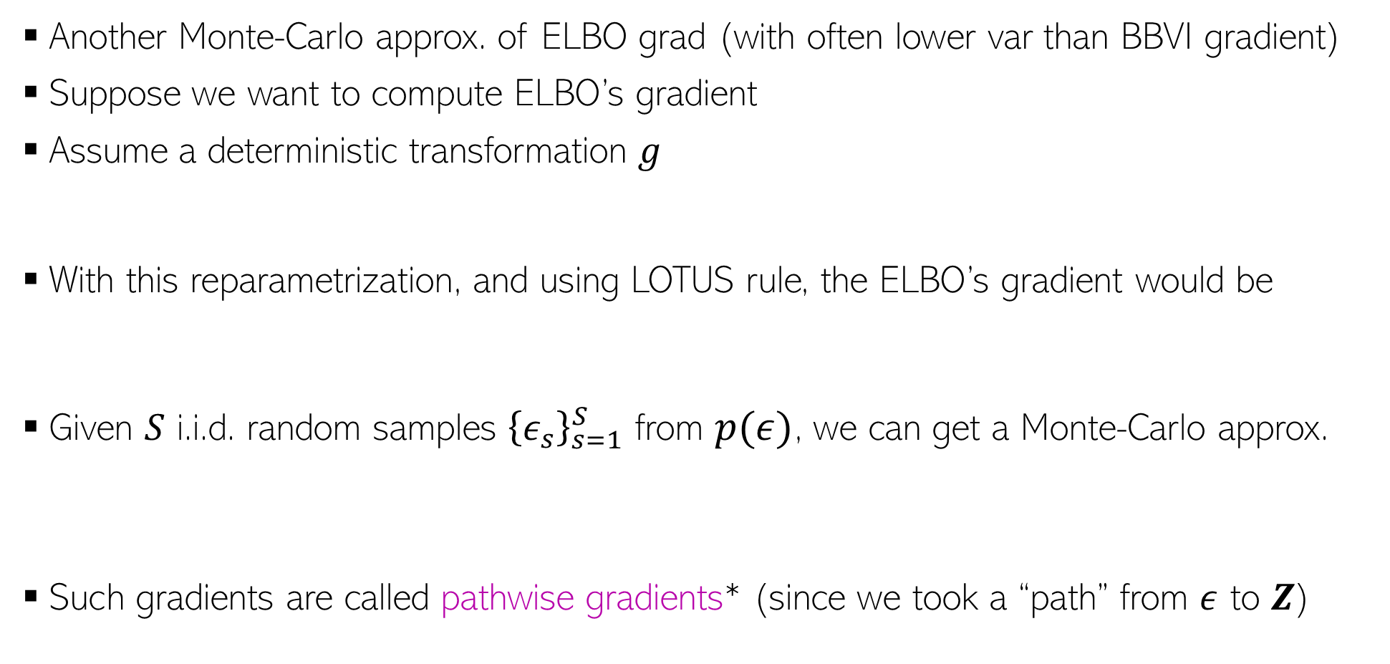
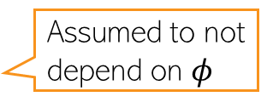
Reparametrization Trick
9
Another Monte-Carlo approx. of ELBO grad (with often lower var than BBVI gradient)
Suppose we want to compute ELBO’s gradient
Assume a deterministic transformation $g$
With this reparametrization, and using LOTUS rule, the ELBO’s gradient would be
Given $S$ i.i.d. random samples ${\left\{ε_{s}\right\}}_{s=1}^{S}$ from $p(ε)$, we can get a Monte-Carlo approx.
Such gradients are called pathwise gradients* (since we took a “path” from $ε$ to $Z$)
Assumed to not depend on $φ$
$$Z=g(ε, φ)$$
where
$$ε∼p(ε)$$
*Autoencoding Variational Bayes - Kingma and Welling (2013), Stochastic Backpropagation and Approximate Inference in Deep Generative Models- Rezende et al (2014)

Slide 10
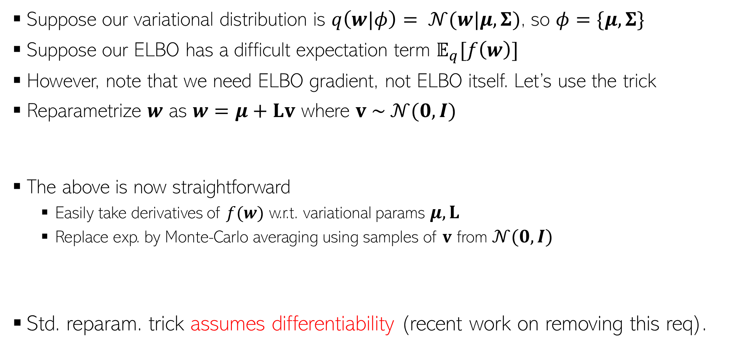
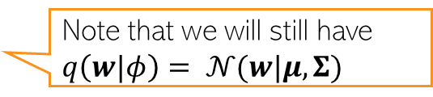

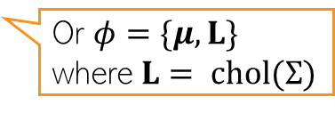

Reparametrization Trick: An Example
10
Suppose our variational distribution is $q\left(w|φ\right)= 𝒩(w|μ,Σ)$, so $φ=\{μ, Σ\}$
Suppose our ELBO has a difficult expectation term $𝔼_{q}[f\left(w\right)]$
However, note that we need ELBO gradient, not ELBO itself. Let’s use the trick
Reparametrize $w$ as $w=μ+Lv$ where $v \sim 𝒩(0,I)$
The above is now straightforward
  Easily take derivatives of $f(w)$ w.r.t. variational params $μ, L$
  Replace exp. by Monte-Carlo averaging using samples of $v$ from $𝒩(0,I)$
Std. reparam. trick assumes differentiability (recent work on removing this req).
Or $φ=\{μ, L\}$ where $L= chol(Σ)$
Note that we will still have $q\left(w|φ\right)= 𝒩(w|μ,Σ)$
Often even one (or very few) samples suffice
$$\frac{∂f}{∂w}\frac{∂w}{∂μ}$$
Chain Rule
$$\frac{∂f}{∂w}\frac{∂w}{∂L}$$
*Autoencoding Variational Bayes - Kingma and Welling (2013), Stochastic Backpropagation and Approximate Inference in Deep Generative Models- Rezende et al (2014)

Slide 11
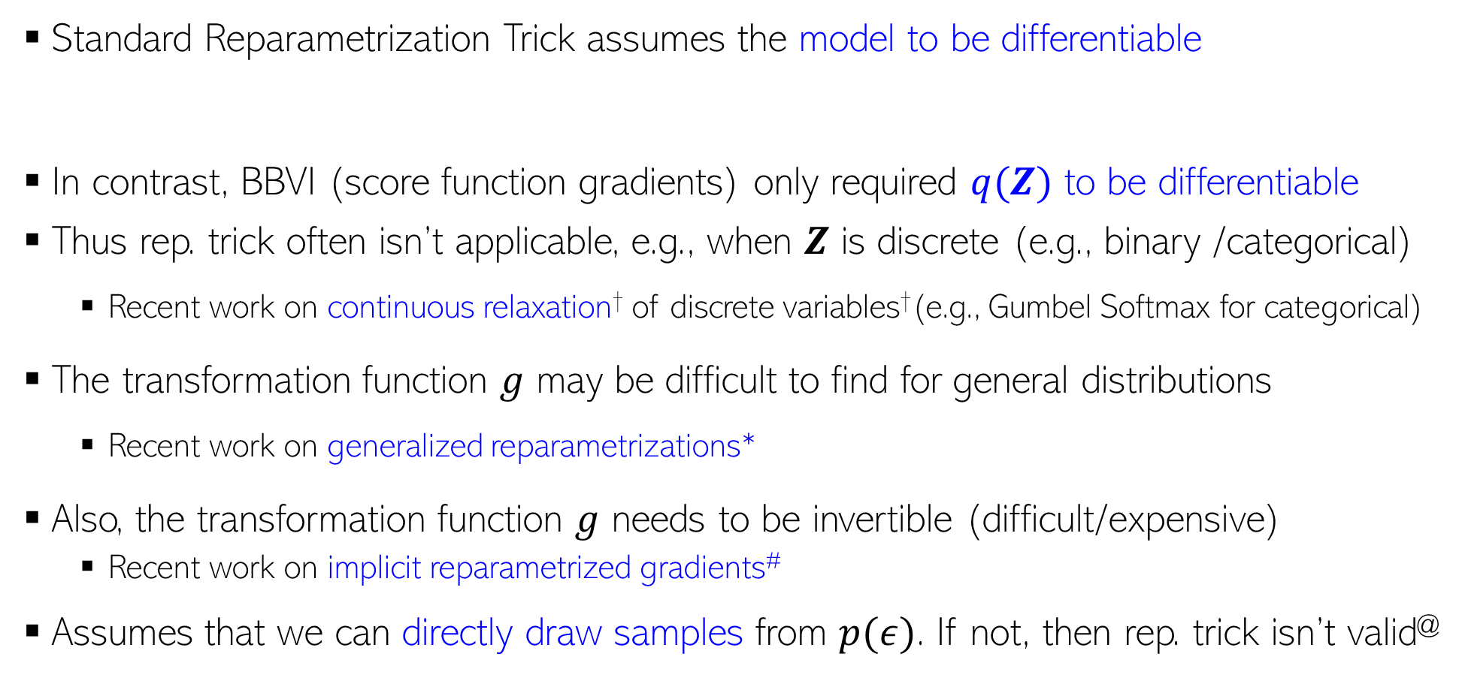
Reparametrization Trick: Some Comments
11
Standard Reparametrization Trick assumes the model to be differentiable
In contrast, BBVI (score function gradients) only required $q(Z)$ to be differentiable
Thus rep. trick often isn’t applicable, e.g., when $Z$ is discrete (e.g., binary /categorical)
  Recent work on continuous relaxation† of discrete variables†(e.g., Gumbel Softmax for categorical)
The transformation function $g$ may be difficult to find for general distributions
  Recent work on generalized reparametrizations*
Also, the transformation function $g$ needs to be invertible (difficult/expensive)
  Recent work on implicit reparametrized gradients#
Assumes that we can directly draw samples from $p(ε)$. If not, then rep. trick isn’t valid@
†Categorical Reparameterization with Gumbel-Softmax (Jang et al, 2017), ∗ The Generalized Reparameterization Gradient (Ruiz et al, 2016), # Implicit Reparameterization Gradients (Figurnov et al, 2018), @ Reparameterization Gradients through Acceptance-Rejection Sampling Algorithms (Naesseth et al, 2016)

Slide 12
(3) Some Model-Specific Tricks
12

Slide 13
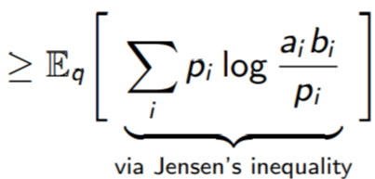
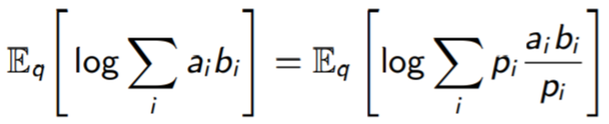


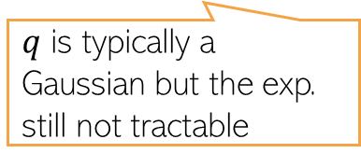
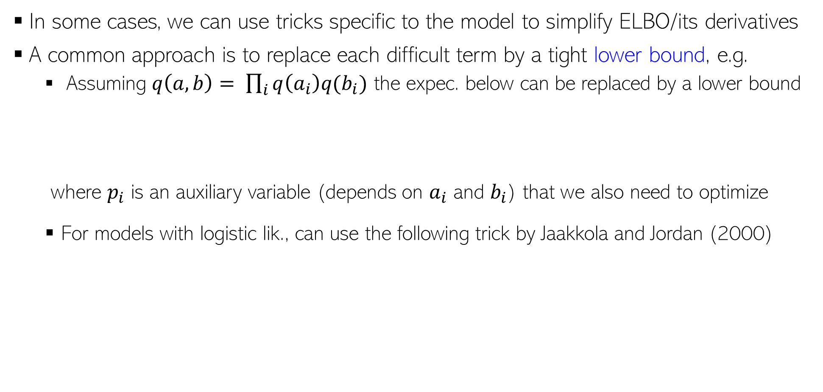
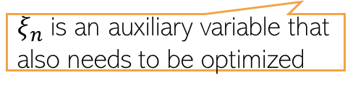
Some Model-Specific Tricks for Difficult Cases
13
In some cases, we can use tricks specific to the model to simplify ELBO/its derivatives
A common approach is to replace each difficult term by a tight lower bound, e.g.
  Assuming $q\left(a,b\right)= \prod_{i}{q\left(a_{i}\right)q(b_{i})}$ the expec. below can be replaced by a lower bound
  where $p_{i}$ is an auxiliary variable (depends on $a_{i}$ and $b_{i}$) that we also need to optimize
  For models with logistic lik., can use the following trick by Jaakkola and Jordan (2000)
Now easy to compute expectations
$q$ is typically a Gaussian but the exp. still not tractable
$ξ_{n}$ is an auxiliary variable that also needs to be optimized
Now easy to compute expectations

Slide 14
Some Other Recent Advances in VI
14

Slide 15
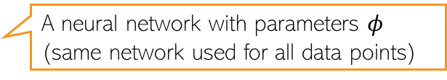
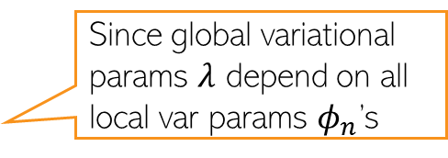
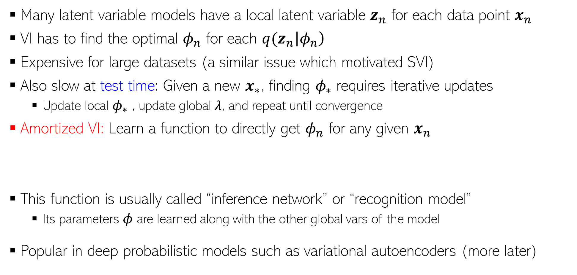
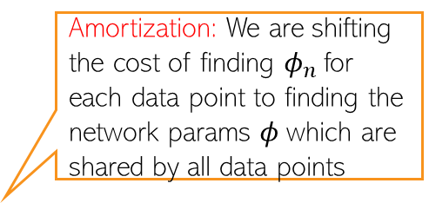
Amortized Variational Inference
15
In addition to global variables
Many latent variable models have a local latent variable $z_{n}$ for each data point $x_{n}$
VI has to find the optimal $φ_{n}$ for each ${q(z}_{n}\left|φ_{n}\right)$
Expensive for large datasets (a similar issue which motivated SVI)
Also slow at test time: Given a new $x_{∗}$, finding $φ_{∗}$ requires iterative updates
  Update local $φ_{∗}$ , update global $λ$, and repeat until convergence
Amortized VI: Learn a function to directly get $φ_{n}$ for any given $x_{n}$
This function is usually called “inference network” or “recognition model”
  Its parameters $φ$ are learned along with the other global vars of the model
Popular in deep probabilistic models such as variational autoencoders (more later)
Since global variational params $λ$ depend on all local var params $φ_{n}$’s
Amortization: We are shifting the cost of finding $φ_{n}$for each data point to finding the network params $φ$which are shared by all data points
A neural network with parameters $φ$ (same network used for all data points)

Slide 16
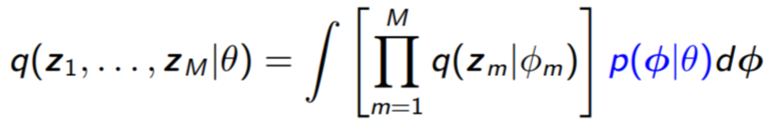
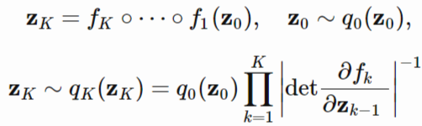
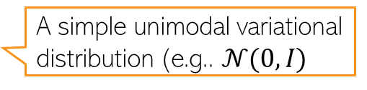
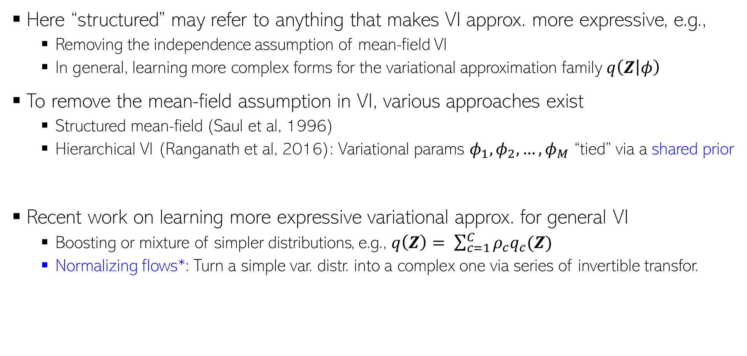
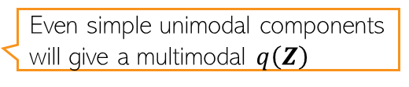
Structured Variational Inference
16
Here “structured” may refer to anything that makes VI approx. more expressive, e.g.,
  Removing the independence assumption of mean-field VI
  In general, learning more complex forms for the variational approximation family $q\left(Z | φ\right)$
To remove the mean-field assumption in VI, various approaches exist
  Structured mean-field (Saul et al, 1996)
  Hierarchical VI (Ranganath et al, 2016): Variational params $φ_{1},φ_{2},…, φ_{M}$ “tied” via a shared prior
Recent work on learning more expressive variational approx. for general VI
  Boosting or mixture of simpler distributions, e.g., $q\left(Z\right)= \sum_{c=1}^{C}{ρ_{c}q_{c}(Z)}$
  Normalizing flows*: Turn a simple var. distr. into a complex one via series of invertible transfor.
Even simple unimodal components will give a multimodal $q\left(Z\right)$
A much more complex(e.g., multimodal) variational distribution obtained via the flow idea
A simple unimodal variational distribution (e.g.. $𝒩(0,I)$
∗Variational Inference with Normalizing Flows (Rezende and Mohamed, 2015)

Slide 17
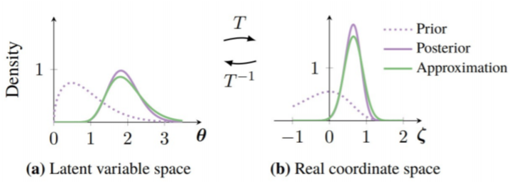
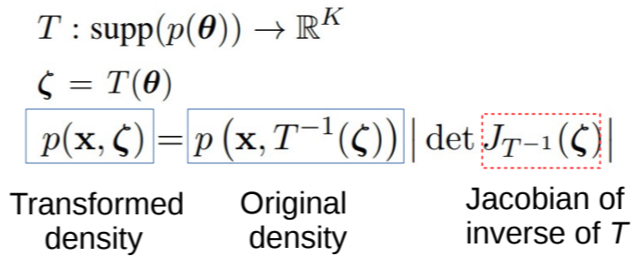
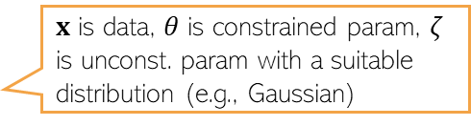
Automatic Differentiation Variational Inference
17
Auto. Diff. (AD): A way to automate diff. of functions with unconstrained variables
These derivatives is all what we need to optimize the function (in our case, ELBO)
VI is also optimization. However, often the variables are constrained, e.g.,
  Gamma’s shape and scale can only be non-negative
  Beta’s parameters can only be non-negative
  Dirichlet’s probability parameter sums to one
If we could transform our distributions to unconstrained ones, AD can be used for VI
$x$ is data, $θ$ is constrained param, $ζ$ is unconst. param with a suitable distribution (e.g., Gaussian)
∗Automatic Differentiation Variational Inference (Kucukelbir et al, 2017)

Slide 18
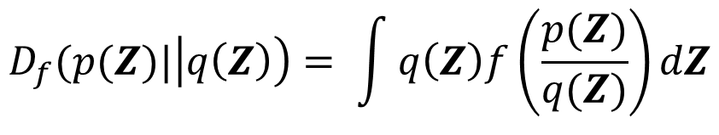
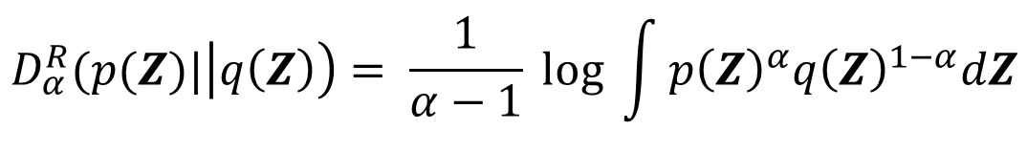
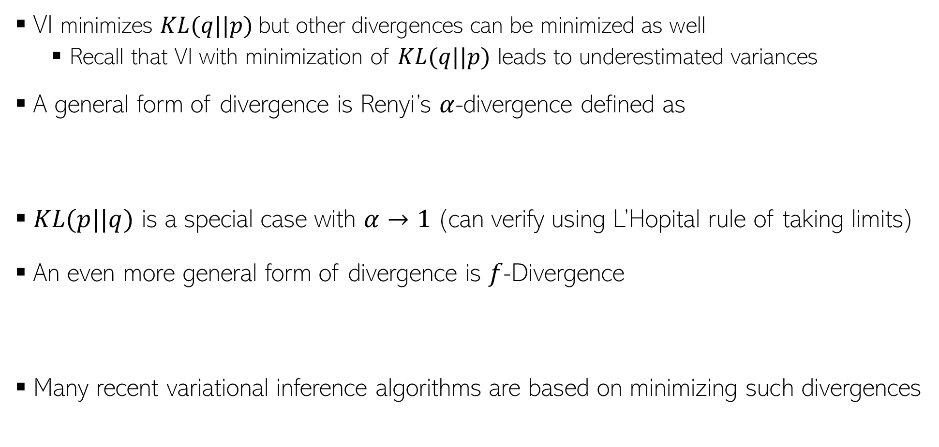
Other Divergence Measures
18
VI minimizes $KL(q||p)$but other divergences can be minimized as well
  Recall that VI with minimization of $KL(q||p)$ leads to underestimated variances
A general form of divergence is Renyi’s $α$-divergence defined as
$KL(p||q)$ is a special case with $α→1$(can verify using L’Hopital rule of taking limits)
An even more general form of divergence is $f$-Divergence
Many recent variational inference algorithms are based on minimizing such divergences
$$D_{α}^{R}(p(Z)|\left|q\left(Z\right)\right)= \frac{1}{α−1} log \int{p{\left(Z\right)}^{α}q{\left(Z\right)}^{1−α}dZ}$$
$$D_{f}(p(Z)|\left|q\left(Z\right)\right)= \int{q\left(Z\right)f\left(\frac{p(Z)}{q(Z)}\right)dZ}$$

Slide 19

Variational Inference: Some Comments
19
Many probabilistic models nowadays rely on VI to do approx. inference
Even mean-field with locally-conjugacy used in lots of models
  This + SVI gives excellent scalability as well on large datasets
Progress in various areas has made VI very popular and widely applicable
  Stochastic Optimization (e.g., SGD)
  Automatic Differentiation
  Monte-Carlo gradient of ELBO
Note: Most of these ideas apply also to Variational EM
Many VI and advanced VI algos are implemented in probabilistic prog. packages (e.g., Tensorflow Probability, PyTorch, etc), making VI easy even for complex models
Still a very active area of research, especially for doing VI in complex models
  Models with discrete latent variables
  Reducing the variance in Monte-Carlo estimate of ELBO gradients
  More expressive variational distribution for better approximation
We covered many of the threads being explored in recent work but a lot of work still being done in this area

