Slide 1
Variational Inference (Contd)
CS772A: Probabilistic Machine Learning
Piyush Rai

Slide 2

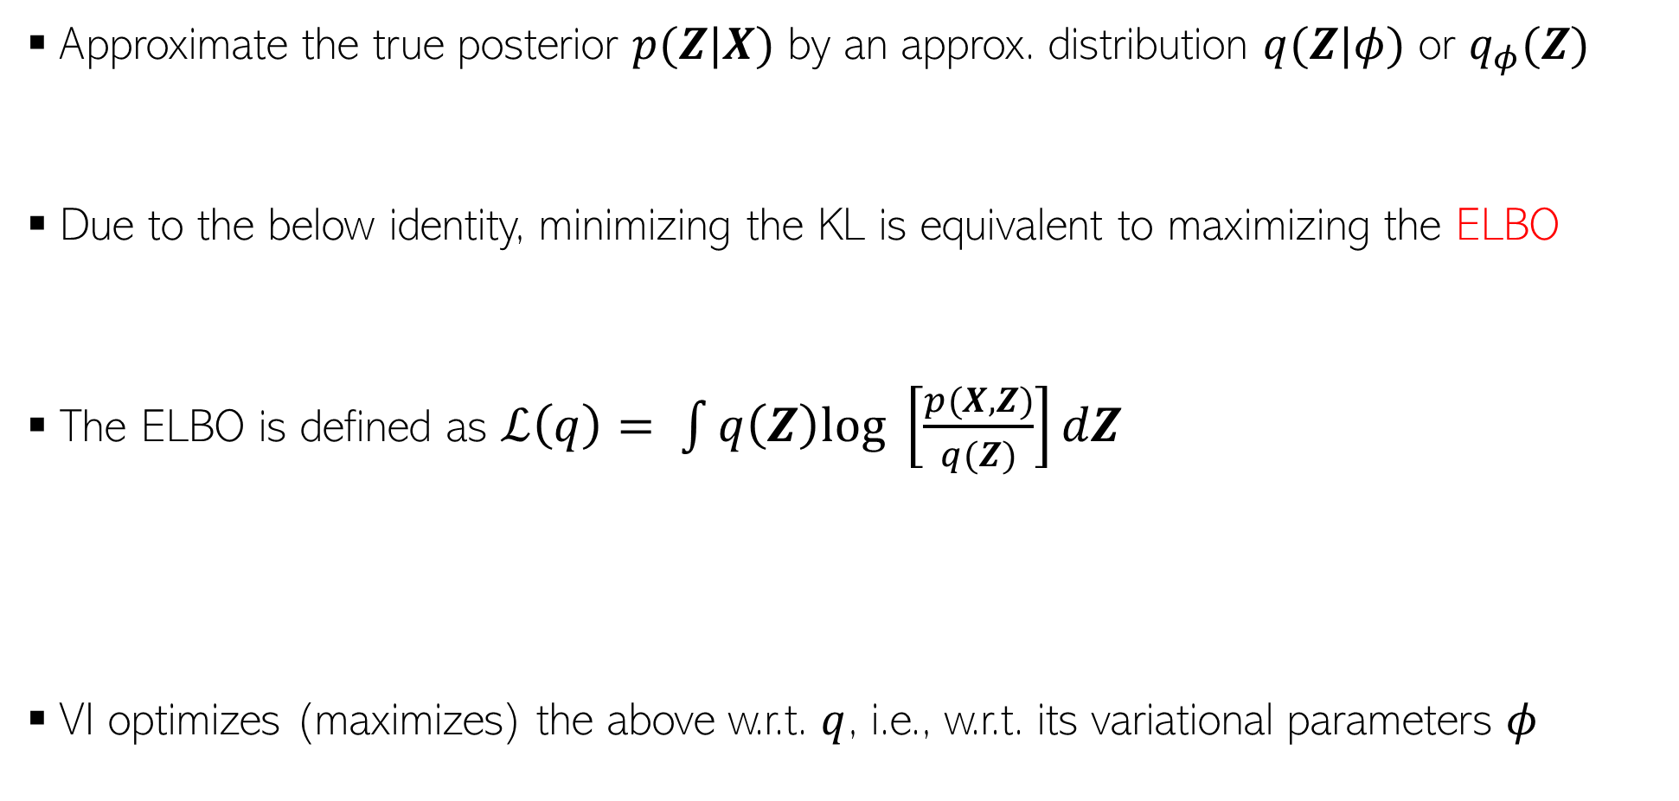





Quick Recap: Variational Inference (VI)
2
Defines a class of distributions parametrized by $φ$
Approximate the true posterior $p(Z|X)$ by an approx. distribution $q(Z|φ)$ or $q_{φ}(Z)$
Due to the below identity, minimizing the KL is equivalent to maximizing the ELBO
The ELBO is defined as $ℒ\left(q\right)= \int{q\left(Z\right)log \left[\frac{p(X,Z)}{q(Z)}\right]dZ}$
VI optimizes (maximizes) the above w.r.t. $q$, i.e., w.r.t. its variational parameters $φ$
$$φ^{∗}= {argmin}_{φ} KL[q_{φ}(Z)||p(Z|X)]$$
Often, we will simply write it as ${argmin}_{q} KL[q|\left|p_{z}\right]$
Log-evidence of model $m$
Evidence lower bound (ELBO)
Non-negative
$$log p\left(X | m\right)= ℒ\left(q\right)+KL(q||p_{z})$$
$$ℒ\left(q\right)=ℒ\left(φ\right)= 𝔼_{q}\left[log p(X,Z)\right]−𝔼_{q}\left[log q(Z)\right]$$
Find $q$ such that $Z$ explains data well
$$= 𝔼_{q}\left[log p(X|Z)\right]−KL\left[q(Z)||p(Z)\right]$$
Find $q$ that is “simple”, i.e., is close to the prior

Slide 3
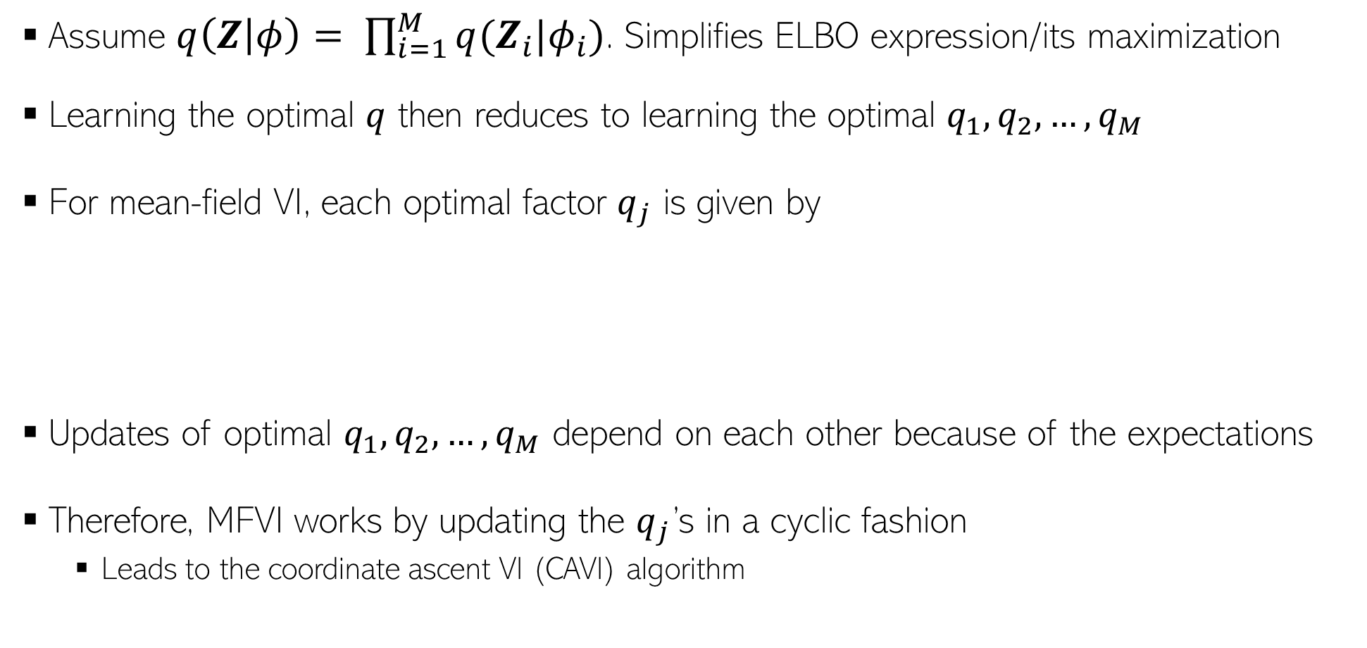
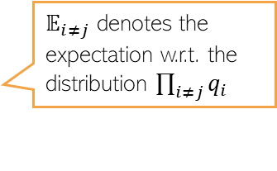
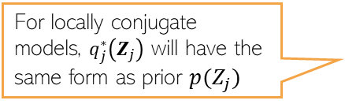
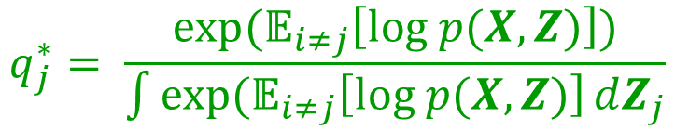
Quick Recap: Mean-Field VI
3
Assume $q\left(Z | φ\right)= \prod_{i=1}^{M}{q(Z_{i}|φ_{i})}$. Simplifies ELBO expression/its maximization
Learning the optimal $q$ then reduces to learning the optimal $q_{1},q_{2},…, q_{M}$
For mean-field VI, each optimal factor $q_{j}$ is given by
Updates of optimal $q_{1},q_{2},…, q_{M}$ depend on each other because of the expectations
Therefore, MFVI works by updating the $q_{j}$’s in a cyclic fashion
  Leads to the coordinate ascent VI (CAVI) algorithm
This general expression holds even if there is no local conjugacy
For locally conjugate models, $q_{j}^{∗}\left(Z_{j}\right)$ will have the same form as prior $p(Z_{j})$
$$q_{j}^{∗}= \frac{exp(𝔼_{i≠j}\left[log p(X,Z)\right])}{\int{exp(𝔼_{i≠j}\left[log p(X,Z)\right]}dZ_{j}}$$
$𝔼_{i≠j}$ denotes the expectation w.r.t. the distribution $\prod_{i≠j}{q_{i}}$

Slide 4


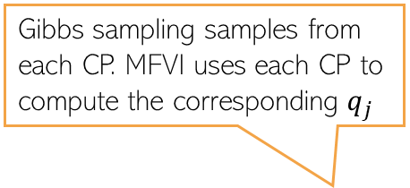
Mean-Field VI: A Closer Look
4
Since $log q_{j}^{∗}\left(Z_{j}\right)=𝔼_{i≠j}\left[log p(X,Z)\right]$ + const = $𝔼_{i≠j}\left[log p(X,Z_{j},Z_{−j})\right]$ + const
Thus opt variational distr $q_{j}^{∗}\left(Z_{j}\right)$basically requires expectations of CP $p\left(Z_{j} | X,Z_{−j}\right)$
For locally conjugate models, CP can be easily found and is an exp-fam distr of the form
Using the above, we can rewrite the optimal variational distribution as follows
Thus, with local conj, we just require expectation of nat. params. of CP of $Z_{j}$
For any model
Gibbs sampling samples from each CP. MFVI uses each CP to compute the corresponding $q_{j}$

Slide 5
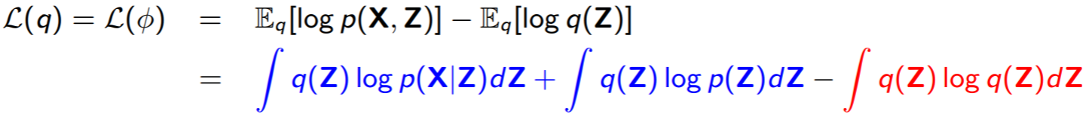
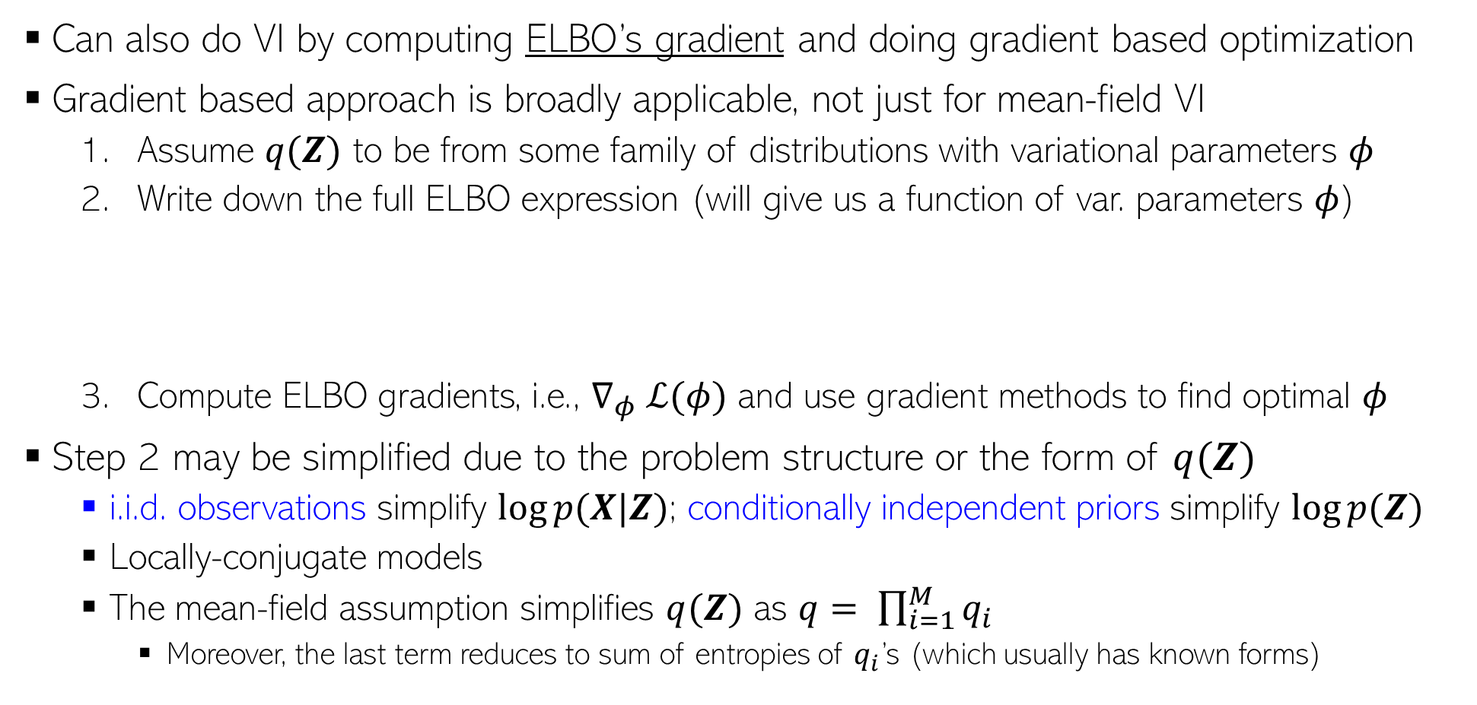
VI by Computing ELBO Gradients
5
Can also do VI by computing ELBO’s gradient and doing gradient based optimization
Gradient based approach is broadly applicable, not just for mean-field VI
  Assume $q(Z)$ to be from some family of distributions with variational parameters $φ$
  Write down the full ELBO expression (will give us a function of var. parameters $φ$)
  Compute ELBO gradients, i.e., $∇_{φ} ℒ(φ)$ and use gradient methods to find optimal $φ$
Step 2 may be simplified due to the problem structure or the form of $q(Z)$
  i.i.d. observations simplify $log⁡p(X|Z)$; conditionally independent priors simplify $log⁡p(Z)$
  Locally-conjugate models
  The mean-field assumption simplifies $q(Z)$ as $q= \prod_{i=1}^{M}{q_{i}}$
    Moreover, the last term reduces to sum of entropies of $q_{i}$’s (which usually has known forms)

Slide 6
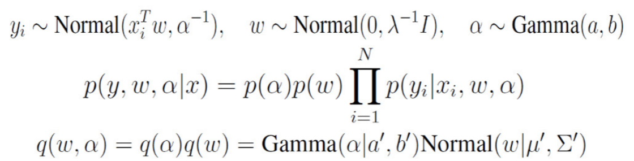

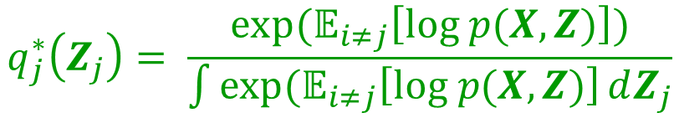


Mean-Field VI by Taking ELBO’s Gradients
6
Mean-field assumption $q\left(Z | φ\right)= \prod_{i=1}^{M}{q(Z_{i}|φ_{i})}$ results in following optimal distribution
Alternatively, we can take ELBO’s partial deriv w.r.t. $φ_{1},φ_{2},…,φ_{M}$ to find their optimal values
Consider a Bayesian linear regression model
Now doing VI amounts to maximizing ELBO to find the optimal variational params $a^{′},b^{′}, μ^{′},Σ^{′}$
Note that here we do not have to assume the form of this variational distribution. We simply compute the RHS and find what it is (in the locally-conjugate case, it will be the same distribution as the prior)
$$q_{j}^{∗}\left(Z_{j}\right)= \frac{exp(𝔼_{i≠j}\left[log p(X,Z)\right])}{\int{exp(𝔼_{i≠j}\left[log p(X,Z)\right]}dZ_{j}}$$
This approach is applicable even if we don’t have mean-field assumption
Prior on variance of Gaussian likelihood
Prior on $w$
$λ$assumed fixed
Likelihood
Needed in ELBO
Joint distribution on data and unknowns
Note that in this approach, we have to assume a form for each variational distribution. It is common to assume them to have the same form as the respective priors
Assumed variational posterior with mean-field assumption

Slide 7
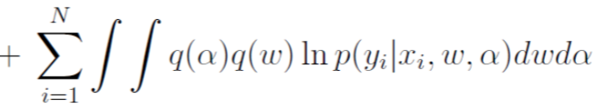


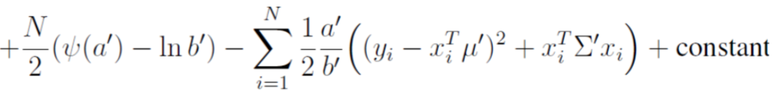

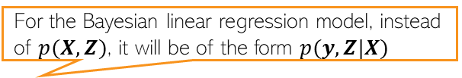
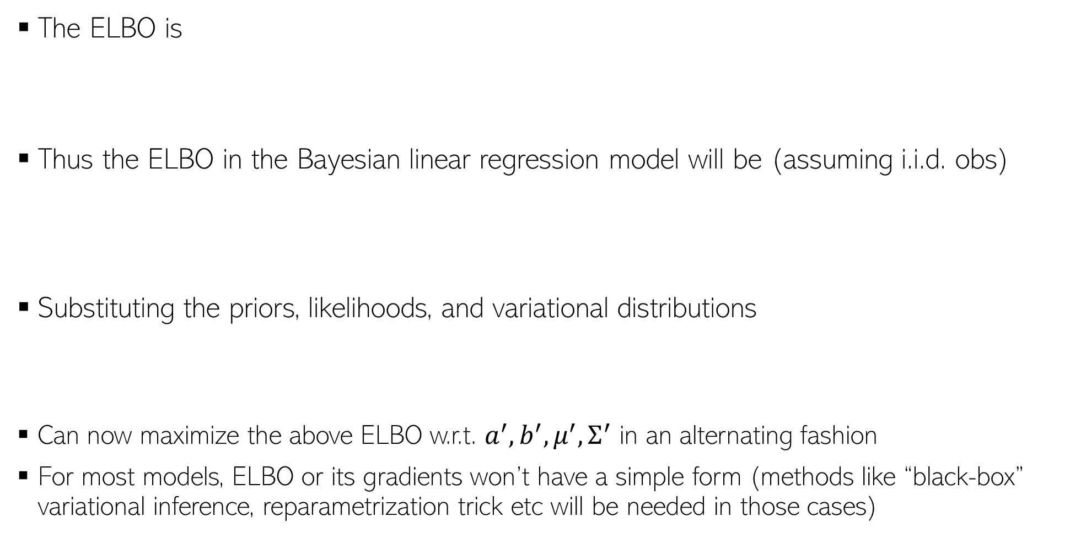
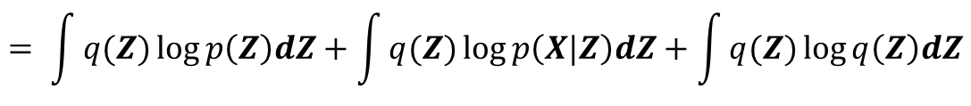
Mean-Field VI by Taking ELBO’s Gradients
7
The ELBO is
Thus the ELBO in the Bayesian linear regression model will be (assuming i.i.d. obs)
Substituting the priors, likelihoods, and variational distributions
Can now maximize the above ELBO w.r.t. $a^{′},b^{′}, μ^{′},Σ^{′}$ in an alternating fashion
For most models, ELBO or its gradients won’t have a simple form (methods like “black-box” variational inference, reparametrization trick etc will be needed in those cases)
For the Bayesian linear regression model, instead of $p(X,Z)$, it will be of the form $p(y,Z|X)$
$$ℒ\left(q\right)=ℒ\left(φ\right)= 𝔼_{q}\left[log p(X,Z)\right]−𝔼_{q}\left[\log{q\left(Z\right)}\right]= 𝔼_{q}\left[\log{p\left(Z\right)}\right]+𝔼_{q}\left[log p(X|Z)\right]−𝔼_{q}\left[log q(Z)\right]$$
$$= \int{q(Z)\log{p\left(Z\right)dZ}}+\int{q(Z)\log{p\left(X|Z\right)dZ}}+\int{q(Z)\log{q\left(Z\right)dZ}}$$
Expectations of the log of the likelihood
Expectations of the log of the var. distributions (= their entropies)
Expectations of the log of the prior
Digamma function (log of gamma function)

Slide 8






MFVI for LVMs with Local and Global Unknowns
8
Many LVMs have local and global unknowns
Examples: Gaussian Mixture Model, Prob. PCA, Variational Autoencoder (VAE), etc
Denote all local unknowns $\{z_{1},z_{2},…, z_{N}\}$ as $Z$ and global unknown as $β=(θ, φ)$
The goal is to infer the posterior $p(Z,β|X)$ which is intractable in general
Mean-field VI will approximating this posterior as $p\left(Z,β | X\right)≈q\left(Z,β\right)≈q\left(Z\right)q(β)$
$$θ$$
Global
$$φ$$
$$z_{n}$$
$$x_{n}$$
Global
Local
$$N$$

Slide 9
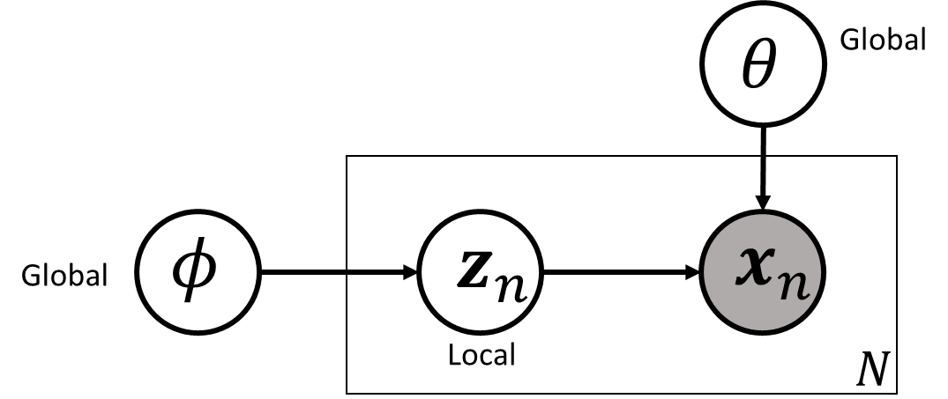
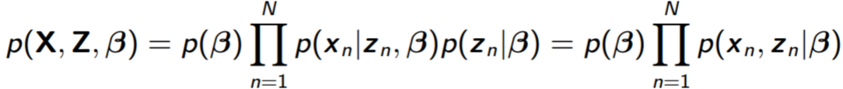
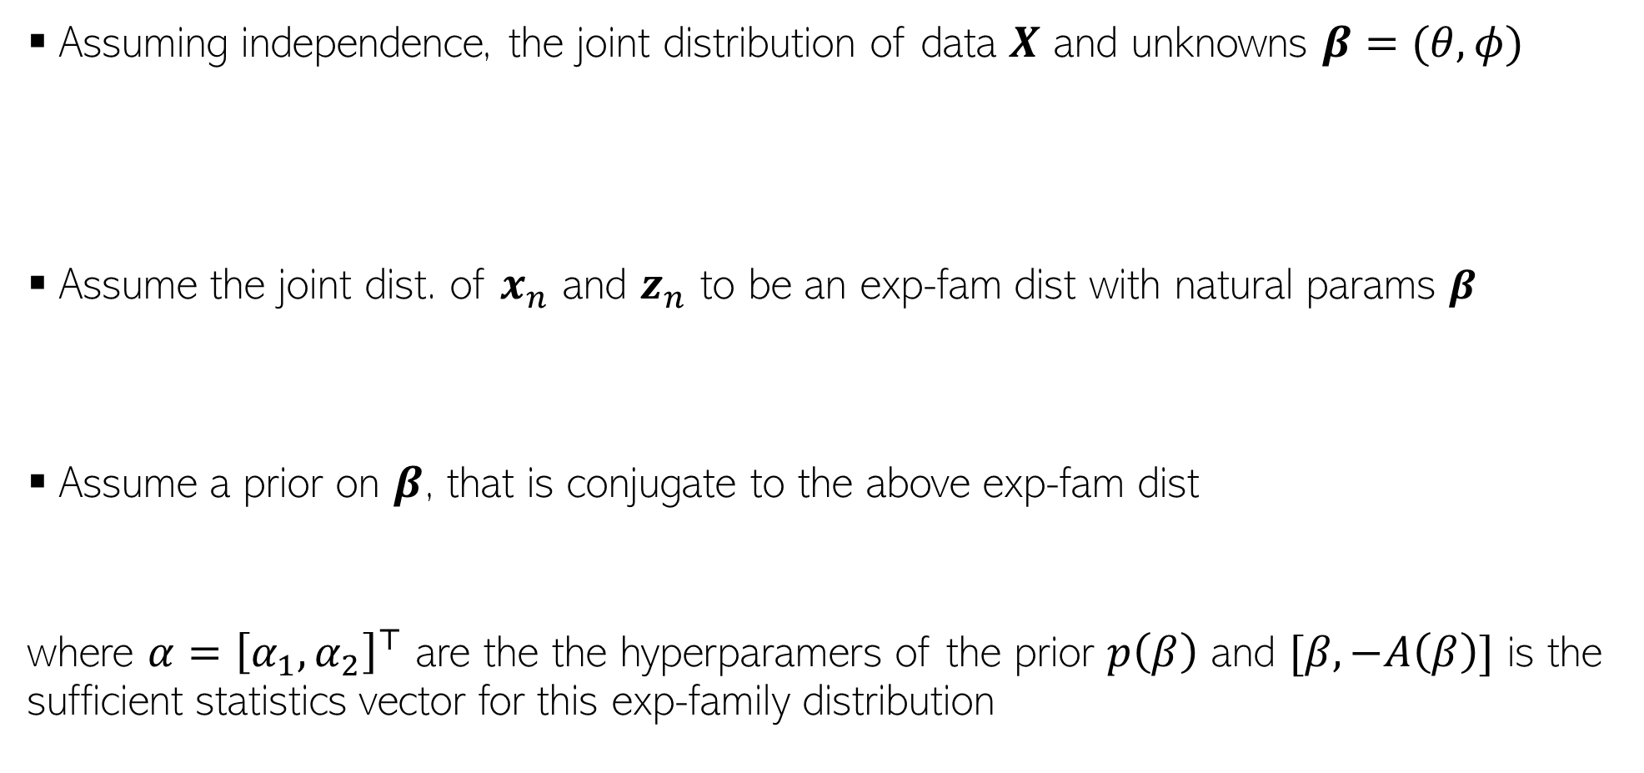
MFVI for LVMs with Local and Global Unknowns
9
Assuming independence, the joint distribution of data $X$ and unknowns $β=(θ, φ)$
Assume the joint dist. of $x_{n}$ and $z_{n}$ to be an exp-fam dist with natural params $β$
Assume a prior on $β$, that is conjugate to the above exp-fam dist
where $α={\left[α_{1},α_{2}\right]}^{⊤}$ are the the hyperparamers of the prior $p\left(β\right)$ and $[β, −A\left(β\right)]$ is the sufficient statistics vector for this exp-family distribution
Sufficient statistics

Slide 10
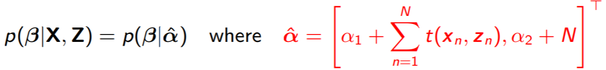


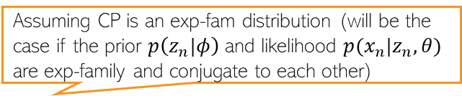


MFVI for LVMs with Local and Global Vars
10
Recall that mean-field VB can be obtained using CP of each unknown
Optimal var. distribution for each unknown requires expec. of nat. params of its CP
Due to conj, CP of global vars $β=(θ,φ)$, will have the same form as prior $p(β|α)$
Likewise, CP of each local variable $z_{n}$
Having these CPs, we can compute the mean-field updates for $q\left(β\right)$ and $q(z_{n})$
Updates to the natural parameters requires a summing suff-stats over all data and local variables
Due to the independence structure
Assuming CP is an exp-fam distribution (will be the case if the prior $p\left(z_{n}|φ\right)$ and likelihood $p(x_{n}|z_{n},θ)$ are exp-family and conjugate to each other)
Nat. params depends on data $x_{n}$ and global var $β$

Slide 11
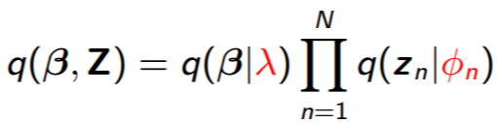

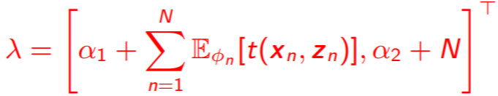

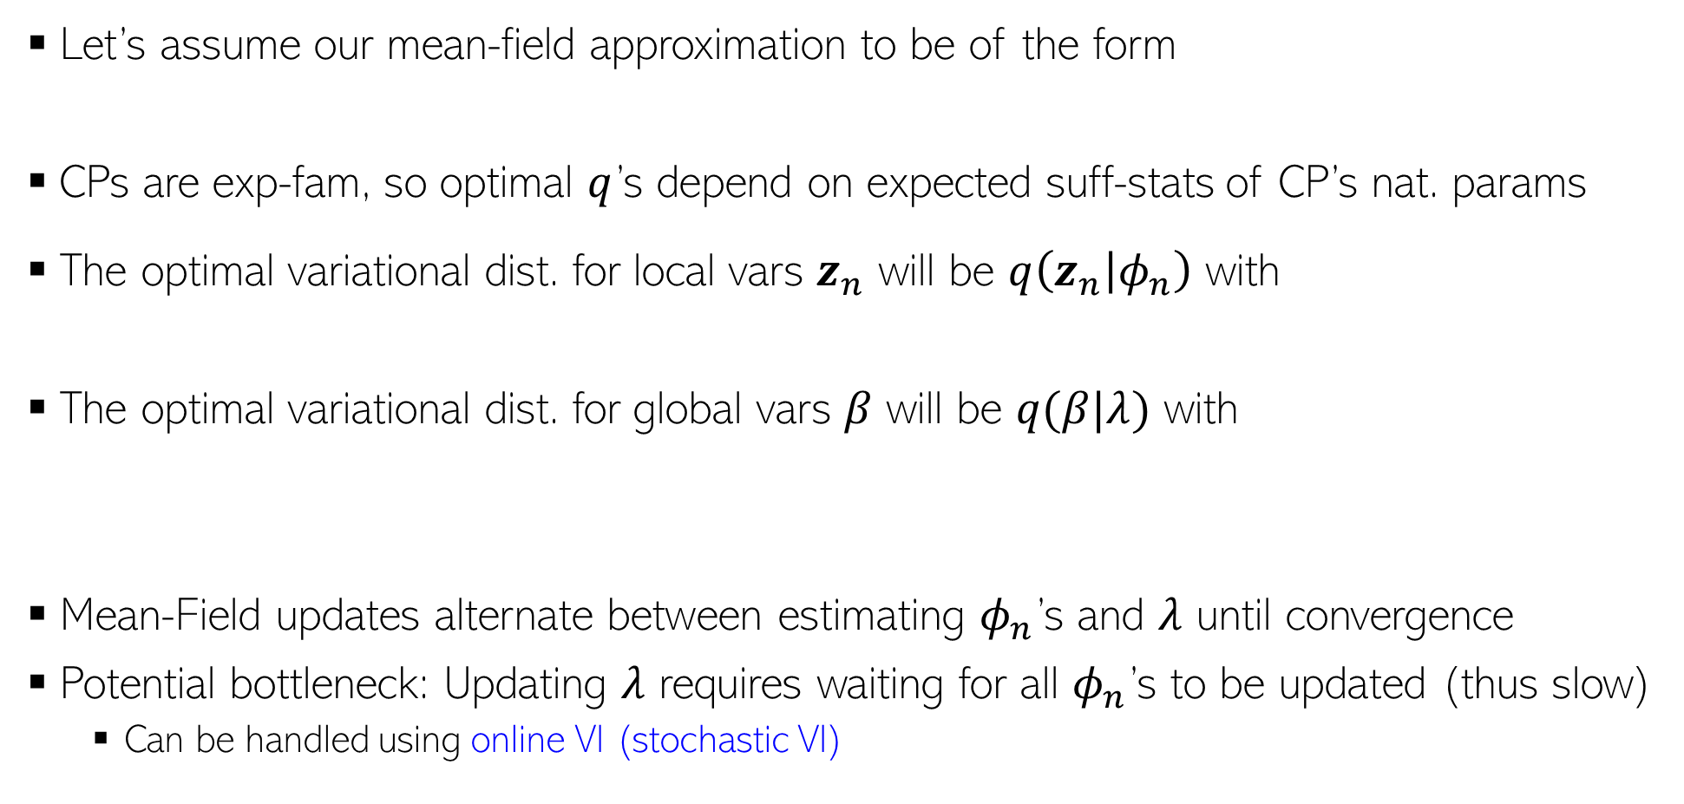

MFVI for LVMs with Local and Global Vars
11
Let’s assume our mean-field approximation to be of the form
CPs are exp-fam, so optimal $q$’s depend on expected suff-stats of CP’s nat. params
The optimal variational dist. for local vars $z_{n}$ will be $q\left(z_{n} | φ_{n}\right)$ with
The optimal variational dist. for global vars $β$ will be $q(β|λ)$ with
Mean-Field updates alternate between estimating $φ_{n}$’s and $λ$ until convergence
Potential bottleneck: Updating $λ$ requires waiting for all $φ_{n}$’s to be updated (thus slow)
  Can be handled using online VI (stochastic VI)
Basically requires expectation over the $q\left(β | λ\right)$ distribution
Basically requires expectation over the $q\left(z_{n} | φ_{n}\right)$ distribution

Slide 12




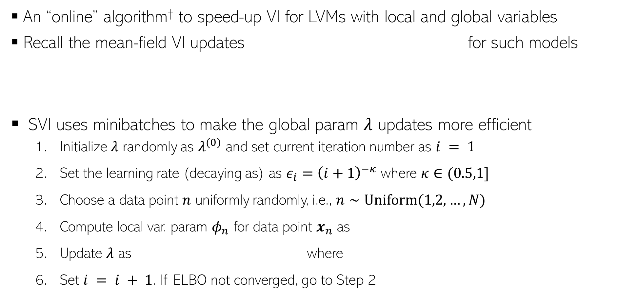
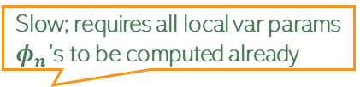

Stochastic Variational Inference (SVI)
12
An “online” algorithm† to speed-up VI for LVMs with local and global variables
Recall the mean-field VI updates for such models
SVI uses minibatches to make the global param $λ$ updates more efficient
  Initialize $λ$ randomly as $λ^{(0)}$ and set current iteration number as $i = 1$
  Set the learning rate (decaying as) as $ε_{i}={\left(i+1\right)}^{−κ}$ where $κ∈(0.5,1]$
  Choose a data point $n$ uniformly randomly, i.e., $n∼Uniform(1,2,…, N)$
  Compute local var. param $φ_{n}$ for data point $x_{n}$ as
  Update $λ$ as where
  Set $i = i + 1$. If ELBO not converged, go to Step 2
Local var. params
Nat. param of CP of $z_{n}$
Global var. params
Slow; requires all local var params $φ_{n}$’s to be computed already
Nat. param of CP of $β$
Assuming minibatch size = 1
†Stochastic Variational Inference (Hoffman et al, 2013)

Slide 13
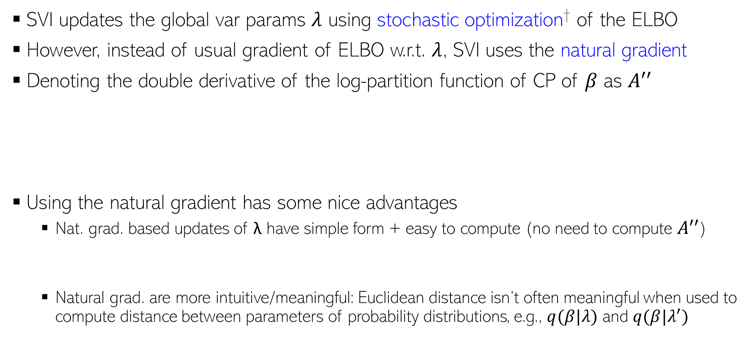
What is SVI Doing?
13
SVI updates the global var params $λ$ using stochastic optimization† of the ELBO
However, instead of usual gradient of ELBO w.r.t. $λ$, SVI uses the natural gradient
Denoting the double derivative of the log-partition function of CP of $β$ as $A^{′′}$
Using the natural gradient has some nice advantages
  Nat. grad. based updates of λ have simple form + easy to compute (no need to compute $A^{′′}$)
  Natural grad. are more intuitive/meaningful: Euclidean distance isn’t often meaningful when used to compute distance between parameters of probability distributions, e.g., $q(β|λ)$ and $q(β|λ^{′})$
If interested in the proof, can see the derivation in the SVI paper
†Stochastic Variational Inference (Hoffman et al, 2013)

Slide 14
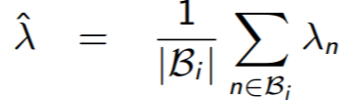


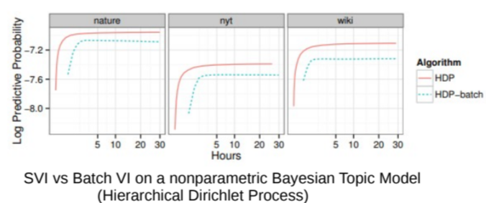
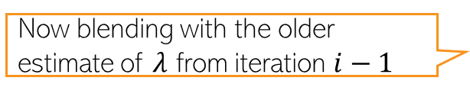

SVI: Some Comments
14
Often operates on minibatches: For iteration $i$ minibatch $ℬ_{i}$, update $λ$ as follows
Decaying learning rate $ε_{i}$ is necessary for convergence (need )
SVI successfully used on many large-scale problems (topic modeling, citation network analysis, etc). Much faster convergence (and better results) compared to batch VI
Global var. param computed on this minibatch
Now blending with the older estimate of $λ$ from iteration $i−1$
†Stochastic Variational Inference (Hoffman et al, 2013)

Slide 15
Coming Up Next
15
VI for non-conjugate models
  Black-box VI (BBVI) for general purpose VI
  Reparametrization Trick for general purpose VI
  Some model-specific tricks
Other recent advances in VI
  Amortized VI
  Structured VI

