Slide 1
Variational Inference
CS772A: Probabilistic Machine Learning
Piyush Rai

Slide 2
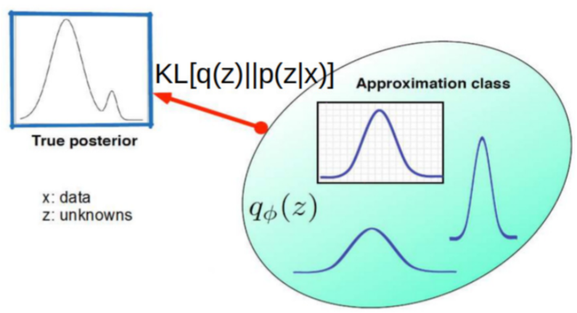
Variational Bayes (VB) or Variational Inference (VI)
2
Consider a model with data $X$ and unknowns $Z$. Goal: Compute the posterior $p(Z|X)$
$Z$ denotes all unknowns (params, latent vars, hyperparams of likelihood, prior, etc)
Assuming $p(Z|X)$ is intractable, VB/VI approximates it by a distr $q(Z|φ)$ or $q_{φ}(Z)$
We find the best approx. distr by finding $φ$ s.t. its distance from $p(Z|X)$ is minimized
Note: The name “variational” comes from Physics
Optimizing functions of distributions (KL is a func of distr)
Defines a class of distributions parametrized by $φ$
Often called variational parameters
But since we don’t know $p(Z|X)$, can we easily solve this optimization problem?
Other measures have also been used such as reverse KL ($KL[p||q]$), and various other divergence functions defined for distributions
VI turns inference into optimization
Often, we will simply write it as ${argmin}_{q} KL[q|\left|p_{z}\right]$
$$φ^{∗}= {argmin}_{φ} KL[q_{φ}(Z)||p(Z|X)]$$

Slide 3
Variational Bayes (VB) or Variational Inference (VI)
3
VB/VI is based on following identity for the log marg-lik (log evidence) of a model $m$
Since the log evidence $log p\left(X | m\right)$ is constant w.r.t $Z$, we must have
Also note that since $KL[q|\left|p_{z}\right]≥0$, we must have $log p\left(X | m\right)≥ ℒ\left(q\right)$
Therefore, $ℒ\left(q\right)$ is also known as Evidence Lower Bound (ELBO)
VB/VI finds the best $q(Z)$ by maximizing the ELBO w.r.t. $q$
Similar as the identify we had in case of EM, which was defined for log of the ILL
$$log p\left(X | m\right)= ℒ\left(q\right)+KL(q||p_{z})$$
Also, unlike EM, here we don’t have any distinction b/w latent variables $Z$ and parameters $Θ$ (all unknowns will be denoted by $Z$ here, and we have $ℒ\left(q\right)$, not $ℒ\left(q,Θ\right)$)
$$ℒ\left(q\right)= \int{q\left(Z\right)log\left\{\frac{p(X,Z)}{q(Z)}\right\}dZ}$$
$$KL(q|\left|p_{z}\right)=− \int{q\left(Z\right)log\left\{\frac{p(Z|X)}{q(Z)}\right\}dZ}$$
$${argmin}_{q} KL[q|\left|p_{z}\right]={argmax}_{q} ℒ\left(q\right)$$

Slide 4
VB/VI = Maximizing the ELBO
4
Notation: $q(Z)$, $q(Z|φ)$, $q_{φ}(Z)$, all refer to the same thing (the approx. distr.)
VB/VI finds an approximating distribution $q(Z)$ that maximizes the ELBO
Since $q(Z)$ depends on $φ$, the ELBO is essentially a function of $φ$
Thus maximizing the ELBO will give an approximating distr. $q(Z)$ which
Explains the data $X$ well, i.e., gives it large probability (large $𝔼_{q}\left[log p(X|Z)\right]$)
Is close to the prior $p(Z)$, i.e. is simple/regularized (small $KL\left[log q(Z)||p(Z)\right]$)
$$ℒ\left(q\right)= \int{q\left(Z\right)log \left[\frac{p(X,Z)}{q(Z)}\right]dZ}$$
$$ℒ\left(q\right)=ℒ\left(φ\right)= 𝔼_{q}\left[log p(X,Z)\right]−𝔼_{q}\left[log q(Z)\right]$$
$$= 𝔼_{q}\left[log p(X|Z)\right]−KL\left[q(Z)||p(Z)\right]$$

Slide 5
Maximizing the ELBO
5
The goal is to maximize the ELBO
This may still be hard because
ELBO expression has expectations, computed which may be intractable
Maximizing the ELBO will require computing gradients which may not always be easy
Some of the ways to make this problem easier
Restricting the form of our approximation $q(Z)$, e.g., mean-field VI
Using Monte-Carlo approximation of the expectation/gradient of the ELBO
For locally conjugate models, ELBO maximization is easy
Closed form updates for $q(Z)$
$$ℒ\left(q\right)=ℒ\left(φ\right)= 𝔼_{q}\left[log p(X,Z)\right]−𝔼_{q}\left[log q(Z)\right]$$
$$= 𝔼_{q}\left[log p(X|Z)\right]−KL\left[log q(Z)||p(Z)\right]$$
E.g., part of the ELBO may have terms that are not differentiable

Slide 6
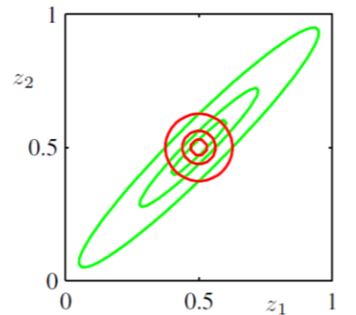
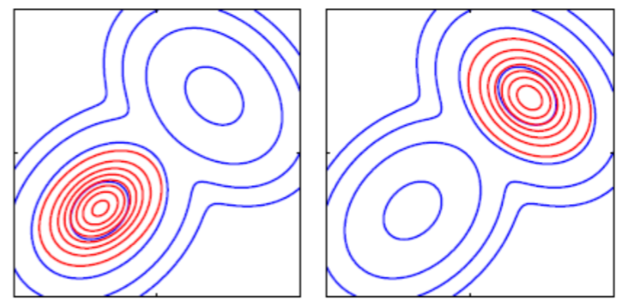
Some Properties of VI
6
Recall that VI approximates a posterior $p$ by finding $q$ that minimizes $KL(q||p)$
$q(Z)$ will be small where $p(Z|X)$ is small otherwise KL will blow up
Thus $q(Z)$ avoids low-probability regions of the true posterior
Some methods, e.g., Expectation Propagation (EP), can avoid this behavior
$q$(red) avoids regions of $p$ (green) where the latter has low values
$q$(red) concentrated on one of the modes of $p$ (blue)
For $q$ to also capture the other mode, it will require crossing the low-probability region of $p$, thereby blowing up the KL
EP minimizes $KL(p||q)$

Slide 7
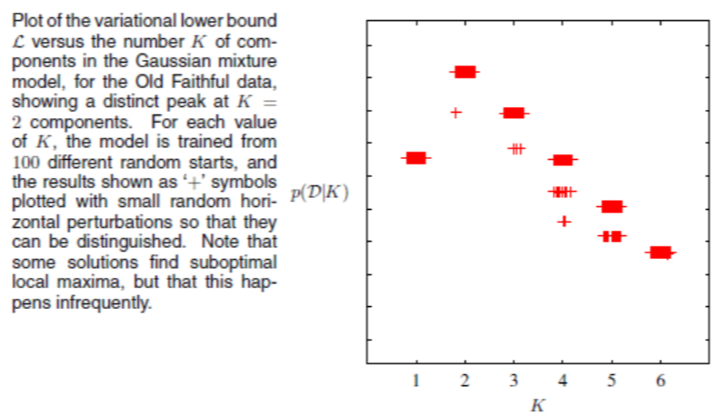
ELBO for Model Selection
7
Recall that ELBO is a lower bound on log of model evidence $log p(X|m)$
Can compute ELBO for each model $m$ and choose the one with largest ELBO
Some criticism since we are using a lower-bound but often works well in practice
Each value of $K$ represents a different model

Slide 8
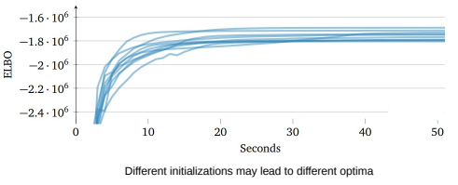
VI and Convergence
8
VI is guaranteed to converge to a local optima (just like EM)
Therefore proper initialization is important (just like EM)
Can sometimes run multiple times with different initializations and choose the best run
ELBO increases monotonically with iterations
Can thus monitor the ELBO to assess convergence

Slide 9
Variational Inference and Expectation Maximization
9
VI can be seen as a generalization of the EM algorithm
In VI, there is no distinction between parameters $Θ$ and latent variables $Z$
Also recall that EM finds CP of $Z$ and point estimate for $Θ$
VI treats all unknowns identically and infers posterior for all
VI can be used within an EM algorithm if the E step is intractable
E step is intractable if the CP of latent variables given params is intractable
This version of EM is known as Variational EM (VEM)
If we only care about point estimates of the parameters, VEM is widely used if the CP of latent variables is intractable

Slide 10
Mean-Field VI
10
The name “mean-field” comes from statistical physics literature
One of the simplest ways for doing VB/VI
Assumes unknowns $Z$ can be partitioned into $M$ groups $Z_{1}, Z_{2},. . . , Z_{M}$, s.t.,
Learning the optimal $q$ reduces to learning the optimal $q_{1},q_{2},…, q_{M}$
Groups usually chosen based on model’s structure, e.g., in Bayesian linear regression
Mean-field is a very restrictive assumption. Ignores the correlations among unknowns
Less restrictive versions also exist, such as structured mean-field (factorization is still there but only among groups of unknowns)
$$q\left(Z | φ\right)= \prod_{i=1}^{M}{q(Z_{i}|φ_{i})}$$
As a shorthand, often written as $q= \prod_{i=1}^{M}{q_{i}}$ where $q_{i}=q\left(Z_{i} | φ_{i}\right)$
$$p\left(w,β, λ | X,y\right)≈q\left(Z | φ\right)$$
$$=q\left(w,β, λ | φ\right)$$
$$=q\left(w | φ_{w}\right)p\left(β | φ_{β}\right)p(λ|φ_{λ})$$

Slide 11
Deriving Mean-Field VI Updates
11
With $q= \prod_{i=1}^{M}{q_{i}}$, what’s the optimal $q_{i}$ when we do ${argmax}_{q} ℒ\left(q\right)$?
Note that under this mean-field assumption, the ELBO simplifies to
Suppose we wish to find the optimal $q_{j}$ given all other $q_{i}$’s ($i≠j$) as fixed, then
Thus $q_{j}^{∗}$ = ${argmax}_{q_{j}} ℒ\left(q\right)$= ${argmin}_{q_{j}}KL(q_{j}||\hat{p}) =\hat{p}(X,Z_{j})$
$$ℒ\left(q\right)= \int{q\left(Z\right)log \left[\frac{p(X,Z)}{q(Z)}\right]dZ}= \int{\prod_{i}{q_{i}}}\left[log p\left(X,Z\right)−\sum_{i}{log q_{i}}\right]dZ$$
$$ℒ\left(q\right)= \int{q_{j}}\left[\int{log p\left(X,Z\right)\prod_{i≠j}{q_{i}}{dZ}_{i}}\right]{dZ}_{j} − \int{q_{j}log q_{j}{dZ}_{j}}+const w.r.t. q_{j}$$
$$= \int{q_{j}}log \hat{p}(X,Z_{j}) {dZ}_{j} − \int{q_{j}log q_{j}Z_{j}}$$
$$q_{j}^{∗}= \frac{exp(𝔼_{i≠j}\left[log p(X,Z)\right])}{\int{exp(𝔼_{i≠j}\left[log p(X,Z)\right]}dZ_{j}}$$
$$=−KL(q_{j}||\hat{p})$$
$log \hat{p}\left(X,Z_{j}\right)=𝔼_{i≠j}\left[log p(X,Z)\right]$ + const

Slide 12
Deriving Mean-Field VI Updates
12
So we saw that the optimal $q_{j}$ when doing mean-field VI is
Note: Can often just compute the numerator and recognize denominator by inspection
Important: For locally conjugate models, $q_{j}^{∗}\left(Z_{j}\right)$ will have the same form as prior $p(Z_{j})$
Only the distribution parameters will be different
Important: For estimating $q_{j}$ the required expectation depends on other ${\left\{q_{i}\right\}}_{i≠j}$
Thus we use an alternating update scheme for these (akin to ALT-OPT, Gibbs sampling, etc)
Guaranteed to converge (to a local optima)
We are basically solving a sequence of concave maximization problems
Reason: $ℒ\left(q\right)=\int{q_{j}}log \hat{p}(X,Z_{j}) Z_{j} − \int{q_{j}log q_{j}Z_{j}}$ is concave in $q_{j}$
$$q_{j}^{∗}\left(Z_{j}\right)= \frac{exp(𝔼_{i≠j}\left[log p(X,Z)\right])}{\int{exp(𝔼_{i≠j}\left[log p(X,Z)\right]}dZ_{j}}$$

Slide 13
The Mean-Field VI Algorithm
13
Also known as Co-ordinate Ascent Variational Inference (CAVI) Algorithm
Input: Model in form of priors and likelihood, or joint $p(X,Z)$, Data $X$
Output: A variational distribution $q(Z)= \prod_{j=1}^{M}{q_{j}(Z_{j})}$
Initialize: Variational distributions $q_{j}(Z_{j})$, $j=1,2,…M$
While the ELBO has not converged
For each $j=1,2,…M$, set
Compute ELBO $ℒ\left(q\right)= 𝔼_{q}\left[log p(X,Z)\right]−𝔼_{q}\left[log q(Z)\right]$
$$q_{j}\left(Z_{j}\right)∝ exp(𝔼_{i≠j}\left[log p(X,Z)\right])$$

Slide 14
Mean-Field VI: A Simple Example
14
Consider data $X =\{x_{1},x_{2},…, x_{N}\}$ from a one-dim Gaussian $𝒩(μ, τ^{−1})$
Assume the following normal-gamma prior on $μ$ and $τ$
Posterior is also normal-gamma due to the jointly conjugate prior
Let’s anyway verify this by trying mean-field VI for this model
With mean-field assumption on the variational posterior $q\left(μ, τ\right)=q_{μ}\left(μ\right)q_{τ}(τ)$
In this example, the log-joint . Thus

Slide 15
Mean-Field VI: A Simple Example
15
Substituting $p\left(X | μ, τ\right)= \prod_{n=1}^{N}{p(x_{n}|μ, τ)}$ and $p(μ|τ)$, we get
(Verify) The above is log of a Gaussian. This $q_{μ}^{∗}=𝒩(μ|μ_{N},λ_{N})$ with
Proceeding in a similar way (verify), we can show that $q_{τ}^{∗}=Gamma(τ|a_{N},b_{N})$
Note: Updates of $q_{μ}^{∗}$ and $q_{τ}^{∗}$ depend on each other (hence alternating updates needed)
This update depends on $q_{τ}$
This update depends on $q_{μ}$

Slide 16
Mean-Field VI: A Closer Look
16
Since $log q_{j}^{∗}\left(Z_{j}\right)=𝔼_{i≠j}\left[log p(X,Z)\right]$ + const = $𝔼_{i≠j}\left[log p(X,Z_{j},Z_{−j})\right]$ + const
Thus opt variational distr $q_{j}^{∗}\left(Z_{j}\right)$basically requires expectations of CP $p\left(Z_{j} | X,Z_{−j}\right)$
For locally conjugate models, CP can be easily found and is usually an exp-fam distr
Using the above, we can rewrite the optimal variational distribution as follows
Thus, with local conj, we just require expectation of nat. params. of CP of $Z_{j}$
For any model
For locally conjugate model

Slide 17
VI by Computing ELBO Gradients
17
Modern VI methods (e.g., those used in Bayesian deep learning) use this idea (more later)
Can also do VI by computing ELBO’s gradient and doing gradient ascent/descent
Gradient based approach is broadly applicable, not just for mean-field VI
Assume $q(Z)$ to be from some family of distributions with variational parameters $φ$
Write down the full ELBO expression (will give us a function of var parameters $φ$)
Compute ELBO gradients, i.e., $∇_{φ} ℒ(φ)$ and use gradient methods to find optimal $φ$
Step 2 may be simplified due to the problem structure or the form of $q(Z)$
i.i.d. observations simplify $log⁡p(X|Z)$; conditionally independent priors simplify $log⁡p(Z)$
Locally-conjugate models
The mean-field assumption simplifies $q(Z)$ as $q= \prod_{i=1}^{M}{q_{i}}$
Moreover, the last term reduces to sum of entropies of $q_{i}$’s (which usually has known forms)

Slide 18
Mean-Field VI by Taking ELBO’s Gradients
18
Mean-field assumption $q\left(Z | φ\right)= \prod_{i=1}^{M}{q(Z_{i}|φ_{i})}$ results in following optimal distribution
Alternatively, we can take ELBO’s partial deriv w.r.t. $φ_{1},φ_{2},…,φ_{M}$ to find their optimal values
Consider a Bayesian linear regression model
Now doing VI amounts to maximizing ELBO to find the optimal variational params $a^{′},b^{′}, μ^{′},Σ^{′}$
Note that here we do not have to assume the form of this variational distribution. We simply compute the RHS and find what it is (in the locally-conjugate case, it will be the same distribution as the prior)
$$q_{j}^{∗}\left(Z_{j}\right)= \frac{exp(𝔼_{i≠j}\left[log p(X,Z)\right])}{\int{exp(𝔼_{i≠j}\left[log p(X,Z)\right]}dZ_{j}}$$
This approach is applicable even if we don’t have mean-field assumption
Prior on variance of Gaussian likelihood
Prior on $w$
$λ$assumed fixed
Likelihood
Needed in ELBO
Joint distribution on data and unknowns
Note that in this approach, we have to assume a form for each variational distribution. It is common to assume them to have the same form as the respective priors
Assumed variational posterior with mean-field assumption

Slide 19
Mean-Field VI by Taking ELBO’s Gradients
19
The ELBO is
Thus the ELBO in the Bayesian linear regression model will be (assuming i.i.d. obs)
Substituting the priors, likelihoods, and variational distributions
Can now maximize the above ELBO w.r.t. $a^{′},b^{′}, μ^{′},Σ^{′}$ in an alternating fashion
For most models, ELBO or its gradients won’t have a simple form (methods like BBVI, reparam trick etc will be needed in those cases)
For the Bayesian linear regression model, instead of $p(X,Z)$, it will be of the form $p(y,Z|X)$
$$ℒ\left(q\right)=ℒ\left(φ\right)= 𝔼_{q}\left[log p(X,Z)\right]−𝔼_{q}\left[\log{q\left(Z\right)}\right]= 𝔼_{q}\left[\log{p\left(Z\right)}\right]+𝔼_{q}\left[log p(X|Z)\right]−𝔼_{q}\left[log q(Z)\right]$$
$$= \int{q(Z)\log{p\left(Z\right)dZ}}+\int{q(Z)\log{p\left(X|Z\right)dZ}}+\int{q(Z)\log{q\left(Z\right)dZ}}$$
Expectations of the log of the likelihood
Expectations of the log of the var. distributions (= their entropies)
Expectations of the log of the prior
Digamma function (log of gamma function)

Slide 20
Coming Up Next
20
VI for latent variable models with local and global unknowns
VI for non-conjugate models
Mostly such methods rely on computing approximations of ELBO and/or its gradients

