Slide 1
Latent Variable Models and the EM Algorithm (Contd)
CS772A: Probabilistic Machine Learning
Piyush Rai

Slide 2
Announcement
2
Mid-sem exam on Sept 19, 1800-2000
Venue: L17, ERES seating scheme
Syllabus: Up to today’s lecture
Closed book exam
  Necessary formulae/equations will be provided in the question paper

Slide 3
Plan Today
3
Expectation Maximization (EM) algorithm for param-est/inference in LVMs
An example of EM
  Parameter estimation for Gaussian mixture models

Slide 4






Parameter Estimation in Latent Variable Models
4
Assume each observation $x_{n}$ to be associated with a “local” latent variable $z_{n}$
Although we can do fully Bayesian inference for all the unknowns, suppose we only want a point estimate of the “global” parameters $Θ = (θ, φ)$ via MLE/MAP
Such MLE/MAP problems in LVMs are difficult to solve in a “clean” way
  Can do gradient based opt on log-lik but usually won’t get closed form updates for $Θ$
  However, EM algo gives a clean way to obtain closed form updates for $Θ$ for such LVMs
$p\left(z_{n} | φ\right):$ A suitable prior distribution based on the nature of $z_{n}$
$$θ$$
$p\left(x_{n} | z_{n},θ\right):$ A suitable likelihood based on the nature of $x_{n}$
$$φ$$
$$z_{n}$$
$$x_{n}$$
$$N$$

Slide 5
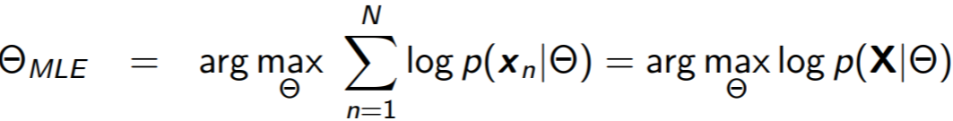
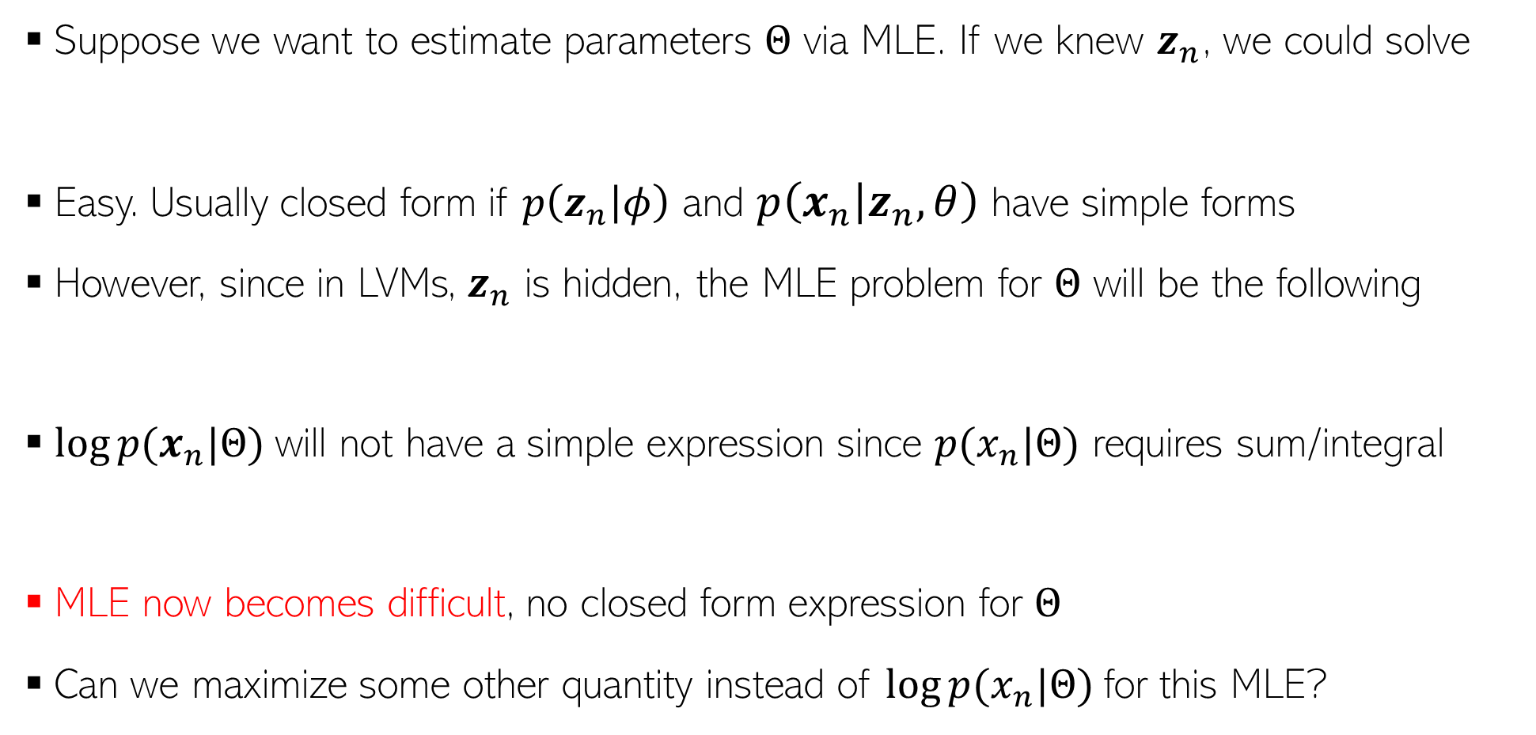

Why MLE/MAP of Params is Hard for LVMs?
5
Suppose we want to estimate parameters $Θ$ via MLE. If we knew $z_{n}$, we could solve
Easy. Usually closed form if $p\left(z_{n} | φ\right)$ and $p\left(x_{n} | z_{n},θ\right)$ have simple forms
However, since in LVMs, $z_{n}$ is hidden, the MLE problem for $Θ$ will be the following
$log⁡p(x_{n}|Θ)$will not have a simple expression since $p(x_{n}|Θ)$ requires sum/integral
MLE now becomes difficult, no closed form expression for $Θ$
Can we maximize some other quantity instead of $log⁡p(x_{n}|Θ)$for this MLE?
Easy to solve
In particular, if they are exp-fam distributions
Can still use gradient based methods but won’t get clean, closed-form updates for $Θ$

Slide 6
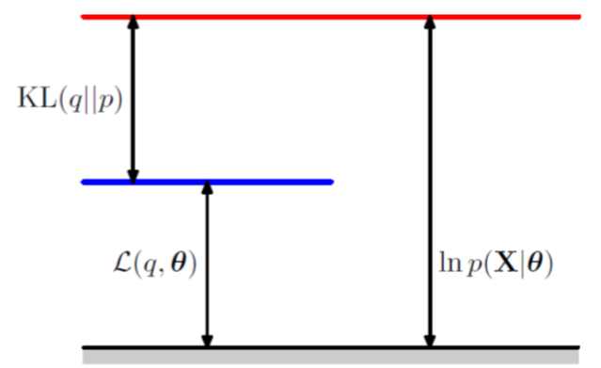
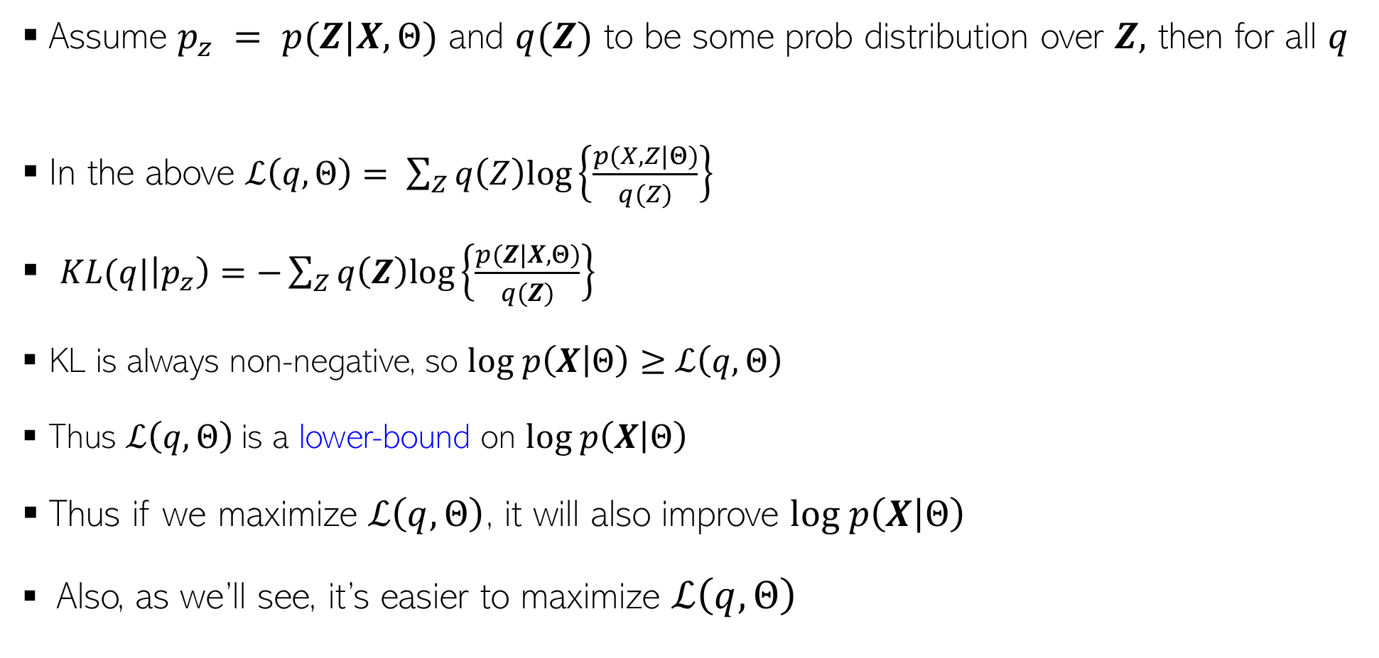

An Important Identity
6
Assume $p_{z} = p(Z|X,Θ)$ and $q(Z)$ to be some prob distribution over $Z,$ then for all $q$
In the above $ℒ\left(q,Θ\right)= \sum_{Z}{q\left(Z\right)log\left\{\frac{p(X,Z|Θ)}{q(Z)}\right\}}$
$KL(q|\left|p_{z}\right)=−\sum_{Z}{q\left(Z\right)log\left\{\frac{p(Z|X,Θ)}{q(Z)}\right\}}$
KL is always non-negative, so $log p\left(X | Θ\right)≥$ $ℒ\left(q,Θ\right)$
Thus $ℒ\left(q,Θ\right)$ is a lower-bound on $log p\left(X | Θ\right)$
Thus if we maximize $ℒ\left(q,Θ\right)$, it will also improve $log p\left(X | Θ\right)$
Also, as we’ll see, it’s easier to maximize $ℒ\left(q,Θ\right)$
$$log p\left(X | Θ\right)= ℒ\left(q,Θ\right)+KL(q||p_{z})$$
Verify the identity
Assume $Z$ discrete

Slide 7

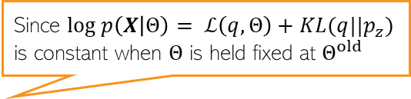
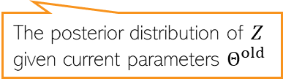

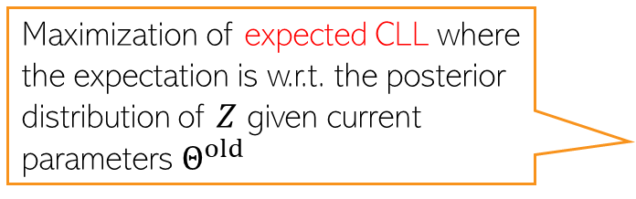
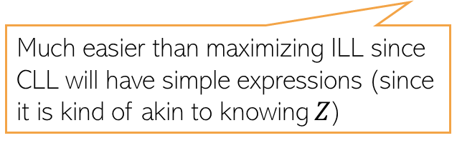
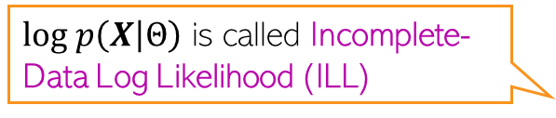


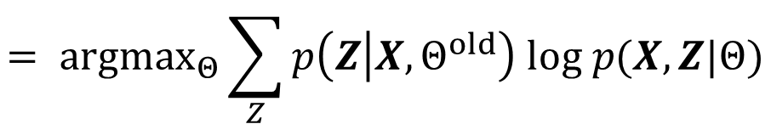

Maximizing $ℒ\left(q,Θ\right)$
7
7
$log p\left(X | Θ\right)$ is called Incomplete-Data Log Likelihood (ILL)
$ℒ\left(q,Θ\right)$ depends on $q$ and $Θ$. We’ll use ALT-OPT to maximize it
Let’s maximize $ℒ\left(q,Θ\right)$ w.r.t. $q$ with $Θ$ fixed at some $Θ^{old}$
Now let’s maximize $ℒ\left(q,Θ\right)$ w.r.t. $Θ$ with $q$ fixed at $\hat{q}=p_{z}=p(Z|X,Θ^{old})$
Since $log p\left(X | Θ\right)= ℒ\left(q,Θ\right)+KL(q||p_{z})$ is constant when $Θ$ is held fixed at $Θ^{old}$
$$\hat{q}= {argmax}_{q}ℒ\left(q,Θ^{old}\right)= {argmin}_{q}KL(q|\left|p_{z}\right)$$
$$=p_{z}=p(Z|X,Θ^{old})$$
The posterior distribution of $Z$ given current parameters $Θ^{old}$
$$Θ^{new}= {argmax}_{Θ}ℒ\left(\hat{q},Θ\right)= {argmax}_{Θ}\sum_{Z}{p(Z|X,Θ^{old}) log\left\{\frac{p(X,Z|Θ)}{p(Z|X,Θ^{old}) }\right\}}$$
Maximization of expected CLL where the expectation is w.r.t. the posterior distribution of $Z$ given current parameters $Θ^{old}$
$$= {argmax}_{Θ}\sum_{Z}{p\left(Z | X,Θ^{old}\right) log p(X,Z|Θ)}$$
Complete-Data Log Likelihood (CLL)
$$= {argmax}_{Θ} 𝔼_{p\left(Z | X,Θ^{old}\right)}[log p(X,Z|Θ)]$$
Much easier than maximizing ILL since CLL will have simple expressions (since it is kind of akin to knowing $Z$)
$$= {argmax}_{Θ} 𝒬(Θ,Θ^{old})$$

Slide 8
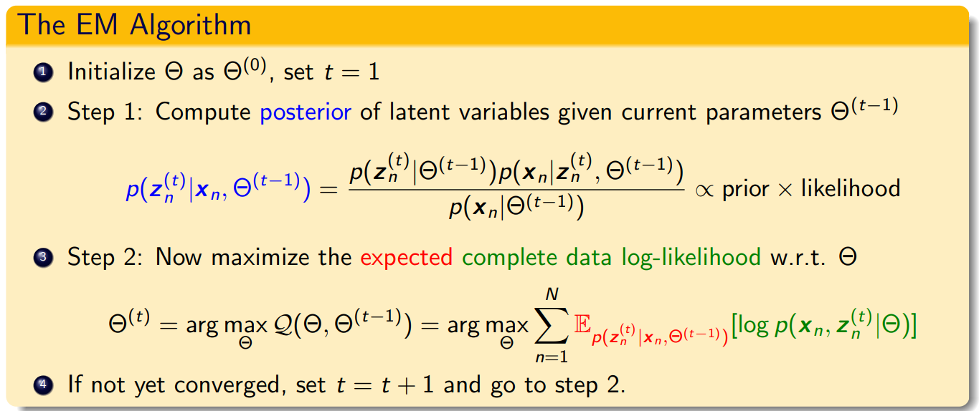
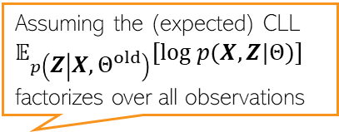


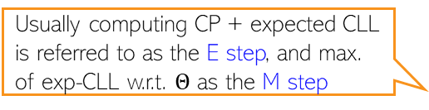

The Expectation-Maximization (EM) Algorithm
8
ALT-OPT of $ℒ\left(q,Θ\right)$ w.r.t. $q$ and $Θ$ gives the EM algorithm (Dempster, Laird, Rubin, 1977)
Note: If we can take the MAP estimate ${\hat{z}}_{n}$ of $z_{n}$ (not the CP) in Step 1 and maximize the CLL in Step 2 using that, i.e., do ${argmax}_{Θ}\sum_{n=1}^{N}{\left[log p\left(x_{n}, {{\hat{z}}_{n}}^{(t)} | Θ\right)\right]}$then this will be std ALT-OPT
Primarily designed for doing point estimation of the parameters $Θ$ but also gives (CP of) latent variables $z_{n}$
Usually computing CP + expected CLL is referred to as the E step, and max. of exp-CLL w.r.t. $Θ$ as the M step
Conditional posterior of each latent variable $z_{n}$
Latent variables also assumed indep. a priori
Assuming the (expected) CLL $𝔼_{p\left(Z | X,Θ^{old}\right)}[log p(X,Z|Θ)]$ factorizes over all observations

Slide 9
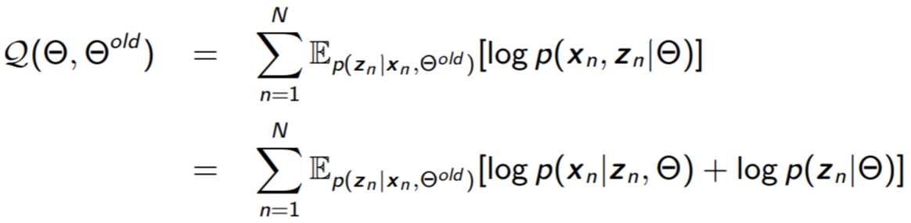
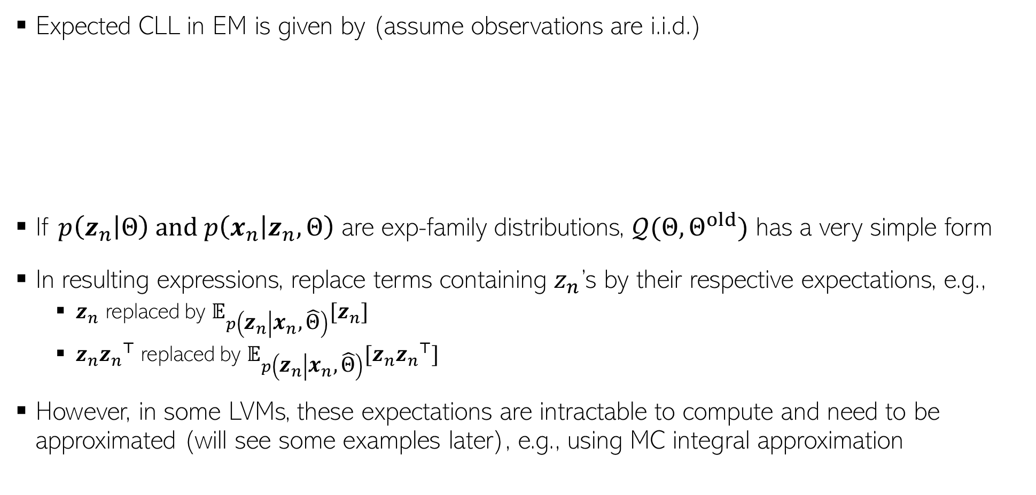
The Expected CLL
Expected CLL in EM is given by (assume observations are i.i.d.)
If $p\left(z_{n} | Θ\right)$ and $p\left(x_{n} | z_{n},Θ\right)$ are exp-family distributions, $𝒬(Θ,Θ^{old})$ has a very simple form
In resulting expressions, replace terms containing $z_{n}$’s by their respective expectations, e.g.,
  $z_{n}$ replaced by $𝔼_{p\left(z_{n} | x_{n},\hat{Θ}\right)}[z_{n}]$
  $z_{n}{z_{n}}^{⊤}$ replaced by $𝔼_{p\left(z_{n} | x_{n},\hat{Θ}\right)}[z_{n}{z_{n}}^{⊤}]$
However, in some LVMs, these expectations are intractable to compute and need to be approximated (will see some examples later), e.g., using MC integral approximation

Slide 10

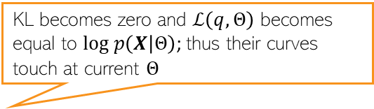

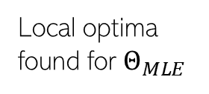
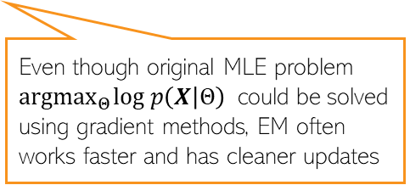




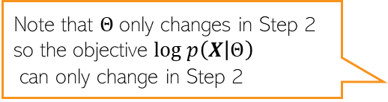


10
What’s Going On In EM?
Alternating between them until convergence to some local optima
KL becomes zero and $ℒ\left(q,Θ\right)$ becomes equal to $log p\left(X | Θ\right)$; thus their curves touch at current $Θ$
As we saw, the maximization of lower bound $ℒ\left(q,Θ\right)$ had two steps
Step 1 finds the optimal $q$ (call it $\hat{q}$) by setting it as the posterior of $Z$ given current $Θ$
Step 2 maximizes $ℒ\left(\hat{q},Θ\right)$ w.r.t. $Θ$which gives a new $Θ$.
Note that $Θ$only changes in Step 2 so the objective $log p\left(X | Θ\right)$
can only change in Step 2
Local optima found for $Θ_{MLE}$
Green curve: $ℒ\left(\hat{q},Θ\right)$ after setting $q$ to $\hat{q}$
$$log p\left(X | Θ\right)$$
Also kind of similar to Newton’s method (and has second order like convergence behavior in some cases)
Good initialization matters; otherwise would converge to a poor local optima
Unlike Newton’s method, we don’t construct and optimize a quadratic approximation, but a lower bound
Even though original MLE problem ${argmax}_{Θ}log p\left(X | Θ\right)$ could be solved using gradient methods, EM often works faster and has cleaner updates
$$Θ^{(0)}$$
$$Θ^{(1)}$$
$$Θ^{(2)}$$
$$Θ^{(3)}$$
$$Θ^{(MLE)}$$

Slide 11

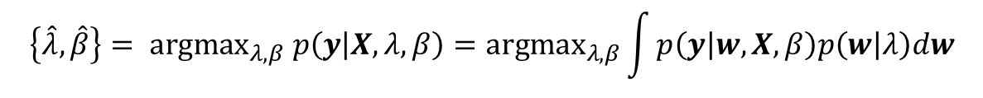
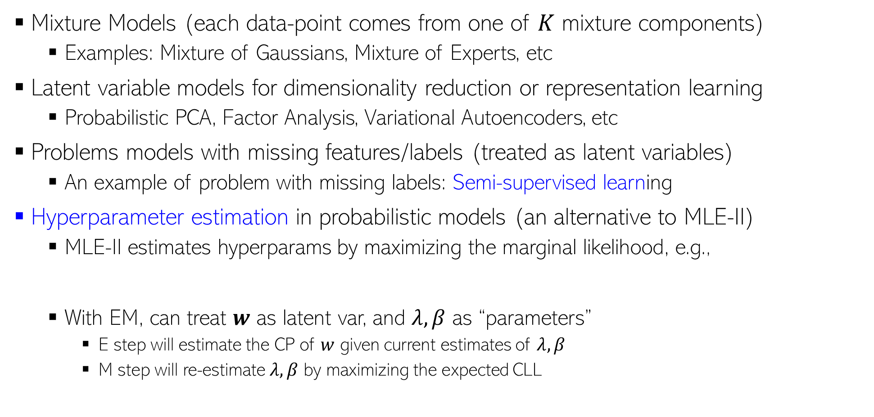
Some Applications of EM
11
Mixture Models (each data-point comes from one of $K$ mixture components)
  Examples: Mixture of Gaussians, Mixture of Experts, etc
Latent variable models for dimensionality reduction or representation learning
  Probabilistic PCA, Factor Analysis, Variational Autoencoders, etc
Problems models with missing features/labels (treated as latent variables)
  An example of problem with missing labels: Semi-supervised learning
Hyperparameter estimation in probabilistic models (an alternative to MLE-II)
  MLE-II estimates hyperparams by maximizing the marginal likelihood, e.g.,
  With EM, can treat $w$ as latent var, and $λ, β$ as “parameters”
    E step will estimate the CP of $w$ given current estimates of $λ, β$
    M step will re-estimate $λ, β$ by maximizing the expected CLL
$$\left\{\hat{λ},\hat{β}\right\}= {argmax}_{λ,β} p\left(y | X,λ, β\right)={argmax}_{λ,β}\int{p\left(y | w,X, β\right)p\left(w | λ\right)dw}$$
For a Bayesian linear regression model
Expectations w.r.t. the CP of $w$

Slide 12
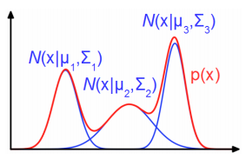





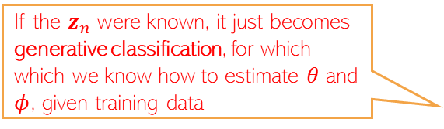


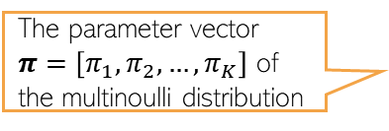





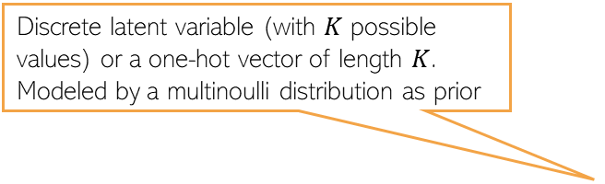
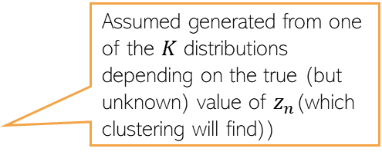
An Example: Mixture Models
If the $z_{n}$ were known, it just becomes generative classification, for which which we know how to estimate $θ$ and $φ$, given training data
12
Assume $K$ probability distributions (e.g., Gaussians), one for each cluster
The log-likelihood will be
$p(x)$ is a Gaussian mixture model (GMM)
$$p\left(z_{n} | φ\right)=multinoulli(π)$$
Parameters of the $K$ distributions, e.g,. ${θ= \left\{μ_{k}, Σ_{k}\right\}}_{k=1}^{K}$
(also means $p\left(z_{n}=k | φ\right)=π_{k})$
$$θ$$
Discrete latent variable (with $K$ possible values) or a one-hot vector of length $K$. Modeled by a multinoulli distribution as prior
Assumed generated from one of the $K$ distributions depending on the true (but unknown) value of $z_{n}$(which clustering will find))
The likelihood distributions
The parameter vector $π=\left[π_{1},π_{2},…,π_{K}\right]$ of the multinoulli distribution
$$φ$$
$$z_{n}$$
$$x_{n}$$
$$N$$
$$p\left(x_{n} | z_{n}=k,θ\right)= 𝒩\left(μ_{k},Σ_{k}\right)$$
MLE on this objective won’t give closed form solution for the parameters
$$log p\left(x_{n} | Θ\right)= log\sum_{k=1}^{K}{p\left(x_{n},z_{n}=k | Θ\right)}$$
$$= log\sum_{k=1}^{K}{p\left(z_{n}=k | φ\right)p(x_{n}|z_{n}=k,θ)}=log\sum_{k=1}^{K}{π_{k}𝒩\left({x_{n}|μ}_{k},Σ_{k}\right)}$$

Slide 13
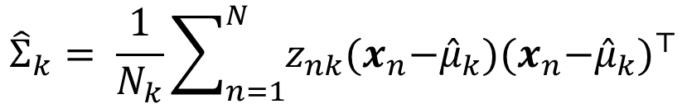

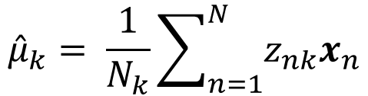
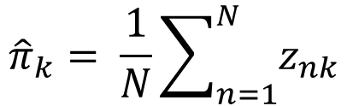
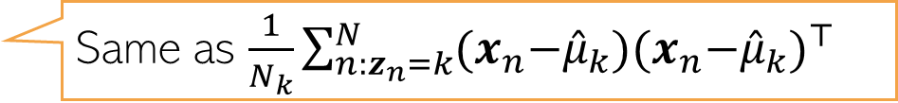
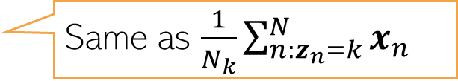
Detour: MLE for Generative Classification
Assume a $K$ class generative classification model with Gaussian class-conditionals
Assume class $k=1,2,…,K$ is modeled by a Gaussian with mean $μ_{k}$ and cov matrix $Σ_{k}$
The labels $z_{n}$ (known) are one-hot vecs. Also, $z_{nk}=1$if $z_{n}= k$, and $z_{nk}=0$, o/w
Assuming class prior as $p$($z_{n}=k)=π_{k}$, the model has params $Θ={\{π_{k},μ_{k},Σ_{k}\} }_{k=1}^{K}$
Given training data ${\{x_{n}, z_{n}\} }_{n=1}^{N}$, the MLE solution will be
$${\hat{π}}_{k}= \frac{1}{N}\sum_{n=1}^{N}{z_{nk}}$$
Same as $\frac{N_{k}}{N}$ where $N_{k}$ is # of training ex. for which $y_{n}= k$
$${\hat{μ}}_{k}= \frac{1}{N_{k}}\sum_{n=1}^{N}{z_{nk}x_{n}}$$
Same as $\frac{1}{N_{k}}\sum_{n:z_{n}=k}^{N}{x_{n}}$
$${\hat{Σ}}_{k}= \frac{1}{N_{k}}\sum_{n=1}^{N}{z_{nk}{(x}_{n}−{\hat{μ}}_{k}){{(x}_{n}−{\hat{μ}}_{k})}^{⊤}}$$
Same as $\frac{1}{N_{k}}\sum_{n:z_{n}=k}^{N}{{(x}_{n}−{\hat{μ}}_{k}){{(x}_{n}−{\hat{μ}}_{k})}^{⊤} }$

Slide 14
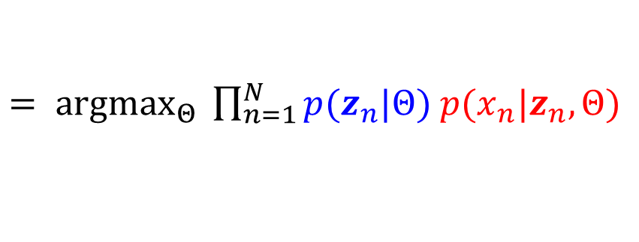
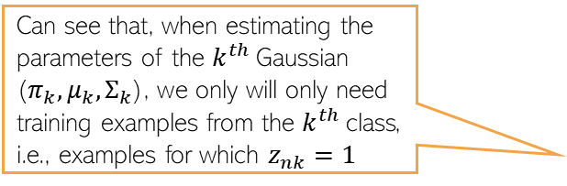


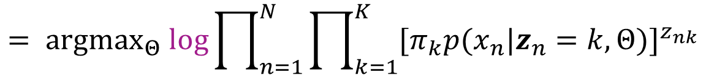
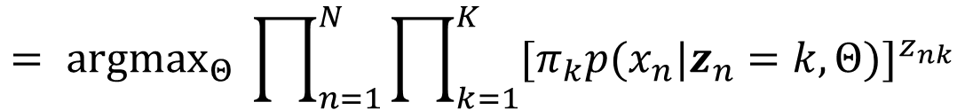
Detour: MLE for Generative Classification
Here is a formal derivation of the MLE solution for $Θ={\{π_{k},μ_{k},Σ_{k}\} }_{k=1}^{K}$
$$\hat{Θ}= {argmax}_{Θ} p(X,Z|Θ)$$
$= {argmax}_{Θ} \prod_{n=1}^{N}{p(x_{n},z_{n}|Θ)}$
multinoulli
Gaussian
$= {argmax}_{Θ} \prod_{n=1}^{N}{p(z_{n}|Θ)}$ $p({x_{n}|z}_{n},Θ)$
In general, in models with probability distributions from the exponential family, the MLE problem will usually have a simple analytic form
$= {argmax}_{Θ} \prod_{n=1}^{N}{\prod_{k=1}^{K}{π_{k}^{z_{nk}}}}$ $\prod_{k=1}^{K}{{p({x_{n}|z}_{n}=k,Θ)}^{z_{nk}}}$
Also, due to the form of the likelihood (Gaussian) and prior (multinoulli), the MLE problem had a nice separable structure after taking the log
$$= {argmax}_{Θ} \prod_{n=1}^{N}{\prod_{k=1}^{K}{{{[π}_{k}p({x_{n}|z}_{n}=k,Θ)]}^{z_{nk}}}}$$
$$= {argmax}_{Θ} log\prod_{n=1}^{N}{\prod_{k=1}^{K}{{{[π}_{k}p({x_{n}|z}_{n}=k,Θ)]}^{z_{nk}}}}$$
Can see that, when estimating the parameters of the $k^{th}$Gaussian ($π_{k},μ_{k},Σ_{k}$), we only will only need training examples from the $k^{th}$class, i.e., examples for which $z_{nk}=1$
$$= {argmax}_{Θ} \sum_{n=1}^{N}{\sum_{k=1}^{K}{z_{nk}[log π_{k}+ log 𝒩\left({x_{n}|μ}_{k},Σ_{k}\right)]}}$$
The form of this expression is important; will encounter this in GMM too

Slide 15


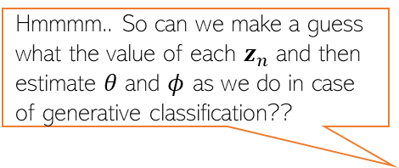
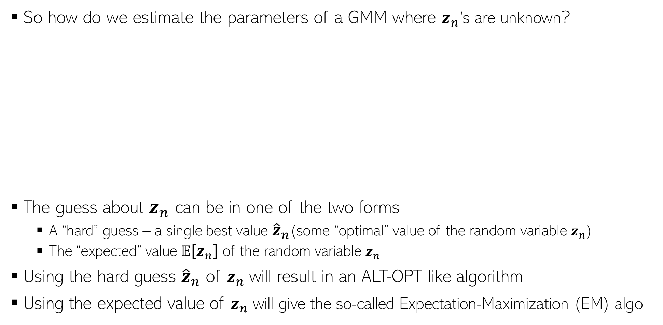




EM for Mixture Models
15
So how do we estimate the parameters of a GMM where $z_{n}$’s are unknown?
The guess about $z_{n}$ can be in one of the two forms
  A “hard” guess – a single best value ${\hat{z}}_{n}$(some “optimal” value of the random variable $z_{n}$)
  The “expected” value $𝔼\left[z_{n}\right]$ of the random variable $z_{n}$
Using the hard guess ${\hat{z}}_{n}$ of $z_{n}$ will result in an ALT-OPT like algorithm
Using the expected value of $z_{n}$ will give the so-called Expectation-Maximization (EM) algo
Well, you kind of already know how to do this. ☺ Remember generative classification?
Hmmmm.. So can we make a guess what the value of each $z_{n}$ and then estimate $θ$ and $φ$ as we do in case of generative classification??
$$θ$$
Yes, exactly. ☺ However, just like in gen-class, you will need to repeat the guess and estimate them a few times until you converge
$$φ$$
$$z_{n}$$
$$x_{n}$$
$$N$$
EM is pretty much like ALT-OPT but with soft/expected values of the latent variables

Slide 16











EM for Gaussian Mixture Model (GMM)
Expectation of CLL
EM finds $Θ_{MLE}$ by maximizing $𝔼\left[log p\left(X,Z | Θ\right)\right]$ rather than $log p\left(X,\hat{Z} | Θ\right)$
Note: Expectation will be w.r.t. the conditional posterior distribution of $Z$, i.e., $p(Z|X,Θ)$
The EM algorithm for GMM operates as follows
  Initialize $Θ= {\{π_{k}, μ_{k}, Σ_{k}\}}_{k=1}^{K}$ as $\hat{Θ}$
  Repeat until convergence
    Compute conditional posterior $p(Z|X,\hat{Θ})$. Since obs are i.i.d, compute separately for each $n$ (and for $k=1,2,..K$)
    Update $Θ$ by maximizing the expected complete data log-likelihood
It is “conditional” posterior because it is also conditioned on $Θ$, not just data $X$
Requires knowing $Θ$
Needed to get the expected CLL
Same as $p(z_{nk}=1| x_{n},\hat{Θ}),$just a different notation
$$p\left(z_{n}=k | x_{n},\hat{Θ}\right)∝p\left(z_{n}=k | \hat{Θ}\right) p\left(x_{n} | z_{n}=k,\hat{Θ}\right)\text{ =} {\hat{π}}_{k}𝒩\left(x_{n}|{\hat{μ}}_{k},{\hat{Σ}}_{k}\right)$$
Solution has a similar form as ALT-OPT (or gen. class.), except we now have the expectation of $z_{nk}$being used
$${\hat{Θ}={argmax}_{Θ}𝔼}_{p(Z|X,\hat{Θ})}\left[log p\left(X,Z | Θ\right)\right]= \sum_{n=1}^{N}{𝔼_{p(z_{n}|x_{n},\hat{Θ})}\left[log p\left(x_{n},z_{n} | Θ\right)\right]}$$
$${=argmax}_{Θ}𝔼\left[\sum_{n=1}^{N}{\sum_{k=1}^{K}{ z_{nk}[log π_{k}+ log 𝒩\left({x_{n}|μ}_{k},Σ_{k}\right)]}}\right]$$
$${\hat{π}}_{k}= \frac{1}{N}\sum_{n=1}^{N}{𝔼[z_{nk}]}$$
$${\hat{μ}}_{k}= \frac{1}{N_{k}}\sum_{n=1}^{N}{𝔼[z_{nk}]x_{n}}$$
$N_{k}$ : Effective number of points in cluster k
$${=argmax}_{Θ}\sum_{n=1}^{N}{\sum_{k=1}^{K}{𝔼[z_{nk}][log π_{k}+ log 𝒩\left({x_{n}|μ}_{k},Σ_{k}\right)]}}$$
$${\hat{Σ}}_{k}= \frac{1}{N_{k}}\sum_{n=1}^{N}{𝔼[z_{nk}]{(x}_{n}−{\hat{μ}}_{k}){{(x}_{n}−{\hat{μ}}_{k})}^{⊤}}$$

Slide 17








EM for GMM (Contd)
Reason: $\sum_{k=1}^{K}{γ_{nk}=1}$
Need to normalize: $𝔼\left[z_{nk}\right]= \frac{{\hat{π}}_{k}𝒩\left(x_{n}|{\hat{μ}}_{k},{\hat{Σ}}_{k}\right)}{\sum_{ℓ=1}^{K}{{\hat{π}}_{ℓ}𝒩\left(x_{n}|{\hat{μ}}_{ℓ},{\hat{Σ}}_{ℓ}\right)}}$
The EM algo for GMM required $𝔼[z_{nk}]$. Note $z_{nk}∈\{0,1\}$
$𝔼\left[z_{nk}\right]=γ_{nk}= 0×p(z_{nk}=0|x_{n},$ $\hat{Θ})+1×$ $p(z_{nk}=1|x_{n},$ $\hat{Θ})$
$= p(z_{nk}=1|x_{n},$ $\hat{Θ})$
$∝$ ${\hat{π}}_{k}𝒩\left(x_{n}|{\hat{μ}}_{k},{\hat{Σ}}_{k}\right)$
Accounts for fraction of points in each cluster
Accounts for cluster shapes (since each cluster is a Gaussian
Soft $K$-means, which is more of a heuristic to get soft-clustering, also gave us probabilities but doesn’t account for cluster shapes or fraction of points in each cluster
Effective number of points in the $k^{th}$cluster
M-step:

Slide 18


EM vs Gradient-based Methods
18
Can also estimate params using gradient-based optimization instead of EM
  We can usually explicitly sum over or integrate out the latent variables $Z$, e.g.,
  Now we can optimize $ℒ(Θ)$ using first/second order optimization to find the optimal $Θ$
EM is usually preferred over this approach because
  The M step has often simple closed-form updates for the parameters $Θ$
  Often constraints (e.g., PSD matrices) are automatically satisfied due to form of updates
  In some cases†, EM usually converges faster (and often like second-order methods)
    E.g., Example: Mixture of Gaussians with when the data is reasonably well-clustered
  EM also provides the conditional posterior over the latent variables Z (from E step)
†Optimization with EM and Expectation-Conjugate-Gradient (Salakhutdinov et al, 2003), On Convergence Properties of the EM Algorithm for Gaussian Mixtures (Xu and Jordan, 1996), Statistical guarantees for the EM algorithm: From population to sample-based analysis (Balakrishnan et al, 2017)

Slide 19



EM: Some Final Comments
19
The E and M steps may not always be possible to perform exactly. Some reasons
  The conditional posterior of latent variables $p(Z|X,Θ)$ may not be easy to compute
    Will need to approximate $p(Z|X,Θ)$ using methods such as MCMC or variational inference
  Even if $p(Z|X,Θ)$ is easy, the expected CLL may not be easy to compute
  Maximization of the expected CLL may not be possible in closed form
EM works even if the M step is only solved approximately (Generalized EM)
If M step has multiple parameters whose updates depend on each other, they are updated in an alternating fashion - called Expectation Conditional Maximization (ECM)
Other advanced probabilistic inference algos are based on ideas similar to EM
  E.g., Variational EM, Variational Bayes (VB) inference, a.k.a. Variational Inference (VI)
Results in Monte-Carlo EM
Can often be approximated by Monte-Carlo using sample from the CP of $Z$

