Slide 1
Latent Variable Models and the Expectation Maximization Algorithm
CS772A: Probabilistic Machine Learning
Piyush Rai

Slide 2
Plan
2
Wrap-up the discussion of CP and local conjugacy
  Gibbs sampling (more on this when we discuss MCMC)
Latent Variable Models (LVM)
  The basic formulation of LVMs (specific models later)
  Parameter Estimation in LVMs
Expectation Maximization algorithm for param-est/inference in LVMs

Slide 3
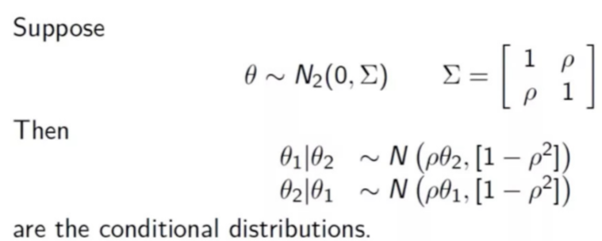
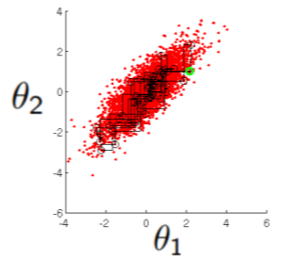

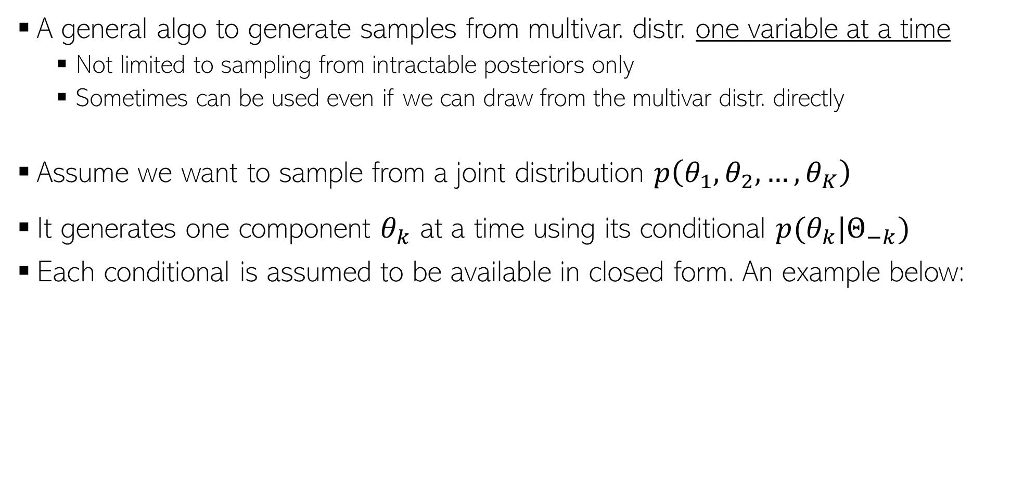
Gibbs Sampling (Geman and Geman, 1982)
3
A general algo to generate samples from multivar. distr. one variable at a time
  Not limited to sampling from intractable posteriors only
  Sometimes can be used even if we can draw from the multivar distr. directly
Assume we want to sample from a joint distribution $p\left(θ_{1},θ_{2},…,θ_{K}\right)$
It generates one component $θ_{k}$ at a time using its conditional $p(θ_{k}|Θ_{−k})$
Each conditional is assumed to be available in closed form. An example below:
Note: If posterior, it will be conditioned on other stuff too (e.g., data, other param, etc)
A 2-dim Gaussian
This example is a toy illustration of sampling from a 2-dim Gaussian by sampling from 1-dim Gaussians
A 1-dim Gaussian
A sample based representation of a 2-dim Gaussian distribution
A 1-dim Gaussian

Slide 4
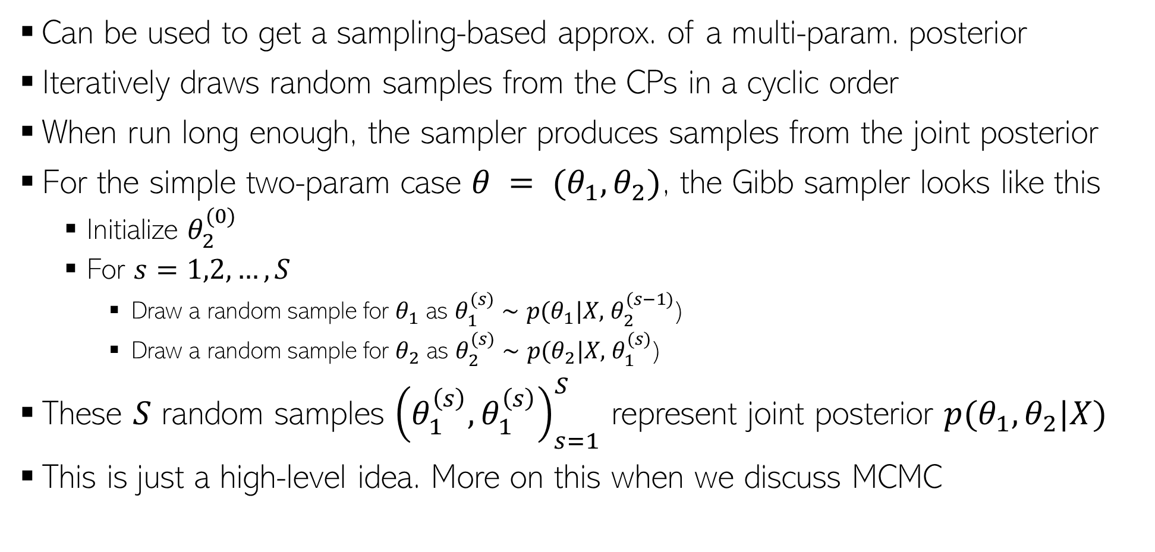
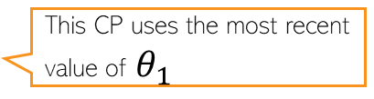
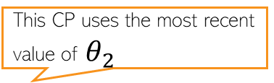
Gibbs Sampling (Geman and Geman, 1982)
4
Can be used to get a sampling-based approx. of a multi-param. posterior
Iteratively draws random samples from the CPs in a cyclic order
When run long enough, the sampler produces samples from the joint posterior
For the simple two-param case $θ = (θ_{1}, θ_{2})$, the Gibb sampler looks like this
  Initialize $θ_{2}^{(0)}$
  For $s=1,2,…,S$
    Draw a random sample for $θ_{1}$ as $θ_{1}^{(s)}∼p(θ_{1}|X,$ $θ_{2}^{(s−1)}$)
    Draw a random sample for $θ_{2}$ as $θ_{2}^{(s)}∼p(θ_{2}|X,$ $θ_{1}^{(s)}$)
These $S$ random samples ${\left(θ_{1}^{\left(s\right)},θ_{1}^{\left(s\right)}\right)}_{s=1}^{S}$ represent joint posterior $p(θ_{1},θ_{2}|X)$
This is just a high-level idea. More on this when we discuss MCMC
This CP uses the most recent value of $θ_{2}$
This CP uses the most recent value of $θ_{1}$

Slide 5
Back to Bayesian Matrix Factorization
5

Slide 6
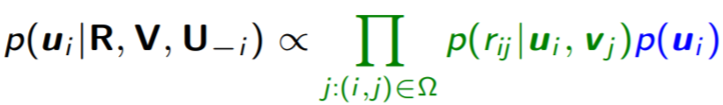
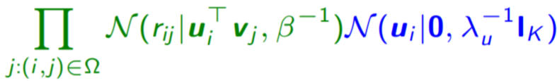


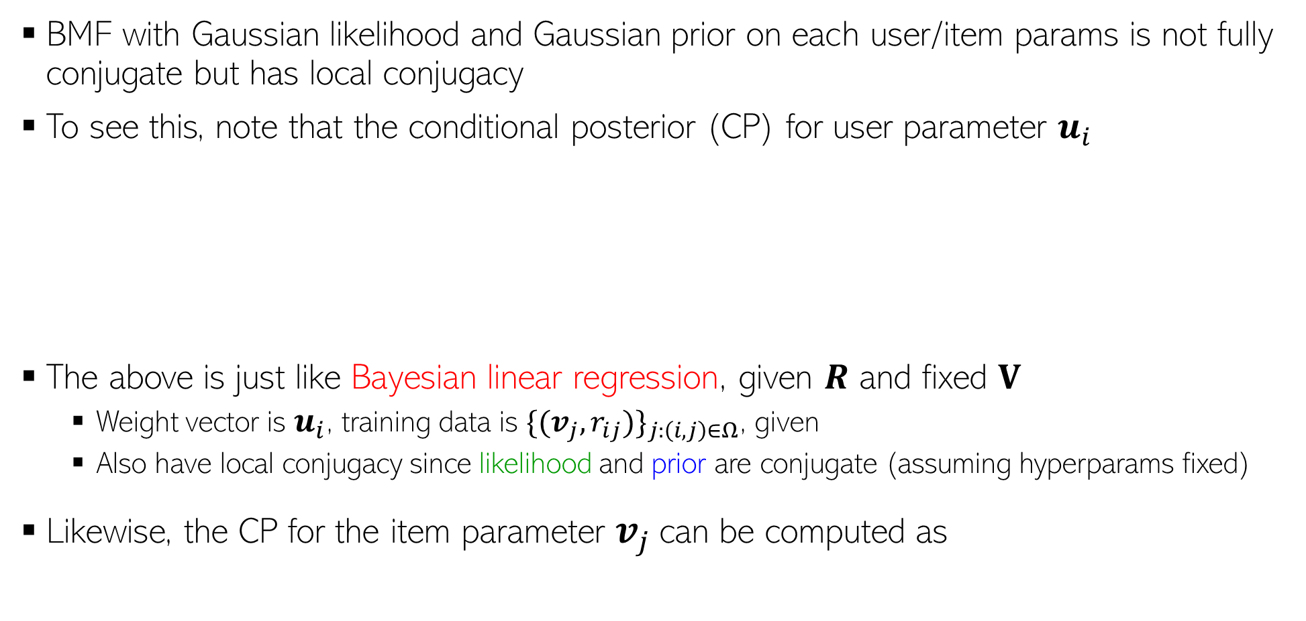
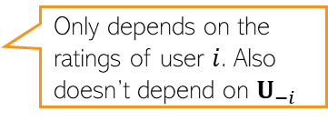
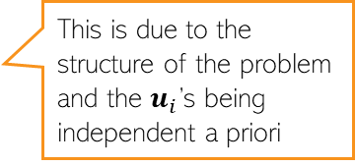
Bayesian Matrix Factorization: The CPs
6
BMF with Gaussian likelihood and Gaussian prior on each user/item params is not fully conjugate but has local conjugacy
To see this, note that the conditional posterior (CP) for user parameter $u_{i}$
The above is just like Bayesian linear regression, given $R$ and fixed $V$
  Weight vector is $u_{i}$, training data is ${\{(v_{j}, r_{ij})\}}_{j:\left(i,j\right)∈Ω}$, given
  Also have local conjugacy since likelihood and prior are conjugate (assuming hyperparams fixed)
Likewise, the CP for the item parameter $v_{j}$can be computed as
Only depends on the ratings of user $i$. Also doesn’t depend on $U_{−i}$
This is due to the structure of the problem and the $u_{i}$’s being independent a priori
=
Another Bayesian linear regression problem with weight vector $v_{j}$

Slide 7

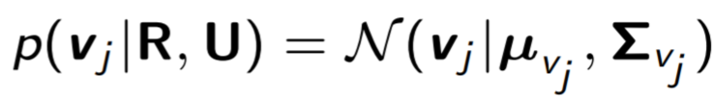
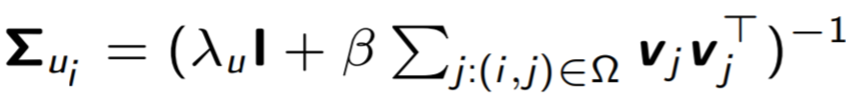
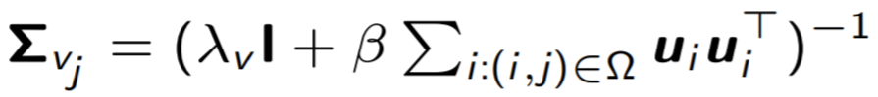


Bayesian Matrix Factorization: The CPs
7
The CPs will have forms similar to solution of Bayesian linear regression
These CPs can be updated in an alternating fashion until convergence
  Many ways. One popular way is to use Gibbs sampling
  Note: Hyperparameters can also be inferred by computing their CPs¹
Can extend Gaussian BMF easily to other exp. family distr. while maintaining local conj.
  Example: Poisson likelihood and gamma priors on user/item parameters²
  ¹“Bayesian Probabilistic Matrix Factorization using Markov Chain Monte Carlo” by Salakhutdinov and Mnih (2008)
  ²“Scalable recommendation with Poisson factorization” by Gopalan et al(2013)

Slide 8
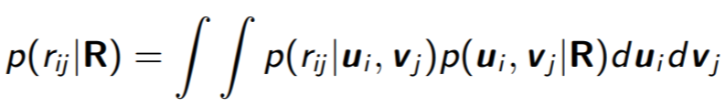
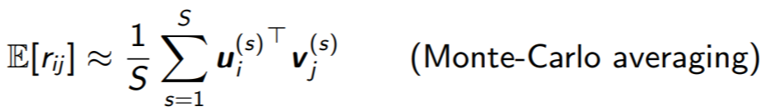
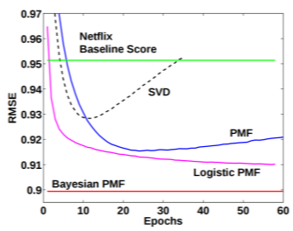
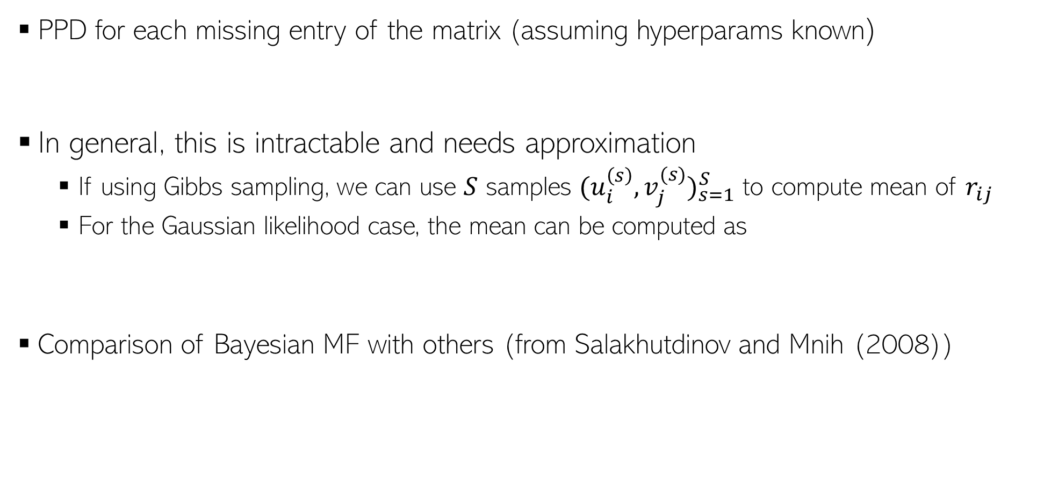
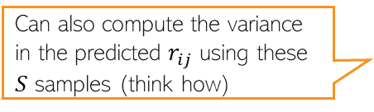
BMF: Making Predictions
8
PPD for each missing entry of the matrix (assuming hyperparams known)
In general, this is intractable and needs approximation
  If using Gibbs sampling, we can use $S$ samples ${(u_{i}^{\left(s\right)},v_{j}^{(s)})}_{s=1}^{S}$ to compute mean of $r_{ij}$
  For the Gaussian likelihood case, the mean can be computed as
Comparison of Bayesian MF with others (from Salakhutdinov and Mnih (2008))
Can also compute the variance in the predicted $r_{ij}$ using these $S$ samples (think how)
All other baselines are optimization based or point estimation based probabilistic models (PMF = probabilistic matrix factorization with point estimation)

Slide 9
Summary
9
Local conjugacy is helpful even for complex prob. models with many params
  CPs will have a closed form
  Easy to implement Gibbs sampling can be used to get the (approx.) posterior
  Many other approx. inference algos (like variational inference) benefit from local conjugacy
Helps to choose likelihood and priors on each param as exp. family distr.
  So if we can’t get a globally conjugate model, we can still get a model with local conjugacy
Even if we can’t have local conjugacy, the notion of CPs is applicable
  We can break the inference problem into estimating CPs (exactly if we have local conjugacy, or approximately if we don’t have local conjugacy)
  Almost all approx. algorithms work by estimating CPs exactly or approximately

Slide 10
Coming Up
10
Latent Variable Models
Expectation Maximization

Slide 11

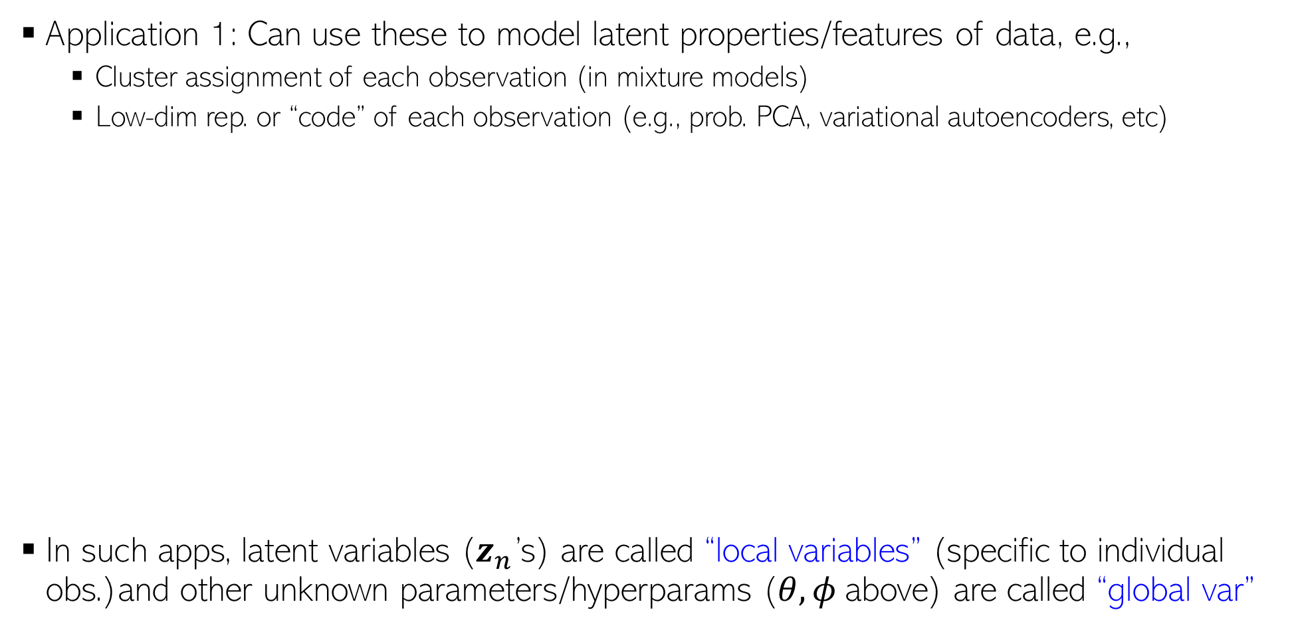




Latent Variable Models
11
Application 1: Can use these to model latent properties/features of data, e.g.,
  Cluster assignment of each observation (in mixture models)
  Low-dim rep. or “code” of each observation (e.g., prob. PCA, variational autoencoders, etc)
In such apps, latent variables ($z_{n}$’s) are called “local variables” (specific to individual obs.)and other unknown parameters/hyperparams ($θ, φ$above) are called “global var”
$p\left(z_{n} | φ\right):$ A suitable prior distribution based on the nature of $z_{n}$
$$θ$$
$p\left(x_{n} | z_{n},θ\right):$ A suitable likelihood based on the nature of $x_{n}$
$$φ$$
$$z_{n}$$
$$x_{n}$$
$$N$$

Slide 12
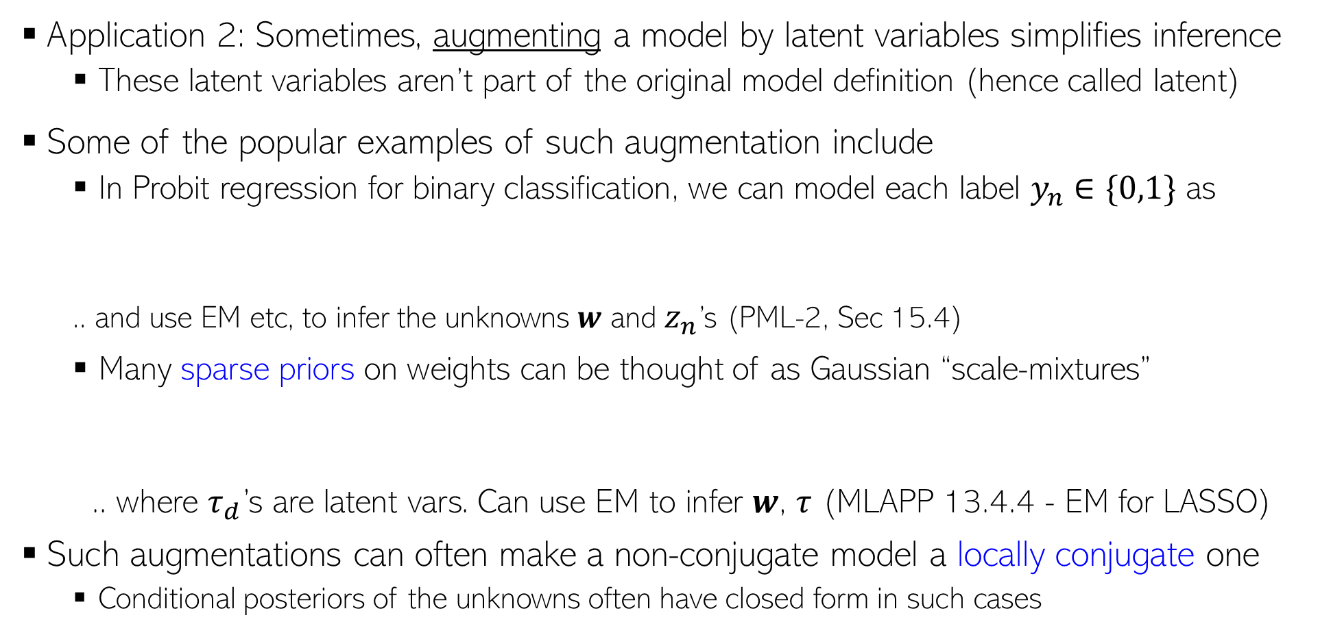

Latent Variable Models
12
Application 2: Sometimes, augmenting a model by latent variables simplifies inference
  These latent variables aren’t part of the original model definition (hence called latent)
Some of the popular examples of such augmentation include
  In Probit regression for binary classification, we can model each label $y_{n}∈\{0,1\}$ as
  .. and use EM etc, to infer the unknowns $w$ and $z_{n}$’s (PML-2, Sec 15.4)
  Many sparse priors on weights can be thought of as Gaussian “scale-mixtures”
  .. where $τ_{d}$’s are latent vars. Can use EM to infer $w$, $τ$ (MLAPP 13.4.4 - EM for LASSO)
Such augmentations can often make a non-conjugate model a locally conjugate one
  Conditional posteriors of the unknowns often have closed form in such cases
$$y_{n}= 𝕀[z_{n}>0]$$
where $z_{n}∼𝒩(w^{⊤}x_{n},1)$ is an auxiliary latent variable

Slide 13
Nomenclature/Notation Alert
13
Why call some unknowns as parameters and others as latent variables?
Well, no specific reason. Sort of a convention adopted by some algorithms
  EM: Unknowns estimated in E step referred to as latent vars; those in M step as params
  Usual distinction: Latent vars – posterior inferred; parameters – point estimation done
Some algos won’t make such distinction and will infer posterior over all unknowns
Sometimes the “global” or “local” unknown distinction makes it clear
  Local variables = latent variables, global variables = parameters
But remember that this nomenclature isn’t really cast in stone, no need to be confused so long as you are clear as to what the role of each unknown is, and how we want to estimate it (posterior or point estimate) and using what type of inference algorithm

Slide 14


Hybrid Inference (posterior infer. + point est.)
14
In many models, we infer posterior on some unknowns and do point est. for others
We have already seen that MLE-II based inference does that
  Maximize the marginal likelihood to do point estimation for hyperparams
  Infer CP over the main parameter given the point estimates of hyperparams
The Expectation-Maximization algorithm (will see today) also does something similar
  In E step, the CP of latent variables is inferred, given current point-est of params
  M step maximizes expected complete data log-lik. to get point estimates of params
If we can’t (due to computational or other reasons) infer posterior over all unknowns, how to decide which variables to infer posterior on, and for which to do point-est?
Usual approach: Infer posterior over local vars and point estimates for global vars
  Reason: We typically have plenty of data to reliably estimate the global variables so it is okay even if we just do point estimation for those (recall the schools problem in HW1)
$$\left\{\hat{λ},\hat{β}\right\}= {argmax}_{λ,β} p(y|X,λ, β)$$
CP of $w$: $p(w|X,y,\hat{λ},\hat{β})$
Akin to maximizing marg-lik

Slide 15
Inference/Parameter Estimation in Latent Variable Models using Expectation-Maximization (EM)
15

Slide 16






Parameter Estimation in Latent Variable Models
16
Assume each observation $x_{n}$ to be associated with a “local” latent variable $z_{n}$
Although we can do fully Bayesian inference for all the unknowns, suppose we only want a point estimate of the “global” parameters $Θ = (θ, φ)$ via MLE/MAP
Such MLE/MAP problems in LVMs are difficult to solve in a “clean” way
  Would typically re quire gradient based methods with no closed form updates for $Θ$
  However, EM gives a clean way to obtain closed form updates for $Θ$
$p\left(z_{n} | φ\right):$ A suitable prior distribution based on the nature of $z_{n}$
$$θ$$
$p\left(x_{n} | z_{n},θ\right):$ A suitable likelihood based on the nature of $x_{n}$
$$φ$$
$$z_{n}$$
$$x_{n}$$
$$N$$

Slide 17
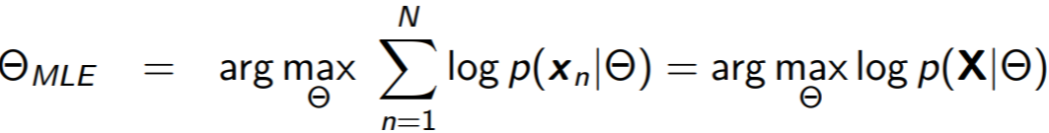
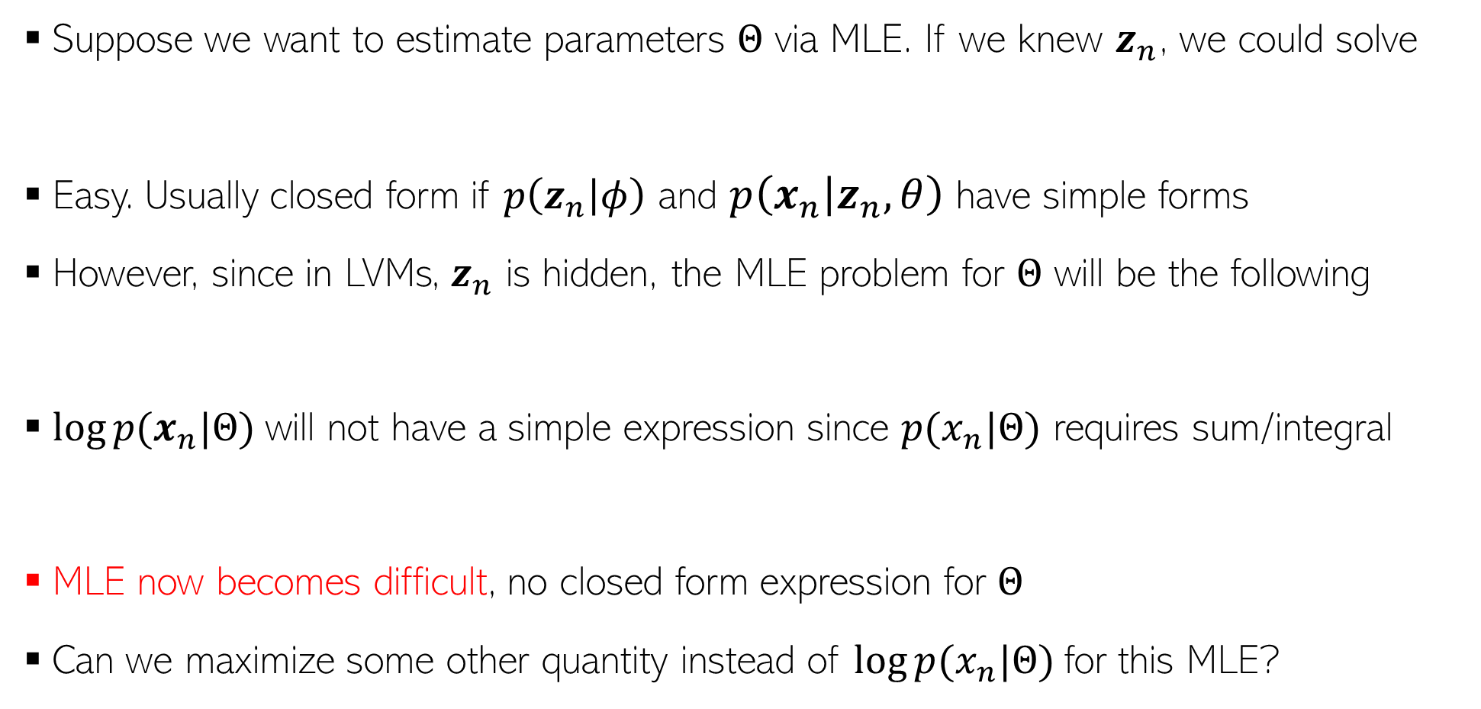
Why MLE/MAP of Params is Hard for LVMs?
17
Suppose we want to estimate parameters $Θ$ via MLE. If we knew $z_{n}$, we could solve
Easy. Usually closed form if $p\left(z_{n} | φ\right)$ and $p\left(x_{n} | z_{n},θ\right)$ have simple forms
However, since in LVMs, $z_{n}$ is hidden, the MLE problem for $Θ$ will be the following
$log⁡p(x_{n}|Θ)$will not have a simple expression since $p(x_{n}|Θ)$ requires sum/integral
MLE now becomes difficult, no closed form expression for $Θ$
Can we maximize some other quantity instead of $log⁡p(x_{n}|Θ)$for this MLE?
Easy to solve
In particular, if they are exp-fam distributions

Slide 18
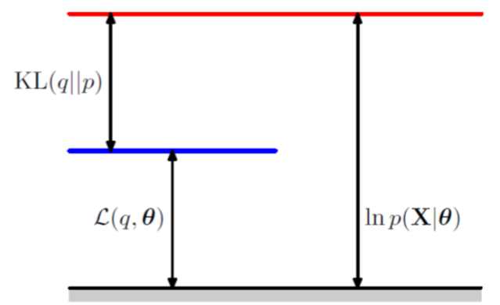

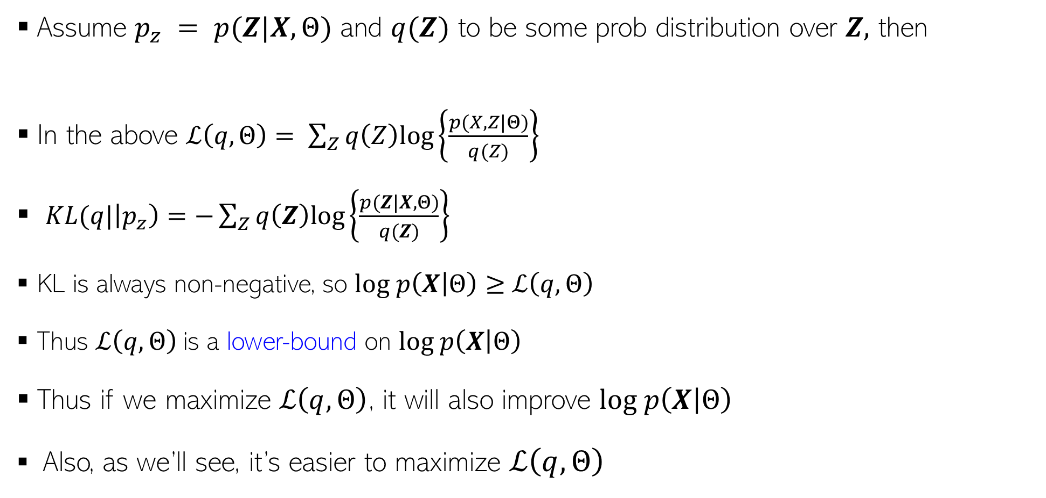
An Important Identity
18
Assume $p_{z} = p(Z|X,Θ)$ and $q(Z)$ to be some prob distribution over $Z,$ then
In the above $ℒ\left(q,Θ\right)= \sum_{Z}{q\left(Z\right)log\left\{\frac{p(X,Z|Θ)}{q(Z)}\right\}}$
$KL(q|\left|p_{z}\right)=−\sum_{Z}{q\left(Z\right)log\left\{\frac{p(Z|X,Θ)}{q(Z)}\right\}}$
KL is always non-negative, so $log p\left(X | Θ\right)≥$ $ℒ\left(q,Θ\right)$
Thus $ℒ\left(q,Θ\right)$ is a lower-bound on $log p\left(X | Θ\right)$
Thus if we maximize $ℒ\left(q,Θ\right)$, it will also improve $log p\left(X | Θ\right)$
Also, as we’ll see, it’s easier to maximize $ℒ\left(q,Θ\right)$
$$log p\left(X | Θ\right)= ℒ\left(q,Θ\right)+KL(q||p_{z})$$
Verify the identity
Assume $Z$ discrete

Slide 19
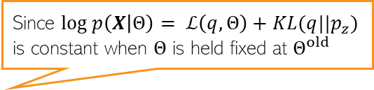
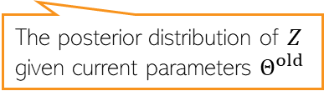
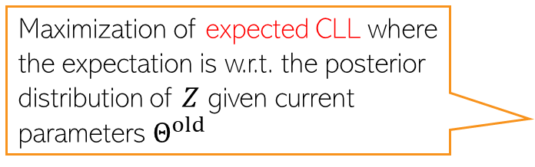
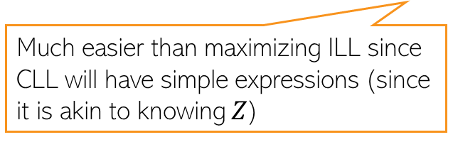
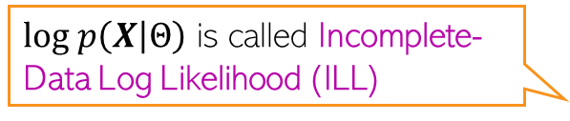


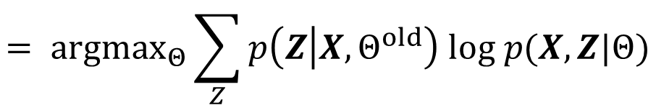

Maximizing $ℒ\left(q,Θ\right)$
19
19
$log p\left(X | Θ\right)$ is called Incomplete-Data Log Likelihood (ILL)
$ℒ\left(q,Θ\right)$ depends on $q$ and $Θ$. We’ll use ALT-OPT to maximize it
Let’s maximize $ℒ\left(q,Θ\right)$ w.r.t. $q$ with $Θ$ fixed at some $Θ^{old}$
Now let’s maximize $ℒ\left(q,Θ\right)$ w.r.t. $Θ$ with $q$ fixed at $\hat{q}=p_{z}=p(Z|X,Θ^{old})$
Since $log p\left(X | Θ\right)= ℒ\left(q,Θ\right)+KL(q||p_{z})$ is constant when $Θ$ is held fixed at $Θ^{old}$
$$\hat{q}= {argmax}_{q}ℒ\left(q,Θ^{old}\right)= {argmin}_{q}KL(q|\left|p_{z}\right)=p_{z}=p(Z|X,Θ^{old})$$
The posterior distribution of $Z$ given current parameters $Θ^{old}$
$$Θ^{new}= {argmax}_{Θ}ℒ\left(\hat{q},Θ\right)= {argmax}_{Θ}\sum_{Z}{p(Z|X,Θ^{old}) log\left\{\frac{p(X,Z|Θ)}{p(Z|X,Θ^{old}) }\right\}}$$
Maximization of expected CLL where the expectation is w.r.t. the posterior distribution of $Z$ given current parameters $Θ^{old}$
$$= {argmax}_{Θ}\sum_{Z}{p\left(Z | X,Θ^{old}\right) log p(X,Z|Θ)}$$
Complete-Data Log Likelihood (CLL)
$$= {argmax}_{Θ} 𝔼_{p\left(Z | X,Θ^{old}\right)}[log p(X,Z|Θ)]$$
Much easier than maximizing ILL since CLL will have simple expressions (since it is akin to knowing $Z$)
$$= {argmax}_{Θ} 𝒬(Θ,Θ^{old})$$

Slide 20
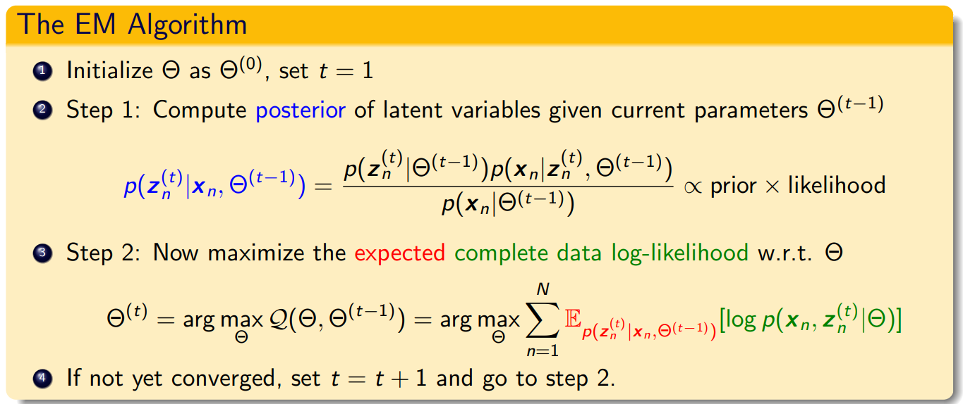
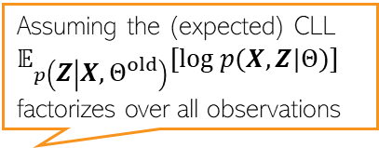

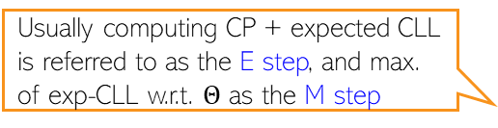


The Expectation-Maximization (EM) Algorithm
20
ALT-OPT of $ℒ\left(q,Θ\right)$ w.r.t. $q$ and $Θ$ gives the EM algorithm (Dempster, Laird, Rubin, 1977)
Note: If we can take the MAP estimate ${\hat{z}}_{n}$ of $z_{n}$ (not full posterior) in Step 1 and maximize the CLL in Step 2 using that, i.e., do ${argmax}_{Θ}\sum_{n=1}^{N}{\left[log p\left(x_{n}, {{\hat{z}}_{n}}^{(t)} | Θ\right)\right]}$ this will be ALT-OPT
Primarily designed for doing point estimation of the parameters $Θ$ but also gives (CP of) latent variables $z_{n}$
Usually computing CP + expected CLL is referred to as the E step, and max. of exp-CLL w.r.t. $Θ$ as the M step
Conditional posterior of each latent variable $z_{n}$
Latent variables also assumed indep. a priori
Assuming the (expected) CLL $𝔼_{p\left(Z | X,Θ^{old}\right)}[log p(X,Z|Θ)]$ factorizes over all observations

Slide 21
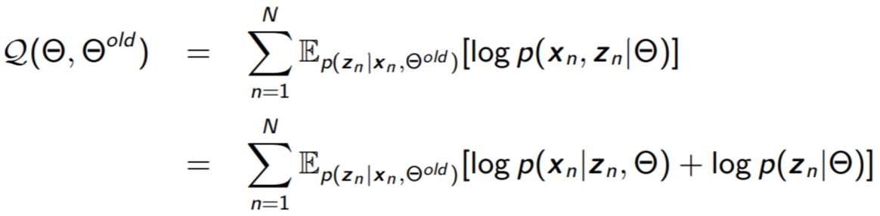
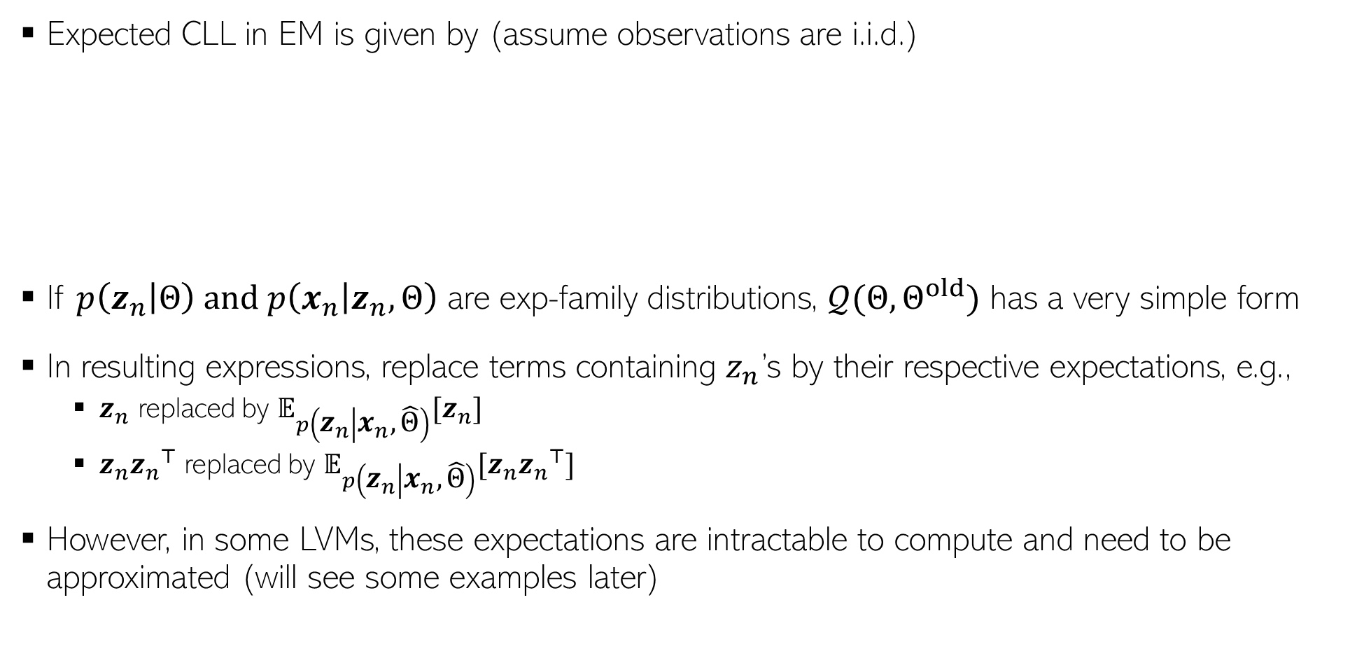
The Expected CLL
Expected CLL in EM is given by (assume observations are i.i.d.)
If $p\left(z_{n} | Θ\right)$ and $p\left(x_{n} | z_{n},Θ\right)$ are exp-family distributions, $𝒬(Θ,Θ^{old})$ has a very simple form
In resulting expressions, replace terms containing $z_{n}$’s by their respective expectations, e.g.,
  $z_{n}$ replaced by $𝔼_{p\left(z_{n} | x_{n},\hat{Θ}\right)}[z_{n}]$
  $z_{n}{z_{n}}^{⊤}$ replaced by $𝔼_{p\left(z_{n} | x_{n},\hat{Θ}\right)}[z_{n}{z_{n}}^{⊤}]$
However, in some LVMs, these expectations are intractable to compute and need to be approximated (will see some examples later)

Slide 22

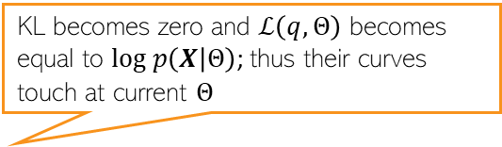

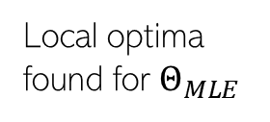
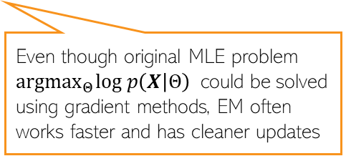




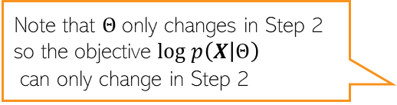
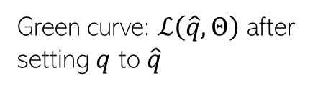

22
What’s Going On?
Alternating between them until convergence to some local optima
KL becomes zero and $ℒ\left(q,Θ\right)$ becomes equal to $log p\left(X | Θ\right)$; thus their curves touch at current $Θ$
As we saw, the maximization of lower bound $ℒ\left(q,Θ\right)$ had two steps
Step 1 finds the optimal $q$ (call it $\hat{q}$) by setting it as the posterior of $Z$ given current $Θ$
Step 2 maximizes $ℒ\left(\hat{q},Θ\right)$ w.r.t. $Θ$which gives a new $Θ$.
Note that $Θ$only changes in Step 2 so the objective $log p\left(X | Θ\right)$
can only change in Step 2
Local optima found for $Θ_{MLE}$
Green curve: $ℒ\left(\hat{q},Θ\right)$ after setting $q$ to $\hat{q}$
$$log p\left(X | Θ\right)$$
Also kind of similar to Newton’s method (and has second order like convergence behavior in some cases)
Good initialization matters; otherwise would converge to a poor local optima
Unlike Newton’s method, we don’t construct and optimize a quadratic approximation, but a lower bound
Even though original MLE problem ${argmax}_{Θ}log p\left(X | Θ\right)$ could be solved using gradient methods, EM often works faster and has cleaner updates
$$Θ^{(0)}$$
$$Θ^{(1)}$$
$$Θ^{(2)}$$
$$Θ^{(3)}$$
$$Θ^{(MLE)}$$

Slide 23


EM vs Gradient-based Methods
23
Can also estimate params using gradient-based optimization instead of EM
  We can usually explicitly sum over or integrate out the latent variables $Z$, e.g.,
  Now we can optimize $ℒ(Θ)$ using first/second order optimization to find the optimal $Θ$
EM is usually preferred over this approach because
  The M step has often simple closed-form updates for the parameters $Θ$
  Often constraints (e.g., PSD matrices) are automatically satisfied due to form of updates
  In some cases†, EM usually converges faster (and often like second-order methods)
    E.g., Example: Mixture of Gaussians with when the data is reasonably well-clustered
  EM applies even when the explicit summing over/integrating out is expensive/intractable
  EM also provides the conditional posterior over the latent variables Z (from E step)
†Optimization with EM and Expectation-Conjugate-Gradient (Salakhutdinov et al, 2003), On Convergence Properties of the EM Algorithm for Gaussian Mixtures (Xu and Jordan, 1996), Statistical guarantees for the EM algorithm: From population to sample-based analysis (Balakrishnan et al, 2017)

Slide 24



Some Applications of EM
24
Mixture Models (each data-point comes from one of $K$ mixture components)
  Examples: Mixture of Gaussians, Mixture of Experts, etc
Latent variable models for dimensionality reduction or representation learning
  Probabilistic PCA, Factor Analysis, Variational Autoencoders, etc
Problems models with missing features/labels (treated as latent variables)
  An example of problem with missing labels: Semi-supervised learning
Hyperparameter estimation in probabilistic models (an alternative to MLE-II)
  MLE-II estimates hyperparams by maximizing the marginal likelihood, e.g.,
  With EM, can treat $w$ as latent var, and $λ, β$ as “parameters”
    E step will estimate the CP of $w$ given current estimates of $λ, β$
    M step will re-estimate $λ, β$ by maximizing the expected CLL
$$\left\{\hat{λ},\hat{β}\right\}= {argmax}_{λ,β} p\left(y | X,λ, β\right)={argmax}_{λ,β}\int{p\left(y | w,X, β\right)p\left(w | λ\right)dw}$$
For a Bayesian linear regression model
Expectations w.r.t. the CP of $w$

Slide 25



EM: Some Comments
25
The E and M steps may not always be possible to perform exactly. Some reasons
  The conditional posterior of latent variables $p(Z|X,Θ)$ may not be easy to compute
    Will need to approximate $p(Z|X,Θ)$ using methods such as MCMC or variational inference
  Even if $p(Z|X,Θ)$ is easy, the expected CLL may not be easy to compute
  Maximization of the expected CLL may not be possible in closed form
EM works even if the M step is only solved approximately (Generalized EM)
If M step has multiple parameters whose updates depend on each other, they are updated in an alternating fashion - called Expectation Conditional Maximization (ECM)
Other advanced probabilistic inference algos are based on ideas similar to EM
  E.g., Variational Bayes (VB) inference, a.k.a. Variational Inference (VI)
Results in Monte-Carlo EM
Can often be approximated by Monte-Carlo using sample from the CP of $Z$

