Slide 1
Inference in Multi-parameter Models,
Conditional Posterior, Local Conjugacy
CS772A: Probabilistic Machine Learning
Piyush Rai

Slide 2
Plan for today
2
Wrapping up GPs
Inference in multi-parameter models
  Conditional posterior
  Local conjugacy
  An example: Bayesian matrix factorization (BMF)

Slide 3
Scalability of GPs
3
Computational costs in some steps of GP models scale in the size of training data
For example, prediction cost is $O(N)$
GP models often require matrix inversions (e.g., in marg-lik computation when estimating hyperparameters) – takes $O(N^{3})$
Storage also requires $O(N^{2})$ since need to store the covariance matrix
A lot of work on speeding up GPs¹. Some prominent approaches include
  Inducing Point Methods (condition predictions only on a small set of “learnable” points)
  Divide-and-Conquer (learn GP on small subsets of data and aggregate predictions)
  Kernel approximations
Note that nearest neighbor methods and kernel methods also face similar issues
  Many tricks to speed up kernel methods can be used for speeding up GPs too
$O(N)$ cost assuming $C_{N}$ is already inverted
$$p\left(y_{∗} | y\right)=𝒩(μ_{∗},σ_{∗}^{2})$$
$$μ_{∗}=k_{∗}^{⊤}C_{N}^{−1}y$$
$$σ_{∗}^{2}=κ\left(x_{∗},x_{∗}\right)−k_{∗}^{⊤}C_{N}^{−1}k_{∗}+β^{−1}$$
$M≪N$ pseudo-inputs and pseudo-outputs
¹When Gaussian Process Meets Big Data: A Review of Scalable GPs - Liu et al, 2018

Slide 4


GP: Some Comments
4
GP is sometimes referred to as a nonparametric model because
  Complexity (representation size) of the function $f$ grows in the size of training data
  To see this, note the form of the GP predictions, e.g., predictive mean in GP regression
  It implies that which means $f$ is written in terms of all training examples
  Thus the representation size of $f$ depends on the number of training examples
In contrast, a parametric model has a size that doesn’t grow with training data
  E.g., a linear model learns a weight vector $w∈ℝ^{D}$ ($D$ parameters, size independent of $N$)
Nonparametric models more flexible since their complexity is not limited beforehand
  Note: Methods like nearest neighbors and kernel SVMs are also nonparametric (but not Bayesian)

Slide 5
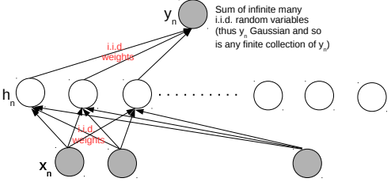
Neural Networks and Gaussian Process
5
An infinitely-wide single hidden layer NN with i.i.d. weights is equivalent to a GP
Shown formally by (Neal², 1994). Based on applying the central limit theorem
This equivalence is useful for several reasons
  Can use a GP instead of an infinitely wide Bayesian NN (which is impractical anyway)
  With GPs, inference is easy (at least for regression and with known hyperparams)
  A proof that GPs can also learn any function (just like infinitely wide neural nets - Hornik’s theorem)
Connection generalized to infinitely wide multiple hidden layer NN (Lee et al³, 2018)
²Priors for infinite networks, Tech Report, 1994
³Deep Neural Networks as Gaussian Processes (ICLR 2018)

Slide 6
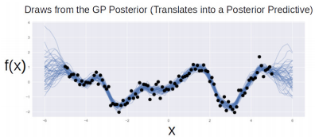
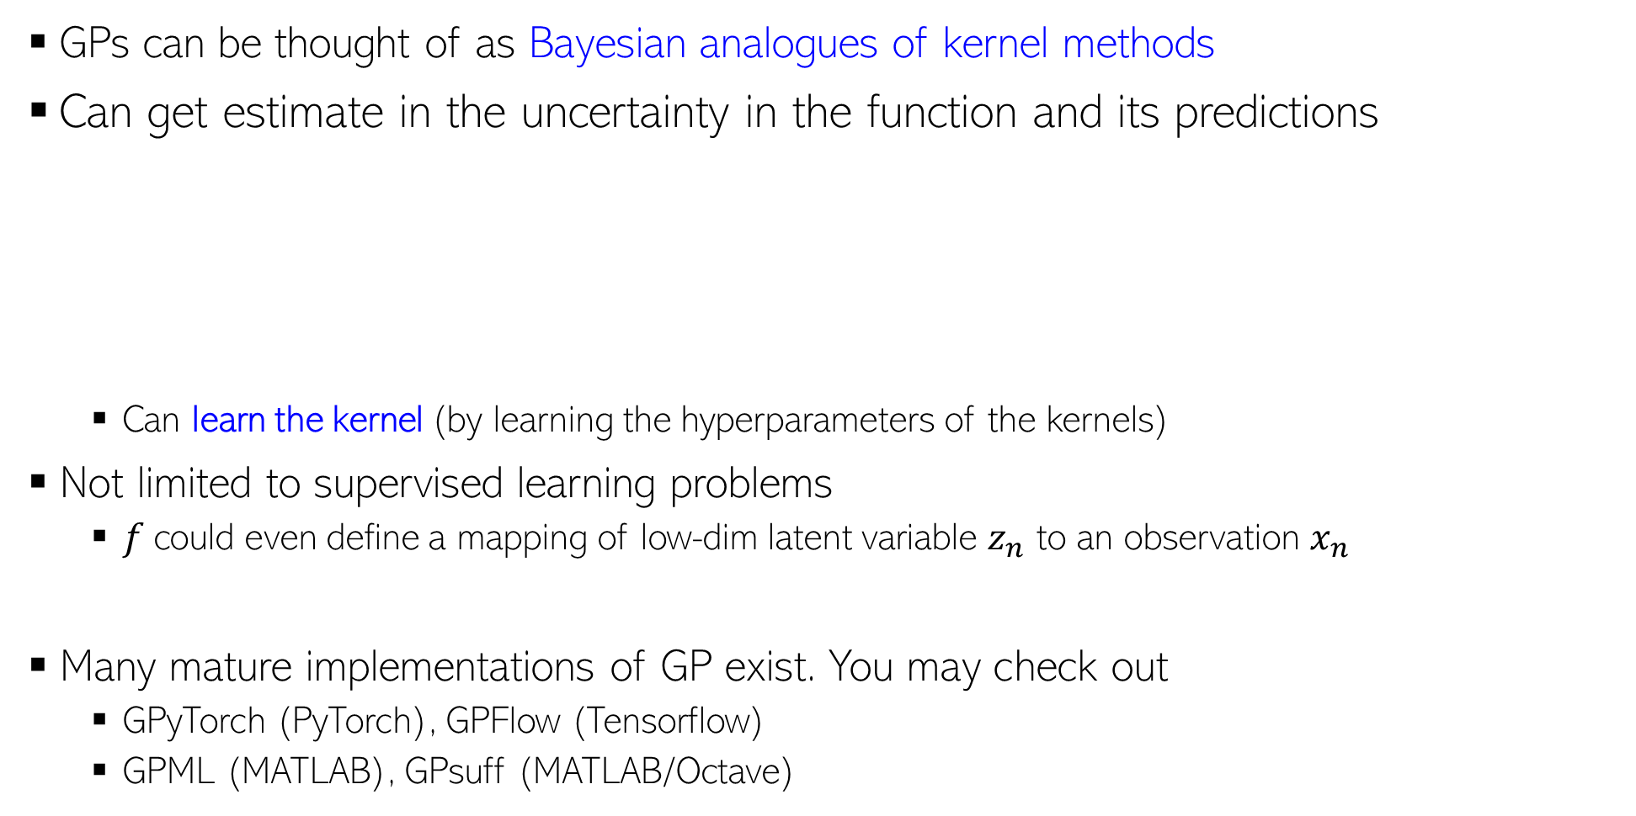
GP: A Few Other Comments
6
GPs can be thought of as Bayesian analogues of kernel methods
Can get estimate in the uncertainty in the function and its predictions
  Can learn the kernel (by learning the hyperparameters of the kernels)
Not limited to supervised learning problems
  $f$could even define a mapping of low-dim latent variable $z_{n}$ to an observation $x_{n}$
Many mature implementations of GP exist. You may check out
  GPyTorch (PyTorch), GPFlow (Tensorflow)
  GPML (MATLAB), GPsuff (MATLAB/Octave)
$$x_{n}=f\left(z_{n}\right)+"noise"$$
GP latent variable model for dimensionality reduction (like a kernel version of probabilistic PCA)

Slide 7
Coming up next
7
Foray into models with several parameters
Goal: Infer the posterior over all of them (not posterior for some, MLE-II for others)
Idea of conditional/local posteriors in such problems
Local conjugacy (which helps in computing conditional posteriors)
Gibbs sampling (an algorithm that infer the joint posterior via conditional posteriors)
An example: Bayesian matrix factorization (a model with many parameters)
Conditional/local posterior, local conjugacy, etc are important ideas (will appear in many inference algorithms that we will see later)

Slide 8
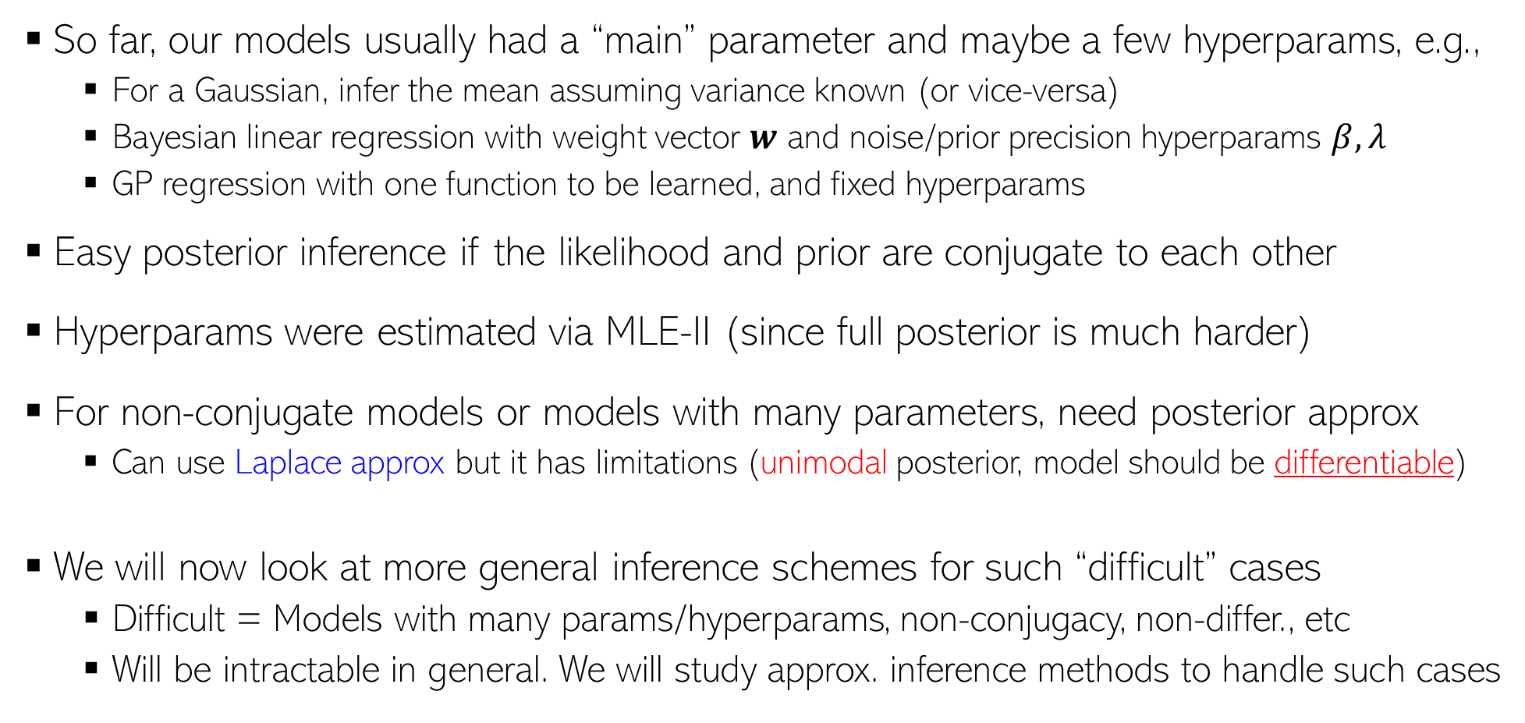
Moving Beyond Simple Models..
8
So far, our models usually had a “main” parameter and maybe a few hyperparams, e.g.,
  For a Gaussian, infer the mean assuming variance known (or vice-versa)
  Bayesian linear regression with weight vector $w$ and noise/prior precision hyperparams $β, λ$
  GP regression with one function to be learned, and fixed hyperparams
Easy posterior inference if the likelihood and prior are conjugate to each other
Hyperparams were estimated via MLE-II (since full posterior is much harder)
For non-conjugate models or models with many parameters, need posterior approx
  Can use Laplace approx but it has limitations (unimodal posterior, model should be differentiable)
We will now look at more general inference schemes for such “difficult” cases
  Difficult = Models with many params/hyperparams, non-conjugacy, non-differ., etc
  Will be intractable in general. We will study approx. inference methods to handle such cases

Slide 9
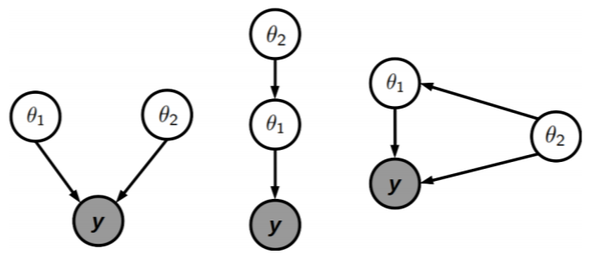
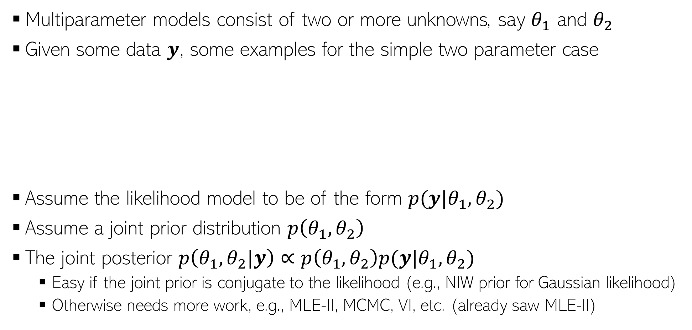


Multiparameter Models
9
Multiparameter models consist of two or more unknowns, say $θ_{1}$ and $θ_{2}$
Given some data $y$, some examples for the simple two parameter case
Assume the likelihood model to be of the form $p(y|θ_{1},θ_{2})$
Assume a joint prior distribution $p\left(θ_{1},θ_{2}\right)$
The joint posterior $p\left(θ_{1},θ_{2}|y\right)∝p\left(θ_{1},θ_{2}\right)p(y|θ_{1},θ_{2})$
  Easy if the joint prior is conjugate to the likelihood (e.g., NIW prior for Gaussian likelihood)
  Otherwise needs more work, e.g., MLE-II, MCMC, VI, etc. (already saw MLE-II)
Unknown hyperparams which $θ_{1}$ depends on
Unknown hyperparams which $θ_{1}$ and the likelihood depends on
This prior may still be conditioned on some fixed hyperparams

Slide 10
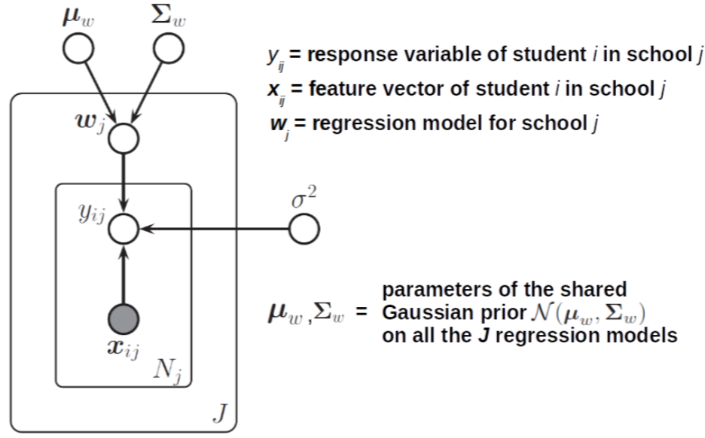
Multiparameter Models: Some Examples
10
Multiparameter models arise in many situations, e.g.,
  Probabilistic models with unknown hyperparams (e.g., Bayesian linear regression)
  Joint analysis of data from multiple (and possibly related) groups: Hierarchical models
  .. and in fact, pretty much in any non-toy example of probabilistic model

Slide 11
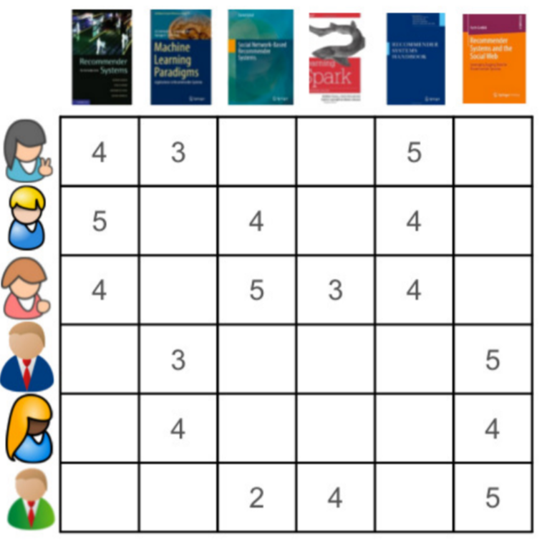
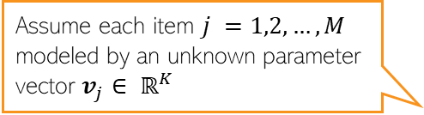


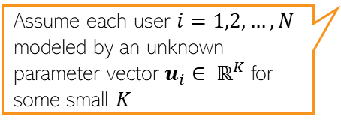



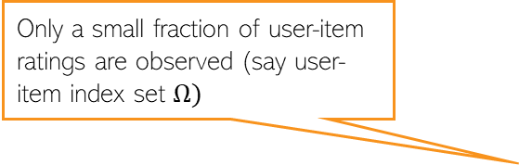
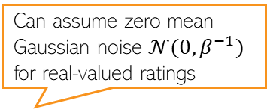
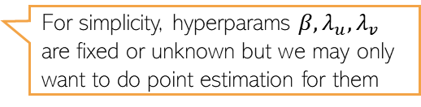
Another Example: Matrix Factorization/Completion
11
Given: Data $R = \{r_{ij}\}$ of “interactions” (e.g., ratings)
  Here $i=1,2,…, N$ denotes users, $j=1,2,…, M$ denotes items
Assume each item $j =1,2,…, M$ modeled by an unknown parameter vector $v_{j}∈ ℝ^{K}$
Similar to assuming a low-rank structure on the ratings matrix
Can assume zero mean Gaussian noise $𝒩(0,β^{−1})$ for real-valued ratings
$$r_{ij}=u_{i}^{⊤}v_{j}+ε_{ij}$$
Likelihood
Only a small fraction of user-item ratings are observed (say user-item index set $Ω)$
$$p\left(r_{ij} | u_{i},v_{j}\right)= 𝒩(r_{ij}|u_{i}^{⊤}v_{j},β^{−1})$$
Need to predict the rest using these
Individual priors for each user and item
$$p(u_{i})= 𝒩(u_{i}|0,λ_{u}^{−1})$$
Many methods exist
$$p(v_{j})= 𝒩(v_{j}|0,λ_{v}^{−1})$$
$${p(\{u_{i}\}}_{i=1}^{N},{\{v_{j}\}}_{j=1}^{M}|R)$$
Assume each user $i=1,2,…, N$ modeled by an unknown parameter vector $u_{i}∈ ℝ^{K}$for some small $K$
For simplicity, hyperparams $β, λ_{u}, λ_{v}$ are fixed or unknown but we may only want to do point estimation for them
Posterior

Slide 12

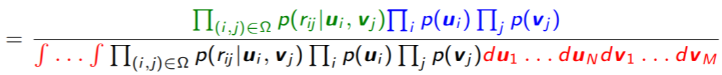




Bayesian Matrix Factorization (BMF): The Posterior
12
Our target posterior distribution for this model is
Posterior still intractable since integrals here are intractable
Need to approx. the posterior. One way is via conditional posteriors (CP), e.g.,
CP of each unknown is conditioned on fixed values of all other unknowns
  The different CPs can be computed in an alternating fashion (like ALT-OPT/EM)
Note: CP individually won’t give us joint posterior. Need to combine them
Due to conditional independence of the observations given params
Assume that the joint prior factorizes into individual priors
$$p(u_{i}|R,V,U_{−i})$$
All of $U$ except $u_{i}$
$$p(v_{j}|R,U,V_{−j})$$
All of $V$ except $v_{j}$
E.g., using MCMC, variational inference, EM, etc

Slide 13
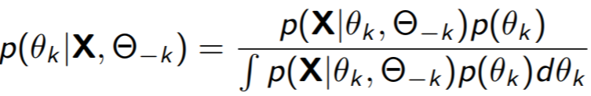

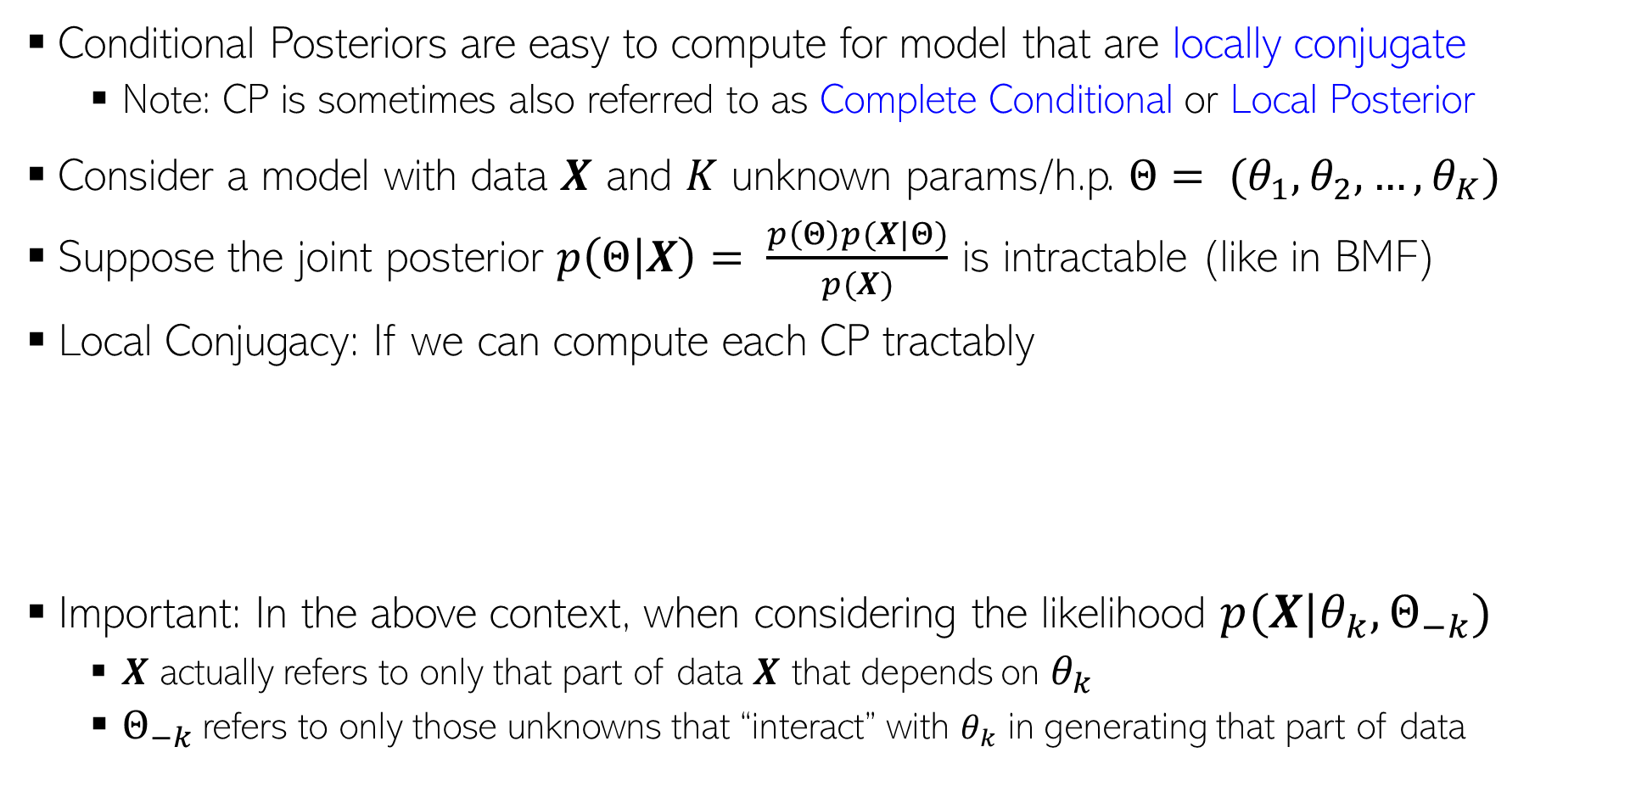
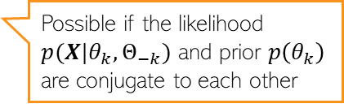
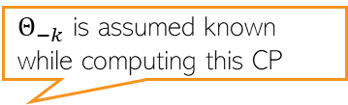
Conditional Posterior and Local Conjugacy
13
Conditional Posteriors are easy to compute for model that are locally conjugate
  Note: CP is sometimes also referred to as Complete Conditional or Local Posterior
Consider a model with data $X$ and $K$ unknown params/h.p. $Θ= (θ_{1},θ_{2},…, θ_{K})$
Suppose the joint posterior $p\left(Θ | X\right)= \frac{p\left(Θ\right)p(X|Θ)}{p(X)}$ is intractable (like in BMF)
Local Conjugacy: If we can compute each CP tractably
Important: In the above context, when considering the likelihood $p(X|θ_{k}, Θ_{−k})$
  $X$ actually refers to only that part of data $X$ that depends on $θ_{k}$
  $Θ_{−k}$refers to only those unknowns that “interact” with $θ_{k}$ in generating that part of data
This is the notion of local conjugacy as opposed to full/joint conjugacy
Possible if the likelihood $p(X|θ_{k}, Θ_{−k})$ and prior $p\left(θ_{k}\right)$ are conjugate to each other
$Θ_{−k}$ is assumed known while computing this CP
In the likelihood model

Slide 14
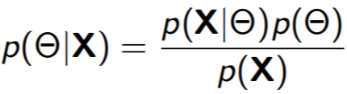
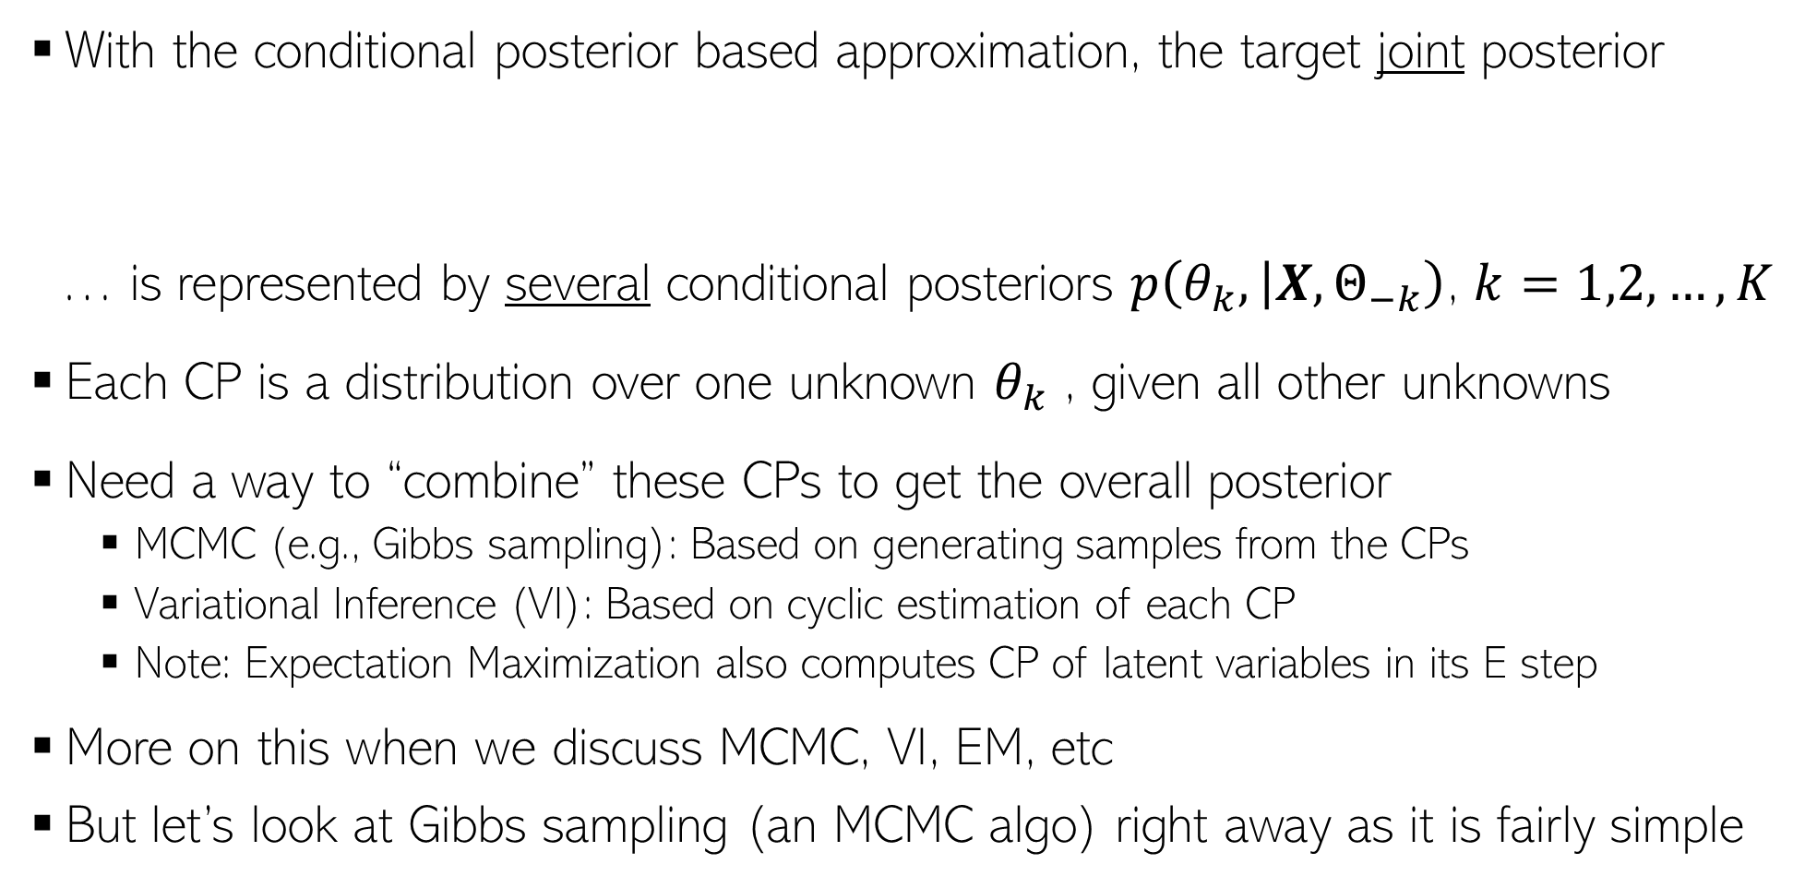
Approximating Joint Posterior via CPs
14
With the conditional posterior based approximation, the target joint posterior
… is represented by several conditional posteriors $p\left(θ_{k}, | X,Θ_{−k}\right)$, $k=1,2,…,K$
Each CP is a distribution over one unknown $θ_{k}$ , given all other unknowns
Need a way to “combine” these CPs to get the overall posterior
  MCMC (e.g., Gibbs sampling): Based on generating samples from the CPs
  Variational Inference (VI): Based on cyclic estimation of each CP
  Note: Expectation Maximization also computes CP of latent variables in its E step
More on this when we discuss MCMC, VI, EM, etc
But let’s look at Gibbs sampling (an MCMC algo) right away as it is fairly simple
Will revisit Gibbs sampling again when discussing MCMC algos

Slide 15
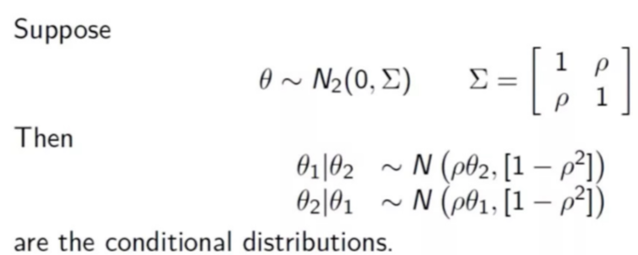
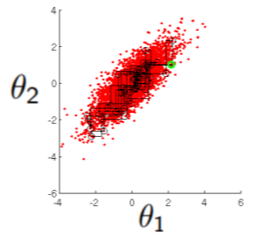

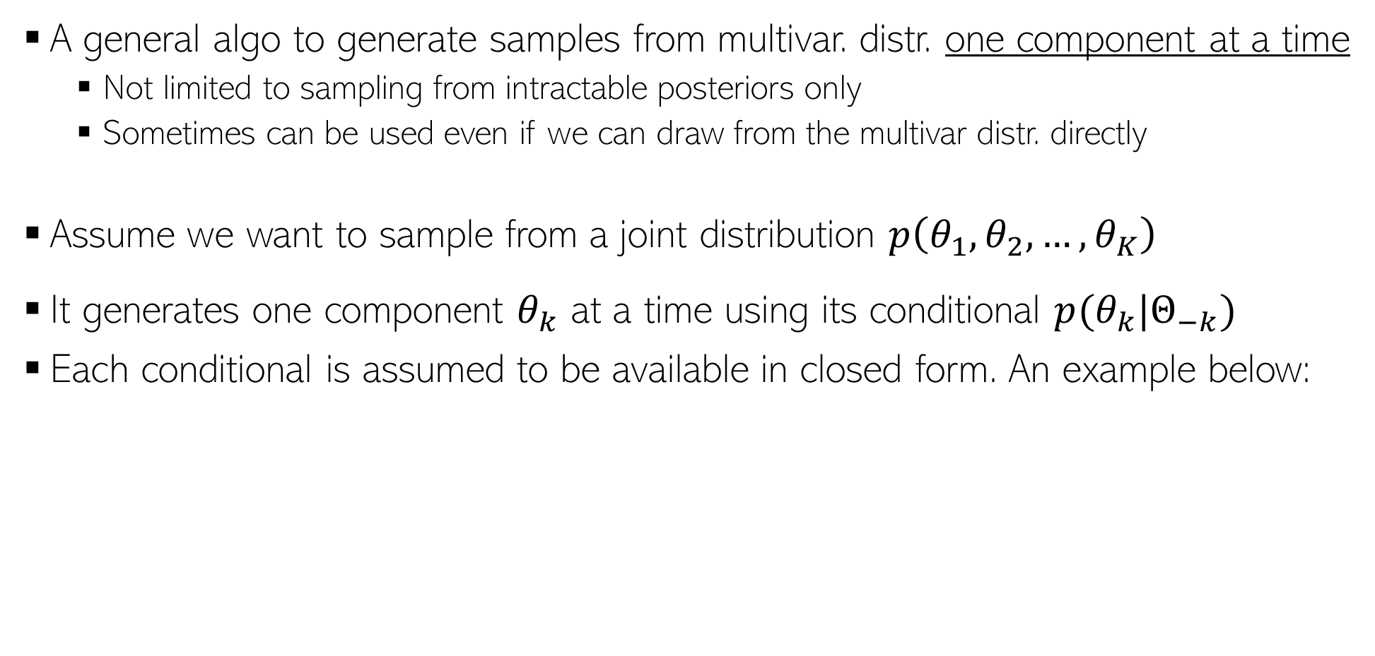
Gibbs Sampling (Geman and Geman, 1982)
15
A general algo to generate samples from multivar. distr. one component at a time
  Not limited to sampling from intractable posteriors only
  Sometimes can be used even if we can draw from the multivar distr. directly
Assume we want to sample from a joint distribution $p\left(θ_{1},θ_{2},…,θ_{K}\right)$
It generates one component $θ_{k}$ at a time using its conditional $p(θ_{k}|Θ_{−k})$
Each conditional is assumed to be available in closed form. An example below:
Note: If posterior, it will be conditioned on other stuff too (e.g., data, other param, etc)
A 2-dim Gaussian
This example is a toy illustration of sampling from a 2-dim Gaussian by sampling from 1-dim Gaussians
A 1-dim Gaussian
A sample based representation of a 2-dim Gaussian distribution
A 1-dim Gaussian

Slide 16
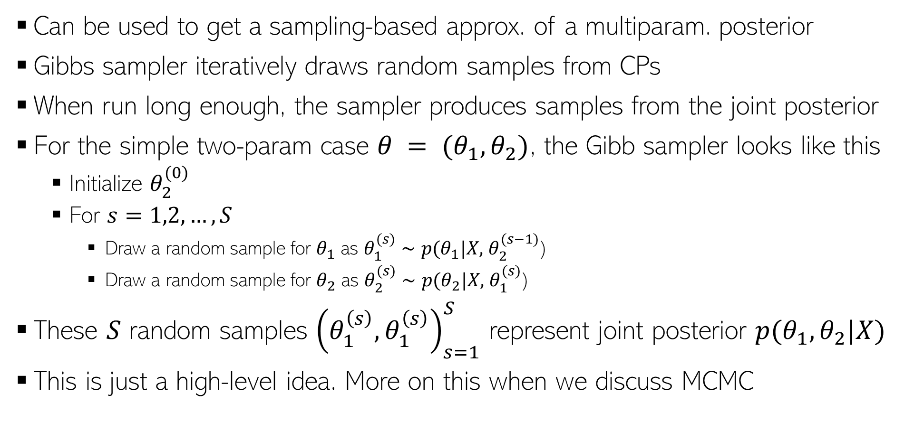
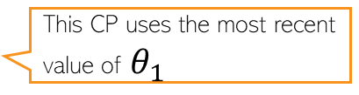
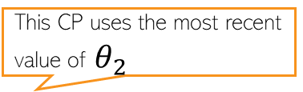
Gibbs Sampling (Geman and Geman, 1982)
16
Can be used to get a sampling-based approx. of a multiparam. posterior
Gibbs sampler iteratively draws random samples from CPs
When run long enough, the sampler produces samples from the joint posterior
For the simple two-param case $θ = (θ_{1}, θ_{2})$, the Gibb sampler looks like this
  Initialize $θ_{2}^{(0)}$
  For $s=1,2,…,S$
    Draw a random sample for $θ_{1}$ as $θ_{1}^{(s)}∼p(θ_{1}|X,$ $θ_{2}^{(s−1)}$)
    Draw a random sample for $θ_{2}$ as $θ_{2}^{(s)}∼p(θ_{2}|X,$ $θ_{1}^{(s)}$)
These $S$ random samples ${\left(θ_{1}^{\left(s\right)},θ_{1}^{\left(s\right)}\right)}_{s=1}^{S}$ represent joint posterior $p(θ_{1},θ_{2}|X)$
This is just a high-level idea. More on this when we discuss MCMC
This CP uses the most recent value of $θ_{2}$
This CP uses the most recent value of $θ_{1}$

Slide 17
Back to Bayesian Matrix Factorization
17

Slide 18
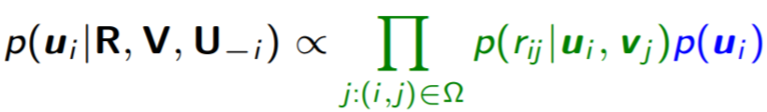
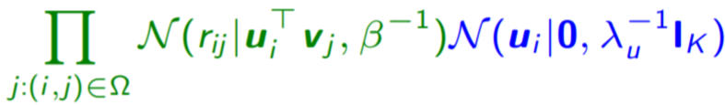


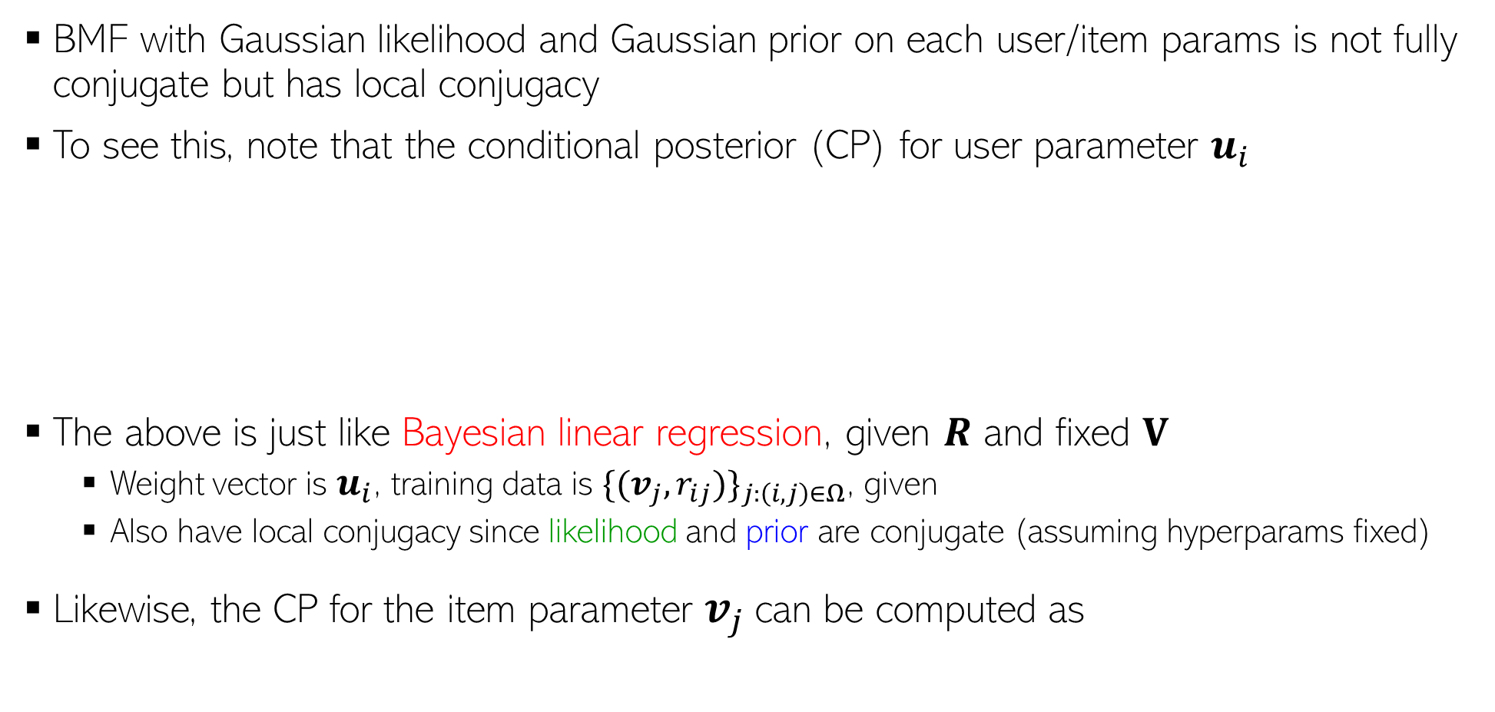
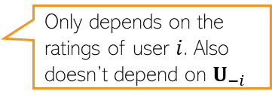
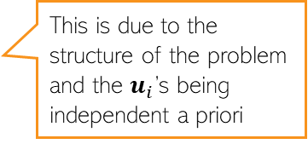
Bayesian Matrix Factorization: The CPs
18
BMF with Gaussian likelihood and Gaussian prior on each user/item params is not fully conjugate but has local conjugacy
To see this, note that the conditional posterior (CP) for user parameter $u_{i}$
The above is just like Bayesian linear regression, given $R$ and fixed $V$
  Weight vector is $u_{i}$, training data is ${\{(v_{j}, r_{ij})\}}_{j:\left(i,j\right)∈Ω}$, given
  Also have local conjugacy since likelihood and prior are conjugate (assuming hyperparams fixed)
Likewise, the CP for the item parameter $v_{j}$can be computed as
Only depends on the ratings of user $i$. Also doesn’t depend on $U_{−i}$
This is due to the structure of the problem and the $u_{i}$’s being independent a priori
=
Another Bayesian linear regression problem with weight vector $v_{j}$

Slide 19

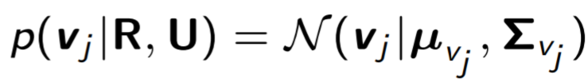
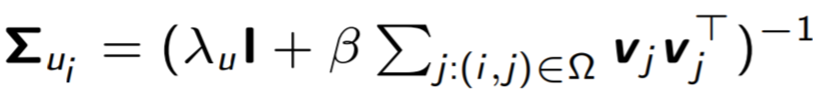
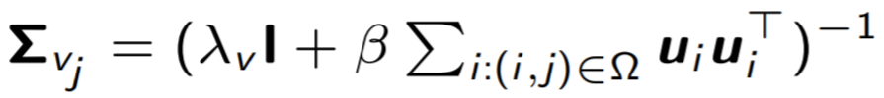


Bayesian Matrix Factorization: The CPs
19
The CPs will have forms similar to solution of Bayesian linear regression
These CPs can be updated in an alternating fashion until convergence
  Many ways. One popular way is to use Gibbs sampling
  Note: Hyperparameters can also be inferred by computing their CPs¹
Can extend Gaussian BMF easily to other exp. family distr. while maintaining local conj.
  Example: Poisson likelihood and gamma priors on user/item parameters²
  ¹“Bayesian Probabilistic Matrix Factorization using Markov Chain Monte Carlo” by Salakhutdinov and Mnih (2008)
  ²“Scalable recommendation with Poisson factorization” by Gopalan et al(2013)

Slide 20
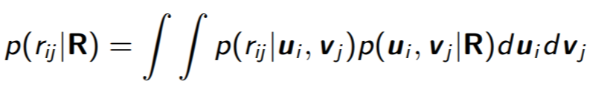
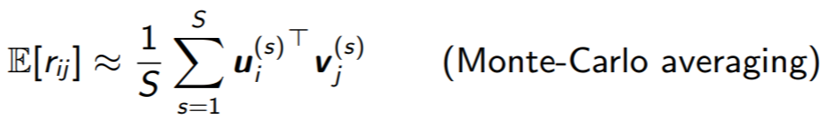
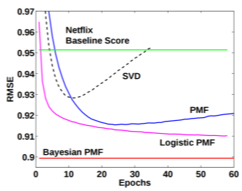
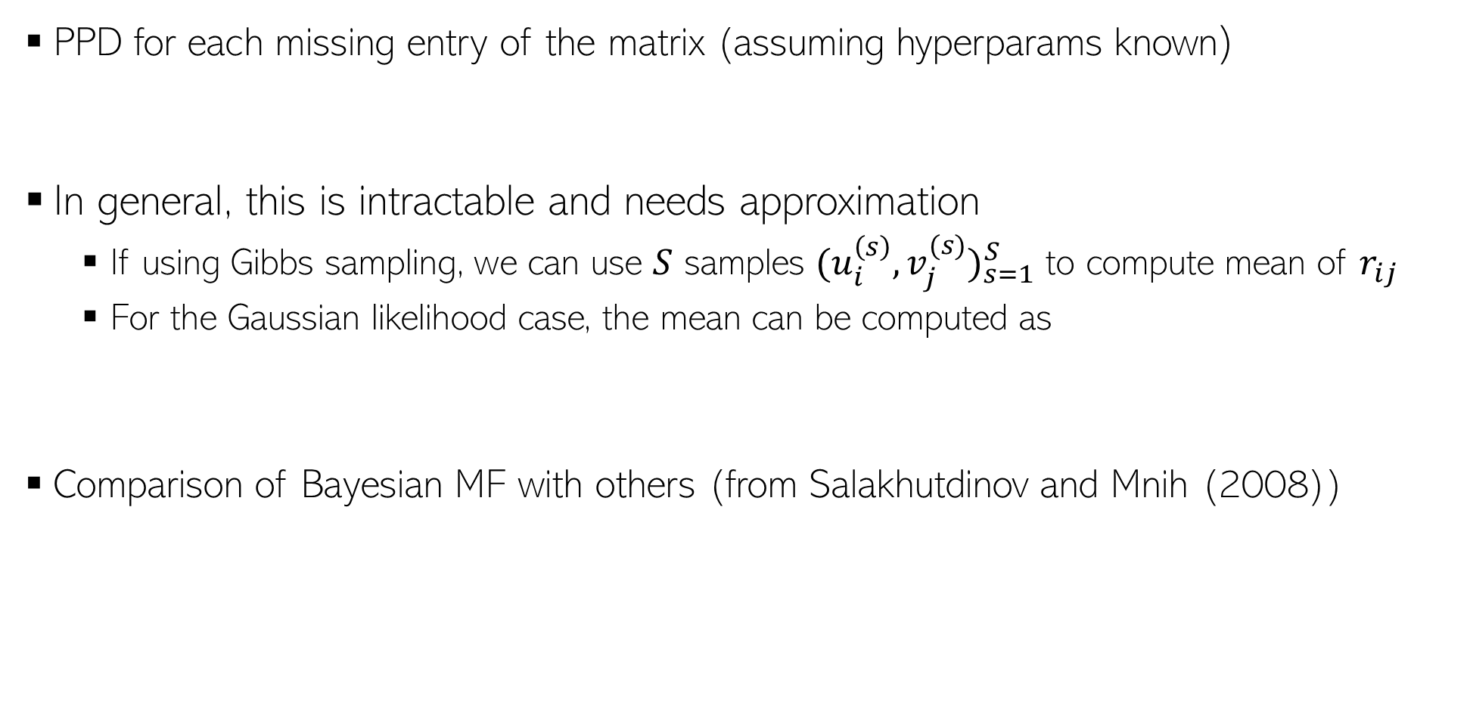
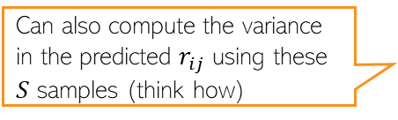
BMF: Making Predictions
20
PPD for each missing entry of the matrix (assuming hyperparams known)
In general, this is intractable and needs approximation
  If using Gibbs sampling, we can use $S$ samples ${(u_{i}^{\left(s\right)},v_{j}^{(s)})}_{s=1}^{S}$ to compute mean of $r_{ij}$
  For the Gaussian likelihood case, the mean can be computed as
Comparison of Bayesian MF with others (from Salakhutdinov and Mnih (2008))
Can also compute the variance in the predicted $r_{ij}$ using these $S$ samples (think how)
All other baselines are optimization based or point estimation based probabilistic models (PMF = probabilistic matrix factorization with point estimation)

Slide 21
Summary
21
Local conjugacy is helpful even for complex prob. models with many params
  CPs will have a closed form
  Easy to implement Gibbs sampling can be used to get the (approx.) posterior
  Many other approx. inference algos (like variational inference) benefit from local conjugacy
Helps to choose likelihood and priors on each param as exp. family distr.
  So if we can’t get a globally conjugate model, we can still get a model with local conjugacy
Even if we can’t have local conjugacy, the notion of CPs is applicable
  We can break the inference problem into estimating CPs (exactly if we have local conjugacy, or approximately if we don’t have local conjugacy)
  Almost all approx. algorithms work by estimating CPs exactly or approximately

Slide 22
Coming Up
22
Latent Variable Models
Expectation Maximization

