Slide 1
Course Logistics and Introduction to Probabilistic Machine Learning
CS772A: Probabilistic Machine Learning
Piyush Rai

Slide 2
Course Logistics
2
Course Name: Probabilistic Machine Learning – CS772A
2 classes each week
  Mon/Thur 18:00-19:30
  Venue: KD-101
All material (readings etc) will be posted on course webpage (internal access)
  URL: https://web.cse.iitk.ac.in/users/piyush/courses/pml_autumn22/pml.html
Q/A and announcements on Piazza. Please sign up
  URL: https://piazza.com/iitk.ac.in/firstsemester2022/cs772a
  If need to contact me by email (piyush@cse.iitk.ac.in), prefix subject line with “CS772”
Auditors are welcome
  However, can’t appear for quizzes/exams. Also, won’t be able to grade your homeworks

Slide 3

Workload and Grading Policy
3
4 homeworks (theory + programming): 40%
  Must be typeset in LaTeX. To be uploaded on Gradescope (login details will be shared)
2 quizzes: 10% (tentative dates: Aug 27, Oct 22)
Mid-sem exam: 20% (date as per DOAA schedule)
End-sem exam: 30% (date as per DOAA schedule)
(Optional) Research project (to be done in groups of 2): 20%
  If opted, will be exempted from appearing in the mid-sem exam
  We may suggest some topics but the project has to be driven by you
  We will not be able to provide compute resources
  Advisable only if you have strong prior experience of working on ML research projects
Tentative dates for release of homeworks: Aug 11, Aug 29, Sept 26, Oct 20
Each homework due roughly in 2 weeks (excluding holidays, exam weeks)

Slide 4
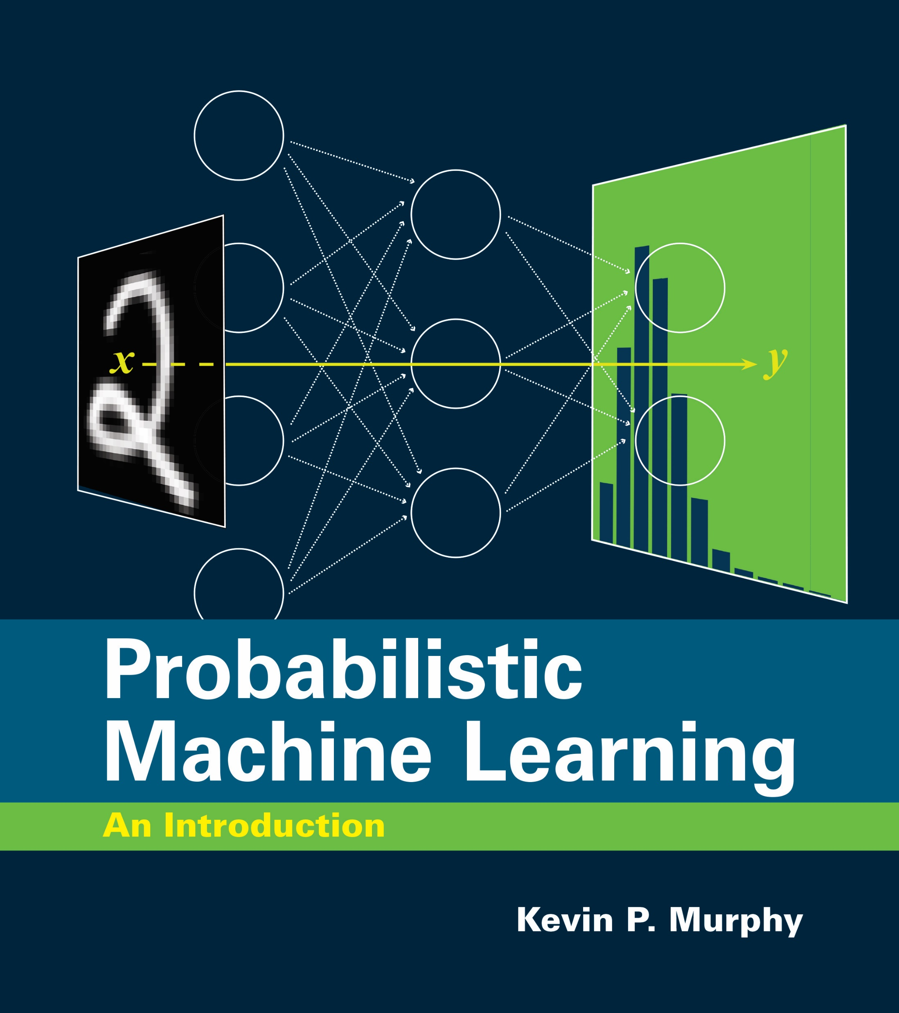
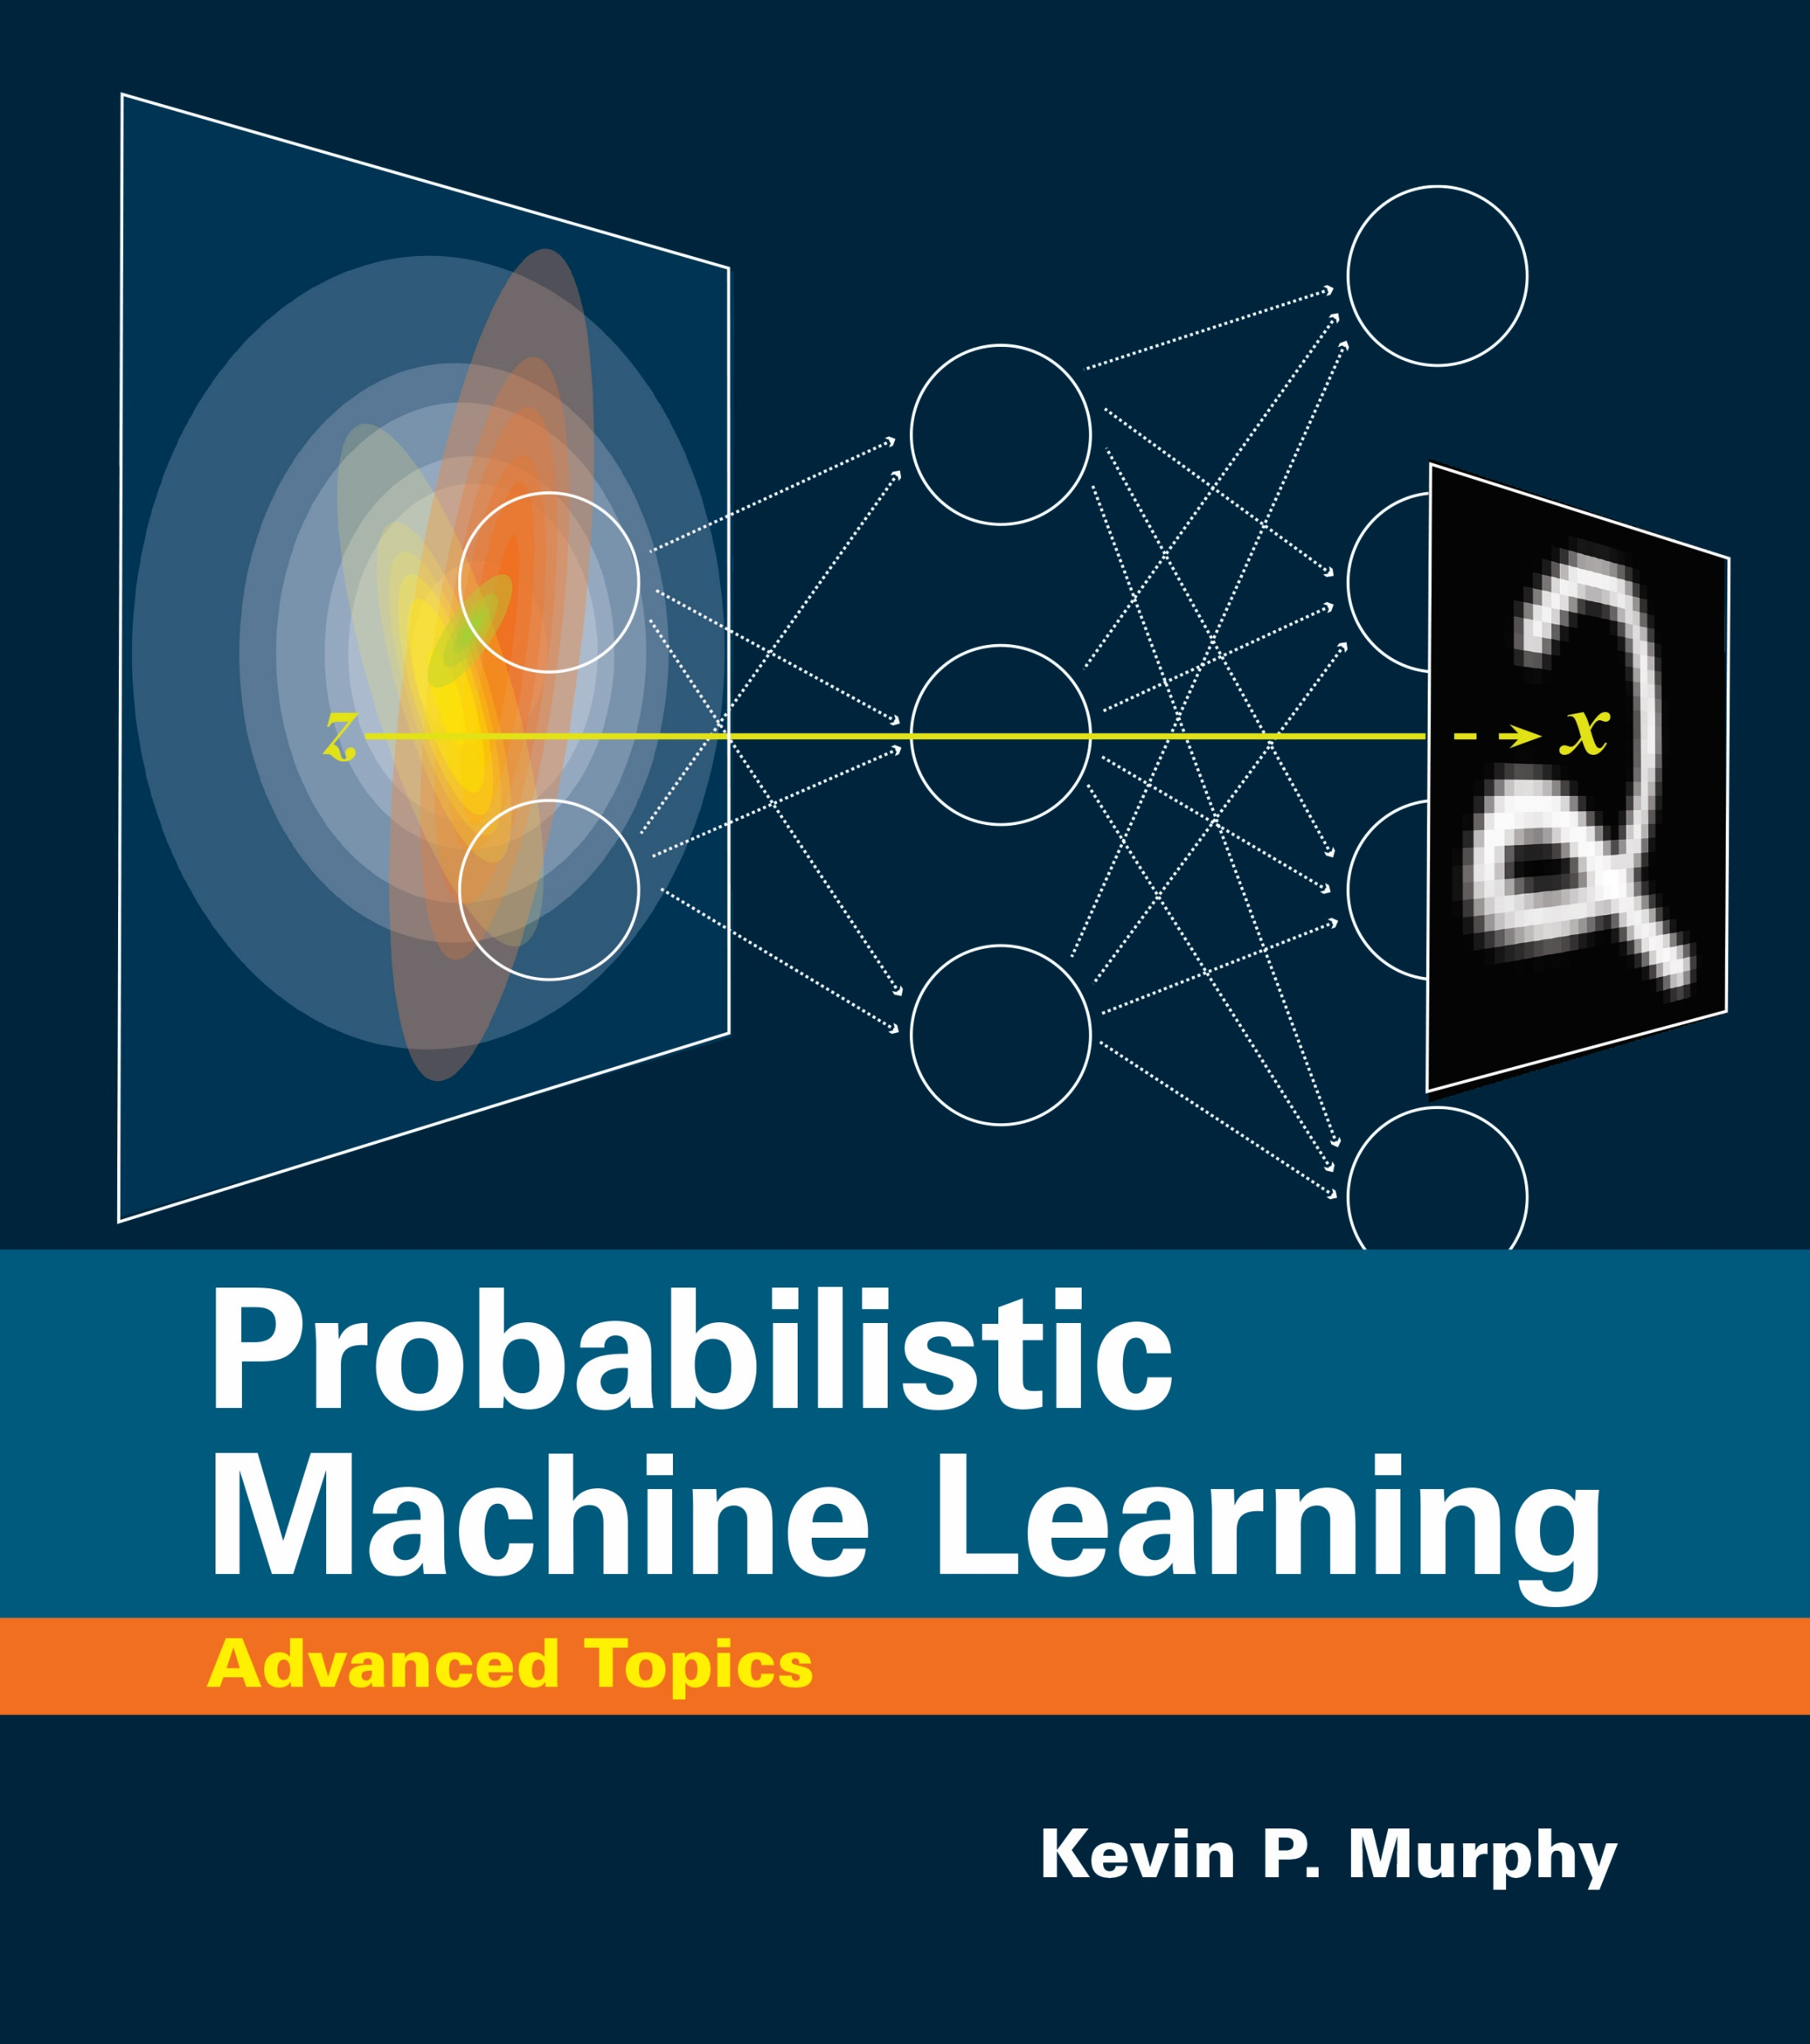
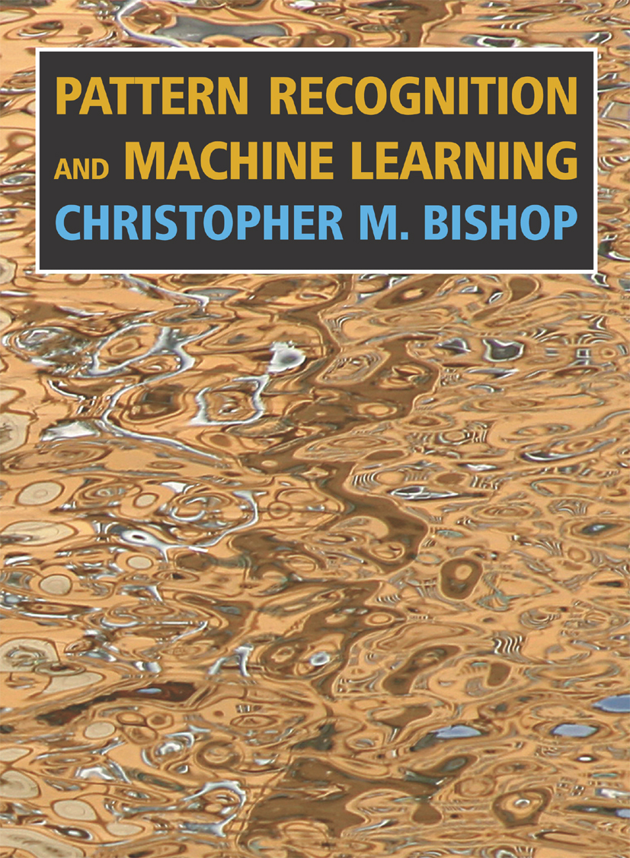
Textbooks and Readings
4
Textbook: No official textbook required
Some books that you may use as reference (freely available PDF)
  Kevin P. Murphy, Probabilistic Machine Learning: An Introduction (PML-1), The MIT Press, 2022.
  Kevin P. Murphy, Probabilistic Machine Learning: Advanced Topics(PML-2), The MIT Press, 2022.
  Christopher M. Bishop, Pattern Recognition and Machine Learning (PRML), Springer, 2007.
Follow the suggested readings for each lecture (may also include some portions from these books), rather than trying to read these books in a linear fashion
855 pages
1347 pages
758 pages
All these books have accompanying Python code. You are encouraged to explore (we will also go through some)
Python code
Python code
Python code

Slide 5
Course Policies
5
Policy on homeworks
  Homework solutions must be in your own words
  Must cite sources you have referred to or used in preparing your HW solutions
  No requests for deadline extension will entertained. Plan ahead of time
  Late submissions allowed up to 72 hours with 10% penalty per 24 hour delay
  Every student entitled for ONE late homework submission without penalty (use it wisely)
Policy on collaboration/cheating
  Punishable as per institute's/department’s rules
  Plagiarism from other sources will also lead to strict punishment
  Both copying as well as helping someone copy will be equally punishable

Slide 6





Course Team
6
TA
TA
TA
Abhinav Joshi
ajoshi@cse.iitk.ac.in
Abhishek Jaiswal
abhijais@cse.iitk.ac.in
Avideep Mukherjee
avideep@cse.iitk.ac.in
TA
Instructor
Soumya Banerjee
soumyab@cse.iitk.ac.in
Piyush Rai
piyush@cse.iitk.ac.in

Slide 7
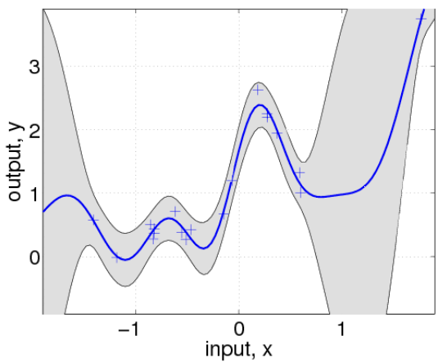

Course Goals
7
Introduce you to the foundations of probabilistic machine learning (PML)
Focus will be on learning core, general principles of PML
  How to set up a probabilistic model for a given ML problem
  How to quantify uncertainty in parameter estimates and predictions
  Estimation/inference algorithms to learn various unknowns in a model
  How to think about trade-offs (computational efficiency vs accuracy)
Will also look at the above using specific examples of ML models
Throughout the course, focus will also be on contemporary/latest advances
  PML is a fast-moving field, especially in the era of modern machine/deep learning
Image source: Probabilistic Machine Learning – Advanced Topics (Murphy, 2022)

Slide 8
Why Probabilistic ML?
8

Slide 9
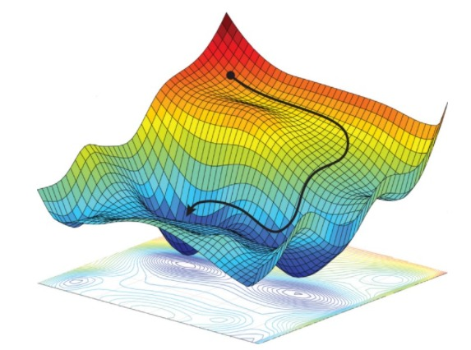
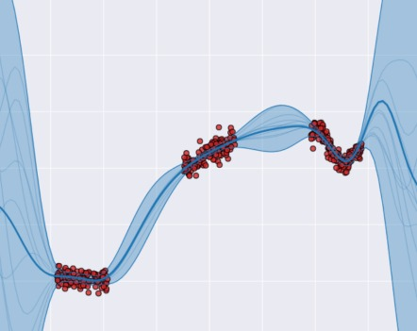


Probabilistic ML because… Uncertainty Matters!
9
9
ML models ingest data, give us predictions, trends in the data, etc
The standard approach: Minimize a loss func. to find optimal parameters. Use them to predict
In many applications, we also care about the parameter/predictive uncertainty
May be unreliable and can overfit especially with limited training data
Training data
Single answer! No estimate of uncertainty about true $θ$
$$\hat{θ}= {arg min}_{θ} ℓ(𝒟,θ)$$
Healthcare applications, autonomous driving, etc.
Regression
Binary classification
Desirable: An approach that reports close to uniform class probability (0.5 in this case) for inputs faraway from training data or for out-of-distribution inputs
Desirable: An approach that reports large predictive uncertainty (variance) in regions where there is little/no training data
Image source: Probabilistic Machine Learning – Advanced Topics (Murphy, 2022)

Slide 10
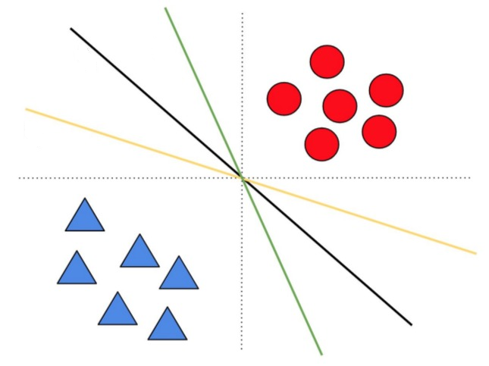
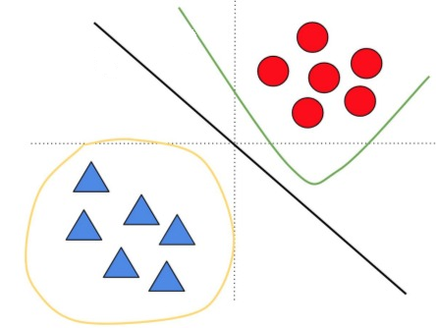
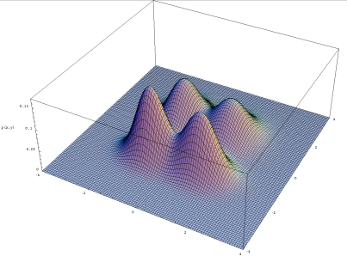


Types of Uncertainty: Model Uncertainty
10
Means uncertainty in model weights
Model uncertainty is due to not having enough training data
Also called epistemic uncertainty. Usually reducible
  Vanishes with “sufficient” training data
Also known as the “posterior distribution”
Same model class (linear models)
but uncertainty about the weights
Uncertainty not just about the weights but also the model class
Distribution of model parameters conditioned on the training data
Hard to compute in general. Will study several methods to do it
A probabilistic way to express model uncertainty
3 different model classes considered here (with linear, polynomial, circular decision boundaries)
$$p(θ|𝒟)$$
Each model class itself will have uncertainty(like left fig) since there isn’t enough training data
An example posterior of a two-dim parameter vector $θ$
Image credit: Balaji L, Dustin T, Jasper N. (NeurIPS 2020 tutorial)

Slide 11
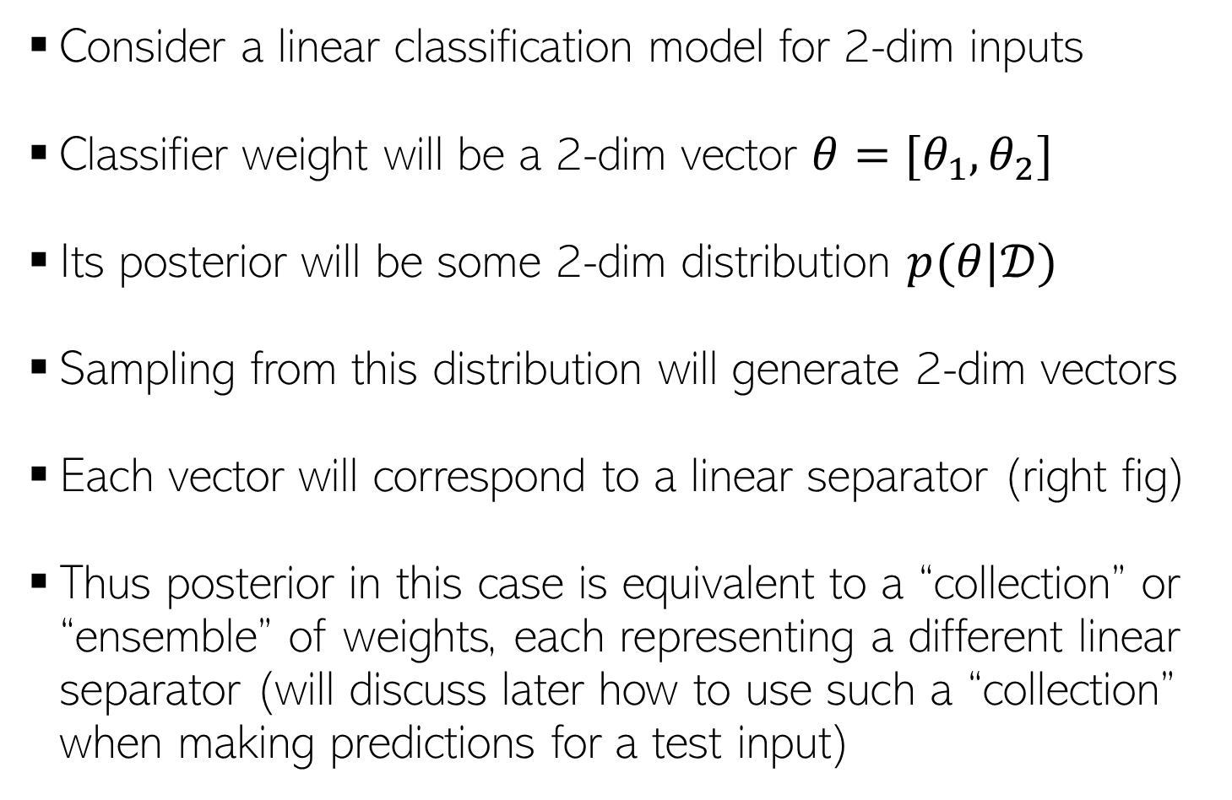
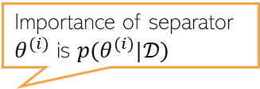
Model Uncertainty via Posterior: An Illustration
11
Consider a linear classification model for 2-dim inputs
Classifier weight will be a 2-dim vector $θ=[θ_{1},θ_{2}]$
Its posterior will be some 2-dim distribution $p(θ|𝒟)$
Sampling from this distribution will generate 2-dim vectors
Each vector will correspond to a linear separator (right fig)
Thus posterior in this case is equivalent to a “collection” or “ensemble” of weights, each representing a different linear separator (will discuss later how to use such a “collection” when making predictions for a test input)
Importance of separator $θ^{(i)}$ is $p(θ^{(i)}|𝒟)$
Not every separator is equally important

Slide 12
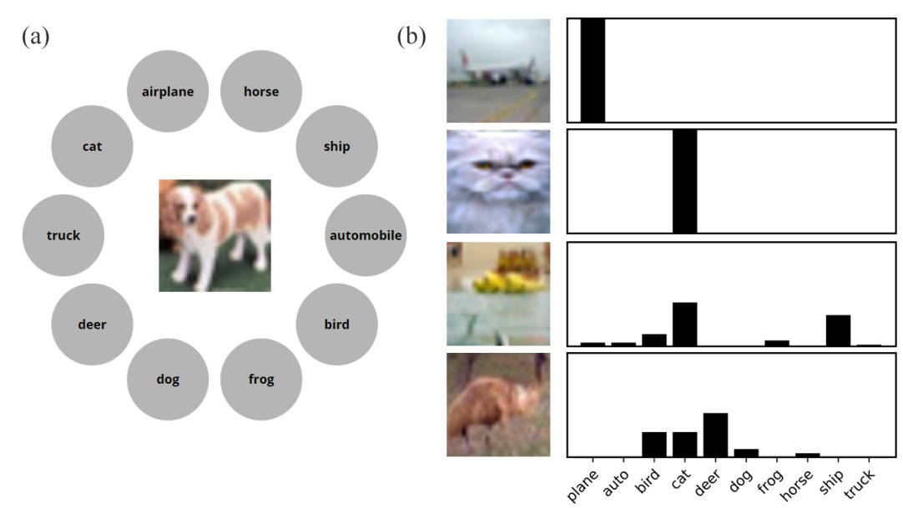
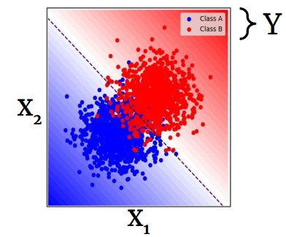
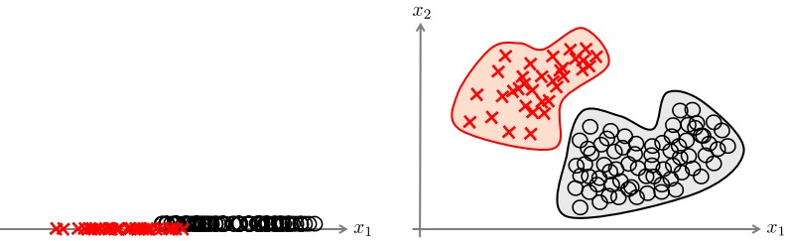

Types of Uncertainty: Data Uncertainty
12
A probabilistic way to express data uncertainty
Data uncertainty can be due to various reasons, e.g.,
  Intrinsic hardness of labeling, class overlap
  Labeling errors/disagreements (for difficult training inputs)
  Noisy or missing features
Also called aleatoric uncertainty. Usually irreducible
  Won’t vanish even with infinite training data
  Note: Can sometimes vanish by adding more features
  (figure on the right) or switching to a more complex model
$$p(y|θ,x)$$
Usually specified by the distribution of data being modeled conditioned on model parameters and other inputs
Image credit: Eric Nalisnick
Image source: “Improving machine classification using human uncertainty measurements” (Battleday et al, 2021)
Image source: “Aleatoric and epistemic uncertainty in machine learning: an introduction to concepts and methods” (H&W 2021)

Slide 13
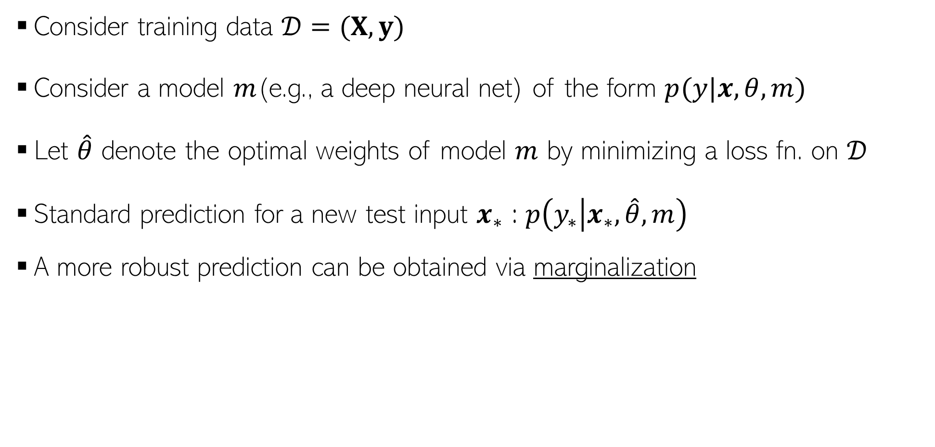
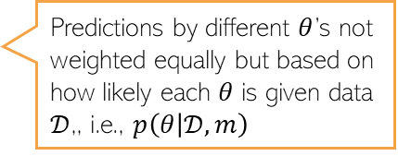



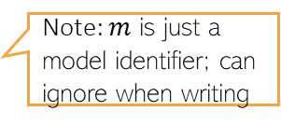
A Key Principle of PML: Marginalization
13
Consider training data $𝒟=(X,y)$
Consider a model $m$(e.g., a deep neural net) of the form $p(y|x,θ,m)$
Let $\hat{θ}$ denote the optimal weights of model $m$ by minimizing a loss fn. on $𝒟$
Standard prediction for a new test input $x_{∗}$ : $p\left(y_{∗} | x_{∗},\hat{θ},m\right)$
A more robust prediction can be obtained via marginalization
e.g., a deep net with softmax outputs
Note: $m$ is just a model identifier; can ignore when writing
Uncertainty about $θ$ ignored
For multi-class classification, this quantity will be a vector of predicted class probabilities
Posterior distribution of the weights
Denotes data / aleatoric uncertainty
Denotes model weight / epistemic uncertainty
For multi-class classification, this too will be a vector of predicted class probabilities but its computation incorporates the uncertainty in $θ$
$p(y_{∗}|x_{∗},$ $𝒟,m)=∫p\left(y_{∗} | x_{∗},θ,m\right)p\left(θ | 𝒟,m\right)dθ$
Prediction via marginalizing the predictions by each value of $θ$ over its posterior distribution
Predictions by different $θ$’s not weighted equally but based on how likely each $θ$ is given data $𝒟$,, i.e., $p\left(θ | 𝒟,m\right)$
Will derive the expression shortly – just a simple application of product and chain rules of probability

Slide 14
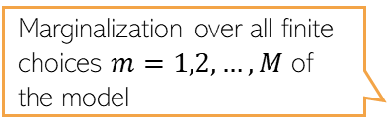

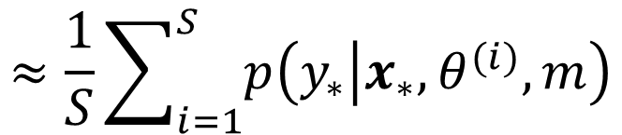
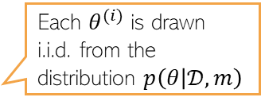
More on Marginalization
14
Marginalization (integral) is usually intractable and needs to be approximated
Marginalization can be done even over several choices of models
$$p(y_{∗}|x_{∗},𝒟,m)=∫p\left(y_{∗} | x_{∗},θ,m\right)p\left(θ | 𝒟,m\right)dθ$$
Will look at these ideas in more depth later
Each $θ^{(i)}$ is drawn i.i.d. from the distribution $p\left(θ | 𝒟,m\right)$
$$≈\frac{1}{S}\sum_{i=1}^{S}{p\left(y_{∗} | x_{∗},θ^{(i)},m\right)}$$
Above integral replaced by a “Monte-Carlo Averaging”
Marginalization over all weights of a single model $m$
$$p(y_{∗}|x_{∗},𝒟,m)=∫p\left(y_{∗} | x_{∗},θ,m\right)p\left(θ | 𝒟,m\right)dθ$$
Marginalization over all finite choices $m=1,2,…, M$ of the model
$p(y_{∗}|x_{∗},$ $𝒟)= \sum_{m=1}^{M}{p\left(y_{∗} | x_{∗},𝒟,m\right)p(m|𝒟)}$
For example, deep nets with different architectures
Like a double averaging (over all model choices, and over all weights of each model choice)
Haven’t yet told you how to compute this quantity but will see shortly

Slide 15
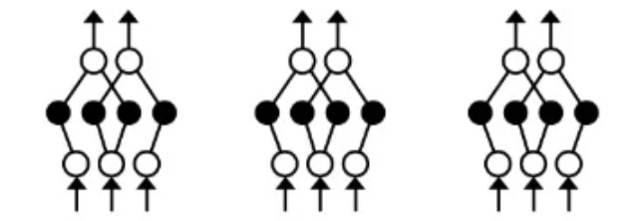

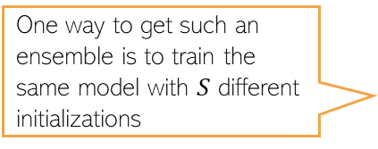


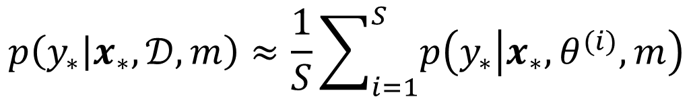

Marginalization is like Ensemble-based Averaging
15
Recall the approximation of the marginalization
Akin to computing averaged prediction using ensemble of weights ${\left\{θ^{(i)}\right\}}_{i=1}^{S}$
Ensembling is a well-known classical technique for strong predictive performance
$$p\left(y_{∗} | x_{∗},𝒟,m\right)≈\frac{1}{S}\sum_{i=1}^{S}{p\left(y_{∗} | x_{∗},θ^{(i)},m\right)}$$
Tip: If you can’t design/use a full-fledged, rigorous probabilistic model, consider using an ensemble* instead
One way to get such an ensemble is to train the same model with $S$ different initializations
$$θ^{(2)}$$
$$θ^{(S)}$$
$$θ^{(1)}$$
May not be as good as doing proper marginalization over the posterior but usually better than using a single estimate of the weights
We will also study ensembles later during this course
*Simple and Scalable Predictive Uncertainty Estimation using Deep Ensembles (Lakshminarayanan et al, 2017)

Slide 16
Probabilistic ML:
The Basic Set-up
16

Slide 17
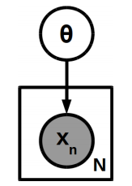
Modeling Data Probabilistically: A Simplistic View
17
Assume data $X=\{x_{1},x_{2},…, x_{N}\}$ generated from a prob. model with params $θ$
Note: Shaded nodes = observed; unshaded nodes = unknown/unobserved
Goal: To estimate the unknowns ($θ$ in this case), given the observed data $X$
  Many ways to do this (point estimate or the posterior distribution of $θ$)
Can use the parameter estimates to make predictions, e.g.,
  Probability density of a new input $x_{∗}$under this model
No outputs/labels in this problem; just modeling the inputs (an unsupervised learning task)
A plate diagram of this simplistic model
$$x_{1},x_{2},…, x_{N}∼p(x|θ)$$

Slide 18
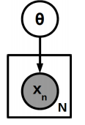
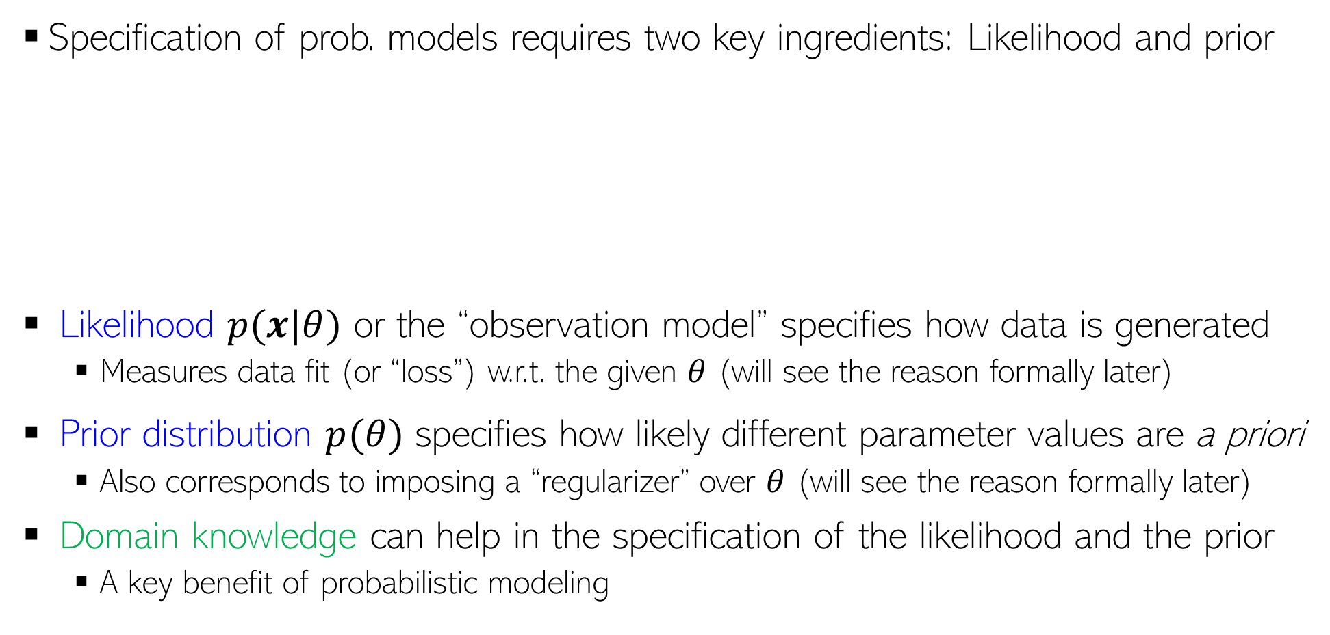
Basic Ingredients in Probabilistic ML
18
Specification of prob. models requires two key ingredients: Likelihood and prior
Likelihood $p(x|θ)$ or the “observation model” specifies how data is generated
  Measures data fit (or “loss”) w.r.t. the given $θ$ (will see the reason formally later)
Prior distribution $p(θ)$ specifies how likely different parameter values are a priori
  Also corresponds to imposing a “regularizer” over $θ$ (will see the reason formally later)
Domain knowledge can help in the specification of the likelihood and the prior
  A key benefit of probabilistic modeling

Slide 19
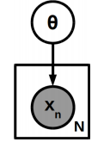






Parameter Estimation in Probabilistic Models
19
A simple way: Find $θ$ for which the observed data is most likely or most probable
More desirable: Estimate the full posterior distribution over $θ$ to get the uncertainty
To make predictions, can use full posterior rather than a point estimate(MLE/MAP) $θ$
  This is typically referred to as posterior averaging
In this course, the use of the word “inference” would mean Bayesian inference, i.e., computing the (usually an approximate) posterior distribution of the model parameters.
Log likelihood
This “point estimate”, called maximum likelihood estimate (MLE), however, does not provide us any information about uncertainty in $θ$
Just like loss function minimization approach
At some other places, especially in deep learning community, the word “inference” usually refers to making prediction on the test inputs
Fully Bayesian inference. In general, an intractable problem (mainly because computing the marginal $p(X)$ is hard), except for some simple cases (will study how to solve such problems)
Can also find a single best estimate of $θ$ by finding the mode of the posterior, i.e., $\hat{θ}=arg\max_{θ} log p(θ|X)$, called the maximum-a-posteriori (MAP) estimate, but we won’t get uncertainty estimate

Slide 20




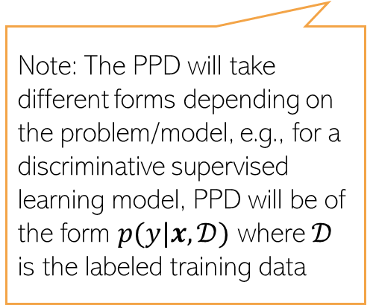

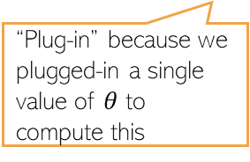
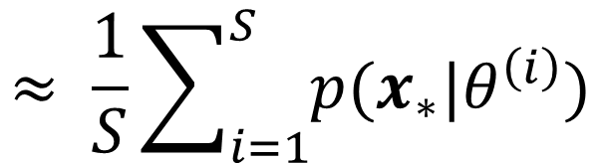
Posterior Averaging
20
Can now use the posterior over params to compute “averaged prediction”, e.g.,
Future (test) data
Past (training) data
$$p\left(x_{∗} | X\right)=∫p\left(x_{∗} | θ\right)p\left(θ | X\right)dθ$$
Posterior predictive distribution (PPD) obtained by doing an importance-weighted averaging over the posterior
Plug-in predictive distribution
Tells us how important this value of $θ$ is
“Plug-in” because we plugged-in a single value of $θ$ to compute this
$$≈ \frac{1}{S}\sum_{i=1}^{S}{p(x_{∗}|θ^{\left(i\right)})}$$
An approximation of the PPD
Note: The PPD will take different forms depending on the problem/model, e.g., for a discriminative supervised learning model, PPD will be of the form $p(y|x,𝒟)$ where $𝒟$ is the labeled training data
Proof of the PPD expression
$$p\left(x_{∗} | X\right)=∫p(x_{∗},θ|X) dθ$$
$$=∫p\left(x_{∗} | θ,X\right)p(θ|X) dθ$$
Assuming observations are i.i.d. given $θ$
$$=∫p\left(x_{∗} | θ\right)p(θ|X) dθ$$

Slide 21
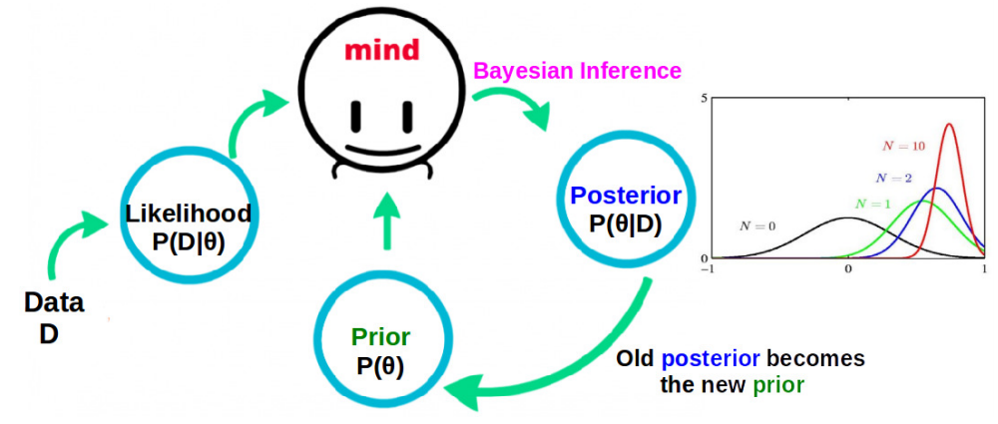

Bayesian Inference
21
Bayesian inference can be seen in a sequential fashion
Our belief about $θ$ keeps getting updated as we see more and more data
  Posterior keeps getting updates as more and more data is observed
  Note: Updates may not be straightforward and approximations may be needed

Slide 22
Other Examples of Probabilistic Models of Data
22

Slide 23
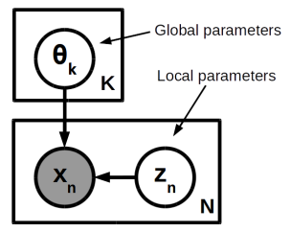
Modeling Data Probabilistically: With Latent Vars
23
Can endow generative models of data with latent variables. For example:
Such models are used in many problems, especially unsupervised learning: Gaussian mixture model, probabilistic PCA, topic models, deep generative models, etc.
We will look at several of these in this course and way to learn such models
Each data point $x_{n}$ is associated with a latent variable $z_{n}$
The latent variable $z_{n}$ can be used to encode some property of $x_{n}$ (e.g., its cluster membership, or its low-dim representation, or missing parts of $x_{n}$)

Slide 24
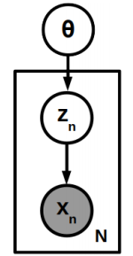
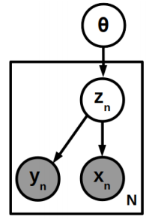
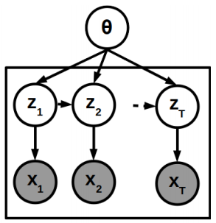
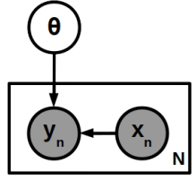
Modeling Data Probabilistically: Other Examples
24
Can construct various other types of models of data for different problems
Any node (even if observed) we are uncertain about is modeled by a prob. distribution
  These nodes become the random variables of the model
The full model is specified via a joint prob. distribution over all random variables
The goal is to infer the distribution of unknowns of the model, given the observed data
A simple supervised learning model
A latent variable model for unsupervised learning
A latent variable model for supervised learning
A latent variable model for sequential data

Slide 25
Use probabilistic ML also because..
25

Slide 26
Helps in Sequential Decision-Making Problems
26
Sequential decision-making: Information about uncertainty can “guide” us, e.g.,
Applications in active learning, reinforcement learning, Bayesian optimization, etc
Given our current estimate of the regression function, which training input(s) should we add next to improve its estimate the most?
Blue curve is the mean of the function, shaded region denotes the predictive uncertainty
Uncertainty can help here: Acquire training inputs from regions where the function is most uncertain about its current predictions

Slide 27
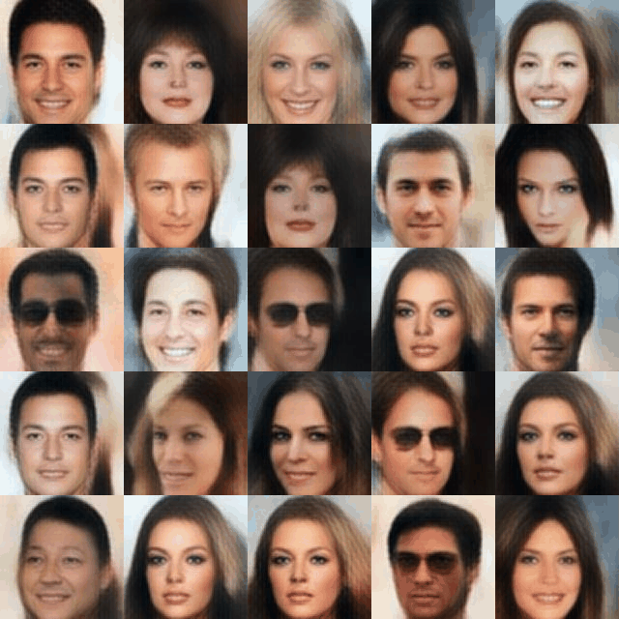
Can Learn Data Distribution and Generate Data
27
Often wish to learn the underlying probability distribution $p(x)$ of the data
Useful for many tasks, e.g.,
  Outlier/novelty detection: Outliers will have low probability under $p(x)$
  Can sample from this distribution to generate new “artificial” but realistic-looking data
Several models, such as generative adversarial networks (GAN), variational auto-encoders (VAE), denoising diffusion models, etc can do this
Pic credit: https://medium.com/analytics-vidhya/an-introduction-to-generative-deep-learning-792e93d1c6d4

Slide 28
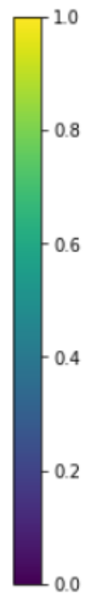
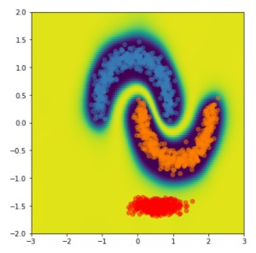
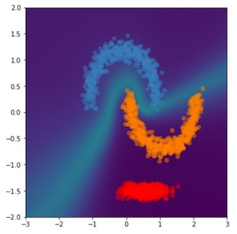
Can Better Handle OOD Data
28
Many modern deep neural networks (DNN) tend to be overconfident
Especially true if test data is “out-of-distribution (OOD)”
PML models are robust and give better uncertainty estimates to flag OOD data
Desirable confidence map
Confidence map of a DNN
Low confidence
Class 1
Example of an overconfident model
Model has high confidence for predictions on even inputs that are far away from training data
Class 2
Some OOD
test data
High confidence
Image source: “Simple and Principled Uncertainty Estimation with Deterministic Deep Learning via Distance Awareness” (Liu et al, 2020)

Slide 29
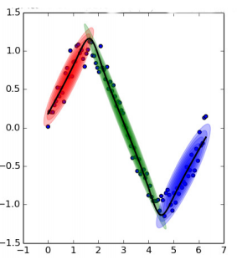

Can Construct Complex Models in Modular Ways
29
Can combine multiple simple probabilistic models to learn complex patterns
Can design models that can jointly learn from multiple datasets and share information across multiple datasets using shared parameters with a prior distribution
A combination of a mixture model for clustering and a probabilistic linear regression model: Result is a probabilistic nonlinear regression model
Can design a latent variable model to do this
Essentially a “mixture of experts” model
Example: Estimating the means of $m$ datasets, assuming the means are somewhat related. Can do this jointly rather than estimating independently
An example of transfer learning or multitask learning using a probabilistic approach
Easy to do it using a probabilistic approach with shared parameters (will see details later)

Slide 30

Hyperparameter Estimation
30
ML models invariably have hyperparams, e.g., regularization/kernel h.p. in a linear/kernel regression, hyperparameters of a deep neural network, etc.
Can specify the hyperparams as additional unknown of the probabilistic model
Can now estimate them, e.g., using a point estimate or a posterior distribution
  To find point estimate of hyperparameters, we can write the probability of data as a function of hyperparameters and maximize this quantity w.r.t. the hyperparameters (details later)
  Posterior can also be estimated if we specify a prior on the hyperparameters as well (details later)
The approach of using marginal likelihood for doing such thing has some issues; other quantities can be used such as “conditional” marginal likelihood* (more on this later)
A way to find the point estimate of the hyperparameters by maximizing the marginal likelihood of data (more on this later)
$$\hat{α}=arg\max_{α} log p(X|α)$$
$=arg\max_{α} log ∫p\left(X | θ\right)p\left(θ | α\right)θ$
*Bayesian Model Selection, the Marginal Likelihood, and Generalization (Lotfi et al, 2022)

Slide 31


Model Comparison
31
Suppose we have a number of models $m=1,2,…, M$ to choose from
The standard way to choose the best model is cross-validation
Can also compute the posterior probability of each candidate model, using Bayes rule
If all models are equally likely a priori ($p(m)$ is uniform) then the best model can be selected as the one with largest marginal likelihood
May not be easy to do exactly but can compute it approximately
$$p\left(m | X\right)= \frac{p\left(m\right)p(X|m)}{p(X)}$$
Marginal likelihood of model $m$
This doesn’t require a separate validation set unlike cross-validation
$$p(X|m)$$
Therefore also useful for doing model selection/comparison for unsupervised learning problems

Slide 32
Non-probabilistic ML Methods?
32
Some non-probabilistic ML methods can give probabilistic answers via heuristics
Doesn’t mean these methods are not useful/used but they don’t follow the PML paradigm, so we won’t study them in this course
Some examples which you may have seen
  Converting distances from hyperplane (in hyperplane classifiers) to compute class probabilities
  Using class-frequencies in nearest neighbors to compute class probabilities
  Using class-frequencies at leaves of a Decision Tree to compute class probabilities
  Soft k-means clustering to compute probabilistic cluster memberships
Or methods like Platt Scaling used to get class probabilities for SVMs

Slide 33
Tentative Outline
33
Basics of probabilistic modeling and inference
  Common probability distributions
  Basic point estimation (MLE and MAP)
Bayesian inference (simple and not-so-simple cases)
Probabilistic models for regression, classification, clustering, dimensionality reduction
Gaussian Processes (probabilistic modeling meets kernels)
Latent Variable Models (for i.i.d., sequential, and relational data)
Approximate Bayesian inference (EM, variational inference, sampling, etc)
Bayesian Deep Learning
Misc topics, e.g., deep generative models, black-box inference, sequential decision-making, etc

