Slide 1
The Last Few Bits..
CS771: Introduction to Machine Learning
Piyush Rai

Slide 2
Debugging ML Algorithms
2

Slide 3
What is going wrong?
3
What to do when our model (say logistic regression) isn’t doing well on test data
  Use more training examples?
  Use a smaller number of features?
  Introduce new features (can be combinations of existing features)?
  Try tuning the regularization parameter?
  Run (the iterative) optimizer longer, i.e., for more iterations
  Change the optimization algorithm (e.g., GD to SGD or Newton..) or the learning rate?
  Give up and switch to a different model (e.g., SVM or deep neural net)?

Slide 4
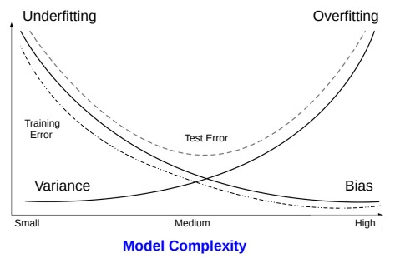
High-Bias or High-Variance?
4
The bad performance (low accuracy on test data) of a model could be due either
  High Bias: Too simple model; doesn’t even do well on training data
  High Variance: Even small changes in training data lead to high fluctuation in model’s performance
High bias means underfitting, high variance means overfitting
Looking at the training and test error can tell which of the two is the case
Both training and test errors are large
Small training error and large test error
Adding more training examples won’t help as the model itself is too simple
Adding more training examples can possibly help here because we possibly have a complex model but not enough training data to learn it well
Use a more complex model or increase the number of features
Or regularize the model better to prevent overfitting or use fewer features, or switch to a simpler model

Slide 5
Learning from Imbalanced Data
5

Slide 6
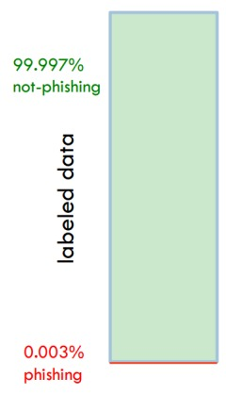
Learning when classes are imbalanced
6
When classes are imbalanced, even a “stupid” classifier can give high accuracy but looking at accuracy alone may be misleading
For such data with imbalanced classes, we need ways so that the majority class is not given undue importance
A stupid classifier: Simply predict everything as non-phishing. Gives close to 100% accuracy
But likely to do badly on test data, particularly phishing mails (all will be predicted as non-phishing)
If we use classification loss/accuracy as our loss function, the learned model may indeed prefer simply predicting each input to be from the majority class

Slide 7
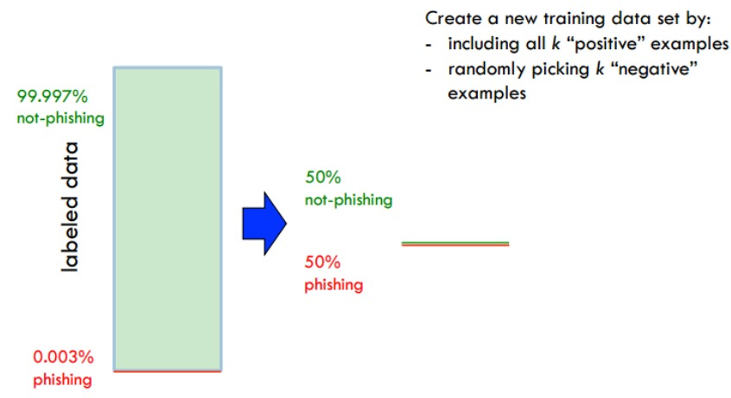
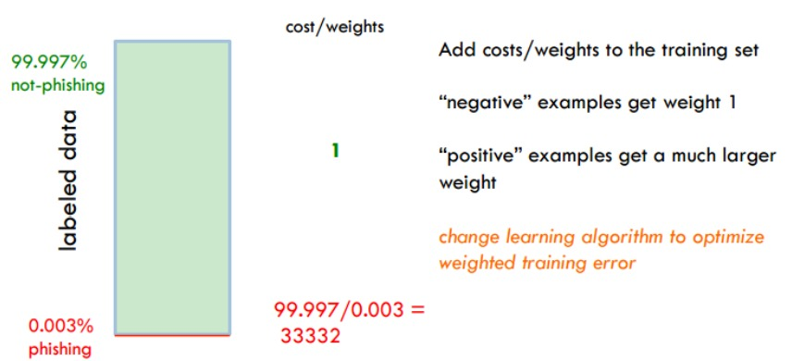
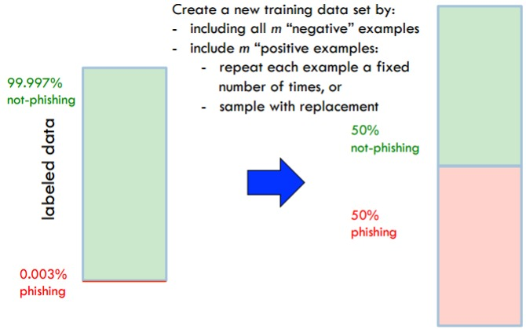
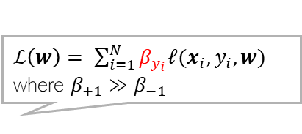
Solution 1: Balancing the training data
7
Weighted loss function with much larger importance given to loss function terms of positive examples than negative examples
Can balanced the training data by
  Under-sampling the majority class examples
  Over-sampling the minority class examples
$ℒ\left(w\right)= \sum_{i=1}^{N}{β_{y_{i}}ℓ(x_{i}, y_{i}, w)}$ where $β_{+1}≫β_{−1}$
Equivalent to

Slide 8
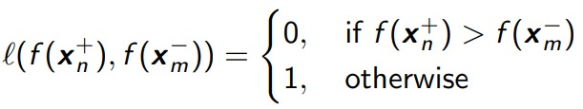
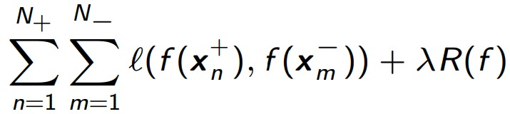


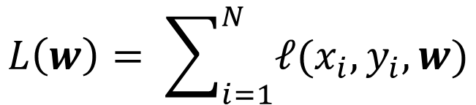
Solution 2: Changing the loss function
8
Don’t use loss functions that define loss or accuracy on per-example basis
Instead, use loss function that use example pairs (one positive and one negative)
Assuming our model to be defined by some function $f(x)$ (e.g., $w^{⊤}x$), define a loss
This loss function is a simple sum of losses on individual training examples. Not ideal for imbalanced classes
$$L\left(w\right)= \sum_{i=1}^{N}{ℓ(x_{i}, y_{i}, w)}$$
An input with positive label
An input with negative label
Now we don’t care about per-example accuracy but care about whether the positive examples get a higher score than the negative examples (i.e., we are only preserving their relative rank)
Usual regularaizer on $f$
Such loss functions can known as “pairwise loss functions”

Slide 9
Ensemble Methods
9

Slide 10
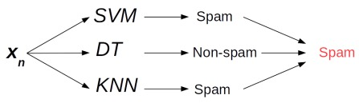
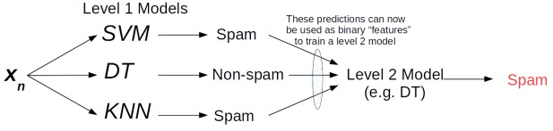
Some Simple Ensembles
10
Voting or Averaging of predictions of multiple models trained on the same data
“Stacking”: Use predictions of multiple already trained models as “features” to train a new model and use the new model to make predictions on test data
Stacking sort of has a flavor of deep learning where hidden layers extract good features
Here, that role is being played by these other already trained models
In stacking, level 1 and level 2 models are trained independently (first level 1 and then level 2)

Slide 11
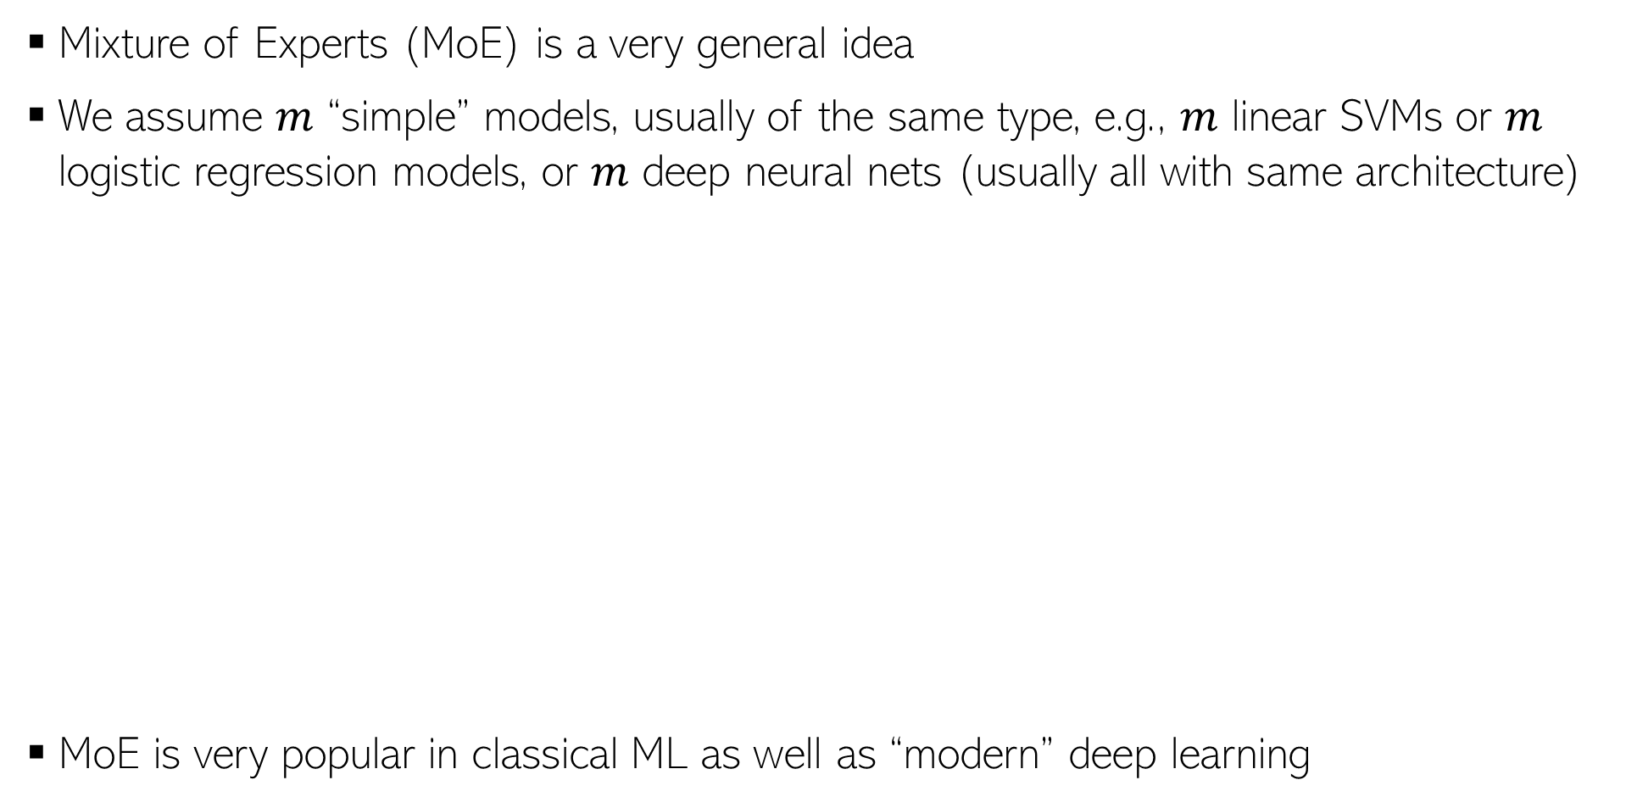
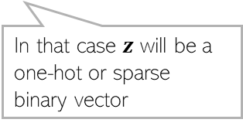
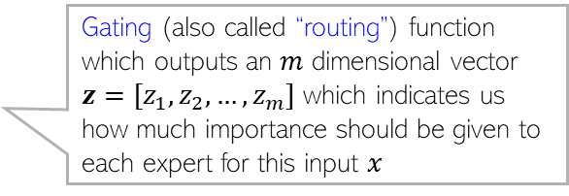
Mixture of Experts (MoE) based Ensemble
11
Mixture of Experts (MoE) is a very general idea
We assume $m$ “simple” models, usually of the same type, e.g., $m$ linear SVMs or $m$ logistic regression models, or $m$ deep neural nets (usually all with same architecture)
MoE is very popular in classical ML as well as “modern” deep learning
Gating (also called “routing”) function which outputs an $m$ dimensional vector $z=[z_{1},z_{2},…, z_{m}]$ which indicates us how much importance should be given to each expert for this input $x$
Experts models and the gating/routing function are learned jointly using all the training data
MoE can also be formulated like a latent variable model and learned using ALT-OPT or EM
Some variants of MoE pick only one expert or a small subset of expert
In that case $z$ will be a one-hot or sparse binary vector
The combination is much more powerful than the individual expert models

Slide 12
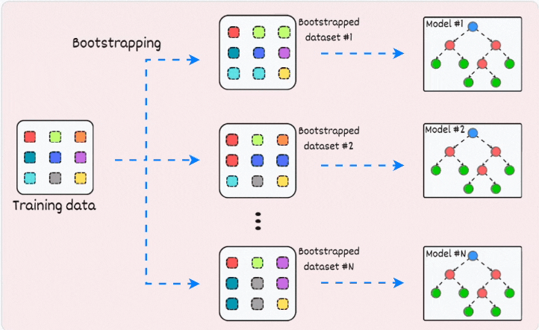
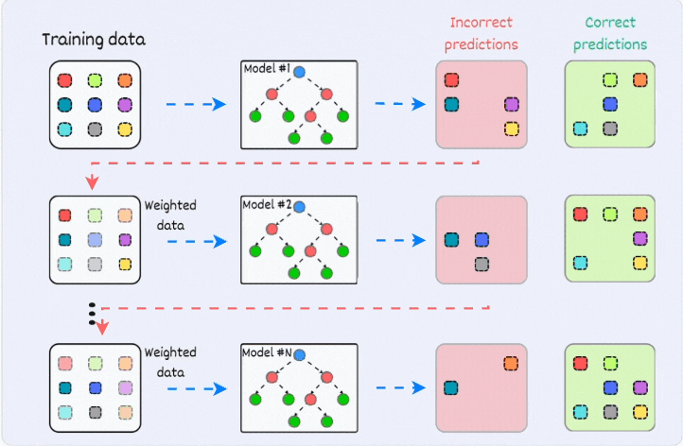

Ensembles using Bagging and Boosting
12
Both use a single training set $𝒟$ to learn an ensemble consisting of several models
Both construct $N$ datasets from the original training set $𝒟$ and learn $N$ models
Bagging can do this in parallel for all the $N$ models
Boosting requires a sequential approach for $N$ rounds
Bagging
Boosting
Figure credit: https://www.blog.dailydoseofds.com/p/an-animated-guide-to-bagging-and

Slide 13
Bagging (Bootstrap Aggregation)
13
Bootstrapping can also be done at feature level (each model using a randomly chosen subset of all the features)
Each bootstrapped dataset consists of a subset of all the training examples
Sampling with replacement will give about 63% unique training examples (if both datasets are of equal size)
Generated bootstrapped datasets using sampling with replacement from original training data
Random forests use both bootstrapping at examples level and at features level
To predict the output for a new test input, we apply all these models and average their predictions
Bagging primarily reduces the variance (reduces chances of overfitting by not relying completely on some example(s) since each model only uses a subset) but can also reduce bias to some extent
Figure adapted from: https://www.blog.dailydoseofds.com/p/an-animated-guide-to-bagging-and

Slide 14



Boosting
14
Boosting trains them sequentially and combines them to get a “boosted” powerful model
Boosting assumes that the individual models are simple/weak models that can be easily learned
$$f_{1}$$
Note that here we have two types of importances: importance of each training example and importance of each model
Importance of each model is its accuracy
“Weighted data” means that we are increasing the importance of examples that were mis-predicted in the previous round and decrease it for examples that were correctly predicted
$$f_{2}$$
The final model will be an important-weighted combination of all these models
$$f_{N}$$
Boosting primarily reduces the bias by making the weak (underfitted) models stronger but can also reduce variance to some extent
Figure adapted from: https://www.blog.dailydoseofds.com/p/an-animated-guide-to-bagging-and

Slide 15

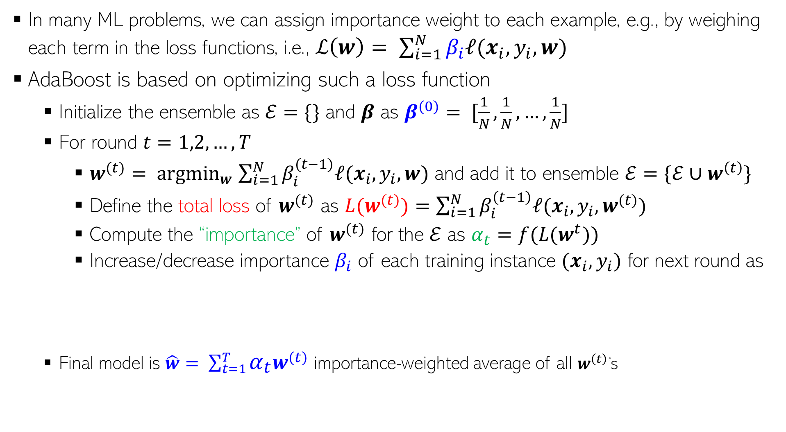


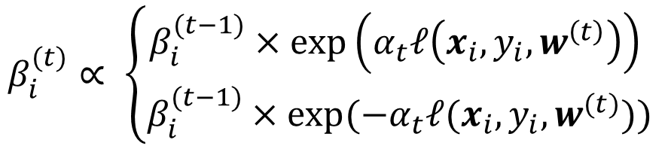

A Boosting Algo: AdaBoost (Adaptive Boosting)
15
Importance of the training example $(x_{i}, y_{i})$
We might know this beforehand or estimate it during training
In many ML problems, we can assign importance weight to each example, e.g., by weighing each term in the loss functions, i.e., $ℒ\left(w\right)= \sum_{i=1}^{N}{β_{i}ℓ(x_{i}, y_{i}, w)}$
AdaBoost is based on optimizing such a loss function
  Initialize the ensemble as $ℰ=\{\}$ and $β$ as $β^{(0)}= [\frac{1}{N},\frac{1}{N},…,\frac{1}{N}]$
  For round $t=1,2,…, T$
    $w^{(t)}= {argmin}_{w}$ $\sum_{i=1}^{N}{β_{i}^{(t−1)}ℓ(x_{i}, y_{i}, w)}$ and add it to ensemble $ℰ=\{ℰ∪w^{\left(t\right)}\}$
    Define the total loss of $w^{(t)}$ as $L(w^{(t)})=\sum_{i=1}^{N}{β_{i}^{\left(t−1\right)}ℓ(x_{i}, y_{i}, w^{(t)})}$
    Compute the “importance” of $w^{(t)}$ for the $ℰ$ as $α_{t}=f(L(w^{t}))$
    Increase/decrease importance $β_{i}$ of each training instance $(x_{i}, y_{i})$ for next round as
  Final model is $\hat{w}= \sum_{t=1}^{T}{α_{t}w^{(t)}}$ importance-weighted average of all $w^{\left(t\right)}$’s
Initially assume equal importance for all training examples
Or the importance weighted total error
$f$ is some function such that $α_{t}$ is high if total loss $L(w^{t})$ is low, and vice-versa
$$β_{i}^{(t)}∝ \left\{\begin{aligned}β_{i}^{(t−1)}×exp\left(α_{t}ℓ\left(x_{i}, y_{i}, w^{\left(t\right)}\right)\right) \\ β_{i}^{(t−1)}×exp(−α_{t}ℓ(x_{i}, y_{i}, w^{(t)}))\end{aligned}\right.$$
(Increase if $w^{(t)}$ mispredicted $(x_{i}, y_{i})$)
(Decrease if $w^{(t)}$ correctly predicted on $(x_{i}, y_{i})$)

Slide 16
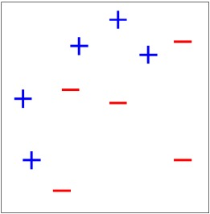
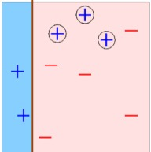
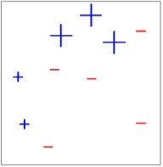
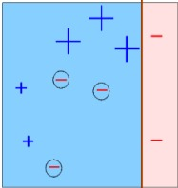
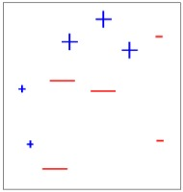
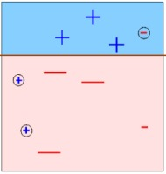
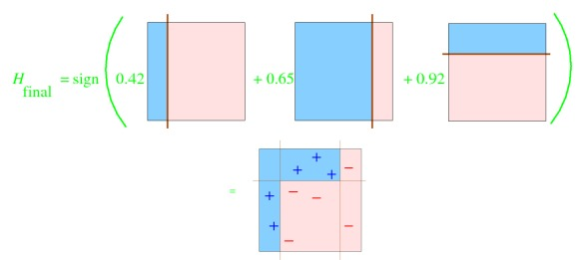




AdaBoost: An Illustration
Mistakes
Original dataset
Suppose we have a binary classification problems with each input having 2 features.
Suppose we have a weak model like a simple DT (decision stump)
Illustration of AdaBoost using a decision stump if run for 3 rounds
The ensemble represents the overall model
We got a nonlinear model from 3 simple linear models
Note that the ensemble was constructed sequentially
Round 1
Round 2
Round 3
Mistakes
Correct
Decreased $β_{i}$
Increased $β_{i}$
Mistakes
Increased $β_{i}$
Correct
Decreased $β_{i}$

Slide 17
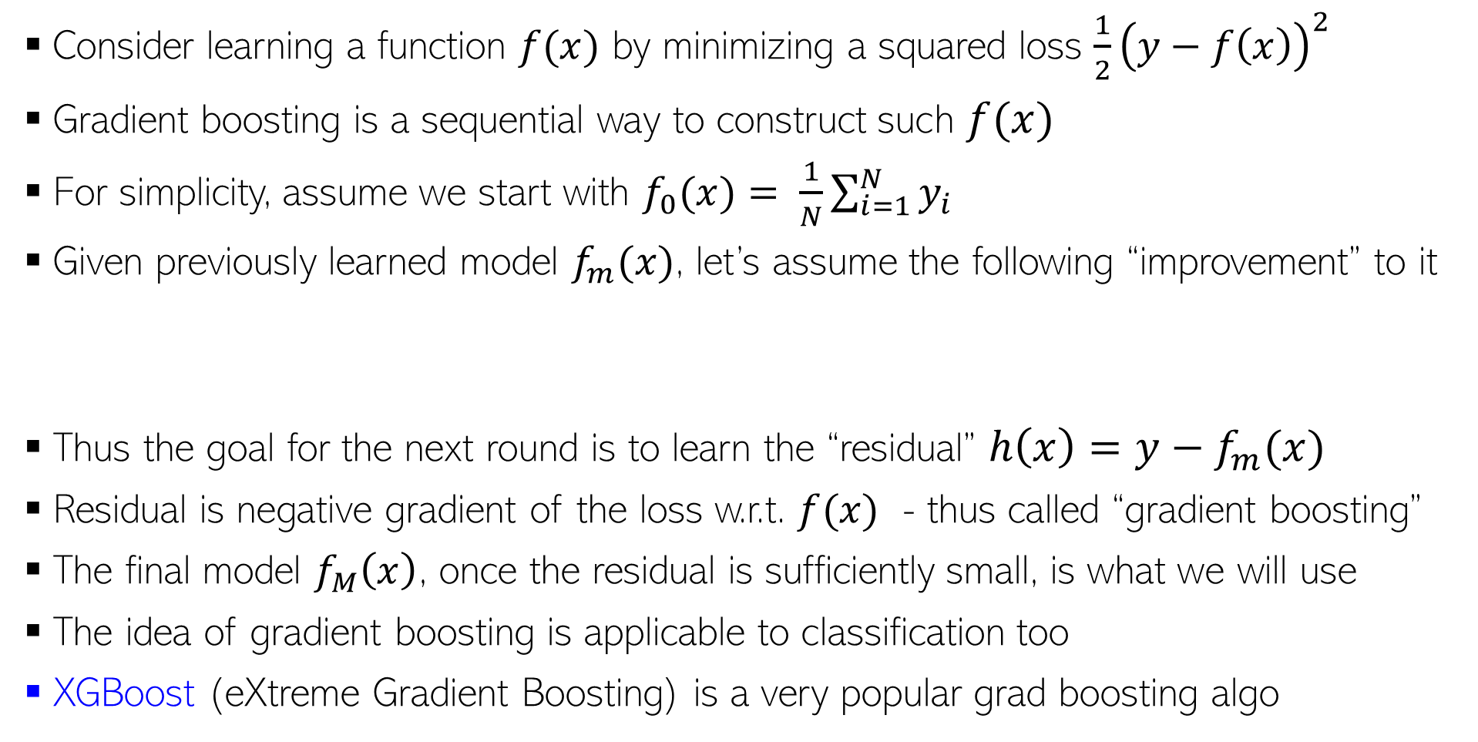
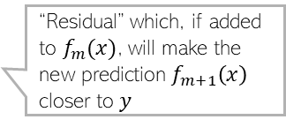

Gradient Boosting
Mistakes
17
Consider learning a function $f(x)$ by minimizing a squared loss $\frac{1}{2}{\left(y−f\left(x\right)\right)}^{2}$
Gradient boosting is a sequential way to construct such $f(x)$
For simplicity, assume we start with $f_{0}(x)= \frac{1}{N}\sum_{i=1}^{N}{y_{i}}$
Given previously learned model $f_{m}(x)$, let’s assume the following “improvement” to it
Thus the goal for the next round is to learn the “residual” $h\left(x\right)=y−f_{m}(x)$
Residual is negative gradient of the loss w.r.t. $f(x)$ - thus called “gradient boosting”
The final model $f_{M}\left(x\right)$, once the residual is sufficiently small, is what we will use
The idea of gradient boosting is applicable to classification too
XGBoost (eXtreme Gradient Boosting) is a very popular grad boosting algo
$$f_{m+1}\left(x\right)=f_{m}\left(x\right)+h(x)$$
“Residual” which, if added to $f_{m}(x)$, will make the new prediction $f_{m+1}\left(x\right)$ closer to $y$
Based on sequentially constructing a DT

Slide 18
Active Learning
(an example of learning with human-in-the-loop)
18

Slide 19
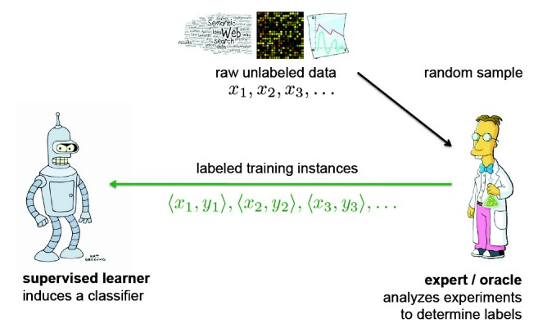
Active Learning
Mistakes
19
Standard supervised learning is “passive” (learner has no control; we just give it data)
We take a random sample of inputs, get them labelled by an expert, and train a model
I had no say in what data I want to learn from ☹ I was just provided some randomly chosen labeled data and was asked to learn

Slide 20
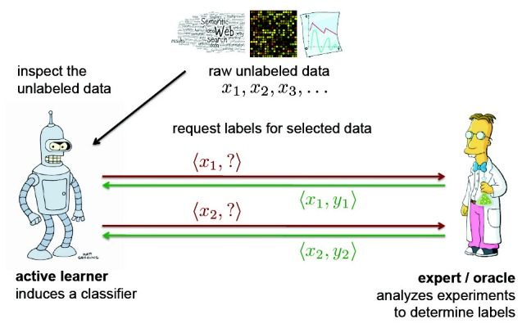
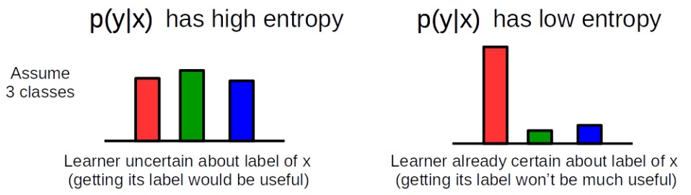
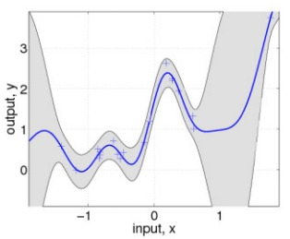
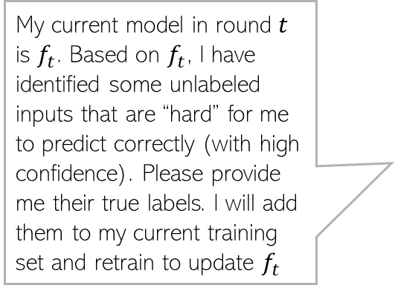
Active Learning
Mistakes
20
In active learning, learner can request what training examples it wants to learn from
Many ways to identify what “hard” inputs are. One way is to look at the confidence of the current model’s predictions on each unlabeled input
Can use entropy as confidence in classification problems
My current model in round $t$ is $f_{t}$. Based on $f_{t}$, I have identified some unlabeled inputs that are “hard” for me to predict correctly (with high confidence). Please provide me their true labels. I will add them to my current training set and retrain to update $f_{t}$
Can use variance as confidence in regression problems

Slide 21
Learning in the wild
21

Slide 22
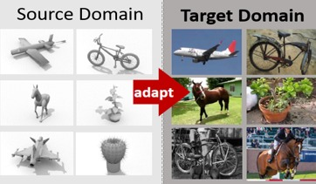
Domain Adaptation
Mistakes
22
We do expect some “commonality” (e.g., some common set of features) between the two domains otherwise we can’t hope to have any adaptation/transfer
We may have a “source” model trained on data from some domain
We might want to deploy it in a new domain
Performance of the source model will suffer
To prevent this, we usually perform “domain adaptation” or “transfer learning”
These are broad terms covering a variety of techniques that “finetune” the source model using labelled/unlabeled data from the new domain

Slide 23
The ending note..
Mistakes
23
Good features are important for learning well
The “classical” ML methods we studied in this course still continue to have high relevance
Success of deep learning is largely attributed to (automatically learned) good features
Deep learning is not a panacea – often simple classical models can do comparably/better
First understand your data (plot/visualize/look at some statistics of the data, etc)
Always start with a simple model that you understand well
  Try to first understand if your data really needs a complex model
Think carefully about your features, how you compute similarities, etc.
Helps to learn to first diagnose a learning algorithm rather than trying new ones
  Understanding of optimization algos, loss function, bias-variance trade-offs, etc is important
No free lunch. No learning algorithm is “universally” good

