Slide 1
Beyond MLPs: Convolutional Neural Networks
CS771: Introduction to Machine Learning
Piyush Rai

Slide 2



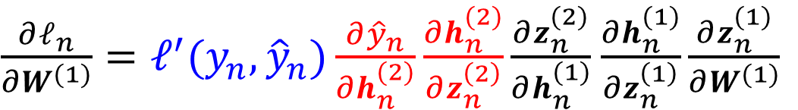

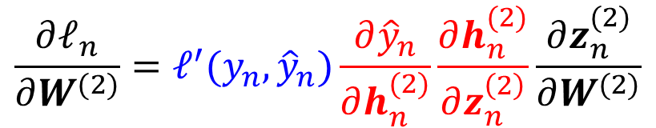

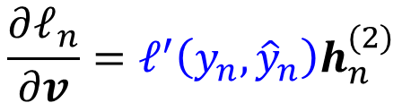


Recap
2
$${\hat{y}}_{n}$$
Multi-layer Perceptrons (MLP)
Backpropagation algorithm to learn the weights
Backprop is based on reuse of previous computations to efficiently compute the gradients required for updating the network weights using (stochastic) GD
$$v$$
$h_{n}^{(2)}=g(z_{n}^{(2)}$)
All these gradients are basically product of Jacobians
$$\frac{∂ℓ_{n}}{∂v}=ℓ^{′}\left(y_{n},{\hat{y}}_{n}\right)h_{n}^{(2)}$$
$$W^{(2)}$$
$h_{n}^{(1)}=g(z_{n}^{(1)}$)
$$\frac{∂ℓ_{n}}{∂W^{(2)}}=ℓ^{′}(y_{n},{\hat{y}}_{n})\frac{∂{\hat{y}}_{n}}{∂h_{n}^{(2)}}\frac{∂h_{n}^{(2)}}{∂z_{n}^{\left(2\right)}}\frac{∂z_{n}^{(2)}}{∂W^{(2)}}$$
$$W^{(1)}$$
$\frac{∂ℓ_{n}}{∂W^{(1)}}=ℓ^{′}(y_{n},{\hat{y}}_{n})\frac{∂{\hat{y}}_{n}}{∂h_{n}^{(2)}}\frac{∂h_{n}^{(2)}}{∂z_{n}^{\left(2\right)}}\frac{∂z_{n}^{(2)}}{∂h_{n}^{(1)}}$ $\frac{∂h_{n}^{(1)}}{∂z_{n}^{\left(1\right)}}\frac{∂z_{n}^{(1)}}{∂W^{(1)}}$
$$x_{n}$$

Slide 3

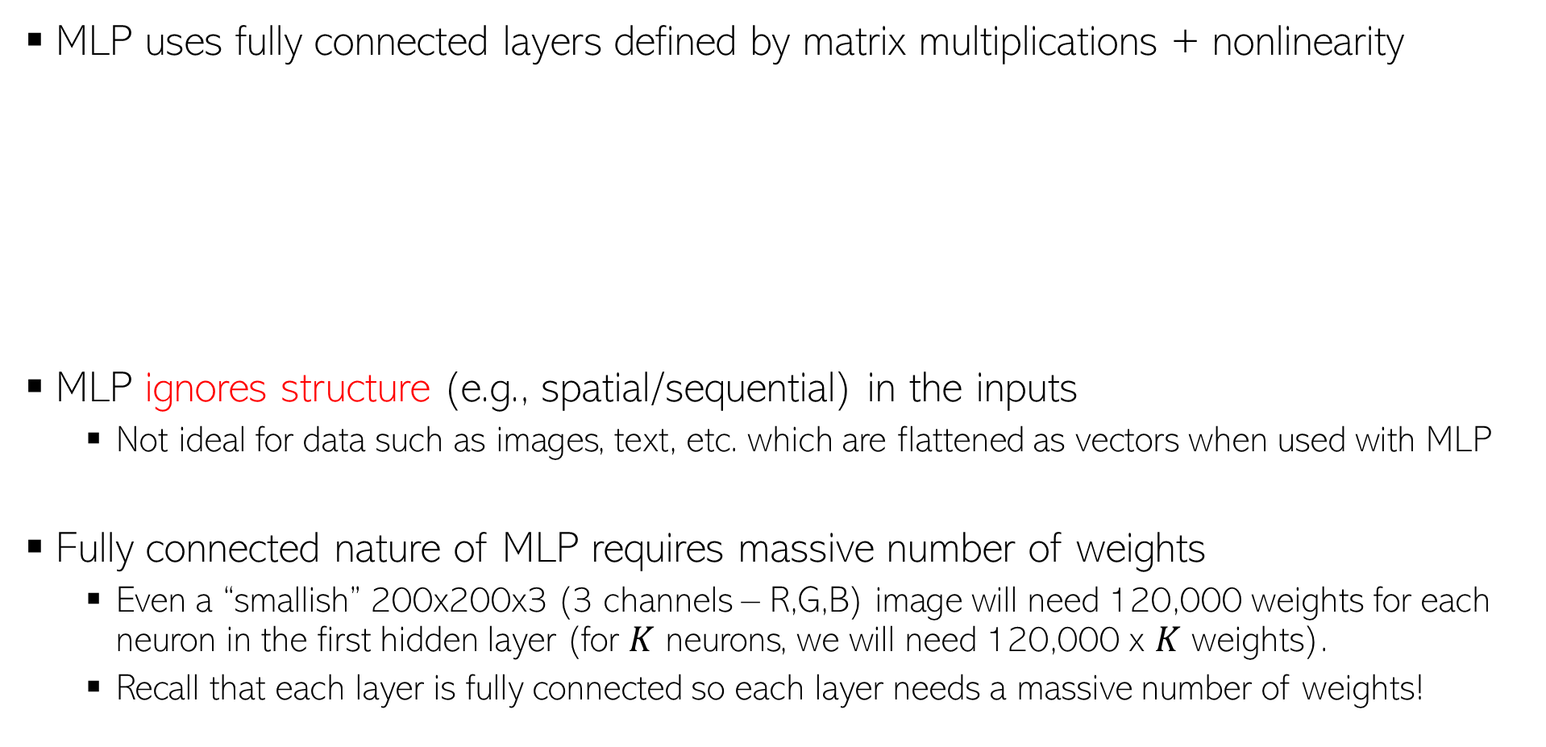





Limitations/Shortcomings of MLP
3
Projection using a “linear layer” + element-wise nonlinearity applied on these linear projections
MLP uses fully connected layers defined by matrix multiplications + nonlinearity
MLP ignores structure (e.g., spatial/sequential) in the inputs
  Not ideal for data such as images, text, etc. which are flattened as vectors when used with MLP
Fully connected nature of MLP requires massive number of weights
  Even a “smallish” 200x200x3 (3 channels – R,G,B) image will need 120,000 weights for each neuron in the first hidden layer (for $K$ neurons, we will need 120,000 x $K$ weights).
  Recall that each layer is fully connected so each layer needs a massive number of weights!
$$h_{n}^{(1)}=g({W^{\left(1\right)}}^{⊤}x_{n})$$
$$h_{n}^{(2)}=g({W^{\left(2\right)}}^{⊤}h_{n}^{\left(1\right)})$$
$$W^{(2)}$$
$$W^{(1)}$$
$$x_{n}$$
$$h_{n}^{(1)}$$

Slide 4
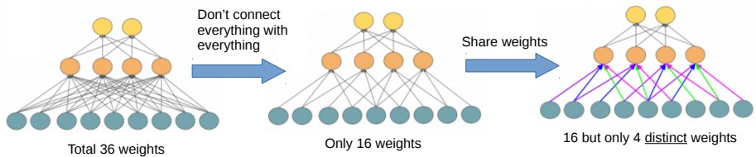
Convolutional Neural Networks (CNN)
4
CNNs use connections between layers that are different from MLPs in two key ways
Change 1: Each hidden layer node is connected only to a local patch in previous layer
Change 2: Same set of weights used for each local patch (purple, blue, green, pink is one set of weights, and this same set of used for all patches)
These changes help in
  Substantial reduction on the number of weights to be learned
  Learning the local structures within the inputs
  Capturing local and global structure in the inputs by repeating the same across layers
Standard MLP

Slide 5
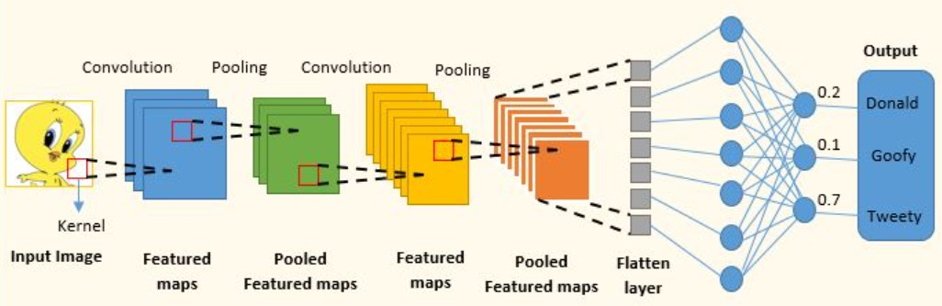
Convolutional Neural Networks (CNN)
5
CNN consists of a sequence of operations to transform an input to output
  Convolution (a linear transformation but more “local” than the one in MLP)
  Nonlinearity (e.g., sigmoid, ReLU, etc) after the convolution operation
  Pooling (aggregates local features into global features and reduce representation size)
Hidden layers
Last (or last few) layer(s) of CNN is (are) usually fully connected just like MLP
Input layer
Figure credit: https://www.analyticsvidhya.com/blog/2022/01/convolutional-neural-network-an-overview/

Slide 6

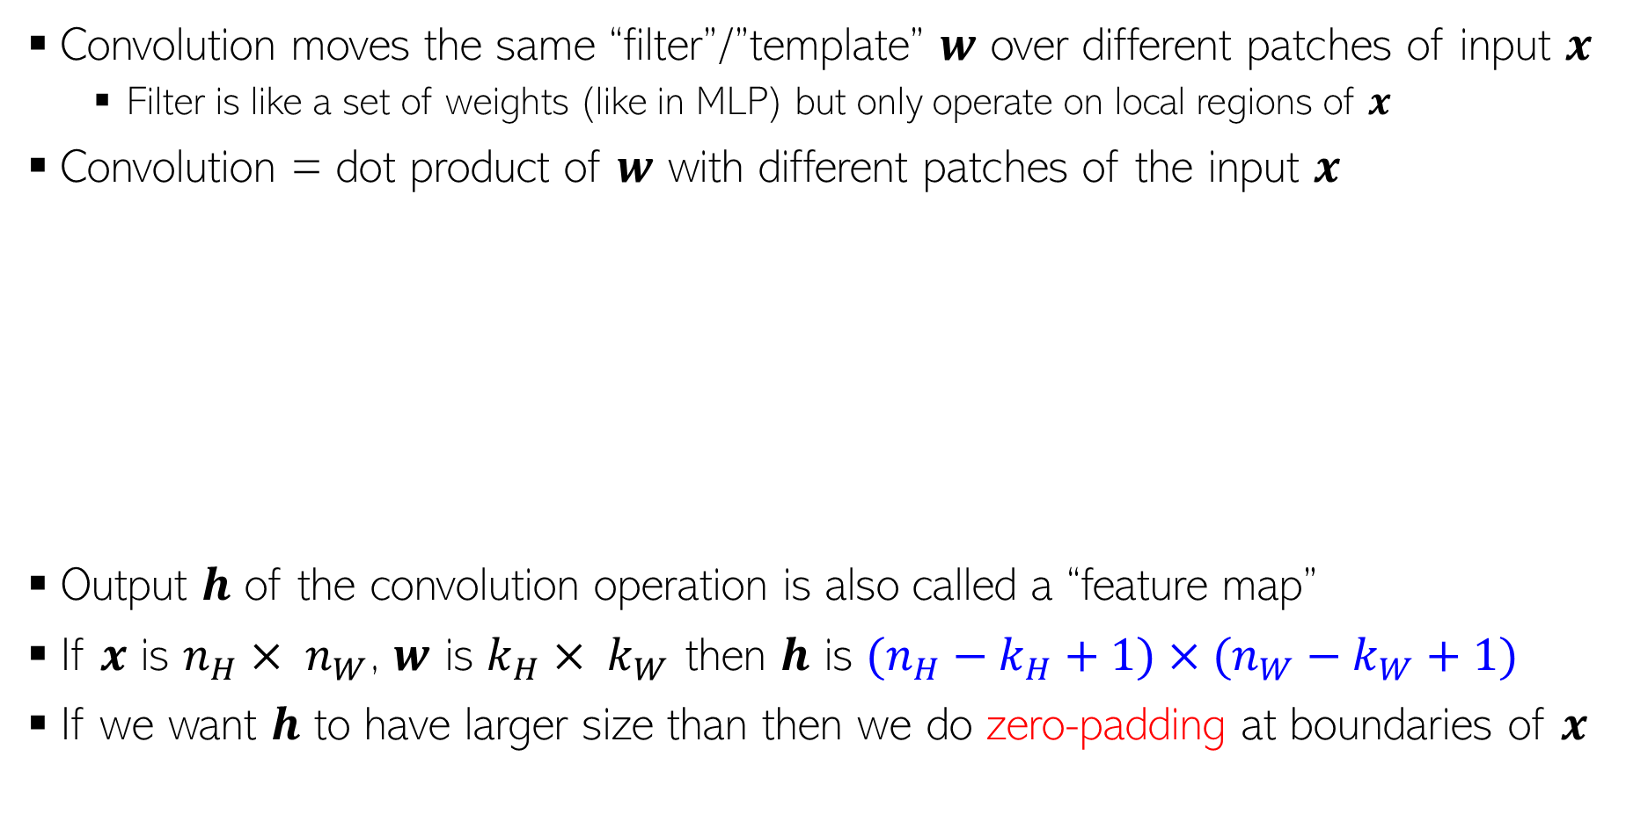





Convolution
Sometimes also called a “kernel”, though not the kernel we have seen in kernel methods ☺
6
Convolution moves the same “filter”/”template” $w$ over different patches of input $x$
  Filter is like a set of weights (like in MLP) but only operate on local regions of $x$
Convolution = dot product of $w$ with different patches of the input $x$
Output $h$ of the convolution operation is also called a “feature map”
If $x$ is $n_{H}× n_{W}$, $w$ is $k_{H}× k_{W}$ then $h$ is $(n_{H}−k_{H}+1)×(n_{W}−k_{W}+1)$
If we want $h$ to have larger size than then we do zero-padding at boundaries of $x$
$$x$$
Each entry is result of conv on one patch
$$w$$
$$w$$
$$x$$
$$h$$
Each entry is result of conv on one patch
$$h$$

Slide 7
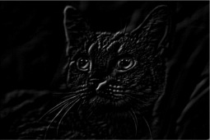


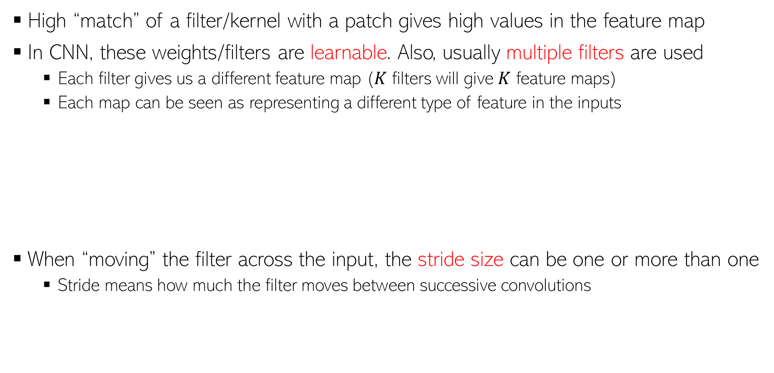




Convolution
7
High “match” of a filter/kernel with a patch gives high values in the feature map
In CNN, these weights/filters are learnable. Also, usually multiple filters are used
  Each filter gives us a different feature map ($K$ filters will give $K$ feature maps)
  Each map can be seen as representing a different type of feature in the inputs
When “moving” the filter across the input, the stride size can be one or more than one
  Stride means how much the filter moves between successive convolutions
“north-west” filter
$$\left[\begin{matrix}−2 & −1 & 0 \\ −1 & 0 & 1 \\ 0 & 1 & 2\end{matrix}\right]$$
“north-east” filter
$$\left[\begin{matrix}0 & −1 & −2 \\ 1 & 0 & −1 \\ 2 & 1 & 0\end{matrix}\right]$$
$$x$$
$$x$$
Stride of 1
Stride of 2

Slide 8
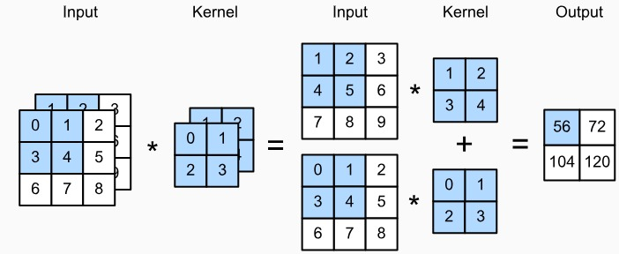
Multiple Input Channels
8
If the input has multiple channels (e.g., images with R,G,B channels), then each filter/kernel also needs to have multiple channels, as shown below (left figure)
We perform per-channel convolution followed by an aggregation (sum across channels)
Note that (right figure above) we typically also have multiple such filters (each with multiple channels) which will give us multiple such feature maps
Input with 3 channels
Output with 2 channels (since we used two filters here)
Figure credit: PML-1 (Murphy, 2022),

Slide 9
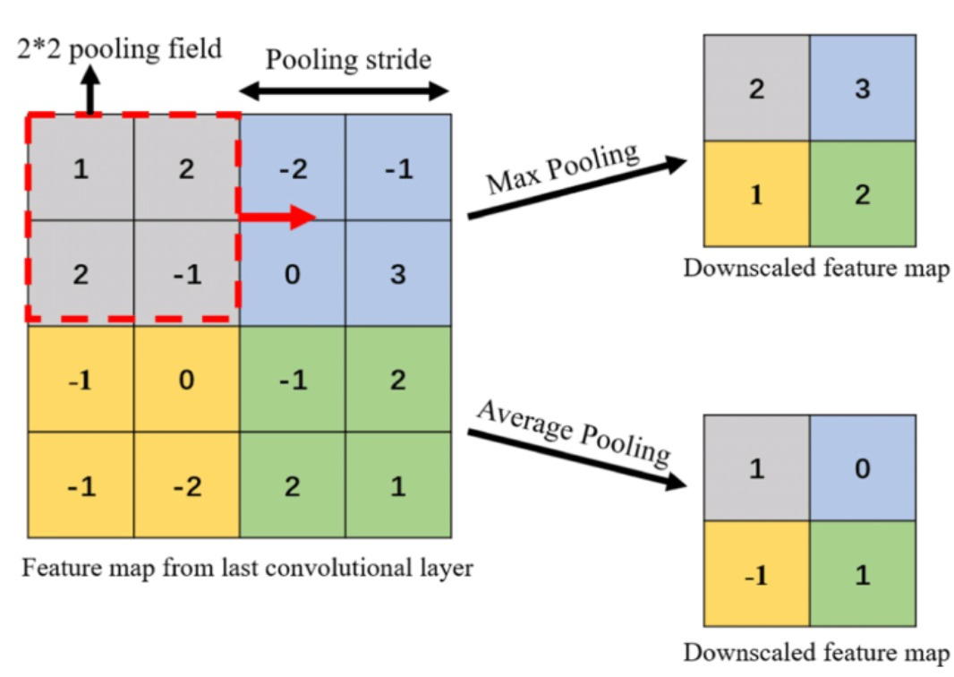
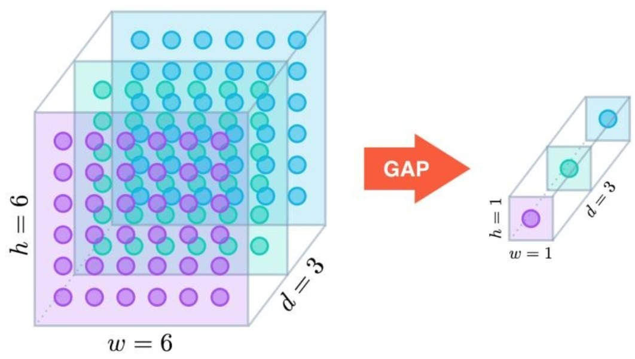
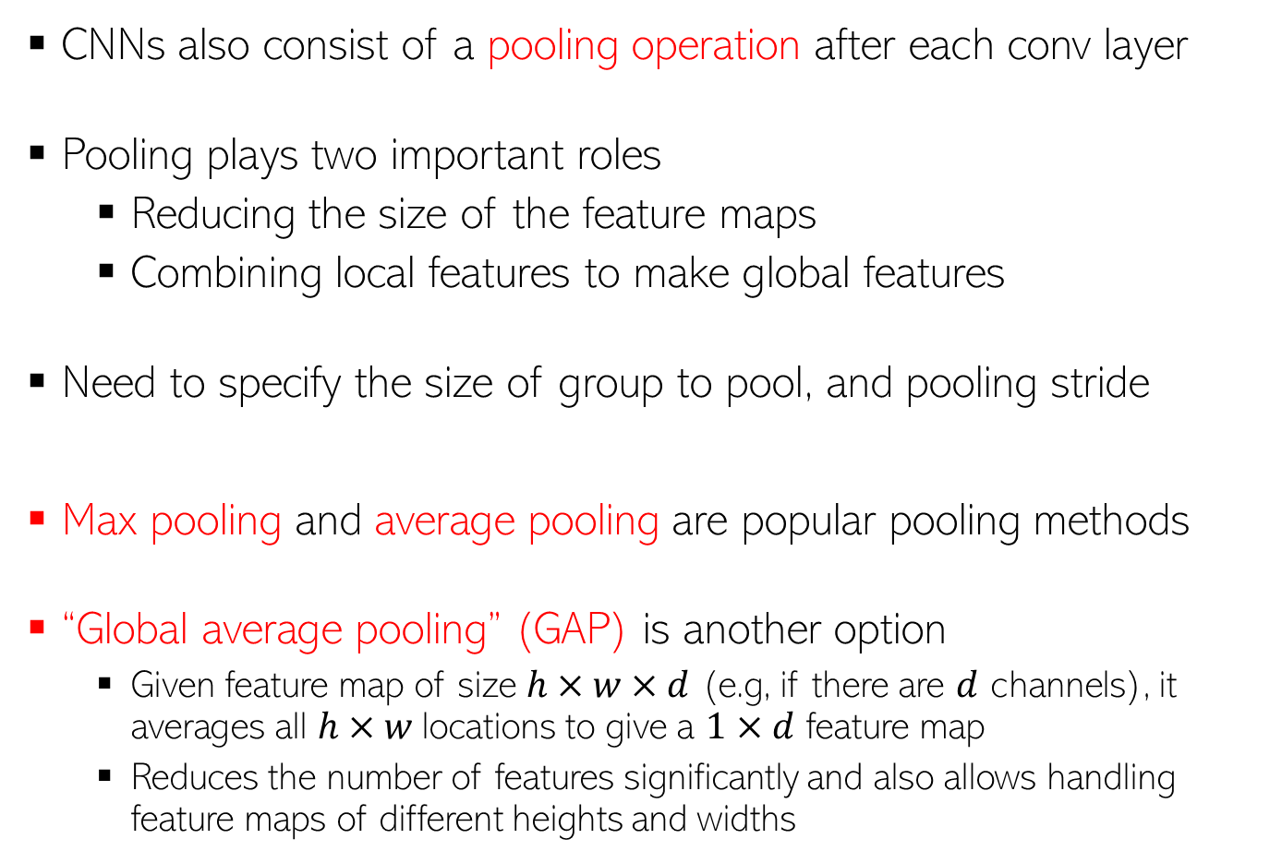
Pooling
9
CNNs also consist of a pooling operation after each conv layer
Pooling plays two important roles
  Reducing the size of the feature maps
  Combining local features to make global features
Need to specify the size of group to pool, and pooling stride
Max pooling and average pooling are popular pooling methods
“Global average pooling” (GAP) is another option
  Given feature map of size $h×w×d$ (e.g, if there are $d$ channels), it averages all $h×w$locations to give a $1×d$ feature map
  Reduces the number of features significantly and also allows handling feature maps of different heights and widths
0

Slide 10
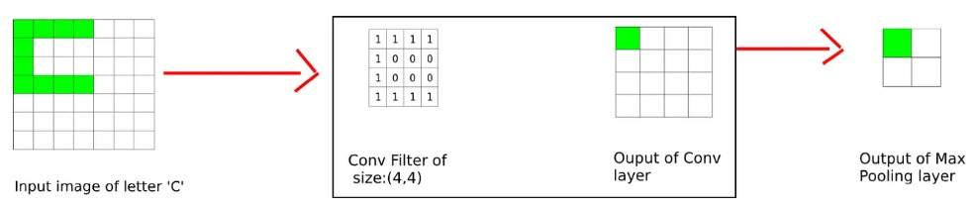
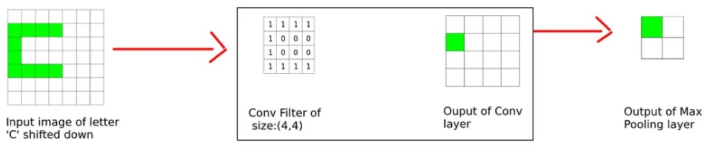
CNNs have Translation Invariance!
10
Even if the object of interest has shifted/translated, CNN don’t face a problem (it will be detected regardless of its location in the image)
The simple example below shows how (max) pooling helps with this
CNNs use a combination of conv + pooling operations in several hidden layers so CNNs remain invariant to even more significant translations
Pic credit: https://divsoni2012.medium.com/translation-invariance-in-convolutional-neural-networks-61d9b6fa03df

Slide 11
CNN: Summary of the overall architecture
11
The overall structure of a CNN looks something like this
Thickness of this box denotes how many filters we used (each filter itself may consist of multiple channels if the input has multiple channels)
Towards the end, we usually flatten the feature map (or use GAP to get a flattened input) and use one or more fully connected layers like in MLP
Pooling only downscales the height and width; The size of the other dimension remains the same as in the previous conv layer
Figure credit: PML-1 (Murphy, 2022),

