Slide 1
Intro to Deep Neural Nets (Contd)
CS771: Introduction to Machine Learning
Piyush Rai

Slide 2
Plan today
2
Training deep neural nets using backpropagation
Some important aspects related to training of deep neural nets
  Vanishing/exploding gradients
  Initialization
  Normalization layers (batch and layer normalization)
  Dropout as a means to regularization
  Residual/skip connections

Slide 3








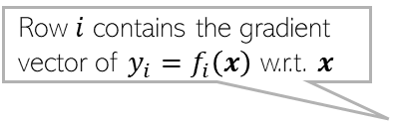


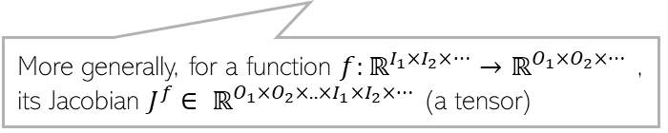

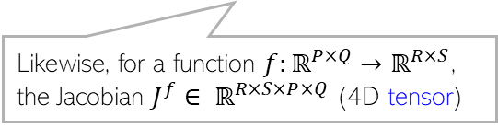

Backpropagation via a Simple Example
3
Consider a single scalar input, single hidden layer with one node, and scalar output
Derivative of the loss $ℓ$ w.r.t. $w$ is $\frac{∂ℓ}{∂w}=\frac{∂ℓ}{∂\hat{y}}\frac{∂\hat{y}}{∂h}\frac{∂h}{∂w}$
Derivative of the loss $ℓ$ w.r.t. $v$ is $\frac{∂ℓ}{∂v}=\frac{∂ℓ}{∂\hat{y}}\frac{∂\hat{y}}{∂v}$
$\frac{∂\hat{y}}{∂h}=\frac{∂\hat{y}}{∂v}\frac{∂v}{∂h}$
$$w$$
$$v$$
$$x$$
$$h$$
$$\hat{y}$$
$$ℓ(y,\hat{y})$$
Row $i$ contains the gradient vector of $y_{i}=f_{i}\left(x\right)$ w.r.t. $x$
For a function $f:ℝ^{P}→ℝ^{Q}$, the Jacobian $J^{f}∈ ℝ^{Q×P}$ (a matrix)
$$J^{f}= \left[\begin{matrix}∇f_{1}(x) \\ ⋮ \\ ∇f_{Q}(x)\end{matrix}\right]∈ ℝ^{Q×P}$$
$$\frac{∂y}{∂x}=J^{f}$$
$$J_{ij}^{f}=\frac{∂y_{i}}{∂x_{j}}$$
Likewise, for a function $f:ℝ^{P×Q}→ℝ^{R×S}$, the Jacobian $J^{f}∈ ℝ^{R×S×P×Q}$ (4D tensor)
More generally, for a function $f:ℝ^{I_{1}×I_{2}×…}→ℝ^{O_{1}×O_{2}×… }$, its Jacobian $J^{f}∈ ℝ^{O_{1}×O_{2}×..×I_{1}×I_{2}×…}$ (a tensor)

Slide 4

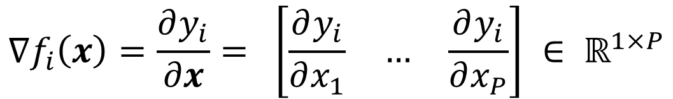
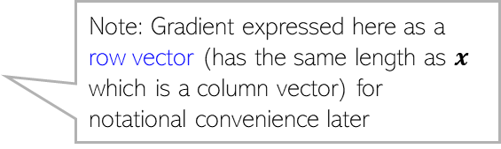
Background: Gradient and Jacobian
4
Let $y=f(x)$, where $f:ℝ^{P}→ℝ^{Q}$, $x∈ ℝ^{P}$, $y∈ ℝ^{Q}$. Denote $y=[f_{1}\left(x\right), …, f_{Q}\left(x\right)]$
The gradient of each component $y_{i}=f_{i}\left(x\right)∈ℝ$ ($i=1,2,…, Q$) w.r.t. $x∈ ℝ^{P}$ is
Likewise, the gradient of whole vector $y∈ ℝ^{Q}$ w.r.t. vector $x∈ ℝ^{P}$ can be defined using the $Q×P$ Jacobian matrix $J^{f}$whose rows consist of the above gradients
$$∇f_{i}\left(x\right)=\frac{∂y_{i}}{∂x}= \left[\begin{matrix}\frac{∂y_{i}}{∂x_{1}} & … & \frac{∂y_{i}}{∂x_{P}}\end{matrix}\right] ∈ ℝ^{1×P}$$
Note: Gradient expressed here as a row vector (has the same length as $x$ which is a column vector) for notational convenience later
Row $i$ contains the gradient vector of $y_{i}=f_{i}\left(x\right)$ w.r.t. $x$
For a function $f:ℝ^{P}→ℝ^{Q}$, the Jacobian $J^{f}∈ ℝ^{Q×P}$ (a matrix)
$$J^{f}= \left[\begin{matrix}∇f_{1}(x) \\ ⋮ \\ ∇f_{Q}(x)\end{matrix}\right]∈ ℝ^{Q×P}$$
$$\frac{∂y}{∂x}=J^{f}$$
$$J_{ij}^{f}=\frac{∂y_{i}}{∂x_{j}}$$
Likewise, for a function $f:ℝ^{P×Q}→ℝ^{R×S}$, the Jacobian $J^{f}∈ ℝ^{R×S×P×Q}$ (4D tensor)
More generally, for a function $f:ℝ^{I_{1}×I_{2}×…}→ℝ^{O_{1}×O_{2}×… }$, its Jacobian $J^{f}∈ ℝ^{O_{1}×O_{2}×..×I_{1}×I_{2}×…}$ (a tensor)

Slide 5

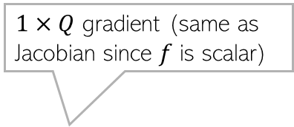




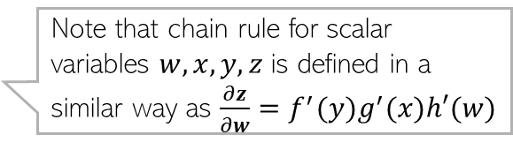
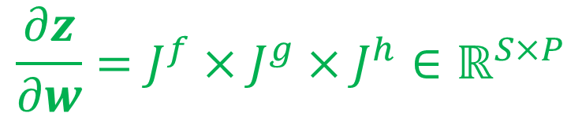




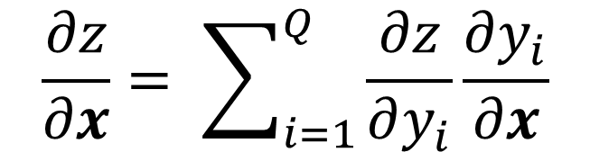
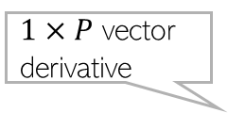
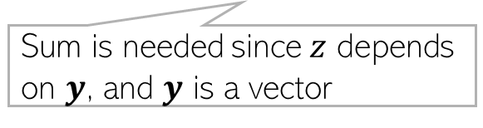


Background: Multivariate Chain Rule of Calculus
5
Let $x∈ℝ^{P}$, $y=g(x)$ $∈ ℝ^{Q}$, $z=f(y)$ $∈ℝ$, where $g:ℝ^{P}→ℝ^{Q}$, $f:ℝ^{Q}→ℝ$
The above can be written as a product of a vector and a matrix
More generally, let $w∈ℝ^{P}$, $x=h(w)$ $∈ℝ^{Q}$, $y=g(x)$ $∈ℝ^{R}$, $z=f(y)$ $∈ℝ^{S}$
Scalar derivative
$1×P$ vector derivative
$1×P$ vector derivative
$$\frac{∂z}{∂x}= \sum_{i=1}^{Q}{\frac{∂z}{∂y_{i}}\frac{∂y_{i}}{∂x}}$$
Used chain rule of total derivatives
g
f
$$z$$
Sum is needed since $z$ depends on $y$, and $y$ is a vector
$$x$$
$$y$$
$1×P$
Turns out to be a product of Jacobian of $f$ and $g$ in that order ☺
$1×Q$ gradient (same as Jacobian since $f$ is scalar)
$Q×P$ Jacobian of $g$
$$\frac{∂z}{∂x}=\left[\begin{matrix}\frac{∂z}{∂y_{1}} & … & \frac{∂z}{∂y_{Q}}\end{matrix}\right]×\left[\begin{matrix}\frac{∂y_{1}}{∂x} \\ ⋮ \\ \frac{∂y_{Q}}{∂x}\end{matrix}\right]$$
$$=∇f(y)×\left[\begin{matrix}∇g_{1}(x) \\ ⋮ \\ ∇g_{P}(x)\end{matrix}\right]$$
$$=∇f(y)×J^{g}$$
$$\frac{∂z}{∂w}=J^{f}×J^{g}×J^{h}∈ℝ^{S×P}$$
Note that chain rule for scalar variables $w,x,y,z$ is defined in a similar way as $\frac{∂z}{∂w}=f^{′}(y)g^{′}(x)h′(w)$
Product of the 3 Jacobians in that order (simple! ☺)

Slide 6


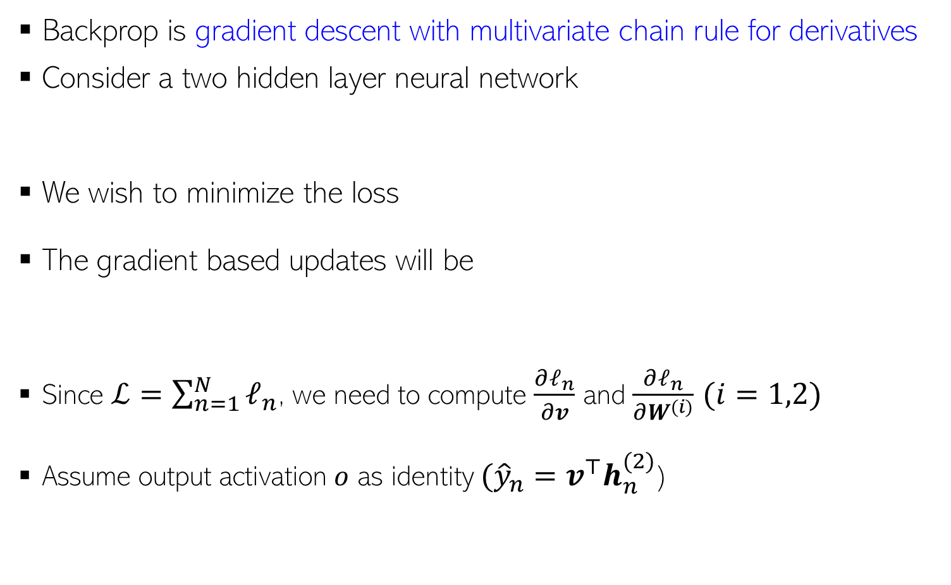
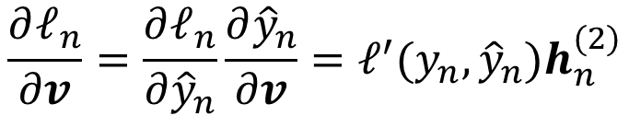







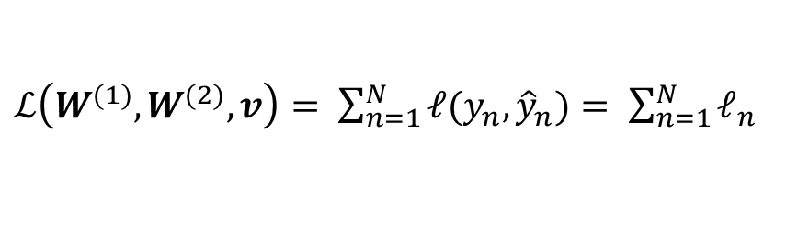


Backpropagation (Backprop)
6
Backprop is gradient descent with multivariate chain rule for derivatives
Consider a two hidden layer neural network
We wish to minimize the loss
The gradient based updates will be
Since $ℒ=\sum_{n=1}^{N}{ℓ_{n}}$, we need to compute $\frac{∂ℓ_{n}}{∂v}$ and $\frac{∂ℓ_{n}}{∂W^{(i)}}$ $(i=1,2)$
Assume output activation $o$ as identity $({\hat{y}}_{n}=v^{⊤}h_{n}^{(2)}$)
$${\hat{y}}_{n}$$
$$v$$
$ℒ\left(W^{(1)},W^{(2)},v\right)= \sum_{n=1}^{N}{ℓ(y_{n},}{\hat{y}}_{n})= \sum_{n=1}^{N}{ℓ_{n}}$
$h_{n}^{(2)}=g(z_{n}^{(2)}$)
$$W^{(2)}$$
$h_{n}^{(1)}=g(z_{n}^{(1)}$)
$$v=v−η \frac{∂ℒ}{∂v}$$
$$W^{(i)}=W^{(i)}−η \frac{∂ℒ}{∂W^{(i)}}$$
$$W^{(1)}$$
$$(i=1,2)$$
$$x_{n}$$
Derivative of $ℓ_{n}$ w.r.t. ${\hat{y}}_{n}$
$$\frac{∂ℓ_{n}}{∂v}=\frac{∂ℓ_{n}}{∂{\hat{y}}_{n}}\frac{∂{\hat{y}}_{n}}{∂v}=ℓ^{′}({y_{n},{\hat{y}}_{n})h}_{n}^{(2)}$$

Slide 7
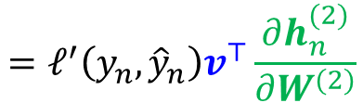


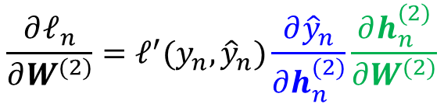
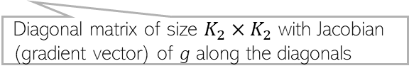
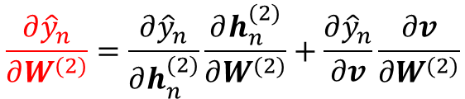



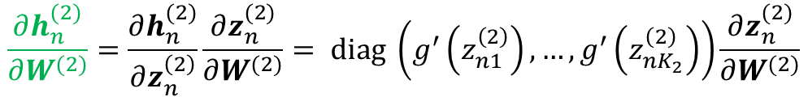
Backpropagation in detail
7
$${\hat{y}}_{n}$$
Let’s now look at $\frac{∂ℓ_{n}}{∂W^{(2)}}$ where $ℓ_{n}=ℓ(y_{n},{\hat{y}}_{n})$ and ${\hat{y}}_{n}=v^{⊤}h_{n}^{(2)}$
Since $v$ doesn’t depend on $W^{(2)}$, $\frac{∂v}{∂W^{(2)}}=0$
We now need $\frac{∂h_{n}^{(2)}}{∂W^{(2)}}$. Using $h_{n}^{(2)}=g(z_{n}^{\left(2\right)})$ where $z_{n}^{\left(2\right)}={W^{\left(2\right)}}^{⊤}h_{n}^{(1)}$ and $g$ is elementwise applied nonlinearity on the vector $z_{n}^{\left(2\right)}$
$$v$$
$$\frac{∂ℓ_{n}}{∂W^{(2)}}=\frac{∂ℓ_{n}}{∂{\hat{y}}_{n} }\frac{∂{\hat{y}}_{n}}{∂W^{(2)}}=ℓ^{′}(y_{n},{\hat{y}}_{n})\frac{∂{\hat{y}}_{n}}{∂W^{(2)}}$$
$h_{n}^{(2)}=g(z_{n}^{(2)}$)
$$\frac{∂{\hat{y}}_{n}}{∂W^{(2)}}=\frac{∂{\hat{y}}_{n}}{∂h_{n}^{(2)}}\frac{∂h_{n}^{(2)}}{∂W^{(2)}}+\frac{∂{\hat{y}}_{n}}{∂v}\frac{∂v}{∂W^{(2)}}$$
$$W^{(2)}$$
$h_{n}^{(1)}=g(z_{n}^{(1)}$)
Using transpose since we assume gradient to be a row vector
$$W^{(1)}$$
Jacobian of size $1×K_{2}×K_{1}$
$$\frac{∂ℓ_{n}}{∂W^{(2)}}=ℓ^{′}(y_{n},{\hat{y}}_{n})\frac{∂{\hat{y}}_{n}}{∂h_{n}^{(2)}}\frac{∂h_{n}^{(2)}}{∂W^{(2)}}$$
$$=ℓ^{′}\left(y_{n},{\hat{y}}_{n}\right)v^{⊤}\frac{∂h_{n}^{(2)}}{∂W^{(2)}}$$
$$x_{n}$$
Jacobian of size $K_{2}×K_{2}×K_{1}$
This Jacobian is a tensor of size $K_{2}×K_{2}×K_{1}$
$$\frac{∂h_{n}^{(2)}}{∂W^{(2)}}=\frac{∂h_{n}^{(2)}}{∂z_{n}^{\left(2\right)}}\frac{∂z_{n}^{(2)}}{∂W^{(2)}}= diag \left(g^{′}\left(z_{n1}^{\left(2\right)}\right),…,g^{′}\left(z_{nK_{2}}^{\left(2\right)}\right)\right)\frac{∂z_{n}^{(2)}}{∂W^{(2)}}$$
Diagonal matrix of size $K_{2}×K_{2}$ with Jacobian (gradient vector) of g along the diagonals

Slide 8
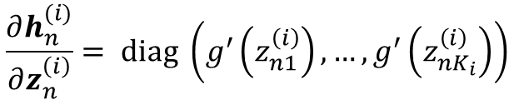
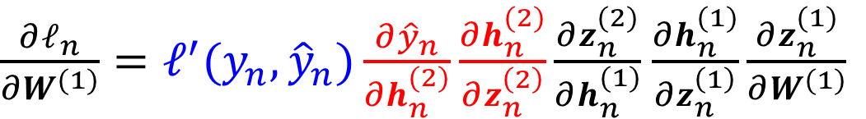
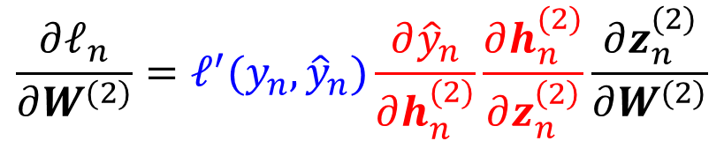
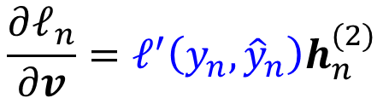
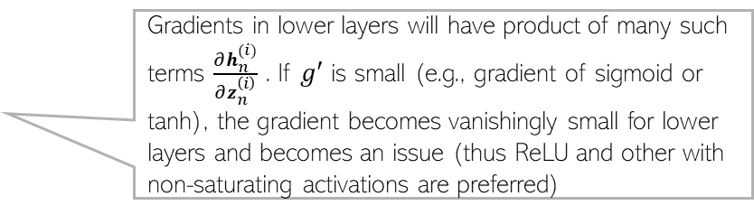
Backpropagation: Computation Reuse
8
Summarizing, the required gradients/Jacobians for this network are
Thus gradient computations done in upper layers can be stored and reused when computing the gradients in the lower layers (libraries like Tensorflow and Pytorch do so efficiently)
Vanishing gradients:
$${\hat{y}}_{n}$$
$$v$$
$$\frac{∂ℓ_{n}}{∂v}=ℓ^{′}\left(y_{n},{\hat{y}}_{n}\right)h_{n}^{(2)}$$
$h_{n}^{(2)}=g(z_{n}^{(2)}$)
$$\frac{∂ℓ_{n}}{∂W^{(2)}}=ℓ^{′}(y_{n},{\hat{y}}_{n})\frac{∂{\hat{y}}_{n}}{∂h_{n}^{(2)}}\frac{∂h_{n}^{(2)}}{∂z_{n}^{\left(2\right)}}\frac{∂z_{n}^{(2)}}{∂W^{(2)}}$$
$$W^{(2)}$$
$h_{n}^{(1)}=g(z_{n}^{(1)}$)
$\frac{∂ℓ_{n}}{∂W^{(1)}}=ℓ^{′}(y_{n},{\hat{y}}_{n})\frac{∂{\hat{y}}_{n}}{∂h_{n}^{(2)}}\frac{∂h_{n}^{(2)}}{∂z_{n}^{\left(2\right)}}\frac{∂z_{n}^{(2)}}{∂h_{n}^{(1)}}$ $\frac{∂h_{n}^{(1)}}{∂z_{n}^{\left(1\right)}}\frac{∂z_{n}^{(1)}}{∂W^{(1)}}$
$$W^{(1)}$$
$$x_{n}$$
Gradients in lower layers will have product of many such terms $\frac{∂h_{n}^{(i)}}{∂z_{n}^{\left(i\right)}}$ . If $g′$ is small (e.g., gradient of sigmoid or tanh), the gradient becomes vanishingly small for lower layers and becomes an issue (thus ReLU and other with non-saturating activations are preferred)
$$\frac{∂h_{n}^{(i)}}{∂z_{n}^{\left(i\right)}}= diag \left(g^{′}\left(z_{n1}^{\left(i\right)}\right),…,g^{′}\left(z_{nK_{i}}^{\left(i\right)}\right)\right)$$

Slide 9
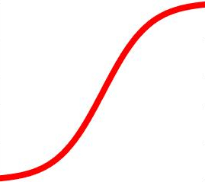

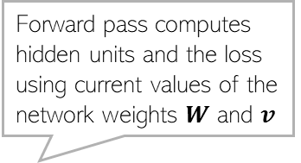
Backpropagation
9
Forward pass computes hidden units and the loss using current values of the network weights $W$ and $v$
Backprop iterates between a forward pass and a backward pass
Software frameworks such as Tensorflow and PyTorch support this already so you don’t need to implement it by hand (so no worries of computing derivatives etc)
Backward pass uses the loss and hidden units’ values to compute the gradient of the loss, starting with weights $v$ in the last layer, updates the weights, and proceeds to do the same for other layers
Backward Pass
Forward Pass

Slide 10
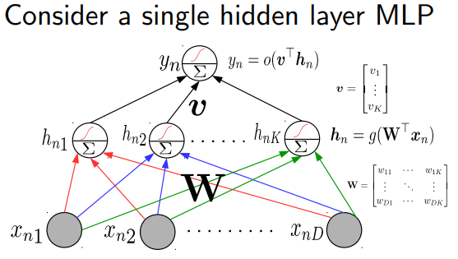
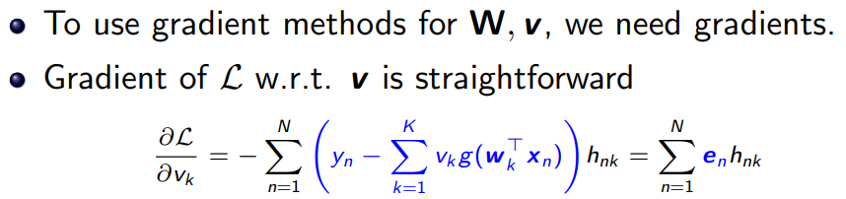
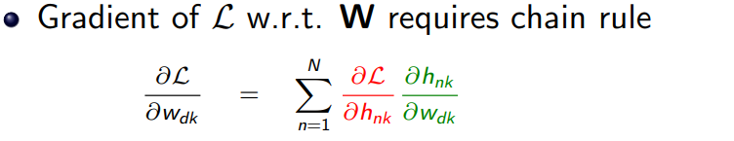
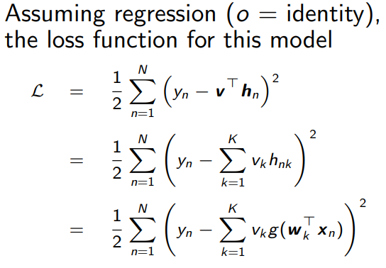


Backpropagation through an example
10

Slide 11

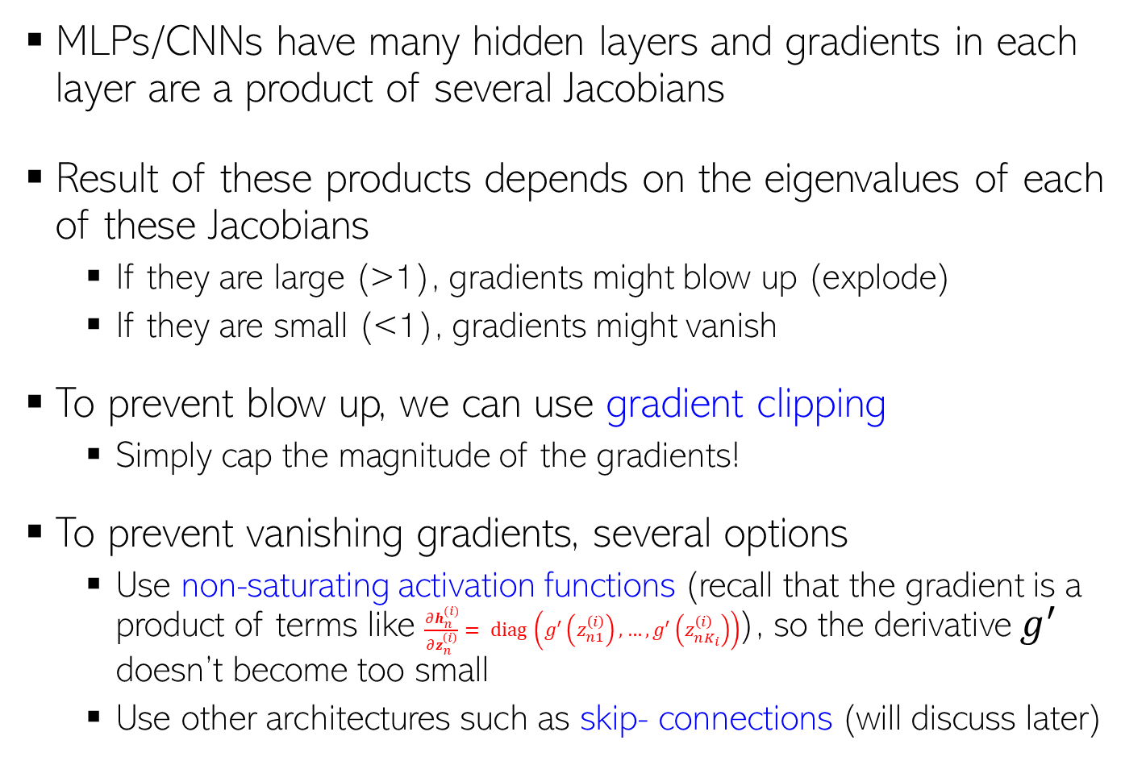






Problem of Exploding/Vanishing Gradients
11
MLPs/CNNs have many hidden layers and gradients in each layer are a product of several Jacobians
Result of these products depends on the eigenvalues of each of these Jacobians
  If they are large (>1), gradients might blow up (explode)
  If they are small (<1), gradients might vanish
To prevent blow up, we can use gradient clipping
  Simply cap the magnitude of the gradients!
To prevent vanishing gradients, several options
  Use non-saturating activation functions (recall that the gradient is a product of terms like $\frac{∂h_{n}^{(i)}}{∂z_{n}^{\left(i\right)}}= diag \left(g^{′}\left(z_{n1}^{\left(i\right)}\right),…,g^{′}\left(z_{nK_{i}}^{\left(i\right)}\right)\right)$), so the derivative $g^{′}$ doesn’t become too small
  Use other architectures such as skip- connections (will discuss later)
$${\hat{y}}_{n}$$
$$v$$
$h_{n}^{(2)}=g(z_{n}^{(2)}$)
$$W^{(2)}$$
$h_{n}^{(1)}=g(z_{n}^{(1)}$)
$$W^{(1)}$$
$$x_{n}$$

Slide 12
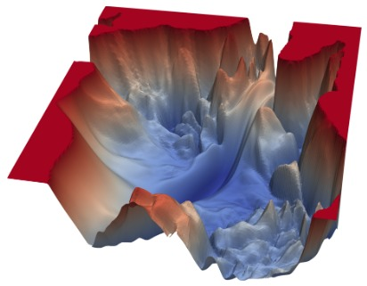
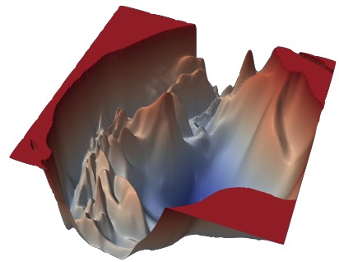
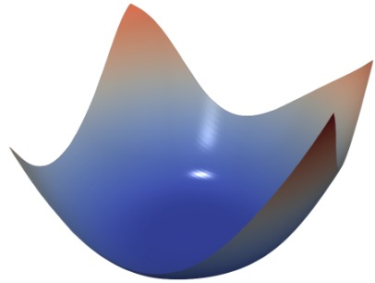
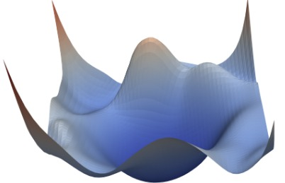

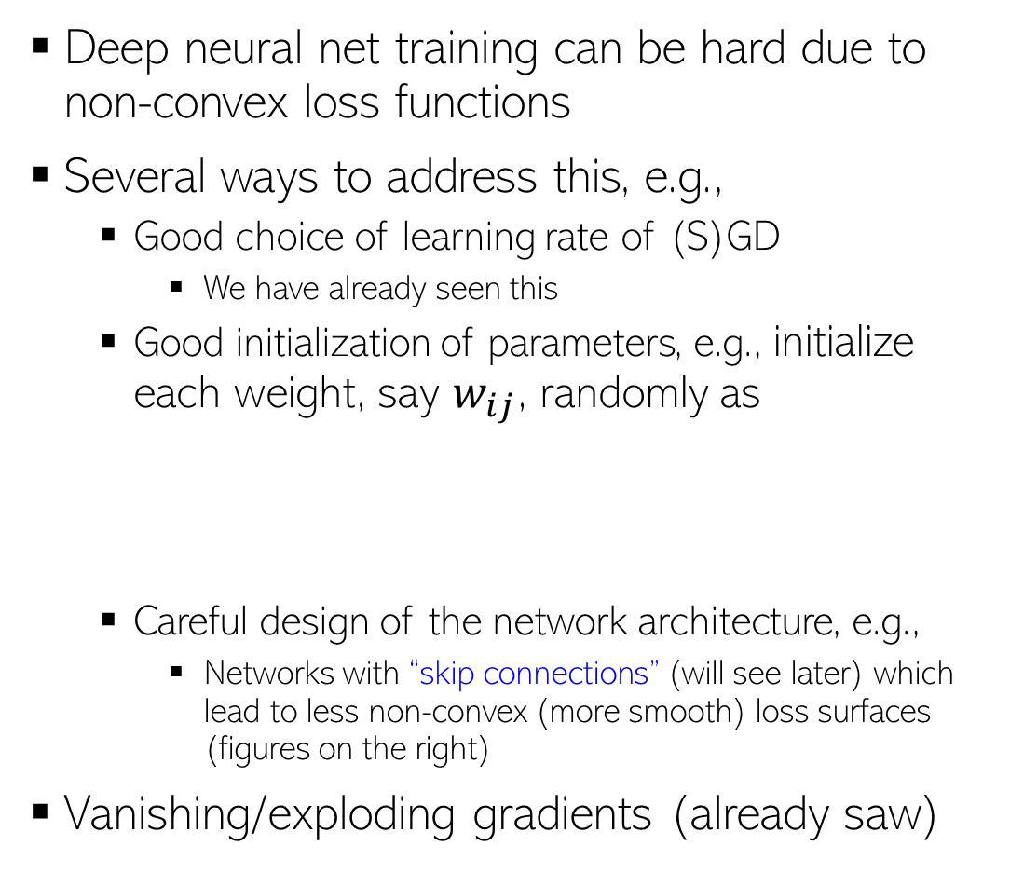


Training of DNNs: Some Important Aspects
12
Deep neural net training can be hard due to non-convex loss functions
Several ways to address this, e.g.,
  Good choice of learning rate of (S)GD
    We have already seen this
  Good initialization of parameters, e.g., initialize each weight, say $w_{ij}$, randomly as
  Careful design of the network architecture, e.g.,
    Networks with “skip connections” (will see later) which lead to less non-convex (more smooth) loss surfaces (figures on the right)
Vanishing/exploding gradients (already saw)
VGG-56
VGG-110
$$w_{ij}∼𝒩(0,σ^{2})$$
or
$$w_{ij}∼Uniform(−a,a)$$
Resnet-56
Densenet-121
Xavier/Gloret initialization, LeCun init, He init, etc
and set the “spread” of these distribution as inversely proportional to $n_{in}+n_{out}$
Fig credit: https://www.cs.umd.edu/~tomg/projects/landscapes/

Slide 13
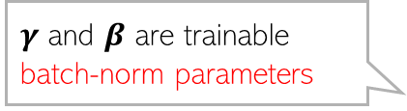
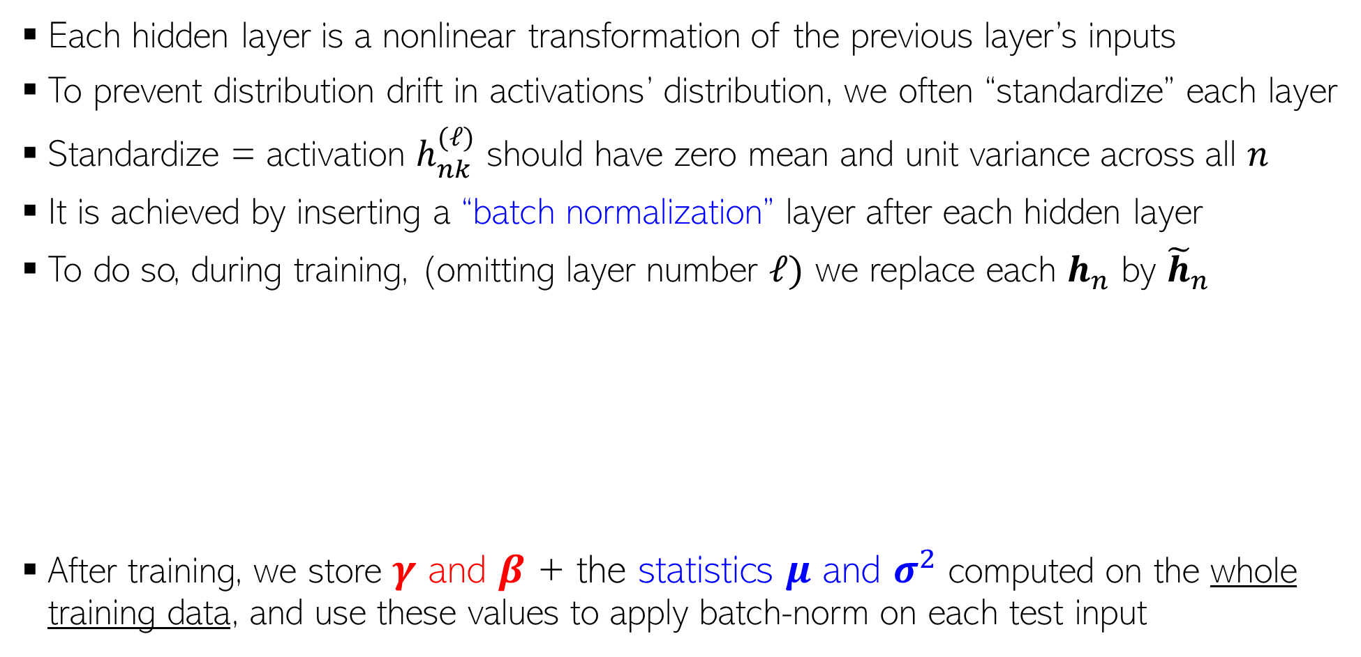
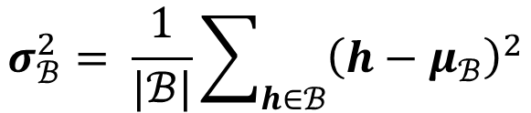





Batch Normalization
Note: Batch-norm assumes sufficiently large mini-batch $ℬ$ to work well. There are variants such as “layer normalization” and “instance normalization” that don’t require a mini-batch can be computed using a single training example
13
Batch normalization is used in MLP, CNN, and various other architectures
Each hidden layer is a nonlinear transformation of the previous layer’s inputs
To prevent distribution drift in activations’ distribution, we often “standardize” each layer
Standardize = activation $h_{nk}^{(ℓ)}$ should have zero mean and unit variance across all $n$
It is achieved by inserting a “batch normalization” layer after each hidden layer
To do so, during training, (omitting layer number $ℓ)$ we replace each $h_{n}$ by ${\tilde{h}}_{n}$
After training, we store $γ$ and $β$ + the statistics $μ$ and $σ^{2}$ computed on the whole training data, and use these values to apply batch-norm on each test input
$γ$ and $β$ are trainable batch-norm parameters
$${\hat{h}}_{n}= \frac{h_{n} −μ_{ℬ}}{\sqrt{σ_{ℬ}^{2}+ε}}$$
$${\tilde{h}}_{n}=γ⊙ {\hat{h}}_{n}+β$$
We compute $μ_{ℬ}$ and $σ_{ℬ}^{2}$ using the data from the current minibatch of examples $ℬ$ (thus the name “batch norm”
$$μ_{ℬ}= \frac{1}{|ℬ|}\sum_{h∈ℬ}{h}$$
$$σ_{ℬ}^{2}= \frac{1}{|ℬ|}\sum_{h∈ℬ}{{\left(h−μ_{ℬ}\right)}^{2}}$$

Slide 14










Layer Normalization
14
Normalization helps improve training and performance overall
Unlike batch normalization (BN), which we already saw, layer normalization (LN) normalizes each $h_{n}$ across its dimensions (not across all minibatch examples)
  Often used for sequence data models (will see later) where BN is difficult to apply
  Also useful when batch sizes are small where BN statistics (mean/var) aren’t reliable
For an MLP, the LN operation would look like this
After LN operation, we apply another transformation defined by another set of learnable weights (just like we did in BN using $γ$ and $β)$
$$h_{n}^{(2)}$$
$$h_{n}^{(2)}$$
$h_{n}^{(2)}$ has zero mean and unit std-dev along its dimensions
0.1
0.8
0.3
-1.02
1.36
-0.34
After LN
$$h_{n}^{(1)}$$
0.5
0.9
0.7
$$h_{n}^{(1)}$$
-1.22
1.22
0.0
$h_{n}^{(1)}$ has zero mean and unit std-dev along its dimensions
$$x_{n}$$
$$x_{n}$$

Slide 15


Dropout Layer
15
Deep neural networks can overfit when trained on small datasets
Dropout is a method to regularize without using an explicit regularizer
In every update of the network, drop neuron $i$ in layer $ℓ$ with probability $p$
If $ε_{i}^{(ℓ)}=0$, set all outgoing weights $w_{ij}^{(ℓ)}$ from neuron $i$ to 0
Each update of weights will change a different subset of weights
  In doing so, we are making individual neurons more self-reliant and less dependent on others
At test time, no dropout is used. After training is complete, we multiply each weight by the keep probability $1−p$ and use these weights for predictions
$$ε_{i}^{(ℓ)}∼Bernoulli(1−p)$$

Slide 16





Residual/Skip Connections
16
Many modern deep nets contain a very large number of layers
In general, just stacking lots of layer doesn’t necessarily help a deep learning model
  Vanishing/exploding gradient may make learning difficult
Skip connections or “residual connections” help if we want very deep networks
  This idea was popularized by “Residual Networks”* (ResNets) which can have hundreds of layers
Basic idea: Don’t force a layer to learn everything about a mapping
May need to perform an additional projection/adjustment to that the sizes of $x$ and $g(x)$ match
Added a “residual branch” or “short-cut” connection to connect $x$ to the residual output $g(x)$ of these layers
These layers trying to learn some function $f(x)$
Reducing their burden by just asking them to learn the “residual” $g\left(x\right)=f\left(x\right)−x$
*Deep Residual Learning for Image Recognition (He et al, 2015)
Pic source: https://www.d2l.ai/index.html

