Slide 1
Unsupervised Learning: Clustering (K-means and other algos)
CS771: Introduction to Machine Learning
Piyush Rai

Slide 2
Unsupervised Learning
It’s about learning interesting/useful structures in the data (unsupervisedly!)
There is no supervision (no labels/responses), only inputs $x_{1},x_{2},…, x_{N}$
Some examples of unsupervised learning
Clustering: Grouping similar inputs together (and dissimilar ones far apart)
Dimensionality Reduction: Reducing the dimensionality of inputs
Estimating the probability density of inputs (which distribution $p(x|θ)$ “generated” the inputs)
Unsupervised feature/representation learning
Most unsup. learning algos also learn a new feature representation of inputs, e.g.,
Clustering gives a one-hot “quantized” representation $z_{n}$ for each input $x_{n}$
Dim-red gives $z_{n}$, a lower-dim representation of $x_{n}$
Unsup. Rep. learning can learn lower/higher dimensional representation $z_{n}$ of $x_{n}$
Some clustering algos learn a soft/probabilistic clustering in which $z_{n}$ will be be probability vector that sums to 1(will see later)
Assuming each input belongs deterministically to a single cluster

Slide 3
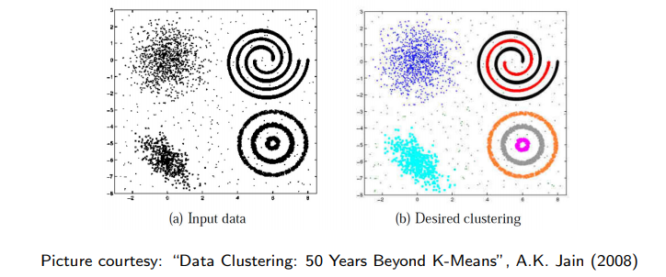
Clustering
In some cases, we may not know the right number of clusters in the data and may want to learn that (technique exists for doing this but beyond the scope)
Given: $N$ unlabeled inputs $x_{1},x_{2},…, x_{N}$; desired no. of partitions $K$
Goal: Group the examples into $K$ “homogeneous” partitions
Loosely speaking, it is classification without ground truth labels of training data
A good clustering is one that achieves
High within-cluster similarity
Low inter-cluster similarity
In addition to partitioning these $N$ inputs, we may also want to predict which partition a new test point belongs to

Slide 4
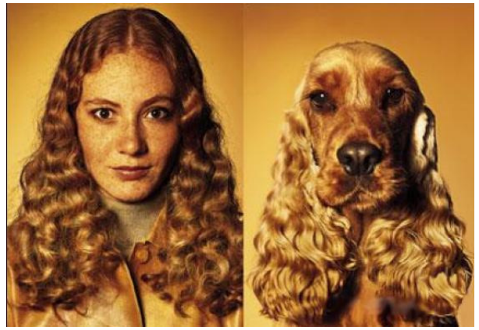
Similarity can be Subjective
Clustering only looks at similarities b/w inputs, since no labels are given
Without labels, similarity can be hard to define
Thus using the right distance/similarity is very important in clustering
In some sense, related to asking: “Clustering based on what”?
Picture courtesy: http://www.guy-sports.com/humor/videos/powerpoint presentation dogs.htm

Slide 5
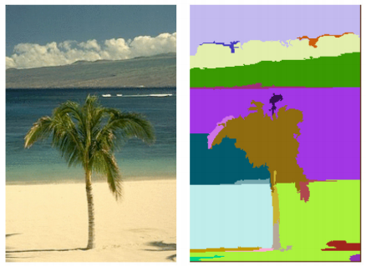
Clustering: Some Examples
Document/Image/Webpage Clustering
Image Segmentation (clustering pixels)
Clustering web-search results
Clustering (people) nodes in (social) networks/graphs
.. and many more..
Picture courtesy: http://people.cs.uchicago.edu/∼pff/segment/

Slide 6
K-means Clustering
Based on the following two steps (applied in alternating fashion until not converged)
Assign each input to the current closest mean
Recompute (update) the means
At the very beginning, the means needs to be
initialized (at random locations or using other schemes that we will see later)

Slide 7
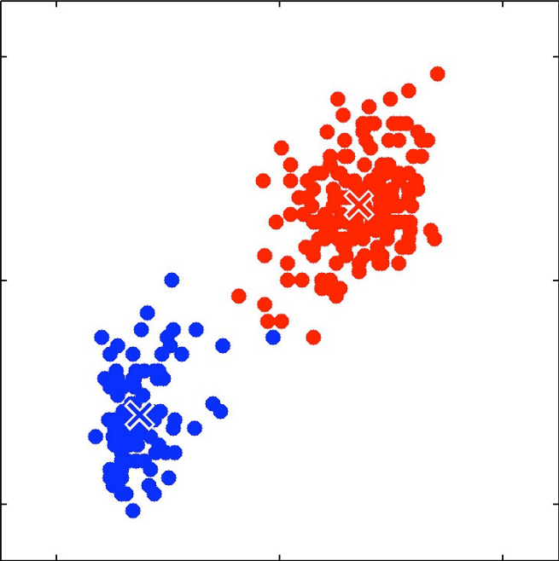
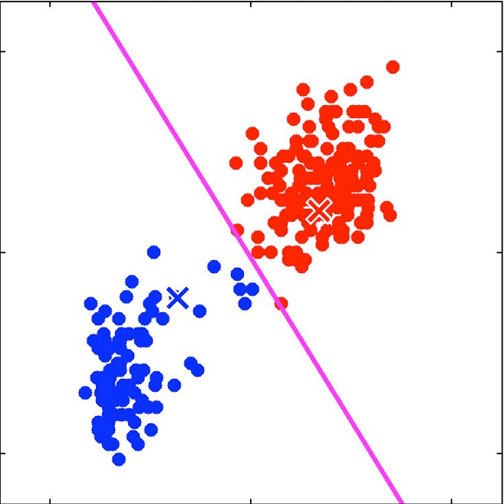
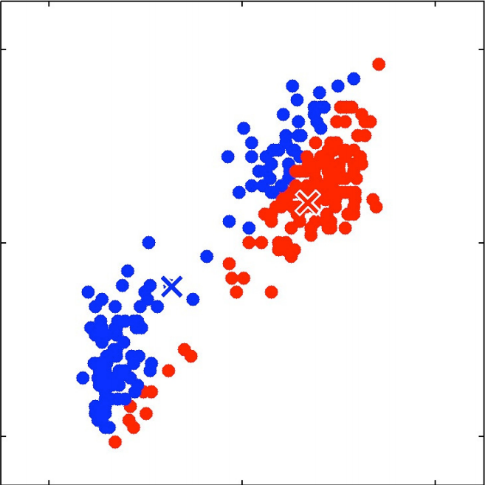
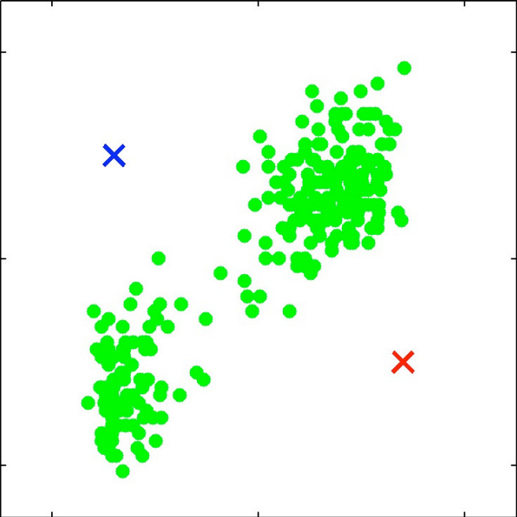
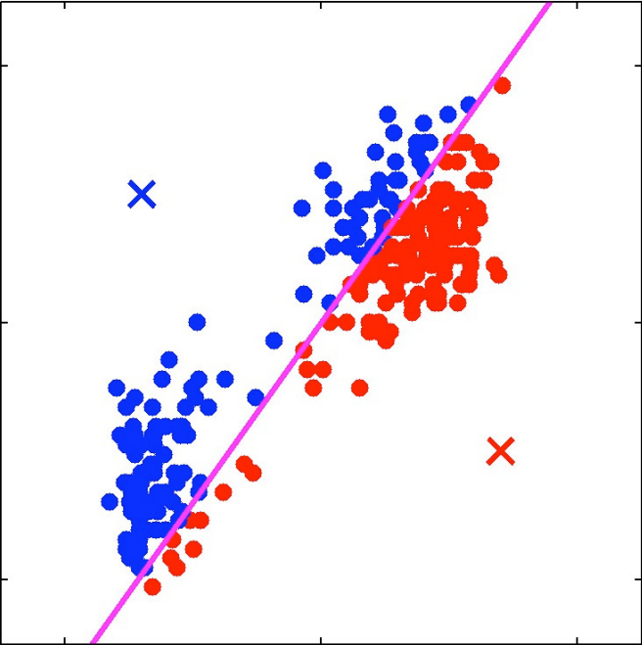
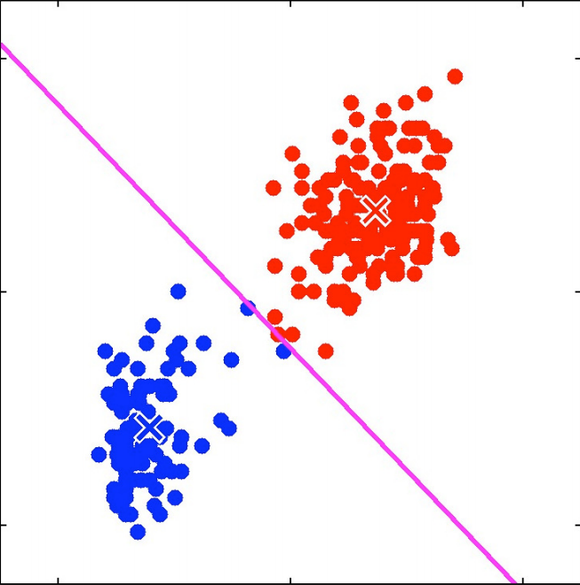
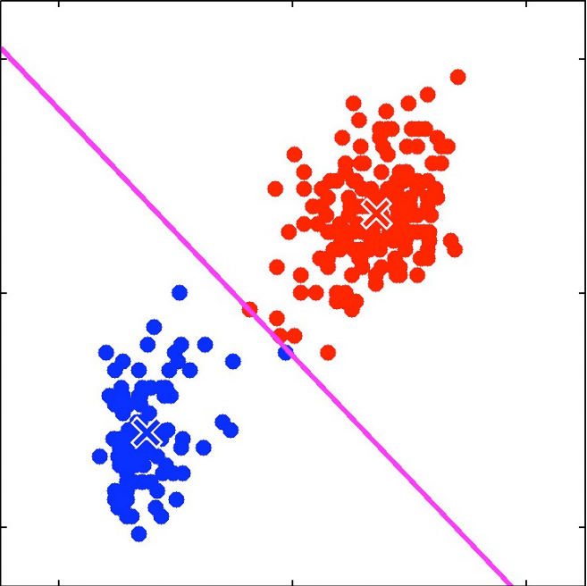
K-means Clustering
Similar to LwP but in LwP the labels are known so the means can be computed in a single step without iterating multiple times
Good initialization matters (some methods exist to pick good initialization, e.g., $K$-means++)
$K$-means clustering with $K=2$
1. Randomly initialize $K$ locations (the means)
2. Using the current means, predict the cluster id for each input (closest mean)
3. Recompute the means using the predicted cluster id of each input
4. Go to step 2 if not converged

Slide 8
K-means (a.k.a. Lloyd’s) Algorithm: Formally
Input: $N$ inputs $x_{1},x_{2},…, x_{N}$; $x_{n}∈ℝ^{D}$; desired no. of partitions $K$
Desired Output: Cluster ids of these $N$ inputs and $K$ cluster means $μ_{1},μ_{2},…, μ_{K}$
$K$-means algo can also be seen as doing a compression by “quantization”: Representing each of the $N$ inputs by one of the $K < N$ means
Can be fixed by modeling each cluster by a probability distribution, such as Gaussian (e.g., Gaussian Mixture Model; will see later)
$z_{n} = k$ means $z_{nk}$ = 1 in one-hot representation of $z_{n}$
This basic $K$-means models each cluster by a single mean $μ_{k}$. Ignores size/shape of clusters

Slide 9
What Loss Function is K-means Optimizing?
Define the distortion or “loss” for the cluster assignment of a single input $x_{n}$
Notation:
$X$ is $N× D$ matrix of inputs, $Z$ is $N×K$ matrix denoting cluster ids(each row is a one-hot $z_{n}$)
$μ$ is $K × D$(each row contains the mean $μ_{k}$ of cluster $k$)
Total distortion over all inputs defines the $K$-means “loss function”
The $K$-means problem is to minimize this objective w.r.t. $μ$ and $Z$
Alternating optimization on this loss would give the K-means (Lloyd’s) algorithm we saw earlier!
No labels here. We are measuring how much error we will incur if we assign $x_{n}$ to its nearest cluster mean
$z_{n} =$[$z_{n1}$, $z_{n2}, …, z_{nK}$] denotes a length $K$ one-hot encoding of $x_{n}$ and $z_{nk}=1$ if $x_{n}$ is assigned to cluster $k$
$$ℓ\left(x_{n},μ, z_{n}\right)= \sum_{k=1}^{K}{z_{nk}}{\left\|x_{n}−μ_{k}\right\|}^{2}$$
$X$ approximated by the product of $Z$ and $μ$
D
K
$$ℓ\left(X,μ, Z\right)= \sum_{n=1}^{N}{\sum_{k=1}^{K}{z_{nk}}{\left\|x_{n}−μ_{k}\right\|}^{2}}$$
X
Z
K
$$μ$$
N
$$≈$$
$K$-means problem viewed as a matrix factorization problem
${\left\|.\right\|}_{F}^{2}$ denotes the matrix Frobenius norm (squared norm for matrices)
Row $k$ is $μ_{k}$
$$= {\left\|X −Zμ\right\|}_{F}^{2}$$
Row $n$ is $z_{n}$ (one-hot vector)

Slide 10
K-means Loss: Several Forms, Same Meaning!
Replacing the $ℓ_{2}$ (Euclidean) squared by $ℓ_{1}$ distances gives the $K$-medoids algorithm (more robust to outliers)
Can write the $K$-means loss function in several ways
Note: Not just $K$-means but many unsup. learning algos try to minimize a distortion or reconstruction error for $X$ by solving a problem of the form
Mean of the cluster which input $x_{n}$ got assigned to
$Z$ denotes a new representation of the inputs and $μ$ denotes the other parameters of the model

Slide 11
Optimizing the K-means Loss Function
The $K$-means problem is
Can’t optimize it jointly for $Z$ and $μ$. Let’s try alternating optimization for $Z$ and $μ$
Given the current estimates of the $K$ means $μ_{1},μ_{2},…, μ_{K}$, find the optimal cluster ids $z_{1},z_{2},…, z_{N}$ for all the inputs
Given the current estimates of the optimal cluster ids $z_{1},z_{2},…, z_{N}$,compute the $K$means $μ_{1},μ_{2},…, μ_{K}$

Slide 12
Solving for Z
Solving for $Z$ with $μ$fixed at $\hat{μ}$
Still not easy. $Z$ is discrete and above is an NP-hard problem
Combinatorial optimization: $K^{N}$ possibilities for $Z$ ($N × K$matrix with one-hot rows)
Greedy approach: Optimize $Z$ one row ($z_{n}$) at a time keeping all others $z_{n}$’s (and the cluster means $μ_{1},μ_{2},…, μ_{K})$ fixed
Easy to see that this is minimized by assigning $x_{n}$ to the closest mean
This is exactly what the $K$-means (Lloyd’s) algo does!

Slide 13
Solving for $μ$
Solving for 𝝁 with $Z$ fixed at $\hat{Z}$
Not difficult to solve (each $μ_{k}$ is a real-valued vector, can optimize easily)
Note that each $μ_{k}$ can be optimized for independently
(Verify) This is minimized by setting ${\hat{μ}}_{k}$ to be mean of points currently in cluster $k$
This is exactly what the $K$-means (Lloyd’s) algo does!

Slide 14
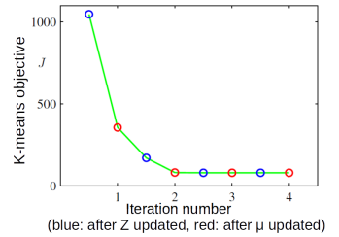
Convergence of K-means algorithm
Each step (updating $Z$ or $μ$) can never increase the $K$-means loss
When we update $Z$ from $Z^{(t−1)}$ to $Z^{(t)}$
When we update $μ$ from $μ^{(t−1)}$ to $μ^{(t)}$
Thus the $K$-means algorithm monotonically decreases the objective
because
because

Slide 15
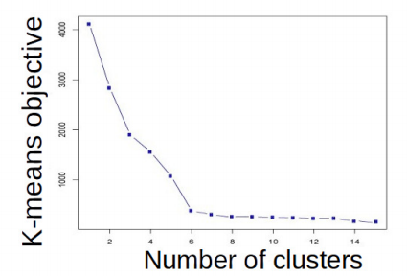
K-means: Choosing K
One way to select $K$ for the $K$-means algorithm is to try different values of $K$, plot the $K$-means objective versus $K$, and look at the “elbow-point”
Can also information criterion such as AIC (Akaike Information Criterion)
and choose $K$ which gives the smallest AIC (small loss + large $K$ values penalized)
More advanced approaches, such as nonparametric Bayesian methods (Dirichlet Process mixture models also used, not within K-means but with other clustering algos)
If we use $K=N$ then $K$-means algo can achieve smallest possible loss (zero!). Think why.
$K$=6 is the elbow point
However, if we use $K=N$ it isn’t a useful clustering

Slide 16
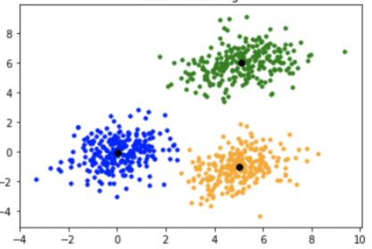
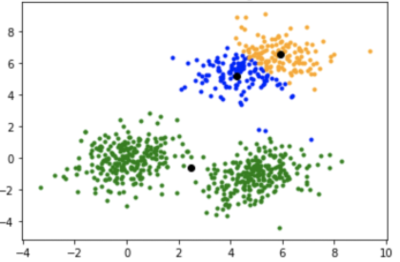
K-means++
$K$-means results can be sensitive to initialization
$K$-means++ (Arthur and Vassilvitskii, 2007) an improvement over $K$-means
Only difference is the way we initialize the cluster centers (rest of it is just $K$-means)
Basic idea: Initialize cluster centers such that they are reasonably far from each other
Note: In $K$-means++, the cluster centers are chosen to be $K$ of the data points themselves
Desired clustering
Poor initialization: bad clustering

Slide 17
K-means++
K-means++ works as follows
Choose the first cluster mean uniformly randomly to be one of the data points
The subsequent $K−1$ cluster means are chosen as follows
For each unselected point $x$, compute its smallest distance $D(x)$ from already initialized means
Select the next cluster mean unif. rand. to be one of the unselected points based on probability prop. to $D{\left(x\right)}^{2}$
Repeat 1 and 2 until the $K−1$ cluster means are initialized
Now run standard $K$-means with these initial cluster means
$K$-means++ initialization scheme sort of ensures that the initial cluster means are located in different clusters
Thus farthest points are most likely to be selected as cluster means

Slide 18
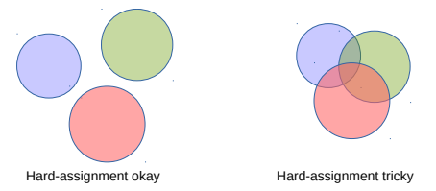
K-means: Hard vs Soft Clustering
K-means makes hard assignments of points to clusters
Hard assignment: A point either completely belongs to a cluster or doesn’t belong at all
When clusters overlap, soft assignment is preferable(i.e., probability of being assigned to each cluster: say $K = 3$and for some point $x_{n}$, $p_{1} = 0.7, p_{2} = 0.2, p_{3} = 0.1$)
A heuristic to get soft assignments: Transform distances from clusters into prob.
Each cluster mean updates changes: (all points contribute fractionally)
A more principled extension of $K$-means for doing soft-clustering is via probabilistic mixture models such as the Gaussian Mixture Model
$$\sum_{k=1}^{K}{γ_{nk}=1}$$

Slide 19
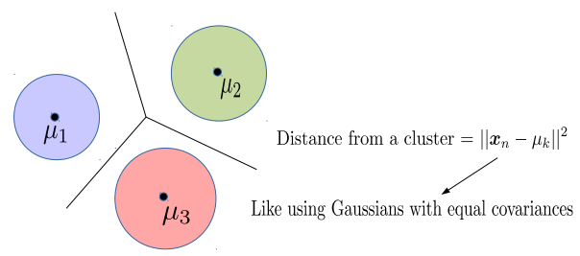
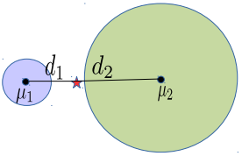
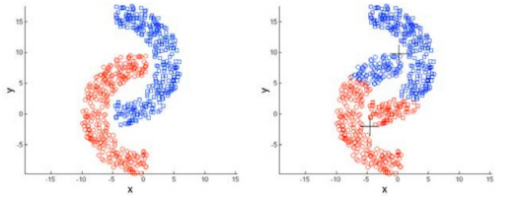
K-means: Decision Boundaries and Cluster Sizes/Shapes
$K$-mean assumes that the decision boundary between any two clusters is linear
Reason: The $K$-means loss function implies assumes equal-sized, spherical clusters
May do badly if clusters are not roughly equi-sized and convex-shaped
Reason: Use of Euclidean distances

Slide 20
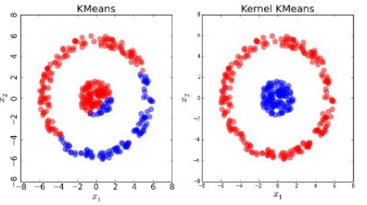
Kernel K-means
Helps learn non-spherical clusters and nonlinear cluster boundaries
Basic idea: Replace the Eucl. distances in $K$-means by the kernelized versions
Here $k(., .)$denotes the kernel function and $φ$ is its (implicit) feature map
Note: $φ(μ_{k})$ is the mean of $φ$ mappings of the data points assigned to cluster $k$
Kernelized distance between input $x_{n}$ and mean of cluster $k$
Not the same as the $φ$mapping of the mean of the data points assigned to cluster $k$
$$φ\left(μ_{k}\right)= \frac{1}{\left|𝒞_{k}\right|}\sum_{n:z_{n}=k}{φ\left(x_{n}\right)}$$
Can also used landmarks or kernel random features idea to get new features and run standard k-means on those
$${\left\|φ\left(μ_{k}\right)\right\|}^{2}=φ{\left(μ_{k}\right)}^{⊤}φ\left(μ_{k}\right)$$
Note: Apart from kernels, it is also possible to use other distance functions in $K$-means. Bregman Divergence* is such a family of distances (Euclidean and Mahalanobis are special cases)
$$=\frac{1}{{\left|𝒞_{k}\right|}^{2}}\sum_{n:z_{n}=k}{\sum_{n:z_{m}=k}{k(x_{n},x_{m})}}$$
$$φ{\left(x_{n}\right)}^{⊤}φ\left(μ_{k}\right)= \frac{1}{|𝒞_{k}|}\sum_{m:z_{m}=k}{k(x_{n},x_{m})}$$
*Clustering with Bregman Divergences (Banerjee et al, 2005)

Slide 21
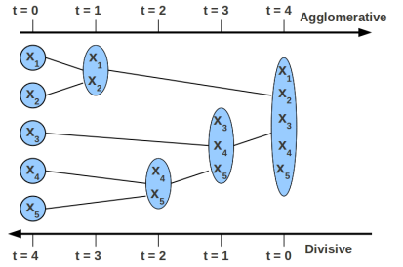
Hierarchical Clustering
Similarity between two clusters (or two set of points) is needed in HC algos (e.g., this can be average pairwise similarity between the inputs in the two clusters)
Can be done in two ways: Agglomerative or Divisive
Agglomerative is more popular and simpler than divisive (the latter usually needs complicated heuristics to decide cluster splitting).
Neither uses any loss function
Agglomerative: Start with each point being in a singleton cluster
Keep recursing until the desired number of clusters found
At each step, greedily merge two most “similar” sub-clusters
At each step, break a cluster into (at least) two smaller homogeneous sub-clusters
Stop when there is a single cluster containing all the points
Divisive: Start with all points being in a single cluster
Learns a dendrogram-like structure with inputs at the leaf nodes. Can then choose how many clusters we want
Tricky because no labels (unlike Decision Trees)

Slide 22
Clustering vs Classification
Any clustering model (prob/non-prob) typically learns two type of quantities
Parameters $Θ$ of the clustering model (e.g., cluster means in K-means)
Cluster assignments $Z = \{z_{1}, z_{2}, …, z_{N}\}$for the points
If cluster assignments $Z$ were known, learning the parameters $Θ$ is just like learning the parameters of a classifn model (typically generative classification) using labeled data
Thus helps to think of clustering as (generative) classification with unknown labels
Therefore many clustering problems are typically solved in the following fashion
Initialize $Θ$ somehow
Predict $Z$ given current estimate of $Θ$
Use the predicted $Z$ to improve the estimate of $Θ$ (like learning a generative classification model)
Go to step 2 if not converged yet

Slide 23
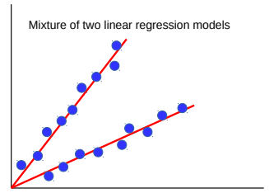
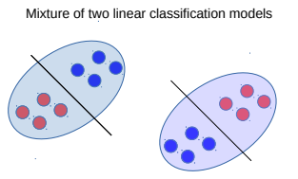
Clustering can help supervised learning, too
Often “difficult” sup. learning problems can be seen as mixture of simpler models
Example: Nonlinear regression or nonlinear classification as mixture of linear models
Don’t know which point should be modeled by which linear model ⇒ Clustering
Can therefore solve such problems as follows
Initialize each linear model somehow (maybe randomly)
Cluster the data by assigning each point to its “closest” linear model (one that gives lower error)
(Re-)Learn a linear model for each cluster’s data. Go to step 2 if not converged.
Such an approach is also an example of divide and conquer and is also known as “mixture of experts” (will see it more formally when we discuss latent variable models)

Slide 24
Evaluating Clustering Algorithms
Clustering algos are in general harder to evaluate since we rarely know the ground truth clustering (since clustering is unsupervised)
If ground truth labels not available, use output of clustering for some other task
For example, use cluster assignment $z_{n}$ (hard or soft) as a new feature representation
Performance on some task using this new rep. is a measure of goodness of clustering
If ground truth labels are available, can compare them with clustering based labels
Not straightforward to compute accuracy since the label identities may not be the same, e.g.,
Ground truth = [1 1 1 0 0 0] Clustering = [0 0 0 1 1 1]
(Perfect clustering but zero “accuracy” if we just do a direct match)
There are various metrics that take into account the above fact
Purity, Rand Index, F-score, Normalized Mutual Information, distortion or loss on test data etc

Slide 25
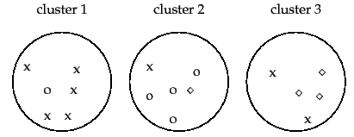
Evaluating Clustering Algorithms
Purity: Looks at how many points in each cluster belong to the majority class in that cluster
Rand Index (RI): Can also look at what fractions of pairs of points with same (resp. different) label are assigned to same (resp. different) cluster
Sum and divide by total number of points
3 classes (x, o , , assuming known ground truth labels)
5
4
3
Purity = (5+4+3)/17 $≈0.71$
Close to 0 for bad clustering, 1 for perfect clustering
Also a bad metric if number of clusters is very large – each cluster will be kind of pure anyway
True Positive: No. of pairs with same true label and same cluster
True Negative: No. of pairs with diff true label and diff clusters
$F_{β}$score is also popular
Precision
Recall
False Positive: No. of pairs with diff true label and same cluster
False Negative: No. of pairs with same true label and diff cluster

Slide 26
Overlapping Clustering
Kind of unsupervised version of multi-label classification (just like standard clustering is like unsupervised multi-class classification)
Have seen hard clustering and soft clustering
In hard clustering, $z_{n}$is a one-hot vector
In soft clustering, $z_{n}$is a vector of probabilities
Overlapping Clustering: A point can simultaneously belong to multiple clusters
This is different from soft-clustering
$z_{n}$ would be a binary vector, rather than a one hot or probability vector, e.g.,
In general, more difficult than hard/soft clustering (for $N$ data points and $K$ clusters, the size of the space of possible solutions is not $K^{N}$ but $2^{NK}$ - exp in both $N$ and $K$)
K-means has extensions* for doing overlapping clustering. There also exist latent variable models for doing overlapping clustering
Example: Clustering people based on the interests they may have (a person may have multiple interests; thus may belong to more than one cluster simultaneously)
$$z_{n}\text{ = [1 0 0 1 0]}$$
K=5 clusters with point $x_{n}$ belonging (in whole, not in terms of probabilities) to clusters 1 and 4
*An extended version of the k-means method for overlapping clustering (Cleuziou, 2008); Non-exhaustive, Overlapping k-means (Whang et al, 2015)

