Slide 1
ESC101: Fundamentals of Computing
Sorting algorithms
Nisheeth

Slide 2


What is Sorting?
250
200
$$N$$
150
Time-taken
Useful in itself – internet search and recommendation systems
100
“
50
$$\log{N}$$
50
100
150
200
250
300
350
400
No. of items
Sorting is the process of arranging items systematically, ordered by some criterion
”
Search within n unsorted elements can take as much as O(n) operations
Makes searching very fast – can search within n sorted elements in just O(log n) operations using Binary Search

Slide 3
Sorting Algorithms
Bubble Sort

Slide 4










Bubble Sort
Consider an array (5 1 4 2 8). Goal: Sort it in ascending order
Idea: Repeatedly swap the adjacent elements if they are in wrong order
First Pass
Second Pass
Third Pass
No swaps in this pass,
hence done! ☺

Slide 5
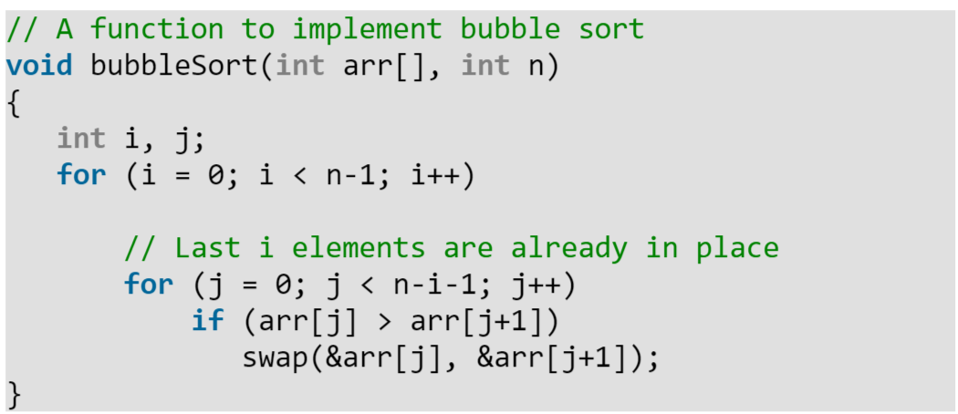
Bubble Sort

Slide 6
Sorting Algorithms
Selection Sort

Slide 7
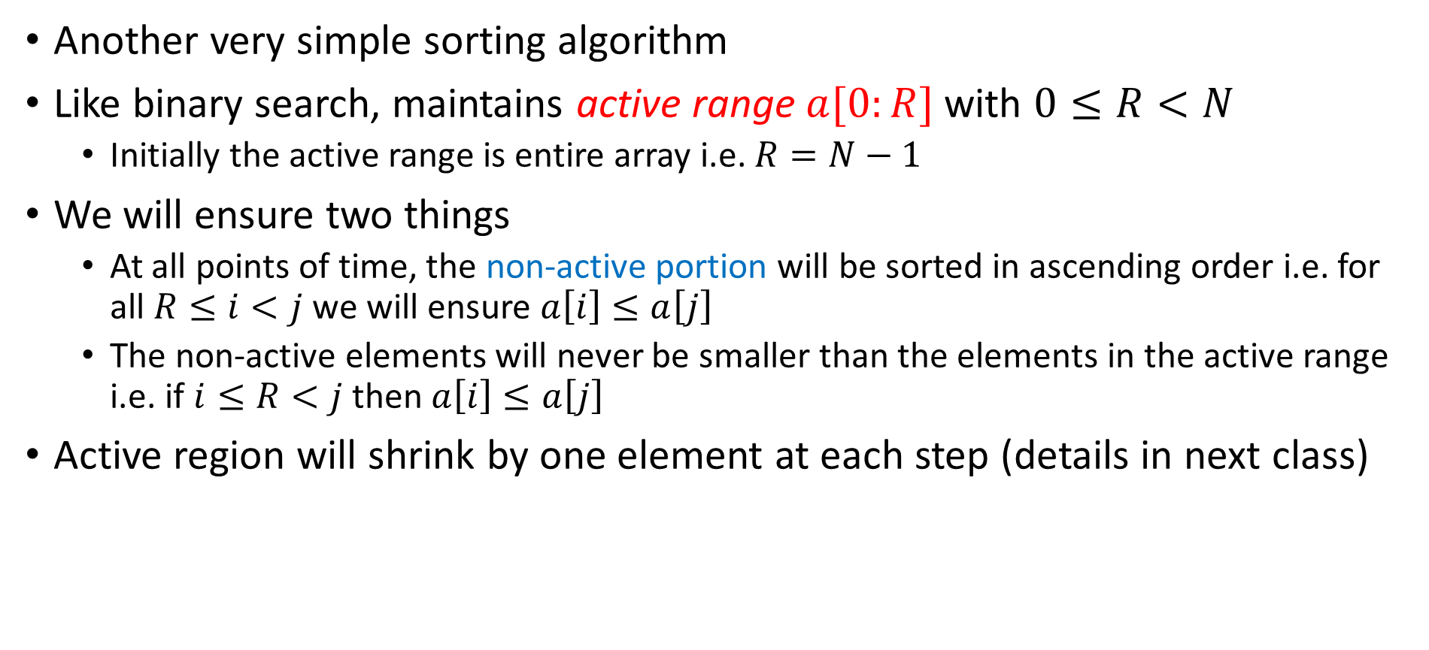
Selection Sort
Another very simple sorting algorithm
Like binary search, maintains active range $a[0:R]$ with $0≤R<N$
  Initially the active range is entire array i.e. $R=N−1$
We will ensure two things
  At all points of time, the non-active portion will be sorted in ascending order i.e. for all $R≤i<j$ we will ensure $a\left[i\right]≤a\left[j\right]$
  The non-active elements will never be smaller than the elements in the active range i.e. if $i≤R<j$ then $a\left[i\right]≤a\left[j\right]$
Active region will shrink by one element at each step (details in next class)
4
1
3
5
6
8
9

Slide 8
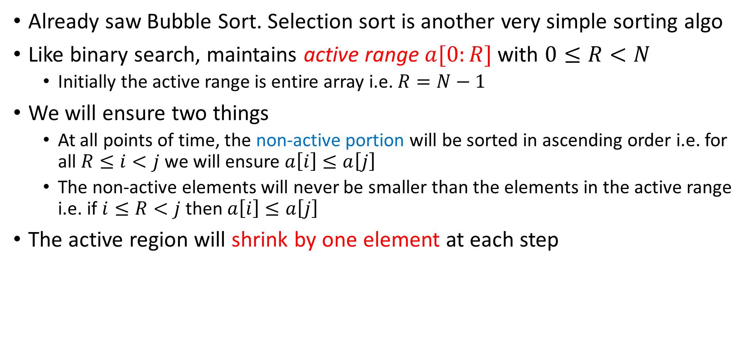
Selection Sort
Already saw Bubble Sort. Selection sort is another very simple sorting algo
Like binary search, maintains active range $a[0:R]$ with $0≤R<N$
  Initially the active range is entire array i.e. $R=N−1$
We will ensure two things
  At all points of time, the non-active portion will be sorted in ascending order i.e. for all $R≤i<j$ we will ensure $a\left[i\right]≤a\left[j\right]$
  The non-active elements will never be smaller than the elements in the active range i.e. if $i≤R<j$ then $a\left[i\right]≤a\left[j\right]$
The active region will shrink by one element at each step
4
1
3
5
6
8
9

Slide 9
Selection Sort
Once an element goes to non-active region, we never touch it again ☺
To maintain our conditions and still shrink the active region
  We find the largest element in the active region
  Bring it to the right-most end of the active region using a swap
4
1
3
5
6
8
9
Verify that our conditions still hold
3
1
4
5
6
8
9

Slide 10
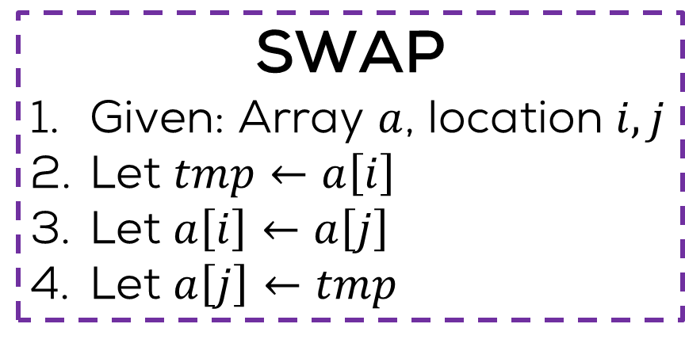
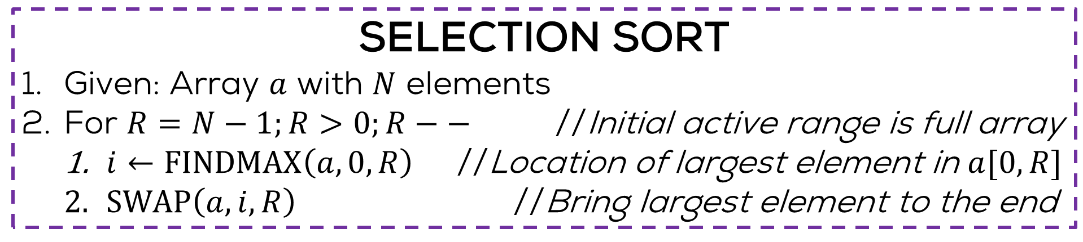
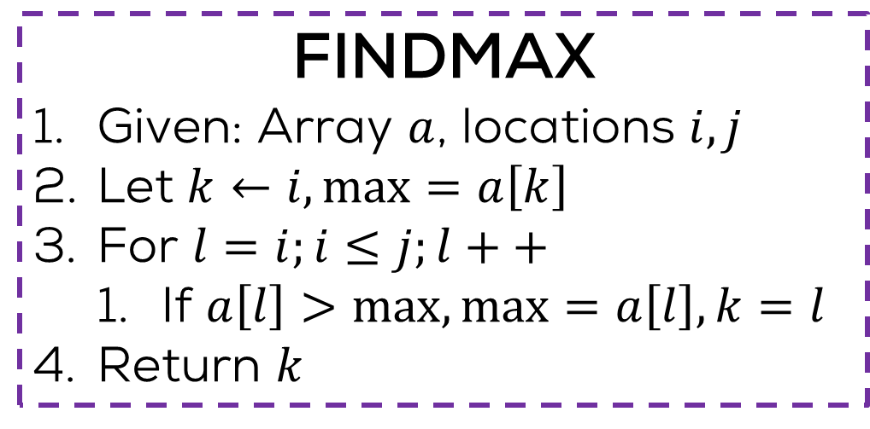
Selection Sort
Exercise: write a recursive version
Exercise: convert this to proper C code
SELECTION SORT
Given: Array $a$ with $N$ elements
For $R=N−1;R>0;R−−$ //Initial active range is full array
  $i←FINDMAX\left(a,0,R\right)$ //Location of largest element in $a[0,R]$
  $SWAP\left(a,i,R\right)$ //Bring largest element to the end
SWAP
Given: Array $a$, location $i,j$
Let $tmp←a\left[i\right]$
Let $a\left[i\right]←a\left[j\right]$
Let $a\left[j\right]←tmp$
FINDMAX
Given: Array $a$, locations $i,j$
Let $k←i,\max{=a\left[k\right]}$
For $l=i;i≤j;l++$
  If $a\left[l\right]>\max{,\max{=a\left[l\right],k=l}}$
Return $k$

Slide 11
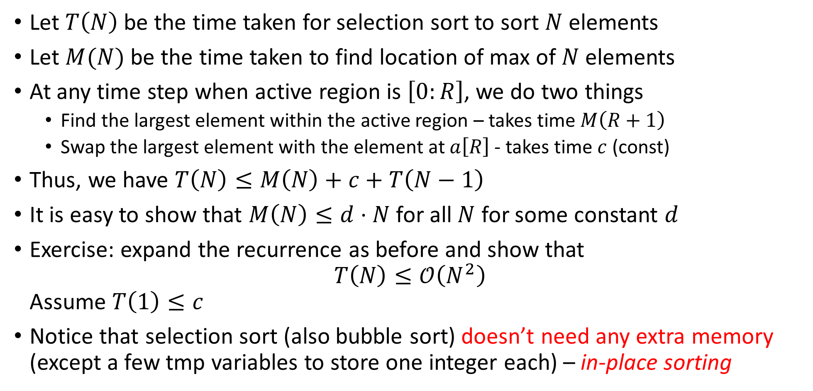
Time Complexity
Let $T\left(N\right)$ be the time taken for selection sort to sort $N$ elements
Let $M(N)$ be the time taken to find location of max of $N$ elements
At any time step when active region is $\left[0:R\right]$, we do two things
  Find the largest element within the active region – takes time $M\left(R+1\right)$
  Swap the largest element with the element at $a\left[R\right]$ - takes time $c$ (const)
Thus, we have $T\left(N\right)≤M\left(N\right)+c+T\left(N−1\right)$
It is easy to show that $M\left(N\right)≤d⋅N$ for all $N$ for some constant $d$
Exercise: expand the recurrence as before and show that
$T\left(N\right)≤𝒪\left(N^{2}\right)$
Assume $T\left(1\right)≤c$
Notice that selection sort (also bubble sort) doesn’t need any extra memory (except a few tmp variables to store one integer each) – in-place sorting

Slide 12
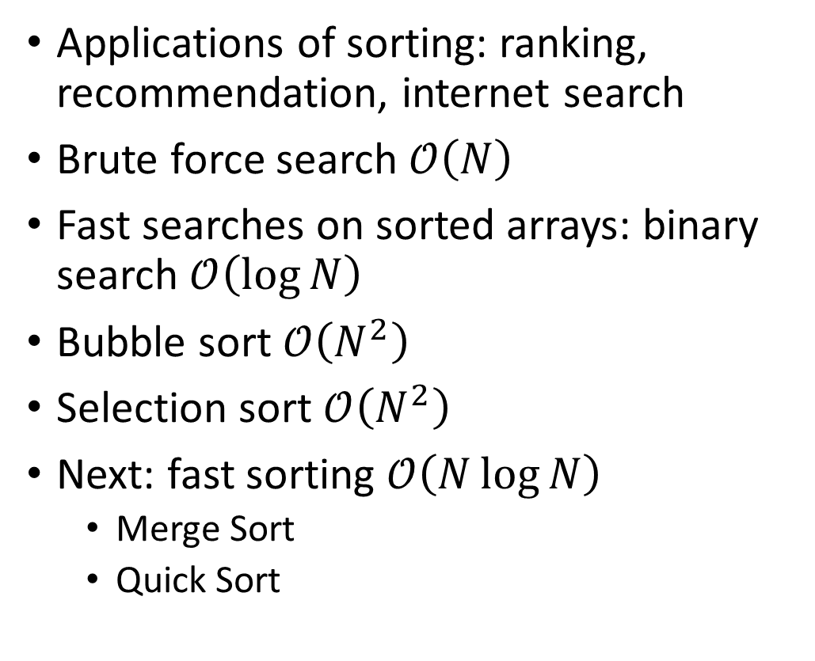


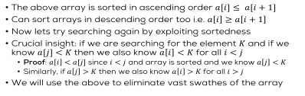

Summary so far..
250
200
$$N$$
Applications of sorting: ranking, recommendation, internet search
Brute force search $𝒪\left(N\right)$
Fast searches on sorted arrays: binary search $𝒪\left(\log{N}\right)$
Bubble sort $𝒪\left(N^{2}\right)$
Selection sort $𝒪\left(N^{2}\right)$
Next: fast sorting $𝒪\left(N\log{N}\right)$
  Merge Sort
  Quick Sort
150
100
50
$$\log{N}$$
50
100
150
200
250
300
350
400
2500
2000
$$N^{2}$$
1500
$$N\log{N}$$
1000
500
50
100
150
200
250
300
350
400

Slide 13
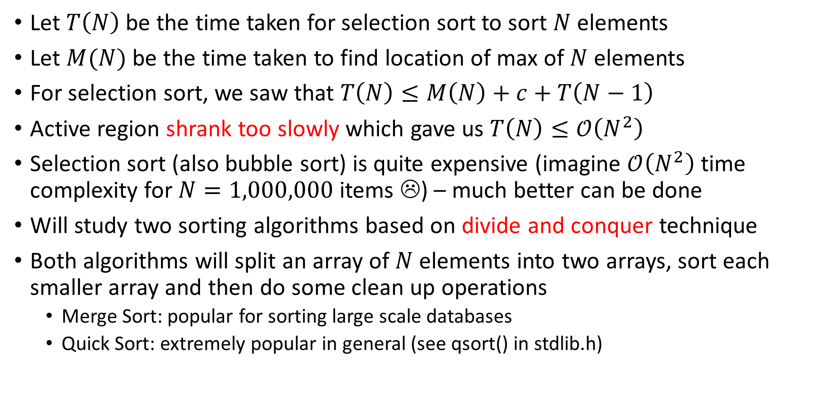
Partition based Sorting Techniques
Let $T\left(N\right)$ be the time taken for selection sort to sort $N$ elements
Let $M(N)$ be the time taken to find location of max of $N$ elements
For selection sort, we saw that $T\left(N\right)≤M\left(N\right)+c+T\left(N−1\right)$
Active region shrank too slowly which gave us $T\left(N\right)≤𝒪\left(N^{2}\right)$
Selection sort (also bubble sort) is quite expensive (imagine $𝒪\left(N^{2}\right)$ time complexity for $N=1,000,000$ items ☹) – much better can be done
Will study two sorting algorithms based on divide and conquer technique
Both algorithms will split an array of $N$ elements into two arrays, sort each smaller array and then do some clean up operations
  Merge Sort: popular for sorting large scale databases
  Quick Sort: extremely popular in general (see qsort() in stdlib.h)

Slide 14
Sorting Algorithms
Merge Sort

Slide 15
Merge Sort
9
1
9
4
2
1
2
7
5
8
3
5
2
1
4
8
?
Merge Sort
?
Merge Sort
1
1
2
2
4
7
9
9
1
2
3
4
5
5
8
8
?
Merge
1
1
1
2
2
2
3
4
4
5
5
7
8
8
9
9
Trick: Merging two sorted arrays is very easy!

Slide 16
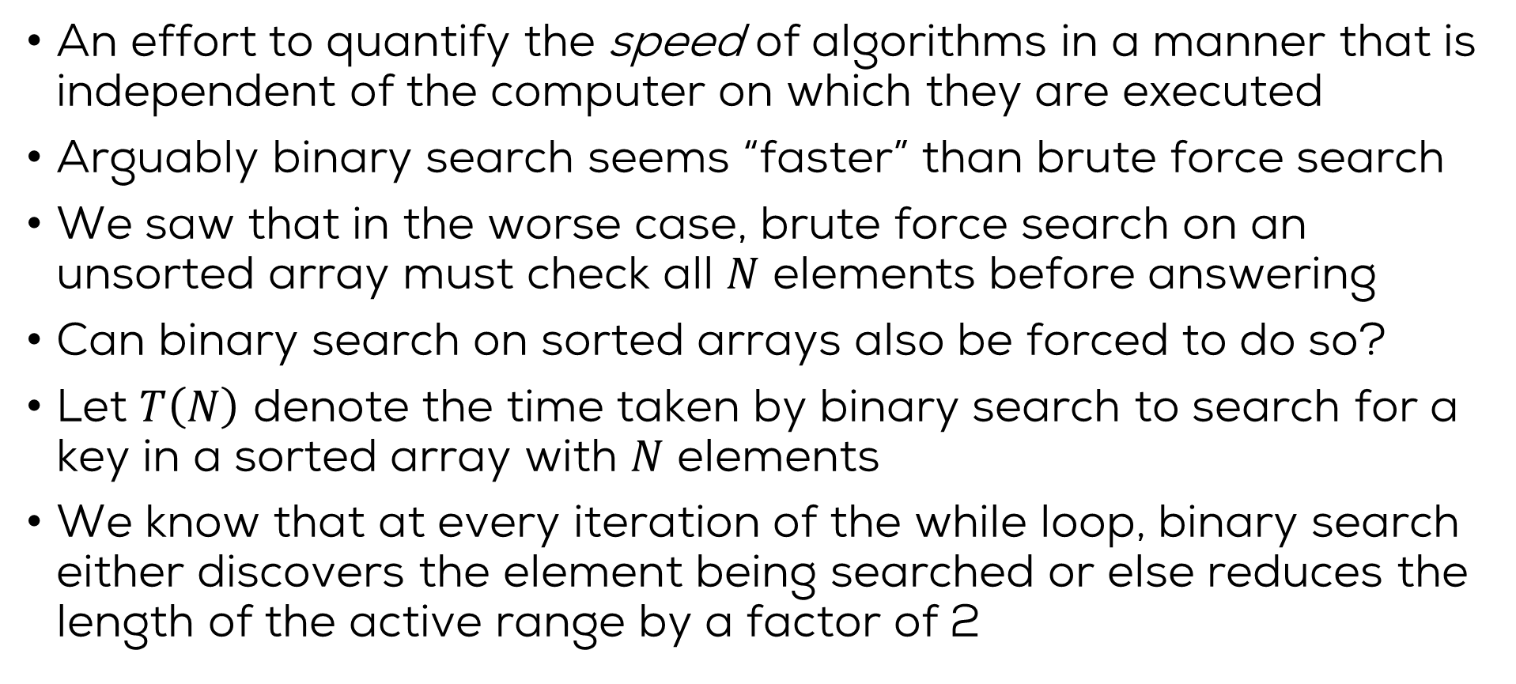
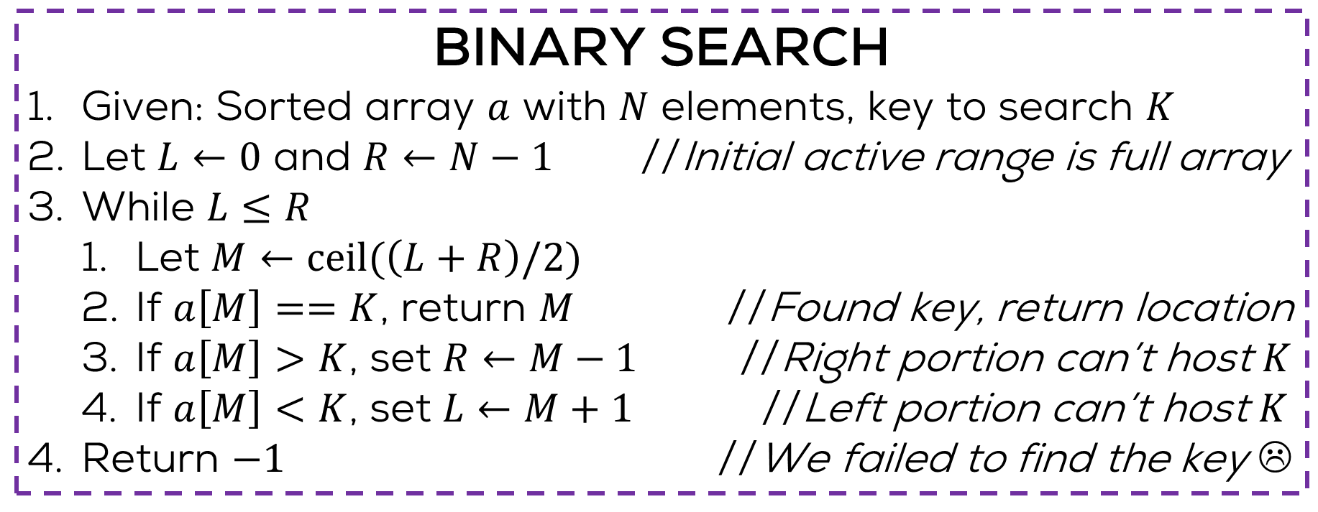
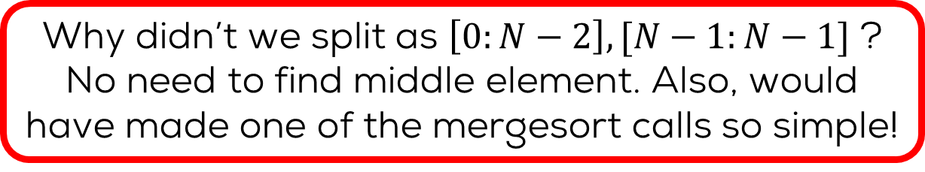
Merge Sort
Why didn’t we split as $\left[0:N−2\right],[N−1:N−1]$ ?
No need to find middle element. Also, would have made one of the mergesort calls so simple!
MERGE SORT
Given: Array $a$ with $N$ elements
If $N<2$ return $a$ //An empty or singleton array is sorted
Let $C←ceil\left(N/2\right)$ //Find the “middle” of the array
$p←$ MERGESORT($a[0:C−1])$ //Sort the left half
$q←$ MERGESORT($a\left[C:N−1\right]$) //Sort the right half
Return MERGE($p,q$) //Merge the two halves
A sort algorithm is called in-place if it does not use extra memory e.g. extra arrays, to sort the given array
Uses a lot of extra memory $p,q$. Even MERGE uses extra memory – not good! Need an in-place version

Slide 17
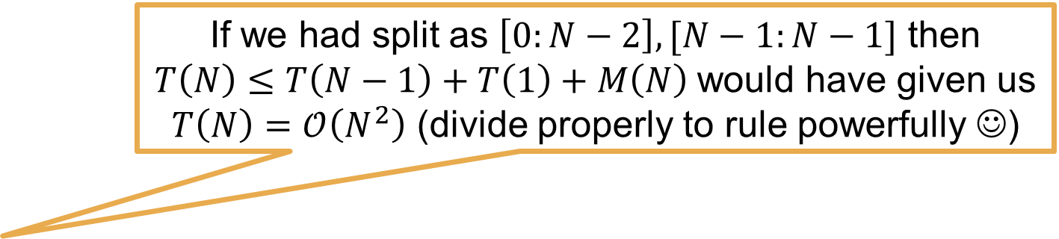
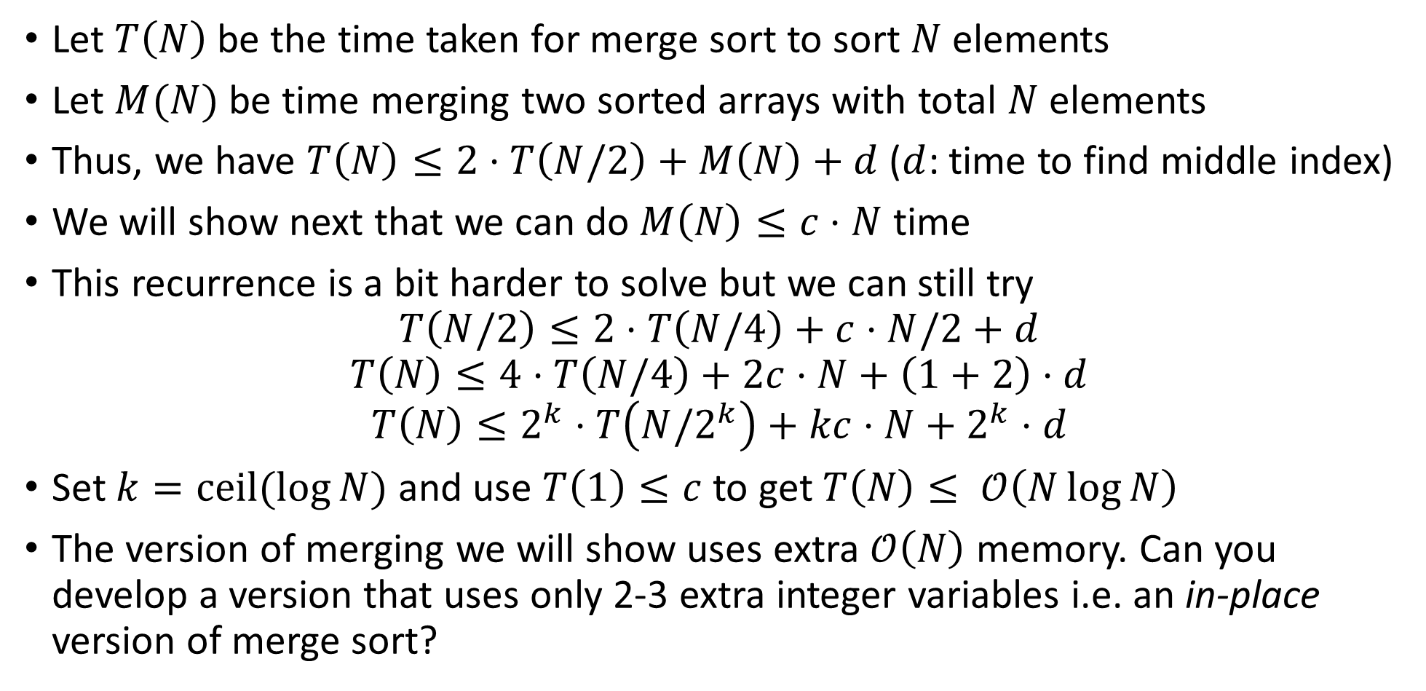
Time Complexity
If we had split as $\left[0:N−2\right],[N−1:N−1]$ then $T\left(N\right)≤T\left(N−1\right)+T\left(1\right)+M\left(N\right)$would have given us
$T\left(N\right)=𝒪\left(N^{2}\right)$ (divide properly to rule powerfully ☺)
Let $T\left(N\right)$ be the time taken for merge sort to sort $N$ elements
Let $M(N)$ be time merging two sorted arrays with total $N$ elements
Thus, we have $T\left(N\right)≤2⋅T\left(N/2\right)+M\left(N\right)+d$ ($d$: time to find middle index)
We will show next that we can do $M\left(N\right)≤c⋅N$ time
This recurrence is a bit harder to solve but we can still try
$T\left(N/2\right)≤2⋅T\left(N/4\right)+c⋅N/2+d$
$$T\left(N\right)≤4⋅T\left(N/4\right)+2c⋅N+\left(1+2\right)⋅d$$
$$T\left(N\right)≤2^{k}⋅T\left(N{/2}^{k}\right)+kc⋅N+2^{k}⋅d$$
Set $k=ceil(\log{N)}$ and use $T\left(1\right)≤c$ to get $T\left(N\right)≤ 𝒪\left(N\log{N}\right)$
The version of merging we will show uses extra $𝒪\left(N\right)$ memory. Can you develop a version that uses only 2-3 extra integer variables i.e. an in-place version of merge sort?

Slide 18
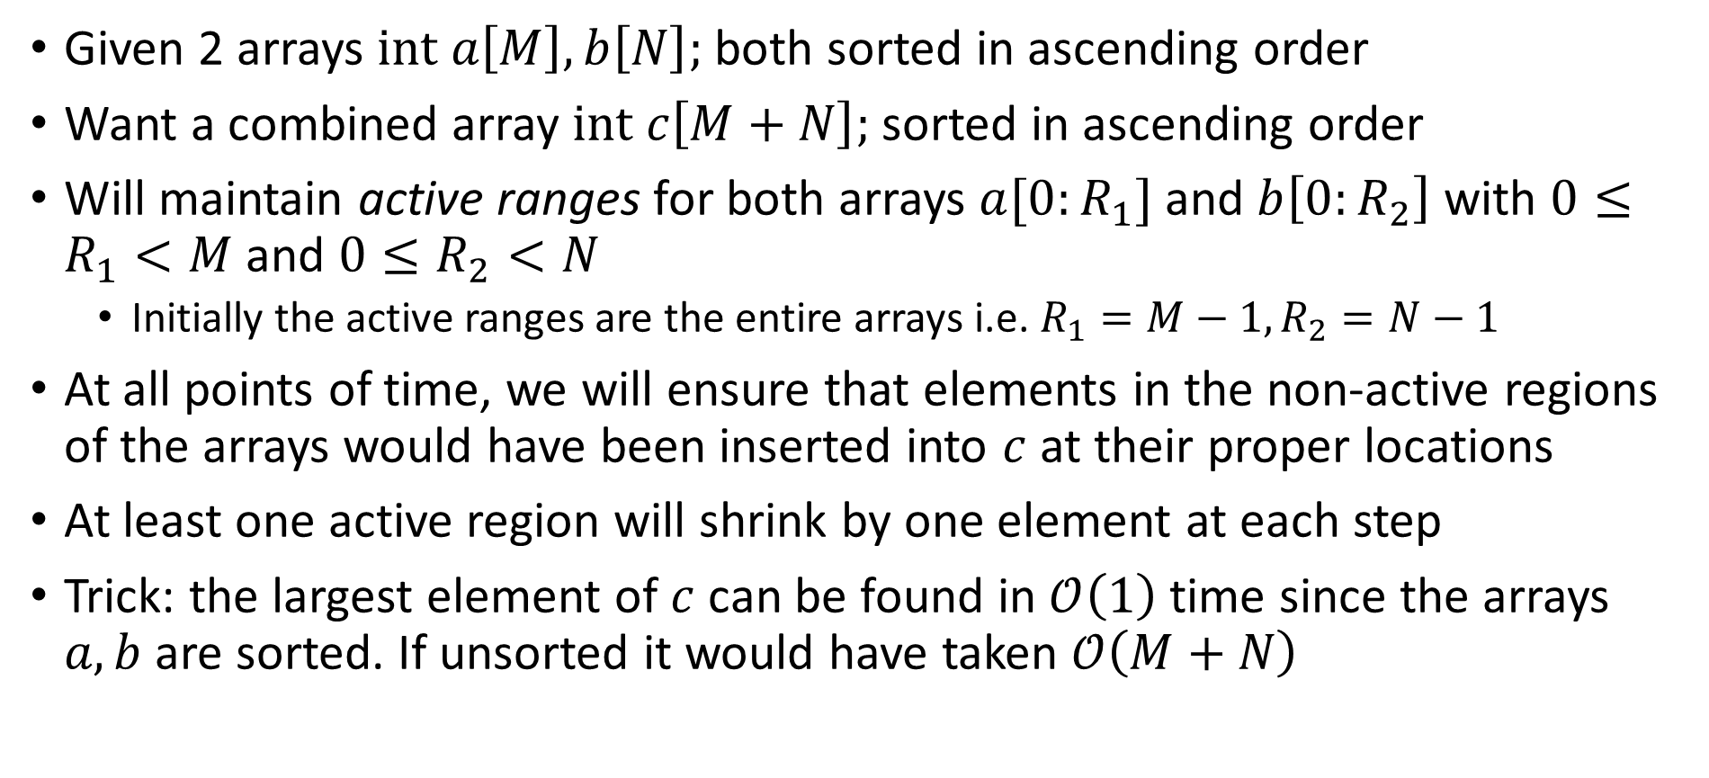
The Merge Operation
Given 2 arrays $int a\left[M\right],b\left[N\right];$ both sorted in ascending order
Want a combined array $int c\left[M+N\right];$ sorted in ascending order
Will maintain active ranges for both arrays $a[0:R_{1}]$ and $b\left[0:R_{2}\right]$ with $0≤R_{1}<M$ and $0≤R_{2}<N$
  Initially the active ranges are the entire arrays i.e. $R_{1}=M−1,R_{2}=N−1$
At all points of time, we will ensure that elements in the non-active regions of the arrays would have been inserted into $c$ at their proper locations
At least one active region will shrink by one element at each step
Trick: the largest element of $c$ can be found in $𝒪\left(1\right)$ time since the arrays $a,b$ are sorted. If unsorted it would have taken $𝒪\left(M+N\right)$

Slide 19
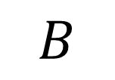
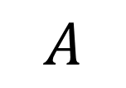
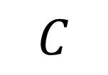
The Merge Operation
1
1
2
2
4
7
9
9
1
2
3
4
5
5
8
8
$$A$$
$$B$$
Merge
1
1
1
2
2
2
3
4
4
5
5
7
8
8
9
9
$$C$$
9 is larger: A wins
9 is larger: A wins again
8 is larger: B wins
8 is larger: B wins again

Slide 20
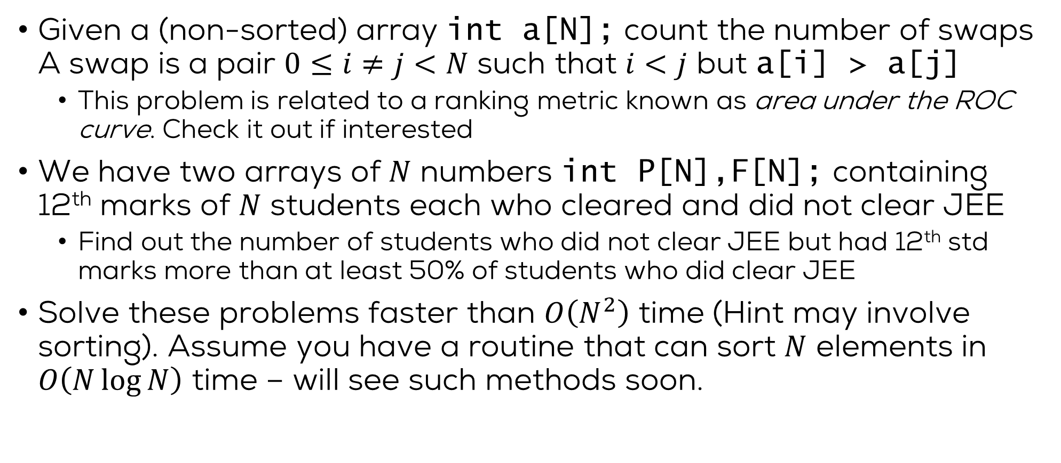
The Merge Operation
MERGE
Given: Sorted arrays $a,b$ with $M,N$ elements respectively.
Let $int c\left[M+N\right], R_{1}←M−1,R_{2}←N−1$
For $k=M+N−1;k≥0;k$--
  If $R_{1}<0$ then $c\left[k\right]=b\left[R_{2}\right];R_{2}$-- //We exhausted a
  Elseif $R_{2}<0$ then $c\left[k\right]=a\left[R_{1}\right];R_{1}$-- //We exhausted b
  Elseif $a\left[R_{1}\right]≥b\left[R_{2}\right]$ then $c\left[k\right]=a\left[R_{1}\right];R_{1}$-- //Both active, a wins
  Else $c\left[k\right]=b\left[R_{2}\right];R_{2}$-- //Both active, b wins
Return $c$

Slide 21
Sorting Algorithms
Quick Sort

Slide 22
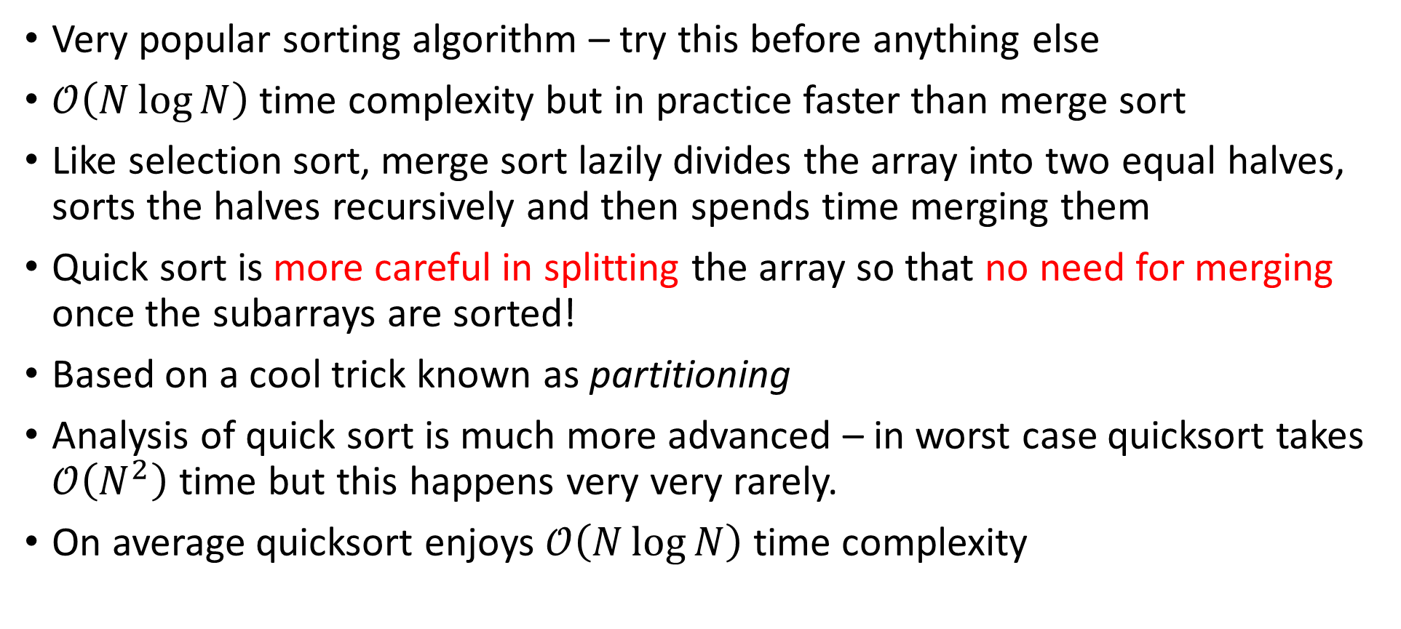
Quick Sort
Very popular sorting algorithm – try this before anything else
$𝒪\left(N\log{N}\right)$ time complexity but in practice faster than merge sort
Like selection sort, merge sort lazily divides the array into two equal halves, sorts the halves recursively and then spends time merging them
Quick sort is more careful in splitting the array so that no need for merging once the subarrays are sorted!
Based on a cool trick known as partitioning
Analysis of quick sort is much more advanced – in worst case quicksort takes $𝒪\left(N^{2}\right)$ time but this happens very very rarely.
On average quicksort enjoys $𝒪\left(N\log{N}\right)$ time complexity

Slide 23

The Partition Technique
Given array $int a\left[N\right]$ and any element of the array $p$ (called pivot)
Create a new array $int b\left[N\right]$ which is arranged as follows
$\left[elements of a≤p, p, elements of a≥p\right]$
Notice that left and right halves are not sorted yet! 😐
Also, the two halves are not balanced (of same size) either 😐
9
1
9
4
2
1
2
7
5
8
3
5
2
1
4
8
1
2
1
2
2
1
3
8
4
5
8
5
7
4
9
9

Slide 24
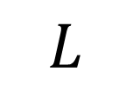
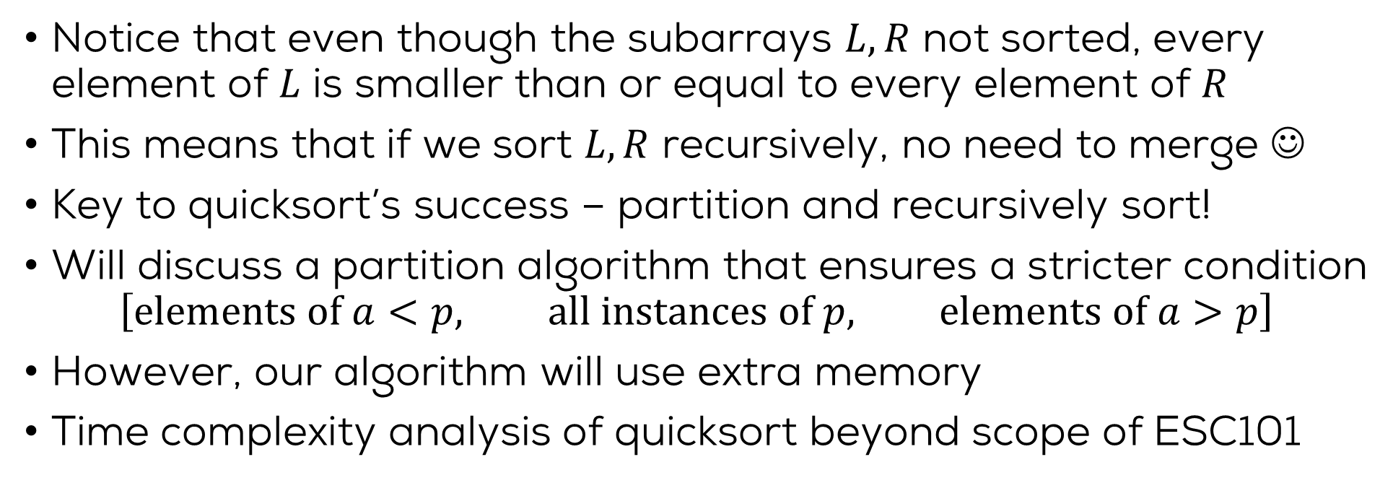
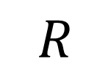
Quick Sort
1
2
1
2
2
1
3
8
4
5
8
5
7
4
9
9
$$L$$
$$R$$
Notice that even though the subarrays $L,R$ not sorted, every element of $L$ is smaller than or equal to every element of $R$
This means that if we sort $L,R$ recursively, no need to merge ☺
Key to quicksort’s success – partition and recursively sort!
Will discuss a partition algorithm that ensures a stricter condition
$\left[elements of a<p, all instances of p, elements of a>p\right]$
However, our algorithm will use extra memory
Time complexity analysis of quicksort beyond scope of ESC101

Slide 25
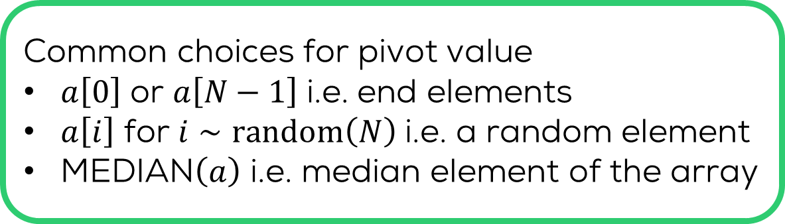
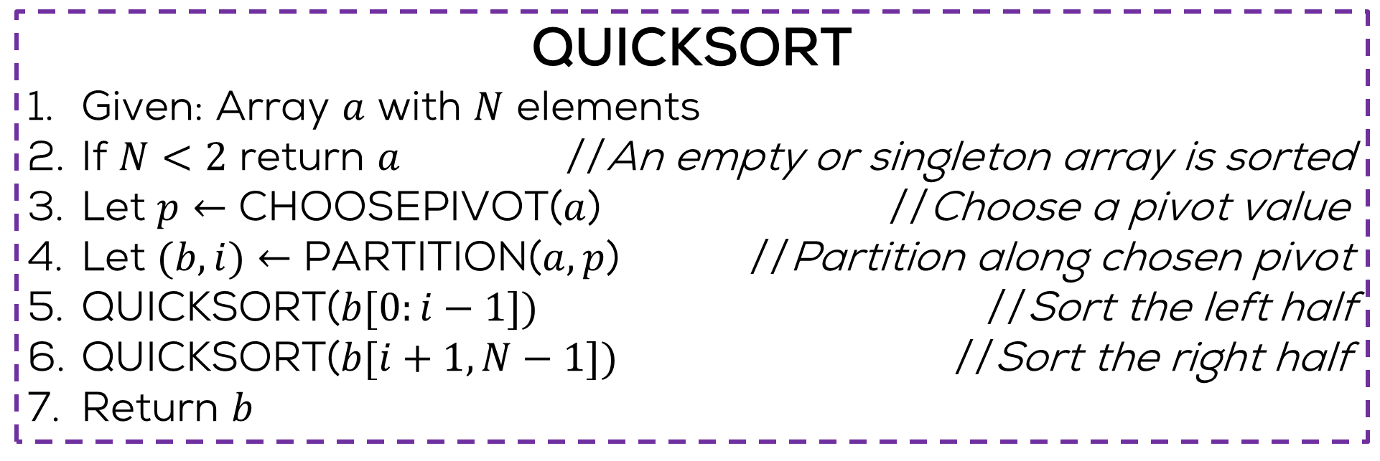

Quick Sort
QUICKSORT
Given: Array $a$ with $N$ elements
If $N<2$ return $a$ //An empty or singleton array is sorted
Let $p←$ CHOOSEPIVOT($a$) //Choose a pivot value
Let $(b,i)←$ PARTITION($a,p$) //Partition along chosen pivot
QUICKSORT($b[0:i−1])$ //Sort the left half
QUICKSORT($b[i+1,N−1])$ //Sort the right half
Return $b$
$i$ is the new location of the pivot element
Most popular, inexpensive
Common choices for pivot value
$a\left[0\right]$ or $a\left[N−1\right]$ i.e. end elements
$a\left[i\right]$ for $i∼random\left(N\right)$ i.e. a random element
MEDIAN$\left(a\right)$ i.e. median element of the array
Also common, inexpensive
Ensures balanced partition but expensive

Slide 26


The Partition Procedure
The partition procedure maintains an interesting structure of one active region sandwiched between two inactive regions ☺
Elements in the left inactive region are strictly less than the pivot, those in right invariant region strictly larger than pivot
What about element(s) equal to the pivot – need to be careful
We will see a visualization of the partition procedure in action
Note: these regions will be maintained on a separate array and not the original array – we will only take a simple left-to-right pass on the original array
$$L$$
$$R$$

Slide 27
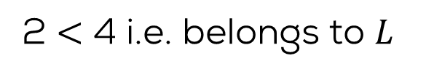
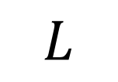
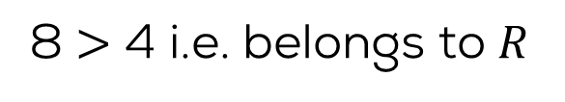
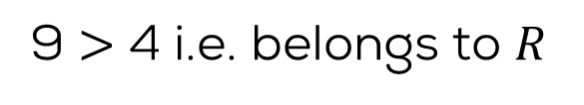
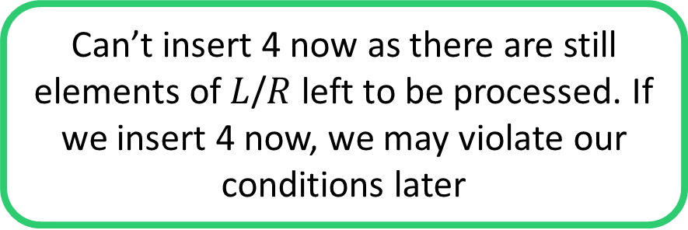
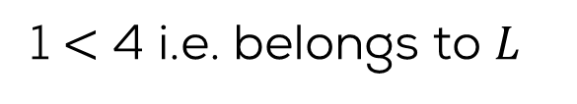
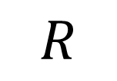
The Partition Procedure
We are sure now that any blank spaces left must be occurrences of pivot 4 that we omitted earlier
We will insert all occurrences of the pivot element 4 after we are done with non-pivot elements
PIVOT =
4
9
1
9
4
2
1
2
7
5
8
3
5
2
1
4
8
1
2
1
2
3
2
1
4
4
8
5
8
5
7
9
9
$$L$$
$$R$$
Can’t insert 4 now as there are still elements of $L$/$R$ left to be processed. If we insert 4 now, we may violate our conditions later
9 $>$ 4 i.e. belongs to $R$
1 $<$ 4 i.e. belongs to $L$
9 $>$ 4 i.e. belongs to $R$
8 $>$ 4 i.e. belongs to $R$
2 $<$ 4 i.e. belongs to $L$

Slide 28

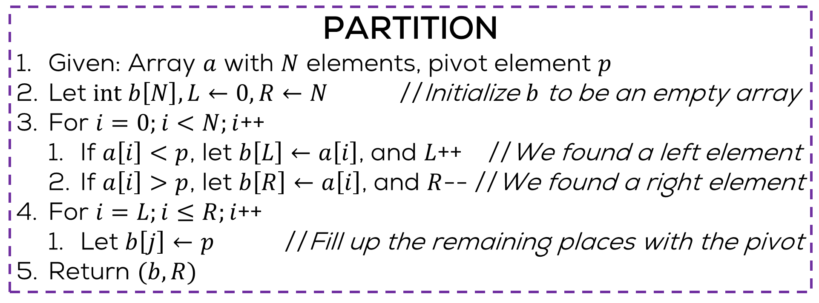
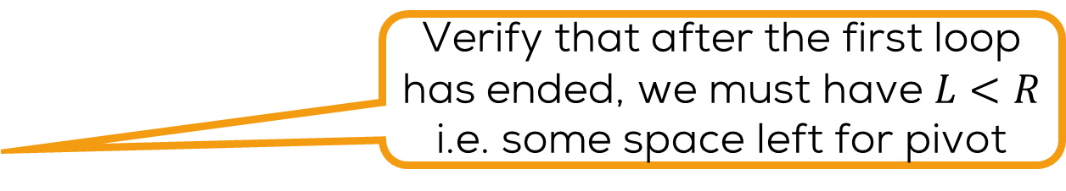
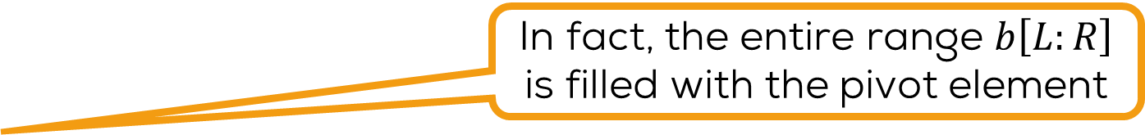
The Partition Procedure
PARTITION
Given: Array $a$ with $N$ elements, pivot element $p$
Let $int b\left[N\right], L←0,R←N$ //Initialize $b$ to be an empty array
For $i=0;i<N;i$++
  If $a\left[i\right]<p$, let $b\left[L\right]←a\left[i\right]$, and $L$++ //We found a left element
  If $a\left[i\right]>p$, let $b\left[R\right]←a\left[i\right]$, and $R$-- //We found a right element
For $i=L;i≤R;i$++
  Let $b\left[j\right]←p$ //Fill up the remaining places with the pivot
Return $(b,R)$
Verify that after the first loop has ended, we must have $L<R$ i.e. some space left for pivot
In fact, the entire range $b\left[L:R\right]$ is filled with the pivot element
$R$ has to be (one of) the new location(s) of the pivot element
Hint: the in-place algorithm uses an identical notion of inactive regions but swaps elements at the boundaries of the regions which are wrongly placed
Explore/invent yourself an
in-place partitioning algorithm

Slide 29

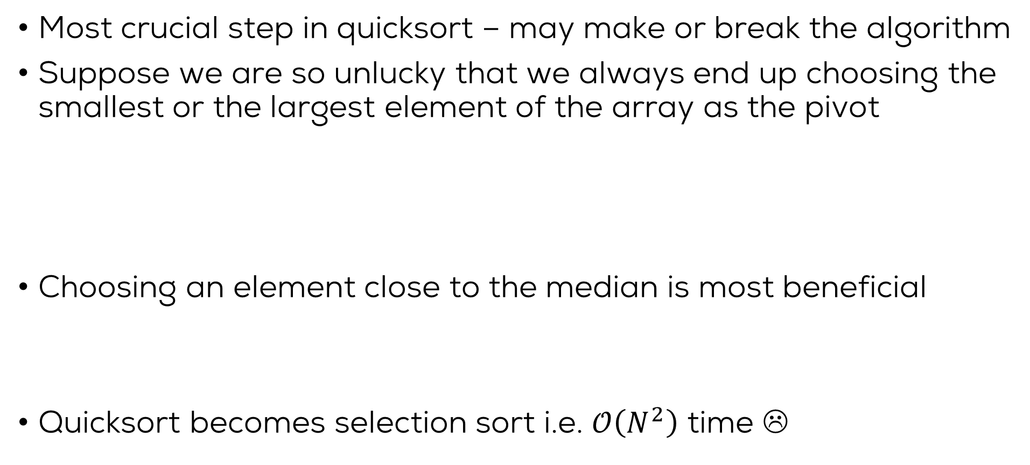
Choice of Pivot
Ironically, if the array is already sorted and we use end elements as pivots, then quicksort takes $𝒪\left(N^{2}\right)$ time ☹
Most crucial step in quicksort – may make or break the algorithm
Suppose we are so unlucky that we always end up choosing the smallest or the largest element of the array as the pivot
Choosing an element close to the median is most beneficial
Quicksort becomes selection sort i.e. $𝒪\left(N^{2}\right)$ time ☹
9
1
8
4
2
1
2
7
5
8
3
5
2
1
4
8
1
2
1
2
2
1
3
8
4
5
8
5
7
4
8
9

Slide 30
Next class and next week..
Wrap up the discussion on sorting
Hashing: a very efficient method for search
File handling in C
Solving numerical problems using programming
Future directions and wrapping up the course

