Slide 1
ESC101: Fundamentals of Computing
Introduction to Programming,
Basic Structure of C Programs
Nisheeth

Slide 2
Announcements
Please make sure you know your section number for ESC101
  Refer to the student list shared on the course website. Final list will be uploaded by Friday evening.
Regularly visit the course website. Slides for each lecture (and other material) will be posted there. Slides in PPTX (Power-point) and PDF
Please make sure you can access Piazza (and can get email notifications of the messages posted on Piazza in real-time or digest mode)
Prutor availability
  During lab hours (1400-1500, M/Tu/Wed/Thu), only in NCL labs
  Outside lab hours, hostels, CC, NCL etc (NCL open till 2AM)
  Correct Prutor link: https://esc101.cse.iitk.ac.in/ (NOT https://prutor.cse.iitk.ac.in/)

Slide 3
Announcements
When logging in on the lab machines (Linux/Windows), use your CC id (without @iitk.ac.in) and your CC password
When logging in on the Prutor website , use your CC id (with @iitk.ac.in) and your CC password
Unable to access the course website and Prutor?
  Are you using a data plan on your smart phone?
  Our course website, Prutor are internal, not accessible outside IITK
    Solution 1: use IITK computers (CC, NCL, hostel)
    Solution 2: install a VPN app on your smart phone
    https://www.iitk.ac.in/ccnew/index.php/13-network/99-how-to-use-ssl-vpn
  Piazza is accessible from all places

Slide 4
Announcements
Hindi lecture videos of many topics in ESC101 are available online
  https://onlinecourses.iitk.ac.in/esc101_hindi/ (created by Prof. Rajat Mittal and his team, link also under References on course website)
We will soon hold some special sessions for students who do not feel very comfortable with English (will discuss what is being covered in lectures)
  Will circulate a form to ask if you need it
We will soon hold a special lab session for students who are not familiar with operating computers
  Will circulate a form to ask if you need it

Slide 5
Programming: Some Benefits
Applications in Engineering (civil, chemical), Sciences, Economics, AI https://www.youtube.com/watch?v=nKIu9yen5nc
Even artists, comedians need to code ☺ https://www.youtube.com/watch?v=EFwa5Owp0-k
Be prepared for the future – job markets changing rapidly
People who can code often deal with day-to-day problems more efficiently

Slide 6

How to Communicate with Computers?
We need a language to communicate with the computer hardware
The language should be one that the computer’s hardware understands
Picture courtesy: www.professionaladviser.com/

Slide 7
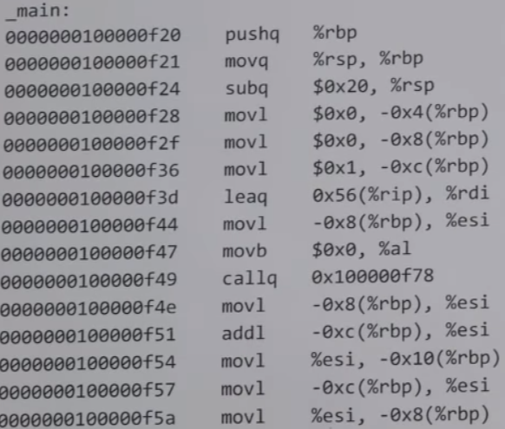
How to Communicate with Computers?
One way is by using the machine language that the hardware understands
Every type of computer hardware has a specific machine language
However, using machine language is tedious/unnatural for humans
Also need to re-write machine code if we want to run the code on another computer that has a different type of hardware – cumbersome

Slide 8
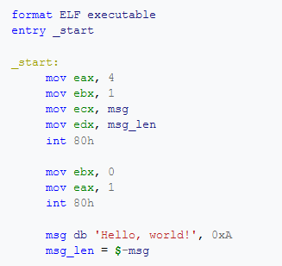
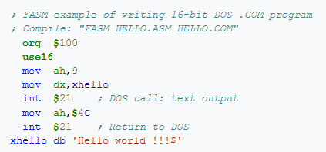
Hello World (in assembly language)
Intel x86, DOS
Intel x86, Linux

Slide 9
Computers and Programming
A better alternative would be to write our programs in a language that is
  Easy for us to write/understand
  Easy to port it to different types of computer hardware without re-writing the code
High-level programming languages like C make it possible
How: Write the code in a high-level language and translate it into machine language using another software called “compiler”

Slide 10
Computers and Programming
A better alternative would be to write our programs in a language that is
  Easy for us to write/understand
  Easy to port it to different types of computer hardware without re-writing the code
High-level programming languages like C make it possible
Program in
C language
Compiler
for C
Equivalent Machine Language
program on target hardware

Slide 11
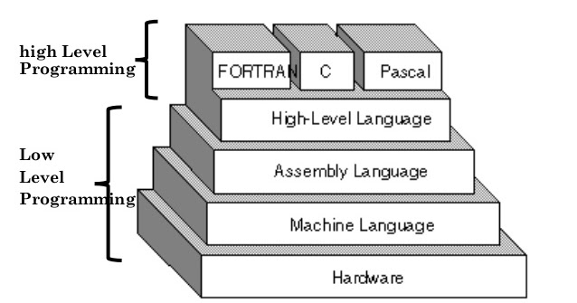
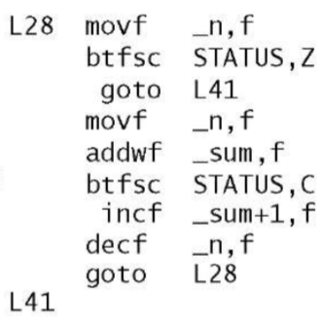
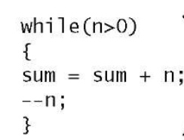
Low-level vs High-level Languages
Low-level: Form is closer to what the machine’s hardware understands
  Examples: Machine Language, Assembly Language
High-level: Form is closer to what humans understand
  Examples: C, C++, Python, etc
High-level
(example: C)
Low-level
(example: Assembly)

Slide 12
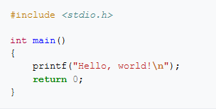
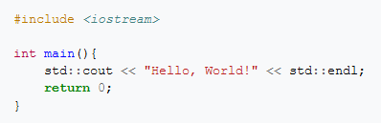


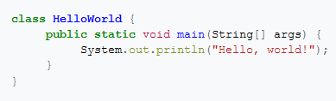
Hello World
Compiled languages
C
C++
Interpreted languages
python
JavaScript
Runtime languages
Java

Slide 13
Programming Cycle for Compiled Languages
(The typical cycle)
Compilation Succeeded ?
YES
Write/Edit
Code
Compile
Run
NO
Got Expected Output?
NO
YES
(more inputs?)
YES
Done
Note: Some high-level languages are not compiled but use an “interpreter”
to communicate with the hardware (Example: Python, MATLAB, etc)

Slide 14
The C Programming Language
A high-level programming language
Originally developed by Dennis Ritchie (1972) to design the UNIX operating system and applications running on UNIX
Widely used. Many operating systems, and even parts of many other programming languages such as Python were developed using C
You are going to learn C language in this course
  Be patient at the beginning
  Some things may seem unfamiliar, strange for few days
  Will get used to these very quickly
  Best way to learn a new language – speak it and practice! (on Prutor and other places)

Slide 15
A Simple C Program
#include<stdio.h>
int main(){
printf(“Welcome to ESC101”);
return 0;
}
The program prints “Welcome to ESC101” (without the quotes)

Slide 16
Structure of A Simple C Program
Every C program’s entry point (program’s execution starts here) is the main function
with return type integer
Tells C compiler to include the standard input/output library stdio.h (collection of functions such as printf, scanf, etc)
#include<stdio.h>
int main(){
printf(“Welcome to ESC101”);
return 0;
}
main function must open with left curly brace {
printf function prints a user specified output
main function must close with right curly brace }
Every statement in a C program must end with semi-colon ;
The main function must return
an integer (return 0 means successful execution of program)
printf(“Welcome to ESC101”) and return 0 are ‘statements’ in the above
code. Each C statement must end with a semi-colon ;

Slide 17
Another Simple C Program
1
2
Spaces are okay at some places
# include <stdio.h>
int main () {
int a = 1;
int b = 2;
int c;
c = a + b;
printf(“Result is %d”, c);
return 0;
}
a
b
Each variable’s declaration creates a “box” big enough to store it at a location in computer’s
main memory (RAM)
3
c
Assigning a value to the variable writes that value in the box
= and + are “operators”
= is assignment operator
+ is addition operator
a+b is an “expression”
The program prints the message “Result is 3”

Slide 18


Multiple Ways of Writing Code: Same Effect
Explore, practice. It will take only a few days to internalize.
# include <stdio.h>
int main () {
int a;
int b;
int c;
a = 1;
b = 2;
c = a + b;
printf(“Result is %d”, c);
return 0;
}
# include <stdio.h>
int main () {
int a = 1;
int b = 2;
int c;
c = a + b;
printf(“Result is %d”, c);
return 0;
}
# include <stdio.h>
int main () {
int a = 1;
int b = 2;
int c = a + b;
printf(“Result is %d”, c);
return 0;
}
Declare all then assign values
Shortcut
How will I remember all this?
# include <stdio.h>
int main () {
int a,b,c;
a = 1;
b = 2;
c = a + b;
printf(“Result is %d”, c);
return 0;
}
# include <stdio.h>
int main () {
int a=1,b=2,c;
c = a + b;
printf(“Result is %d”, c);
return 0;
}
Shortcut
Shortcut
And other possible ways too…

Slide 19
The ‘printf’ Function
A function used for printing the outputs of the C program
Prints the outputs in a format specified by us
We have already seen some simple examples of usage of printf
printf(“Welcome to ESC101”);
printf(“Result is %d”, c);
%d means that we want to print the value of an integer variable (named c here)
More on printf in the next class…

