Slide 1
ESC101: Fundamentals of Computing
Talking to a Turing Machine
Nisheeth

Slide 2
This Course
Introduction to computer programming/logic-based computing using the C Programming Language
Course Name: Fundamentals of Computing (ESC101), 14 credits
Instructor: Nisheeth (CSE Department)
  Email: nsrivast@cse.iitk.ac.in (don’t miss the “cse”)
  For this course, will prefer all communication via Piazza
  (Piazza supports private messages to instructors/students)
Tutors: 16 regular + 3 admin + 1 faculty tutor
TAs: 80
Students: 532

Slide 3
Purpose of This Course
Learning how to program using C programming language
Will do it with a mix of theory (lectures) and practical (programming labs)
Focus primarily on C programming but most concepts we will study apply to programming/logic-based computing in general
Assumes no prior background/exposure to programming
  If you already have good proficiency in C programming, there will be an option of switching to Advanced Track (more info in later slides)

Slide 4
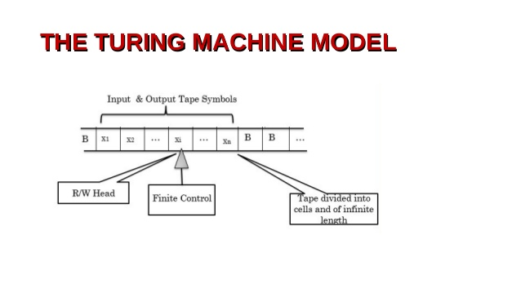
Talking to a Turing machine
How do you talk to a human?
If both know the same language
  Talk using the shared language
If both don’t know the same language
  Talk using shared body language
If both don’t know the same language and can’t see each other
  Can’t really communicate
How do you talk to a Turing machine?
It has no body
Have to talk to it in its language
Need to learn its language
  Or a language that can be automatically translated to its language

Slide 5
Course Schedule
Lectures: M, Tu, W 1200-1300 (in L-20)
Tutorial: Fri 1200-1300 (Tutorial Block rooms). More info in later slides
Labs: M/Tu/W/Th 1400-1700 (New Core Lab). You will attend only one of these 4 days depending on your section. More info in later slides
Lectures
(Mon,Tu,Wed)
Tutorial
(Friday)
Lab
(Next Week’s Mon/Tu/Wed/Thur)
Doubt-clearance session for the week’s lectures + minor quiz
Hands-on practice of what you studied the previous week

Slide 6
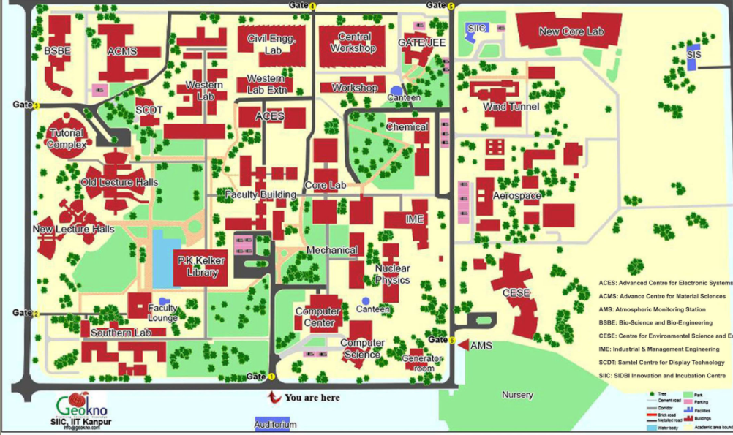
The Locations
New Core Lab
Tutorial
Block
New Lecture Halls (L20 and others)

Slide 7
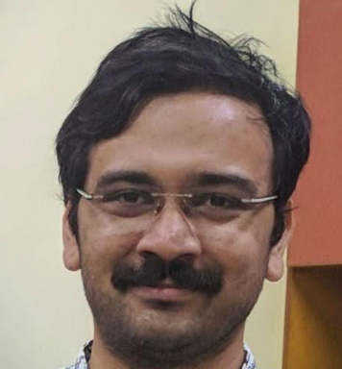
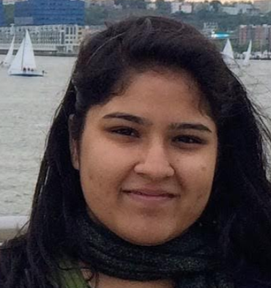
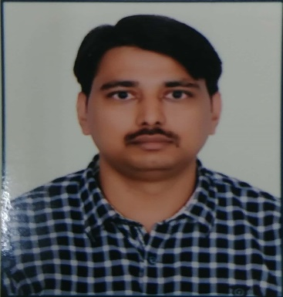
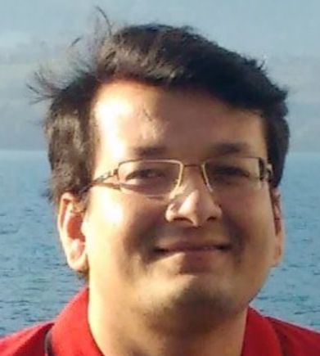
Admin and Faculty Tutors
 | Hrishikesh Terdalkar hrishirt@cse.iitk.ac.in Hindi, Marathi, English (Admin Tutor)
 | Shubhangi Agarwal sagarwal@cse.iitk.ac.in Hindi, English (Admin Tutor)
 | Nitin Kumar Singh nitinks@cse.iitk.ac.in Hindi, English (Admin Tutor)
 | Dr. Biswabandan Panda biswap@cse.iitk.ac.in Hindi, Odia, English (Faculty Tutor)

Slide 8
Tutorials
Tutorial (Every Fri 1200-1300): The tutorial room for each section
Tutorial will have doubt clearing session + examples on lecture material
For some tutorials, last 10-15 minutes may have a surprise minor quiz
  The minor quizzes will be graded
First tutorial on Friday this week
A1 | TB103
A2 | TB104
A3 | TB105
A4 | TB106
A5 | TB107
A6 | TB108
A7 | TB109
A8 | TB110
A9 | TB111
A10 | TB112
A11 | TB203
A12 | TB204
A13 | TB205
A14 | TB207

Slide 9
Labs
Lab days for each section will be as follows
In each lab, you will solve some programming problems
You will solve them on Prutor website (developed at IITK)
Lab will start at 1400. Must finish by 1700. Your solutions will be graded
First week’s lab: Not graded. Just familiarize yourself with Prutor system
Monday | Tuesday | Wednesday | Thursday:
A4, A5, A6, A13 | A1, A2, A3 | A7, A8, A9 | A10, A11, A12, A14

Slide 10
Labs
Must solve lab questions on your own
Can share ideas for solving problems, but not code
Practice Set: Released each week to help students prepare for next week's lab problems
Each lab will have TAs for invigilation/logistical help
If no lab due to a holiday, will have a make-up lab on weekend (Sat/Sun)

Slide 11
Grading Scheme
Minor Quizzes (best 8 of total 10): 8%
  Conducted during tutorial hours
2 Major Quizzes (Aug 28, Oct 30): 10%
  Conducted during lecture hours
Mid-sem Theory Exam: 15%
  Date will be announced by DOAA
End-sem Theory Exam: 25%
  Date will be announced by DOAA
Lab Assignments (best 10 of total 13): 10%
Mid-sem Lab Exam: 15%
  Date: Sept 8
End-sem Lab Exam: 17%
  Date: Nov 3
29 Jan, 23 Mar
Theory: 58%
Practical: 42%
Feb 15
Apr 18

Slide 12
Useful Links
(please bookmark them)

Slide 13
Course Website
Course website: https://www.cse.iitk.ac.in/users/nsrivast/esc101.html
All course material will be posted here (slides, quiz/exam solutions, etc). Also refer to the webpage for other information (Policy etc)

Slide 14
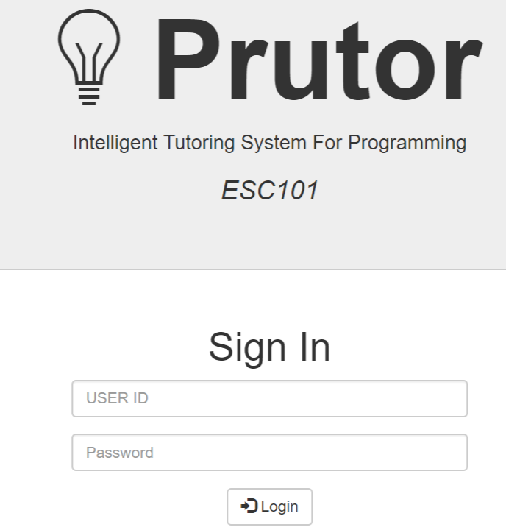
Lab Website (Prutor)
https://esc101.cse.iitk.ac.in .
Will be using it for weekly lab exercises, lab exams, lab practice, etc
Your marks for weekly labs and lab exams will also be shown on Prutor
Accessible only internally from IITK. For external access, will need proxy
User ID: your IITK login
Password: your CC password

Slide 15
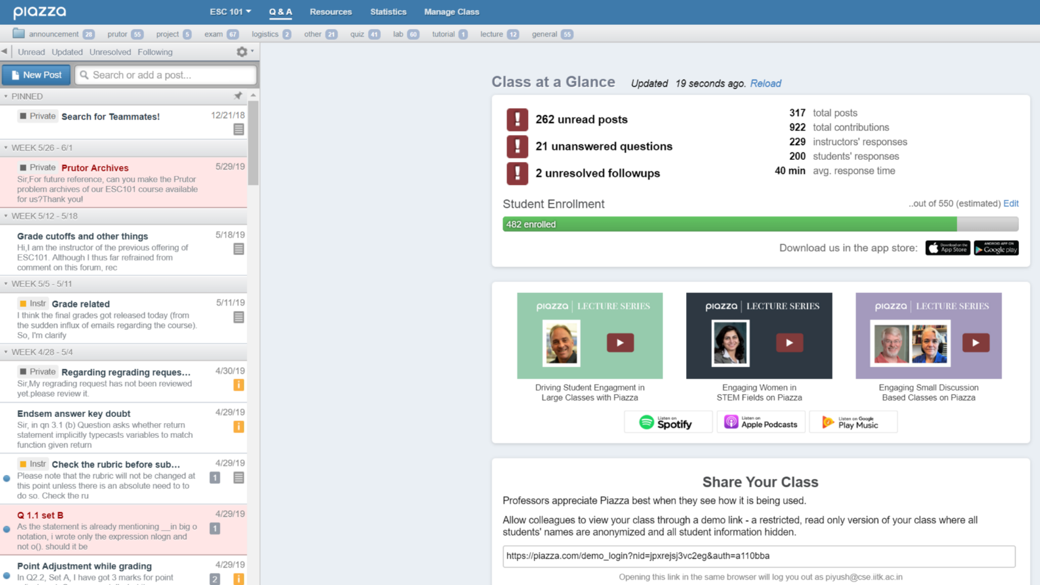
Online Discussion Webpage (Piazza)
Accessible from anywhere (also has a mobile app)
Can set message notifications to real-time or digest mode
Have already added you
(using your IITK email id).
Please choose a password
and start using Piazza

Slide 16
Course Mailing List
esc101a@iitk.ac.in
You must already be signed up for this list (with your IITK email)
All course-related announcements will be sent on this (and on Piazza)
Only instructors can post messages on this mailing list (you can only receive messages)

Slide 17
Textbooks
Several nice books on C. You may pick one of these
  Schaum's Outline of Programming with C by Byron Gottfried, McGraw-Hill India.
  The C Programming Language by Kernighan and Ritchie, PH India.
  Refer to course website for some other references
Advice: Pick one reference book and stick to it throughout

Slide 18
Advanced Track (AT)
For students who already have good proficiency in C programming
Can replace minor quiz and labs with a project (18% course weightage)
Candidates for this track are being selected with a C programming based screening test.
Even if selected for AT, can re-join regular track by Mar 25th , 2020
  With satisfactory project evaluation: 100% score on missed quizzes/labs
  With unsatisfactory project evaluation: Average class score on all missed assignments

Slide 19
Some Course-related Policies
(please follow them carefully)
(more info on course website)

Slide 20
Policy on Conduct of Labs/Quizzes/Exams
Quizzes/exams will be open handwritten notes. You may bring your notebook (must use your own notes)
No printed/photocopied material or electronic material will be allowed in quizzes/exams
During lab hours, only students sitting inside NCL labs will be able to access Prutor
But outside of lab hours, Prutor is available at CC/NCL/Halls, etc

Slide 21
Copying
Please be sincere and honest. Please do not copy.
  .. in any component (lab/quiz/exams/lab exams)
If you are caught, you get penalized on grade (most likely F/D grade).
  Will not be allowed to drop the course
  Case reported to DoAA/SSAC
  No warning or second chance
  All parties involved in copying will be held equally responsible. Copying from internet is penalized equally.
  Policy may change on need basis

Slide 22
Copying: How to Avoid?
Read-protect your directories so that others cannot copy from your directory
Do not share your CC password with friends
Do not leave printouts, notes etc. containing your code unattended
Never hard code inputs in your program (more on this later in the semester)
Use of electronic devices such as mobile phones, tablets, smart watches, etc is not allowed during labs/quizzes/exams and will count as cheating
Refer to the course webpage for more information

Slide 23
Absentee Policy
Absence from a quiz/lab/exam, requires approval from SUGC/Instructor
Minor quizzes: No makeup. Best 8 out of 10 quizzes to be counted.
Major quizzes: Prorated from the nearest future mid-sem or end-sem exam
Labs: No makeup. Best 10 out of 13 quizzes to be counted.
Mid term lab exam: Prorated by final lab exam
Final lab exam: Prorated by End sem exam
Mid-sem: Prorated by End-sem.
End-sem: Makeup, as per DoAA's schedule

Slide 24
Course Drop Policy
Must get course drop applications approved by the instructor by Mar 20, 2020 after giving proper reason for said drop.
Drop applications must be filled out on the standard SUGC drop form
Mar 20, 2020 is a senate deadline. Can’t drop after this deadline
Instructor can’t ensure approval of a drop by DUGC convenors or SUGC

Slide 25
Acknowledgement
Previous instructors of ESC101
  Piyush Rai, Purushottam Kar, Swaprava Nath, Indranil Saha, Amey Karkare, and others
Amey Karkare and his students (especially Umair Ahmed) for Prutor and autograding features of Prutor

