Slide 1
Unsupervised Learning: k-means
CS771: Introduction to Machine Learning
Nisheeth

Slide 2
Unsupervised Learning
It’s about learning interesting/useful structures in the data (unsupervisedly!)
There is no supervision (no labels/responses), only inputs $x_{1},x_{2},…, x_{N}$
Some examples of unsupervised learning
Clustering: Grouping similar inputs together (and dissimilar ones far apart)
Dimensionality Reduction: Reducing the data dimensionality
Estimating the probability density of data (which distribution “generated” the data)
Most unsup. learning algos can also be seen as learning a new representation of data
For example, hard clustering can be used to get a one-hot representation
Already looked at some basic approaches(e.g., estimating a Gaussian given observed data)
Each point belongs deterministically to a single cluster
In contrast, there is also soft/probabilistic clustering in which $z_{n}$ will be be probability vector that sums to 1(will see later)

Slide 3
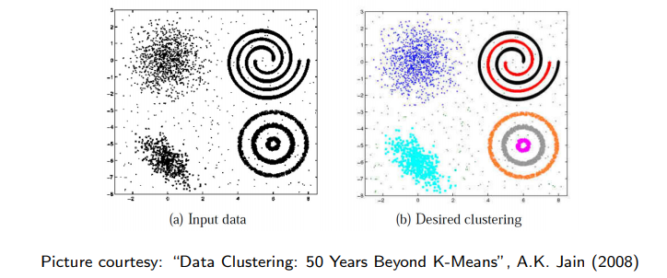
Clustering
In some cases, we may not know the right number of clusters in the data and may want to learn that (technique exists for doing this but beyond the scope)
Given: $N$ unlabeled examples $x_{1},x_{2},…, x_{N}$; desired no. of partitions $K$
Goal: Group the examples into $K$ “homogeneous” partitions
Loosely speaking, it is classification without ground truth labels
A good clustering is one that achieves
High within-cluster similarity
Low inter-cluster similarity

Slide 4
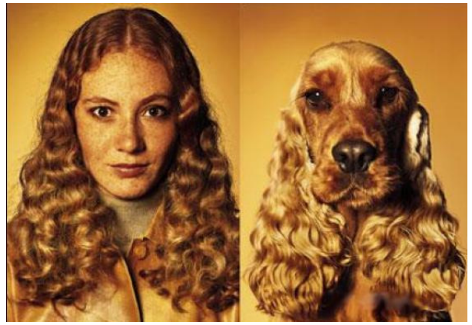
Similarity can be Subjective
Clustering only looks at similarities b/w inputs, since no labels are given
Without labels, similarity can be hard to define
Thus using the right distance/similarity is very important in clustering
In some sense, related to asking: “Clustering based on what”?
Picture courtesy: http://www.guy-sports.com/humor/videos/powerpoint presentation dogs.htm

Slide 5
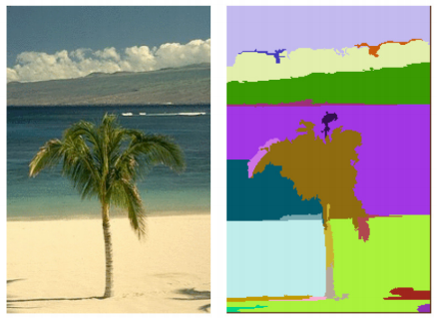
Clustering: Some Examples
Document/Image/Webpage Clustering
Image Segmentation (clustering pixels)
Clustering web-search results
Clustering (people) nodes in (social) networks/graphs
.. and many more..
Picture courtesy: http://people.cs.uchicago.edu/∼pff/segment/

Slide 6
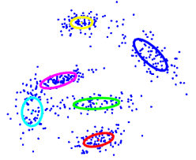
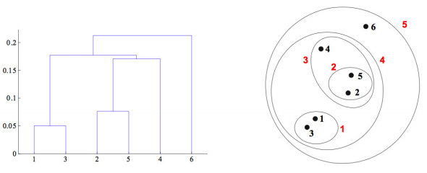
Types of Clustering
Flat or Partitional clustering
Partitions are independent of each other
Hierarchical clustering
Partitions can be visualized using a tree structure (a dendrogram)
In hierarchical clustering, we can look at a clustering for any given number of cluster by “cutting the dendrogram at an appropriate level (so $K$does not have to be specified)
Hierarchical clustering gives us a clustering at multiple levels of granularity

Slide 7
Flat Clustering: K-means algorithm (Lloyd, 1957)
Input: $N$ unlabeled examples $x_{1},x_{2},…, x_{N}$; $x_{n}∈ℝ^{D}$; desired no. of partitions $K$
Desired Output: Cluster assignments of these $N$ examples and $K$ cluster means
Initialize: The $K$ cluster means denoted by $μ_{1},μ_{2},…, μ_{K}$; with each $μ_{k}∈$ $ℝ^{D}$
Usually initialized randomly, but good initialization is crucial; many smarter initialization heuristics exist (e.g., K-means++, Arthur & Vassilvitskii, 2007)
Iterate:
(Re)-Assign each input $x_{n}$ to its closest cluster center (based on the smallest Eucl. distance)
Update the cluster means
Repeat until not converged
$𝒞_{k}$: Set of examples assigned to cluster $k$ with center $μ_{k}$
Some ways to declare convergence if between two successive iterations:
Cluster means don’t change
Cluster assignments don’t change
Clustering “loss” doesn’t change by much

Slide 8
K-means algorithm: Summarized Another Way
Notation: $z_{n}∈\left\{1,2,…, K\right\}$ or $z_{n}$ is a $K$-dim one-hot vector
($z_{nk}$ = 1 and $z_{n} = k$mean the same)
$K$-means algo can also be seen as doing a compression by “quantization”: Representing each of the $N$ inputs by one of the $K < N$ means
Can be fixed by modeling each cluster by a probability distribution, such as Gaussian (e.g., Gaussian Mixture Model; will see later)
This basic $K$-means models each cluster by a single mean $μ_{k}$. Ignores size/shape of clusters

Slide 9
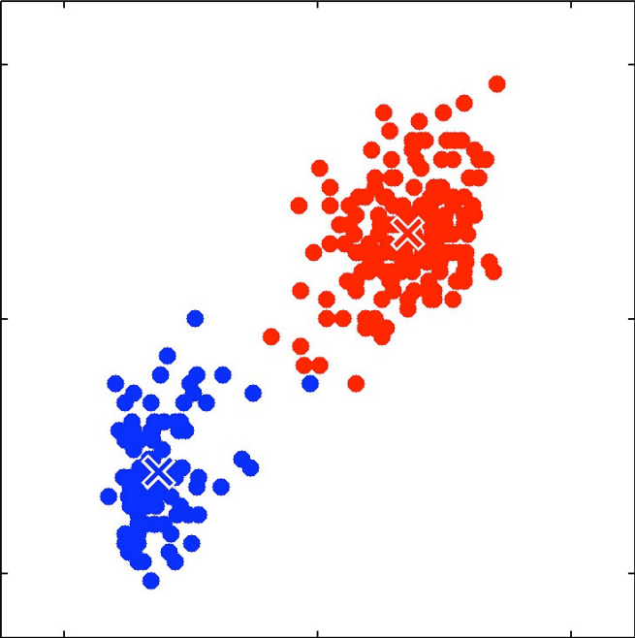
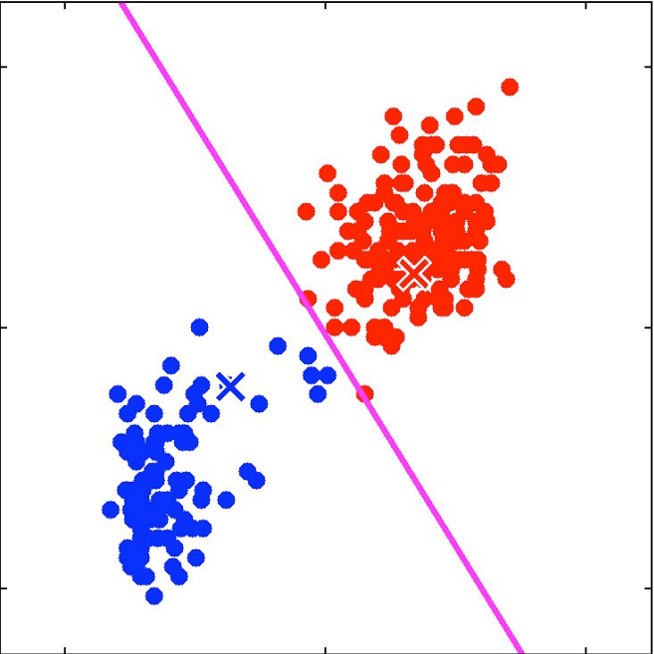
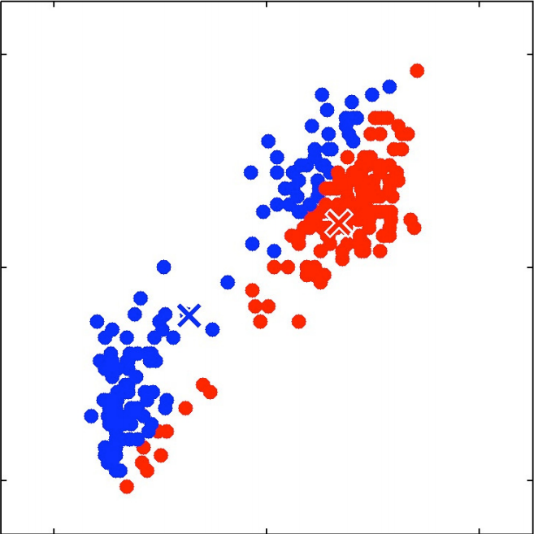
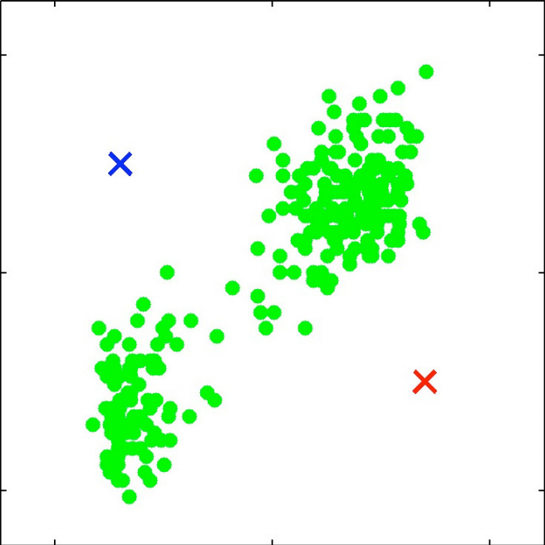
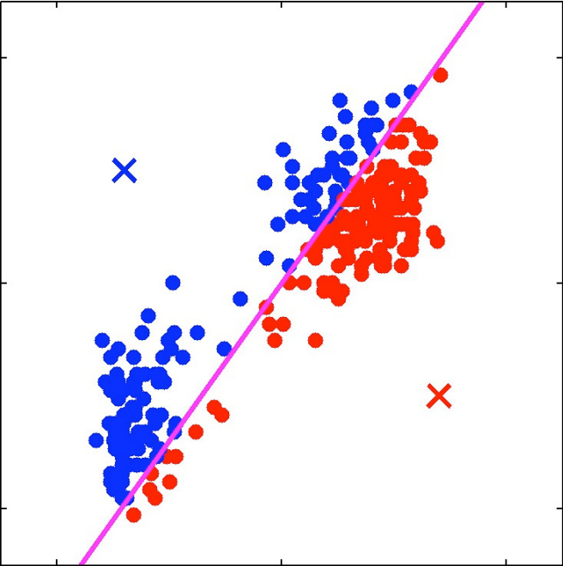
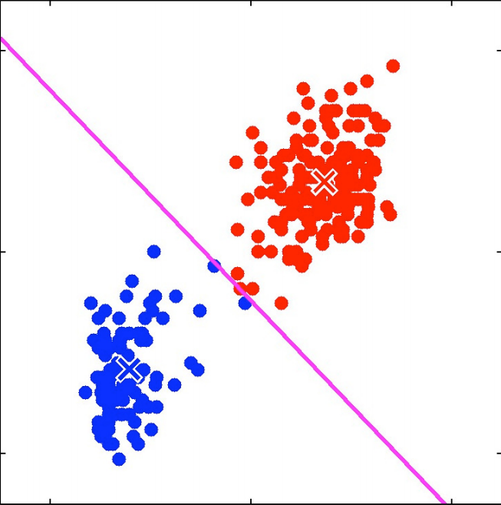
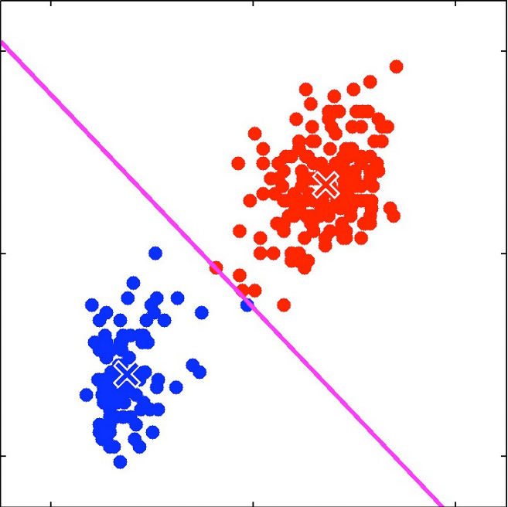
K-means: An Illustration

Slide 10
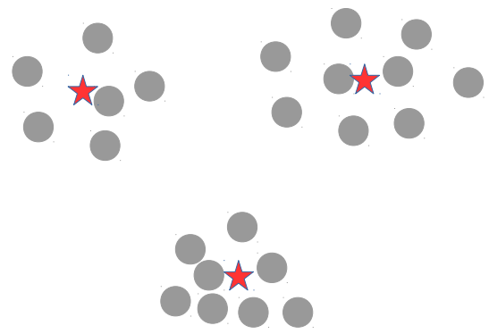
K-means = LwP with Unlabeled Data
Guess the means
Predict the labels (cluster ids)
Recompute the means using these predicted labels
Repeat until not converged

Slide 11
The K-means Algorithm: Some Comments
One of the most popular clustering algorithms
Very widely used, guaranteed to converge (to a local minima; will see a proof)
Can also be used as a sub-routine in graph clustering (in the Spectral Clustering algorithm): Inputs are given as an $N× N$adjacency matrix A ($A_{nm}$= 0/1)
Perform a spectral decomposition of the graph Laplacian of A to get F (an $N× K$matrix)
Run $K$-means using rows of the F matrix as the inputs
Has some shortcomings but can be improved upon, e.g.,
Can be kernelized (using kernels or using kernel-based landmarks/random features)
More flexible cluster sizes/shapes via probabilistic models (e.g., every cluster is a Gaussian)
Soft-clustering (fractional/probabilistic memberships): $z_{n}$ is not one-hot but a probability vector
Overlapping clustering – an input can belong to multiple clusters: $z_{n}$ is a binary vector
.. even deep learning based K-means (use a deep network to extract features and run $K$-means on those)
Let’s look at K-means in some more detail now..

Slide 12
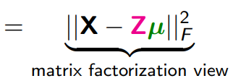
What Loss Function is K-means Optimizing?
$z_{n} =$[$z_{n1}$, $z_{n2}, …, z_{nK}$] denotes a length $K$ one-hot encoding of $x_{n}$
Let $μ_{1},μ_{2},…, μ_{K}$ be the K cluster centroids/means
Let $z_{nk}$ ∈ {0, 1} be s.t. $z_{nk}$ = 1 if $x_{n}$ belongs to cluster $k$, and 0 otherwise
Define the distortion or “loss” for the cluster assignment of $x_{n}$
Total distortion over all points defines the $K$-means “loss function”
The $K$-means problem is to minimize this objective w.r.t. $µ$ and $Z$
Alternating optimization on this loss would give the K-means (Lloyd’s) algorithm we saw earlier!
K
K
X
Z
K
$$μ$$
N
$$≈$$
Row $k$ is $μ_{k}$
Row $n$ is $z_{n}$ (one-hot vector)

Slide 13
K-means Loss: Several Forms, Same Meaning!
Replacing the $ℓ_{2}$ (Euclidean) squared by $ℓ_{1}$ distances givesn the K-medoids algorithm (more robust to outliers)
Notation: $X$ is $N× D$
$Z$ is $N×K$(each row is a one-hot $z_{n}$ or equivalently $z_{n}$ $∈ \{1,2,…,K\}$)
$μ$ is K × D (each row is a $μ_{k}$)
Note: Most unsup. learning algos try to minimize a distortion or recon error
Distortion on assigning $x_{n}$ to cluster $z_{n}$
Total “distortion” or reconstruction error

Slide 14
Optimizing the K-means Loss Function
So the $K$-means problem is
Can’t optimize it jointly for $Z$ and $μ$. Let’s try alternating optimization for $Z$ and $μ$

Slide 15
Solving for Z
Solving for $Z$ with $μ$fixed at $\hat{μ}$
Still not easy. $Z$ is discrete and above is an NP-hard problem
Combinatorial optimization: $K^{N}$ possibilities for $Z$ ($N × K$matrix with one-hot rows)
Greedy approach: Optimize $Z$ one row ($z_{n}$) at a time keeping all others $z_{n}$’s (and the cluster means $μ_{1},μ_{2},…, μ_{K})$ fixed
Easy to see that this is minimized by assigning $x_{n}$ to the closest mean
This is exactly what the $K$-means (Lloyd’s) algo does!

Slide 16
Solving for $μ$
Solving for 𝝁 with $Z$ fixed at $\hat{Z}$
Not difficult to solve (each $μ_{k}$ is a real-valued vector, can optimize easily)
Note that each $μ_{k}$ can be optimized for independently
(Verify) This is minimized by setting $\hat{μ_{k}}$ to be mean of points currently in cluster $k$
This is exactly what the $K$-means (Lloyd’s) algo does!

Slide 17
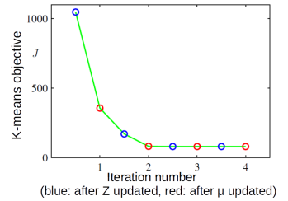
Convergence of K-means algorithm
Each step (updating $Z$ or $μ$) can never increase the $K$-means loss
When we update $Z$ from $Z^{(t−1)}$ to $Z^{(t)}$
When we update $μ$ from $μ^{(t−1)}$ to $μ^{(t)}$
Thus the $K$-means algorithm monotonically decreases the objective
because
because

Slide 18
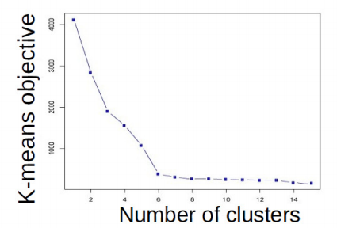
K-means: Choosing K
One way to select $K$ for the $K$-means algorithm is to try different values of $K$, plot the $K$-means objective versus $K$, and look at the “elbow-point”
Can also information criterion such as AIC (Akaike Information Criterion)
and choose K which gives the smallest AIC (small loss + large K values penalized)
More advanced approaches, such as nonparametric Bayesian methods (Dirichlet Process mixture models also used, not within K-means but with other clustering algos)
$K$=6 is the elbow point

Slide 19
Coming up next
Improvements to K-means
Soft-assignments
Handling complex cluster shapes (basic K-means assumes spherical clusters)
Evaluating clustering algorithms (how to evaluate without true labels)
Probabilistic approaches to clustering

