Slide 1
React Native
31st Oct 2019
* Slides heavily borrowed from Andres Kavers’ slide deck

Slide 2
RN – basic principle

Slide 3
RN - architecture

Slide 4
RN – key points
React Native is a JavaScript framework/library for writing real, natively rendering iOS, Android and UWP applications.
Mostly just V part of the application architecture (MVC) paradigm.
FlexBox layout
Reuse almost all non-UI code, most UI code among different platforms
ES6
React isn’t framework, it’s a (view)library – state management, routing, … - up to developer!

Slide 5
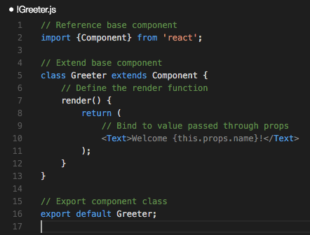
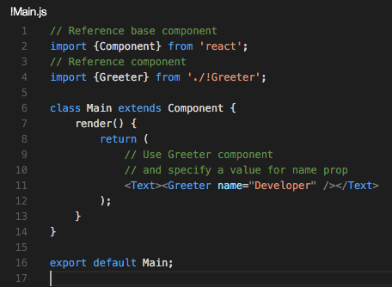
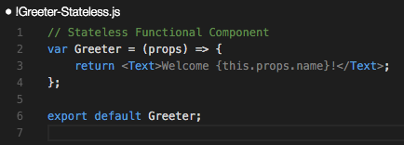
RN – components - lets get started!

Slide 6
RN – js dev environment
Visual Studio Code (or Atom,….)
Node and NPM
npm install -g react-native-cli
Xcode (if you’re working on a Mac)
Android Studio
Dev npm packages
  npm install eslint eslint-plugin-import eslint-plugin-jsx-a11y babel-eslint eslint-config-airbnb eslint-plugin-react eslint-plugin-react-native --save
VS Code plugins – F1 - ext install
  react-native
  eslint

Slide 7
RN – create new project
Create RN project
  react-native init demo-project
  cd demo-project
Prelaunch android emulator from Android Studio
Close Android Studio, just emulator is needed
  react-native run-ios
  react-native run-android
  Launch Visual Studio Code
  code .

Slide 8
RN – packages
package.json
{
"name": "ContactRN",
"version": "0.0.1",
"private": true,
"scripts": {
"start": "node node_modules/react-native/local-cli/cli.js start"
},
"dependencies": {
"react": "^15.1.0",
"react-native": "^0.28.0"
},
"devDependencies": {
"babel-eslint": "^6.1.0",
"eslint": "^2.13.1",
"eslint-config-airbnb": "^9.0.1",
"eslint-plugin-import": "^1.9.2",
"eslint-plugin-jsx-a11y": "^1.5.3",
"eslint-plugin-react": "^5.2.2",
"eslint-plugin-react-native": "^1.1.0"
}
}

Slide 9
RN - eslint
{
"env": {
"es6": true,
"node": true,
"jasmine": true
},
"extends": "airbnb/base",
"installedESLint": true,
"parserOptions": {
"ecmaFeatures": {
"experimentalObjectRestSpread": true,
"jsx": true
},
"sourceType": "module"
},
"plugins": [
"react",
"react-native"
],
"rules": {
"indent": [
1,
4
],
"no-console": 0,
"no-unused-vars": [
1,
{
"vars": "local",
"args": "none"
}
],
"react/forbid-prop-types": 1,
"react/jsx-boolean-value": 1,
"react/jsx-closing-bracket-location": [
1,
{
"selfClosing": "after-props",
"nonEmpty": "after-props"
}
],
"react/jsx-curly-spacing": [
1,
"never",
{
"spacing": {
"objectLiterals": "always"
}
}
],
"react/jsx-indent-props": 1,
"react/jsx-key": 1,
"react/jsx-max-props-per-line": 1,
"react/jsx-no-duplicate-props": 1,
"react/jsx-no-undef": 1,
"react/jsx-quotes": 0,
"react/jsx-sort-prop-types": 1,
"react/jsx-sort-props": 1,
"react/jsx-uses-react": 1,
"react/jsx-uses-vars": 1,
"react/no-danger": 1,
"react/no-did-mount-set-state": 1,
"react/no-did-update-set-state": 1,
"react/no-direct-mutation-state": 1,
"react/no-multi-comp": 1,
"react/no-set-state": 1,
"react/no-unknown-property": 1,
"react/prefer-es6-class": 1,
"react/prop-types": 1,
"react/react-in-jsx-scope": 1,
"react/require-extension": 1,
"react/self-closing-comp": 1,
"react/sort-comp": 1,
"react/wrap-multilines": 1,
"id-length": 0,
"jsx-quotes": 1
}
}
.eslintrc.json

Slide 10
RN – VSCode custom settings
VSCode > Code > Preferences > User Settings
// Place your settings in this file to overwrite the default settings
{
// When opening a file, `editor.tabSize` and `editor.insertSpaces` will be detected based on the file contents.
"editor.detectIndentation": false
}

Slide 11
RN – initial view – login screen
flexbox is used for element positions and scaling
  https://css-tricks.com/snippets/css/a-guide-to-flexbox/
Typical elements
  View
  Text
  Image
  TextInput
  TouchableHighlight

Slide 12
RN – initial view – login screen
Create new react component
Keep app code in new directory - app
Add new file – Login.js

Slide 13
RN – initial view – login
import React, { Component } from 'react';
import {
StyleSheet,
Text,
View,
} from 'react-native';
const styles = StyleSheet.create({
container: {
flex: 1,
justifyContent: 'center',
alignItems: 'center',
},
});
class Login extends Component {
constructor(props) {
super(props);
this.state = {
};
}
render() {
return (
<View style={styles.container}>
<Text>
Login view
</Text>
</View>
);
}
}
module.exports = Login;
ES6 classes
Import
Styles - flexbox
define class
  constructor(props)
  this.state for initial state management
  render() – mandatory
    return (..JSX.. markup);
      - only one root element
Export class

Slide 14
RN – initial view – index.*.js
import React, { Component } from 'react';
import {
AppRegistry,
StyleSheet,
View,
} from 'react-native';
import Login from './app/Login';
const styles = StyleSheet.create({
container: {
flex: 1,
justifyContent: 'center',
alignItems: 'center',
backgroundColor: '#F5FCFF',
},
});
class ContactRN extends Component {
render() {
return (
<View style={styles.container}>
<Login/>
</View>
);
}
}
AppRegistry.registerComponent('ContactRN', () => ContactRN);
Import created module
Use it in view
  import Login from './app/Login';
  <Login/>

Slide 15
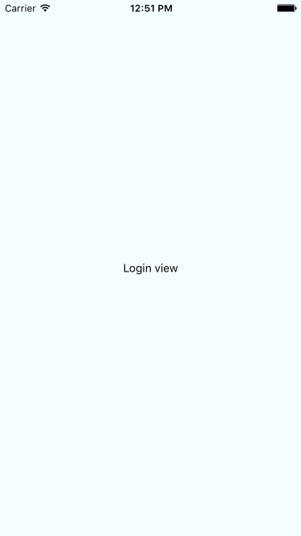
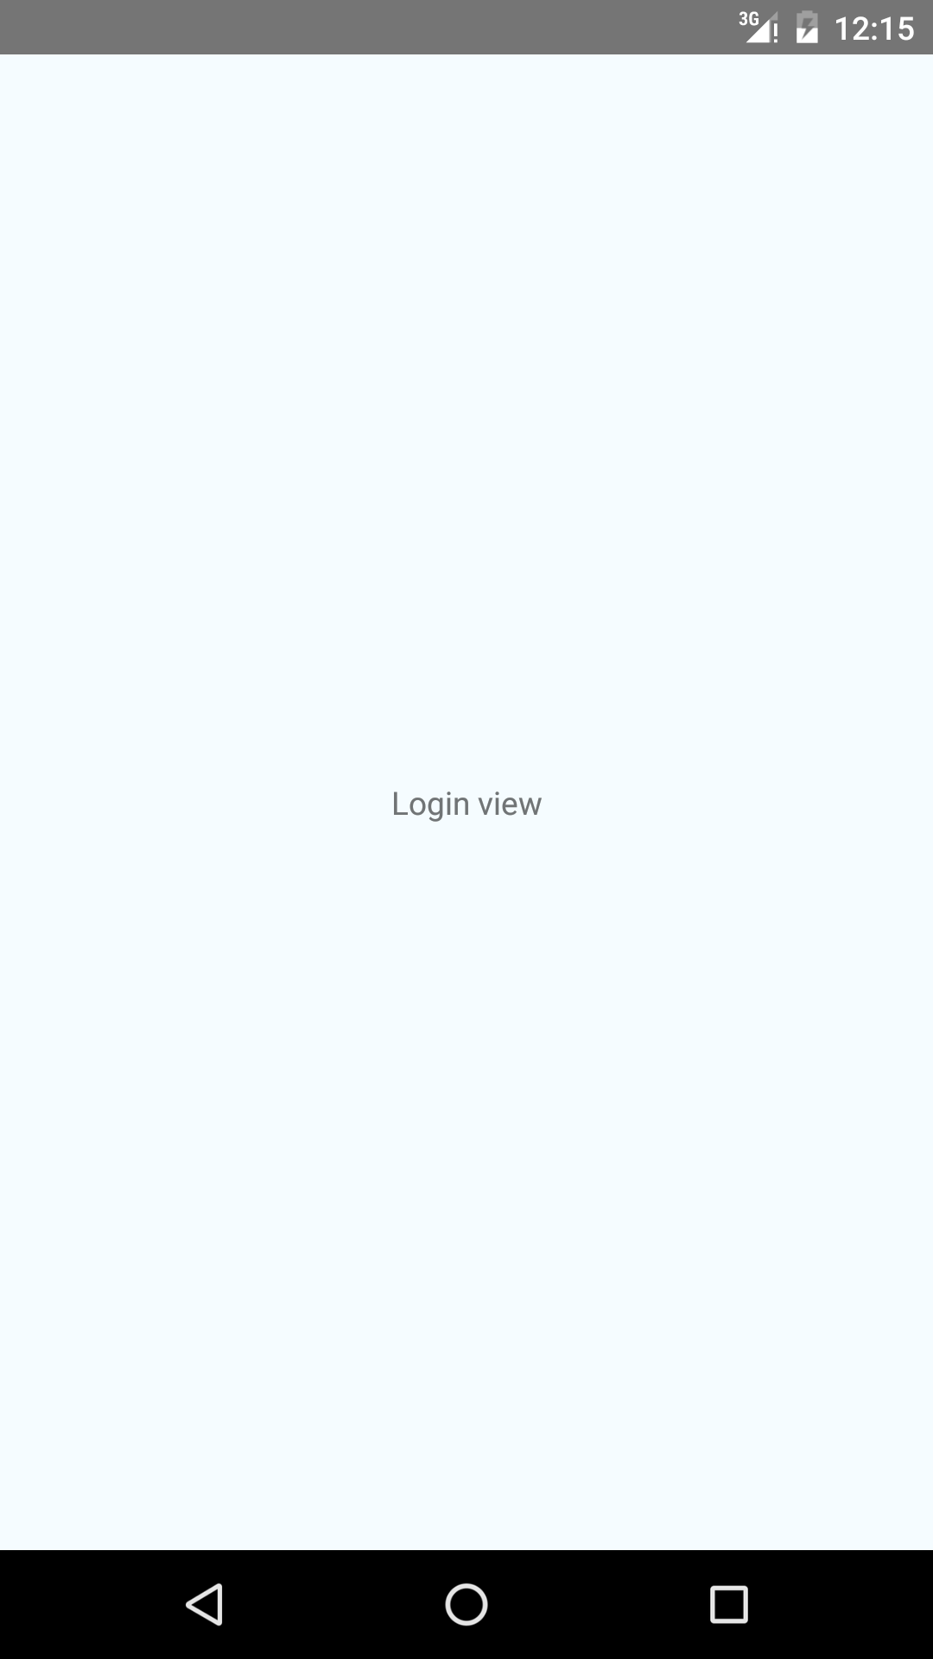
RN - emulators
iOS
  cmd+r for reload
  cmd+d for dev menu
  Enable reload
Android
  cmd+m for dev menu
  Enable reload

Slide 16
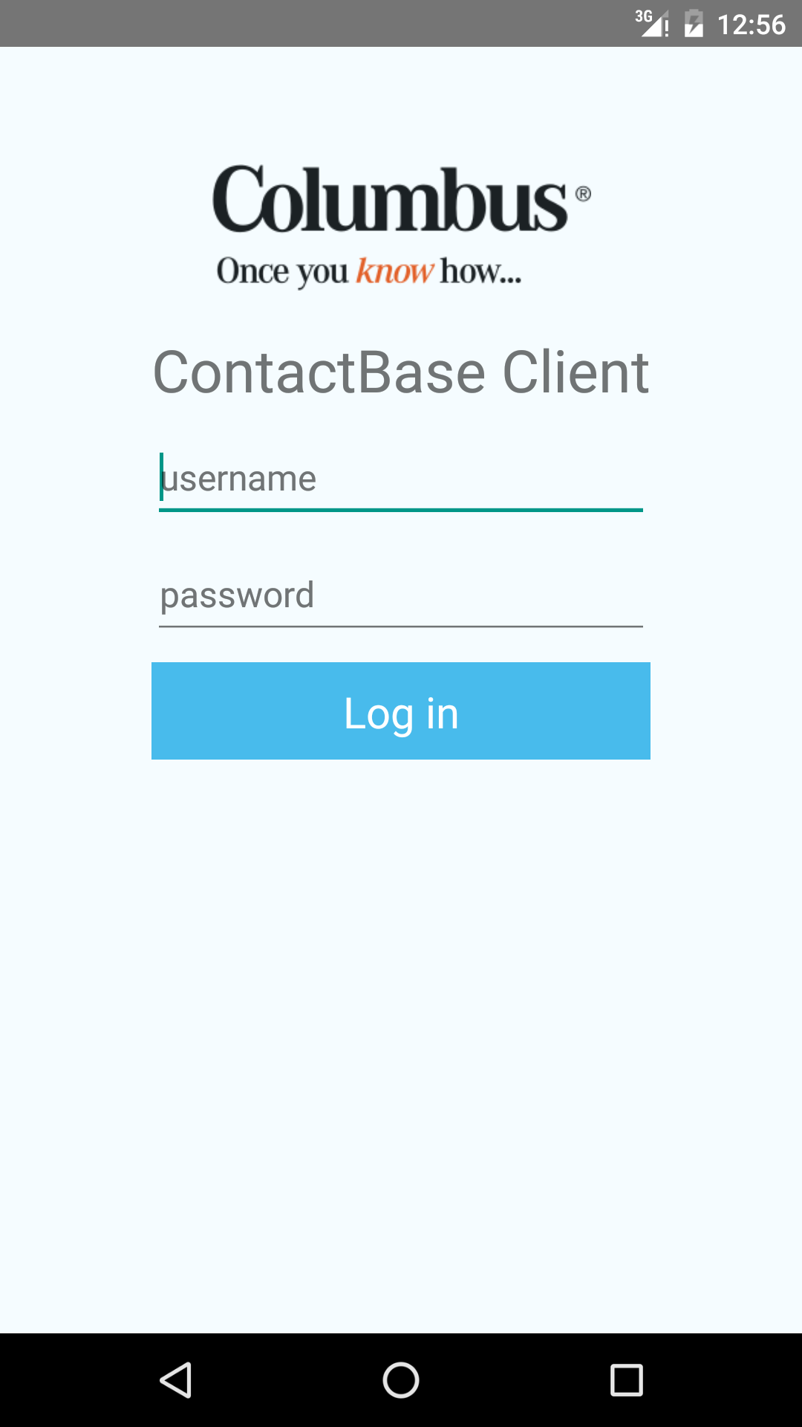
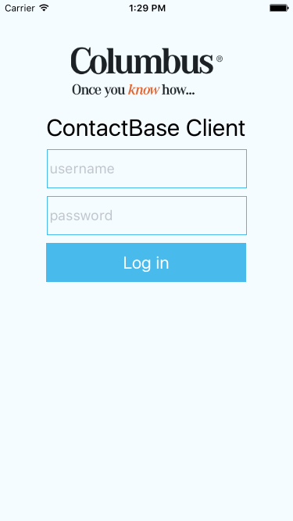
RN – design view
images folder, logo.png
const logo = require('../images/logo.png');

Slide 17
RN – design view
Elements
this.setState for updating state info
{} – for js code
{{}} - for js objects
<View style={styles.container}>
<Image
source={logo}
style={styles.logo} />
<Text style={styles.heading}>
ContactBase Client
</Text>
<TextInput
onChangeText={(text) => this.setState({ username: text }) }
placeholder="username"
style={styles.input} />
<TextInput
onChangeText={(text) => this.setState({ password: text }) }
placeholder="password"
secureTextEntry
style={styles.input} />
<TouchableHighlight
style={styles.button}>
<Text
style={styles.buttonText}>
Log in
</Text>
</TouchableHighlight>
</View>

Slide 18
RN – design view
const styles = StyleSheet.create({
container: {
backgroundColor: '#F5FCFF',
flex: 1,
paddingTop: 60,
alignItems: 'center',
padding: 10,
},
logo: {
width: 194,
height: 65,
},
heading: {
fontSize: 30,
marginTop: 20,
},
input: {
alignSelf: 'stretch',
height: 50,
marginTop: 10,
padding: 4,
fontSize: 18,
borderWidth: 1,
borderColor: '#48bbec',
},
button: {
height: 50,
backgroundColor: '#48BBEC',
alignSelf: 'stretch',
marginTop: 10,
justifyContent: 'center',
},
buttonText: {
fontSize: 22,
color: '#FFF',
alignSelf: 'center',
},
});
Styles

Slide 19
RN – es6 and “this”
”this” is scoped differently in various JS code parts
In arrow functions – surrounding class
Class functions – function itsself
Bind class scope “this” to function scope in class constructor
  this.someFunction = this.someFunction.bind(this);

Slide 20
RN - onPress
class Login extends Component {
constructor(props) {
super(props);
this.onLoginPressed = this.onLoginPressed.bind(this);
this.state = {
};
}
onLoginPressed() {
console.log(`Log in - user:${this.state.username} pass:${this.state.password}`);
console.log(this);
}
render() {
return (
<View style={styles.container}>
<TouchableHighlight
onPress={this.onLoginPressed.bind(this) }
style={styles.button}>
<Text
style={styles.buttonText}>
Log in
</Text>
</TouchableHighlight>
</View>
);
}
}

Slide 21
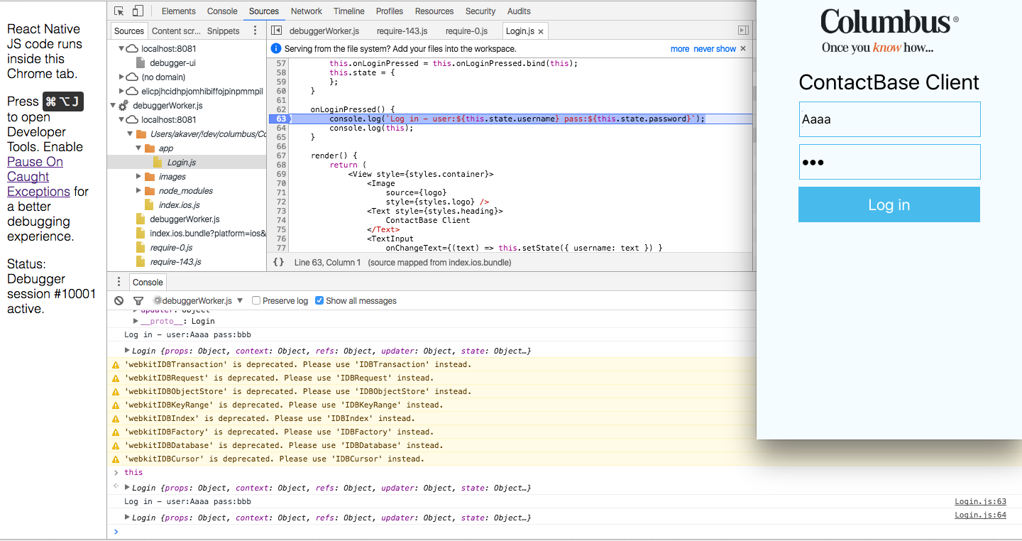
RN – debugging in Chrome
Dev menu
  Debug JS Remotely
  Open dev console in Chrome
  Monitor console
Source code in debuggerWorker.js tree
  Breakpoints!!!!!

Slide 22
RN – state, ActivityIndicator
Add variable to state – to display ActivityIndicator after button touch
Update state in press handler
RN monitors state (it is special object) and redraws screen on updates
Add ActivityIndicator to view

Slide 23
RN – state, ActivityIndicator
import React, { Component } from 'react';
import {
ActivityIndicator,
Image,
StyleSheet,
Text,
TextInput,
TouchableHighlight,
View,
} from 'react-native';
class Login extends Component {
constructor(props) {
super(props);
this.onLoginPressed = this.onLoginPressed.bind(this);
this.state = {
showProgress: false,
};
}
onLoginPressed() {
console.log(`Log in - user:${this.state.username} pass:${this.state.password}`);
this.setState({ showProgress: true });
}
render() {
return (
<View style={styles.container}>
...
<ActivityIndicator
animating={this.state.showProgress}
hidesWhenStopped
size="large"
style={styles.loader}/>
</View>
);
}
}

Slide 24
RN – Rest request (Web API)
Demo app available on my github
RN is running on very limited JS engine
Use Fetch for http requests – promise based
  Note: Errors thrown by rejected Promises need to be caught, or they will be swallowed silently
fetch('https://mywebsite.com/endpoint.php')
.then((response) => response.text())
.then((responseText) => {
console.log(responseText);
})
.catch((error) => {
console.warn(error);
});

Slide 25
RN - AuthService
OAuth2 Web API token
  Post
    https://servername/Token
  Request headers
    Content-Type: application/x-www-form-urlencoded
  Request body (urlencoded)
    grant_type=password&username=user@akaver.com&password=parool

Slide 26
RN - AuthService
Set up info for request
Encode formbody
Callback – callback function to send info back to on various results
class AuthService {
loginOAuth(credentials, callback) {
const loginDetails = {
grant_type: 'password',
username: credentials.username,
password: credentials.password,
};
let formBody = [];
Object.keys(loginDetails).forEach((property, index) => {
if ({}.hasOwnProperty.call(loginDetails, property)) {
const encodedKey = encodeURIComponent(property);
const encodedValue = encodeURIComponent(loginDetails[property]);
formBody.push(`${encodedKey}=${encodedValue}`);
}
});
formBody = formBody.join('&');
const uri = 'https://contacts.akaver.com/Token';
...

Slide 27
RN - AuthService
...
fetch(uri, {
method: 'POST',
headers: {
Accept: 'application/json',
'Content-Type': 'application/x-www-form-urlencoded',
},
body: formBody,
})
.then((response) => {
if (response.status >= 200 && response.status <= 299) {
return response;
}
console.log(response);
throw { // should be Error object or its derivative
badCredentials: response.status === 400,
unknownError: response.status !== 400,
statusCode: response.status,
};
})
.then((response) => response.json())
.then((results) => callback({ success: true }))
.catch((error) => callback(error));
}
}
// new it up immediately
module.exports = new AuthService();
Fetch
Keep track of promises
return response; - it gives data over to next method in chain

Slide 28
RN – using AuthService
render() {
let errorCtrl = <View />;
if (!this.state.success && this.state.badCredentials) {
errorCtrl = (<Text style={styles.error}>
Bad username/password!
</Text>);
}
if (!this.state.success && this.state.unknownError) {
errorCtrl = (<Text style={styles.error}>
Unknown error ({this.state.statusCode}) !
</Text>);
}
return (
<View style={styles.container}>
...
<TouchableHighlight
...
</TouchableHighlight>
{errorCtrl}
<ActivityIndicator
animating={this.state.showProgress}
hidesWhenStopped
size="large"
style={styles.loader}/>
</View>
);
}
Import class
  import authService from './AuthService';
onLoginPressed() {
console.log(`Log in - user:${this.state.username} pass:${this.state.password}`);
this.setState({ showProgress: true });
authService.loginOAuth({
username: this.state.username,
password: this.state.password,
}, (results) => {
this.setState(
// merge objects
Object.assign({ showProgress: false }, results)
);
});
}

Slide 29
RN – navigation in app
After successful login:
  save auth info (token has to be used on every following request)
  navigate to real app content
Tabbed layout
Multiple screens within one Tab
Provide callbacks for login and logout

Slide 30
RN - navigation
Main view
  IOS
    TabBarIOS and NavigatorIOS
  Android
    DrawerLayoutAndroid
Platform detection
File extension
  BigButton.ios.js
  BigButton.android.js
  import BigButton from './components/BigButton';
Platform module
  var { Platform } = ReactNative;
  Platform.OS === 'ios' ( or 'android')
  var Component = Platform.select({
  ios: () => require('ComponentIOS'),
  android: () => require('ComponentAndroid'),
  })();

Slide 31
RN - Navigation
Move all logic out of index.*.js
  App.js – analog to Login.js
App.js
  Add state – isLoggedIn
  Add callback to Login for successful login
    <Login onLogin={this.onLogin.bind(this) } />
  Add onLogin method to App
    onLogin() { this.setState({ isLoggedIn: true }); }
  In render, check for state and select correct component
  Add callback to AppContainer for logout

Slide 32
Next week in lab
Install Android Studio
Install react-native
Get my demo app off of github and get it working on your emulator
Replace the API I used with the API of your choice to make a new app

