Slide 1
SQL database security
5th September 2019

Slide 2
Last week
We reviewed how to work with SQL
We experimented with processing SQL queries programmatically using PHP
We experimented with a sample employees database
Today
  SQL security issues
    Access control
    Injection attacks
  LAMP project specs

Slide 3
SQL security
The database is the critical vulnerability in your web service
  Lower elements in the stack (OS, server) are managed by large organizations
  Higher elements in the stack are static webpages which can’t be compromised
    Wrong!
    We will see XSS attacks later in this course
First rule of database security
  Make sure your SQL server is password protected
  Does mysql –u root work for you?

Slide 4
Access privileges in SQL
Root account has all privileges
Other accounts should be granted privileges selectively
Three types of privileges
  Admin
  Database
  Object
Use SHOW GRANTS to see which accounts have which privileges on your SQL server
Grant privileges defensively

Slide 5
Who should have these privileges?
ALL
ALTER *
CREATE
DROP
EVENT
FILE *
INSERT
SELECT
SHOW DATABASES

Slide 6
How to grant privileges
Can grant privileges to individual user accounts
  Make users with CREATE USER <user_name@sqlserver_addr> statement
  See their current access privileges with
    SHOW GRANTS FOR user_name
  Grant privileges with
    GRANT <permissions> [ON <table>] TO <user> [WITH GRANT OPTION]
  Revoke privileges with
    REVOKE <permissions> [ON <table>] FROM <user>
Can also copy privileges from one user account to another

Slide 7
How to grant privileges
Generally better to
  Create Roles
  Assign multiple user accounts to each role
  Make roles with CREATE ROLE <role_name> statement
  See their current access privileges with
    SHOW GRANTS FOR role_name
  Grant privileges with
    GRANT <permissions> [ON <table>] TO <role> [WITH GRANT OPTION]
  Revoke privileges with
    REVOKE <permissions> [ON <table>] FROM <role>
Users can be assigned to roles with
  GRANT role TO user
To see the privileges of a user in a role
  SHOW GRANTS FOR user USING role

Slide 8
Sample application
Library management system
Database contains records for
  Book list
  Student list
  Borrow dates
  Return dates
  Reservation queue
What roles should we create for this database?
What tables should we use for this database?
What privileges should be granted to each role?

Slide 9
Network security
Basics
  Put the server behind a firewall
  Block port to external access
Transmit data using SSL/SSH
Sanitize data inputs
  Prevent SQL injection attacks

Slide 10
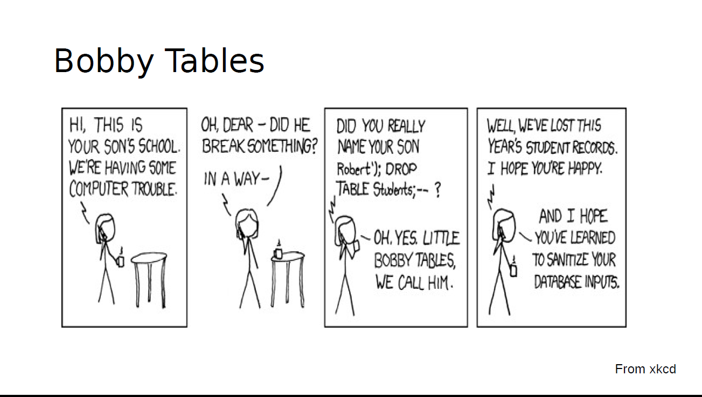

Slide 11
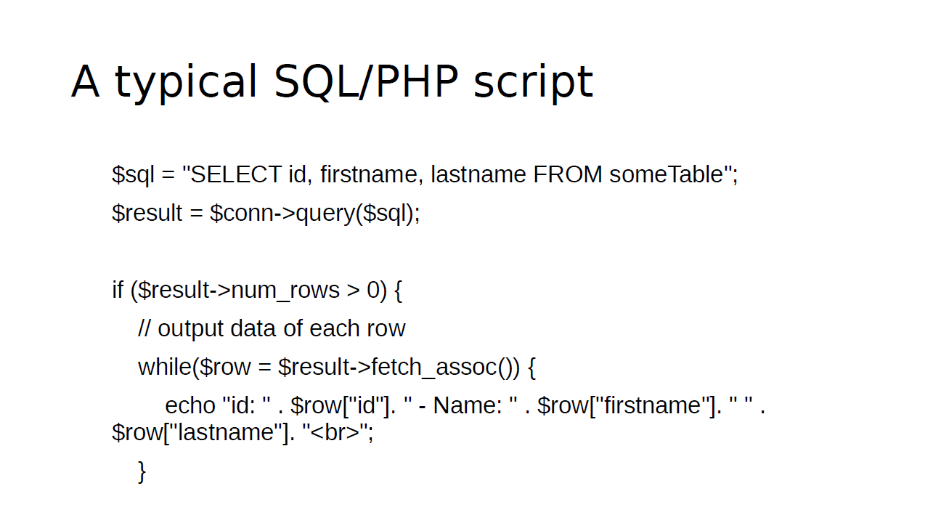

Slide 12
An SQL injection attack
Normal SQL query
  SELECT * FROM Students WHERE Name = ‘Bobby Tables’;
Wrapped as PHP variable
  $sql = “SELECT * FROM Students WHERE Name = ‘Bobby Tables’;”
In general
  $sql = “SELECT * FROM Students WHERE Name = <user_input>;”

Slide 13
SQL injection attack
Pass in user input that makes the $sql variable read
  $sql = “SELECT * FROM Students WHERE Name = ‘Bobby Tables’; DROP TABLE Students; -- ”
Consequences
Moral of the story
  Letting users pass in whatever inputs they want is a bad idea

Slide 14
Prevention
Escaping special characters
  Make a list of special characters
  Escape (prepend with \) them by parsing user inputs
Prepared statements
  Modern scripting languages allow the use of prepared statements with placeholders for user inputs
  Placeholders are typed and don’t allow arbitrary string inputs
  See a PHP example here

Slide 15
In lab next week
Develop your own LAMP application
Specifications
  Should read, and write to a mysql database and display output to a web interface
  Have to pre populate database from some source
    Database must have at least 100 records
  Application must have at least three roles, with appropriate access control:
    Admin, dev, user
  All users must access application via a username and password
    Password should be stored in encrypted form
  All data inputs should be sanitized

Slide 16
Grading policy
Should show me your demo by end of September
No rush, showing me later does not automatically deduct points
Fulfilling all specifications gets you 80 points
I reserve 20 points to assign at my own discretion
  I’m looking for cleanness of code, of interface, and of thought process

