Slide 1
Really learning concepts
CS786
21st April 2022

Slide 2
Summary
We have discussed that there are two types of representations
Propositional
Non-propositional
Identified the central role of similarity in placing stimuli into categories
Seen how visual and symbolic stimuli can be placed into categories
Seen how this categorization can be accomplished in supervised and unsupervised settings

Slide 3
Conceptualization
Is not just classification
Is not just clustering
It lets humans do a whole lot more
(Lake, Salakhutdinov & Tenenbaum, 2015)

Slide 4
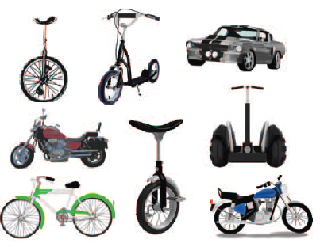
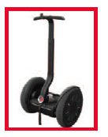
One-shot classification
Humans can do this with about 4% error; leading machine vision algorithms can now do this with about 2% error (Lake, Salakhutdinov & Tenenbaum, 2019)

Slide 5
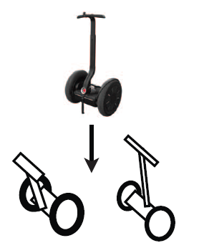
Generation

Slide 6
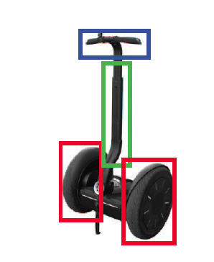
Parsing

Slide 7
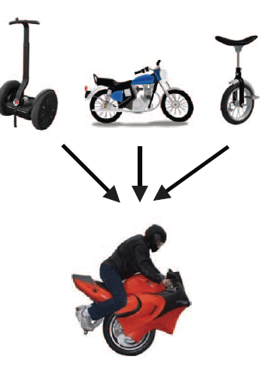
Composition

Slide 8
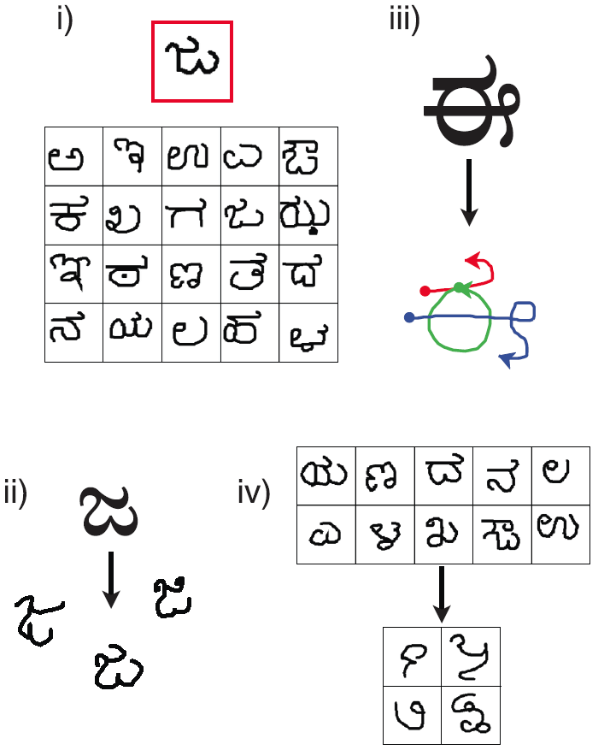
Bayesian program learning
An algorithmic approach that allows all these capabilities
In the restricted domain of handwritten visual symbols
Built around three key ideas
Compositionality
Causality
Learning to learn

Slide 9
Approach
Sampled handwritten characters from various scripts
AMT workers were asked to reproduce characters using a mouse
Tracked mouse movements throughout drawing
Omniglot dataset
mouse trajectory data and final images

Slide 10
Identifying motor primitives in writing
Pen trajectories were normalized in time
50 ms sampling interval
If a pen moved less than one pixel between two time points
Mark as a pause
Define sub-strokes as segments extracted between pairs of pauses

Slide 11
Identifying motor primitives in writing
All sub-stroke trajectories normalized for point density and size
Too small sub-strokes removed
Remaining sub-strokes fit with a spline
Represented by five 10-dimensional control points
A diagonal GMM with 1250 components was fit to this data
Each mixture component is a motor primitive

Slide 12
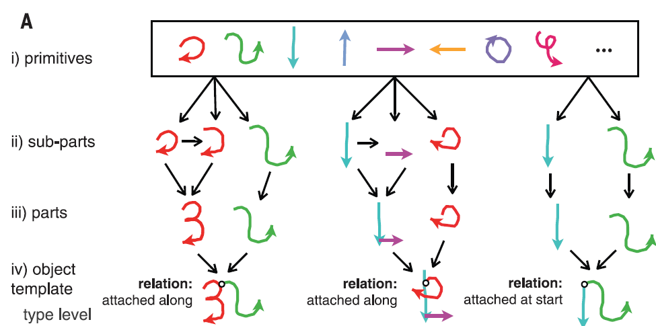
Approach
Generate types of symbols using probabilistic programs; each type becomes a generative model for subsequent tokens

Slide 13
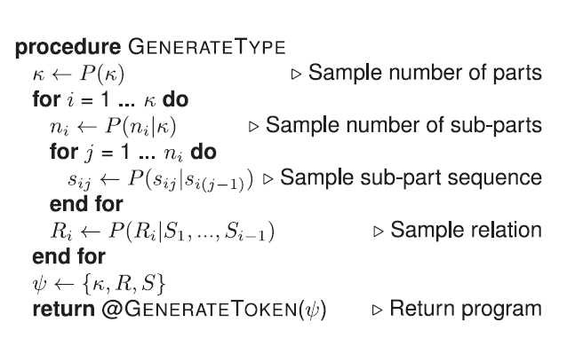
Type generation
Samples drawn from empirical distributions obtained from the Omniglot dataset

Slide 14
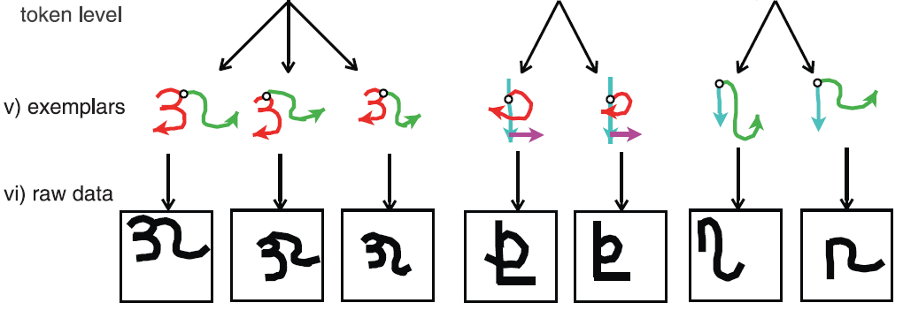
Approach

Slide 15
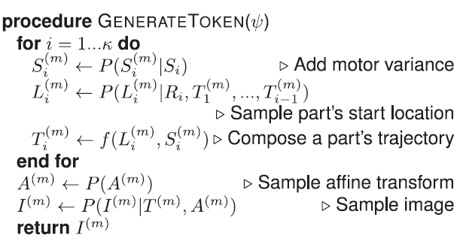
Token generation
All stochastic elements learned from Omniglot dataset

Slide 16
The generative model
Given types ψ , M tokens of each type θ and M images I corresponding to these tokens, we learn a generative model that factors the joint distribution
Type generation
Image generation
Token generation

Slide 17
Inference
Can infer token given image
Generate multiple candidates
Use MAP estimate to select the best ones

Slide 18
Other tasks
Generating new examples
Run the generateToken program trained on target dataset
Parsing
Run the generateType and generateToken programs trained on target dataset
Composition
Place a non-parametric prior on the types

Slide 19
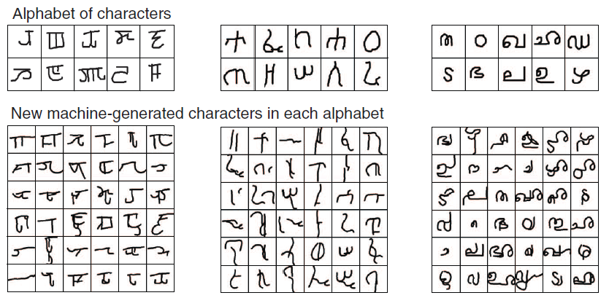
Composition

Slide 20
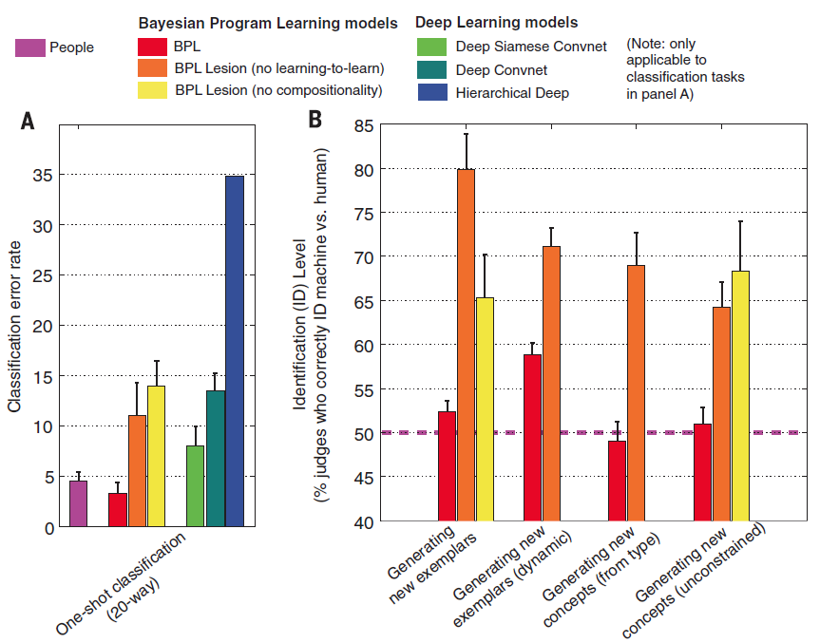
Comparison

Slide 21
Take home message
Concepts are learned by acting upon the world
Computational methods are only just beginning to understand how to accomplish this
This is a very exciting future direction in AI research

