Slide 1
Knowledge-based categorization
CS786
12th April 2022

Slide 2
Knowledge-based Views
Murphy (2002, p. 183):
  “Neither prototype nor exemplar models have attempted to account for knowledge effects . . . The problem is that these models start from a kind of tabula rasa [blank slate] representation, and concept representations are built up solely by experience with exemplars.”

Slide 3
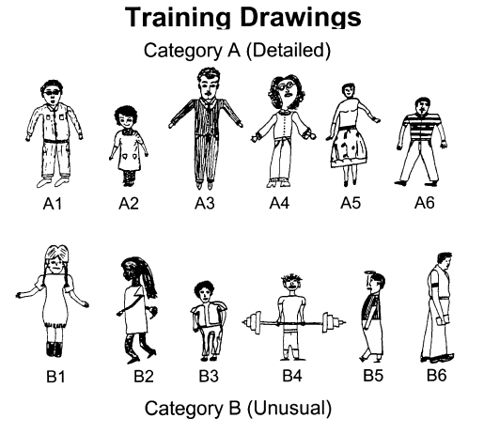
Effect of Knowledge on Concept Learning
Concept learning experiment involving two categories of children’s drawings
Two learning conditions:
  neutral labels for categories (Group 1 vs. Group 2 children)
  Category labels induced use of background knowledge: “Creative and non-creative children created category A and B drawings respectively”
Note: same stimuli are used in both conditions
Palmeri & Blalock (2000)
Notes:
FIGURE 1 FROM THE PAPER: “Training and transfer drawings used in the experiment (adapted from Wisniewski & Medin, 1994).
The top portion of the figure displays the 12 training drawings.
Category A drawings have the abstract property of being relatively `detailed' and could be classi®ed using simple perceptual rules such as `curly
hair and arms not at the sides', or `light-colored shoes or smiling', or `wearing a collar or tie'.
Category B drawings have the abstract property of being relatively `unusual' and could be classi®ed using simple
perceptual rules such as `straight hair or arms at the sides', or `dark-colored shoes and not smiling', or
`ears and short sleeves'.

Slide 4
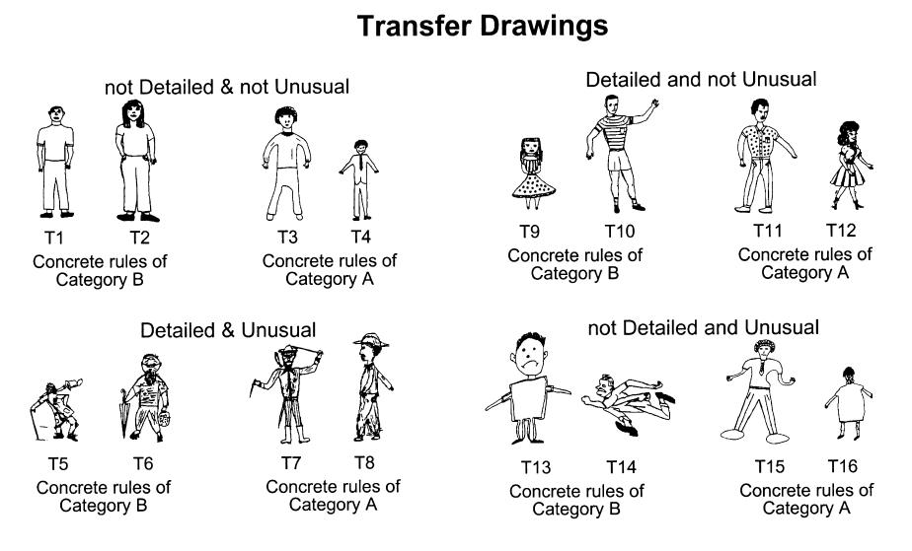
By manipulating the meaningfulness of the labels applied to those categories of drawings, subjects classified new drawings in markedly different ways. E.g., neutral labels led to an emphasis of concrete features. The “creative vs. non-creative” labels led to an emphasis of abstract features
Background knowledge and empirical information about instances closely interact during category learning
Palmeri & Blalock (2000)
Notes:
the 16 transfer drawings. The ®rst set
(T1±T4) have abstract properties of neither category, the second set (T5±T8) have the abstract properties
of both categories, the third set (T9±T12) have the abstract properties of category A, and the fourth set
(T13±T16) have the abstract properties of category B. Within each set of transfer drawings, two drawings
follow the simple perceptual rules of category A and two drawings follow the simple perceptual rules of
category B.”
“For example, T13 has the abstract properties of
category B and the concrete perceptual features of category B, whereas T10 has the
abstract properties of category A but the concrete perceptual features of category B.
W&M observed that subjects classi®ed transfer drawings that con¯icted on abstract
properties and perceptual features in a manner consistent with the type of labels they
were provided. Subjects provided meaningful labels classi®ed according to abstract
properties (e.g. tending to classify T10 and T13 as members of different categories),
whereas subjects provided meaningless labels classi®ed according to perceptual
features (e.g. tending to classify T10 and T13 as members of the same category).”

Slide 5
Learning an exemplar model from labels
Original GCM model had no learning
  Parameters fit to data
  Basically just a clustering model (unsupervised)
Later models offer learning mechanisms
Kruschke’s ALCOVE model (1992)
  Assumes a supervised learning setting
  Learner predicts categories
  Teacher teaches true category

Slide 6


Supervised learning in ALCOVE
Activation of category k given stimulus y
Training loss function
Where t is a training label that is 1 if the predicted response is correct and 0 otherwise

Slide 7


Optimization using gradient descent
All weights and parameters are learned using gradient descent
Weight update
Exemplar-wise error
Attention update

Slide 8
Variations
GCM-class models assume the presence of interval-scaled psychological distances
Can make different assumptions about similarity function, e.g. categorical instead of continuous scale
  # of matches
  # of mismatches
  # matches - # mismatches
Can make different assumptions about the learning mechanism
  Anderson’s Rational Model of Categorization
  We will see this next

Slide 9
Categories of categorization models
Prototype models assume people store singular prototypes
New stimuli are categorized based on distance from psychological distance from prototype
Exemplar models assume people store many examples
New stimuli are categorized based on average distance from these exemplars
Prototype
Exemplars

Slide 10
What do people do?
Let’s look at an experiment by Smith & Minda (1998)
Stimuli were 6 digit binary strings
Category A
  000000, 100000, 010000, 001000, 000100, 000001, 111101
Category B
  111111, 011111, 101111, 110111, 111011, 111101, 111110, 000100
All 14 stimuli presented, randomly permuted, 40 times
People asked to categorize into A and B, with feedback

Slide 11
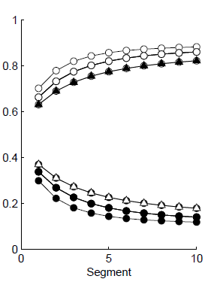
What would a prototype model do?
P(category A)
Can’t get the oddball category members right

Slide 12
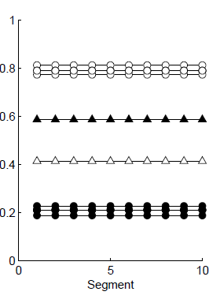
What would an exemplar model do?
p(category A)
Doesn’t learn across segments, because exemplars don’t change

Slide 13
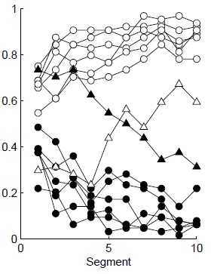
What do people actually do?
p(category A)
Start off as prototype models, but then self-correct

Slide 14
Problems
Can’t explain complex categorization
  Across linearly separable boundaries
Can’t capture effect of category variance
Can’t capture learning curves in categorization
Can’t explain complex categorization
  Across linearly separable boundaries
    Without a lot of ad hoc assumptions

Slide 15
Reality
People behave as if they are storing prototypes sometimes
  Category judgments evolve over multiple presentations
  Sensible thing to do in situations where the category is not competing with others for membership
People behave as if they are storing exemplars sometimes
  Probability matching behavior in describing category membership
  Sensible thing to do when discriminability at category boundaries becomes important
Shouldn’t we have models that can do both?

Slide 16
A Bayesian observer model of categorization
Want to predict category label c of the N^{th} object, given
  All objects seen before and
  Their category labels
Sequential Bayesian update
Assumption: only category labels influence the prior. Can you think of situations when this would be broken?

Slide 17

Connection with classic models
Remember the GCM category response calculation?
Look at the numerator of the Bayesian model
Likelihood
Prior
Prior
Likelihood
Let’s call this likelihood L_{N,j}

Slide 18


A unifying view
In an exemplar model
In a prototype model
Crucial insight
  Prototype model is a clustering model with one cluster
  Exemplar model is a clustering model with N clusters
https://hekyll.services.adelaide.edu.au/dspace/bitstream/2440/46850/1/hdl_46850.pdf

