Slide 1
Learning: Representations
CS786
5th April 2022

Slide 2


Categorization
Ordering experience into distinct sets

Slide 3
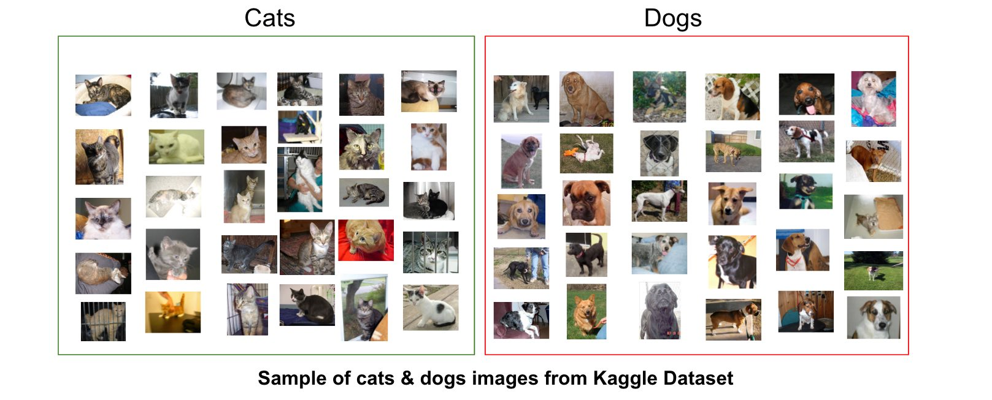
Can solve this using machine learning?
That’s a major thrust of modern ML

Slide 4
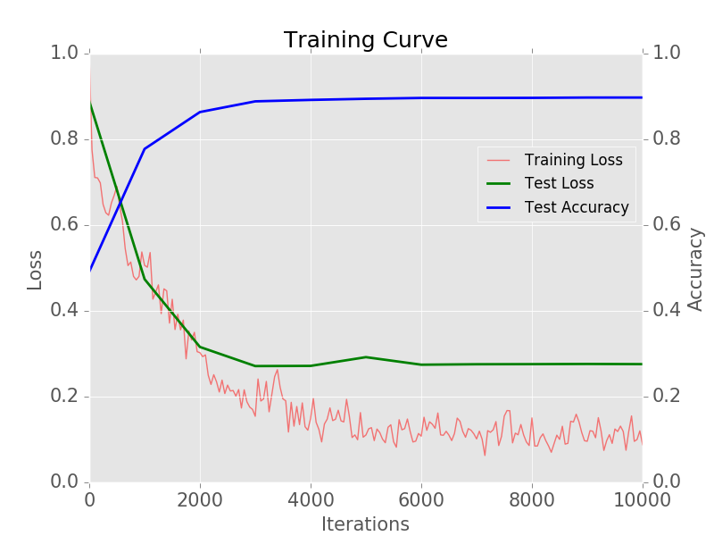
Similarity-based approaches are data-intensive
http://adilmoujahid.com/posts/2016/06/introduction-deep-learning-python-caffe/

Slide 5
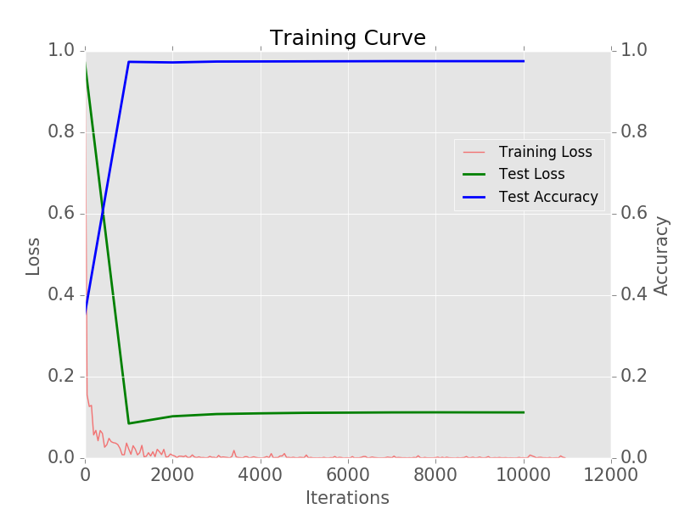
Even assuming transfer learning

Slide 6
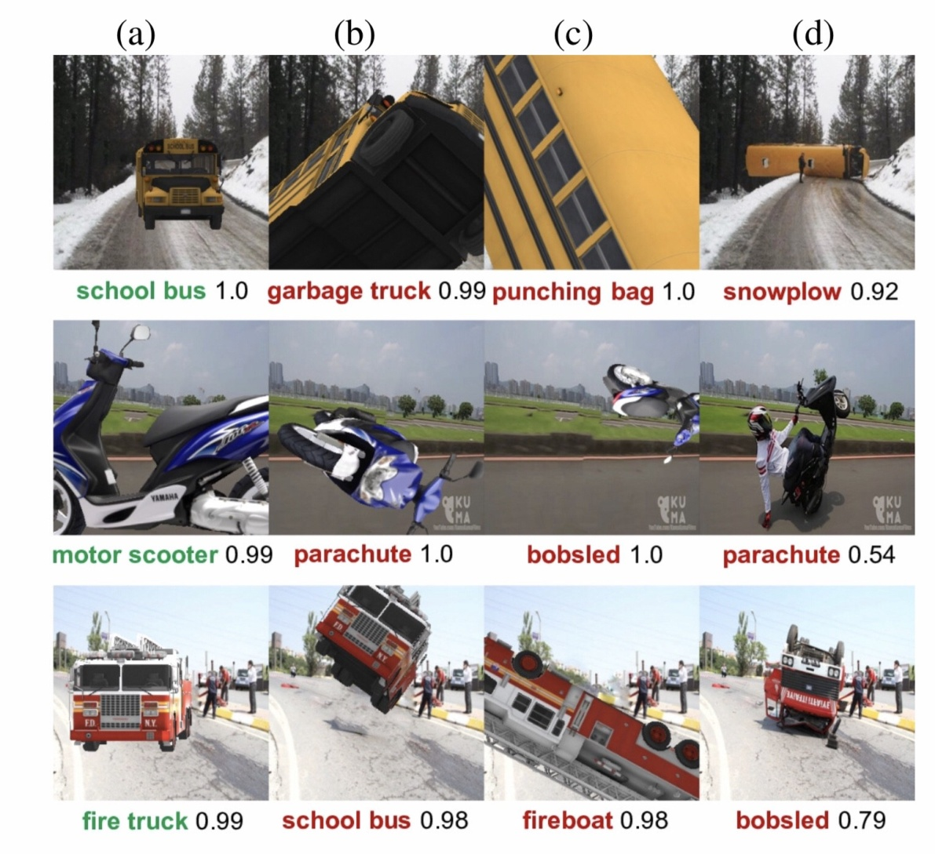
Machine classification fails gracelessly
https://arxiv.org/pdf/1811.11553.pdf

Slide 7
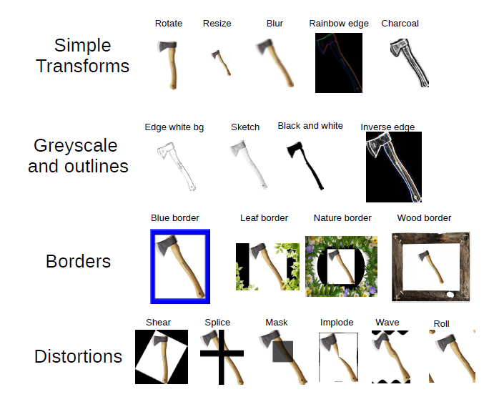
… and for the simplest of causes

Slide 8
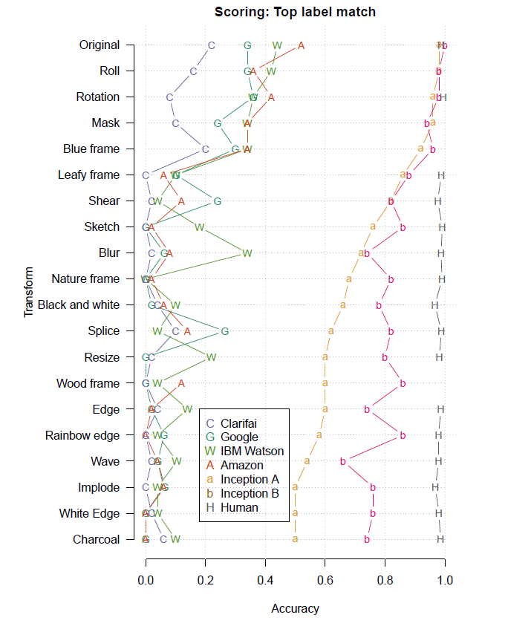
… and for the simplest of causes
Untransformed images are classified with 98% and 100% accuracy
Transformed image accuracy drops enormously
Human performance is unaffected
Humans know when they are going to have trouble

Slide 9
Categorization
Ordering experience into distinct sets

Slide 10
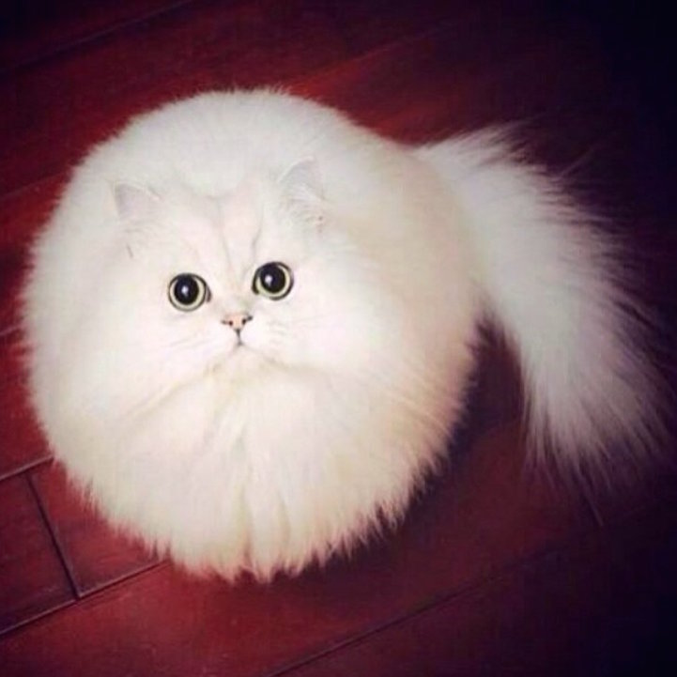

Human categorization is much more frugal
My 3 year old knows which is a cat and which is a dog

Slide 11
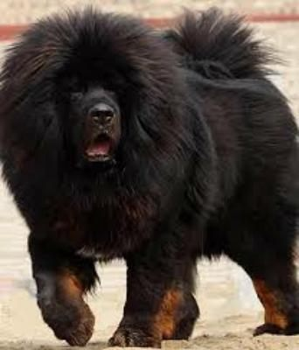

And resilient to visual differences

Slide 12


Similarity is not the only source of category information
Same category?
Different category?

Slide 13
Representation
“any notation or sign or set of symbols which ‘re-presents’ something to us…that is, stands for something in the absence of that thing”
  objects of the external world (things)
  objects of the internal world (ideas)
The “what” and “how” of representation is critical to most core issues in cognitive psychology
implies some storage of information
key problem: what is stored?
nature of representation can be revealed through performance, but there are limitations
Notes:
This slide depicts what represntations are for.
They are cool

Slide 14
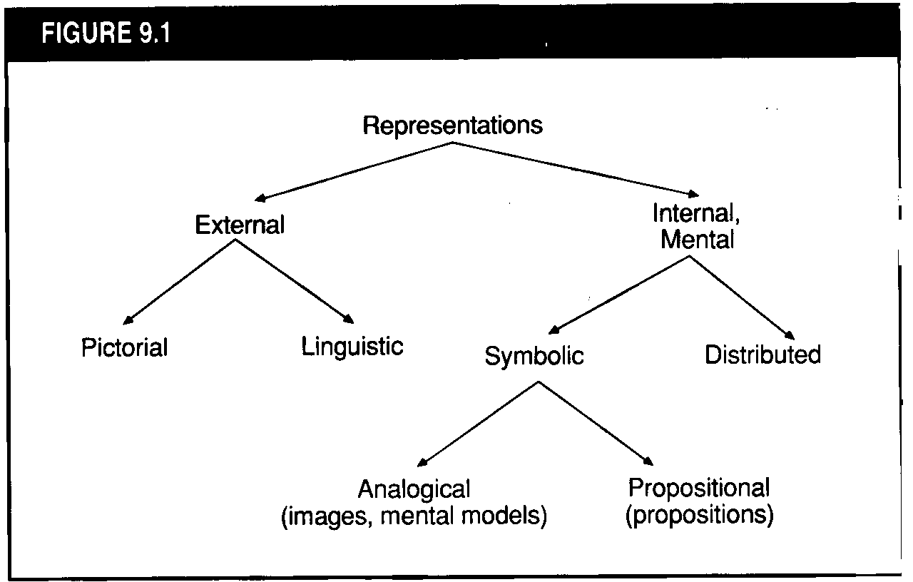
Types of Representations
maps
written language
Notes:
Eysenck’s rubric for separating out representations.

Slide 15
The big debate
Perceptually-based representations
  Imagery (encodes visual+spatial structure)
    visual (object-based)
    spatial
  Linear Orderings (encodes sequence)
Meaning-based representations (encode what is significant about an event)
  Propositions (code relations ‘linguistically’)
  Schemas (large, complex units of knowledge)
    event schemas (scripts)
    object schemas (concepts)
      attributes
      prototypes

Slide 16
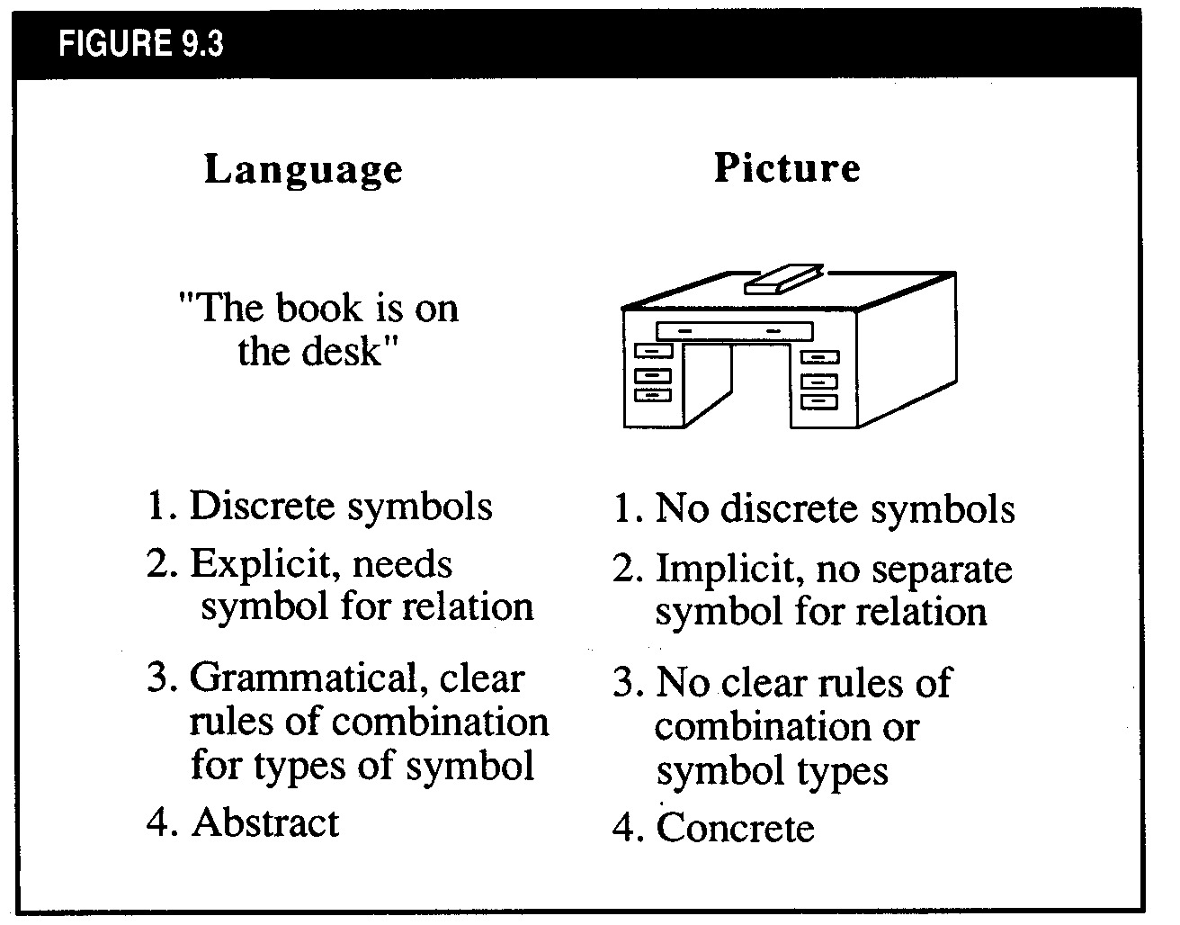

Slide 17
Images vs. Propositions
Are images really different from propositions?
  YES (Paivio dual-coding theory)
  NO (Pylyshyn, Anderson & Bower)
Does imagery have any functional significance?
What is the relationship between perception and imagery?

Slide 18
Memory for Visual Images
Although people are generally good at remembering the general ‘gist’ (meaning) of pictures, memory for picture details is relatively poor
Representative studies:
  Mandler & Ritchey (1977): study classroom pictures, present with distractors (next slide)
  Nickerson & Adams (1979): people virtually at chance in reproducing the correct configuration of a penny
Conclusion: meaning-based representations ARE really different from perceptually-based representations

Slide 19
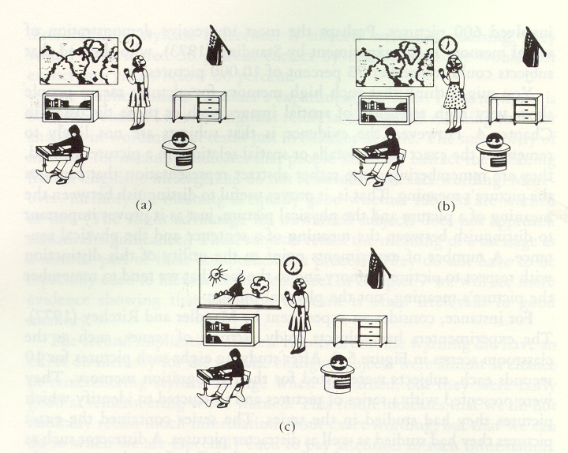

Slide 20
Paivio’s Dual-Coding Theory
Two basic coding systems: verbal and nonverbal
Each is specialized for encoding, storing, organizing and retrieving information
Each system consists of sensorimotor subsystems
Basic representational units: logogens and imagens
Systems interconnected by ‘referential links’

Slide 21
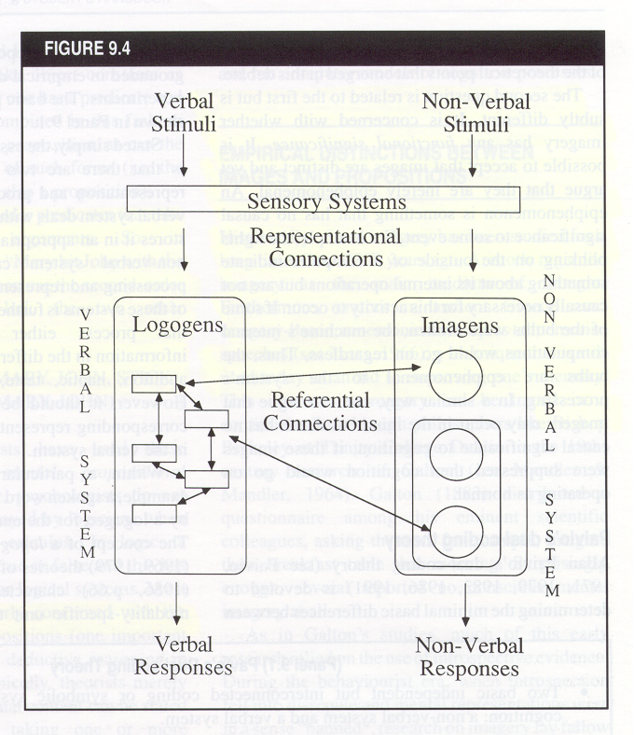
Paivio’s Dual-Coding Theory

Slide 22
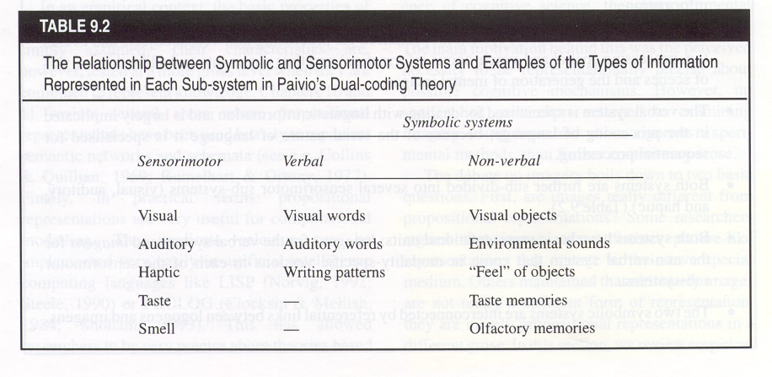

Slide 23
Evidence for and against dual-coding theory
FOR
Free recall of pictures > words
Concrete words > abstract words
Free recall of words encoded with imagery instructions > pronunciation
Spatial interference effects (Baddeley et al., Brooks)
Hemispheric differences in abstract-concrete word recognition
AGAINST
Interactive imagery instructions enhance cued-recall, but separate-imagery instructions do not (enhance relational organization)
Little evidence for cognitive mechanisms of imagery (but see next slides; this may be changing)

Slide 24
Motor imagery task produces more congruent activation (compared to actual movement) in motor cortex after practice
Lacourse, et al., 2005, Neuroimage, 27, 505-519.
Notes:
A sequential button press task was performed using the right hand while it rested on a four-key response pad (Neuroscan, Inc.) during two test sessions and five physical practice sessions over 1 week. The button press sequence was 4–2–3–1–3–4–2, with the numbers (1–4) representing digits (index (1), middle (2), ring (3), and little finger (4)) (see Fig. 1). Participants attempted to perform the motor sequence during the two test sessions at a self-paced NOVEL is either actually pressing (Novel Move) or Imaging Pressing (Novel Image) during an initial session after a brief familiarization period. SKILLED is eith actually pressing (Skilled Move) or Imaging Pressing (Skilled Image) after 5 business days of practice.
Basic findings: in NOVEL, activations for actual move are greater than for Image; these become more congruent after skilled practice.

Slide 25
Auditory Cortex Shows Activation during 5-sec gaps in songs; effect is greater for familiar songs
FL=familiar songs w/ lyrics
FI=familiar instrumentals
UL=unfamiliar songs w/ lyrics
UI=unfamiliar instrumentals
Famil - Unfamil
Famil - Unfamil
Songs With Lyrics
Songs Without Lyrics
Kraemer, et al., Nature, 2005, 434, 158.

Slide 26
Structure of Images
From psychological studies, results suggest that mental operations on images are similar to mental operations on percepts
  MENTAL ROTATION: RT to determine if a figure is mirror reversed is related to how much it is rotated (Cooper & Shephard)
  IMAGE SCANNING: time to scan between two points is a linear function of the distance between them (Kosslyn)
Images have both visual and spatial properties

Slide 27
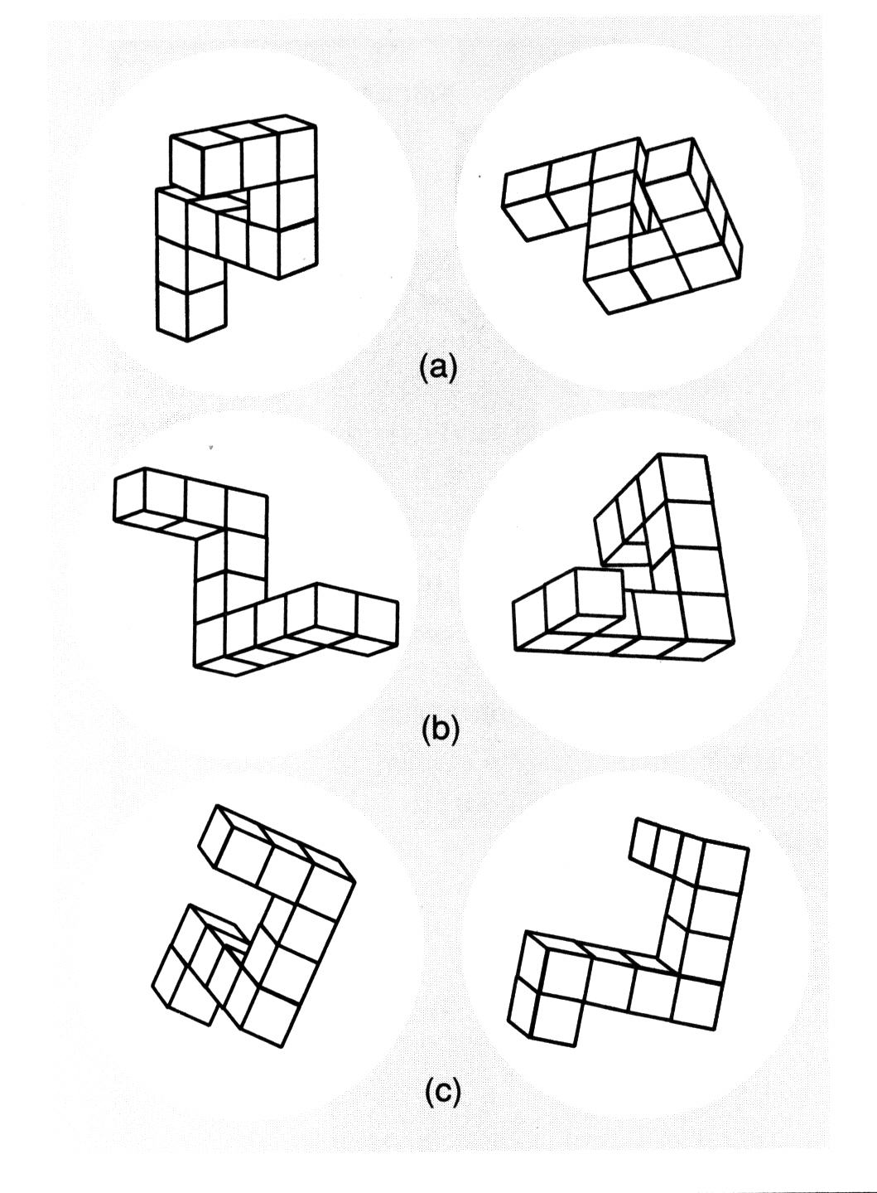

Slide 28
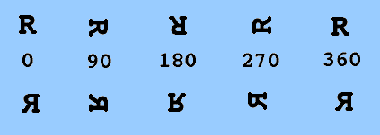
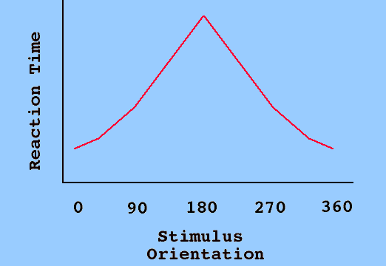
Cooper & Shephard (1973) Mental Rotation Study

Slide 29
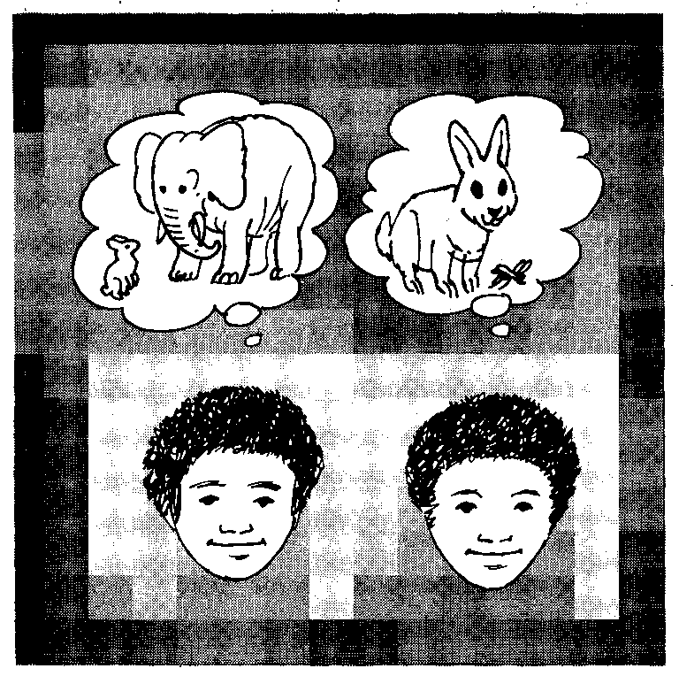
Image granularity matters
Spatial medium has granularity: RT to decide if rabbit has a visible property (e.g., claws) is faster in the right image (Kosslyn, 1980)

Slide 30
Summary
There is evidence that people have at least two types of knowledge representations
  Propositional
  Imagery-based
How do we define similarity judgments in either case?
How do we make categories using both sources of information?

