Slide 1
Hippocampus as a predictive map
CS786
31st March 2022

Slide 2
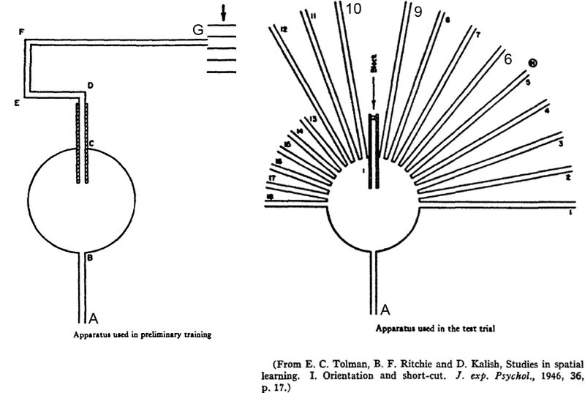
Cognitive maps in rats and men

Slide 3
Revisiting an old debate
Model free learning → learn stimulus-response mappings = habits
What about goal-based decision-making?
Do animals not learn the physics of the world in making decisions?
Model-based learning → learn what to do based on the way the world is currently set up = thoughtful responding?
People have argued for two systems
Model-based systems are difficult to learn
Model-free systems don’t generalize well

Slide 4
The successor representation
Remember the value iteration equation?
Peter Dayan showed long ago that it could be rewritten as
Where
The successor representation offers one explanation for how the TD signal could yield model-based policies

Slide 5
The successor representation
The big problem with model-free RL
Changes in reward distributions entail propagate very slowly across action chains
SR-based RL tries to fix this
https://julien-vitay.net/post/successor_representations/

Slide 6
Benefits over model-free learning
SR based learning uses a sensory prediction error to guide learning
Rather than look at the discrepancy between how rewarding I find a state, and how much I expected it to be
I look at whether I am arriving in the state more frequently than I expected, while trying to maximizing reward
Changes in the reward distribution quickly update the state visitation matrix for all states from this state

Slide 7
Are humans SR RL learners?

Slide 8
What should happen?
Model-free RL would predict no change after both reward and transition re-learning
Model-based RL would predict a change in both conditions
SR-based RL would predict a change in the reward relearning condition, but not in the transition relearning condition

Slide 9
What actually happens
Humans seem pretty model-based in this task, though SR seems to be mildly implicated

Slide 10
A neuroscientific hypothesis
Place cells have historically been seen to represent an animal’s sense of place
Stachenfeld et al (2017) propose that they actually encode the SR matrix for a task
Representing a sense of where they are likely to go next
https://www.nature.com/articles/nn.4650

Slide 11
Consistent with existing data on place cell behavior
Model accommodates deviations from Euclidean geometry seen in actual rat experiments
Also explains several non-spatial task results drawn from fMRI imaging
A subtle hypothesis that is consistent with a primarily predictive role for hippocampus

