Slide 1
From memory to learning
CS786
Mar 22nd 2022

Slide 2
Temporal context model
SAM makes no assumptions about the effect of the environment on retrieval cues guiding the memory process
  Accepted as inputs
  Recent retrievals can become cues for subsequent retrievals
The temporal context model (TCM) changes this
  Assumes a linear drift of the temporal context cue that goes into every episodic memory encoding
  Recommended reading: (Howard & Kahana, 2002)

Slide 3
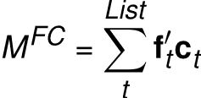
TCM encoding
Items are represented as feature vectors f
Context is also represented as feature vectors c – on a different feature space
Both item and feature vectors are time-indexed
Construct an item-context mapping via an outer product

Slide 4
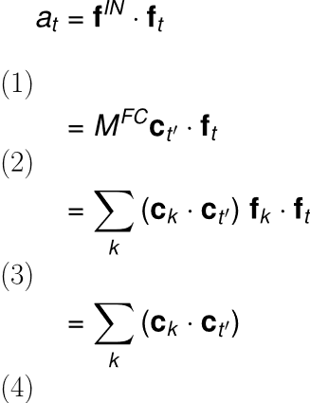
TCM retrieval
Retrieval happens via spreading activation
A state c on C will provide activation input f^{out} = M^{FC} c
Similarity of this input to a given item f can be measured as a dot product
This quantifies the retrieval pull the context exerts on each item
Follows from f orthonormality (assumed)

Slide 5

The context drift assumption
Assume a linear drift in context
A little bit like a recurrent network
Naturally makes contexts at closer times more similar than contexts at farther times from the probe point
Yields long-term recency predictions

Slide 6
Search of associative memory
In the last class, we saw the SAM model of memory encoding and retrieval
If we can assume that we know the associative strength between all possible targets and cues
  We can predict various experimental outcomes in memory experiments
But how do associative strengths get to be the way they are in your head?

Slide 7
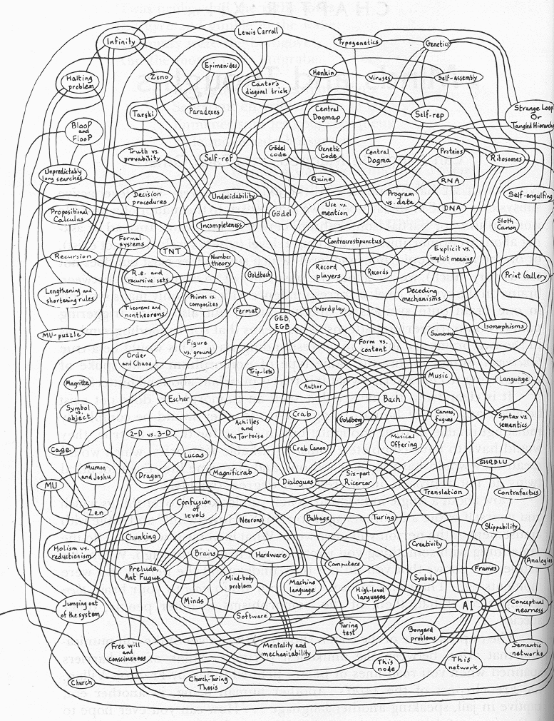
Semantic Networks
Explains everything and predicts nothing
Hofstadter. Godel, Escher, Bach.

Slide 8
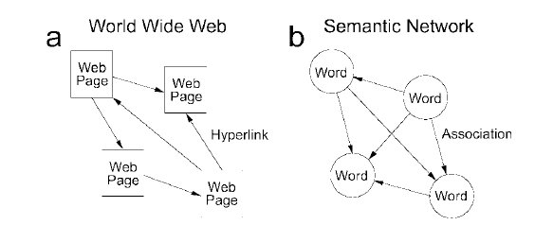
Can we be more precise in dealing with semantic networks?
Griffiths and Steyvers made a great observation
  Search in the semantic network has the same information-theoretic constraints as relevance search on the internet
Recommended reading: Griffiths, Steyvers & Firl. Google in the mind.

Slide 9
Basic idea
Use PageRank to predict word completing task performance
PageRank:
  Consider the adjacency matrix of all web pages L
  Important websites are linked to by other important websites
  Consider each link to be transporting some of each website’s importance to the outbound connection
  Solve for importance; list websites containing search term in order of importance

Slide 10
Memory hypothesis
All brain areas stimulated by a particular retrieval cue constitute nodes in a graph
Consider the adjacency matrix of this graph, measure in terms of synaptic connectivity
Consider accessibility of a memory engram as the equivalent of website ‘importance’
We have a correspondence between web and memory search

Slide 11
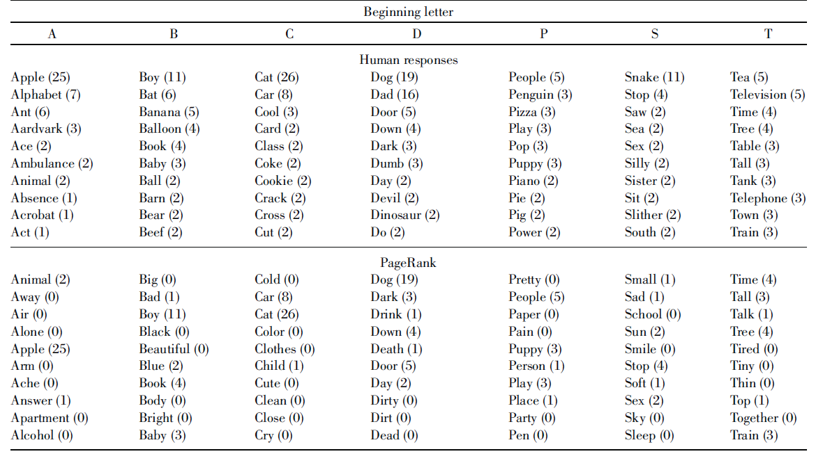
Word completion task
Given a letter, come up with as many words as you can that start with that letter

Slide 12
How to model this?
PageRank-like associativity is the outcome
  What is the process?
One possibility
  Activation spreads from node to node along associative links
  Assume each node spreads its activation equally over all nodes it is connected to
  New activation = old activation – decay + inputs

Slide 13


Modeling formally
Assume the vector x is activation for all nodes
Here M is a matrix whose entries are
L are binary outbound links in the graph

Slide 14
Semantic Networks
Can say something about how the semantic network comes about
Spreading activation from node to node brings the graph into its present shape
Some predictions are possible
Hofstadter. Godel, Escher, Bach.

Slide 15
Exploration in the semantic network
Exploration of memory is affected by the familiar exploration-exploitation tradeoff
  But how? Search in memory is impossible?
  By manipulation of cues
What sort of effect can environmental factors or previous tasks have on memory exploration?
https://warwick.ac.uk/fac/sci/psych/people/thills/thills/2015hillstics.pdf

Slide 16
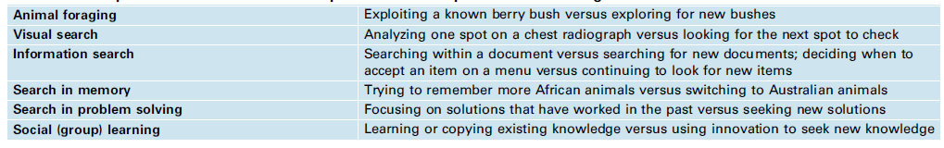
Thomas Hills’ memory search
Optimal foraging theory
  Animal spends some time looking for food
  When it finds a patch of food, the rate of food acquisition drops over time
  Goal is to maximize rate of food accumulation
  Optimal theory predicts: shift to a new patch when food acquisition rate drops below global mean

Slide 17
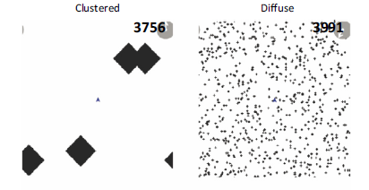
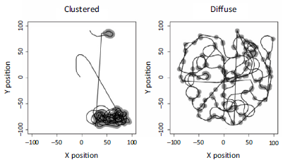
A spatial foraging task
Experimental task: find hidden areas of high reward
Strategies differ

Slide 18
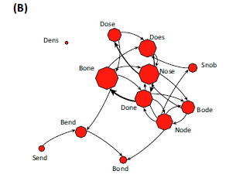
Same participants do a memory task
Scrabble: find all words in the letter set NSBDOE

Slide 19
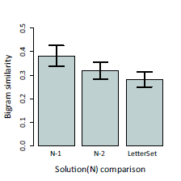
Word production shows sequential dependence

Slide 20
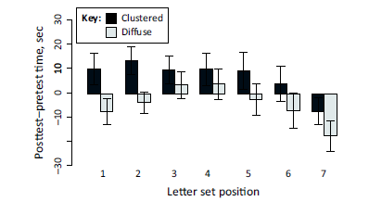
Previous task appears to control exploration propensity
Semantic network traversal is cognitively controllable

