Slide 1
Models of memory
CS786
March 10th 2022

Slide 2
Random access memory
Computer memory can be randomly accessed given address locations
RAM
Address in
Data out
But human memory doesn’t have consistent physical addressing. So how does it still work effectively?

Slide 3
Content addressable memory
Content addressable memories are used in some high-speed search operations
CAM
Data in
Address out
Human memory is closer to content addressable than random addressable
https://en.wikipedia.org/wiki/Content-addressable_memory

Slide 4
Retrieval depends on joint encoding
“Neurons that fire together wire together” – Hebbian postulate
Any memory encoding must store both the target to be stored and the cue that will trigger its retrieval
Can’t store single items in memory
But what are retrieval cues?
Hard to identify in natural settings
Hard to nail down even in experimental settings
In principle, could be any datum of experience

Slide 5
Encoding experiences in memory
Not as straightforward as putting things in boxes and taking them out later
How is the experience represented?
How is it indexed?
How is it retrieved?
What factors affect encoding?

Slide 6
Environmental Effects on Encoding
Encoding specificity principle proposes that the cues present during encoding serve as the best cues for retrieval
This is why elaborative rehearsal helps memory performance
Elaborative rehearsal → plant: tree :: sea: o____, generating targets helps in retention
State-dependent memory is memory that depends upon the relationship of one’s physiological state at the time of encoding and at the time of retrieval
Relationship of smell to memory is a common literary trope, see c.f. Proust’s Remembrance of things past

Slide 7
Environmental Effects on Encoding
Mood-dependent memory effects attest to the fact that memory is better when a person’s mood is the same during encoding and retrieval
For example, if you are happy during encoding information, it is easier to retrieve that information if you are happy at the time of retrieval
Mood-congruence effect is the fact that memory is better for experiences that are congruent with a person’s current mood
For example, when we are sad it is easier to retrieve negative events in our lives

Slide 8
Encoding Specificity
– When conditions of retrieval are similar to conditions of encoding, retrieval is more likely to be successful
– You are more likely to remember things if the conditions under which you recall them are similar to the conditions under which you learned them

Slide 9
Encoding Specificity
Context effects—environmental cues to recall
State dependent retrieval—physical, internal factors
Mood Congruence—factors related to mood or emotions

Slide 10
Encoding-dependent memory tricks
The spacing effect (or distributed study effect) shows that your memory will improve if you study for an exam over an extended time interval rather than just a few days before the exam
Can be because studying in a diverse set of circumstances makes more retrieval cues accessible for encoding
Overlearning is studying material past the point of initial learning, and has been demonstrated to aid in retrieval of that information
Can be because multiple retrieval cues are associated with the same target, aiding retrieval

Slide 11
Measuring memory performance
Recall is a measure of retrieval that requires the reproduction of the information with essentially no retrieval cues
Typical measure = # of items successfully retrieved/# of items on list
Recognition is a measure of retrieval that only requires the identification of the information in the presence of retrieval cues
Typical measure = d’ in n-AFC with n-1 non-targets
Relearning, also called the savings method, is a measure of the amount of time saved when learning the information for a second time

Slide 12
Why do we forget?
Sensory memory
The senses momentarily register
amazing detail
Forgetting can occur at any memory stage
Short-term memory
A few items are both noticed
and encoded
Long-term storage
Some items are altered or lost
Retrieval from long-term memory
Depending on interference, retrieval
cues, moods, and motives, some
things get retrieved, some don’t
Notes:
Hockenbury slides (Schulman)
key words: forgetting

Slide 13
Why We Forget
Encoding failure : sometimes forgetting is not really forgetting, information never entered long-term memory in the first place
Storage decay theory suggests that forgetting occurs because of a problem in the storage of the information
The biological trace of the memory gradually decays over time and the periodic usage of the information helps to maintain it in storage
Highly recommended extra work: watch Inside Out

Slide 14
A classic relearning experiment
Ebbinghaus conducted the first experimental studies on human memory more than 100 years ago using the relearning method.
He would study a list of nonsense syllables until he could correctly recite the complete list without any hesitations. He then put the list aside and waited some period of time and then relearned the list to the same criterion.
To get a measure of learning, he computed a savings score – the reduction in the number of trials it took him to reach criterion.
Result? The “forgetting curve” reveals that most forgetting occurs in the first two days after learning material.

Slide 15
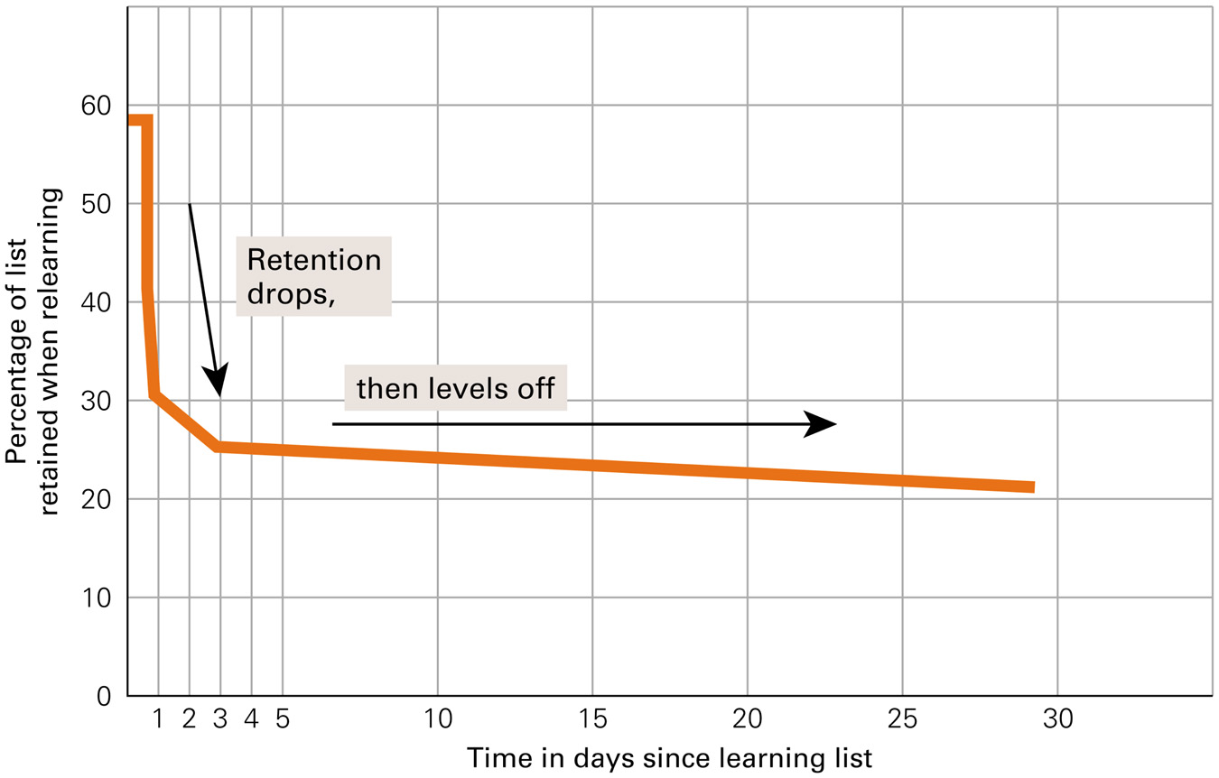
Forgetting Curve for Long-Term Memory

Slide 16
Decay Theories
100%
Memories fade away or decay gradually if unused
Time plays critical role
Ability to retrieve info declines with time after original encoding
Lately subsumed quite well by cue-dependent forgetting theories
Average
percentage of information
retained
20
mins
1
hr
8
hrs
24
hrs
2
days
6
days
31
days
Interval between original learning of nonsense syllables and memory test

Slide 17
Why We Forget
Cue-dependent theory says we forget because the cues necessary for retrieval are not available
The information is in memory, but we cannot access it
This theory is analogous to knowing a book is in the library but you cannot access it because the library lacks call numbers
Interference theory proposes that other similar information interferes and makes the forgotten information inaccessible

Slide 18
Types of Interference
Proactive interference occurs when information you already know makes it hard to retrieve newly learned information
Retroactive interference occurs when information you just learned makes it hard to retrieve old information

Slide 19
Types of Interference
Think about changing phone numbers after having a certain number for many years. When asked for your new phone number, remembering the old one interferes with retrieving the new one.
This is proactive interference
Now think about being at a party with many people you don’t know. You meet someone whom you want to talk to later, but after meeting her, you are introduced to many more people. Now, you cannot remember her name.
This is retroactive interference

Slide 20
Search of Associative memory
Modeling these facts together

Slide 21
Elements of memory models
Search
To explain list-length and fan effects
Direct access
To explain rapid true negatives in recognition
Implicit recognition
To explain the mind’s solution to the correspondence problem
https://pdfs.semanticscholar.org/7ebc/6fb776eb2250da7c925946424b9fee37097c.pdf

Slide 22
Modeling retrieval
Search of associative memory (SAM) was the first modern computational model of memory retrieval (Gillund & Shiffrin, 1984)
Assumes that information is stored in a distributed manner as memory ‘images’
Images contain item, associative and contextual information
Retrieval is modeled as a cue-dependent process
Whether an image is retrieved or not is a function of the associative strengths of the retrieval cues to that image
Single process model of recall and recognition

Slide 23
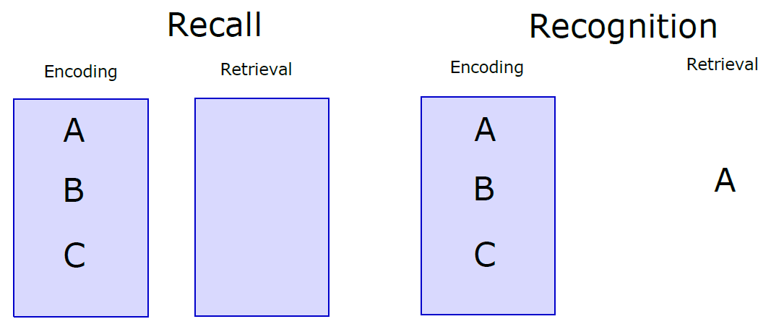
Recognition and recall

Slide 24
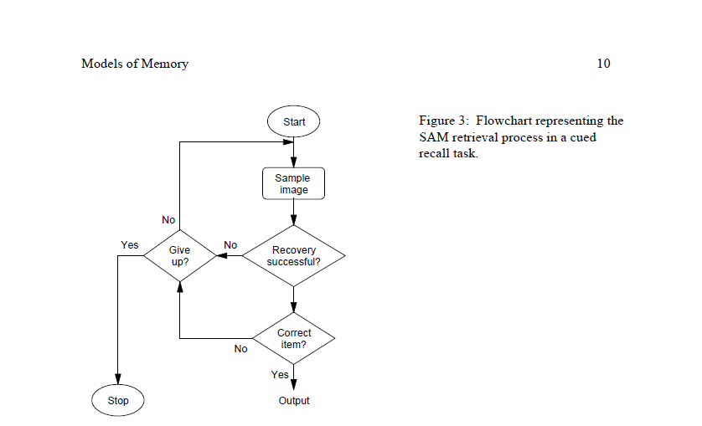
SAM basic idea

Slide 25
SAM implementation
Assume the retrieval probe contains multiple cues Q₁, Q₂, … Q_{m}
Combined activation of image I_{i} is a multiplicative combination of individual image-cue associations
Probability of sampling an image is a simple Luce choice rule
Not the same as the probability of successful memory retrieval
An image may or may not activate recovery of the correct target of retrieval

Slide 26
SAM implementation
Probability of successful recovery
Probability of recall success
If attempt succeeds, association between probe cues and sampled image strengthens
SAM had basic learning built into it

Slide 27
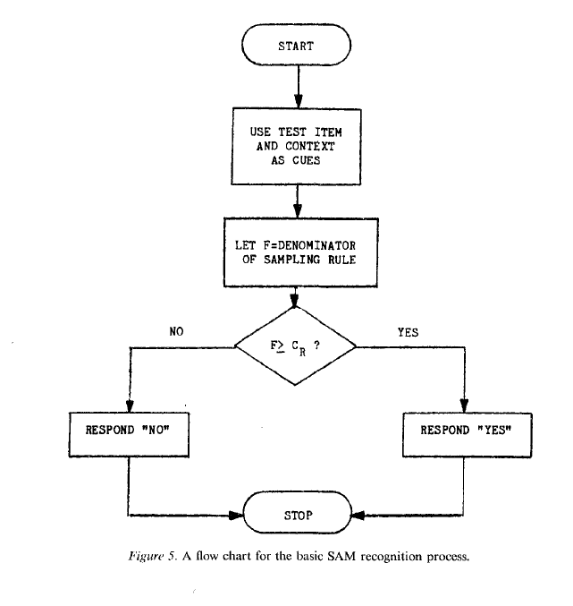
SAM recognition algorithm

Slide 28
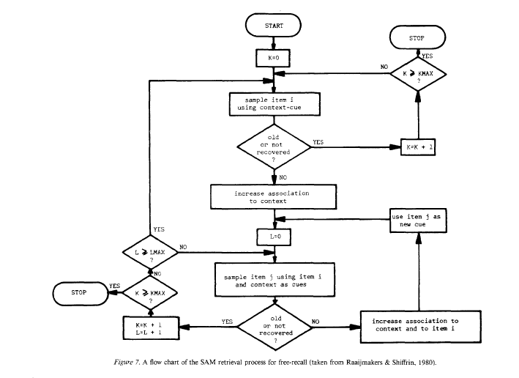
SAM recall algorithm

Slide 29
Successful predictions
List length effects in recall
Probability of sampling an item decreases as the number of items increases
Presentation time effects
Increased presentation time → stronger associations → better recall and recognition
Primacy effects
In recall because of reinforcement of previous samples
In recognition because of the generation of new images corresponding to each successful recognition

Slide 30
Successful predictions
Part set cuing
Cuing set reduces set of items that can be sampled from
This is what the browser experiment is testing
Word frequency effects
Recall prefers high frequency items because they have more associations
Recognition prefers low frequency items because there is a lower variance in the associative strength distribution for LF items

Slide 31
SAM failures
Long term recency effects
Null list length effect in recognition
Empirical list length observations in recognition confounded with time to testing
Recognition memory for up to 10000 images documented (Standing, 1973; Brady et al., 2014)
List strength effect
Strength of items = presentation time
Recognition of strong items in lists of purely strong items better than in mixed lists
Recognition of weak items in lists of purely weak items worse than recognition in mixed lists
Mirror effect
Greater true positives and fewer false positives in recognition of low frequency items

Slide 32
Temporal context model
SAM makes no assumptions about the effect of the environment on retrieval cues guiding the memory process
Accepted as inputs
Recent retrievals can become cues for subsequent retrievals
The temporal context model (TCM) changes this
Assumes a linear drift of the temporal context cue that goes into every episodic memory encoding
Recommended reading: (Howard & Kahana, 2002)

Slide 33
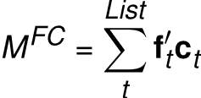
TCM encoding
Items are represented as feature vectors f
Context is also represented as feature vectors c – on a different feature space
Both item and feature vectors are time-indexed
Construct an item-context mapping via an outer product

Slide 34
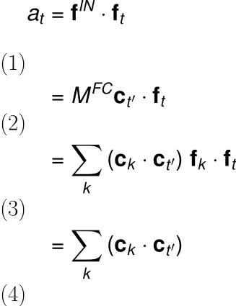
TCM retrieval
Retrieval happens via spreading activation
A state c on C will provide activation input f^{out} = M^{FC} c
Similarity of this input to a given item f can be measured as a dot product
This quantifies the retrieval pull the context exerts on each item
Follows from f orthonormality (assumed)

Slide 35
The context drift assumption
Assume a linear drift in context
A little bit like a recurrent network
Naturally makes contexts at closer times more similar than contexts at farther times from the probe point
Yields long-term recency predictions

