Slide 1
Perceptual learning: a computational perspective
CS786
3rd March 2022

Slide 2
Course logistics
I have extended the Assignment 2 deadline to Mar 7 11:59:59PM
Please don’t ask me to extend it further
Many people have still not sent in their research paper topics
Please do so immediately
I will discuss topics shared already with me in our first in-person discussion hour, scheduled for tomorrow at 1830 in CGS classroom

Slide 3
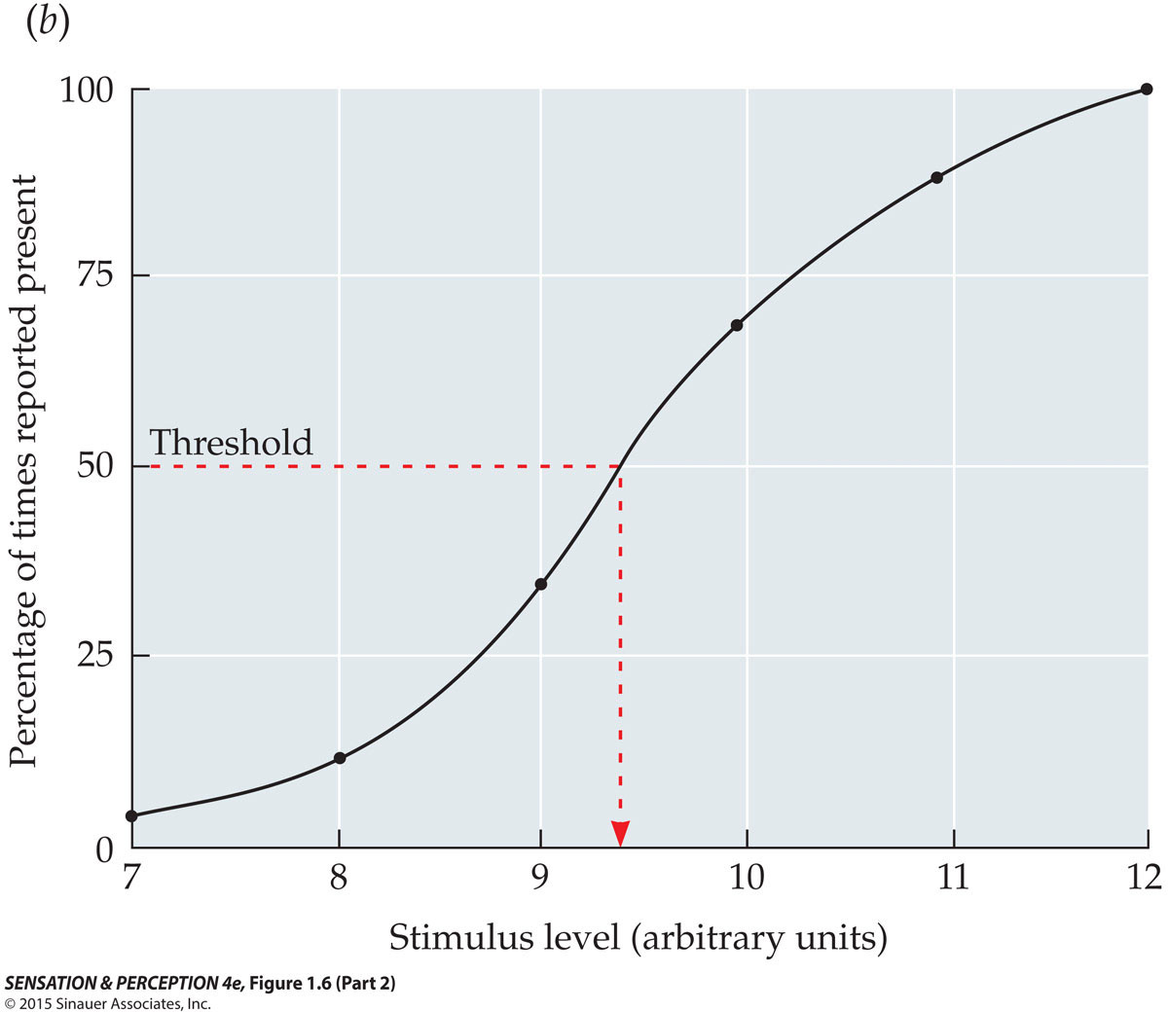
Absolute Thresholds
Psychometric function demonstrating the probabilistic (statistical) nature of the threshold
Notes:
SensationPerception4e-Fig-01-06-2R.jpg

Slide 4
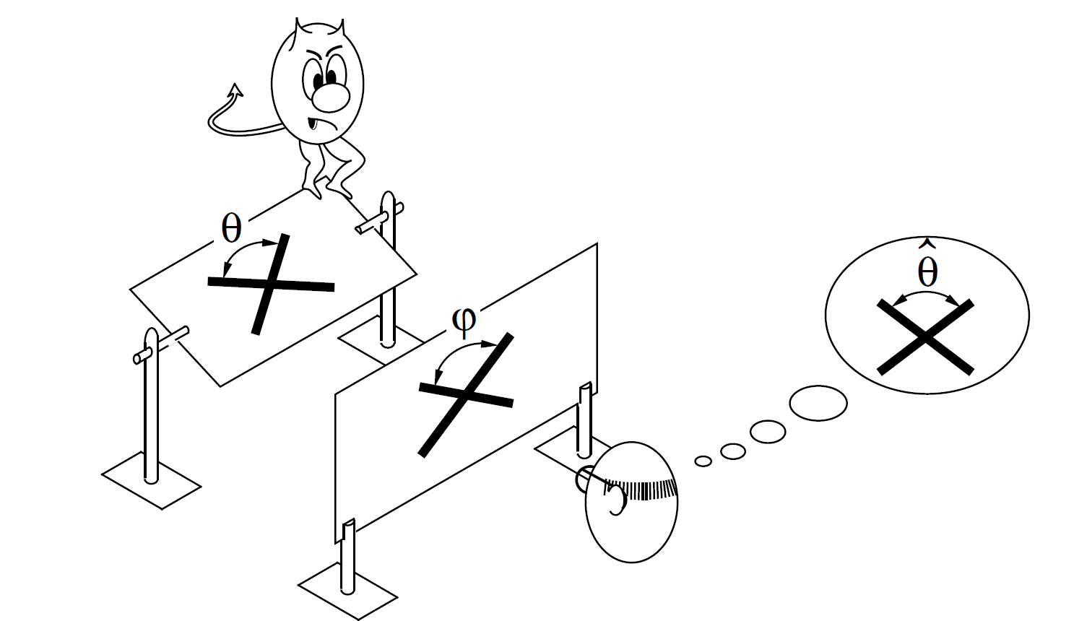
Perception as inference
Want to know θ, get to see φ

Slide 5
Can perceptual ability improve?
Classic psychophysics imagined perception to be governed by absolute limits
Signal detection theory was developed to measure these limits
Visual perception research shows
Perception strongly influenced by prior knowledge
Question: how does this influence work?
Evidence for perceptual learning presents some hypotheses

Slide 6
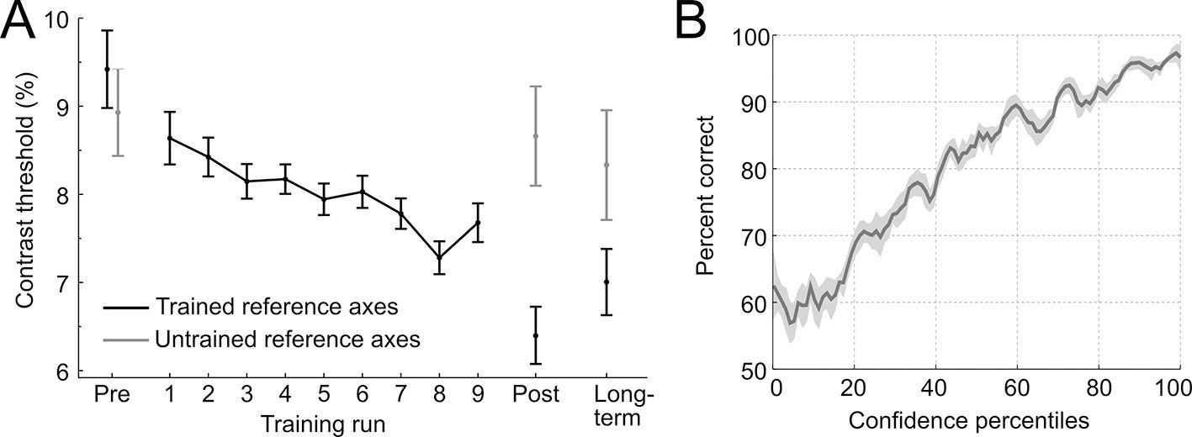
Perceptual learning
Perceptual discrimination improves with training
(Guggenmos, Wilbertz, Hebart & Sterzer, 2016)

Slide 7
Practice makes perfect
https://www.youtube.com/watch?v=Qzhs1Z8Rwnk

Slide 8
Hypotheses
Attentional weighting
Observers learn to attend to discriminative features of stimuli
Stimulus imprinting
Detectors developed that are specialized for stimuli
Differentiation
Perceptual adaptation by the development of increasingly differentiated object representations
Unitization
Development of sensory units that are triggered when a complex configuration occurs

Slide 9
Hypotheses
Attentional weighting
Observers learn to attend to discriminative features of stimuli
Stimulus imprinting
Detectors developed that are specialized for stimuli
Differentiation
Perceptual adaptation by the development of increasingly differentiated object representations
Unitization
Development of sensory units that are triggered when a complex configuration occurs

Slide 10
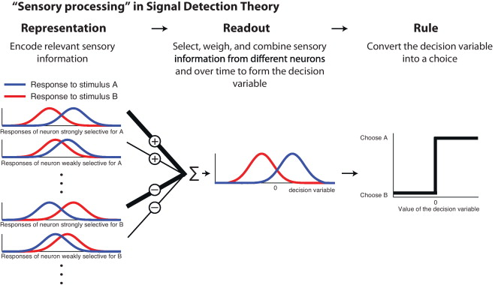
Perceptual learning as improved decision-making
(Gold & Ding, 2013)

Slide 12
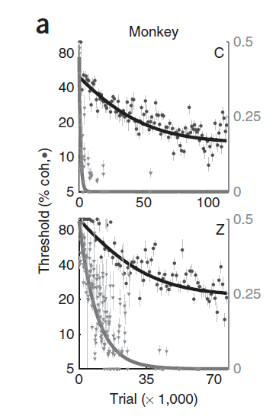
The dataset
Recorded spiking response of neurons in monkey LIP cortex
Neurons responsive to different motion directions
Measured behavioral and neural data across multiple sessions (e.g. 165 sessions over 645 days for monkey C)
Lapse rate

