Slide 1
Bayesian Vision
CS786
February 18th 2022

Slide 2
Which curves are raised?

Slide 3
Which curves are raised?

Slide 4
http://www.psych.nyu.edu/maloney/MamassianLandyMaloney.MITPress2003.pdf

Slide 5
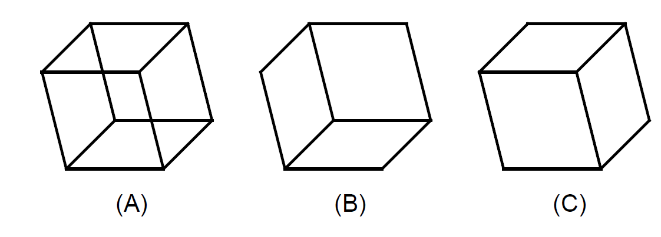
Vision uses more information than impacts the retina
What you see isn’t exactly what you get

Slide 6
Perception as inference
Want to know θ, get to see φ

Slide 7
Bayesian visual perception
Observer constructs p(θ|φ) using
p(φ|θ), physiologically determined likelihood
p(θ), visual priors on percepts
Bayesian revolution in perception (Knill, 2004)
Using Bayesian analysis to estimate visual priors using behavior responses

Slide 8
Bayesian prior estimation
Regular sequential Bayes
Update prior by multiplying with likelihood
Obtain posterior
Use posterior as prior for next time step
Inverse procedure
Know posterior distribution given all data
Divide posterior by data likelihood sequentially
Each obtained prior serves as posterior for earlier time step
Finally left with original prior

Slide 9
Bayes 101
P(H|D) proportional to p(H)p(D|H)
Basic Bayes claim
We have a bunch of data D
And there are several possible h that can potentially account for the data
With a Bayesian analysis, we can construct a probability p(H|D)
Which hypothesis is most likely, given we’ve seen the data D

Slide 10
Sequential Bayes 101
Let’s assume that the data are sequential D = {d1, d2, ….. dn}
P(H|D(1:n)) proportional to p(H|D(1:n-1))p(dn|H)
Prior is p(H|D(1:n-1))
Likelihood is p(dn|H)

Slide 11
Bayesian analysis
P(H|D(1:5))
1,2,4,8,16 ….
All natural numbers
All powers of two
Members of the table of two
d6 = 31
P(H|D(1:6))

Slide 12
Bayesian parameter estimation
Typically hard to obtain likelihoods for multiple sequential updates in closed form
Alternative procedure
Generate posterior distributions using different parameters determining the prior
Find parameters that yield posterior distributions that best fit the true distribution
Frequently have to use some form of MCMC sampling

Slide 13
Demo
String of binary observations modeled using binomial likelihood and beta prior
Posterior update
Prior estimation

Slide 14
Prior estimation

Slide 15
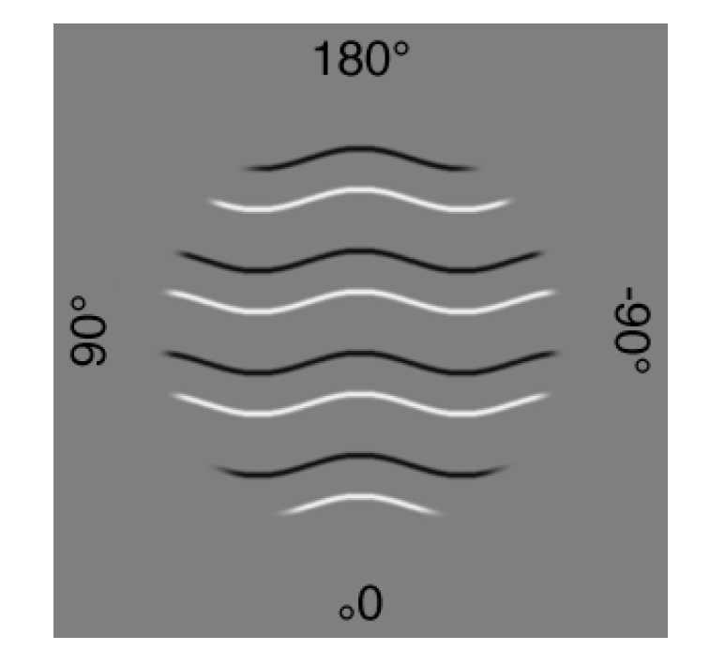
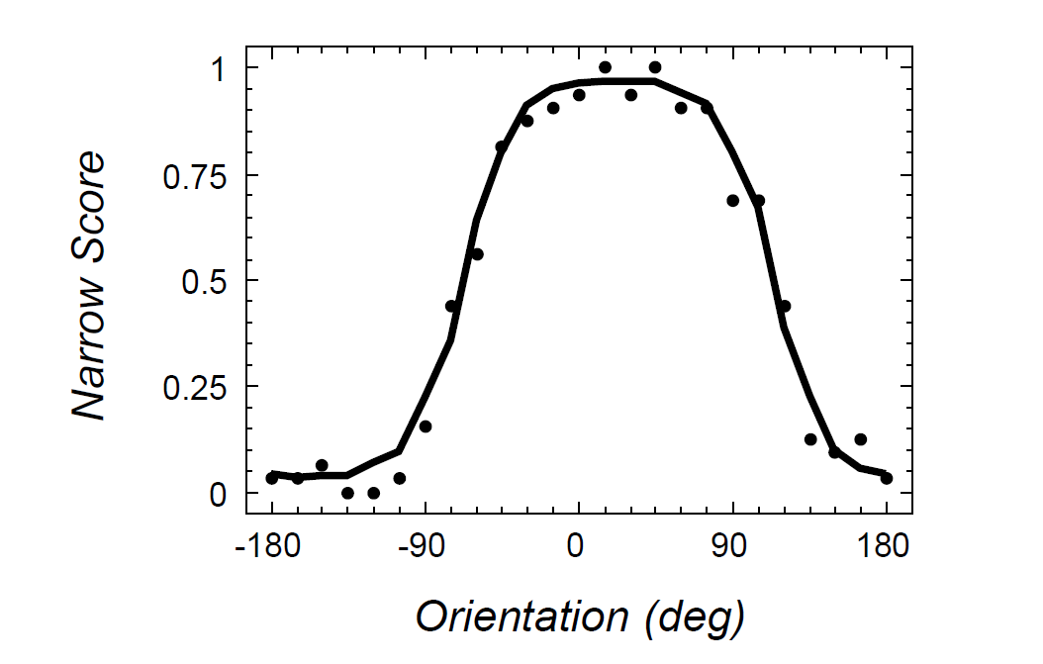
Applied to vision data
Narrow score = proportion of times image is described with bulging narrow ridges
http://www.psych.nyu.edu/maloney/MamassianLandyMaloney.MITPress2003.pdf

Slide 16
Simplifying assumptions
Response proportions assumed to reflect posterior probability p(narrow|image)
Prior biases assumed to influence response independently
Model illumination and viewpoint as drawn from a normal distribution on the respective angles

Slide 17
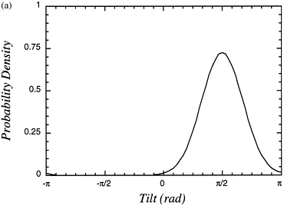
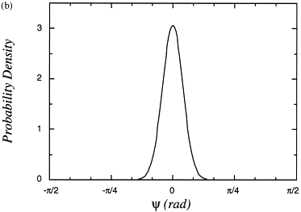
Findings
Illumination angles are a priori assumed to be above and to the left
Increasing shading contrast reduces the variance of the illumination prior
Increasing contour contrast reduces the variance of the viewpoint prior
In other experiments, shown that
People think they are looking at objects from above
People think angles are a priori likely to be right angles
And many more

Slide 18
What does it mean?
Bayesian models of visual perception give us a way of describing the priors that people use
But they don’t explain how the priors come to be the way they are
Positives: can describe both perceptual and cognitive priors
Negatives: Hard to characterize the true provenance of empirically determined priors

