Slide 1
Feature Integration Theory
CS786
Feb 17th 2022

Slide 2
Announcements
No course participation grade
Attendance grade continues
Discussion hour in CGS conference room

Slide 3
Visual search (easy)

Slide 4
Visual search (hard)

Slide 5
Visual search
X
X
X
X
X
O
O
X
X
X
X
X
X
O
X
X
X
X
O
X
O
O
X
X
X
X
X
Feature search
Conjunction search
Treisman & Gelade 1980

Slide 6
“Serial” vs “Parallel” Search
Reaction Time (ms)
Set size

Slide 7
Feature Integration Theory: Basics (FIT) Treisman (1988, 1993)
Distinction between objects and features
Attention used to bind features together (“glue”) at the attended location
Code 1 object at a time based on location
Pre-attentional, parallel processing of features
Serial process of feature integration

Slide 8
FIT: Details
Sensory “features” (color, size, orientation etc) coded in parallel by specialized modules
Modules form two kinds of “maps”
Feature maps
color maps, orientation maps, etc.
Master map of locations

Slide 9
Feature Maps
Contain 2 kinds of info
presence of a feature anywhere in the field
there’s something red out there…
implicit spatial info about the feature
Activity in feature maps can tell us what’s out there, but can’t tell us:
where it is located
what other features the red thing has

Slide 10
Master Map of Locations
codes where features are located, but not which features are located where
need some way of:
locating features
binding appropriate features together
[Enter Focal Attention…]

Slide 11
Role of Attention in FIT
Attention moves within the location map
Selects whatever features are linked to that location
Features of other objects are excluded
Attended features are then entered into the current temporary object representation

Slide 12
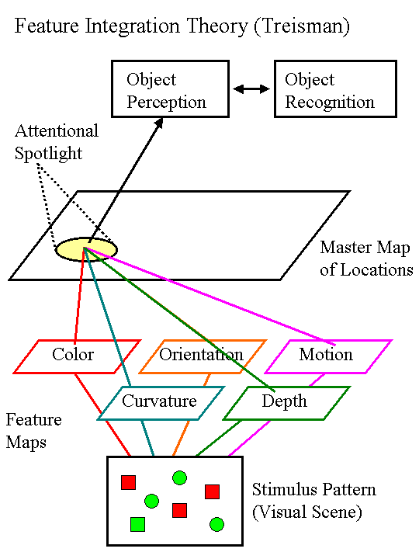

Slide 13
Evidence for FIT
Visual Search Tasks
Illusory Conjunctions

Slide 14
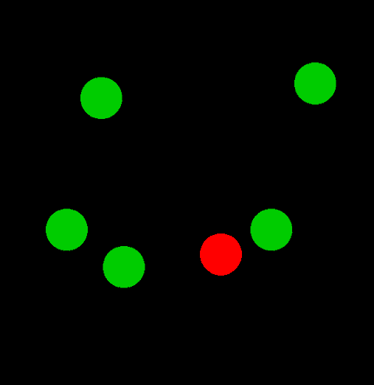
Feature Search: Find red dot

Slide 15
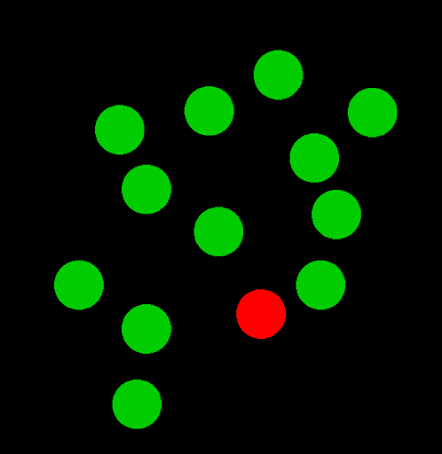
“Pop-Out Effect”

Slide 16
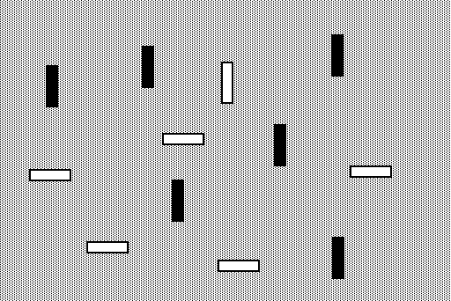
Conjunction: white vertical

Slide 17
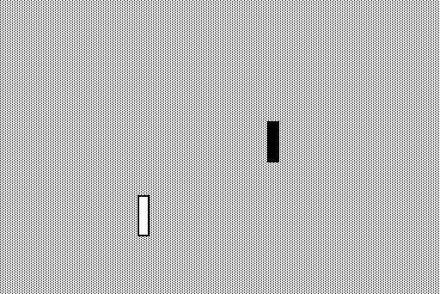
1 Distractor

Slide 18
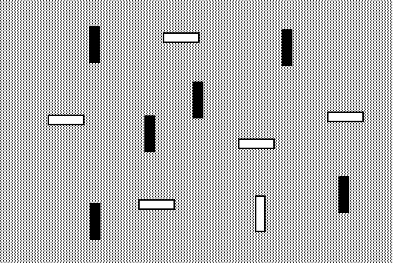
12 Distractors

Slide 19
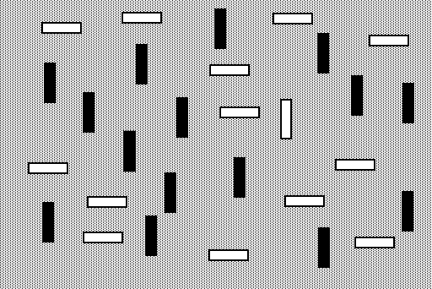
29 Distractors

Slide 20
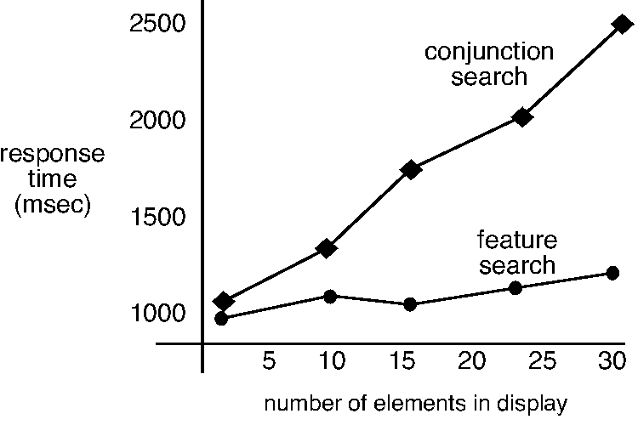

Slide 21
Feature Search
Is there a red T in the display?
Target defined by a single feature
According to FIT target should “pop out”
T
T
T
T
T
T
T
T
T
T
T

Slide 22
Conjunction Search
T
Is there a red T in the display?
Target defined by shape and color
Target detection involves binding features, so demands serial search w/focal attention
X
X
T
X
T
T
T
T
T
T
T
X
X

Slide 23
Visual Search Experiments
Record time taken to determine whether target is present or absent
Vary the number of distracters
FIT predicts that
Feature search should be independent of the number of distracters
Conjunction search should get slower w/more distracters

Slide 24
Typical Findings & interpretation
Feature targets pop out
flat display size function
Conjunction targets demand serial search
non-zero slope

Slide 25
… not that simple...
X
O
X
O
X
X
O
X
O
X
O
O
X
easy conjunctions - -
depth & shape, and movement & shape
Theeuwes & Kooi (1994)

Slide 27
Problems for FIT accounts of vision
Search is very fast in this situation only when the objects look 3D - can the direction a whole object points be a “feature”?

Slide 28
Asymmetries in visual search
Vs
Vs
the presence of a “feature” is easier to find than the absence of a feature

Slide 29
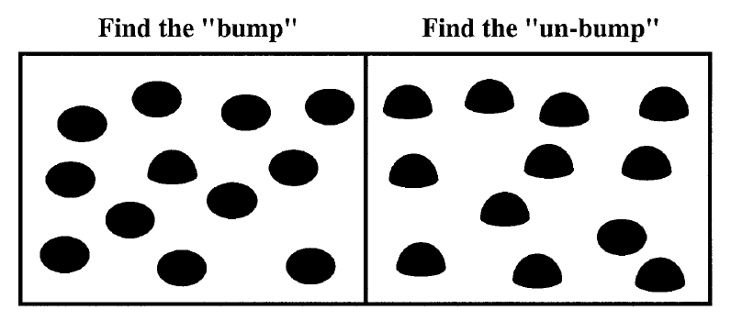
Kristjansson & Tse (2001)
Faster detection of presence than absence - but what is the “feature”?

Slide 30
Familiarity and asymmetry
asymmetry for German but not Cyrillic readers

Slide 31
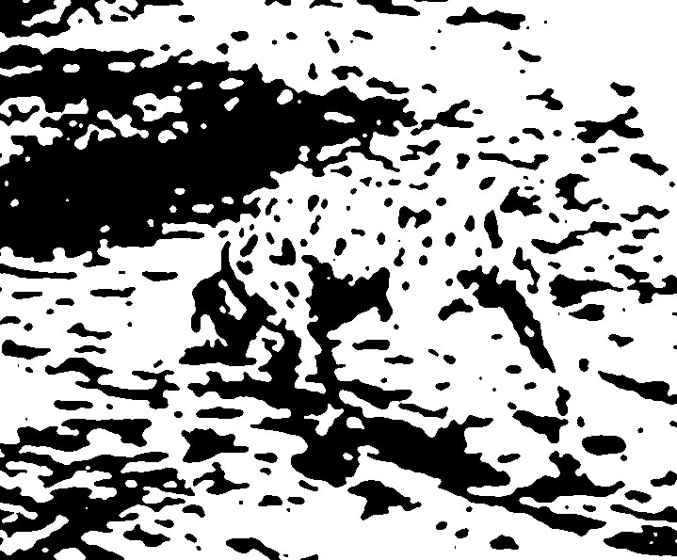
Gestalt effects

Slide 32
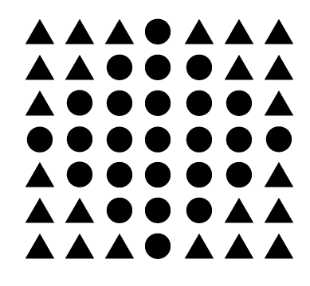
Pragnanz
Perception is not just bottom up integration of features. There is more to a whole image than the sum of its parts.

Slide 33
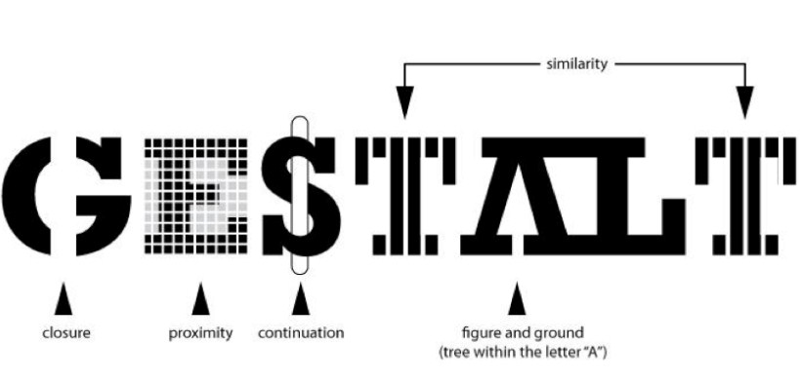
Not understood computationally
Principles are conceptually clear; DCNNs can learn them, but translation is missing
https://arxiv.org/pdf/1709.06126.pdf

Slide 34
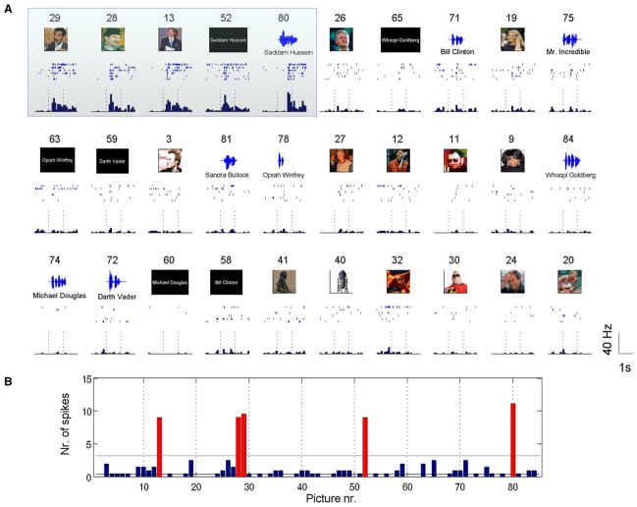
Concept-selective neurons
https://www.newscientist.com/article/dn7567-why-your-brain-has-a-jennifer-aniston-cell/

Slide 35
Summary
Classic accounts of visual perception have focused on bottom-up integration of features
Consistent with data from visual search experiments
Inconsistent with phenomenological experience in naturalistic settings
Top down influences affect visual perception
But how?
We will see one promising modeling strategy today

