Slide 1
Embodiment
CS786
February 15th 2022

Slide 2
Recap: the mind constructs information
Current neuroscience and AI fashions argue for the brain as a passive store of information
The mind is not a passive receptacle
It exists in a body with a long history and a complex present
It constructs information based on being in the world (Heidegger)

Slide 3

The Debate on the Joy of Fish
Zhuangzi and Huizi were enjoying themselves on the bridge over the Hao River. Zhuangzi said, "The minnows are darting about free and easy! This is how fish are happy.“
Huizi replied, "You are not a fish. How do you know that the fish are happy?" Zhuangzi said, "You are not I. How do you know that I do not know that the fish are happy?“
Huizi said, "I am not you, to be sure, so of course I don't know about you. But you obviously are not a fish; so the case is complete that you do not know that the fish are happy.“
Zhuangzi said, "Let's go back to the beginning of this. You said, How do you know that the fish are happy; but in asking me this, you already knew that I know it. I know it right here above the Hao."
How do we know which dog is happy
And which is sad?

Slide 4


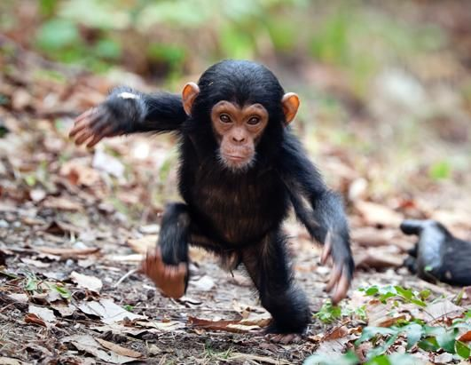

Where do cuteness judgments come from?

Slide 5
Embodied cognition
The claim that cognition is deeply dependent on the fact that we inhabit bodies of flesh and blood
Always in tension with efforts to abstract human-like ‘intelligence’ into machines
Flavors of embodiment
  Perceptual
  Memory
  Social

