Slide 1
RL: Concluding remarks
CS786
11th February 2022

Slide 2

RL is as intelligent as a railway engine
You tell it what to do
  Shape behavior using reward signals
It does what you tell it to do
  After tons of cost-free simulations
Can work in specific toy domains
Does not work as a model of real real-time learning
https://www.sciencedirect.com/science/article/pii/S0921889005800259

Slide 3
Elephants don’t play chess
The world as its own model
  Subsumption architecture
  Don’t try to model the world with states and rewards
  Give individual robot components their own (simple, maybe hardwired) goals
  Tweak components until you get behavior that looks reasonable
  Big success
    Roomba!
https://en.wikipedia.org/wiki/BEAM_robotics
http://cid.nada.kth.se/en/HeideggerianAI.pdf

Slide 4
What is the mind?
Classical Antiquity
  Vata, pitta and kapha
    Explain dispositions and traits
  Greeks had the same concept
    Five humors for the five elements
Middle Ages
  Humans are machines (Descartes)
  The brain is a telegraph (von Helmholtz )
Modern Age
  The human nervous system is basically digital (von Neumann)
  The brain is a complex computer (a 21st century truism)

Slide 5
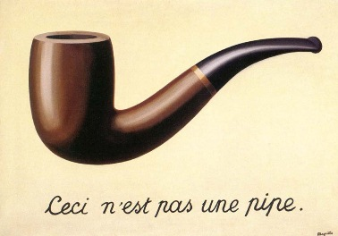
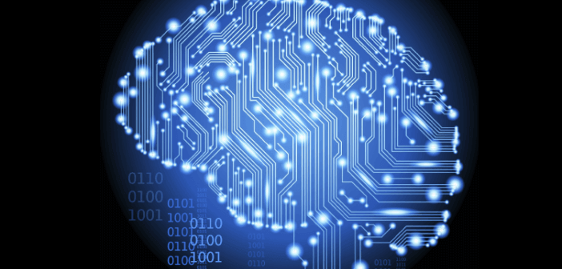
The map-territory illusion
Metaphors are useful to guide thinking about natural phenomena
Have to be philosophically careful not to mistake metaphors for reality

Slide 6
The mind constructs information
Current neuroscience and AI fashions argue for the brain as a passive store of information
The mind is not a passive receptacle
It exists in a body with a long history and a complex present
It constructs information based on being in the world (Heidegger)

Slide 7
Neural RL
Positives
Negatives
The Schultz, Montague & Dayan result shows a clear role for RL in human learning systems
Supported by evidence from neurophysiology (link, link)
We are beginning to understand how model-free learning could support model-based behavior (link)
Representation of time and timing remains a gaping hole in the RL paradigm (link)
Assumption of reward availability remains problematic
Simulations are too sample inefficient to match human behavior (link)

Slide 8
Coda: the successor representation
Remember the value iteration equation?
Peter Dayan showed long ago that it could be rewritten as
Where
The successor representation offers one explanation for how the TD signal could yield model-based policies

Slide 9
Summary
Principles of association and reinforcement are being used prominently in both ML and cognitive science
They work well for specific applications and as partial explanations of human learning
But not as general models of learning to be in the world
Much remains to be learned about
  Internal representations
  Processes controlling internal representations
  Embodied priors
  How embodied priors interact with processes controlling internal representations
We will start talking about how this is currently being done computationally beginning next week

