Slide 1
Open Problems in RL (contd.)
CS786
10th Feb 2022

Slide 2

Value function approximation
RL methods have traditionally approximated the state value function using linear basis functions
  w is a k valued parameter vector, where k is the number of features that are part of the function φ
  Implicit assumption: all features contribute independently to evaluation

Slide 3
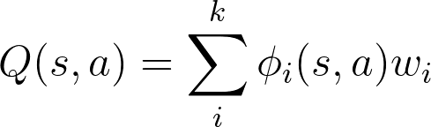

Function approximation in Q-learning
Approximate the Q table with linear basis functions
Update the weights
  Where δ is the TD term

Slide 4
Non-linear approximations
Universal approximation theorem – a neural network with even one hidden layer can approximately represent any continuous-valued function
Neural nets were always attractive for their representation generality
  But were hard to train
  That changed with the GPU revolution ten years ago

Slide 5
The big idea
Approximate Q values using non-linear function approximation
  Where θ are the parameters of the neural network and f(x) is the output of the network for input x
Combines both association and reinforcement principles
  Association buys us state inference
  Reinforcement buys as action policy learning
https://www.nature.com/articles/nature14236

Slide 6
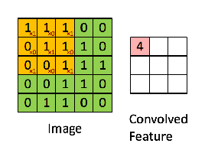
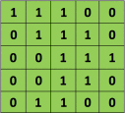

Conv nets basics
Image patch
Filter
Convolution
https://ujjwalkarn.me/2016/08/11/intuitive-explanation-convnets/

Slide 7
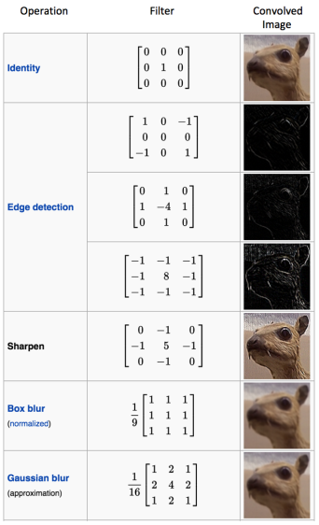
Discriminability from diverse filtering

Slide 8
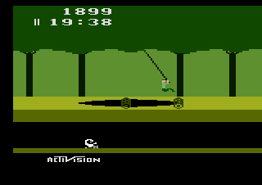
The Atari test bench
A very popular RL test bench
Limited space of actions
Non-stop reward feedback
Free to use
Earlier methods used features handcrafted for each game

Slide 9
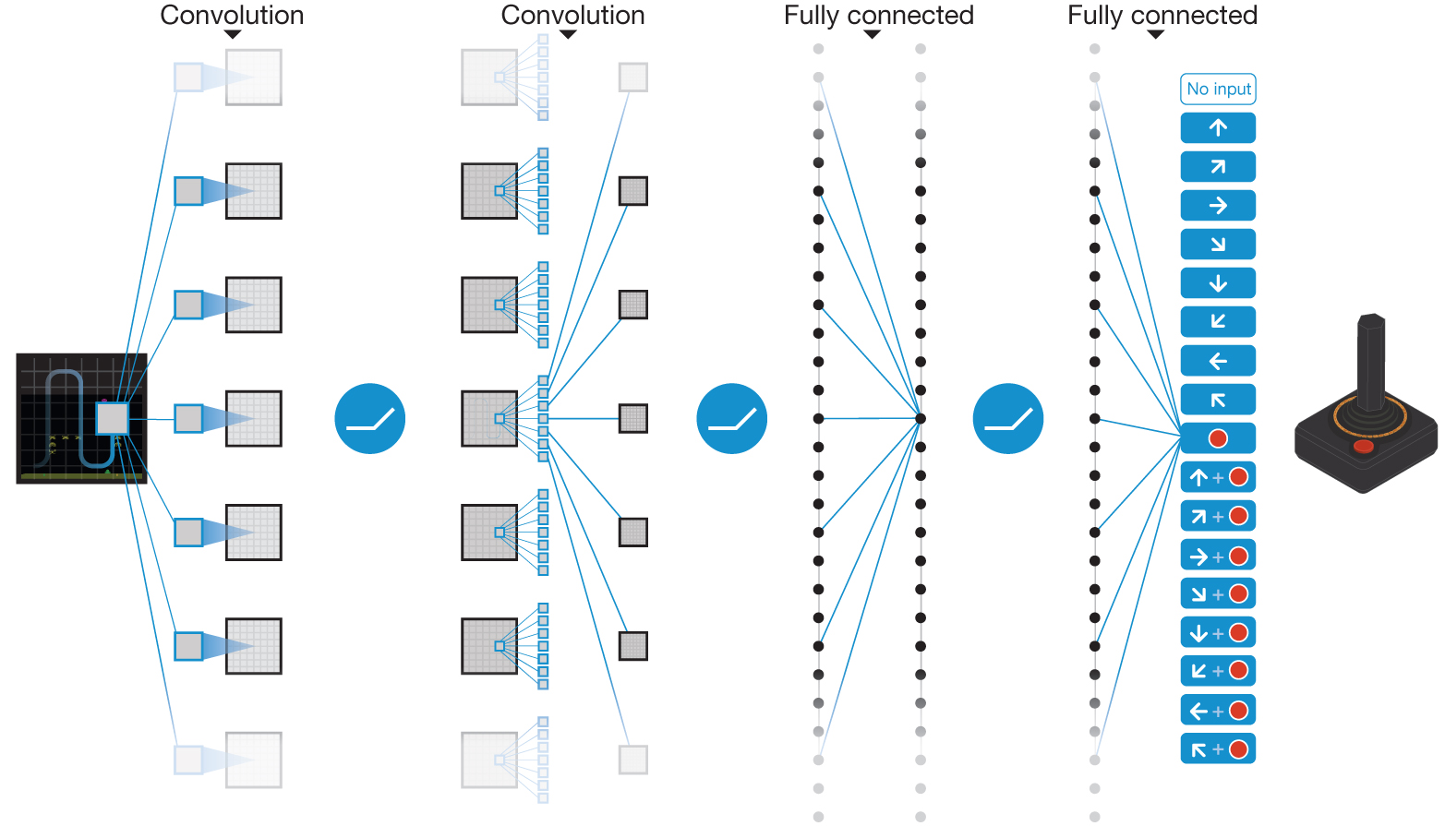

Schematic illustration of the convolutional neural network.
V Mnih et al. Nature 518, 529-533 (2015) doi:10.1038/nature14236

Slide 10

Deep Q network
Basic Q learning algorithm augmented a bunch of different ways
  Use of experience replay
  Use of batch learning
  Use of non-linear function approximation

Slide 11
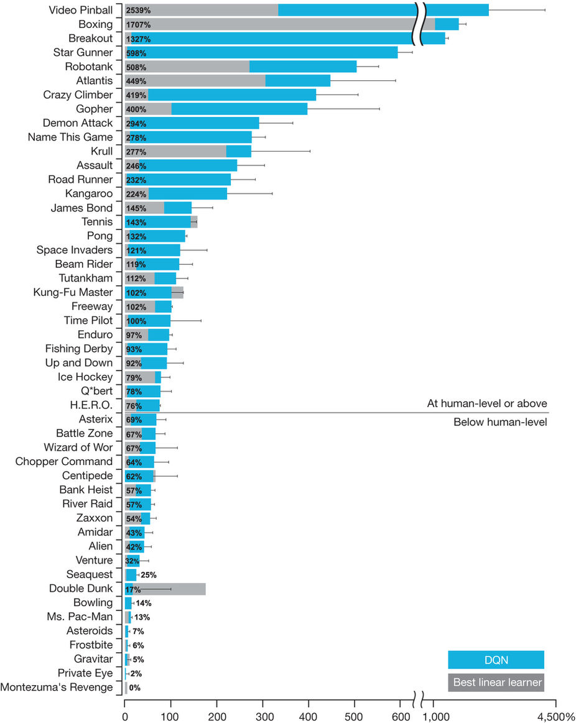

Slide 12
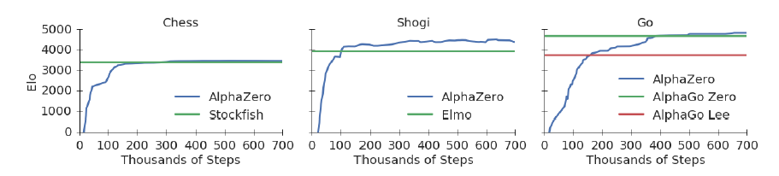
AlphaZero
Figure 1: Training AlphaZero for 700,000 steps. Elo ratings were computed from evaluation games between different players when given one second per move. a Performance of AlphaZero in chess, compared to 2016 TCEC world-champion program Stockfish. b Performance of AlphaZero in shogi, compared to 2017 CSA world-champion program Elmo. c Performance of AlphaZero in Go, compared to AlphaGo Lee and AlphaGo Zero (20 block / 3 day) (29).

Slide 13
Secret ingredient
Some algorithmic innovations
  MCTS
Mostly, just lots and lots of computation
5000 TPUs to generate game-play
64 TPUs to train the DQN
This work closes a long chapter in game-based AI research
  And brings research in RL to a dead end!
https://www.quora.com/Is-reinforcement-learning-a-dead-end

Slide 14
Summary
Deep reinforcement learning is the cognitive architecture of the moment
  Perhaps of the future also
  Beautifully combines the cognitive concepts of association and reinforcement
  Excellent generalizability across toy domains
  Limitations exist: timing, higher-order structure, computational complexity etc.

