Slide 1
Open problems in RL
CS786
7th February 2022

Slide 2
Announcement: research paper timelines
Topic due by 1st March
Either reviewing literature addressing a specific question in cognitive science, or programming a previously published model
Extended abstract due by 15th March
400 words
Describes the methods and/or the scope of the paper in detail
First draft due by 1st April
Should be a nearly complete version of the paper
I will give comments for improvement by 10th April
Final version due by 20th April
Incorporating my comments
Submit via email, with [CS786 paper] in subject line

Slide 3
Open RL problems
Switching between habits and goals

Slide 4
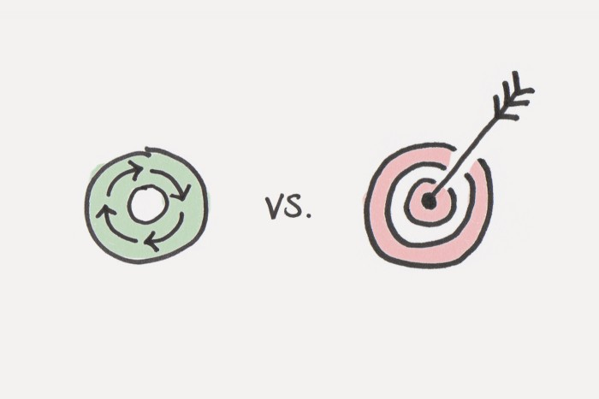
Big ticket application
How to practically shift behavior from habitual to goal-directed in the digital space
Vice versa is understood pretty well by
Social media designers

Slide 5
The social media habituation cycle
Reward
State

Slide 6
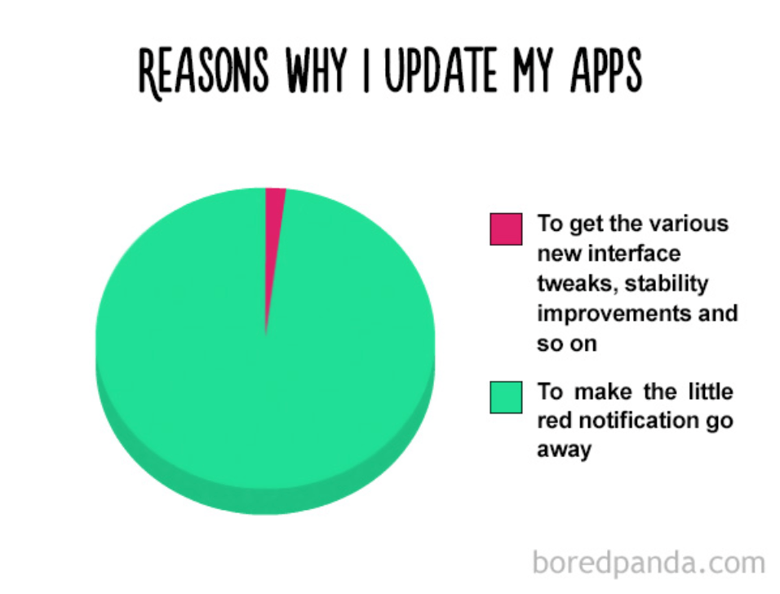
Designed based on cognitive psychology principles

Slide 7
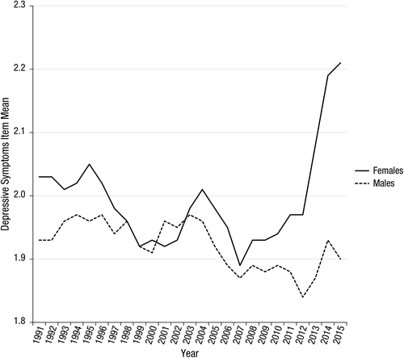
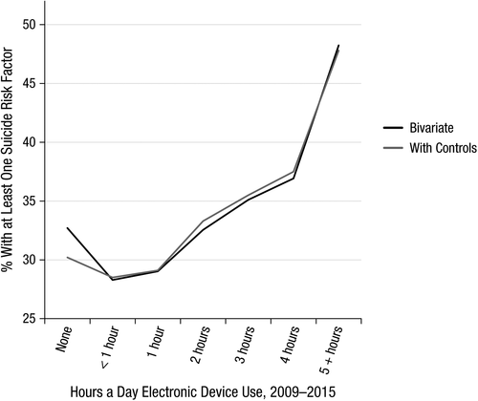
Competing claims
First World kids are miserable!
https://journals.sagepub.com/doi/full/10.1177/2167702617723376
(Twenge, Joiner, Rogers & Martin, 2017)
Not true!
https://www.nature.com/articles/s41562-018-0506-1
(Orben & Przybylski, 2019)

Slide 8
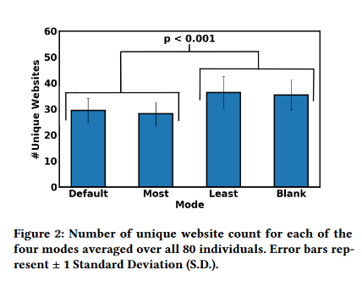
Big ticket application
How to change computer interfaces from promoting habitual to thoughtful engagement
Depends on being able to measure habitual vs thoughtful behavior online
Bharadwaj & Srivastava (2019)

Slide 9
Open RL problems
Designing better state spaces

Slide 10
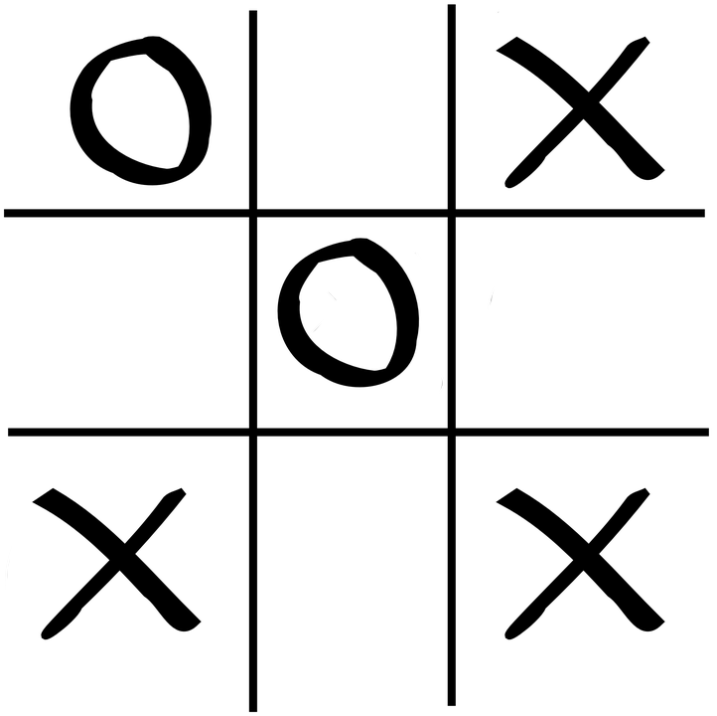
The state space problem in model-free RL
Number of states quickly becomes too large
Even for trivial applications
Learning becomes too dependent on right choice of exploration parameters
Explore-exploit tradeoffs become harder to solve
State space = 765 unique states

Slide 11
Solution approach
Cluster states
Design features to stand in for important situation elements
Close to win
Close to loss
Fork opp
Block fork
Center
Corner
Empty side

Slide 12
What’s the basis for your evaluation?
Use domain knowledge to spell out what is better
φ₁(s) → self center, opponent corner
φ₂(s) → opponent corner, self center
φ₃(s) → self fork, opponent center
φ₄(s) → opponent fork, self center
… as many as you can think of
These are basis functions

Slide 13
Value function approximation
RL methods have traditionally approximated the state value function using linear basis functions
w is a k valued parameter vector, where k is the number of features that are part of the function φ
Implicit assumption: all features contribute independently to evaluation

Slide 14
Function approximation in Q-learning
Approximate the Q table with linear basis functions
Update the weights
Where δ is the TD term

Slide 15
Non-linear approximations
Universal approximation theorem – a neural network with even one hidden layer can approximately represent any continuous-valued function
Neural nets were always attractive for their representation generality
But were hard to train
That changed with the GPU revolution ten years ago

