Slide 1
World models
CS786
3rd Feb 2022

Slide 2
Levels of analysis
Level | Description
Computational | What is the problem?
Algorithmic | How is the problem solved?
Implementation | How this is done by networks of neurons?

Slide 3
RL in the brain
What is the problem?
  Reinforcement → learning preferences for actions that lead to desirable outcomes
How is it solved?
  MDPs provide a general mathematical structure for solving decision problems under uncertainty
  RL was developed as a set of online learning algorithms to solve MDPs
  A critical component of model-free RL algorithms is the temporal difference signal
  Hypothesis: brain is implementing model-free RL?
Implementation
  Spiking rates of dopaminergic neurons in the basal ganglia and ventral striatum behave as if they are encoding this TD signal

Slide 4
Implication?
Model-free learning
  Learn the mapping from action sequences to rewarding outcomes
  Don’t care about the physics of the world that lead to different outcomes
  Is this a realistic model of how human and non-human animals learn?

Slide 5
Learning maps of the world

Slide 6
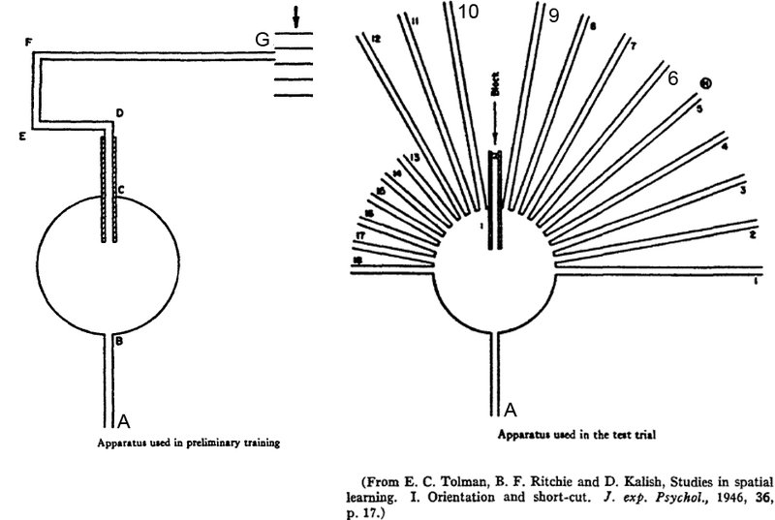
Cognitive maps in rats and men

Slide 7
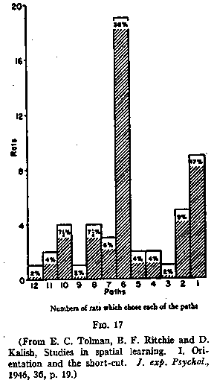
Rats learned a spatial model
Rats behave as if they had some sense of p(s’|s,a)
This was not explicitly trained
Generalized from previous experience
Corresponding paper is recommended reading
So is Tolman’s biography
http://psychclassics.yorku.ca/Tolman/Maps/maps.htm

Slide 8
The model free vs model-based debate
Model free learning → learn stimulus-response mappings = habits
What about goal-based decision-making?
  Do animals not learn the physics of the world in making decisions?
Model-based learning → learn what to do based on the way the world is currently set up = thoughtful responding?
People have argued for two systems
  Thinking fast and slow (Balleine & O’Doherty, 2010)

Slide 9
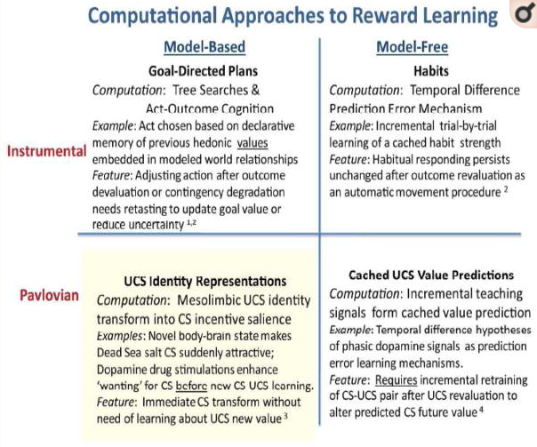
Multiple modes of learning
https://www.ncbi.nlm.nih.gov/pmc/articles/PMC4074442/

Slide 10
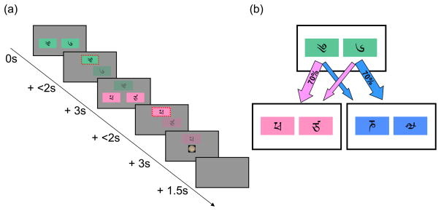
A contemporary experiment
The Daw task (Daw et al, 2011) is a two-stage Markov decision task
Differentiates model-based and model-free RL accounts empirically

Slide 11
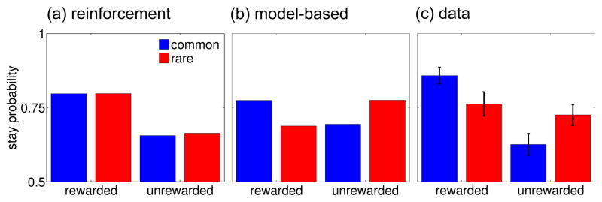
Predictions meet data
Behavior appears to be a mix of both strategies
What does this mean?
Active area of research

Slide 12
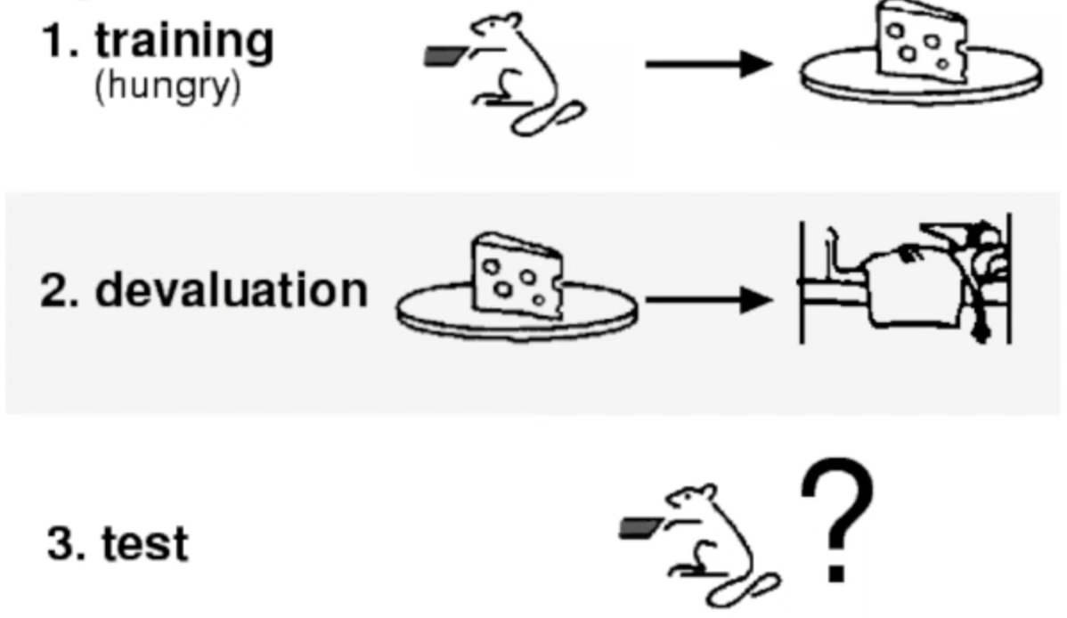
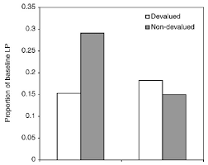
Some hunches
Moderate training
Extensive training
(Holland, 2004; Kilcross & Coutureau, 2003)

Slide 13
Current consensus
In moderately trained tasks, people behave as if they are using model-based RL
In highly trained tasks, people behave as if they are using model-free RL
Nuance:
  Repetitive training on a small set of examples favors model-free strategies
  Limited training on a larger set of examples favors model-based strategies
(Fulvio, Green & Schrater, 2014)

Slide 14
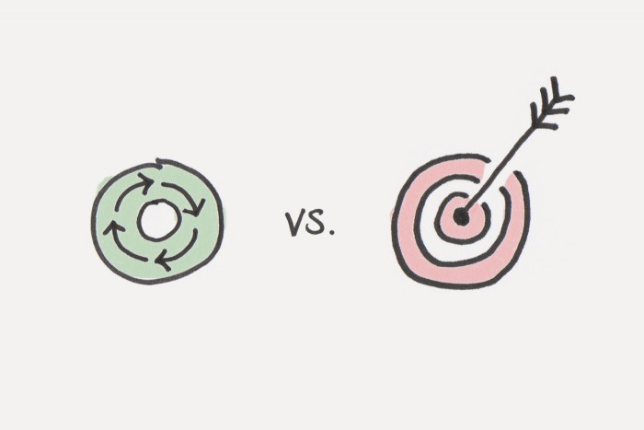
Big ticket application
How to practically shift behavior from habitual to goal-directed in the digital space
  Vice versa is understood pretty well by
    Social media designers

Slide 15
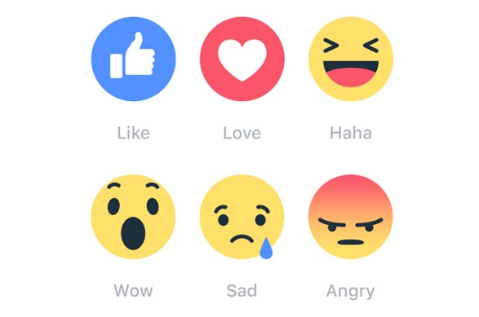
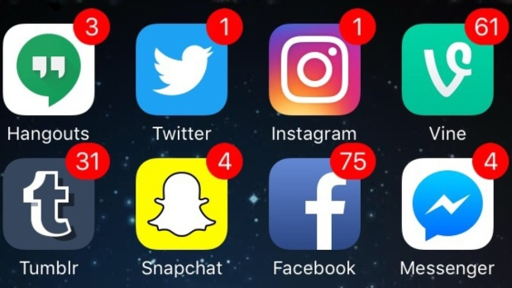

The social media habituation cycle
Reward
State

Slide 16
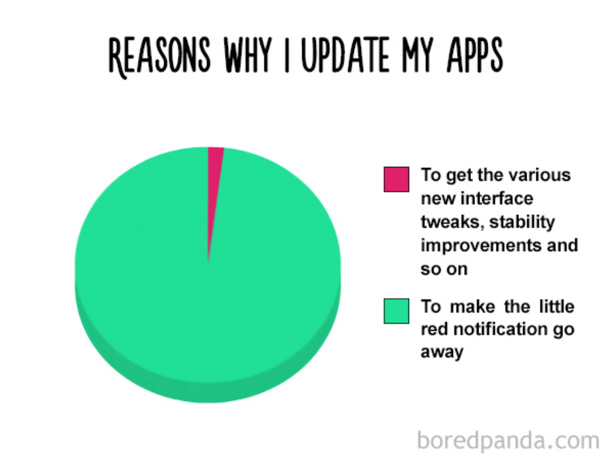
Designed based on cognitive psychology principles

Slide 17
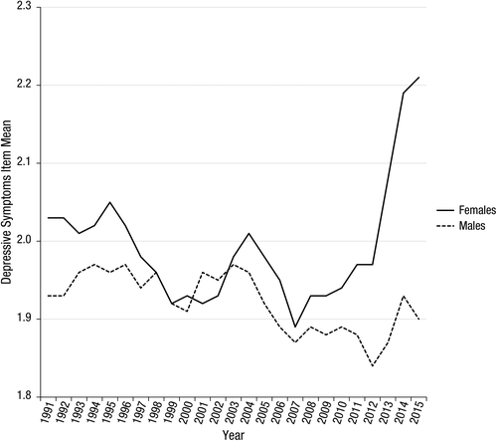
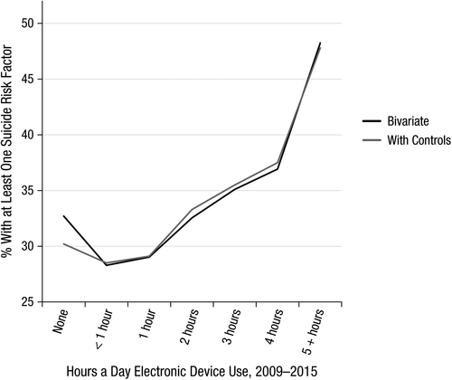
Competing claims
First World kids are miserable!
https://journals.sagepub.com/doi/full/10.1177/2167702617723376
(Twenge, Joiner, Rogers & Martin, 2017)
Not true!
https://www.nature.com/articles/s41562-018-0506-1
(Orben & Przybylski, 2019)

Slide 18

Big ticket application
How to change computer interfaces from promoting habitual to thoughtful engagement
Depends on being able to measure habitual vs thoughtful behavior online

