Slide 1
RL in the brain
CS786
1st February 2022

Slide 2
Temporal difference learning
Consider the Q-learning update
Or the SARSA update
A generic temporal difference principle can be discerned for behavioral reinforcement

Slide 3
The TD learning principle
Bush Mosteller algorithm, with V as learned reinforcement value
Temporal difference learning
Discounted future rewards not available instantaneously
  Use Bellman optimality principle

Slide 4
Reinterpreting the learning gradient
In Bush Mosteller, the reward prediction error is driven by the difference between
  A discounted average of received rewards
  The current reward
In TD learning, RPE is the difference between
  Expected value of discounted future rewards F
  Information suggesting the expectation is mistaken
http://www.scholarpedia.org/article/Temporal_difference_learning

Slide 5
The TD reward prediction error
Learning continues until reward expectations are perfectly aligned with received reward

Slide 6
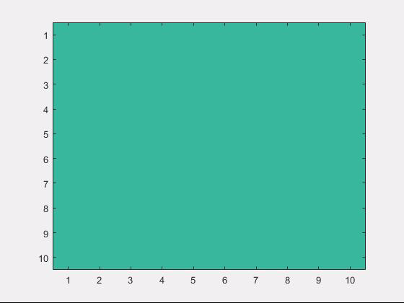
The role of the future
Myopic learning (λ = 0)
Future-sensitive learning (λ > 0)

Slide 7
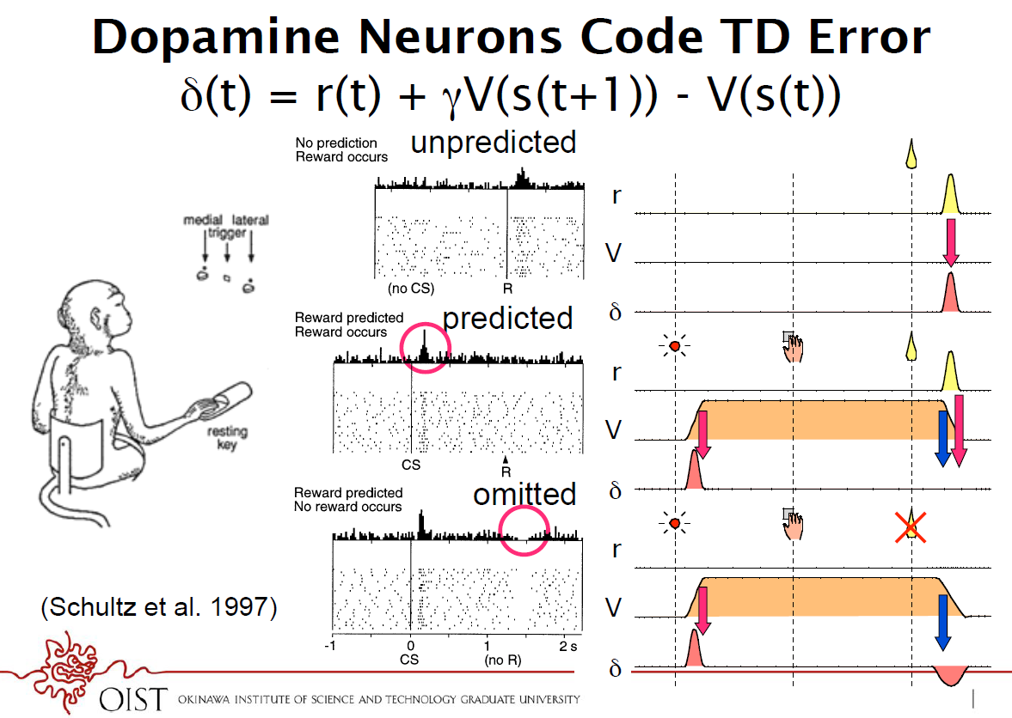

Slide 8
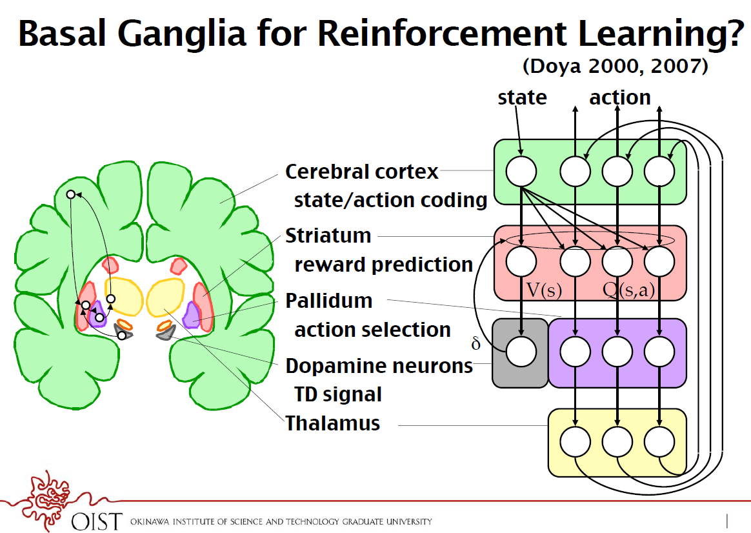

Slide 9
Cocaine addiction (a success story)
Cocaine pharmacodynamics
  Is a dopamine reuptake inhibitor
Under normal circumstances the TD signal is
When you take cocaine

Slide 10
The mechanics of physical addiction
In the beginning, taking cocaine is associated with positive TD signal
  So taking cocaine is learned
But presence of cocaine in the system prevents the TD signal from becoming negative
  No matter what you do
  Behavior cannot be unlearned!

Slide 11
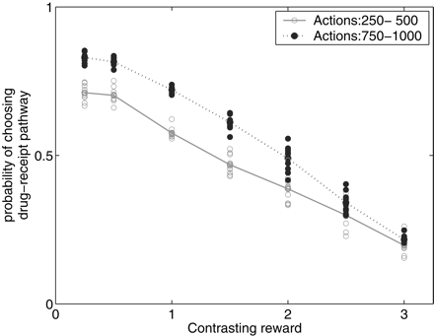
Reward insensitivity
Observer will become unable to tradeoff drug consumption with other rewards

Slide 12
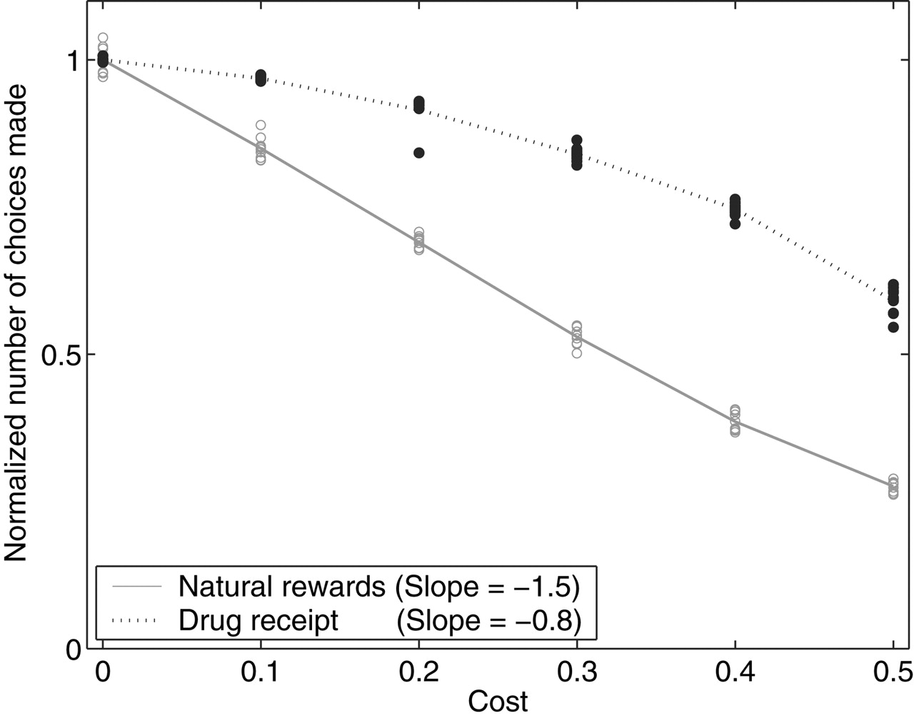
Cost insensitivity
Observe is unable to reduce preference with increasing cost

Slide 13
Cocaine addiction (a success story)
Cocaine pharmacodynamics
  Is a dopamine reuptake inhibitor
Under normal circumstances the TD signal is
When you take cocaine
Addiction: a computational process gone awry (Redish, 2004)

Slide 14
The model free vs model-based debate
Model free learning → actions that lead to rewards become more preferable
What about goal-based decision-making?
  Do animals not learn the physics of the world in making decisions?
Model-based learning
People have argued for two systems
  Thinking fast and slow (Balleine & O’Doherty, 2010)

Slide 15
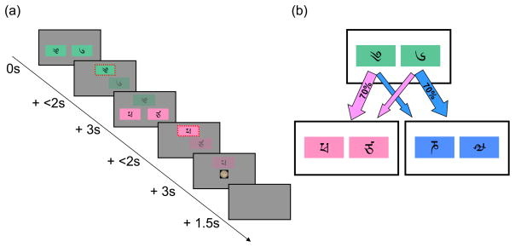
A clever experiment
The Daw task (Daw et al, 2011) is a two-stage Markov decision task
Differentiates model-based and model-free accounts empirically

Slide 16
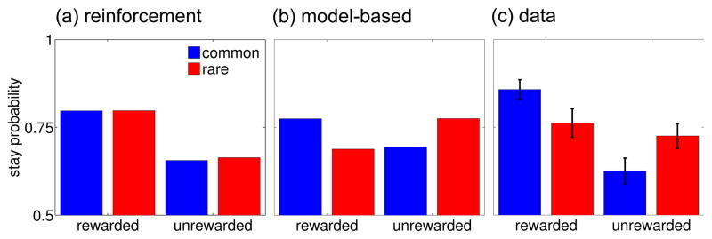
Predictions meet data
Behavior appears to be a mix of both strategies
What does this mean?
Active area of research

