Slide 1
Solving MDPs
CS786
27th January 2022

Slide 2
The MDP framework
An MDP is the tuple {S,A,R,P}
Set of states (S)
Set of actions (A)
Possible rewards (R) for each {s,a} combination
P(s’|s,a) is the probability of reaching state s’ given you took action a while in state s

Slide 3
Solving an MDP
Solving an MDP is equivalent to finding an action policy AP(s)
Tells you what action to take whenever you reach a state s
Typical rational solution is to maximize future-discounted expected reward

Slide 4
Solution strategy
Notation:
P(s’|s,a) is the probability of moving to s’ from s via action a
R(s’,a) is the reward received for reaching state s’ via action a
Update value and action policy iteratively
https://towardsdatascience.com/getting-started-with-markov-decision-processes-reinforcement-learning-ada7b4572ffb

Slide 5
Part of a larger universe of AI models
Control over actions?
 | No | Yes
No | HMM | POMDP
Yes | Markov chain | MDP
States observable?

Slide 6
Modeling human decisions?
States are seldom nicely conceptualized in the real world
Where do rewards come from?
Storing transition probabilities is hard
Do people really look ahead into the infinite time horizon?

Slide 7
Markov chain
Goal in solving a Markov chain
Identify the stationary distribution
0.1
Sunny
Rainy
0.3

Slide 8
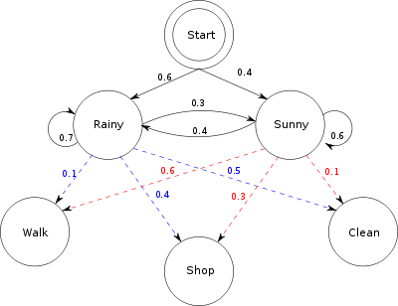
HMM
HMM goal → estimate latent state transition and emission probability from sequence of observations

Slide 9
MDP → RL
In MDP, {S,A,R,P} are known
In RL, R and P are not known to begin with
They are learned from experience
Optimal policy is updated sequentially to account for increased information about rewards and transition probabilities
Model-based RL
Learns transition probabilities P as well as optimal policy
Model-free RL
Learns only optimal policy, not the transition probabilities P

