Slide 1
Reinforcement
CS786
25th January 2022

Slide 2
Association vs reinforcement
Association: things that occur together in the world, occur together in the mind
  Tested using classical conditioning
  Environment acts on the observer
Reinforcement: actions that are rewarded become desirable in future
  Tested using operant/instrumental conditioning
  Observer acts on the environment

Slide 3
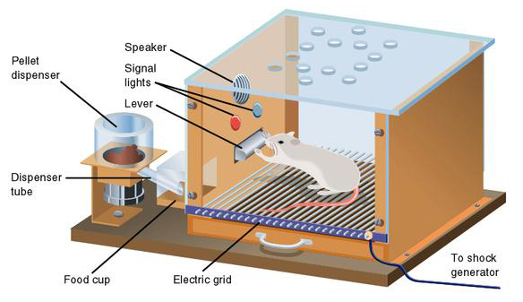
Operant conditioning
Observers act upon the world, and face consequences
  Consequences can be interpreted as rewards

Slide 4


Modeling classical conditioning
Most popular approach for years was the Rescorla-Wagner model
Could reproduce a number of empirical observations in classical conditioning experiments
Some versions replace V_{tot} with V_{x}; what is the difference?
http://users.ipfw.edu/abbott/314/Rescorla2.htm

Slide 5
Can modify to accommodate reward prediction
Original equation
  Update size based on associative strength available
Bush-Mosteller model of reinforcement, for action a

Slide 6
The MDP framework
An MDP is the tuple {S,A,R,P}
  Set of states (S)
  Set of actions (A)
  Possible rewards (R) for each {s,a} combination
  P(s’|s,a) is the probability of reaching state s’ given you took action a while in state s

Slide 7
An example MDP
States: hungry, taste-deprived, full, happy, unhappy
Actions: go to hostel mess, delivery from restaurant, make Maggi
Reward(state, action)
  R(hungry, mess) = 10
  R(taste-deprived, mess) = -100
State transition probability:
Hungry to full, maggi = 0.4
Taste-deprived to happy, mess = 0

Slide 8
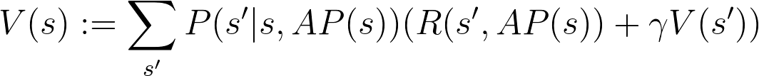
Solution strategy
Update value and action policy iteratively
https://towardsdatascience.com/getting-started-with-markov-decision-processes-reinforcement-learning-ada7b4572ffb

