Slide 1
Neurons
CS786
18th January 2021

Slide 2
What neurons do – the ML version
A neuron collects signals from dendrites (not quite)
Sends out spikes of electrical activity through an axon, which splits into thousands of branches.
At the end of each branch, a synapse converts activity into either exciting or inhibiting activity of a dendrite at another neuron (more complicated than this)
Neuron fires when exciting activity surpasses inhibitory activity above some threshold (neurotransmitters govern the threshold and activity rate)
Learning changes the strength of synapses (but what sort of learning?)

Slide 3
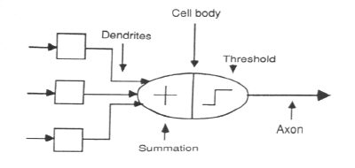
Artificial neurons
Logical abstraction of natural neurons to perform these functions

Slide 4
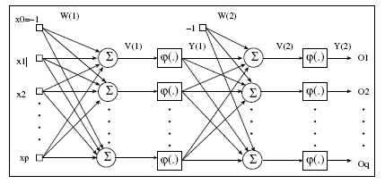
ANN Forward Propagation

Slide 5
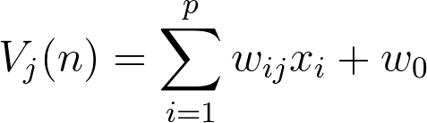
ANN Forward Propagation
Apply input vector X to layer of neurons.
Calculate
  where x_{i} is the activation of previous layer neuron i
  w_{ji} is the weight of going from node i to node j
  p is the number of neurons in the previous layer
Calculate output activation

Slide 6
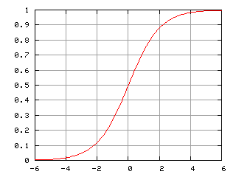
Possible firing rules
Firing Rules: Sigmoid functions:
  Hyperbolic tangent function
  Logistic activation function

Slide 7
ANN Forward Propagation
Example: Three layer network
  Calculates xor of inputs
-4.8
0
2
5.9
5.1
4
4.6
1
3
5.2
-5.2
-3.2
-2.6
-2.7
Bias

Slide 8
ANN Forward Propagation
Input (0,0)
-4.8
0
2
5.9
5.1
4
4.6
1
3
5.2
-5.2
-3.2
-2.6
-2.7
Bias

Slide 9
ANN Forward Propagation
Input (0,0)
  Node 2 activation is ϕ(-4.8 ⋅ 0+4.6 ⋅ 0 - 2.6)= 0.0691
-4.8
0
2
5.9
5.1
4
4.6
1
3
5.2
-5.2
-3.2
-2.6
-2.7
Bias

Slide 10
ANN Forward Propagation
Input (0,0)
  Node 3 activation is ϕ(5.1 ⋅ 0 - 5.2 ⋅ 0 - 3.2)= 0.0392
-4.8
0
2
5.9
5.1
4
4.6
1
3
5.2
-5.2
-3.2
-2.6
-2.7
Bias

Slide 11
ANN Forward Propagation
Input (0,0)
  Node 4 activation is ϕ(5.9 ⋅ 0.069 + 5.2 ⋅ 0.04 – 2.7)= 0.110227
-4.8
0
2
5.9
5.1
4
4.6
1
3
5.2
-5.2
-3.2
-2.6
-2.7
Bias

Slide 12
ANN Forward Propagation
Input (0,1)
  Node 2 activation is ϕ(4.6 -2.6)= 0.153269
-4.8
0
2
5.9
5.1
4
4.6
1
3
5.2
-5.2
-3.2
-2.6
-2.7
Bias

Slide 13
ANN Forward Propagation
Input (0,1)
  Node 3 activation is ϕ(-5.2 -3.2)= 0.000224817
-4.8
0
2
5.9
5.1
4
4.6
1
3
5.2
-5.2
-3.2
-2.6
-2.7
Bias

Slide 14
ANN Forward Propagation
Input (0,1)
  Node 4 activation is ϕ(5.9 ⋅ 0.153269 + 5.2 ⋅ 0.000224817 -2.7 )= 0.923992
-4.8
0
2
5.9
5.1
4
4.6
1
3
5.2
-5.2
-3.2
-2.6
-2.7
Bias

Slide 15
ANN Forward Propagation
Network can learn a non-linearly separated set of outputs.
Need to map output (real value) into binary values.

Slide 16
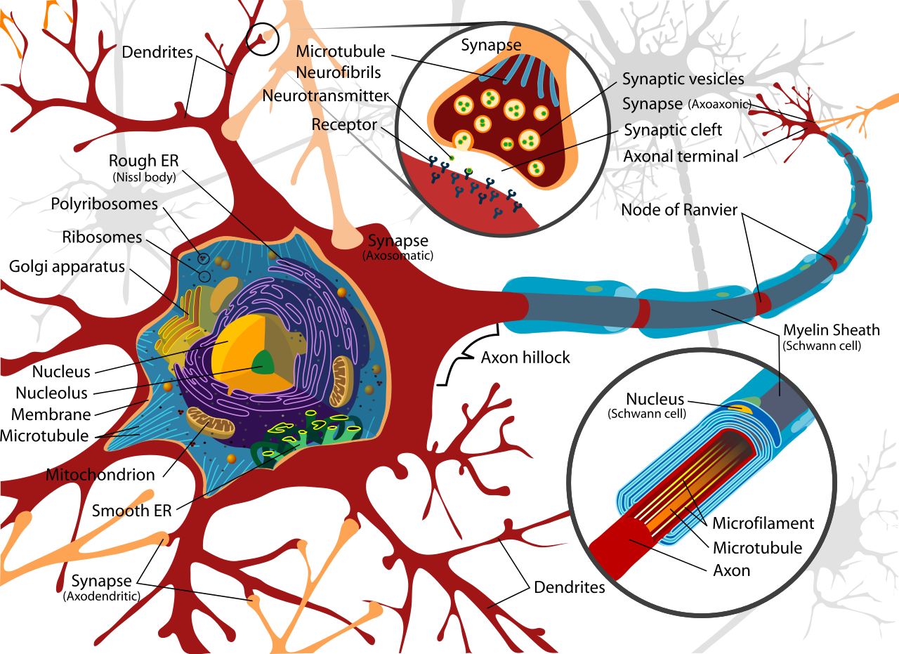
Real neurons

Slide 17
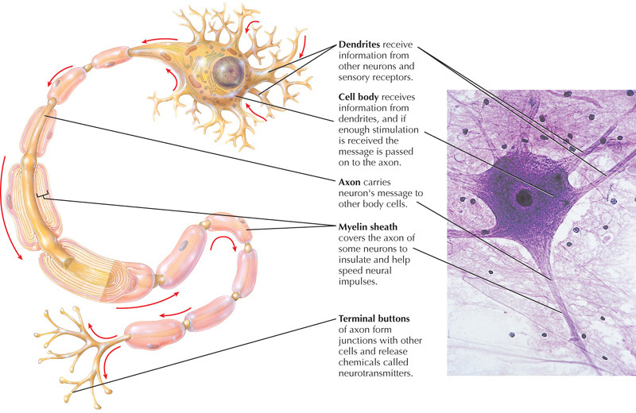
Let’s Review!

Slide 18
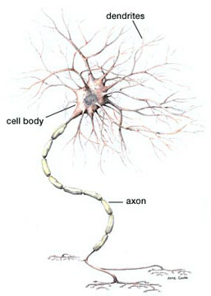
The Neuron
The Cell body contains the cell nucleus
The cell body relays the information down to the axon

Slide 19
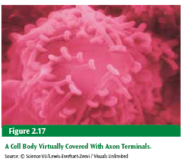
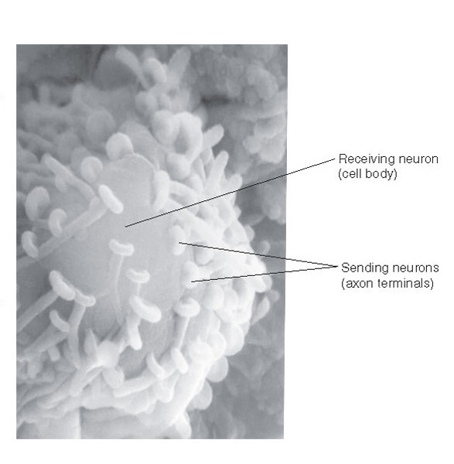
The cell body is covered with Axon Terminals

Slide 20
-Electrical Communication
-Chemical Communication
How do Neurons Communicate?

Slide 21
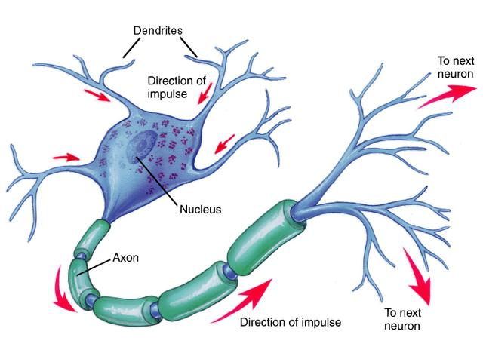

Slide 22
The Electrical Part
Action potential is an electrical current sent down the axon.
The activity within the neurons is electrical. This current causes the neuron to “fire”
  This is an “all-or-none” process

Slide 23
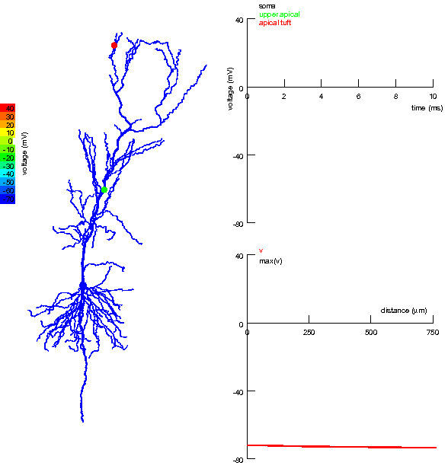

Slide 24
Synaptic transmission
The Synapse is the space between neurons
  The synaptic gap or cleft
Information must be transmitted across the synapse to other neurons via the neurotransmitters.
This is an electrochemical process

Slide 25
The perception-action circuit
sensory neuron
interneuron
sensory receptors
effector
motor neuron
Notes:
Interaction Between Neurons

Slide 26
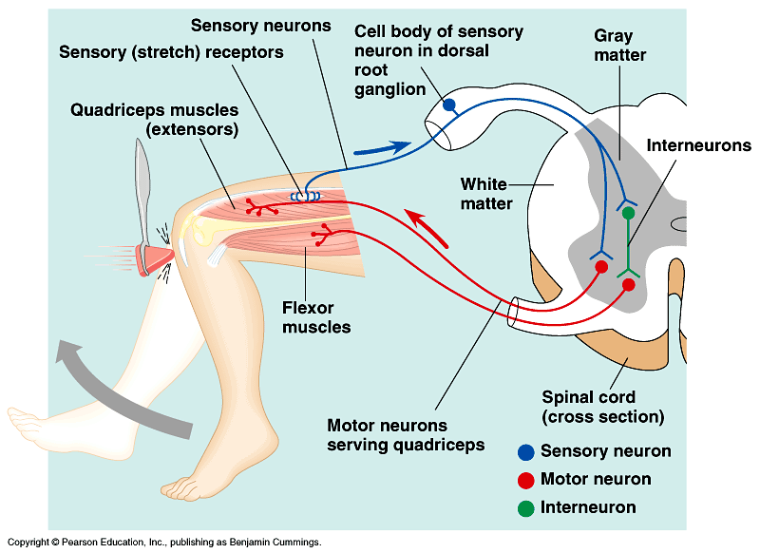
A Simple Nerve Circuit – the Reflex Arc.
  A reflex is an autonomic response.

Slide 27
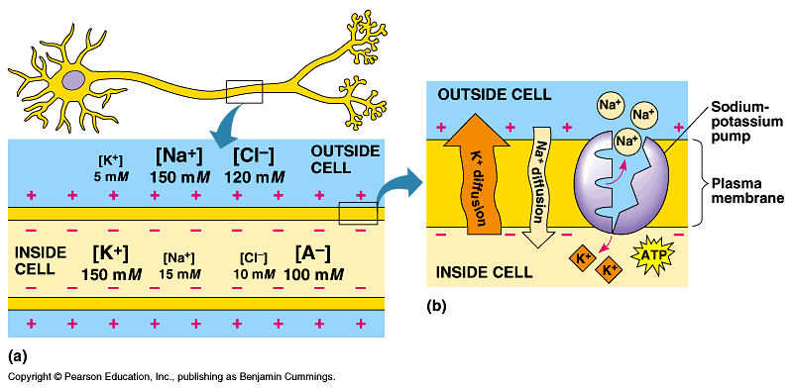
Neuron electrochemistry

Slide 28
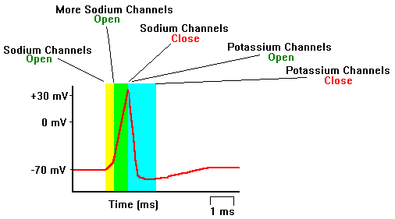
Neuron electrochemistry
At rest, the neuron has a higher concentration of K than Na
Channels
  Na channels are quick-responding
  K channels are slow-responding
Impulse from neurotransmitters opens ion channels locally in neuron
Na rushes into neuron cell body quickly
K takes time, because channels are slower

Slide 29
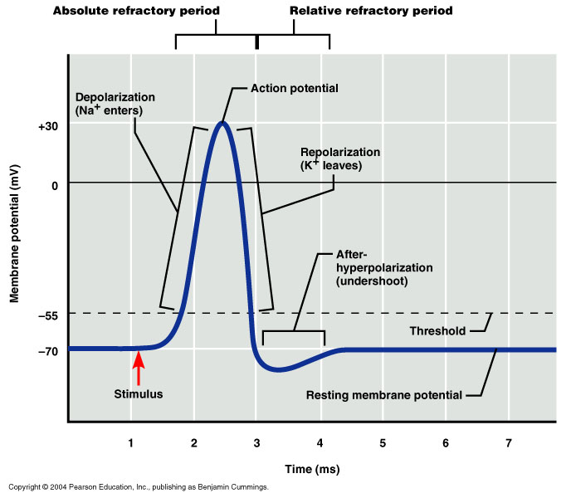
Action potential

Slide 30
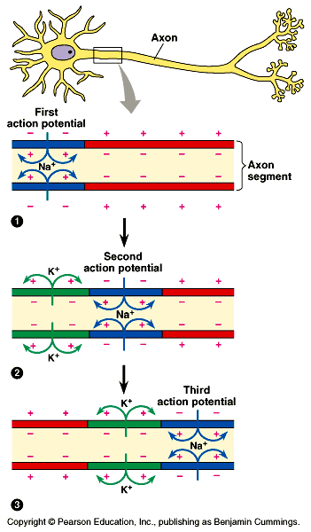

Slide 31
Three Steps for firing
Resting potential: voltage is about -70mV
  Dendrites receive incoming signals
  If sufficient, cell goes into firing mode
Action potential
  Voltage changes from -70mV to +40mV
  Ions exchange places
  Repeats itself rapidly down axon
  Only in places where myelin sheath doesn’t cover: Nodes of Ranvier
Refractory Period:
  below resting or lower than -70mV
  Cell recovers from firing
  Absolute refractor period: Brief time period when cannot fire again
  Relative refractory period: Brief time period when difficult for it to fire again.

Slide 32
The Neuron Fires
Action potential causes nearby Na+ channels to open, so another action potential is triggered right next to first one, and this continues all the way down the axon
  Chain reaction
  Like a bunch of dominoes
Action potential ≠ local potential in several important ways:
  Local potential = graded potential- it varies in magnitude depending on strength of stimulus that produced it; action potential is ungraded
  Action potential obeys all or none law: occurs at full strength or not at all
  Action potential is nondecremental: does NOT lose strength at each successive point (local potentials do degrade)

Slide 33
The Neurotransmitter
Neurotransmitter is chemical
  Several specific kinds- each act on certain neurons
  Most neurons respond to and release one kind of neurotransmitter
Neurotransmitter stored in synaptic vesicles
The synaptic vesicles move to and fuse to end of membrane
  Action potential opens channels that allow Ca+ ions to enter terminals from extracellular fluid
  Ca+ ions cause vesicles nearest the membrane to fuse with membrane
  Membrane then opens and transmitter is dumped into synapse
  Diffuses across synapse to postsynaptic neuron and attaches to chemical receptor

Slide 34
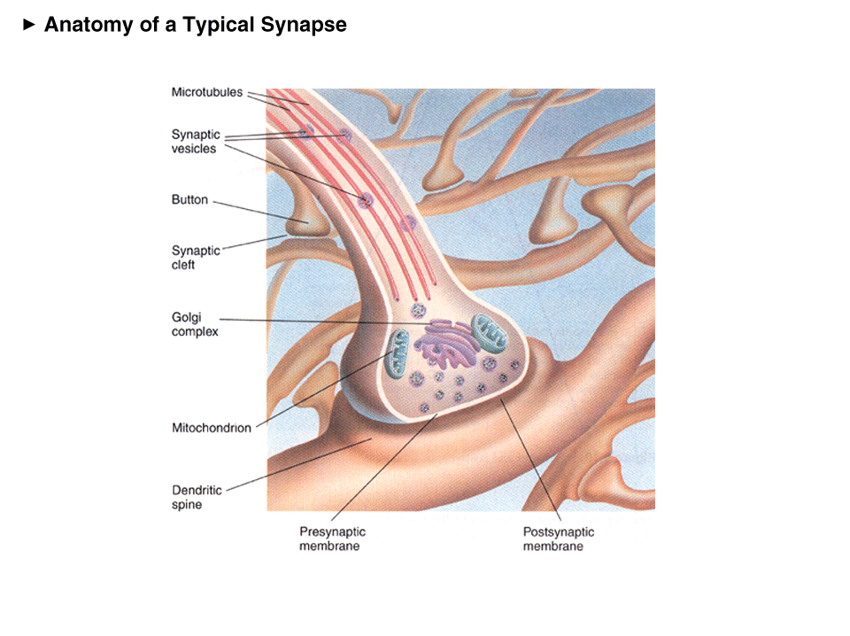

Slide 35
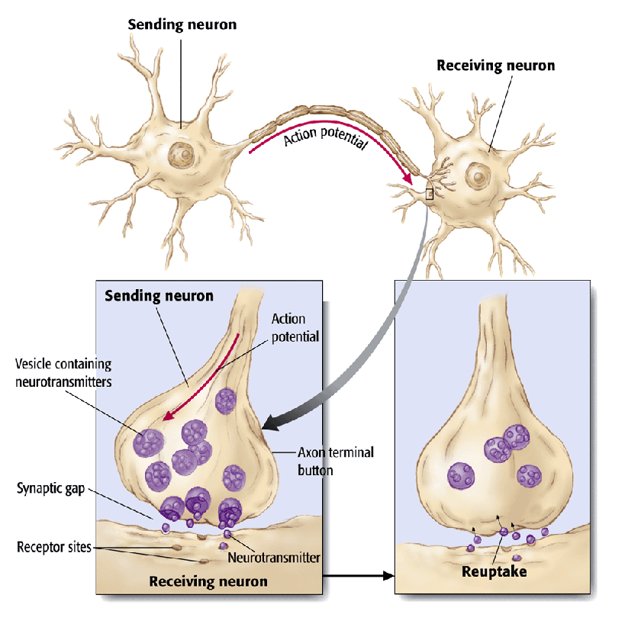

Slide 36
Action in the Synapse
Neurotransmitter is released into the synapse
  diffuses across synapse to next neuron’s dendrite
  This “next dendrite” is post-synaptic
Neurotransmitter is attracted to the POST-synaptic side:
  receptor sites on the next neurons dendrites
  neurotransmitter must match molecular shape of receptor site
  Activation of receptor causes ion channels in membrane to open

Slide 37
Two kinds of Receptor Action
Ionotropic receptors open channels directly to produce immediate reactions required for motor and sensory processing
Metabotropic receptors open channels indirectly
  slower: but produce longer-lasting effects
  Sets off graded potentials for next action potential
Movement across the synapse is relatively slow: several milliseconds

Slide 38
Excitation and Inhibition
The NT opens ion channels on dendrites and soma
Two effects on local membrane potential:
  shifts in positive direction (towards 0), partially depolarizing
  Shifts in negative direction (away from 0): hyperpolarization
Thus two effects:
  Excitatory: depolarization (moves toward and past 0)
  Inhibitory: hyperpolarization (moves away from 0)

Slide 39
Two kinds of postsynaptic potentials:
EPSPs: excitatory postsynaptic potentials
  Excitatory effect: increases likelihood of action potential
  Opens Na+ channels
IPSPs: inhibitory postsynaptic potentials
  Inhibitory effect: decreases likelihood of action potential
  Opens K+ channels
Thus: bidirectional effects
  Summative effects
  Overall change must be sufficient to produce action potential

Slide 40
Postsynaptic integration
Summation across all the IPSPs and EPSPs
  Summates algebraically
  Adds both positive and negatives together
Two kinds:
  Spatial summation:
    Sum of all IPSPs and EPSPs occurring simultaneously at different locations along dendrites and cell body
    Must be sufficient number of “hits”
  Temporal summation
    Sum of all IPSPs and EPSPs occurring within a short time
    Must occur within a few milliseconds
    Must get sufficient number of “hits” within certain time
Neuron is an information integrator!
  A decision maker
  Small microprocessor

Slide 41
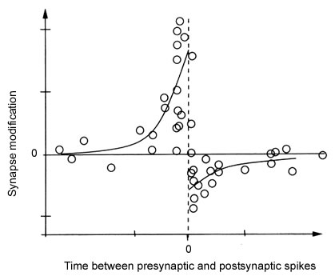
Temporal dynamics of synaptic response
Spike-timing dependent plasticity has been experimentally documented

Slide 42
