Slide 1
Learning to associate
CS786
14th January 2022

Slide 2
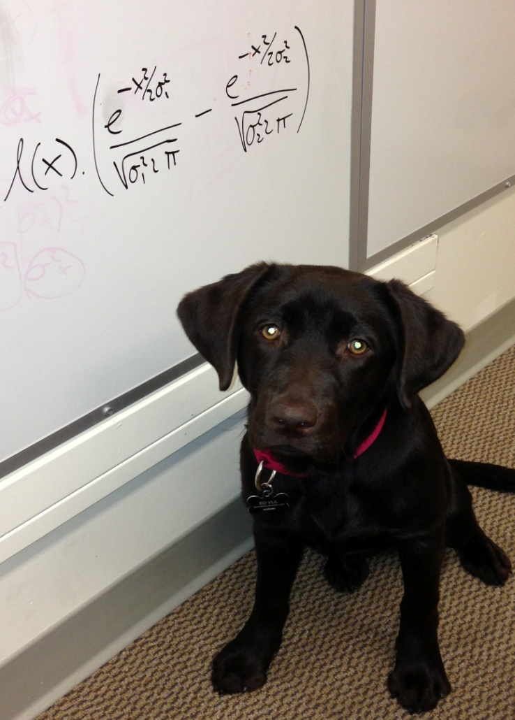
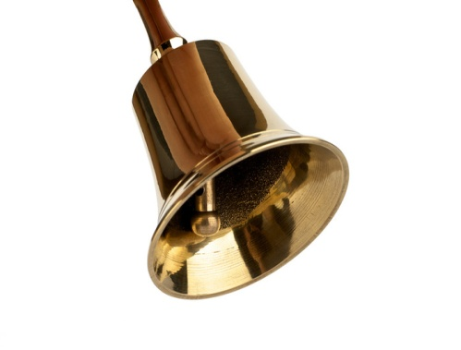
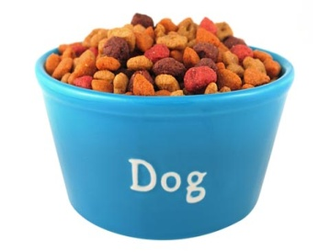
What RW could explain

Slide 3
What it couldn’t
Pre-exposed
Latent inhibition

Slide 4
Latent cause modeling of conditioning
Rescorla Wagner model
Latent cause model*
s
CS
UCS
CS
UCS
* See Courville, Daw & Touretzky (2005) for a formal description

Slide 5
https://link.springer.com/article/10.3758/s13420-012-0080-8

Slide 6
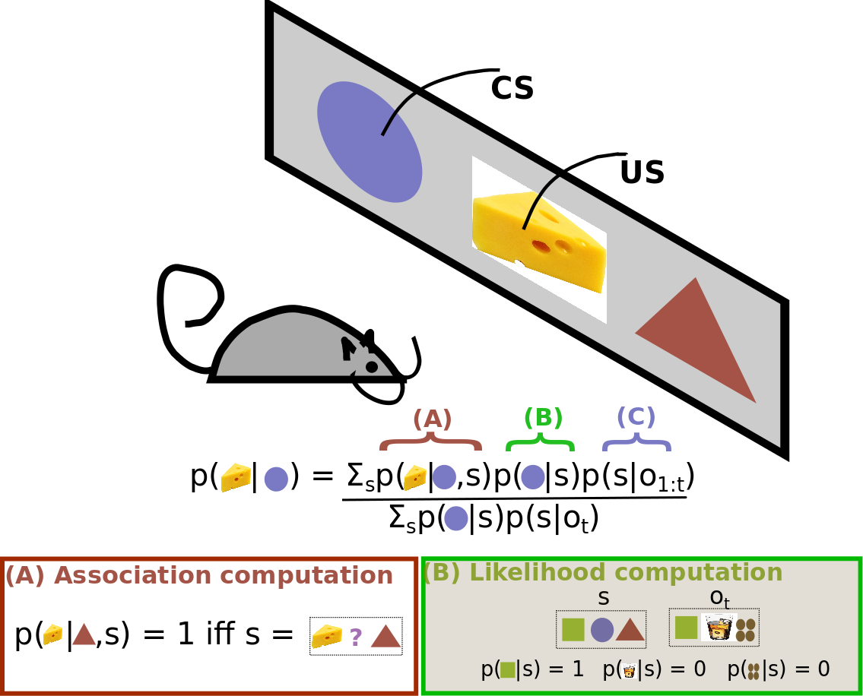

Slide 7
Bayes 101
Bayes theorem is a simple consequence of conditional probability factoring
Lends itself easily to sequential updates
Great fit for cognitive modeling
Models interaction of already known with new data

Slide 8
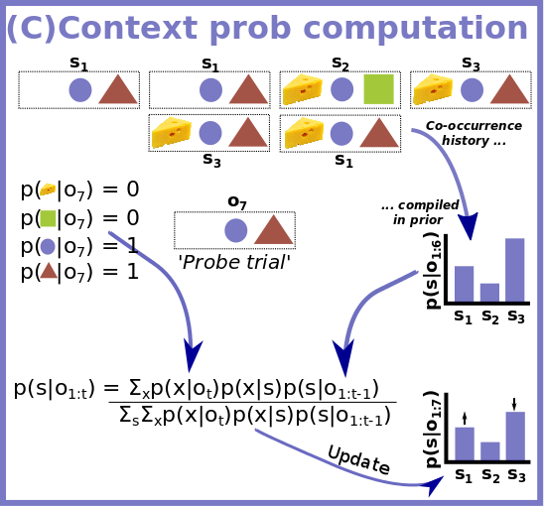

Slide 9
Some RW failures explained by latent cause model
Spontaneous recovery from extinction
Facilitated reacquisition
Conditioned inhibitor pairing
Pre-exposure effect
Higher order conditioning

Slide 10
Summary
The mind learns by association
Associates novel with known, based on a number of ways of relation
Association of novel to known causes generalization
Association of known with known causes reinforcement
Important question: why is the mind associative?

Slide 11
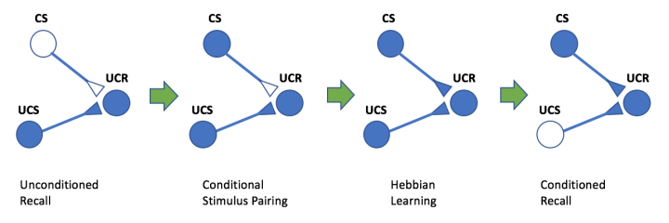
Explaining associativity

Slide 12
Hebbian learning
If two information processing units are activated simultaneously, their activity will become correlated, such that activity in one will make activity in the other more likely
We will see
How Hebbian learning works in artificial neurons
How Hebbian learning works in real neurons

Slide 13
Hebbian learning
j
w_{ij}
i

Slide 14
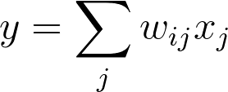
Hebb’s rule in action
Common variant
Problem
No way to weaken weights
Weights can climb up without bound
Solution: normalization?

Slide 15
Normalizing Hebb’s rule
Oja’s rule can be derived as an approximate normalized version of Hebb’s rule
Other formulations are also possible, e.g. BCM, generalized Hebb
Hebbian learning partially explains how neurons can encode new information
And explains how this learning is fundamentally associative

Slide 16
What neurons do – the ML version
A neuron collects signals from dendrites (not quite)
Sends out spikes of electrical activity through an axon, which splits into thousands of branches.
At the end of each branch, a synapse converts activity into either exciting or inhibiting activity of a dendrite at another neuron (more complicated than this)
Neuron fires when exciting activity surpasses inhibitory activity above some threshold (neurotransmitters govern the threshold and activity rate)
Learning changes the strength of synapses (but what sort of learning?)

Slide 17
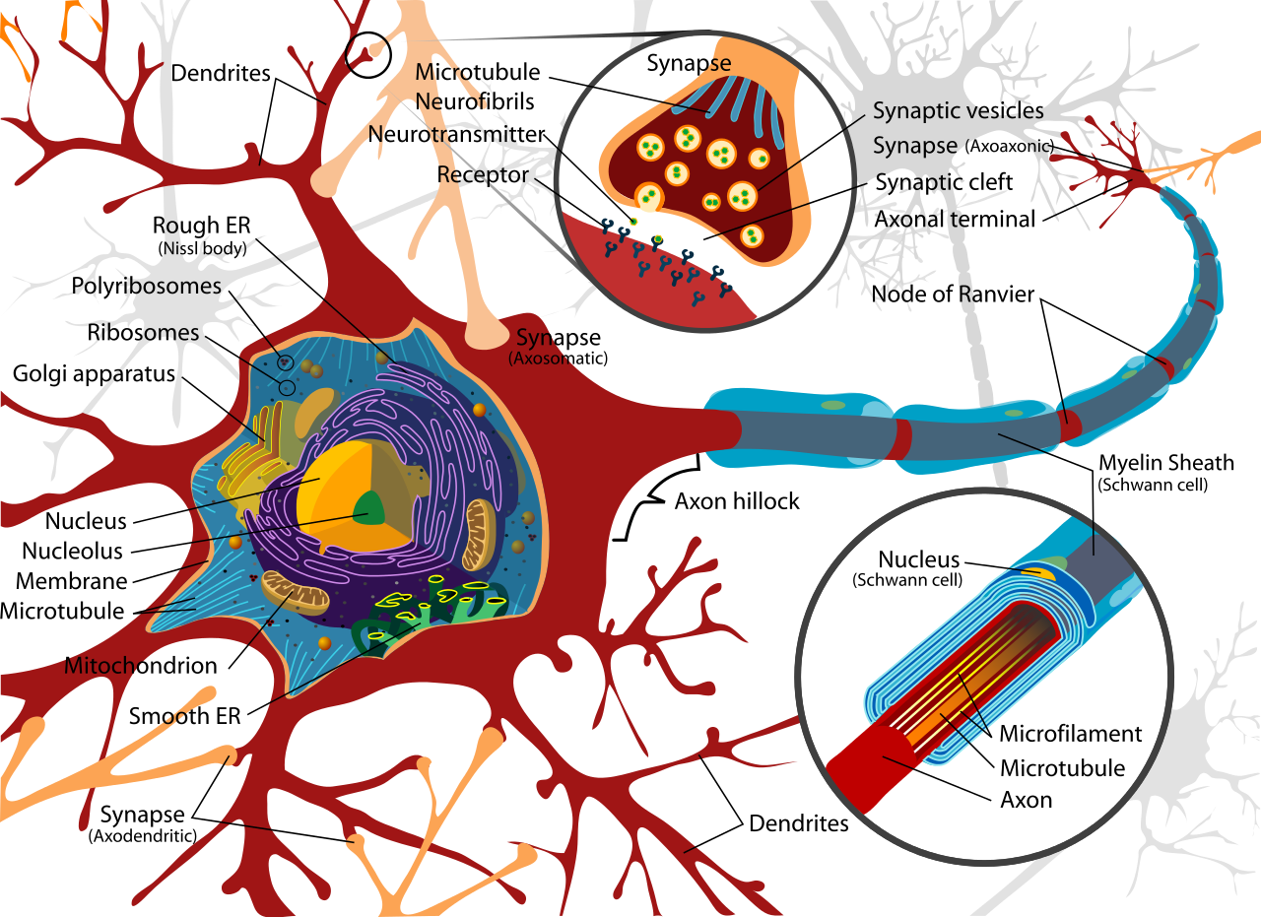
Real neurons

