Slide 1
Association
Nisheeth
11th January 2022

Slide 2
Course TAs
Pragya (pragyaa20@iitk.ac.in)
Abhishek (abhijais@iitk.ac.in)
Samarth (samarthm20@iitk.ac.in)
Pritam (pritaml20@iitk.ac.in)

Slide 3
Course website
Here (link)

Slide 4
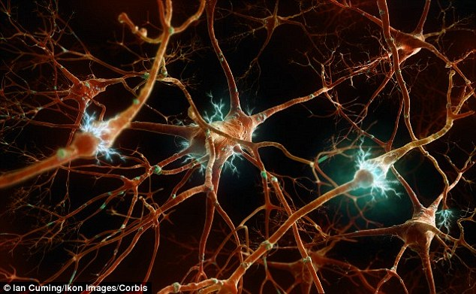
Association
A computer stores information randomly. A mind contains concepts associatively

Slide 5
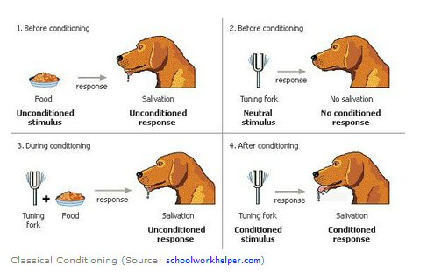
What is relatedness?
Co-occurrence → Among the first behavior invariants discovered
Functionally unrelated concepts become related when they are presented together
Pavlov’s dogs learned to associate sound with food.

Slide 6
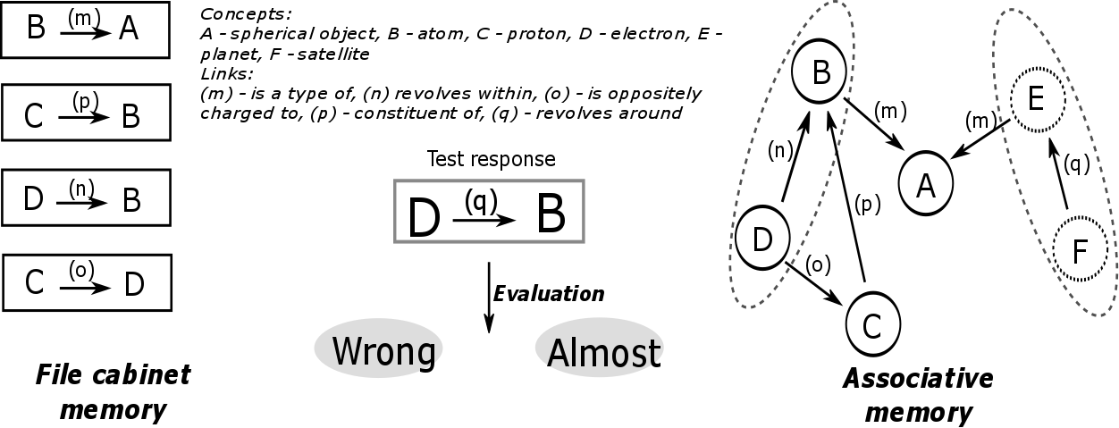
Knowing concepts associatively
Related concepts are activated concurrently

Slide 7

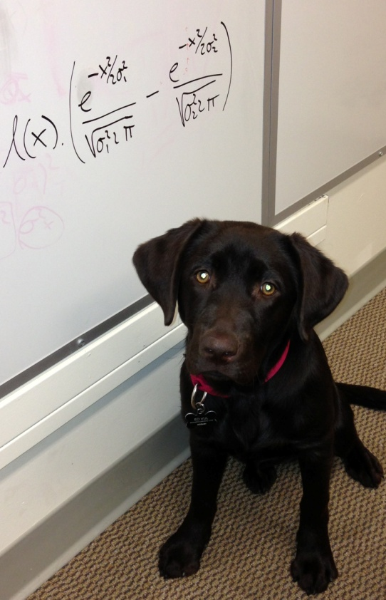
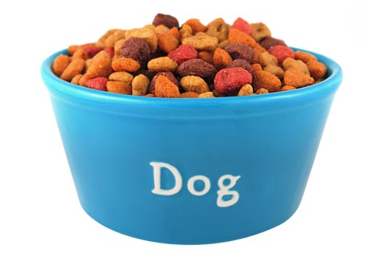
Appearance of stimulus is closely followed by a particular behavior

Slide 8
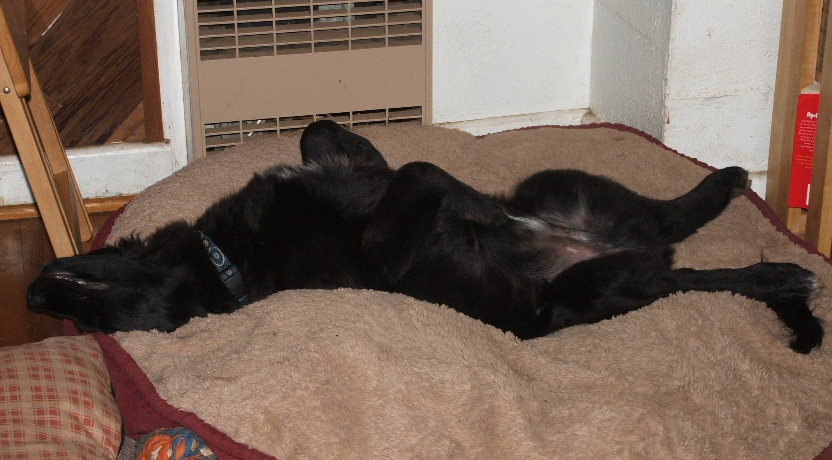
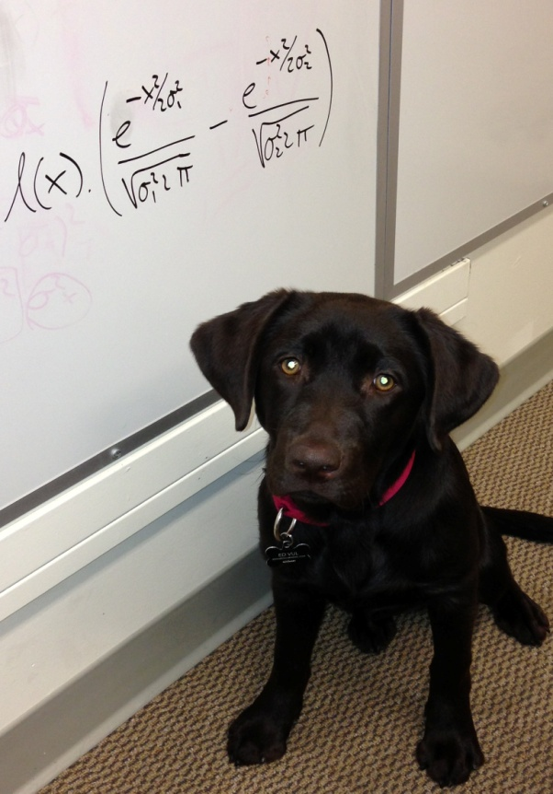
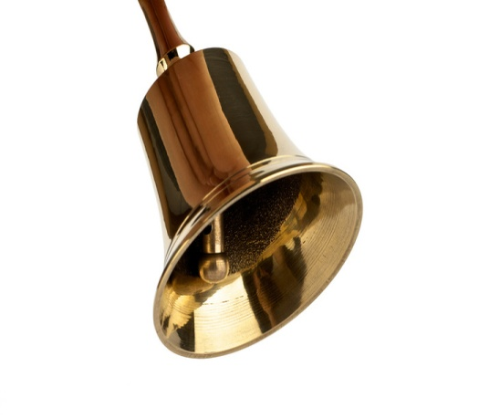

Slide 9



CS: conditioned stimulus
US: unconditioned stimulus

Slide 10
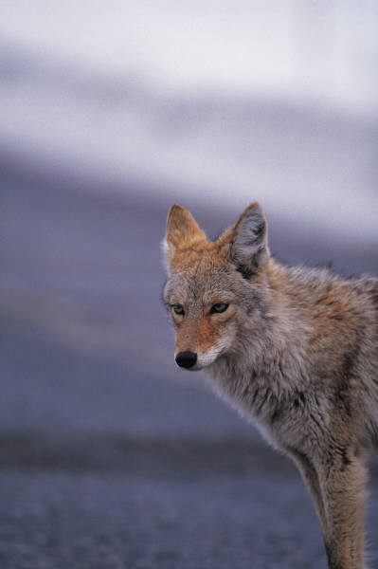
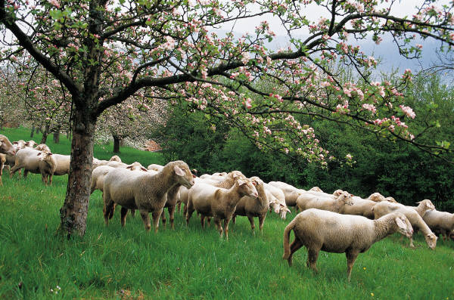
Real-Life Examples of Classical Conditioning
Gustavson and Gustavson (1985) – Conditioned Taste Aversion
Coyotes killing sheep – problem to sheep farmers
Study conditioned coyotes not to eat the sheep
Sheep meat (CS) sprinkled with a chemical (UCS) that would produce a stomachache (UCR)
After coyotes ate the treated meat,
they avoided the live sheep (CR)
This humane application of conditioned taste aversion might be used to control other predators as well

Slide 11

Real-Life Examples of Classical Conditioning
Metalmikov & Chorine (1926, 1928) – Immune System
Injected Guinea Pigs with Foreign agents (non lethal)
→ antibodies → boost their immune system
Then paired injections with Lights
Lights + Injections = better immunity
Lights alone = better immunity
Later Injected Cholera: animals with prior conditioning
better survival vs controls with no conditioning

Slide 12
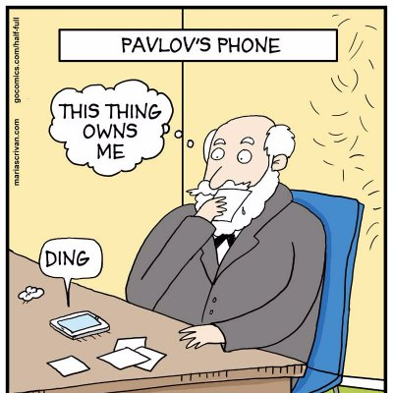
Closer home …
The average person picks up their phone 80+ times a day
More than 2k interactions per day

Slide 13


Modeling classical conditioning
Most popular approach for years was the Rescorla-Wagner model
Could reproduce a number of empirical observations in classical conditioning experiments
Some versions replace V_{tot} with V_{x}; what is the difference?
http://users.ipfw.edu/abbott/314/Rescorla2.htm

Slide 14
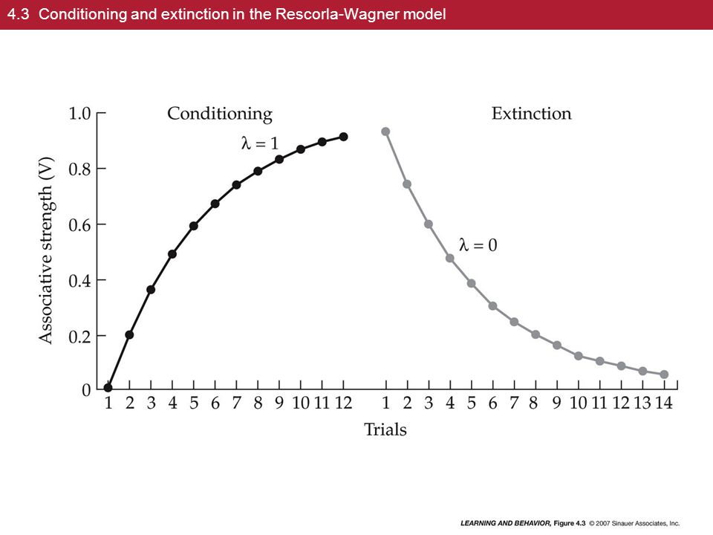

Slide 15
What RW could explain

Slide 16

What it couldn’t
Pre-exposed
Latent inhibition

Slide 17
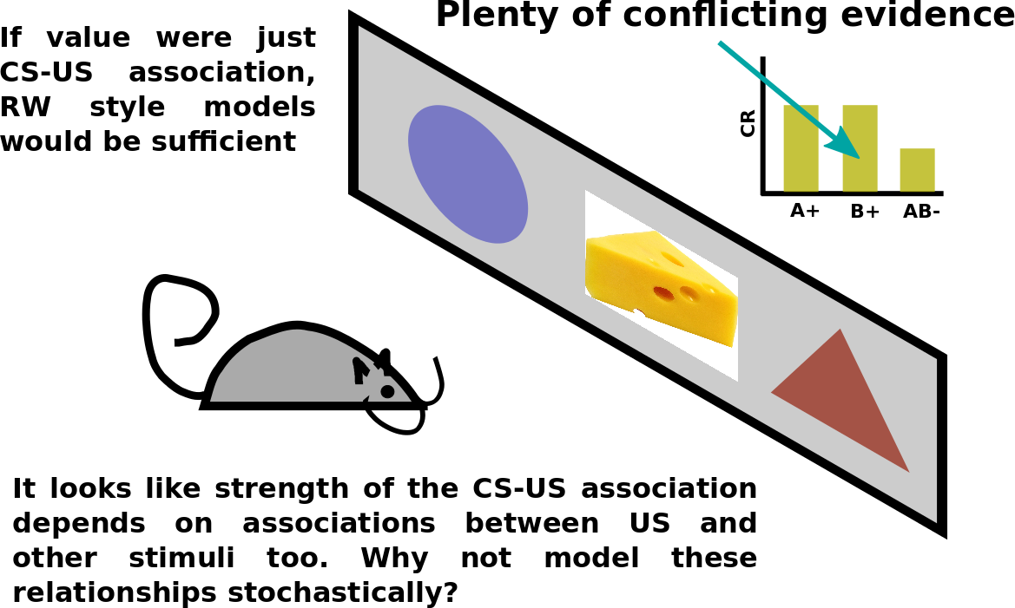
https://en.wikipedia.org/wiki/Rescorla%E2%80%93Wagner_model

Slide 18
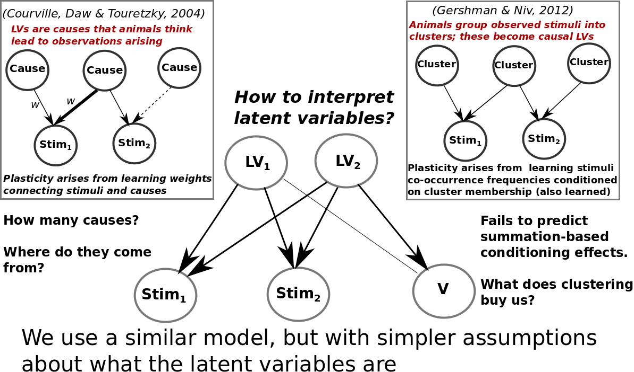
Bayesian models of classical conditioning

Slide 19
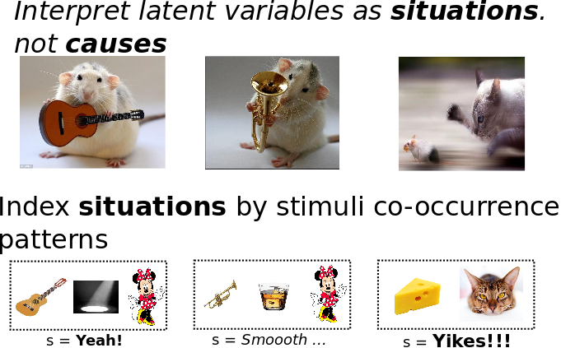
https://link.springer.com/article/10.3758/s13420-012-0080-8

Slide 20
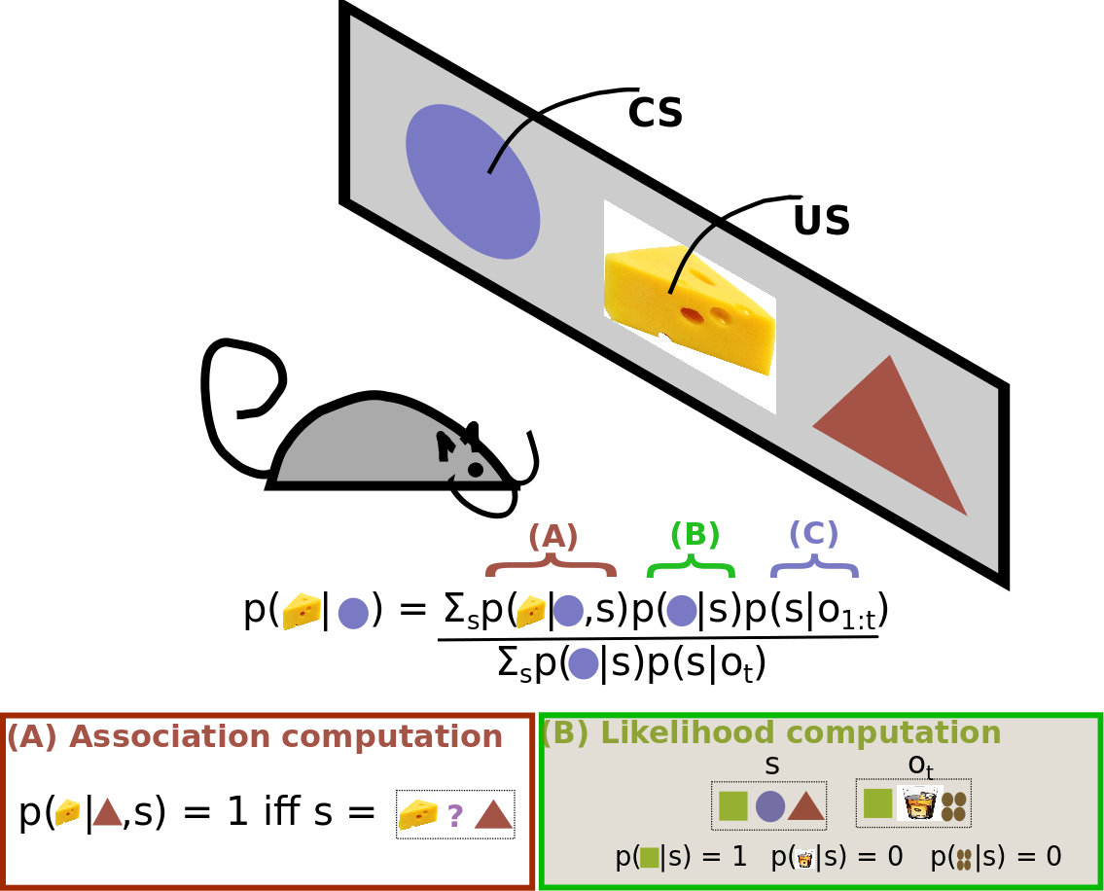

Slide 21
Summary
The mind learns by association
  Associates novel with known, based on a number of ways of relation
Association of novel to known causes generalization
Association of known with known causes reinforcement
We will talk more about reinforcement soon

