Slide 1
Modeling associativity
CS786
19th January 2021

Slide 2
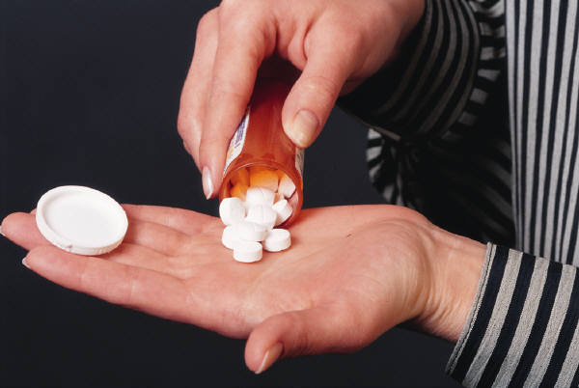
Real-Life Examples of Classical Conditioning
drug users become increasingly less responsive
to the effects of the drug
tolerance is specific to specific environments (e.g. bedroom)
familiar environment becomes associated with a compensatory response (Physiology)
taking drug in unfamiliar environment leads to lack of tolerance → drug overdose

Slide 4
Clinical therapies
People keep trying to use conditioning-based methods, e.g. ‘flooding’ to treat phobias, fears and trauma-related disorders
Doesn’t work very well – fear conditioning is much stronger than fear extinction
For reasons that may become clearer as we go along
Can you think why?

Slide 5
Modeling classical conditioning
Most popular approach for years was the Rescorla-Wagner model
Could reproduce a number of empirical observations in classical conditioning experiments
Some versions replace V_{tot} with V_{x}; what is the difference?
http://users.ipfw.edu/abbott/314/Rescorla2.htm

Slide 7
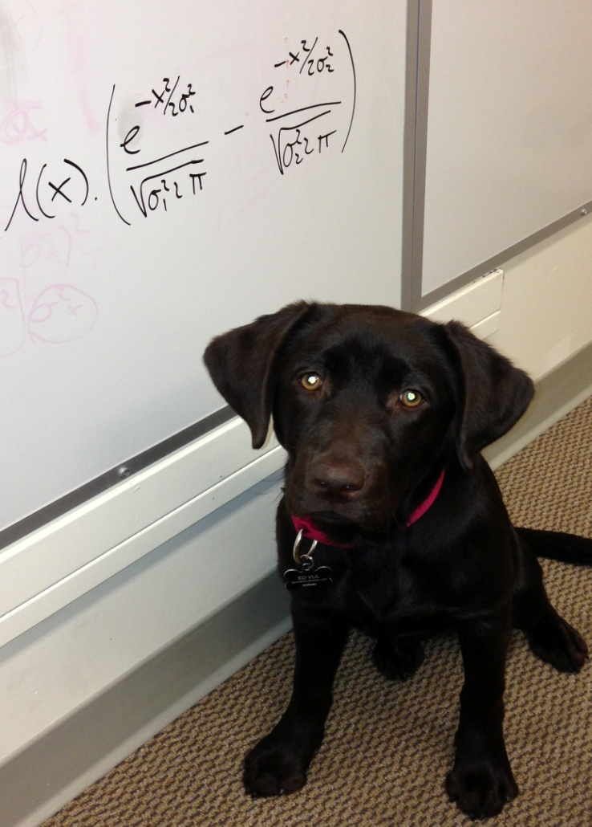
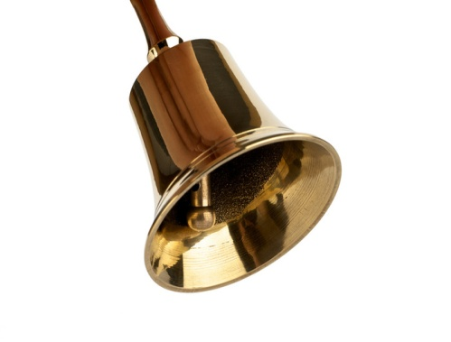
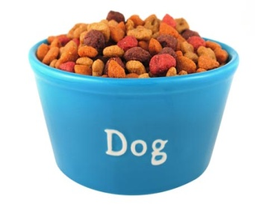
What RW could explain

Slide 8
What it couldn’t
Pre-exposed
Latent inhibition

Slide 9
Latent cause modeling of conditioning
Rescorla Wagner model
Latent cause model*
s
CS
UCS
CS
UCS
* See Courville, Daw & Touretzky (2005) for a formal description

Slide 10
https://link.springer.com/article/10.3758/s13420-012-0080-8

Slide 11
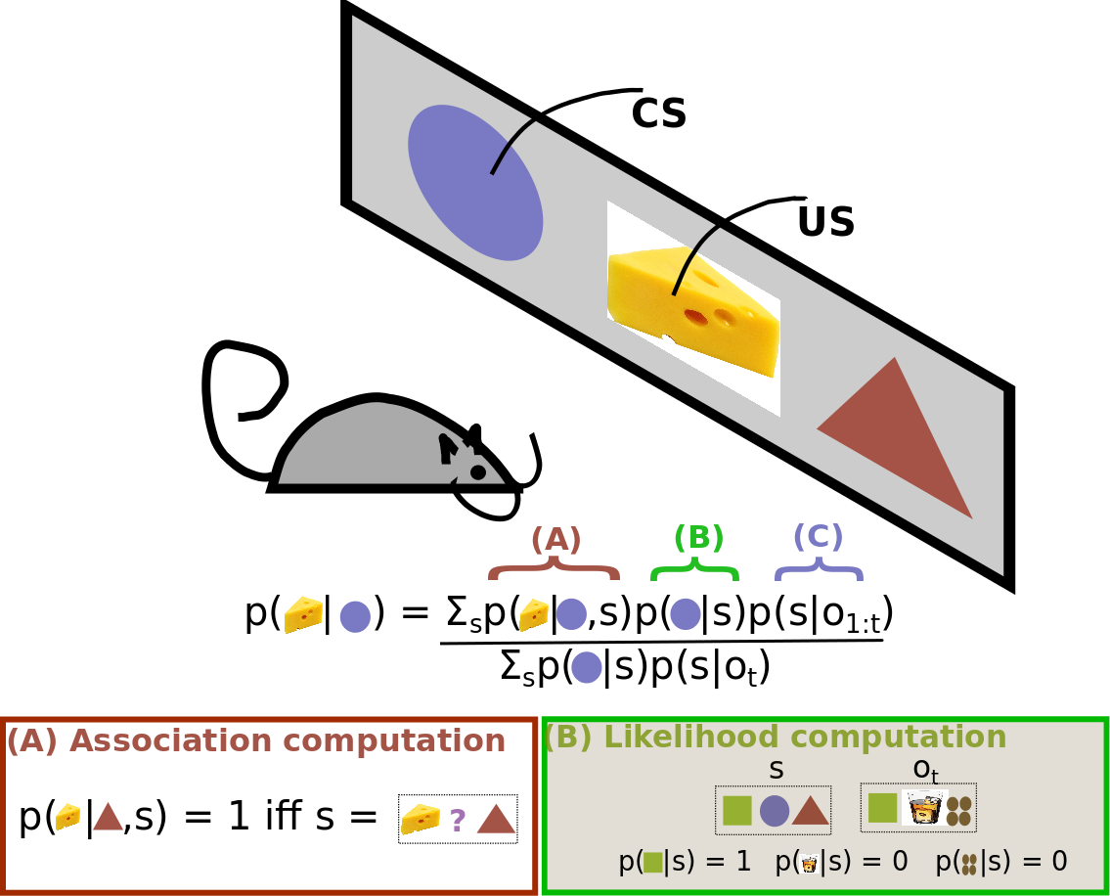

Slide 12
Bayes 101
Bayes theorem is a simple consequence of conditional probability factoring
Lends itself easily to sequential updates
Great fit for cognitive modeling
Models interaction of already known with new data

Slide 13
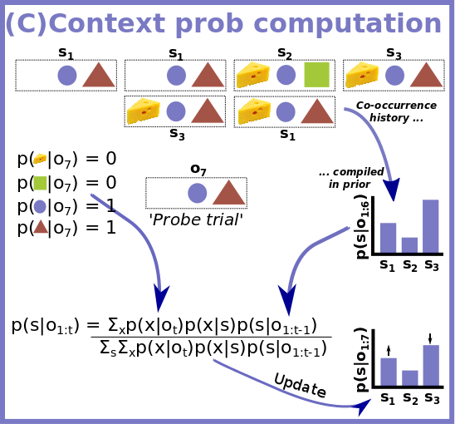

Slide 14
Some RW failures explained by latent cause model
Spontaneous recovery from extinction
Facilitated reacquisition
Conditioned inhibitor pairing
Pre-exposure effect
Higher order conditioning

Slide 15
Summary
The mind learns by association
Associates novel with known, based on a number of ways of relation
Association of novel to known causes generalization
Association of known with known causes reinforcement
Important question: why is the mind associative?

Slide 16
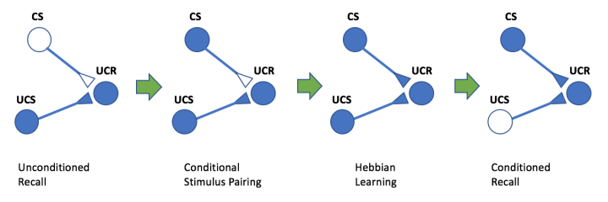
Explaining associativity

Slide 17
Hebbian learning
If two information processing units are activated simultaneously, their activity will become correlated, such that activity in one will make activity in the other more likely
We will see
How Hebbian learning works in artificial neurons
How Hebbian learning works in real neurons

Slide 18
Hebbian learning
j
w_{ij}
i

Slide 19
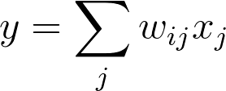
Hebb’s rule in action
Common variant
Problem
No way to weaken weights
Weights can climb up without bound
Solution: normalization?

Slide 20
Normalizing Hebb’s rule
Oja’s rule can be derived as an approximate normalized version of Hebb’s rule
Other formulations are also possible, e.g. BCM, generalized Hebb
Hebbian learning partially explains how neurons can encode new information
And explains how this learning is fundamentally associative

Slide 21
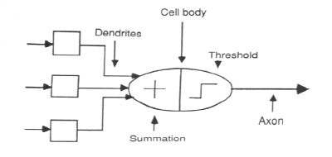
Artificial neurons
Logical abstraction of natural neurons to perform these functions

Slide 22
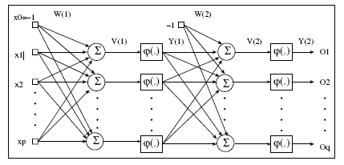
ANN Forward Propagation

Slide 23
ANN Forward Propagation
Bias Nodes
Add one node to each layer that has constant output
Forward propagation
Calculate from input layer to output layer
For each neuron:
Calculate weighted average of input
Calculate activation function

Slide 24
Neuron Model
Firing Rules:
Threshold rules:
Calculate weighted average of input
Fire if larger than threshold
Perceptron rule
Calculate weighted average of input input
Output activation level is

Slide 25
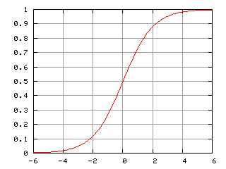
Neuron Model
Firing Rules: Sigmoid functions:
Hyperbolic tangent function
Logistic activation function

Slide 26
ANN Forward Propagation
Apply input vector X to layer of neurons.
Calculate
where x_{i} is the activation of previous layer neuron i
w_{ji} is the weight of going from node i to node j
p is the number of neurons in the previous layer
Calculate output activation

Slide 27
ANN Forward Propagation
Example: Three layer network
Calculates xor of inputs
-4.8
0
2
5.9
5.1
4
4.6
1
3
5.2
-5.2
-3.2
-2.6
-2.7
Bias

Slide 28
ANN Forward Propagation
Input (0,0)
-4.8
0
2
5.9
5.1
4
4.6
1
3
5.2
-5.2
-3.2
-2.6
-2.7
Bias

Slide 29
ANN Forward Propagation
Input (0,0)
Node 2 activation is ϕ(-4.8 ⋅ 0+4.6 ⋅ 0 - 2.6)= 0.0691
-4.8
0
2
5.9
5.1
4
4.6
1
3
5.2
-5.2
-3.2
-2.6
-2.7
Bias

Slide 30
ANN Forward Propagation
Input (0,0)
Node 3 activation is ϕ(5.1 ⋅ 0 - 5.2 ⋅ 0 - 3.2)= 0.0392
-4.8
0
2
5.9
5.1
4
4.6
1
3
5.2
-5.2
-3.2
-2.6
-2.7
Bias

Slide 31
ANN Forward Propagation
Input (0,0)
Node 4 activation is ϕ(5.9 ⋅ 0.069 + 5.2 ⋅ 0.069 – 2.7)= 0.110227
-4.8
0
2
5.9
5.1
4
4.6
1
3
5.2
-5.2
-3.2
-2.6
-2.7
Bias

Slide 32
ANN Forward Propagation
Input (0,1)
Node 2 activation is ϕ(4.6 -2.6)= 0.153269
-4.8
0
2
5.9
5.1
4
4.6
1
3
5.2
-5.2
-3.2
-2.6
-2.7
Bias

Slide 33
ANN Forward Propagation
Input (0,1)
Node 3 activation is ϕ(-5.2 -3.2)= 0.000224817
-4.8
0
2
5.9
5.1
4
4.6
1
3
5.2
-5.2
-3.2
-2.6
-2.7
Bias

Slide 34
ANN Forward Propagation
Input (0,1)
Node 4 activation is ϕ(5.9 ⋅ 0.153269 + 5.2 ⋅ 0.000224817 -2.7 )= 0.923992
-4.8
0
2
5.9
5.1
4
4.6
1
3
5.2
-5.2
-3.2
-2.6
-2.7
Bias

Slide 35
ANN Forward Propagation
Network can learn a non-linearly separated set of outputs.
Need to map output (real value) into binary values.

Slide 36
ANN Training
Weights are determined by training
Back-propagation:
On given input, compare actual output to desired output.
Adjust weights to output nodes.
Work backwards through the various layers
Start out with initial random weights
Best to keep weights close to zero (<<10)

Slide 37
ANN Training
Weights are determined by training
Need a training set
Should be representative of the problem
During each training epoch:
Submit training set element as input
Calculate the error for the output neurons
Calculate average error during epoch
Adjust weights

Slide 38
ANN Training
Error is the mean square of differences in output layer
y – observed output
t – target output

Slide 39
ANN Training
Error of training epoch is the average of all errors.

Slide 40
ANN Training
Update weights and thresholds using
Weights
Bias
η is a possibly time-dependent learning rate that should prevent overcorrection
https://machinelearningmastery.com/implement-perceptron-algorithm-scratch-python/

Slide 41
What neurons do – the ML version
A neuron collects signals from dendrites (not quite)
Sends out spikes of electrical activity through an axon, which splits into thousands of branches.
At the end of each branch, a synapse converts activity into either exciting or inhibiting activity of a dendrite at another neuron (more complicated than this)
Neuron fires when exciting activity surpasses inhibitory activity above some threshold (neurotransmitters govern the threshold and activity rate)
Learning changes the strength of synapses (but what sort of learning?)

Slide 42
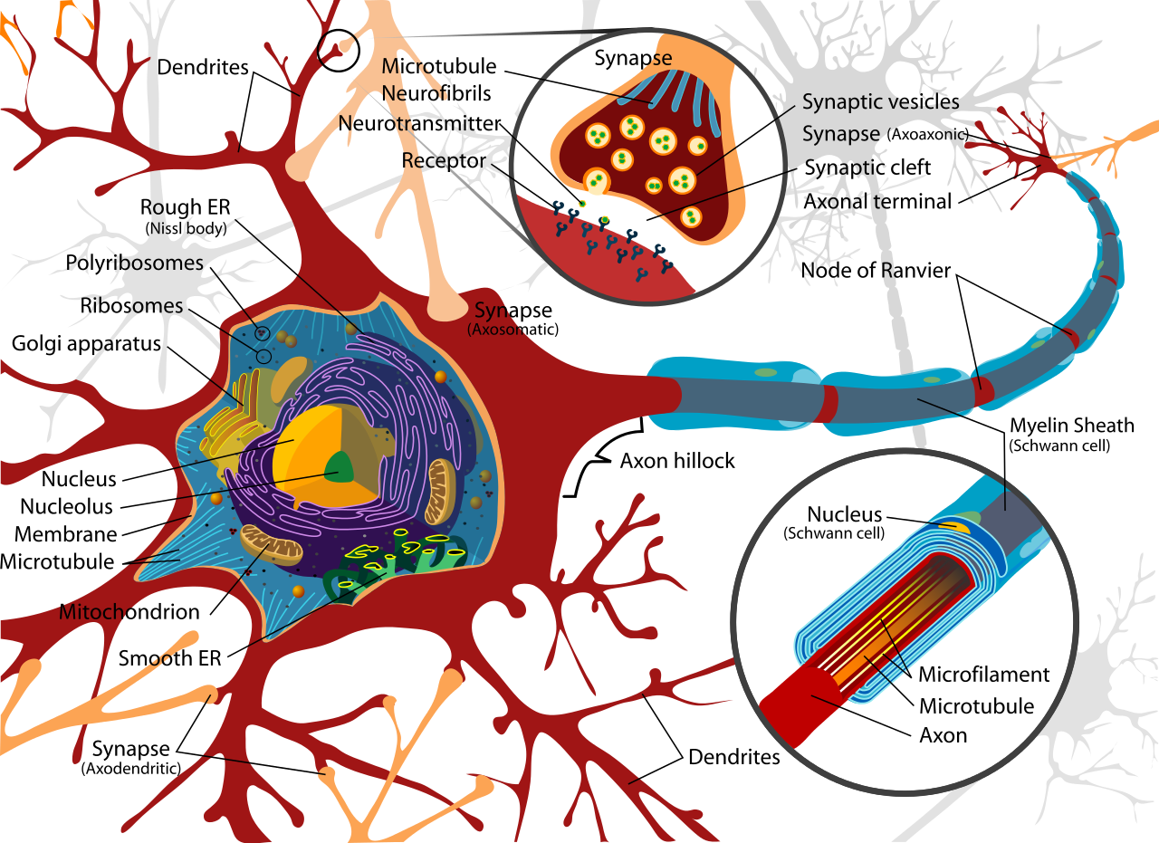
Real neurons

