Slide 1
Human vision: function
Nisheeth
12th February 2019

Slide 2
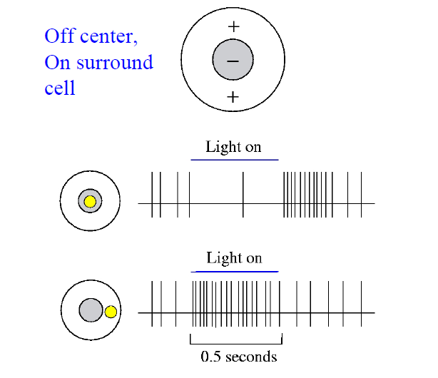
Retina as filter

Slide 3
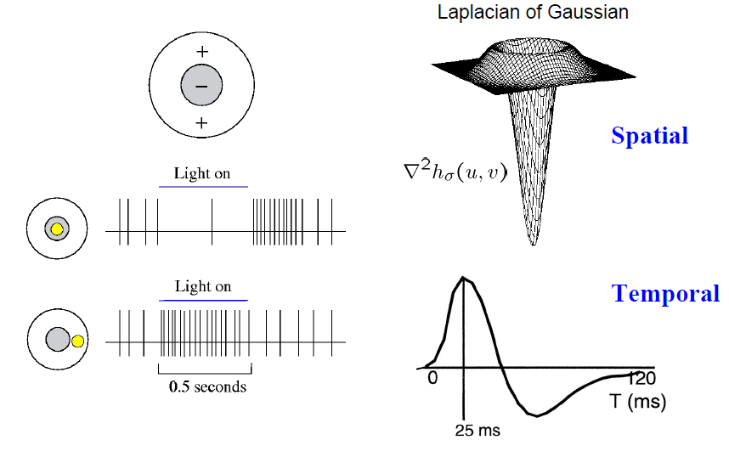
Retina can calculate derivatives

Slide 4
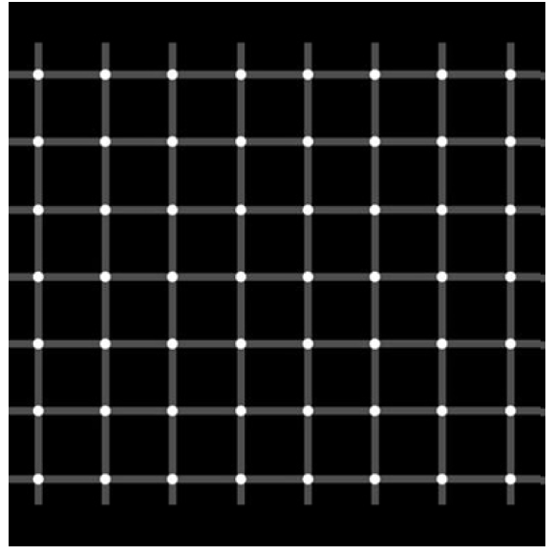
Evidence

Slide 5
The visual pathway: LGN
Optic nerves terminate in LGN
Cortical feed-forward connections also seen to LGN
LGN receptive fields seem similar to retina receptive fields
Considerable encoding happens between the retina-LGN junction
  130 million rods and cones
  1.2 million axon connections reach LGN

Slide 6
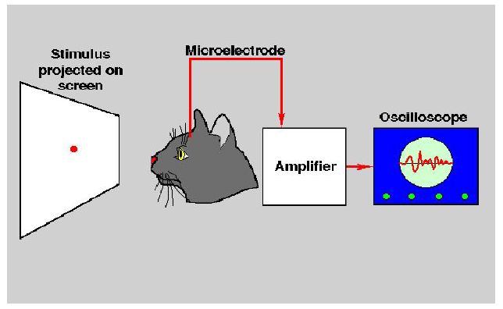
The visual pathway: V1
V1 is the primary visual cortex
V1 receptive fields sensitive to orientation, edges, color changes

Slide 7
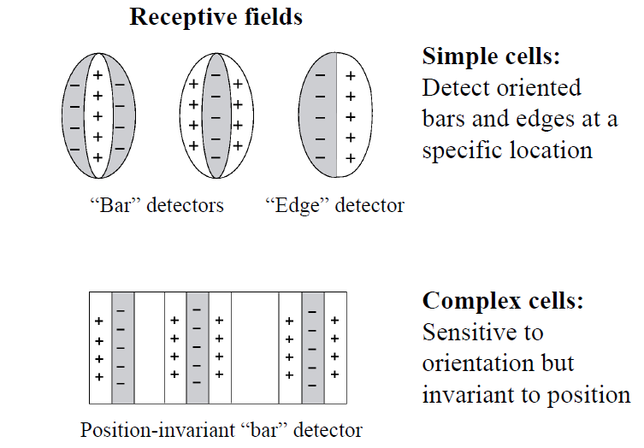
Simple and complex cells in V1

Slide 8
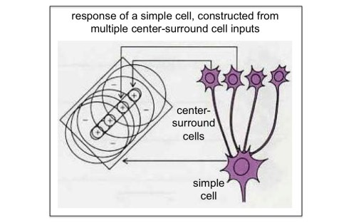
Emergent orientation selectivity
http://www.scholarpedia.org/article/Models_of_visual_cortex

Slide 9
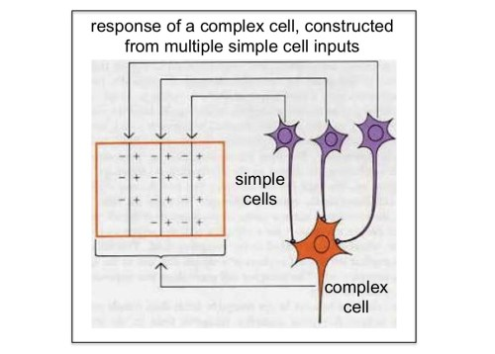
Complexity from simplicity
http://www.brains-explained.com/how-hubel-and-wiesel-revolutionized-neuroscience/

Slide 10
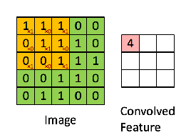


Remember this?
Image patch
Filter
Convolution

Slide 11
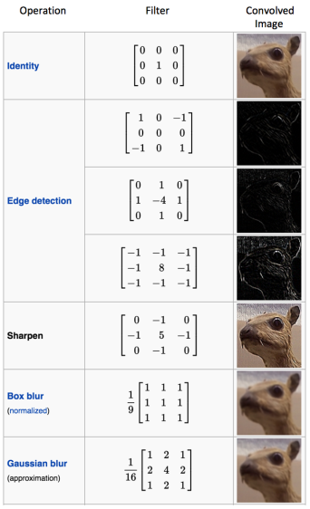
Edge detection filters designed from V1 principles

Slide 12
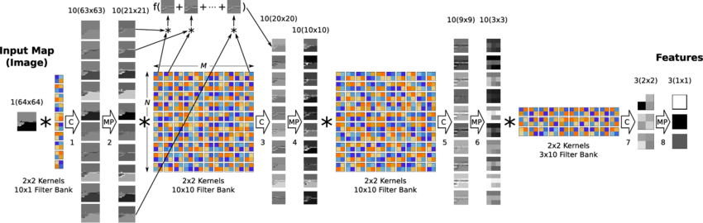
Influenced models of object recognition
Most successful models of visual function use mixed selective feed-forward information transfer now, e.g. CNN

Slide 13
Visual search
Attention in vision

Slide 14
Feature search

Slide 15
Conjunction search

Slide 16
Visual search
X
X
X
X
X
O
O
X
X
X
X
X
X
O
X
X
X
X
O
X
O
O
X
X
X
X
X
Feature search
Conjunction search
Treisman & Gelade 1980

Slide 17
“Serial” vs “Parallel” Search
Reaction Time (ms)
Set size

Slide 18
Feature Integration Theory: Basics (FIT) Treisman (1988, 1993)
Distinction between objects and features
Attention used to bind features together (“glue”) at the attended location
Code 1 object at a time based on location
Pre-attentional, parallel processing of features
Serial process of feature integration

Slide 19
FIT: Details
Sensory “features” (color, size, orientation etc) coded in parallel by specialized modules
Modules form two kinds of “maps”
  Feature maps
    color maps, orientation maps, etc.
  Master map of locations

Slide 20
Feature Maps
Contain 2 kinds of info
  presence of a feature anywhere in the field
    there’s something red out there…
  implicit spatial info about the feature
Activity in feature maps can tell us what’s out there, but can’t tell us:
  where it is located
  what other features the red thing has

Slide 21
Master Map of Locations
codes where features are located, but not which features are located where
need some way of:
  locating features
  binding appropriate features together
[Enter Focal Attention…]

Slide 22
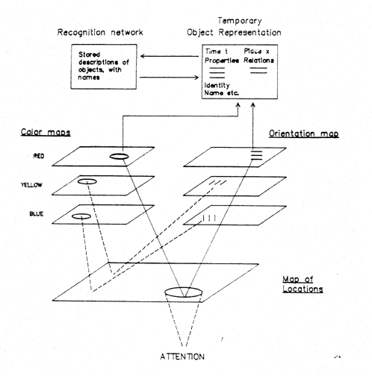
Role of Attention in FIT
Attention moves within the location map
Selects whatever features are linked to that location
Features of other objects are excluded
Attended features are then entered into the current temporary object representation

Slide 23
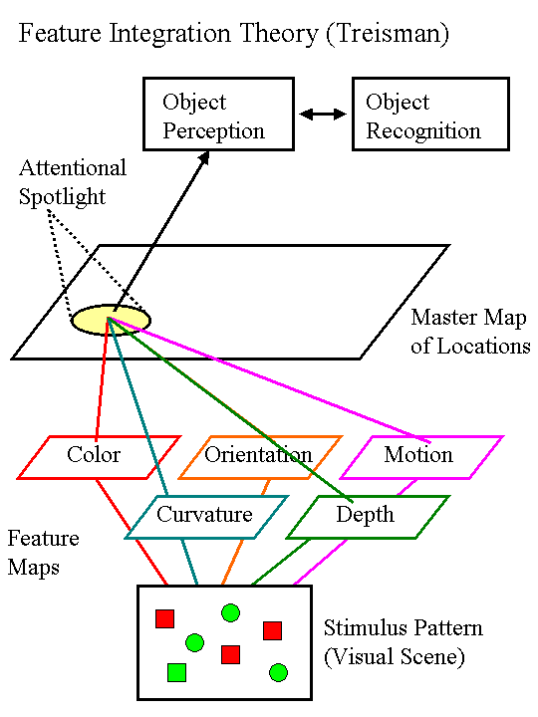

Slide 24
Evidence for FIT
Visual Search Tasks
Illusory Conjunctions

Slide 25
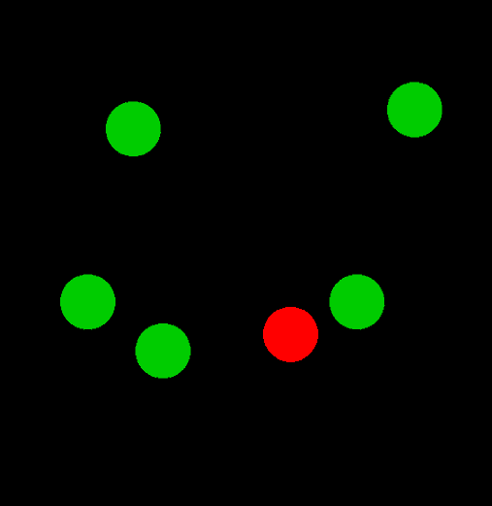
Feature Search: Find red dot

Slide 26
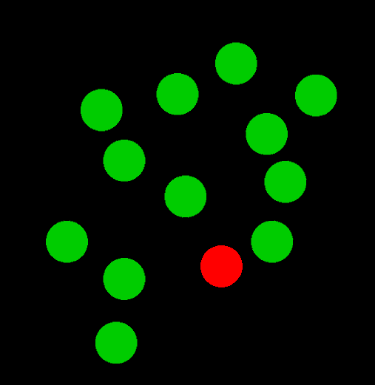
“Pop-Out Effect”

Slide 27
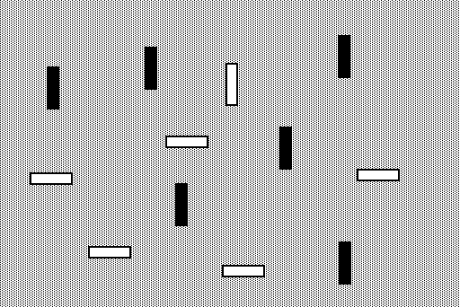
Conjunction: white vertical

Slide 28

1 Distractor

Slide 29
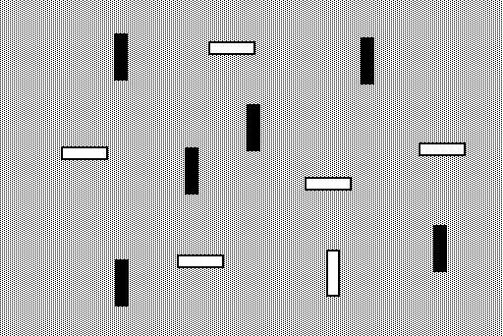
12 Distractors

Slide 30
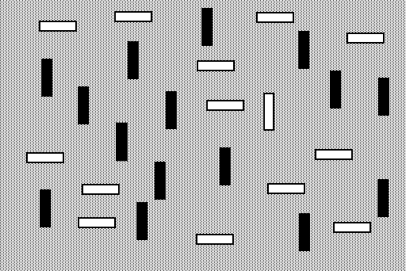
29 Distractors

Slide 31
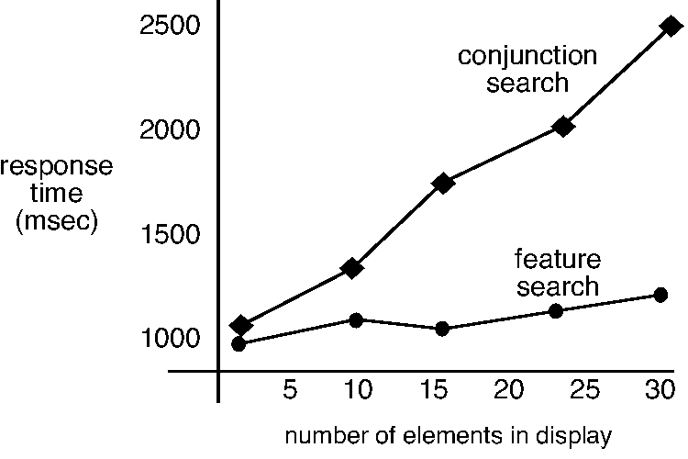

Slide 32
Feature Search
Is there a red T in the display?
Target defined by a single feature
According to FIT target should “pop out”
T
T
T
T
T
T
T
T
T
T
T

Slide 33
Conjunction Search
T
Is there a red T in the display?
Target defined by shape and color
Target detection involves binding features, so demands serial search w/focal attention
X
X
T
X
T
T
T
T
T
T
T
X
X

Slide 34
Visual Search Experiments
Record time taken to determine whether target is present or absent
Vary the number of distracters
FIT predicts that
  Feature search should be independent of the number of distracters
  Conjunction search should get slower w/more distracters

Slide 35
Typical Findings & interpretation
Feature targets pop out
  flat display size function
Conjunction targets demand serial search
  non-zero slope

Slide 36
… not that simple...
X
O
X
O
X
X
O
X
O
X
O
O
X
easy conjunctions - -
depth & shape, and movement & shape
Theeuwes & Kooi (1994)

Slide 37
Guided Search
Triple conjunctions are frequently easier than double conjunctions
This lead Wolfe and Cave modified FIT --> the Guided search model
    - Wolfe & Cave

Slide 38
Guided Search - Wolfe and Cave
X
O
X
O
X
X
O
X
O
X
O
O
X
Separate processes search for Xs and for white things (target features), and there is double activation that draws attention to the target.

Slide 39
Problems for both of these theories
Both FIT and Guided Search assume that attention is directed at locations, not at objects in the scene.
Goldsmith (1998) showed much more efficient search for a target location with redness and S-ness when the features were combined (in an “object”) than when they were not.

Slide 40
more problems
Hayward & Burke (2000)
Lines
Lines in circles
Lines + circles

Slide 41
Results - target present only
a popout search should be unaffected by the circles

Slide 42
more problems
Enns & Rensink (1991)
Search is very fast in this situation only when the objects look 3D - can the direction a whole object points be a “feature”?

Slide 43
Duncan & Humphreys (1989)
SIMILARITY
visual search tasks are :
  easy when distracters are homogeneous and very different from the target
  hard when distracters are heterogeneous and not very different from the target

Slide 44
Asymmetries in visual search
Vs
Vs
the presence of a “feature” is easier to find than the absence of a feature

Slide 45
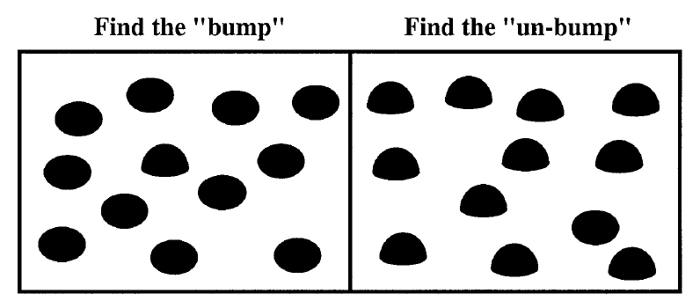
Kristjansson & Tse (2001)
Faster detection of presence than absence - but what is the “feature”?

Slide 46
Familiarity and asymmetry
asymmetry for German but not Cyrillic readers

Slide 47
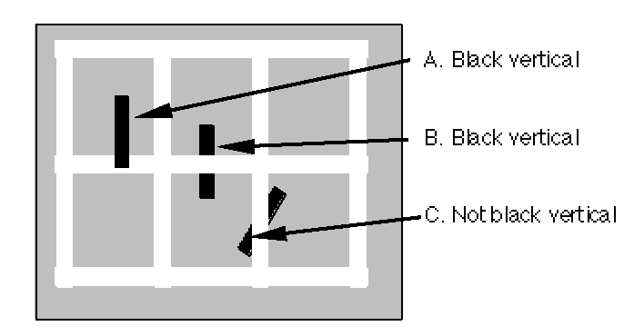
Other high level effects
finding a tilted black line is not affected by the white lattice - so “feature” search is sensitive to occlusion
Wolfe (1996)

Slide 48
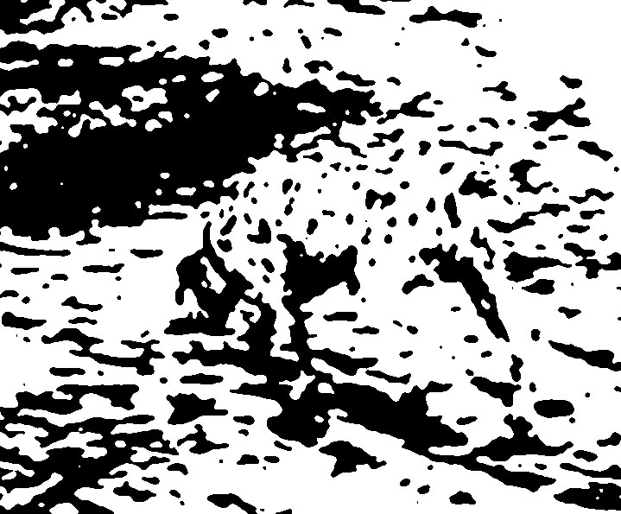
Gestalt effects

Slide 49
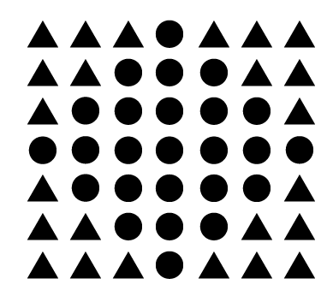
Pragnanz
Perception is not just bottom up integration of features. There is more to a whole image than the sum of its parts.

Slide 50
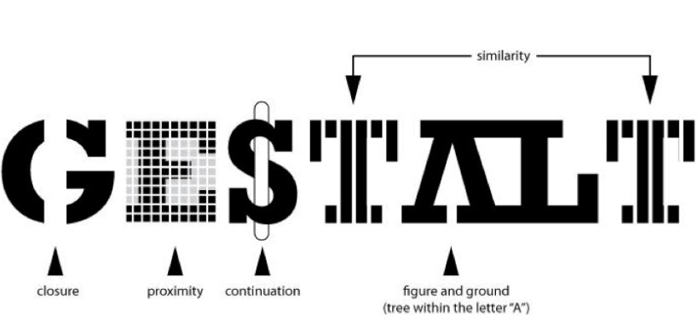
Not understood computationally
Principles are conceptually clear; DCNNs can learn them, but translation is missing
https://arxiv.org/pdf/1709.06126.pdf

Slide 51
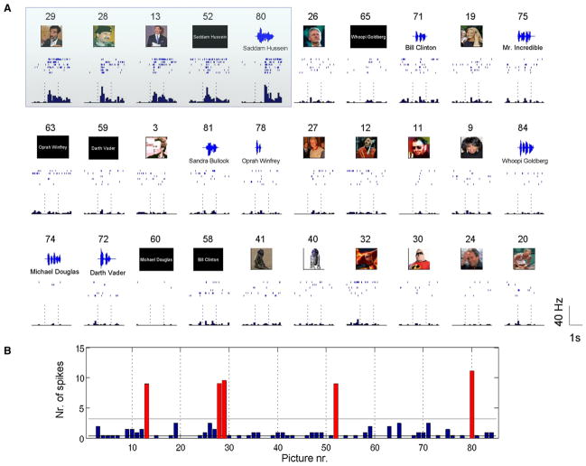
Concept-selective neurons
https://www.newscientist.com/article/dn7567-why-your-brain-has-a-jennifer-aniston-cell/

Slide 52
Summary
Classic accounts of visual perception have focused on bottom-up integration of features
  Consistent with data from visual search experiments
  Inconsistent with phenomenological experience in naturalistic settings
Top down influences affect visual perception
  But how?
  We will see some computational approaches in the next class

