Slide 1
Human vision: physical apparatus
Nisheeth
8th February 2019

Slide 2
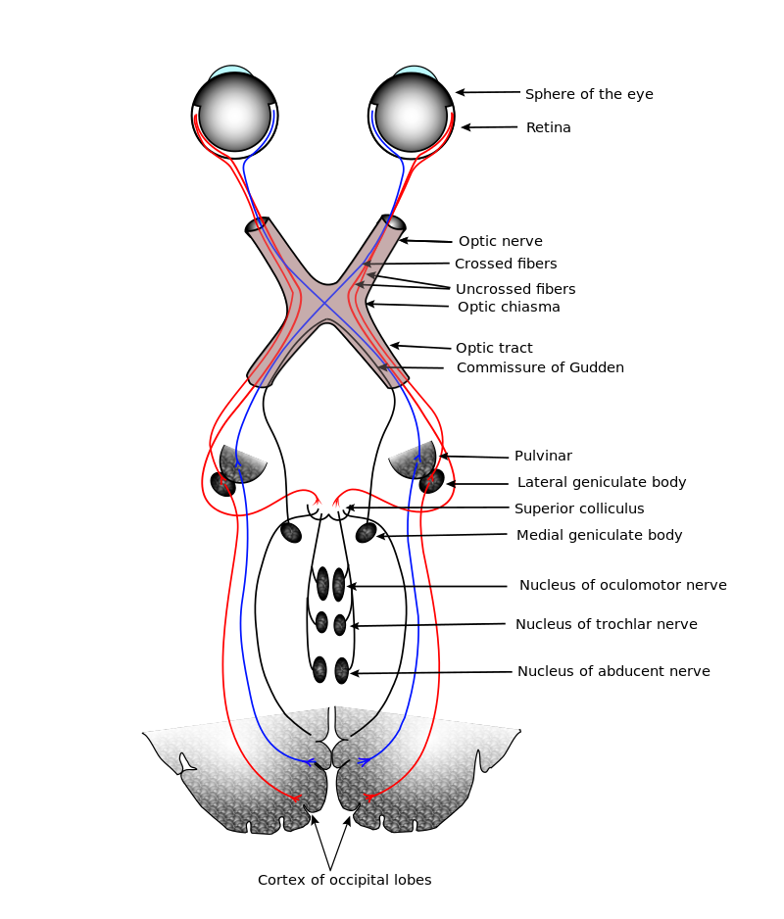
The visual pathway
Pathway begins at the physical apparatus of the eye
Works its way through connecting nerves
Lateral geniculate nucleus (LGN) is an important junction
Terminates in primary visual cortex
https://en.wikipedia.org/wiki/Visual_system

Slide 3
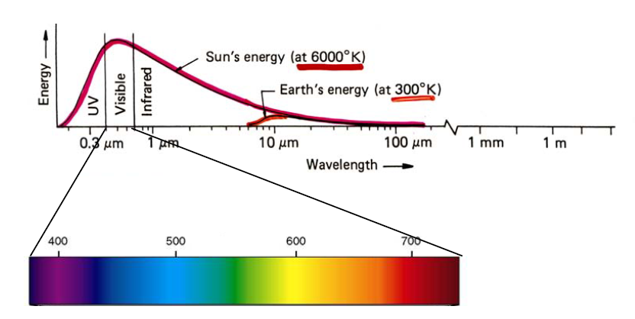
Vision has evolved for seeing sunlight

Slide 4
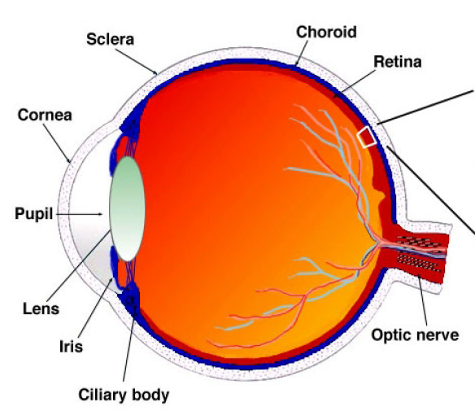
The eye
Cornea and lens focus image onto retina
Lens accommodation affects focal length of image
Retina has two functions
Photoreception
Filtering

Slide 5
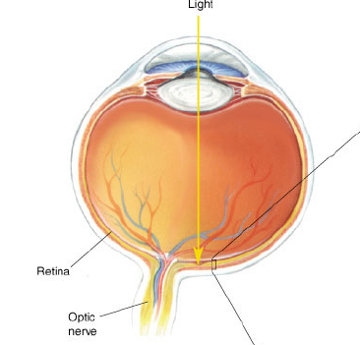
The retina
The retina functions as a screen for visual images
Outer layer of retina composed of photoreceptor cells
Photoreceptor cells synapse with bipolar cells, which in turn synapse with ganglion cells, which fire action potentials down the optic nerve to the brain
Photons falling on photoreceptor cells trigger downstream action potentials in ganglion cells
This is called phototransduction

Slide 6
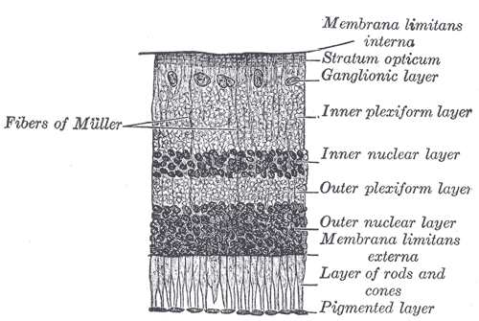
The retina
Retina is composed of multiple stacks of
Photoreceptors
Bipolar cells
Ganglion cells
The physical distribution of photoreceptor cells in space on the retina surface matters

Slide 7
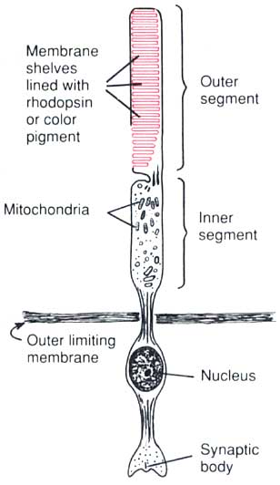
Anatomy of a photoreceptor
A photoreceptor is a neuron, but it doesn’t fire action potentials
Membrane shelves are lined with rhodopsin (rod cells) or photopsins (cone cells)
All bound with a compound called retinal
In scotopic (dark) conditions
Photoreceptors release glutamate to bipolar cells
In light
Retinal undergoes isomerization upon absorbing a photon
No longer fits the opsin binding site; triggers a series of intermediate chemical reactions
Photoreceptors no longer release glutamate, ON bipolar cells are now free to excite ganglion cells

Slide 8
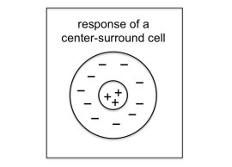
Bipolar cells
Bipolar cells are either ON or OFF
Receive signals from photoreceptors and transmit to
Ganglion cells
Other (horizontal) bipolar cells
Arrangements of bipolar cells yield center-surround pattern in retinal receptive fields

Slide 9
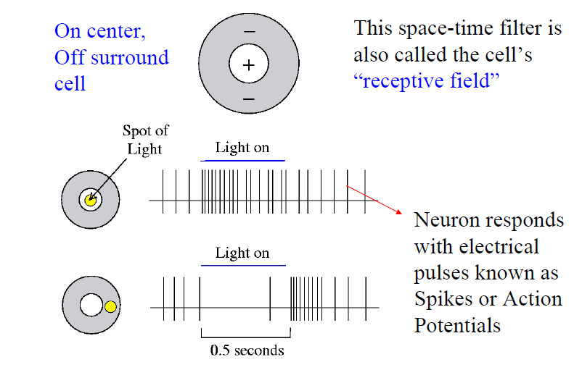
Retina as filter

Slide 10
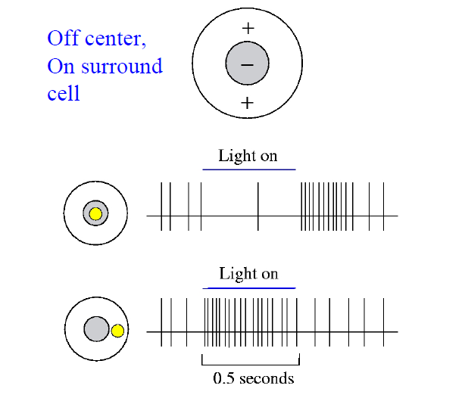
Retina as filter

Slide 11
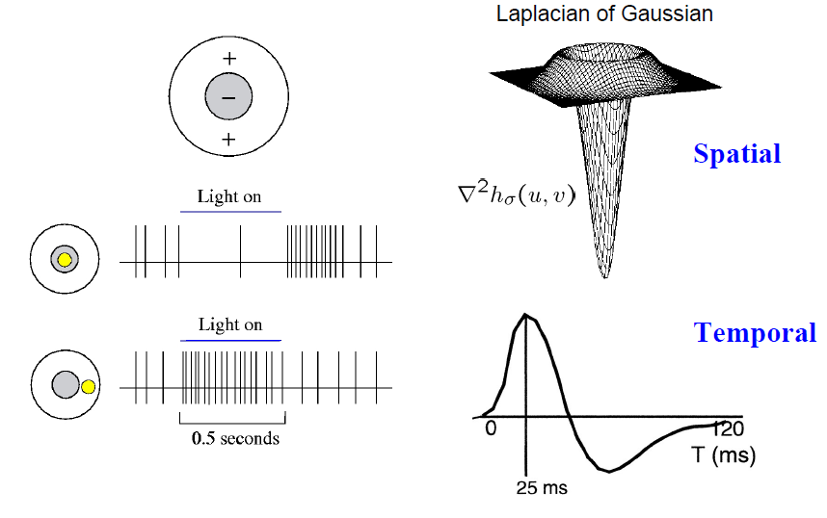
Retina can calculate derivatives

Slide 12
Evidence

